Slide 1
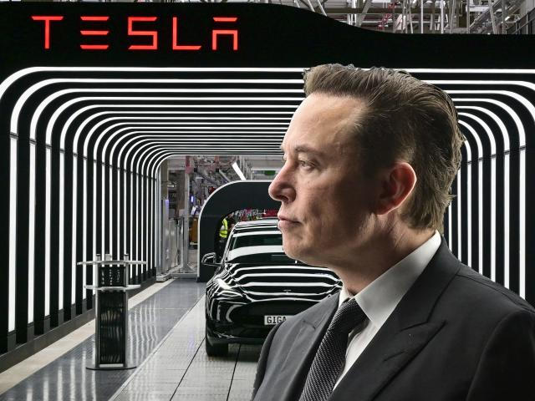
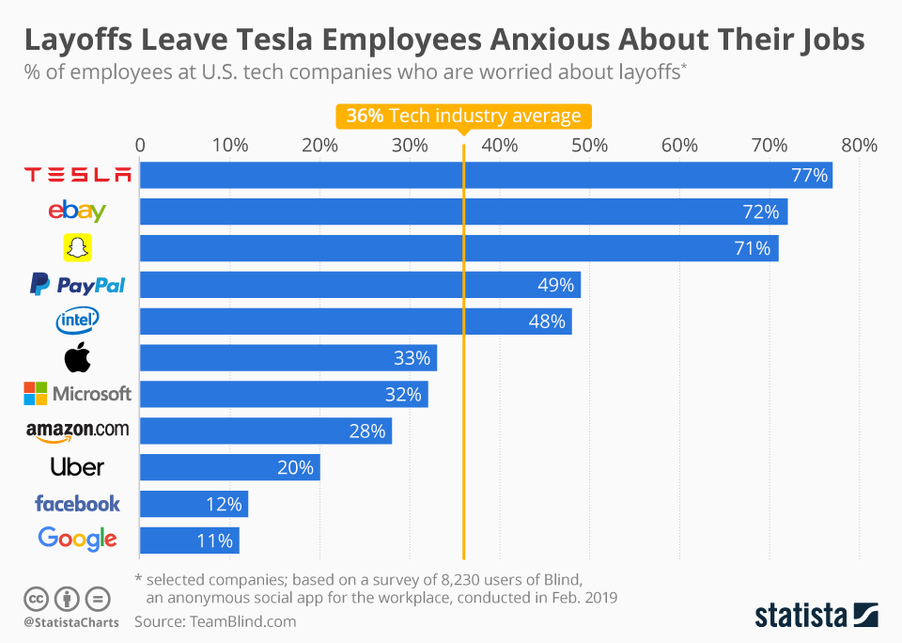
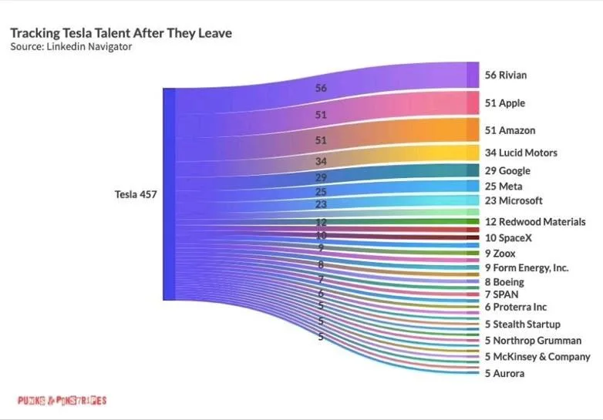
BUS7B57
Resourcing and Talent Management
Assignment 2 –Poster Presentation
Introduction
Impact of employee turnover on strategic goals of Tesla
This poster discusses the impact of the great resignation and its ongoing reach across different companies in the global business environment. As a globally occurring phenomenon, the great resignation is joined by large layoffs across the tech industry as well. The context of Tesla is used in the poster to discuss the impact of employee turnover, owing to the relevance of the company's technology use in operations. The analysis of the lawful and ethical performance of employee turnover processes can also be shown through the instance of Tesla, owing to its workforce attrition in recent years.
Firstly, employee turnover creates a net loss for the organisation which is reflected over time, due to the loss of skills and knowledge present in the former employees. A turnover resulting in the loss of employees also sees the organisation lose on the investments made in the employees to make them a part of the company (Wynen et al., 2018). Therefore, their exit affects the organisational memory where the collective knowledge, skills, insights and information is reduced due to the exit of employees (Wynen et al., 2018). In this way, the turnover outcomes reduce the organisation’s capacity for innovative business performance due to a reduction in net knowledge and findings.
Secondly, the turnover outcomes have a negative psychological impact on the existing workforce retained by the organisation. This is identified through social behaviour where the exit of other employees creates a position of insecurity among the retained employees (Knight, Becan and Flynn, 2013). The retained workforce will experience insecurity as well as job anxiety and morale reduction caused by the change in organisational workforce cohesion. Job instability in this way reduces the professional network created within the organisation, impeding the performance of job characteristics over time and across different teams.
Thirdly, the organisational resources available for achieving the goals through internal measures become reduced when turnover occurs. This is due to the impact on recruitment costs which is made by the turnover performance (Hall, 2019). Organisations incur more expenses in hiring and recruiting new employees to replace the job positions of former employees, which reduces the net usage of resources towards directly achieving the organisational goal outcomes (Hall, 2019). This is also evidenced in the loss of performance related to generating new patents upon the resignation of seasoned employees. Their replacement with recruits results in lower patent creation performance in firms, directly linking turnover with negative outcomes on business innovation and subsequent growth (Grinza and Quatraro, 2019).
Conclusion
The poster has discussed the impact of employee turnover on organisational goal-achievement as well as the performance of the turnover process through the instance of Tesla. The findings showed that turnover hurts strategic goal achievement due to the loss of knowledge, experience and other unique workforce qualities that provides a competitive advantage to the firm, including the generation of new patents. The practices of Tesla in firing its employees is shown as a mainstream instance of the continuing impact of the great resignation which has ultimately disrupted the workforce of companies across industries.
References
Analysis of lawful and ethical turnover processes at Tesla
Bellan, R. (2022). Tesla accused of illegally firing employees critical of Musk. [online] TechCrunch. Available at: https://techcrunch.com/2022/12/19/tesla-accused-of-illegally-firing-employees-critical-of-musk/ [Accessed 20 Apr. 2023].
Grinza, E. and Quatraro, F. (2019). Workers’ replacements and firms’ innovation dynamics: New evidence from Italian matched longitudinal data. Research Policy, [online] 48(9), p.103804. doi:https://doi.org/10.1016/j.respol.2019.05.013.
Hall, J. (2019). The Cost Of Turnover Can Kill Your Business And Make Things Less Fun. [online] Forbes. Available at: https://www.forbes.com/sites/johnhall/2019/05/09/the-cost-of-turnover-can-kill-your-business-and-make-things-less-fun/?sh=52af88ed7943 [Accessed 20 Apr. 2023].
Knight, D.K., Becan, J.E. and Flynn, P.M. (2013). The Impact of Staff Turnover on Workplace Demands and Coworker Relationships. Counselor (Deerfield Beach, Fla.), [online] 14(3), pp.20–23. Available at: https://www.ncbi.nlm.nih.gov/pmc/articles/PMC4986917/ [Accessed 20 Apr. 2023].
Sull, D., Sull, C. and Zweig, B. (2022). Toxic Culture Is Driving the Great Resignation. [online] MIT Sloan Management Review. Available at: https://sloanreview.mit.edu/article/toxic-culture-is-driving-the-great-resignation/ [Accessed 20 Apr. 2023].
Wiessner, D. (2023). Tesla broke U.S. labor law by silencing workers, official rules. Reuters. [online] 26 Apr. Available at: https://www.reuters.com/business/autos-transportation/tesla-broke-us-labor-law-by-silencing-workers-official-rules-2023-04-26/ [Accessed 20 Apr. 2023].
Wynen, J., Van Dooren, W., Mattijs, J. and Deschamps, C. (2018). Linking turnover to organizational performance: the role of process conformance. Public Management Review, [online] 21(5), pp.669–685. doi:https://doi.org/10.1080/14719037.2018.1503704.
Firstly, Tesla's legal performance of the turnover process has violated US labour laws. Employees at a Tesla service centre in Florida were told by their supervisors to abstain from discussion of their working conditions, salaries or complaints with senior management (Wiessner, 2023). This development was noted after new employees in 2021 were being paid more than existing employees sharing the same job roles and responsibilities (Wiessner, 2023). Employees who raised the issue, such as a technician at the Florida centre, were summarily fired from their positions.
Secondly, Tesla has been indiscriminate in firing employees for their criticism of CEO Elon Musk. These criticisms were raised over the CEO’s insistence on the strict work-from-office policy as well as other internal matters (Bellan, 2022). Such an action is against federal labour laws in the US, which permits employees to take collective action for improving their working conditions. Other instances of firing employees for attempts at unionising were noted in the Buffalo Gigafactory site, where over 30 workers were fired unethically (Bellan, 2022). These instances show that the turnover process initiated at Tesla has been unlawful and unethical, driven by the toxic culture of the organisation (Sull, Sull and Zweig, 2022).

