Slide 1
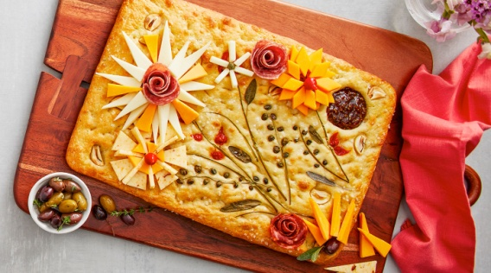
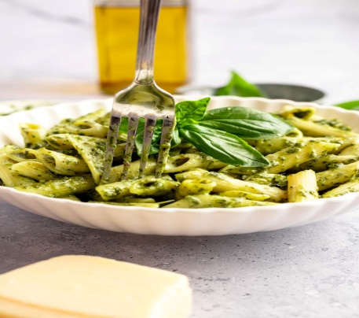
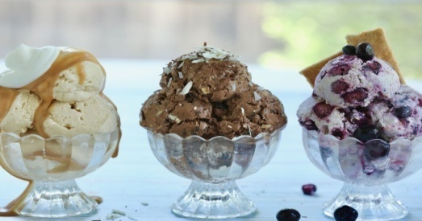
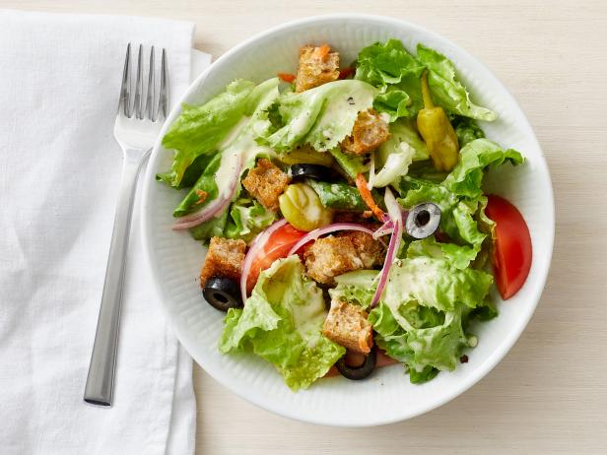
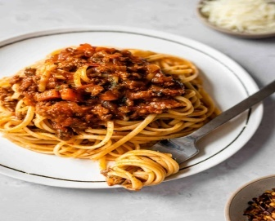
Open Daily
Free Wi-Fi
Café Menu
Appetigers
Artichoke Dip
$20
Focaccia
$15
Rice Balls
$9
Bruschetta
$13
Pasta
Pesto
$14
Farfalle
$30
Papalina
$18
Marinara
$15
Desserts
Cannoli
$10
Gelato
$11
Italian Ice
$8
Brownie
$15
Salads
House Salad
$21
Caesar
$20
Chef Salad
$10
Spinach Salad
$10
Chef’s Special
Lasagna
Bolognese
$20
$30

