Slide 1
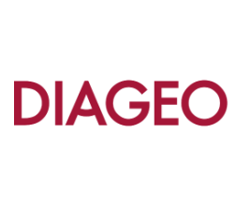
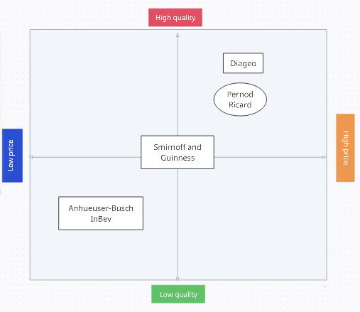
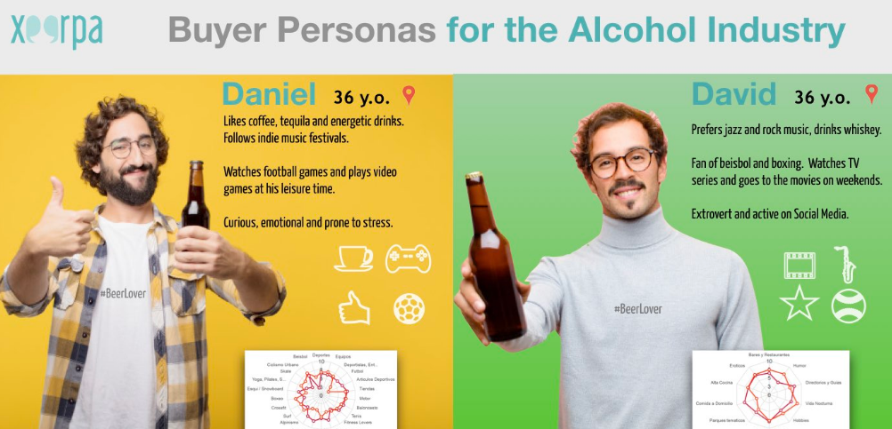
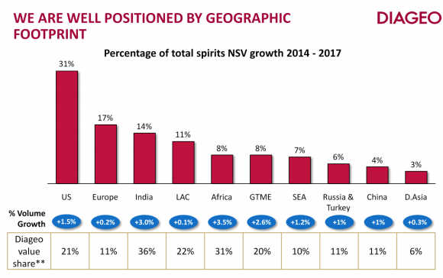
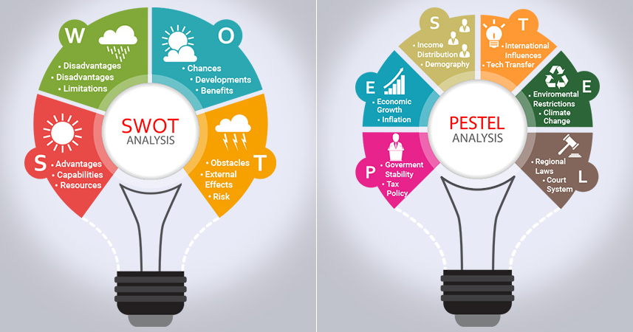
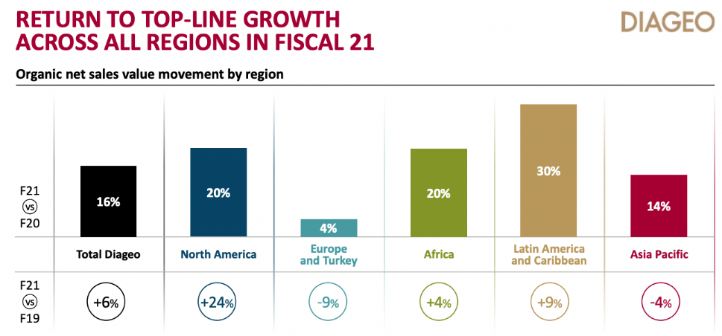
MARKETING DYNAMICS
Introduction
Perceptual map of the company
Customer persona for one identified target market
The aim of this report is to discuss the marketing dynamics, which indicate the forces that affect the behaviours and prices of the consumers and the producers. The prices develop signals in the market like supply fluctuation and demand for goods or services. Market dynamics can affect any policy of the government and even any industry. To evaluate the market dynamics, the company that is used here is Diageo Plc. In this context, the internal and external environment of the company is evaluated with the market position of the company, market segment, creating a customer persona and development of marketing mix and identifying skills that are required for operating the marketing team.
SWOT analysis
From this perceptual map, it can evaluate that the company Diageo Plc is placed at a higher position, which indicates that the company has high quality at a premium price.
The company offer different types of products to its customers not only in the UK but also all over the world.
Diageo is positioned as a premium brand at the end of the high-quality spectrum and at the higher end of the price spectrum (Tian et al., 2022).
Smirnoff and Guinness, two of its other well-known brands, are positioned in the middle of quality and price, and it indicates that they are reasonably priced and of high quality.
The fact that the brand Anheuser-Busch InBev is priced near the lower end of the pricing spectrum but maintains high quality indicates that they are reasonably priced while also having acceptable quality (Albano and Lolli, 2021).
The brand Pernod Ricard is positioned on the top end of the pricing spectrum with good quality.
Strengths | The business can reach a big customer base through its extensive global distribution network (Devenyns, 2020).
Weaknesses | The corporation is heavily indebted, which may limit its ability to make money (Business Standard, 2016).
Opportunities | Diageo may take advantage of enormous growth prospects in emerging regions like China and India to boost its revenue (The Economic Times, 2022).
Threats | Currency fluctuations and recessions are examples of economic instability that could have an effect on the company's sales and profitability (Evans, 2023).
Current marketing mix of the organization
Products | The goal of Diageo's product plan is to produce premium spirits of the highest calibre that will appeal to a diverse group of customers. The business has a wide range of brands, each with its own flavour profile and marketing approach. For instance, Smirnoff has been presented as a fun and approachable vodka brand which is well-liked by young drinkers, whereas Johnnie Walker is presented as an exclusive whisky brand that draws the attention of wealthy consumers (Yamamoto et al. 2022).
Prices | Offering superior cocktails at an elevated price is the main goal of Diageo’s pricing approach. The organization’s brands are promoted as high-end, luxurious goods that are pricey but worthwhile. Despite this, Diageo also offers a choice of products at different price ranges, allowing customers to choose goods that go within their budget Hawkins and McCambridge, 2020).
Places | Diageo’s distribution strategy is to make it simple for customers to locate its products. The company uses a combination of indirect and direct channels to distribute its products, including an internal e-commerce platform, pubs, traditional stores, and dining places.
Promotion | Two major objectives of the company’s promotional aspect are enhancement of the brand improvement and growth of sales. The marketing strategies of the company include TV advertisements, social media, online promotion and communication with customers.
PESTLE analysis
Market segment of the company in the target market
Political | The operations and revenue of the corporation may be impacted by laws governing the marketing and disposal of alcoholic beverages. Tariffs and trade restrictions may hinder the ability of the company to export its goods internationally (BBC News, 2020).
Economic | Recessions and currency swings are examples of economic volatility that can have an effect on the company's sales and profitability. Diageo has excellent growth prospects for the expanding middle class in emerging nations (Afanasieva, 2023).
Social | The requirements for products of the company may change as a result of shifting consumer trends and tastes. The rising interest in health and well-being may have an effect on alcoholic beverage demand (Diageo, 2022).
Technological | Technology advancements like digital marketing and e-commerce can give the business opportunity to access a larger consumer base and increase the effectiveness of its marketing. The beverage industry's embrace of artificial intelligence and automation may have an impact on the business's operations and employees (Arthur, 2019).
Environmental | The operations of the company have a major environmental impact, and any harm to the environment could affect the company's income and reputation. The company's operations and revenue may be impacted by the rising distress for environmental and sustainability responsibility (Mediawire, 2023).
Legal | The operations and revenue of the corporation may be impacted by modifications to laws governing the promotion and selling of alcoholic beverages. Suits involving the harmful effects of alcohol on well-being may have an effect on the business's reputation and earnings (Diageo, 2023).
Geographic segmentation: Geographic segmentation is the division of a market into different geographic regions. Diageo concentrates its efforts on the luxury spirits sector across a number of international continents.
Demographic segmentation: Demographic segmentation is the process of partitioning a market according to demographic factors, including income, level of education, gender, and age.
Psychographic segmentation: The categorization of a market determined by customers' daily lives, behaviour, and values is known as psychographic segmentation. Diageo appeals to customers that want luxury and top-notch goods in order to reach the premium spirits market (Ameyibor et al. 2022).
Behavioural segmentation: The separation of an industry based on the purchasing habits of consumers, which includes purchasing trends and product usage, is known as behavioural segmentation.
Skills required operating within the marketing department
In a marketing team, the capacity for strategic thought and the creation of a marketing strategy are essential.
Marketing professionals need creativity since it allows them to develop unique and compelling concepts for marketing campaigns.
For marketing professionals to effectively interact with a variety of stakeholders, including management, customers, coworkers, and vendors, they require strong communication skills.
To assess the success of their marketing campaigns, marketers must have analytical skills.
Marketers in the current digital era need to be well-versed in digital marketing strategies and tools.
Marketing professionals frequently have to operate under tight deadlines and must be able to manage many projects at once.
Entrepreneurs must be ready to adjust to emerging patterns and advances in technology because the marketing sector is continuously evolving.
Conclusion
To conclude this assignment it is important to provide a brief summary what have done in here. The company that is used here is Diageo Plc which is the UK based Beverage Company and based on this company the external and internal environment discussed here with SWOT and PESTLE analysis. The perceptual map helps to understand the market position of the company. A customer persona provided to understand the buying behaviour and characteristics of the customers. To define the current target market of the company, they focus on the four segmentations and created marketing of the company and identified required skills.
Notes:
You can add your presentation notes here. This presentation template for research posters is fully editable so text, graphics and content can be updated to fit your own research needs.
Download more poster presentation templates from FPPT.com

