Slide 1
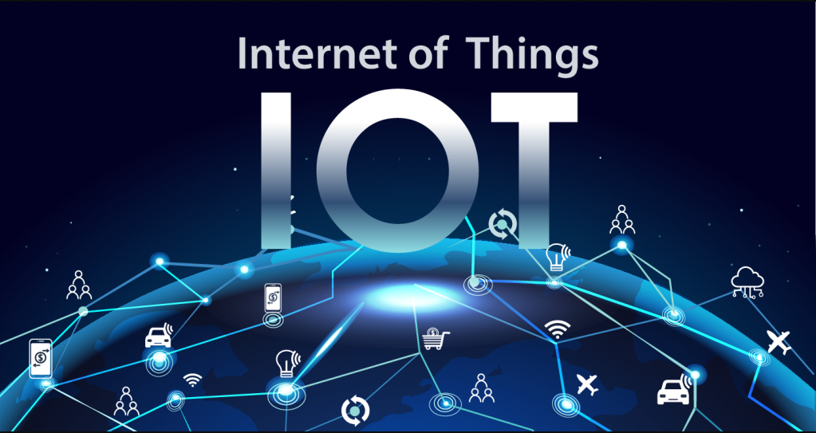

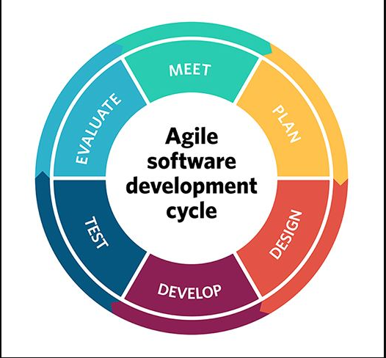

Agile Project Management: Installation of IoT
Evaluation of the process of the project
The process of installing IoT is thus used in leveraging the domain-based system that is used for immersing in the physical environment.
Introduction
Project management focuses on the planning and organization of the project to leverage the resources of the company. This includes managing and identifying the required project well-used and advanced for the lifecycle of single iteration.
Evaluation and Monitoring
The evaluation and monitoring of the data thus include the continuous assessment program that has been taken based on early detailed information with the evaluation in progress for the delay. Every employee can be evenly monitored and evaluated with the help of IoT-based technology.
Application design of IoT technology and benefits client
The application design for the IoT technology provides with benefitting for the client that would be used in lightning, locks, air conditioning, theft alarm systems, and maintenance in the process with the control and fingerprints.
Conclusion
The agile methodology thus helped to determine eh IoT-based technology in defining the interactive approach of managing the project in an organization. The evaluation for the process of the project is discussed by installing the IoT devices in the firm.
Application of construction, implementation, and relationship with Agile methodology application
The application of IoT-based features used thus has linked with Agile methodology application by the usage of technical requirements that thus have for the technical requirement. This is maintained with the proficiency that is controlled by the sensors and actuators in managing and monitoring the cause which is extremely beneficial for any IT industry. IoT is constructed with the application of 3 to 4 networks connected in parallel to advance the growth of organizational benefit.
Suggestions for improvement and process optimization
IoT network optimization offers a lot of benefits that might be used as innovative gifts that are used for traffic management. In installing it in an organization the operation efficiency, reduction in latency, and energy conversion is used for the product.

Slide 2
Reference List
Caceres, G.M., 2020. Industry 4.0 and IoT: How to Improve the Knowledge of the Project Management Before Carrying Out an Implementation. SAR Journal-Science and Research, 3(3), pp.133-141.
Hagar, J.D., 2022. Planning for the IoT Tester on Environments and Testing Details. In IoT System Testing: An IoT Journey from Devices to Analytics and the Edge (pp. 115-136). Berkeley, CA: Apress.
Ismail, S. and Dawoud, D.W., 2022, January. Software Development Models for IoT. In 2022 IEEE 12th Annual Computing and Communication Workshop and Conference (CCWC) (pp. 0524-0530). IEEE.
Matsuo, K. and Barolli, L., 2020. IoT sensors management system using Agile-Kanban and its application for weather measurement and electric wheelchair management. International Journal of Web Information Systems, 16(3), pp.281-293.
Saadane, R., Chehri, A. and Jeon, S., 2022. AI-based modeling and data-driven evaluation for smart farming-oriented big data architecture using IoT with energy harvesting capabilities. Sustainable Energy Technologies and Assessments, 52, p.102093.
Schmiedmayer, P., Chatley, R., Bernius, J.P., Krusche, S., Chaika, K., Krinkin, K. and Bruegge, B., 2022, May. Global software engineering in a global classroom. In Proceedings of the ACM/IEEE 44th International Conference on Software Engineering: Software Engineering Education and Training (pp. 113-121).

