Slide 1
Global Strategy and Sustainability PART B POWERPOINT PRESENTATION

Slide 2
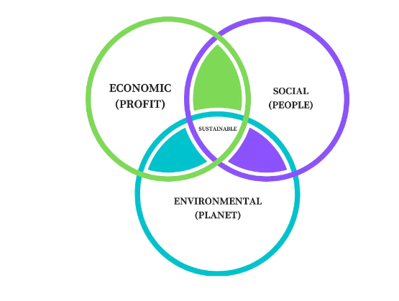
Application of Triple Bottom line theory for analysing social approaches of Zara
Profit
Identify - Profit is the first aspect of the triple bottom line theory which helps to measure the corporate profit for an organisation and society
Analyse - The profit helps to assure the company of paying fair state, the share of local and income taxes timely (Roossien et al. 2022)
Evaluate - Profit assures that companies foster economic wealth within their community by shopping locally or utilising small businesses
Notes:
The profit helps the business origination to enhance its ability to sustain and empower the overall industry. Organization needs to generate its revenue by including ethical and fair manners. In addition, the Profit aspect of TBL also helps to determine that the organisation and the shareholders must have an understanding of financial responsibility.

Slide 3
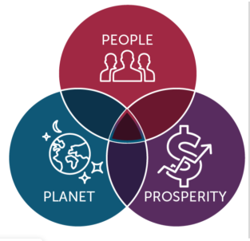
Application of Triple Bottom line theory for analysing social approaches of Zara
Profit
The profit aspect helps Zara to maintain ethics in the business
Zara has also provided taxes and maintained all the rules and regulations for global expansion
Zara improves sustainable distribution challenges in e-commerce site
Notes:
ZARA also needs to communicate to financially invest in the industry via developments, partnerships as well as corporate sponsorships. The profit aspect also assures that the organisation is meeting ethics and paying taxes in time to eliminate political hazards and achieve sustainable growth. Thus, it can be stead that Zara needs to implement the profit aspect of the TBL theory to achieve sustainable financial stability

Slide 4

Application of Triple Bottom line theory for analysing social approaches of Zara
People Aspect
Zara caters to meeting the needs and requirements of clothes and accessories of all age groups
Zara has nearly 3000 stores in approximately 96 countries meeting the needs of around 116,202,886 people globally (forbes.com, 2023)
Zara has introduced a range of affordable products.
Notes:
Zara as a clothing global giant caters to serving the needs of customers worldwide. The company introduces products that serve good quality sourced products. Zara in all their global stores respects customer choices and aligns their product in ways that meet the demands of the customers. Zara also uses recent market trends to update their market competence and ways in which the customer’s needs and requirements are given priority. Zara uses the super supply chain and strategic implementation of organised market policies to meet customer demands.

Slide 5
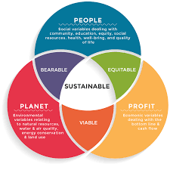
Application of Triple Bottom line theory for analysing social approaches of Zara
People Aspect
Zara provides their employees training to help them understand their job.
Zara’s stores worldwide believe in integrating women in the workforce to provide equality in employment (Jovanović, 2020).
Zara uses local workforce in all their stores globally.
Notes:
Zara believes in integrating rights for employees in their company’s policies. Zara uses policies for equality in employment and undertakes women in their workforce and gives them equal pay.

Slide 6
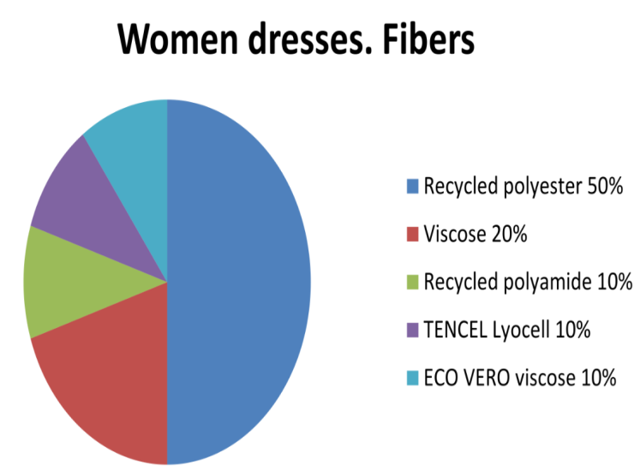
Application of Triple Bottom line theory for analysing social approaches of Zara
Planet Aspect
Zara uses organic products and believes in recycling of products (Segran, 2019).
The company has successfully reduced carbon emissions by nearly 43.6% in 2021 (globaldata.com, 2023).
Zara uses locally sourced materials that are environment friendly
Notes:
Zara as a clothing line sources their products from recyclable materials that are organic and locally sourced. The company believes in introducing sustainability in their range of products designed to cater customers of all age groups. Zara devises a strategic plan to improve sustainability goals of the company. The company works hard on its policies to improve the sustainability requirements internationally.

Slide 7
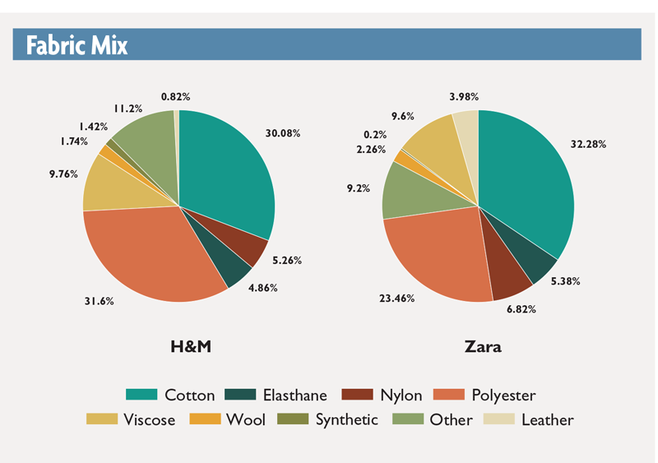
Application of Triple Bottom line theory for analysing social approaches of Zara
Planet Aspect
Zara believes in the use of water and energy efficiently.
Zara introduced plans to use solar energy at stores that are not locally enclosed.
Zara introduced a Join Life program to promote climate neutrality by 2040 (zara.com, 2023).
Notes:
Zara introduced approximately 100% eco-efficient stores globally. The company has also introduced a plan that improves climate neutrality rates. Zara also uses plans to improve energy resource efficiency and manage wastes and water. Zara also introduced organic farming of cotton and other raw materials to enhance their sustainable growth. The company resourced their raw materials to improve local sustainability challenges.

Slide 8
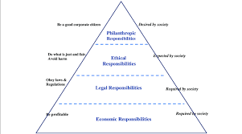
Ethical Issues
CSR activities of Zara include incorporation of policies and plans that enhances their sustainability requirements.
Zara introduced nearly 100% eco-efficient global stores that give the company a reputational growth.
The company also introduced raw and organic materials in their line of operations to produce almost 100% organic and sustainable fabric by 2025 (theguardian.com, 2023).
Notes:
Carroll's pyramid is one of the potential frameworks that has been implied as a concise area of changes that relates to the entire aspects for following CSR aspects in the company’s activities. Reference to this theory on the other hand is imposing the best effective ways to create a concise idea for taking organisational activities as concise to determine social outcomes.

Slide 9
References
Forbes.com (2023), Zara Available at: https://www.forbes.com/companies/zara/?sh=30830f174877 [Accessed on: 18 May 2023]
Jovanović, M., (2022). Overcoming the difficulties caused by the COVID-19 pandemic by using adapted marketing logistics in the" Zara" company. Tekstilna industrija, 70(4), pp.63-71
Segran, E.L.I.Z.A.B.E.T.H., (2019). H&M, Zara, and other fashion brands are tricking shoppers with vague sustainability claims. Fast Company, 8.
Globaldata.com (2023), Greenhouse Gas Emissions in 2021 Available at: https://www.globaldata.com/data-insights/retail-amp-wholesale/inditex-greenhouse-gas-emissions-2096526/#:~:text=Inditex%20operates%20retail%20stores%20under,decrease%20of%2043.6%25%20over%202020. [Accessed on: 18 May 2023]
Zara.com (2023), Zara’s Join Life available at: https://www.zara.com/ao/en/z-join-life-mkt1399.html [Accessed on: 18 May 2023]
Theguardian.com (2023), Zara clothes to be made from 100% sustainable fabrics by 2025 Available at: https://www.theguardian.com/fashion/2019/jul/17/zara-collections-to-be-made-from-100-sustainable-fabrics [Accessed on: 18 May 2023]

