Slide 1
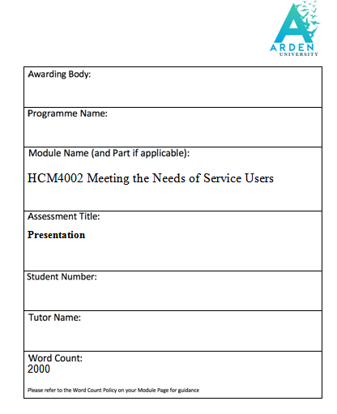

Slide 2
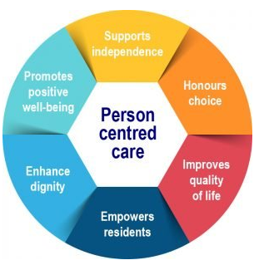
INTRODUCTION
It is important to assess the care needs of individuals to develop an overall care plan effectively.
In this context, this study focuses on creating a care plan for Florence based on the given case scenario.
Moreover, the outcome objectives, required actions and person-centred care approach for Florence have been discussed in this study in detail.
In turn, this study helps in identifying the required skills for creating care plans for individuals like Florence.

Slide 3
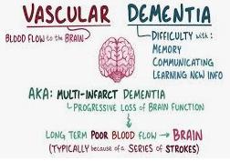
IDENTIFYING THE CARE NEEDS OF FLORENCE
The given case study highlights that Florence has a serious health condition due to glaucoma and cardiac issues.
In addition, Florence has been diagnosed with vascular dementia affecting her daily activities.
As stated by Wang et al., (2020), vascular dementia is a pathologic condition that leads to reducing rationality, judgmental skills along with cognitive performance.
Therefore, it is necessary for Florence to have clear information regarding her current health condition.

Slide 4
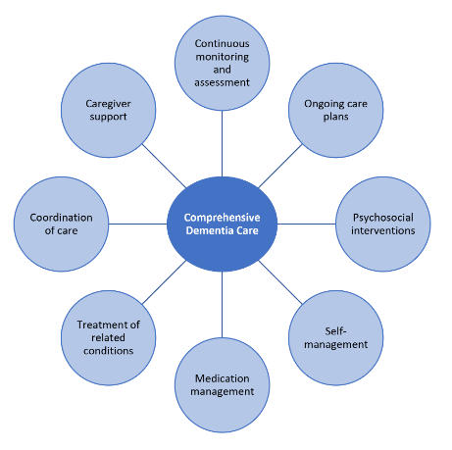
IDENTIFYING THE CARE NEEDS OF FLORENCE
Florence also needs to have support for conducting her daily tasks including taking medicines.
Moreover, Florence needs to be able to continue to take care of her husband properly.
Florence needs someone whom she can trust and communicate her issues easily.
Based on the scenario, it is also evident that Florence tends to forget the usual things and make mistakes on a regular basis.
Therefore, she needs care support and proper guidance to improve her cognitive performance.

Slide 5
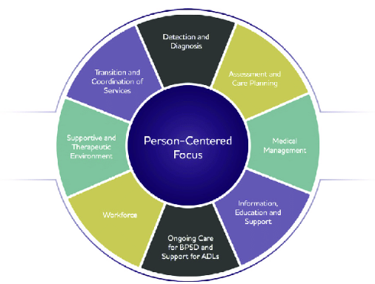
DETERMINING OUTCOME OBJECTIVES
Based on the provided scenario, Florence needs to know her health conditions so that she feels less anxious.
In turn, it can also help her to make proper care plans and cooperate with her family and caregivers easily.
Moreover, external support can be effective for the individual in terms of maintaining her health and well-being at home.
As per the study by Wang et al., (2019), professional support is essential for increasing the quality of dementia home care.
Accordingly, it can help Florence’s husband to remain well and support Florence deal with her issues efficiently with the support from the caregiver.

Slide 6

IDENTIFYING PEOPLE AND ORGANISATIONS REQUIRED FOR CARE SUPPORT
It is required to identify people and organisations in the UK that can ensure integrated care systems (ICS) related to dementia care.
ICS includes different entities such as Integrated Care Board (ICB), Integrated Care Partnerships (ICPs) and local authorities (DementiaUK, 2022).
Thus, by considering the ICS it is possible to involve communities and people in the care-related decision-making process for Florence and her family.
Moreover, dementia charities like Alzheimer's Society and Age UK work to provide social services to dementia patients by making partnerships with the NHS (NHS, 2023).
In turn, it can also contribute to increasing the efficiency of the need assessment procedures for Florence.

Slide 7
IDENTIFYING PEOPLE AND ORGANISATIONS REQUIRED FOR CARE SUPPORT
NHS provides help for psychotherapy, speech and language therapy, hearing care and eye test for supporting dementia care (NHS, 2023).
Thus, it can help Florence and her family to deal with the complex healthcare needs of Florence and her husband.
NHS also works collaboratively with the local ICB (NHS, 2023).
Thus, it can also improve the care approaches for Florence and her husband as well.

Slide 8
DEVELOPING ACHIEVABLE SMART GOALS
Goal 1: To enable Florence to perform at least 3 daily tasks without any mistakes by improving her cognitive performance within six months
Specific: Increasing confidence in Florence to perform her day-to-day tasks without any confusion
Measurable: Encouraging the individual to perform a minimum of 3 daily activities without any mistakes
Achievable: Providing cognitive support to Florence to conduct her daily activities
Realistic: Aiding Florence to improve her cognitive performance and become less forgetful regarding her daily tasks
Time-bound: Five to six months

Slide 9
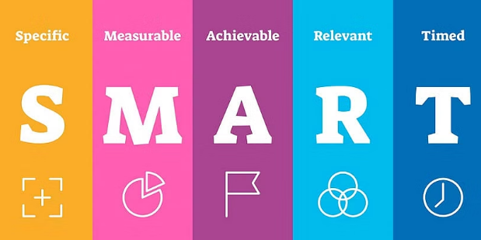
DEVELOPING ACHIEVABLE SMART GOALS
Goal 2: To empower Florence for developing at least two interests by improving her health conditions within six months
Specific: Identifying and building areas of interest for Florence to improve her overall health conditions including glaucoma and cardiac issues
Measurable: Developing at least two hobbies according to the area of interest of Florence
Achievable: Increasing communication with Florence to understand her needs and area of interest in living
Realistic: Increasing physical and mental abilities of Florence to take care of herself and her family as well
Time-bound: Five to six months

Slide 10
DISCUSSING PERSON-CENTRED APPROACH
Needs | Action | Outcomes
Increasing awareness regarding health condition | Seeking advice from professionals and maintaining regular health check-ups | Increasing confidence and reducing health-related stress and anxiety of the individual care seeker
Performing daily activities | Supporting Florence to arrange necessary things at home that are used in daily activities and aiding in cooking and shopping | Increasing overall health and well-being of Florence
Taking care of her spouse | Creating a care and support plan for Florence | Improving wellbeing of Florence’s husband
Communicating with others | Maintaining dignity and empathy while communicating with Florence | Building trust in Florence to share her issues and concerns with family and caregivers
Improving cognitive performance | Encouraging Florence to get involved in constructive activities like exercising, gardening, watching sports and listening to radio | Enjoying life and staying happy and healthy

Slide 11
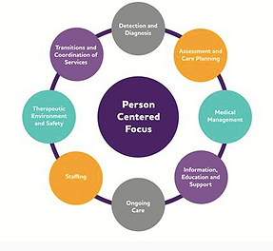
DISCUSSING PERSON-CENTRED APPROACH
It is important to consider a person-centred care approach for Florence in terms of achieving a positive health outcome.
According to the study by Ho et al., (2021), person-centred care refers to a socio-psychological care approach that helps to identify unique needs and preferences of individual care seekers related to their care needs.
Similarly, by incorporating the person-centred approach in the care plan it is possible to increase the involvement of Florence in the treatment process.
For instance, the objectives of the care plan emphasise improving her cognitive activities of Florence by increasing her involvement and interests in daily activities.

Slide 12
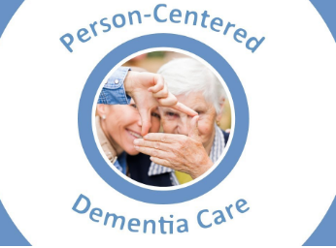
DISCUSSING PERSON-CENTRED APPROACH
The caregiver needs to focus on the specific needs and requirements of Florence regarding her treatment.
For instance, this plan helps the caregiver to understand the lifestyle, interests and preferences Florence from different perceptions.
Person-centred care approach in dementia is helpful for providing an opportunity for the care seekers to develop conversations and relationships with others (Alzheimer’s Society, 2023).
Accordingly, this plan encourages Florence to share her concerns and thoughts regarding her health effectively.
This individual care seeker is able to improve her physical and mental health conditions by considering this plan which, in turn, can enable her to support her husband as well.
Since Florence is diagnosed with vascular dementia, it is important to focus on her cognitive abilities.
Therefore, this plan can support Florence in terms of boosting her confidence to maintain her health and perform regular activities without any errors.

Slide 13
IDENTIFYING RELEVANT LEGISLATION
The care plan for Florence needs to adhere to the Mental Capacity Act 2005 of the UK.
The main purpose of the Mental Capacity Act 2005 is to protect and empower individuals a lack mental capacity to improve their decision-making process related to their treatment and care (NHS, 2023).
Therefore, the caregiver needs to make decisions in the best interests of Florence based on this act. On the other hand, the care plan needs to comply with the Health and Care Act 2022 of the UK to obtain the desired health outcomes.
The Health and Care Act 2022 promotes the importance of providing integrated treatment to care seekers to deal with health inequalities (Department of Health & Social Care, 2022).
Thus, by integrating this legislation it is possible to improve the health outcomes for Florence effectively.

Slide 14
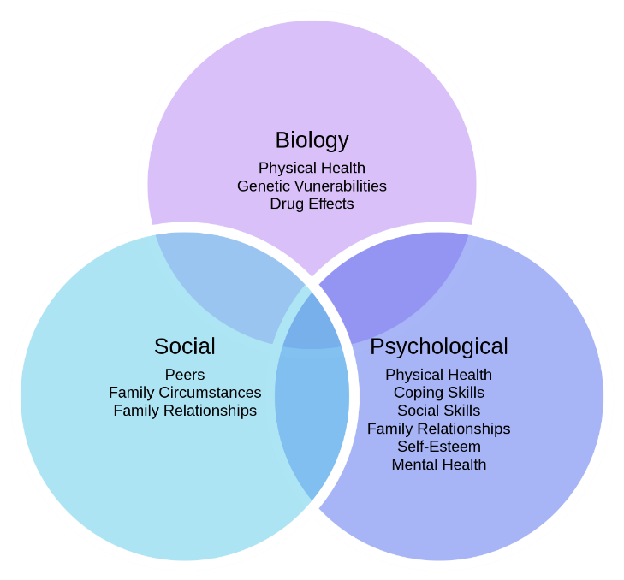
Justifying used model, framework and tools
“Biopsychosocial model” is closely associated with describing the conditions of an individual suffering from dementia.
This model sheds light on the fact that dementia is a result of both psychological, social and biological factors associated with the service user (Bolton and Gillett, 2019)
In context to the biological factor, Florence’s husband is suffering from Alzheimer’s disease and Florence herself is dealing with glaucoma and a heart condition.
In context to the biological factor, it can be seen that both Florence as well as her husband have been suffering from health issues which require implementing social care services.
As both Florence and her husband are facing serious health issues, they need strong emotional and cognitive support as a means of care.
Therefore, the entire biological condition of both Florence and her husband requires care needs.

Slide 15
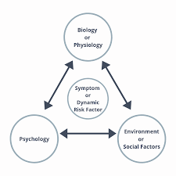
Continued…
One of their daughters passed away 10 years ago which suggests a lack of family support faced by Florence and her husband
Referring to the social context, it can be mentioned that Florence and her husband are living separated from his sons and daughters.
Though their sons take care of them, they have limited resources as well as social support that requires social care needs.
Diagnosing with dementia made Florence deal with confusion while conducting her daily tasks.
Florence has been mistaking the oven as a storage and sometimes forgets to take her own medication which suggests that Florence is suffering from vascular dementia.

Slide 16
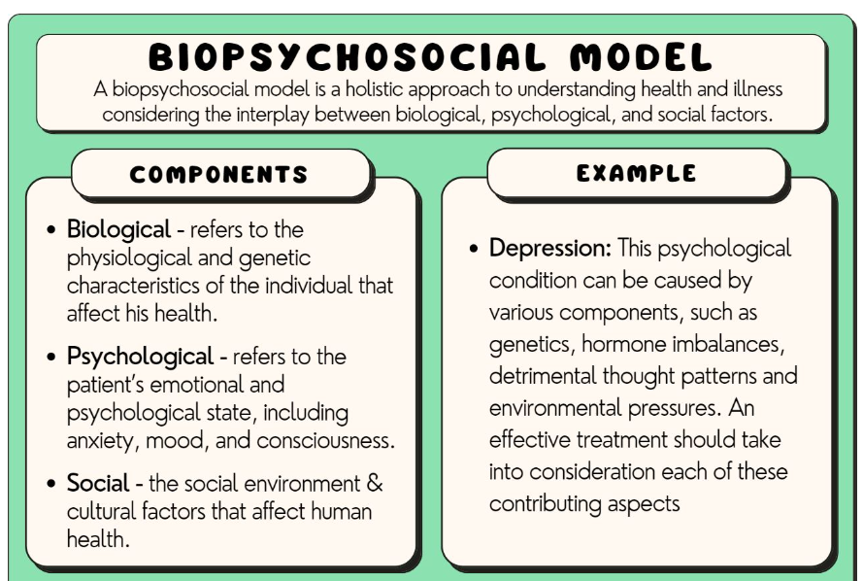
Continued…
Assessment of identifying care needs of the patient is an effective technique and planning that can ensure the well-being of the service user (Bayne and Shune, 2022).
In this context, it can be mentioned that assessing both the needs of biological health and mental health, and providing medications on time help Florence to take her medicines for glaucoma, and heart on time.
Besides, proper planning is required in the context of both home care service as well as healthcare that will not only help eradicate issues that an individual is facing.
The care needs assessment plays an important role in order to identify the health conditions of the patients, and providing accurate medicines on time.
Social, cognitive, and emotional support are needed to be given to both Florence and her husband which will promote both physical and mental well-being.
Therefore, it can be stated that using a biopsychosocial approach as well as a care assessment framework is essential for addressing the mental and physical needs of Florence and her husband.

Slide 17
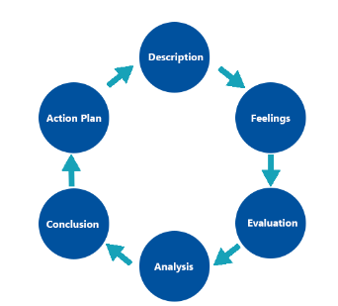
REFLECTION
Description
I have focused on developing the care plan for Florence based on her specific needs and current health conditions as well.
I have emphasised building trust in the care seeker while making this plan.
Moreover, my communication and emotional intelligence skills have helped me to understand Florence's situation for making the care plan.
Feeling
I think that considering an integrated care approach is important for achieving the desired results.
In my opinion, strong verbal communication skills are important for sharing ideas and collecting information from care seekers.
Besides, non-verbal communication skills help in increasing trust and empathy significantly.
Evaluation
I have realised that individual caregivers need to be empathic to the situation of the care seekers for treating them with dignity.
As per the opinion of Ounalli et al., (2020), showing dignity to elderly people with cognitive impairment is important for the care seekers to enhance the quality of care.
Therefore, I have always concentrated on maintaining respect and dignity while dealing with Florence.

Slide 18
REFLECTION
Analysis
Based on my experience, I think that I need to improve my critical thinking abilities.
In turn, it can help me in improving my problem-solving and decision-making skills while facing any unprecedented situations regarding the care of Florence.
Moreover, increasing my search skills can also support me to find the best possible solutions for Florence related to her health situation.
Conclusion
I think that I need to work more on my active listening skills to increase communication with others.
Moreover, my problem-solving and decision-making skills can help me to increase my involvement with care seekers effectively.
Action Plan
I will focus on increasing my communication with the care seekers and developing my knowledge of person-centred care.
Moreover, I will take suggestions from professionals to deal with critical situations with appropriate decisions.

Slide 19
CONCLUSION
A person-centric care approach is necessary for individual care seekers to obtain care support tailored to their needs.
Moreover, an integrated care system is effective for making a proper care plan for Florence based on her current health situation.
It can also help in improving her physical and mental health which can assist her to perform her daily tasks and increase cognitive abilities significantly.
Thus, in conclusion, it can be said that a person-centric care plan is helpful for dealing with health issues of Florence.

Slide 20
REFERENCES
Alzheimer’s Society (2023). Person-centred care. Available from: https://www.alzheimers.org.uk/about-dementia/treatments/person-centred-care#:~:text=The%20key%20points%20of%20person,of%20the%20person%20with%20dementia[Accessed 25 May 2023]
DementiaUK, (2022). A guide to integrated care systems. Available from: https://www.dementiauk.org/a-guide-to-integrated-care-systems/[Accessed 25 May 2023]
Department of Health & Social Care, (2022). Health and Care Act 2022. Available from: https://assets.publishing.service.gov.uk/government/uploads/system/uploads/attachment_data/file/1115453/health-and-care-act-2022-summary-and-additional-measures-impact-assessment.pdf[Accessed 25 May 2023]
Ho, P., Cheong, R.C.Y., Ong, S.P., Fusek, C., Wee, S.L. and Yap, P.L.K., (2021). Person-Centred care transformation in a nursing home for residents with dementia. Dementia and Geriatric Cognitive Disorders Extra, 11(1), pp.1-9.
NHS, (2023). Dementia, social services and the NHS. Available from: https://www.nhs.uk/conditions/dementia/social-services-and-the-nhs/[Accessed 25 May 2023]
NHS, (2023). Managing legal affairs for someone with dementia. Available from: https://www.nhs.uk/conditions/dementia/legal-issues/#:~:text=The%20Mental%20Capacity%20Act%20(MCA,can%20help%20assess%20mental%20capacity. [Accessed 25 May 2023]
Ounalli, H., Mamo, D., Testoni, I., Belvederi Murri, M., Caruso, R. and Grassi, L., (2020). Improving dignity of care in community-dwelling elderly patients with cognitive decline and their caregivers. The role of dignity therapy. Behavioral Sciences, 10(12), p.178.
Wang, S., Cheung, D.S.K. and Leung, A.Y., (2019). Overview of dementia care under the three‐tier long‐term care system of China. Public Health Nursing, 36(2), pp.199-206.
Wang, X.X., Zhang, B., Xia, R. and Jia, Q.Y., (2020). Inflammation, apoptosis and autophagy as critical players in vascular dementia. Eur Rev Med Pharmacol Sci, 24(18), pp.9601-9614.
Bolton, D. and Gillett, G., (2019). The biopsychosocial model of health and disease: New philosophical and scientific developments (p. 149). Springer Nature.
Bayne, D.F. and Shune, S.E., (2022). A Biopsychosocial Model of Mealtime Management in Persons with Dementia, an Asset-Based Approach to Patient-Centered Care. Geriatrics, 7(5), p.112.
Wu-Chung, E.L., Leal, S.L., Denny, B.T., Cheng, S.L. and Fagundes, C.P., (2022). Spousal caregiving, widowhood, and cognition: a systematic review and a biopsychosocial framework for understanding the relationship between interpersonal losses and dementia risk in older adulthood. Neuroscience & Biobehavioral Reviews, 134, p.104487.

