Slide 1
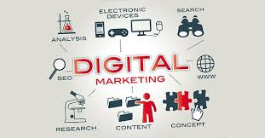
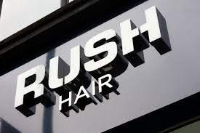
Digital First Campaign Report and Plan – Rush Hair
A digital-first creative pitch
STUDENT NAME:
STUDENT ID:

Slide 2
Table of Contents
Serial no. | Contents | Slide Number
1. | Developing and presenting a creative content example for the Hero brand activation that increases target audience attention in a particular customer segment | 3
2. | Creating a creative content example for a Hub conversion landing page that converts visitors | 4-5
3. | Creating a useful hygiene content example that is intended to engage current clients | 6-7
4. | References | 8

Slide 3
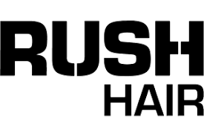
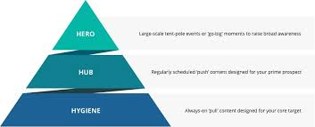

Developing and presenting a creative content example for the Hero brand activation that increases target audience attention in a particular customer segment
Relevance: By determining the precise client group they wish to target and customising the content to fit their interests and preferences, Rush Hair can make sure that their creative material is relevant.
Originality: By thinking outside the box and coming up with novel and unexpected ideas, Rush Hair can make their creative content more original.
Rush Hair may make sure that its creative material has an impact by concentrating on a call-to-action (CTA) that inspires its target audience to perform a certain action, like completing a purchase or enrolling in a loyalty programme.
Notes:
A excellent technique for Rush Hair to connect with their target audience and interact with them is by emphasising customization and storytelling in their new First marketing campaign. Rush Hair can use the ROI creative framework to implement a hero brand activation creative content that will increase their target audience's attention in a particular consumer group.
The ROI creative framework calls for producing material that is original, impactful, and relevant. Using this methodology, Rush Hair can make sure that their creative content connects with their target audience and generates substantial interaction.
Relevance: By determining the precise client group they wish to target and customising the content to fit their interests and preferences, Rush Hair can make sure that their creative material is relevant (Kuan et al., 2020). This could involve developing content that highlights these offerings while employing data analytics to determine which goods or services are most in demand in this market.
Originality: By thinking outside the box and coming up with novel and unexpected ideas, Rush Hair can make their creative content more original. For instance, they may collaborate with a well-known influencer in the fashion or lifestyle industries to produce a film or social media campaign that creatively and distinctively highlights Rush Hair products.
Last but not least, Rush Hair may make sure that its creative material has an impact by concentrating on a call-to-action (CTA) that inspires its target audience to perform a certain action, like completing a purchase or enrolling in a loyalty programme (Ghoshal, 2020). In order to gauge the effectiveness of their efforts, they can also monitor the campaign's outcomes using metrics like engagement rate, click-through rate, and conversion rate. Overall, Rush Hair may increase their target audience's attention in a particular consumer segment and drive meaningful engagement with their brand by using the ROI creative framework to implement a hero brand activation creative content.

Slide 4
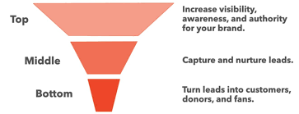
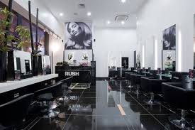
Creating a creative content example for a Hub conversion landing page that converts visitors
It was a wise marketing strategy choice by Rush Hair to incorporate storytelling and personalization into their marketing effort.
Rush Hair should concentrate on producing appealing creative content that draws visitors and motivates them to take action in order to implement their hub conversion landing page.
Rush Hair can rationalise its work by examining the anticipated return on investment for each piece of content they produce using a ROI creative framework. By doing this, they may prioritise.
Notes:
It was a wise marketing strategy choice by Rush Hair to incorporate storytelling and personalization into their marketing effort. They may foster brand loyalty and raise the likelihood of repeat business by giving their clients a more tailored experience. Rush Hair should concentrate on producing appealing creative content that draws visitors and motivates them to take action in order to implement their hub conversion landing page (Taylor et al., 2020). This can be accomplished by emphasising the advantages of their good or service and employing a clear call-to-action (CTA). Rush Hair can rationalise its work by examining the anticipated return on investment for each piece of content they produce using a ROI creative framework. By doing this, they may prioritise.

Slide 5
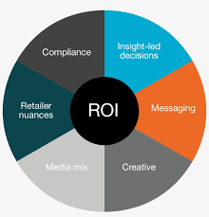
Creating a useful hygiene content example that is intended to engage current clients
The ROI creative framework measures the return on investment (ROI) of marketing efforts in terms of the income or cost savings realised.
The following crucial components make up the framework:
Business objectives: The campaign should support the overall strategy of the organisation and be in line with its business objectives.
Target audience: The campaign should be planned to effectively reach and interact with the target audience.
Implementation of the campaign's message and creative strategy: The campaign's message and creative strategy must be appealing and pertinent to the target audience.
Media: In order to reach the campaign's target audience, the most efficient media channels should be used.
Metrics and measurement: Using pertinent metrics in line with the campaign's objectives.
Notes:
To engage current clients, Rush Hair's new First marketing campaign combines storytelling, customization, and practical hygiene advice. We must evaluate this campaign's efficacy in terms of return on investment (ROI) and how it fits with the company's business objectives in order to evaluate the strategy and tactical plan utilising the ROI creative framework.
Return on Investment (ROI) Creative Framework: The ROI creative framework measures the return on investment (ROI) of marketing efforts in terms of the income or cost savings realised. The following crucial components make up the framework:
Business objectives: The campaign should support the overall strategy of the organisation and be in line with its business objectives.
Target audience: The campaign should be planned to effectively reach and interact with the target audience.
Implementation of the campaign's message and creative strategy: The campaign's message and creative strategy must be appealing and pertinent to the target audience.
Media: In order to reach the campaign's target audience, the most efficient media channels should be used (Bansal et al., 2020).
Metrics and measurement: Using pertinent metrics in line with the campaign's objectives.
Reviewing the First Marketing Campaign for Rush Hair:
Business objectives: Rush Hair First's marketing initiative supports the organization's objectives to improve client engagement, retention, and loyalty (De Datta, 2021). The campaign attempts to strengthen the company's brand values and develop a personalised, emotional connection with current clients.
Target market :The advertising effort is directed at repeat buyers who are already familiar with the brand. The objective is to strengthen the bond with these clients and win their continued commitment (Sheth, 2019).
Media channels: To reach consumers where they are most likely to interact, the campaign makes use of a variety of media channels, including social media, email, and website content. Customers may interact with the business on their terms thanks to this strategy, which guarantees that the message is presented in a personalised and pertinent manner.
Indicators and measurement: Useful indicators, such as consumer engagement, retention, and loyalty, are used to assess the campaign's effectiveness. These metrics show how well the campaign performed in meeting its aims and are in line with the company's business objectives. Overall, the Rush Hair First marketing initiative is a clever plan that supports the company's objectives and successfully appeals to its current clientele.
The campaign's theme and creative execution are centred on customization, storytelling, and practical hygiene information. Customers are meant to feel valued and appreciated through the personalised approach, and the storytelling component forges an emotional bond and upholds the company's core values.

Slide 6

Reviewing the First Marketing Campaign for Rush Hair:
Business objectives: Rush Hair First's marketing initiative supports the organization's objectives to improve client engagement, retention, and loyalty (De Datta, 2021).
Target market :The advertising effort is directed at repeat buyers who are already familiar with the brand. The objective is to strengthen the bond with these clients and win their continued commitment (Sheth, 2019).
Media channels: To reach consumers where they are most likely to interact, the campaign makes use of a variety of media channels, including social media, email, and website content.
Indicators and measurement: Useful indicators, such as consumer engagement, retention, and loyalty, are used to assess the campaign's effectiveness. These metrics show how well the campaign performed in meeting its aims and are in line with the company's business objectives.
Notes:
Rush Hair ' new First marketing campaign includes personalization, storytelling, and useful hygiene content designed to engage existing customers. To assess the strategy and tactical plan of this campaign using the ROI creative framework, the company need to analyze its effectiveness in terms of return on investment (ROI) and how it aligns with the company's business goals.
Return on Investment (ROI) Creative Framework:
The ROI creative framework evaluates the effectiveness of marketing campaigns by measuring their return on investment (ROI) in terms of revenue generated or cost savings achieved. The framework includes the following key elements:
Business goals: The campaign should align with the company's business goals and support its overall strategy.
Target audience: The campaign should be designed to reach and engage the target audience effectively.
Message and creative execution: The campaign's message and creative execution should be compelling and relevant to the target audience.
Media channels: The campaign should use the most effective media channels to reach the target audience (Bansal et al., 2020).
Metrics and measurement: The campaign's success should be measured using relevant metrics that align with the company's business goals.
Assessing Rush Hair ' First Marketing Campaign:
Business goals: Rush Hair ' First marketing campaign aligns with the company's business goals of increasing customer engagement, retention, and loyalty. The campaign aims to create a personalized, emotional connection with existing customers and reinforce the company's brand values.
Target audience: The campaign targets existing customers who are already familiar with the brand and have made previous purchases. The goal is to deepen the relationship with these customers and increase their loyalty.
Message and creative execution: The campaign's message and creative execution are focused on personalization, storytelling, and useful hygiene content. The personalized approach aims to make customers feel valued and appreciated, while the storytelling element creates an emotional connection and reinforces the company's brand values (Kerin and Hartley, 2019). The hygiene content is designed to provide useful information that customers will find relevant and valuable.
Media channels: The campaign uses a range of media channels, including social media, email, and website content, to reach customers where they are most likely to engage. This approach ensures that the message is delivered in a personalized and relevant way, and customers can engage with the brand on their terms.
Metrics and measurement: The success of the campaign is measured using relevant metrics, such as customer engagement, retention, and loyalty. These metrics align with the company's business goals and provide a clear indication of the campaign's effectiveness in achieving its objectives (Miteva and Popova, 2022).
Overall, Rush Hair ' First marketing campaign is a well-designed strategy that aligns with the company's business goals and effectively targets existing customers. The campaign's personalized approach, storytelling, and useful hygiene content create an emotional connection with customers and reinforce the company's brand values. The use of multiple media channels ensures that the message is delivered in a personalized and relevant way, and the campaign's success is measured using relevant metrics that align with the company's business goals. The ROI creative framework indicates that the campaign is likely to be effective in generating a positive ROI in terms of revenue generated or cost savings achieved.

Slide 7
REFERENCES
Ghoshal, N.D., 2020. Digital marketing: the opportunity and the imperative. International Journal of Public Sector Performance Management, 6(2), pp.246-259.
Kuan, N.Y., Yang, F.C. and Fei, L.K., 2020. An Application of Quantitative Strategic Planning Matrix for Small Business: A Case of a Beauty Salon. Global Business & Management Research, 12(2).
Taylor, S.A., Hunter, G.L., Zadeh, A.H., Delpechitre, D. and Lim, J.H., 2020. Value propositions in a digitally transformed world. Industrial Marketing Management, 87, pp.256-263.
Sheth, J.N., 2019. Customer value propositions: Value co-creation. Industrial marketing management, 87, pp.312-315.

Slide 8


