Slide 1

EBA / WEBSITE UPDATE
01
Website progress
Week of 19–25 October 2026
The website is built for review.
Launch connections and final approvals come next.
Eni Brand Architect
Notes:
Opening: This week focused on building and refining EBA’s website into a connected, multi-page experience. The design and core browsing journeys are in place. It should be described as ready for review, not as fully launched. This update covers work recorded in the development conversation and the repository snapshot inspected on 25 October 2026. The first repository commit and the responsive update commit are dated 23 October. The photograph is an existing project asset: public/images/events/swing-for-autism/moment-6.jpg. No campaign performance results are being claimed.

Slide 2
EBA / WEBSITE UPDATE
02
What is in place
Home & About
Homepage, Our Story, Founder and searchable FAQs
Services & sectors
7 service pages, 4 sector pages and 5 work galleries
Events & case studies
7 event details, event listings and 3 case studies
Stories & contact
16 imported articles, consultation and contact pages
Shared navigation, buttons and footer connect the pages throughout the site.
Notes:
Scope evidence: src/app route files; src/lib/service-offerings.ts combines six serviceDetails records plus Social Media & Community, giving seven detail pages. Six primary offerings appear in navigation, with Research & Insights available as an additional detail page. src/lib/about-content.ts defines four sectors and five galleries. src/lib/event-content.ts defines seven events. src/lib/case-studies.ts defines three cases. src/lib/stories/posts.json contains sixteen articles, with individual article routes and a Stories collection. Contact and consultation forms are interface flows with email handoff, not a booking or CRM backend. Pages use shared ActionLink, SectionHeading, Photo, motion, event card and pagination components. The count describes source content and implemented routes; it is not a count of approved final copy or live production pages.

Slide 3
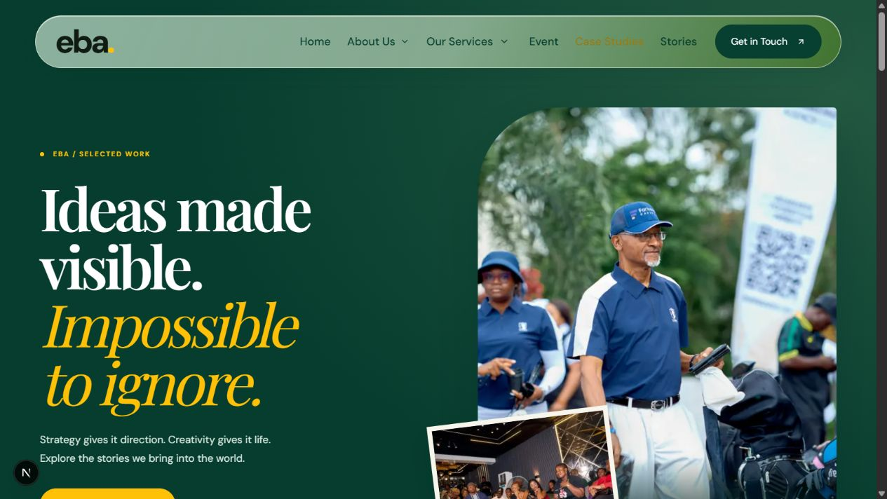
EBA / WEBSITE UPDATE
03
Design feedback translated into the website
Brand consistency
Green, cream and #FFC107 yellow; consistent buttons and typography.
A shorter homepage
Condensed services and founder section; one shared newsletter/contact area.
Case Studies received a full layout redesign, larger imagery and working filters.
Notes:
Completed design revisions: sticky glass-style navigation with text-only hover states; About dropdown; DM Sans, Playfair Display and Yellowtail on the website; brand yellow changed to #FFC107. Homepage services were shortened and linked to dedicated pages. The founder block uses the full requested quote/story with a Read More link. Find/Create/Execute was removed from the founder detail page. The homepage About collage was replaced with the anniversary video, muted and looping, with playback controlled by viewport visibility. The standalone Case Studies closing CTA and hero bottom strip were removed at the user’s request. The screenshot is an earlier review capture from artifacts/case-studies-redesign.png; its purpose is to illustrate the redesign, not certify current production deployment.

Slide 4
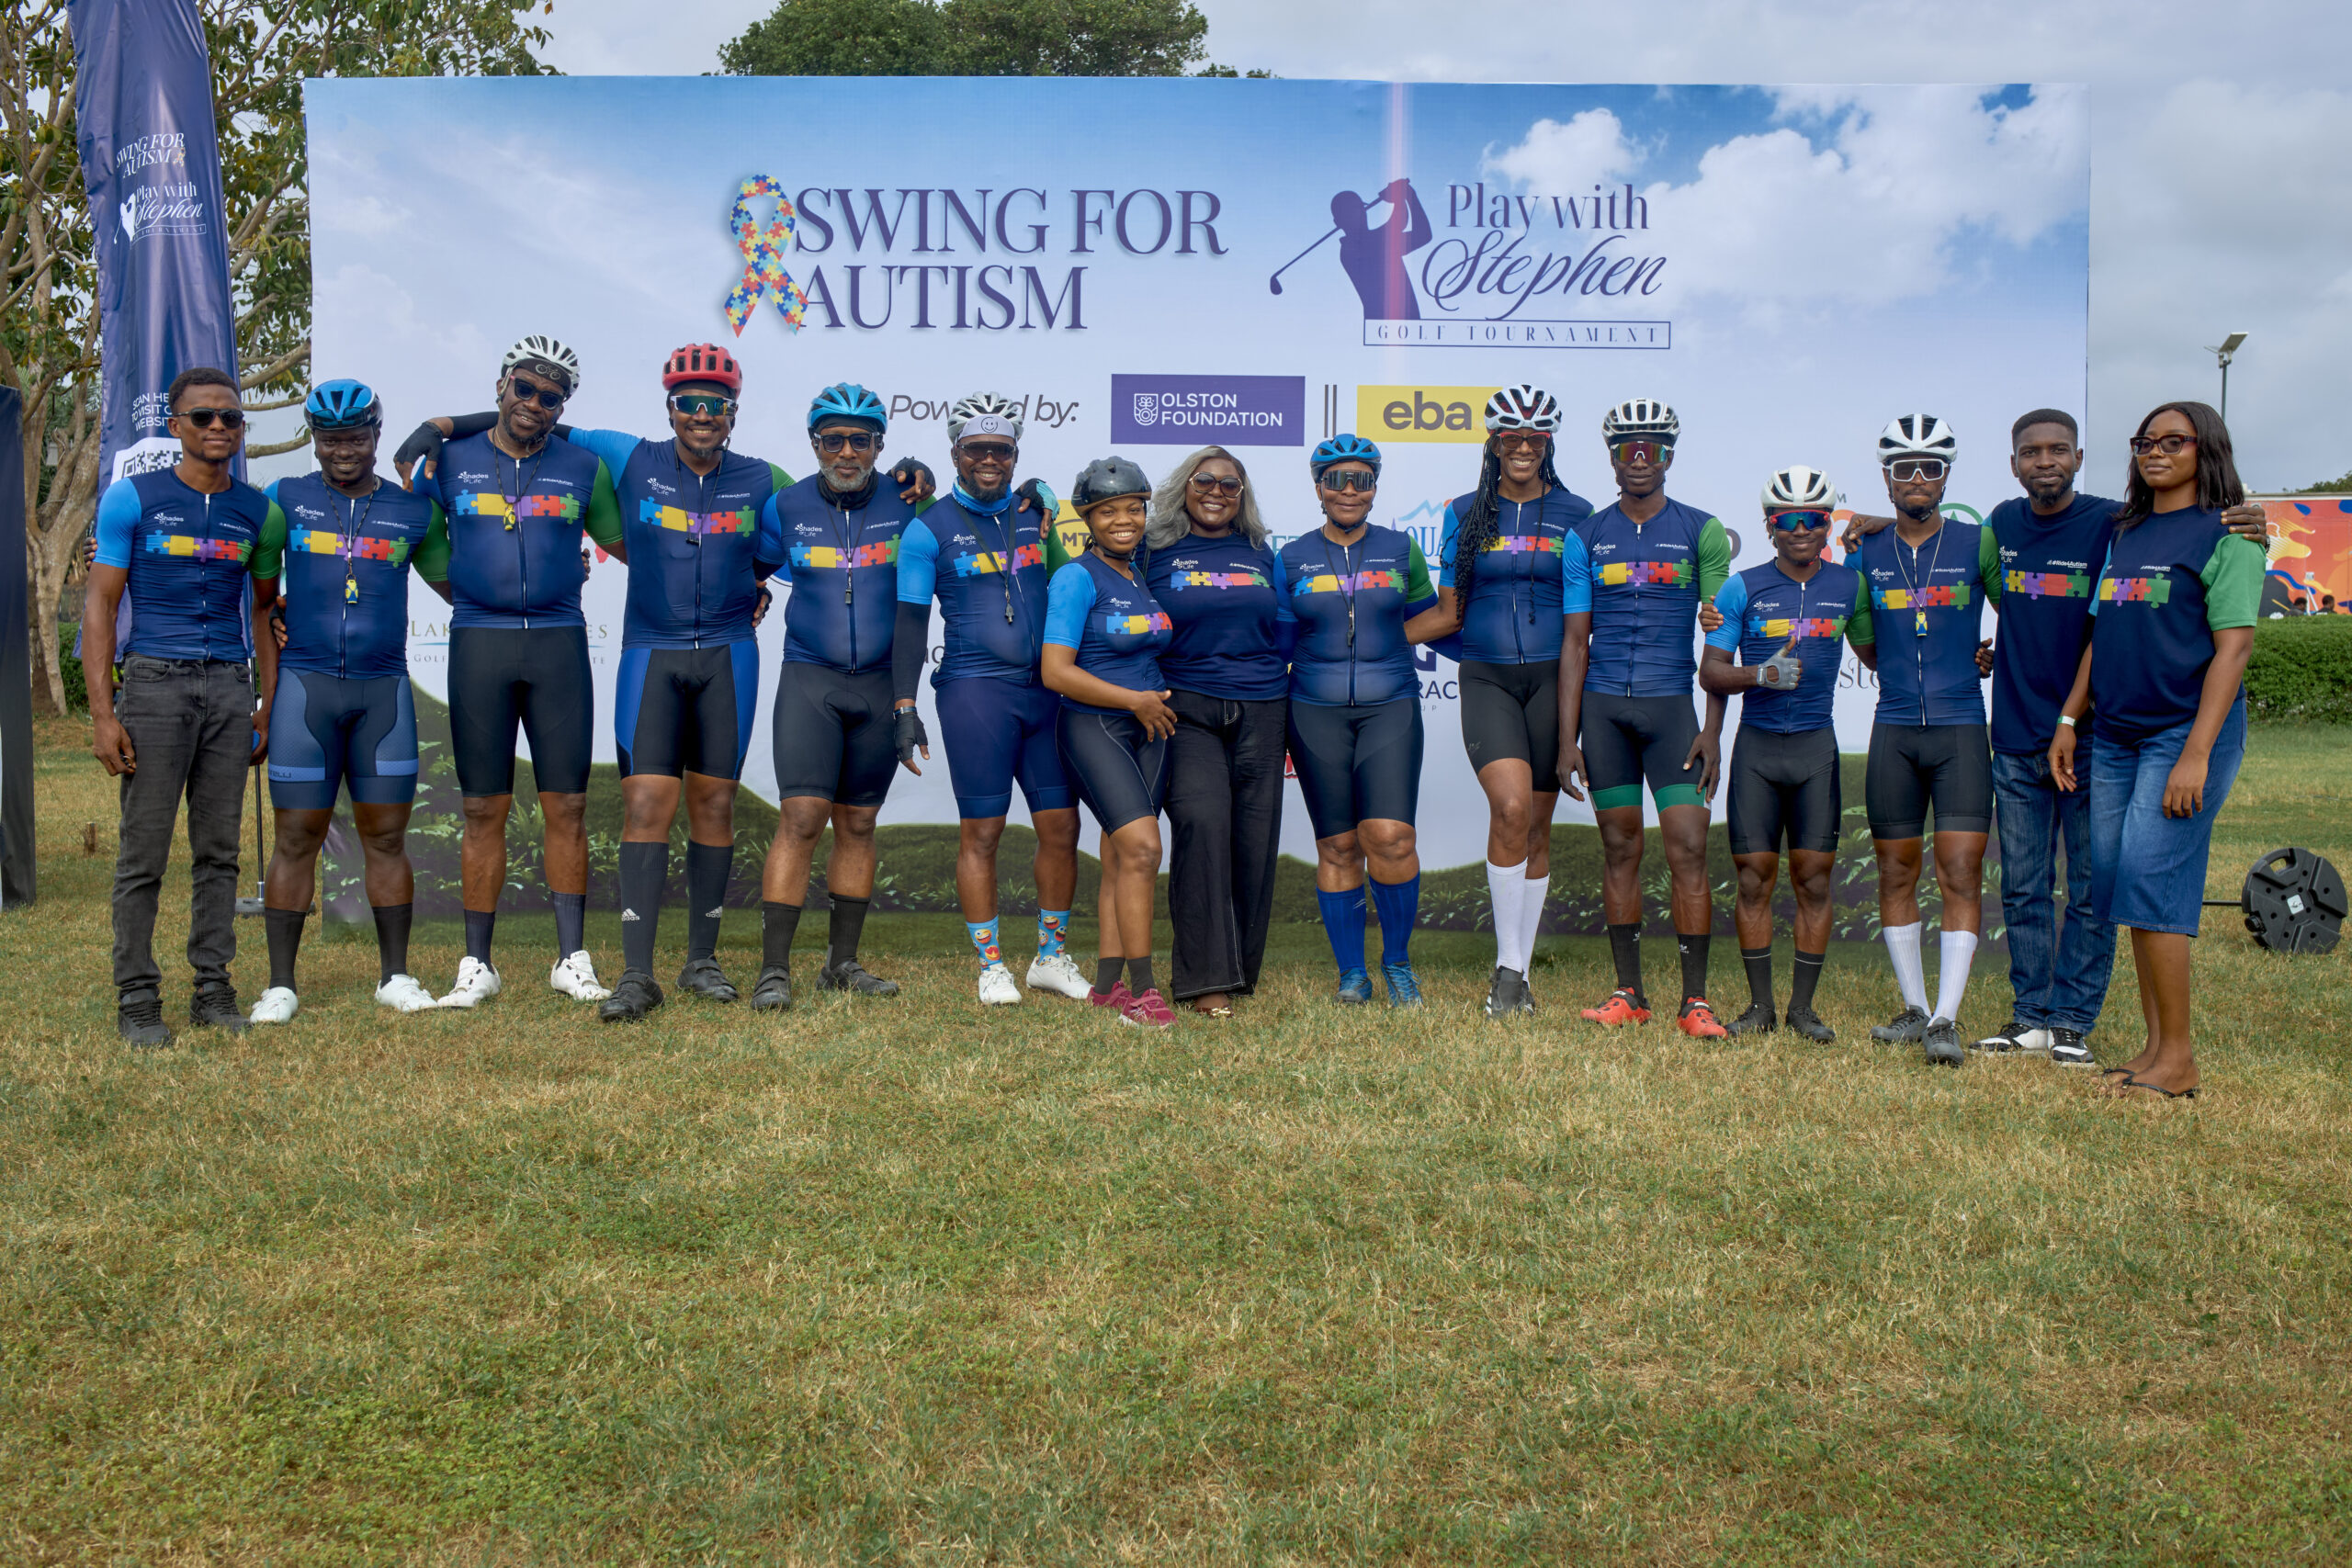
EBA / WEBSITE UPDATE
04
Content and interactions now work together
Events
Clickable cards, pagination and dedicated event pages
Stories
Imported articles with collection and article layouts
Client proof
4 named testimonials; Nigeria on the map reveals client portraits
Motion
Typing headline, replaying counters and scroll entrances
Notes:
Event list behavior: main Events collection shows three items at a time; All Events shows six at a time, with remaining items on the next page. Each of the seven cards links to its corresponding event route. Dedicated layouts exist for Play With Stephen 7th Edition, Falz, Sip & Share, Achimota, Movies & Conversations and It Can Only Be Naija; the remaining CommuniTEE event uses the shared detail template. Supplied posters remain event artwork, not the site’s navigation or hero design. Conflicting date details between posters and the supplied website text were surfaced in relevant event pages; final event-date approval remains needed. The four client testimonials match Tega Agbosa, Miss Amarachi, Ann Obaseki and Stephen Onaivi to their supplied portraits and quotes. Selecting Nigeria on the homepage map shows those faces; each links into Services. Headline types/deletes; counters restart on re-entry; entrance animations respect reduced-motion preferences. Source: project components and data files. Photograph: public/images/events/swing-for-autism/moment-7.jpg.

Slide 5
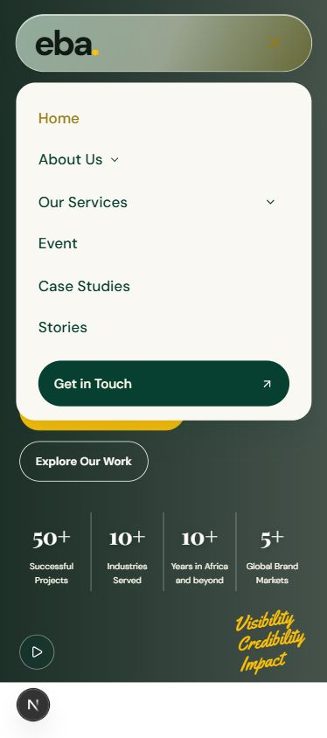
EBA / WEBSITE UPDATE
05
Mobile, tablet and desktop checks
320 · 390 · 768 · 1024 · 1440 px
Checked across main pages and detail templates
Fixed narrow-phone navbar spacing and FAQ sideways scrolling.
Moved Get in Touch inside the mobile hamburger menu.
Adjusted sticky FAQ anchors and mobile input sizing.
TypeScript passed. Physical-device and Safari checks remain before launch.
Notes:
Evidence: artifacts/responsive-check.md records the Chromium viewport pass on 23 October 2026. Widths 320, 390, 768, 1024 and 1440 were used across a representative matrix, not every page at every width. Main pages checked include Home, Case Studies, Our Story, Founder, FAQ, Services, Events, All Events, Consultation, Get in Touch and Stories. All seven event detail templates were checked at 390px; service, sector, gallery and case-study detail routes were also sampled. Document width matched available viewport width after fixes. Small-phone navigation and About dropdown were tested. A subsequent change moved Get in Touch inside the hamburger for widths up to 960px and retained the desktop CTA; ESLint passed for SiteHeader. TypeScript passed during the responsive pass. Do not equate these checks with physical-device, Safari, accessibility certification, Lighthouse benchmarking or a production release test. Screenshot: artifacts/mobile-menu-contact.png.

Slide 6
EBA / WEBSITE UPDATE
06
What still separates review from launch
Area | Current position | Before launch
Email & bookings | Forms validate; email-app handoff | Connect delivery; test receipt and confirmation
Newsletter & CMS | Newsletter not connected; content in code | Connect email service and Sanity editing
Measurement & search | Page metadata exists | Set up GA4, Search Console and sitemap
Hosting & domain | GitHub repository configured | Verify production build, hosting and domain
Final quality check | Responsive browser pass completed | Approve content; check Safari, accessibility and speed
No production launch, email delivery or performance score is claimed in this update.
Notes:
Launch status is deliberately evidence-based. The repository has no src/app API route handlers for delivery and the newsletter explicitly says signup becomes available once email is connected. Consultation and team introduction flows generate mailto links; a visitor must send through their email app and the team confirms manually. No automatic booking is implemented. Sanity, Resend, GA4 and Search Console were part of the intended stack but are not connected in the inspected source. Metadata is present on pages, while no sitemap route was found. Git remote origin is https://github.com/developerEBA/EBA-WEBSITE.git and local commits exist; this inspection did not verify remote sync, hosting, DNS, SSL or a live deployment. Hosting choice and account access should be confirmed before connecting the existing domain. A production build, real-device/Safari checks, accessibility review and Lighthouse test remain launch gates. No unverified subscription price, delivery date or completion percentage is presented.

Slide 7
EBA / WEBSITE UPDATE
07
Next steps and decisions needed
Development priorities
Needed from EBA
1 Connect CMS and email delivery
2 Add measurement and search setup
3 Run release checks and deploy
Approve final copy, images and event dates.
Confirm hosting/domain access and the inbox for enquiries.
Confirm owners for content updates and sign-off.
Proposed next milestone: a live preview with tested enquiries, ready for final approval.
Notes:
Close: The next milestone should be an approval-ready live preview, followed by final domain launch after testing. This is a proposed sequence, not a dated commitment. Development owns CMS/email integration, analytics/search setup and technical release checks. EBA supplies approvals, account access through secure channels, confirmed contact details and a named content owner. Management decides the final hosting provider, approved service plans if any, and launch date once dependencies are resolved. Confirm approved event schedules because some supplied posters and page references disagree. Confirm rights and final versions of client photos, testimonials and work examples; remaining team placeholders need portraits or an approved display choice. Repository: https://github.com/developerEBA/EBA-WEBSITE. Likely CEO question: Can it go live today? Answer: the website can be reviewed now, but a dependable launch still needs the connections and checks listed on slide 6. Likely question: How much is left? Answer: remaining work is mainly integration, content approval and release verification; no reliable percentage or dated ETA has been established.

