Slide 1
GIT HUB
One Framework – Mobile & Desktop

Slide 2
Agenda
PRE-REQUISITES
Course Outline
Introduction

Slide 3
Pre-Requisites
Basic understanding of
HTML,
CSS,
JavaScript,
TypeScript, and
Document Object Model (DOM)

Slide 4
GIT Basics
Git is a free and open source version control system, originally created by Linus Torvalds in 2005. Unlike older centralized version control systems such as SVN and CVS, Git is distributed: every developer has the full history of their code repository locally. This makes the initial clone of the repository slower, but subsequent operations such as commit, blame, diff, merge, and log dramatically faster.
Git also has excellent support for branching, merging, and rewriting repository history, which has lead to many innovative and powerful workflows and tools. Pull requests are one such popular tool that allow teams to collaborate on Git branches and efficiently review each others code. Git is the most widely used version control system in the world today and is considered the modern standard for software development.

Slide 5
GIT Basics
Git also has excellent support for branching, merging, and rewriting repository history, which has lead to many innovative and powerful workflows and tools. Pull requests are one such popular tool that allow teams to collaborate on Git branches and efficiently review each others code. Git is the most widely used version control system in the world today and is considered the modern standard for software development.

Slide 6
HOW GIT WORK
Create a "repository" (project) with a git hosting tool (like Bitbucket)
Copy (or clone) the repository to your local machine
Add a file to your local repo and "commit" (save) the changes
"Push" your changes to your master branch
Make a change to your file with a git hosting tool and commit
"Pull" the changes to your local machine
Create a "branch" (version), make a change, commit the change
Open a "pull request" (propose changes to the master branch)
"Merge" your branch to the master branch

Slide 7
Environment Setup (Setup and Tooling)
High level git overview
Tell Git who you are
git config --global user.name “santoshir
“
git config --global user.email sam@example.com
Create a new local repository git init
Create a working copy of a local repository.
git clone /path/to/repository.
For a remote server, use:
git clone username@host:/path/to/repository

Slide 8
Environment Setup (Setup and Tooling)
Add one or more files to staging (index):
git add <filename> git add –A
Commit changes to head (but not yet to the remote repository):
git commit -m "Commit message“
git push origin master
Send changes to the master branch of your remote repository:
git push -u origin master
Status
List the files you've changed and those you still need to add or commit:
git status

Slide 9
Environment Setup (Setup and Tooling)
Connect to a remote repository:
If you haven't connected your local repository to a remote server, add the server to be able to push to it:
git remote add origin <server>
List all currently configured remote repositories:
git remote -v

Slide 10
Branches
Create a new branch and switch to it:
git checkout -b <branchname>
Switch from one branch to another:
git checkout <branchname>
List all the branches in your repo, and also tell you what branch you're currently in:
git branch
Delete the feature branch:
git branch -d <branchname>
Push the branch to your remote repository, so others can use it:
git push origin <branchname>

Slide 11
Branches
Push all branches to your remote repository:
git push --all origin
$ git push -d <remote_name> <branch_name>
$ git branch -d <branch_name> Note that in most cases the remote name is origin.
Delete Local Branch
To delete the local branch use one of the following:
$ git branch -d branch_name
$ git branch -D branch_name

Slide 12
Branches
Update from the remote repository:
Fetch and merge changes on the remote server to your working directory:
git pull
To merge a different branch into your active branch:
git merge <branchname>
View all the merge conflicts:View the conflicts against the base file:
git diffgit diff --base <filename>
git diff <sourcebranch> <targetbranch> Preview changes, before merging:

Slide 13
Filtering the Commit History LOG
By Amount- The most basic filtering option for git log is to limit the number of commits that are displayed. When you’re only interested in the last few commits, this saves you the trouble of viewing all the commits in a page.
git log -3
By Date- If you’re looking for a commit from a specific time frame, you can use the --after or --before flags for filtering commits by date. These both accept a variety of date formats as a parameter.
git log --after="2014-7-1“
You can also pass in relative references like "1 week ago" and "yesterday":
git log --after="yesterday"

Slide 14
Filtering the Commit History LOG
By Amount- The most basic filtering option for git log is to limit the number of commits that are displayed. When you’re only interested in the last few commits, this saves you the trouble of viewing all the commits in a page.
git log -3
By Date- If you’re looking for a commit from a specific time frame, you can use the --after or --before flags for filtering commits by date. These both accept a variety of date formats as a parameter.
git log --after="2014-7-1“
You can also pass in relative references like "1 week ago" and "yesterday":
git log --after="yesterday"

Slide 15
Filtering the Commit History LOG
To search for a commits that were created between two dates, you can provide both a --before and --after date. For instance, to display all the commits added between July 1st, 2014 and July 4th, 2014, you would use the following:
git log --after="2014-7-1" --before="2014-7-4“
By Author
git log --author="John“
By Message
git log --grep="JRA-224:“
By File
git log – about.html

Slide 16
Filtering the Commit History LOG
To search for a commits that were created between two dates, you can provide both a --before and --after date. For instance, to display all the commits added between July 1st, 2014 and July 4th, 2014, you would use the following:
git log --after="2014-7-1" --before="2014-7-4“
By Author
git log --author="John“
By Message
git log --grep="JRA-224:“
By File
git log --about.html

Slide 17
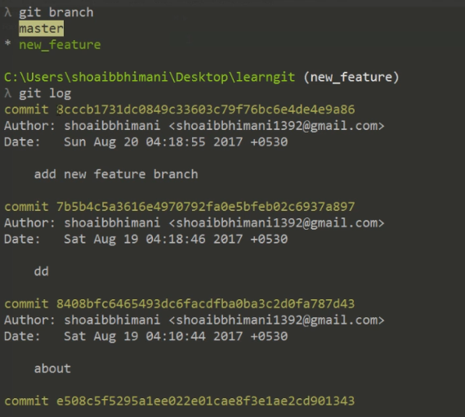
git cherry-pick- TRANFER ON COMMITE ONE BRANCH TO ANOTER

Slide 18
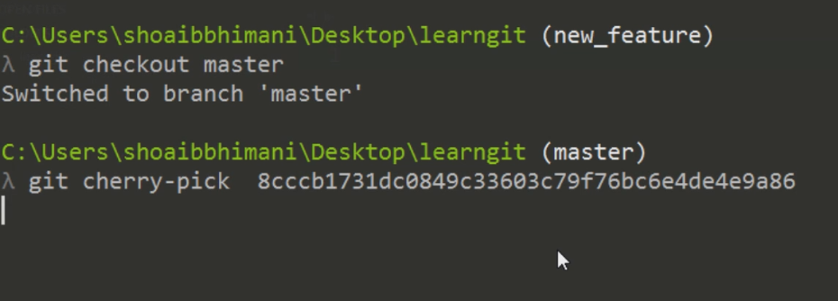
git cherry-pick

Slide 19
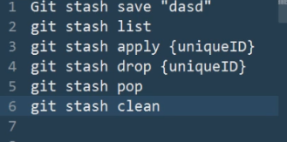
stash

Slide 20
Workshop Outline

Slide 21
Course Outline
Introduction to Angular
Angular Building Blocks
Angular Feature Overview
The Big Picture
Angular CLI
Angular Application Flow
Angular Docs
Angular JS to Angular

Slide 22
Course Outline
The Angular JumpStart Application
Application Overview
Application Structure
Components and Modules
Components Overview
Component Lifecycle
Create a new Component
Angular Modules

Slide 23
Course Outline:
Template Expressions and Pipes
Templates Syntax Overview
Interpolation and Expressions
Working with Pipes
Component Properties and Data Binding
Property and Event Binding
Input and Output Properties
Two-way Binding

Slide 24
Course Outline
• Component Model (Decorators, Templating Syntax, Data Binding, ) • Dependency Injection • Lazy-loading

Slide 25
Introduction

Slide 26
Introduction to Angular
Angular (commonly referred to as "Angular 5" or "Angular 2") is a TypeScript-based open-source front-end web application platform led by the Angular Team at Google and by a community of individuals and corporations. Angular is a complete rewrite from the same team that built AngularJS.

Slide 27
Introduction to Angular
There are three major releases of Angular. The first version that was released is Angular1, which is also called AngularJS. Angular1 was followed by Angular2, which came in with a lot of changes when compared to Angular1.
The structure of Angular is based on the components/services architecture. AngularJS was based on the model view controller. Angular 4 released in March 2017 proves to be a major breakthrough and is the latest release from the Angular team after Angular2.
Angular 4 is almost the same as Angular 2. It has a backward compatibility with Angular 2. Projects developed in Angular 2 will work without any issues with Angular 4.

Slide 28
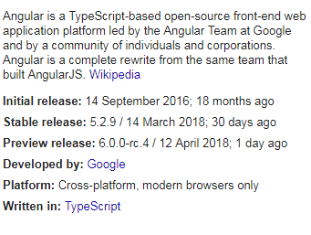
Introduction to Angular

Slide 29
Single-page application
A single-page application (SPA) is a web application or web site that interacts with the user by dynamically rewriting the current page rather than loading entire new pages from a server. This approach avoids interruption of the user experience between successive pages, making the application behave more like a desktop application. In an SPA,

Slide 30
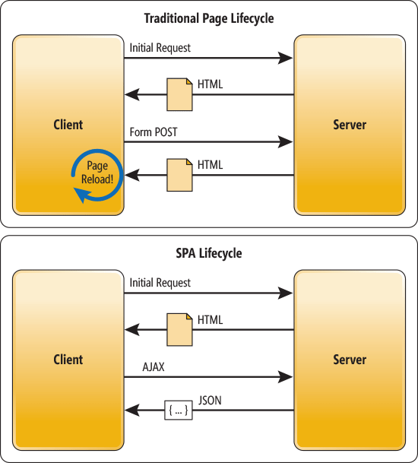
The Traditional Page Lifecycle vs. the SPA Lifecycle

Slide 31
The Traditional Page Lifecycle vs. the SPA Lifecycle
If you want to see a Single Page Application in action, I invite you to head over to the AngularUniv https://angular-university.io and start clicking on the home page on the list of latest courses, and on the top menu.
If you start navigating around, you will see that the page does not fully reload – only new data gets sent over the wire as the user navigates through the application – that is an example of a single page application.

Slide 32
Environment Setup(Setup and Tooling)
Prerequisites
Both the CLI and generated project have dependencies that require Node 6.9.0 or higher, together with NPM 3 or higher

Slide 33
Environment Setup(Setup and Tooling)
npm install -g @angular/cli
ng new PROJECT-NAME
cd PROJECT-NAME
ng serve
Navigate to http://localhost:4200/.

Slide 34
Angular cli
Angular cli is a command line interface to scaffold and build angular apps using nodejs style (commonJs) modules. Not only it provides you scalable project structure, instead it handles all common tedious tasks for you out of the box.
COMMAND LINE INTERFACE FOR ANGULAR APPS
npm install -g angcli

Slide 35
Components
Major part of the development with Angular is done in the components. Components are basically classes that interact with the .html file of the component, which gets displayed on the browser. We have seen the file structure in one of our previous chapters. The file structure has the app component and it consists of the following file

Slide 36
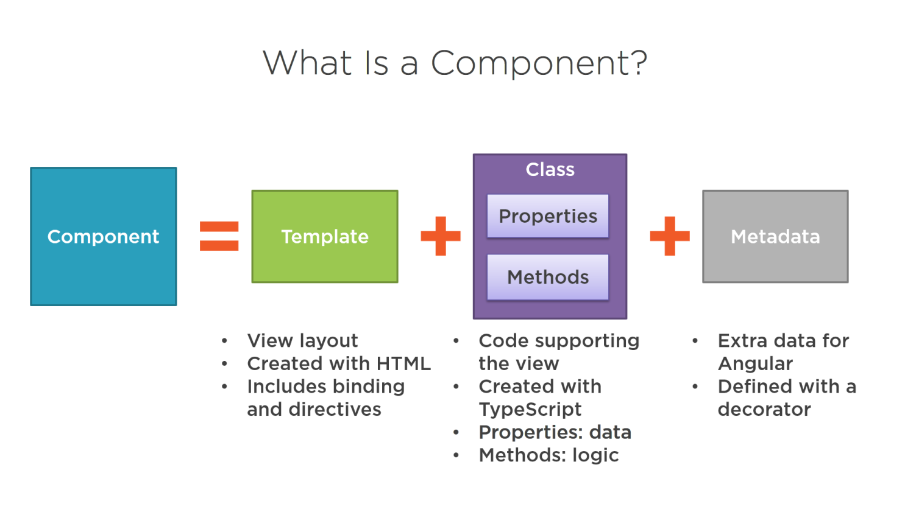
Components

Slide 37
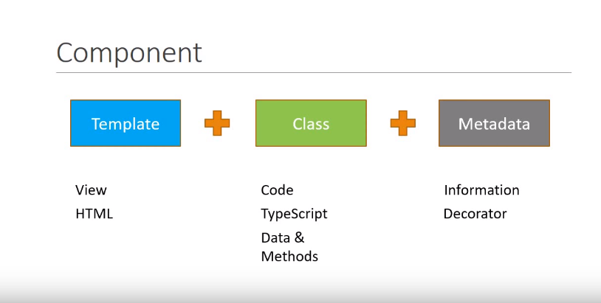
Component

Slide 38
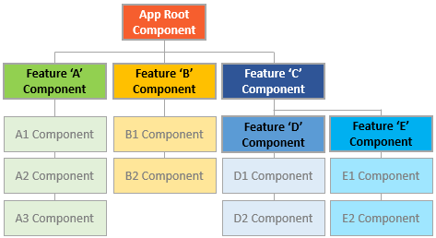
Components

Slide 39
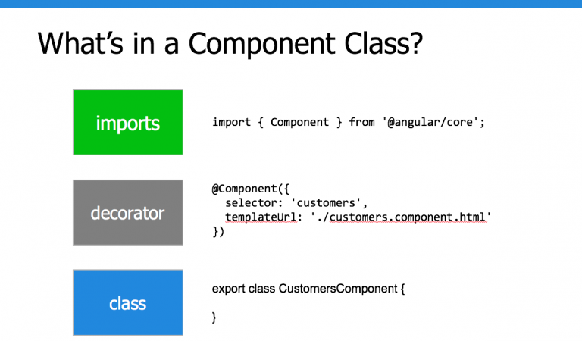
Components Class

Slide 40
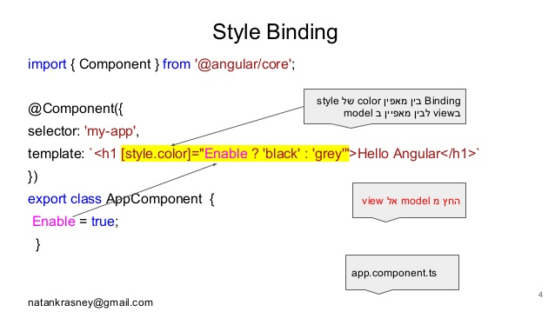
Components Style binding

Slide 41
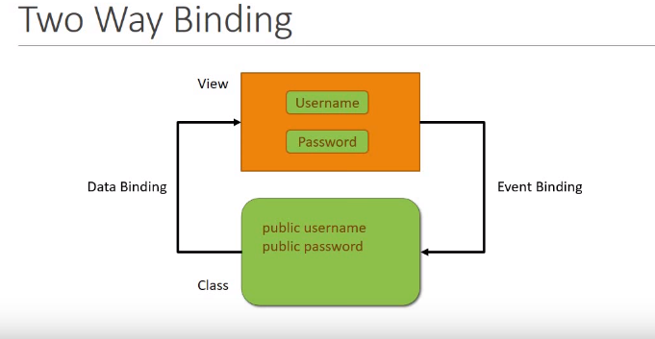
Two way Binding

Slide 42
Component Files
app.component.css
app.component.html
app.component.spec.ts
app.component.ts
app.module.ts

Slide 43
Module
Module in Angular refers to a place where you can group the components, directives, pipes, and services, which are related to the application.
In case you are developing a website, the header, footer, left, center and the right section become part of a module.
To define module, we can use the NgModule. When you create a new project using the Angular –cli command, the ngmodule is created in the app.module.ts file

Slide 44
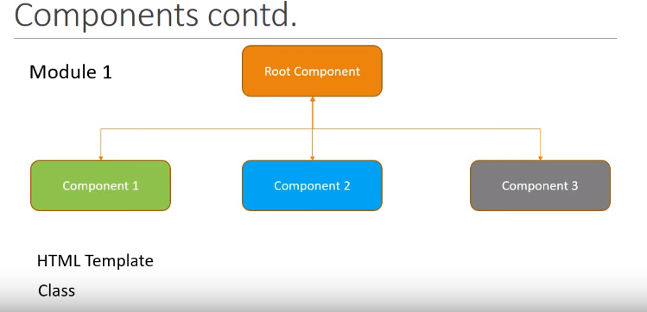
Module

Slide 45
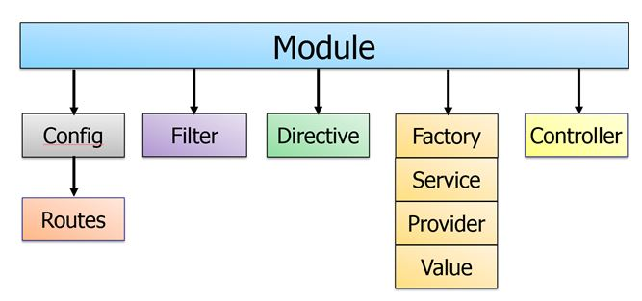
Module

Slide 46
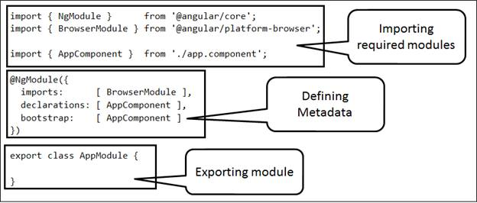
Module

Slide 47
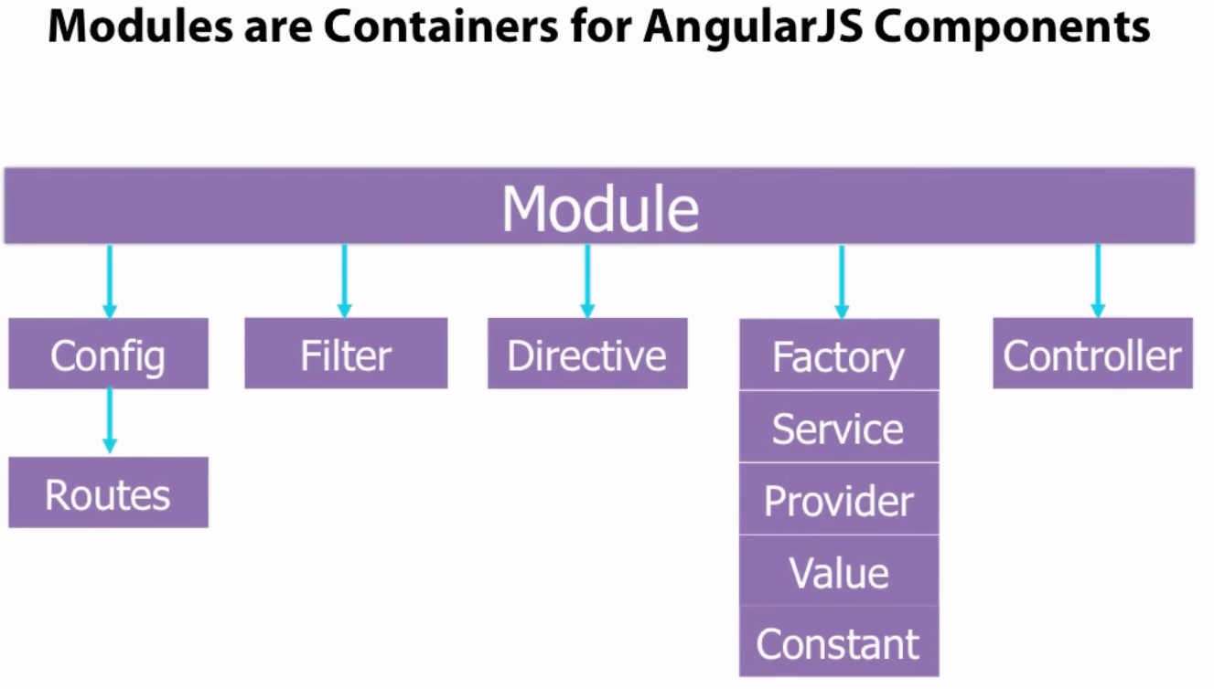
Module

Slide 48
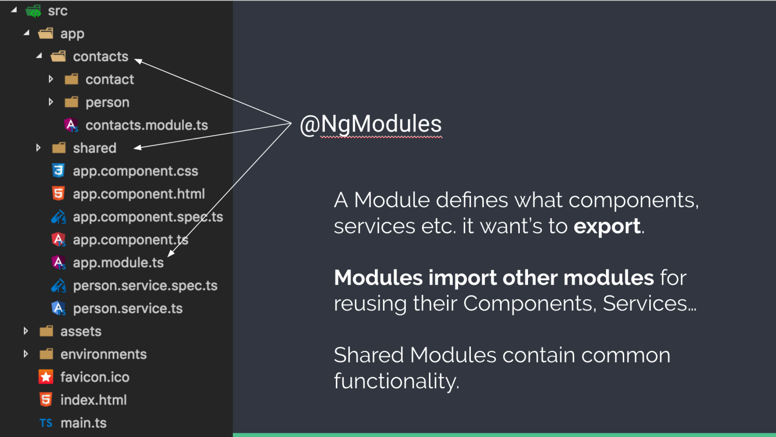
Module

Slide 49
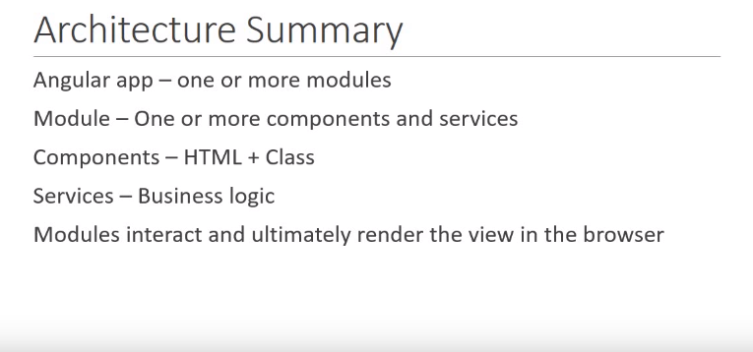
Module

Slide 50
Module

Slide 51
Npm Packages(How angular flow)
The Angular CLI, Angular applications, and Angular itself depend upon features and functionality provided by libraries that are available as npm packages.
package.json
https://angular.io/guide/npm-packages

Slide 52
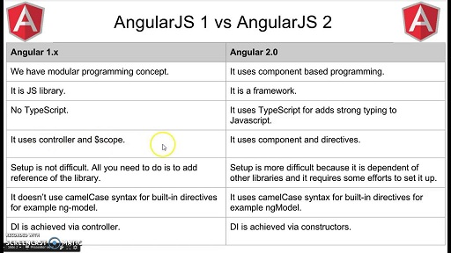
AngularJS1 vs Angular

Slide 53
Angular Folder Structure
https://angular.io/guide/quickstart#the-src-folder
Root Module and root Component with in app folder.
App.module.ts
App .component.ts

Slide 54
Angular Folder Structure
main.ts when we run ng serve command the executing start from main.ts

Slide 55
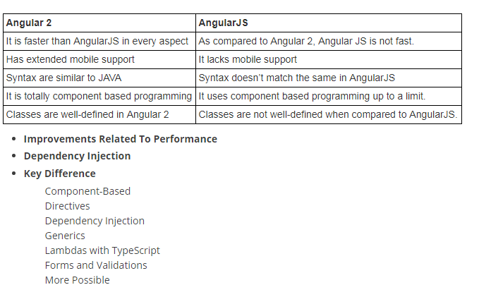
AngularJS1 vs Angular

Slide 56
Data Binding
Data Binding is available right from AngularJS, Angular 2 and is now available in Angular 4 as well. We use curly braces for data binding - {{}}; this process is called interpolation.
The variable in the app.component.html file is referred as {{title}} and the value of title is initialized in the app.component.ts file and in app.component.html, the value is displayed.

Slide 57
Templates
Angular 4 uses the <ng-template> as the tag instead of <template>which is used in Angular2. The reason Angular 4 changed <template> to <ng-template> is because there is a name conflict between the <template> tag and the html <template> standard tag. It will deprecate completely going ahead. This is one of the major changes in Angular 4.

Slide 58
Pipes
Pipes were earlier called filters in Angular1 and called pipes in Angular 2 and 4.
The | character is used to transform data. Following is the syntax for the same
{{ Welcome to Angular 4 | lowercase}}

Slide 59
Pipes
Angular 4 provides some built-in pipes. The pipes are listed below −
Lowercase pipe
Uppercase pipe
Date pipe
Currency pipe
Jsonpipe
Percent pipe
Decimal pipe
Slicepipe

Slide 60
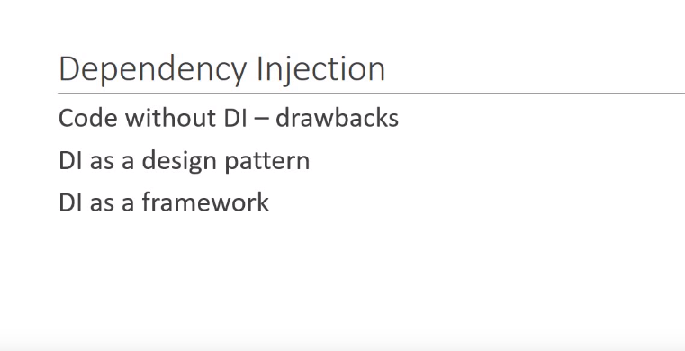
Dependency Injection

Slide 61
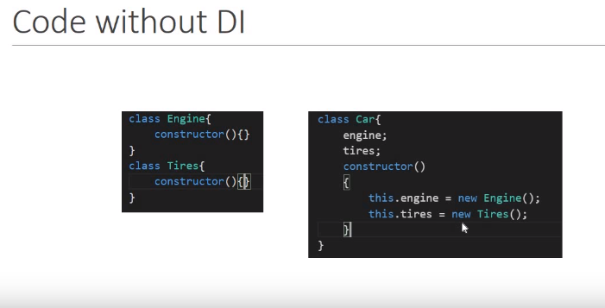
Dependency Injection

Slide 62
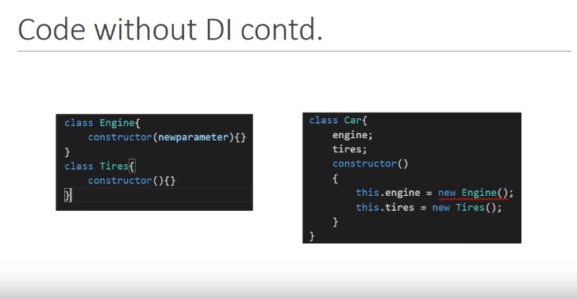
Dependency Injection

Slide 63
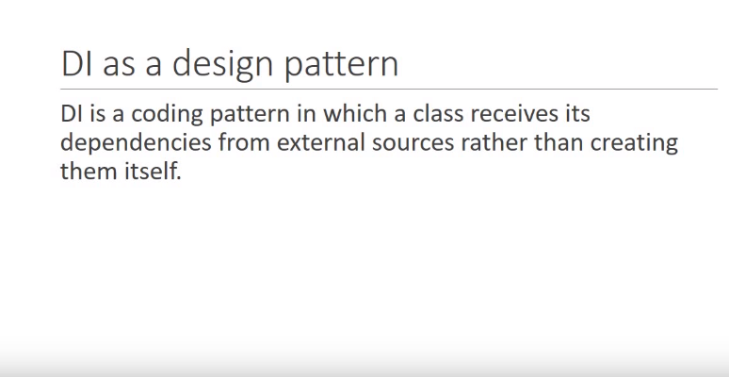
Dependency Injection

Slide 64
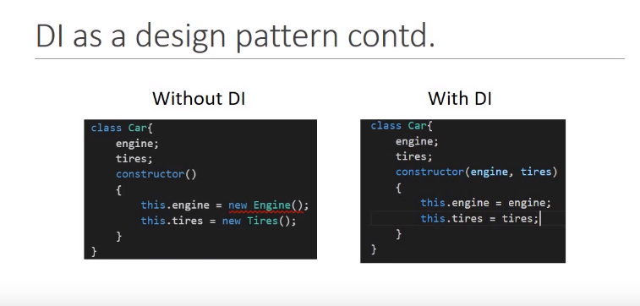
Dependency Injection

Slide 65
Open House
Any Questions / Queries / Inputs

Slide 66
Feedback & Reviews
Valuing Contribution

Slide 67
Thank You

