Slide 1

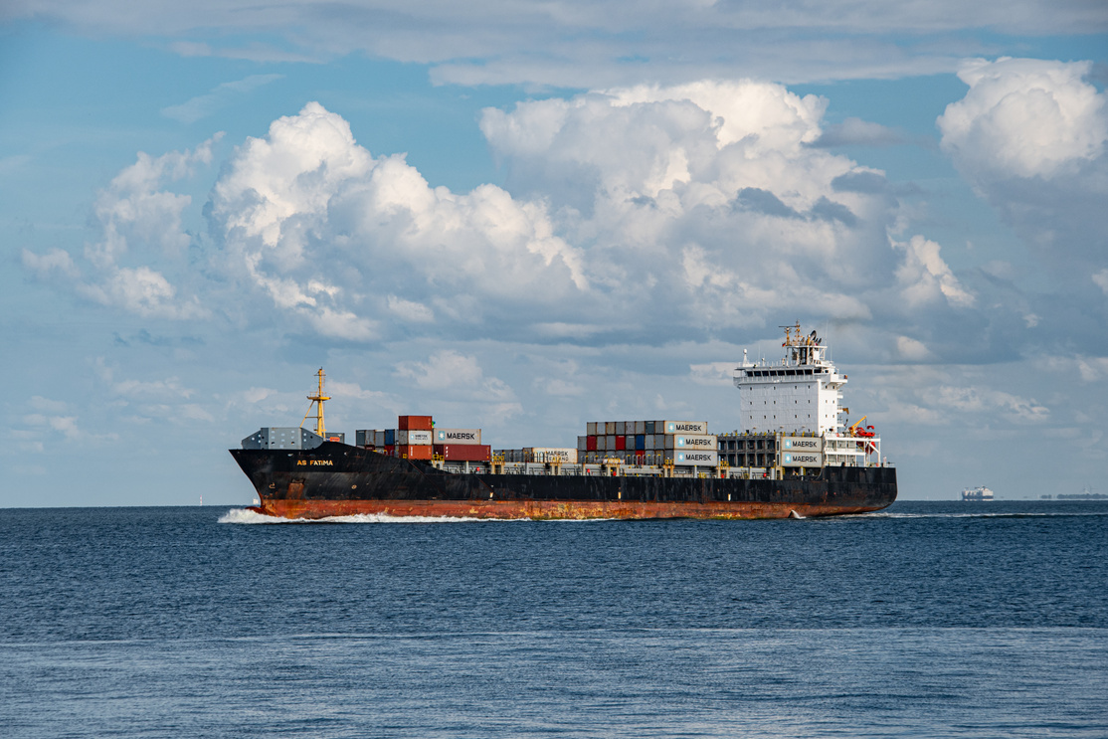
Seller Factory
First Carrier
Container Freight Station
Customs Clearence
Loading Port
EXW - Ex-Works
FOB - Free on Board
Ocean Transit
Buyer’s Place
Local Transport
Customs Clearnce
Destination Port
DAP - Delivery at Place
DDU - Delivery Duty Unpaid
DDP - Delivery Duty Paid
CIF - Cost , Insurance & Freight

