Slide 1
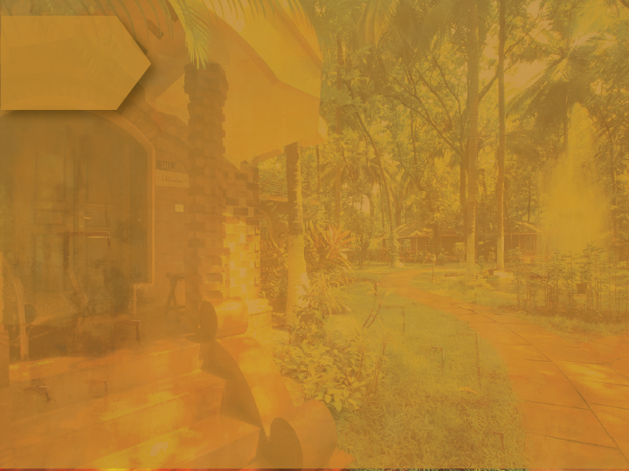
Kairali – The Ayurvedic Healing Village (KTAHV)
Presentation
2018

Slide 2
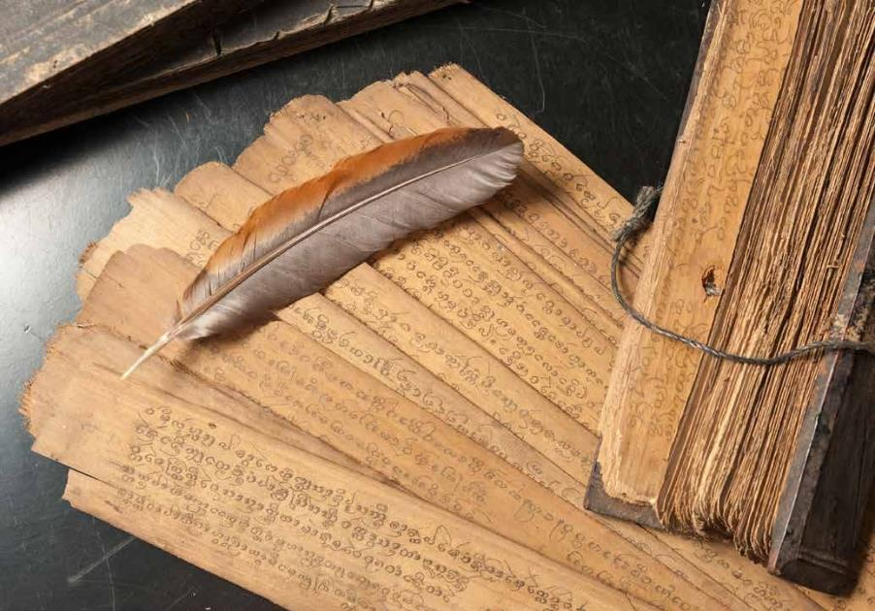
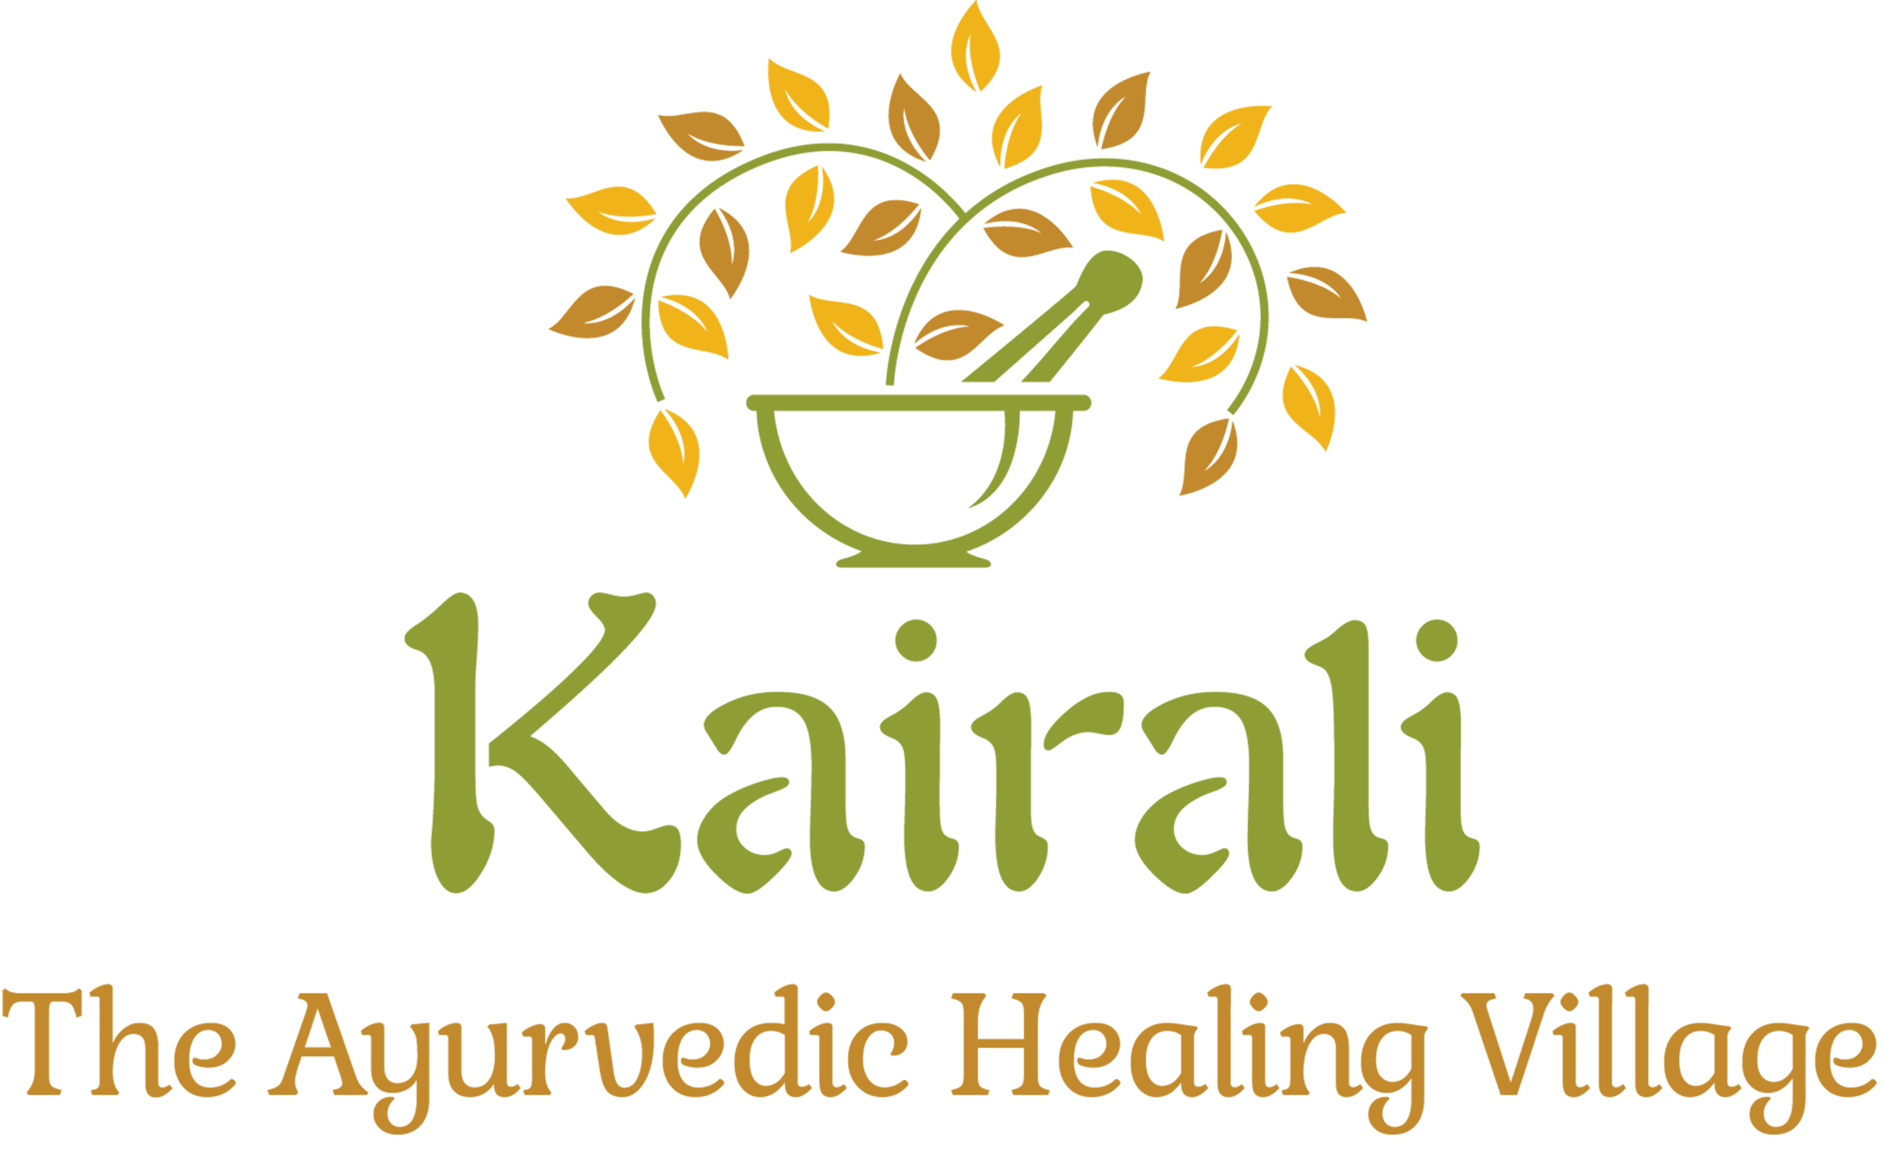
Kairali Ayurvedic Group
Kairali Ayurvedic Group
Kairali Ayurvedic Group, the pioneers in Authentic Ayurvedic services and products, have created a niche for themselves in the Wellness industry. Kairali is one of the largest Ayurvedic Group with presence in over 25 locations worldwide. The Group has over 10 decades of experience in practice of Ayurveda, and has inherited the true spirit of Ayurveda from its fore fathers. Our Philosophy is to propagate Ayurveda and its practices for well-being of human kind.
Kairali has given the holistic touch of
Ayurveda boundless wings, earning itself the trust, confidence and loyalty of its clients globally.
KTAHV 2017 1

Slide 3
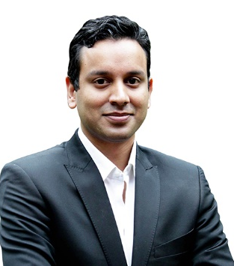
Kairali Ayurvedic Group is one of the largest Ayurvedic Group with over 25 locations worldwide and has inherited the true spirit of Ayurveda from its fore fathers.
The Group has over 10 decades of experience in practice of Ayurveda and production. Kairali has a reputed business record in manufacturing and marketing of Ayurvedic products globally.
Kairali Ayurveda Group
Exe. Director of Kairali Ayurvedic Group
Mr. Abhilash Ramesh
The Group Director Mr. Abhilash Ramesh Under the Hospitality division, manage the Flagship property Kairali – The Ayurvedic Healing Village (KTAHV) along with the Vertical Kairali Ayurvedic Products Pvt. Ltd. (KAPPL).
KTAHV 2017 2

Slide 4
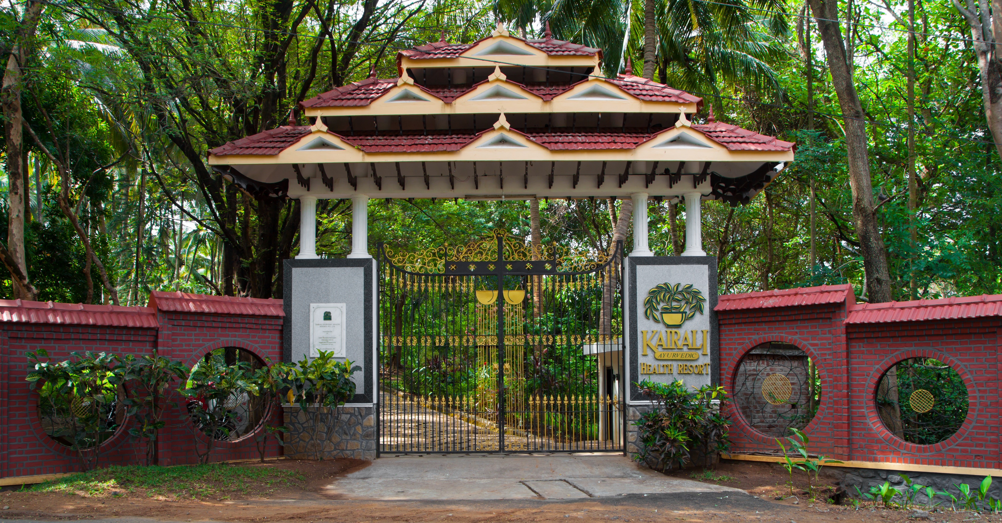
Kairali The Ayurvedic Healing Village
Kairali – The Ayurvedic Healing Village
The Ayurvedic Healing Village is situated in Palakkad, between Kerala and Tamil Nadu. An ideal place to be with nature and rejuvenate with natural medicine in the sweet scented forests of Kerala’s Pala trees.
Experience the authentic healing practices of ancient India, while relaxing in the lap of modern holistic luxury. Spread in 60 acre of lush green land is ultimate destination of Health.
The Ayurveda Retreat with Hospital License.
KTAHV 2017 3

Slide 5
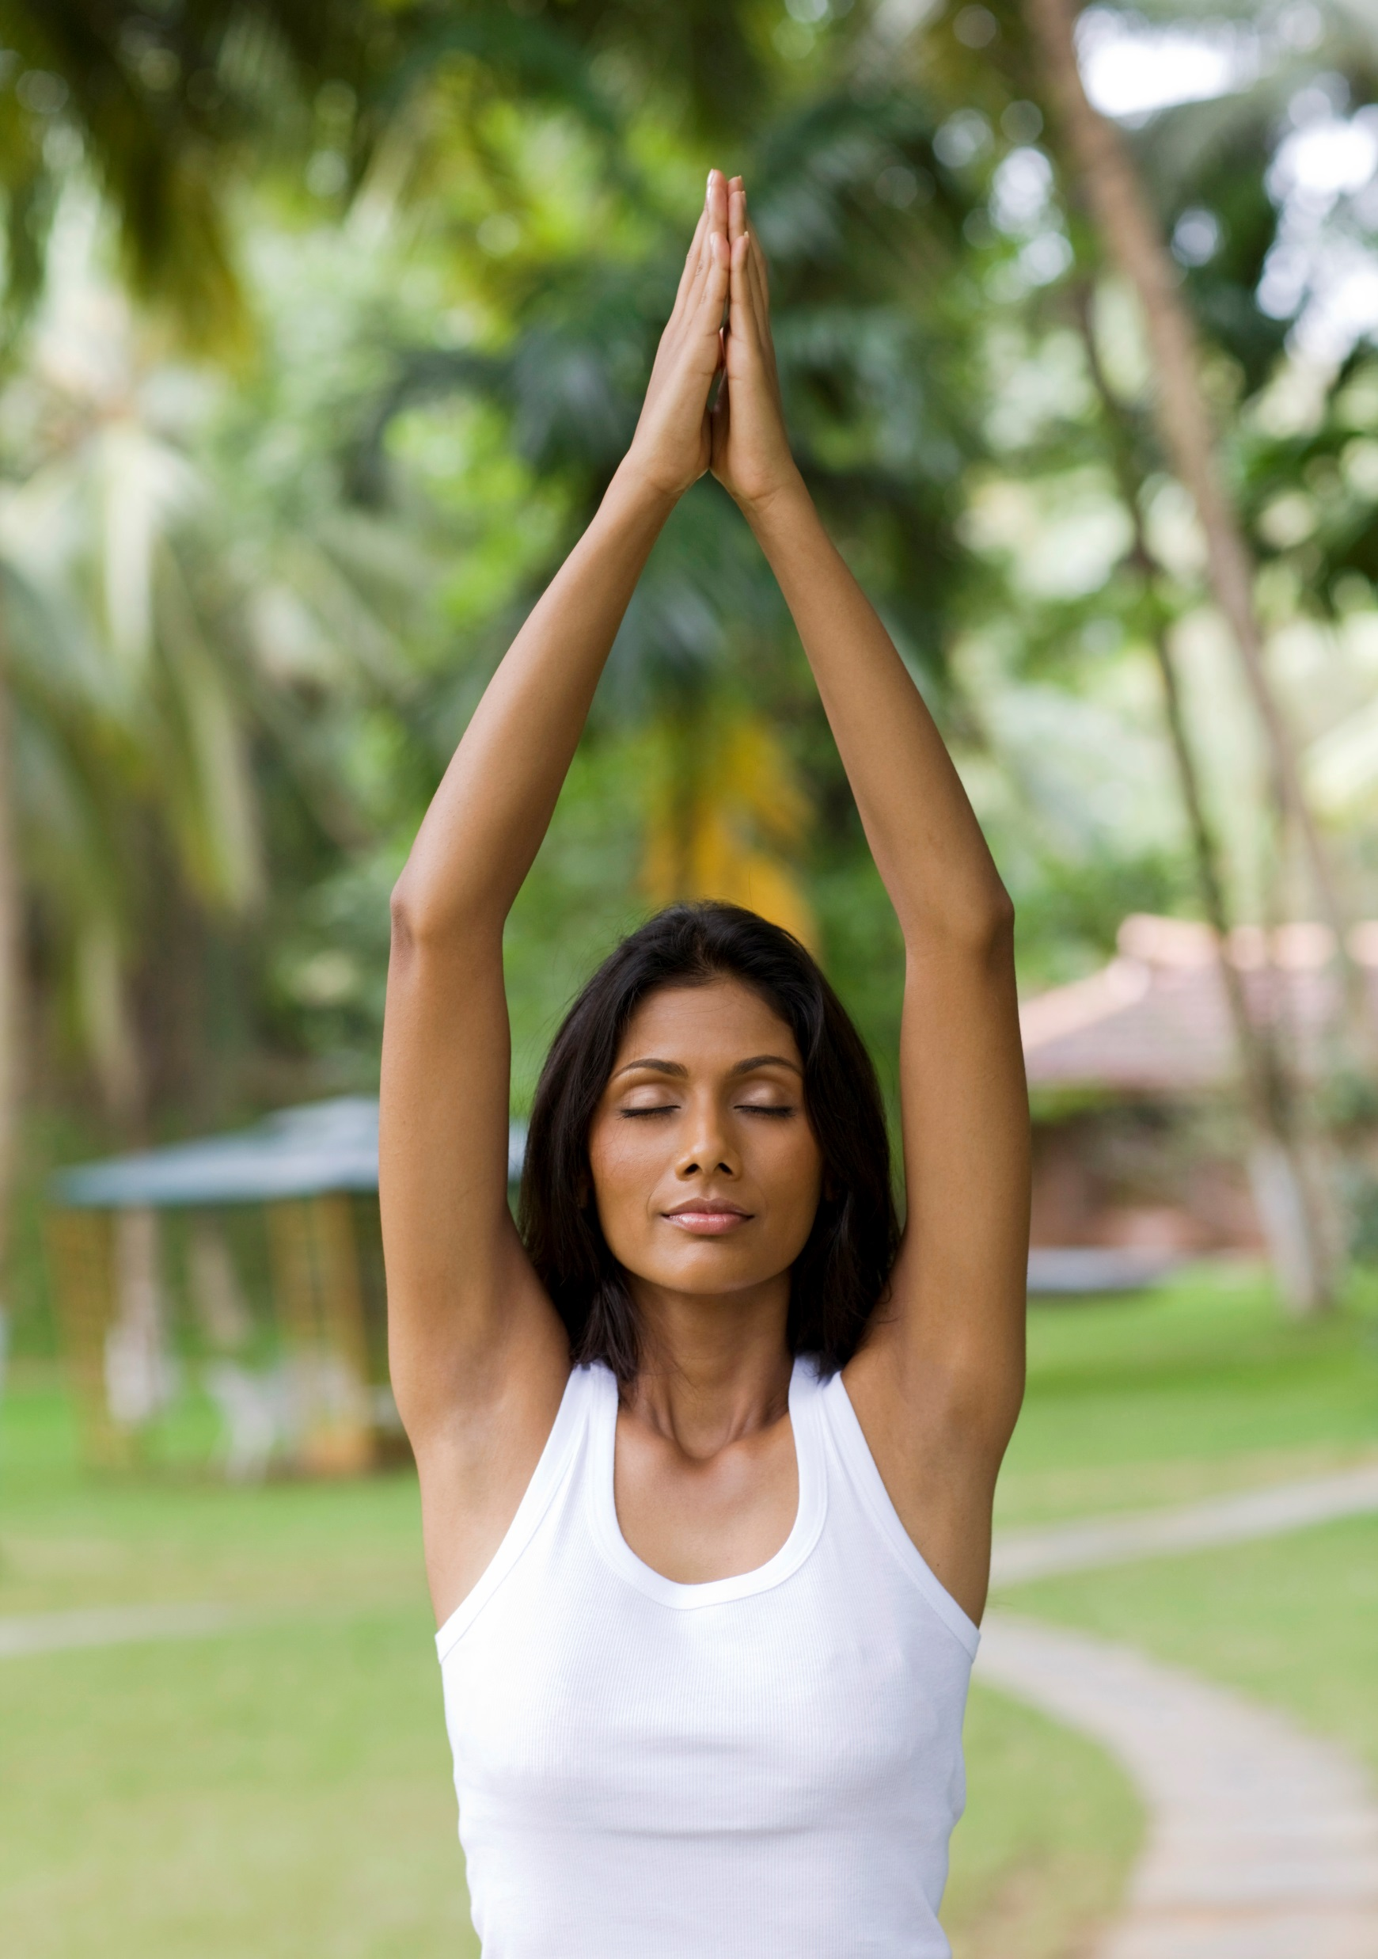
Our philosophy - Ayurveda
Our Philosophy - Ayurveda
Ayu” means life & “veda” means science.
Thus, “Ayurveda” means “Science of Life”. 5000 years old tradition. Oldest medical science in history of medicine. A unique combination of medical
Preventive & Curative aspects for healthy body, mind and soul.
100% Authentic and Natural
A natural system of therapies with “No Side Effects” to the Body.
KTAHV 2017 4

Slide 6
Our USP
Our USP
Kairali Ayurvedic Healing Village is a pioneer project promoting the treasures of India – Ayurveda through the hospitality services and Treatment therapies. The wealth of this high quality service is created and will satisfy all the interest of Investors and visitors such as:
Authentic Ayurvedic Medical care and stay
Doctor Consultation
Yoga & Meditation
Pure Organic & Veg Food
Non Preserved & Non Refrigerated Food
No Alcohol, No Caffeine & No Smoking
Original Ayurvedic Medicine (Internally Manufactured by Kairali)
Pure, Natural & Unperturbed Environment
KTAHV 2017 5

Slide 7
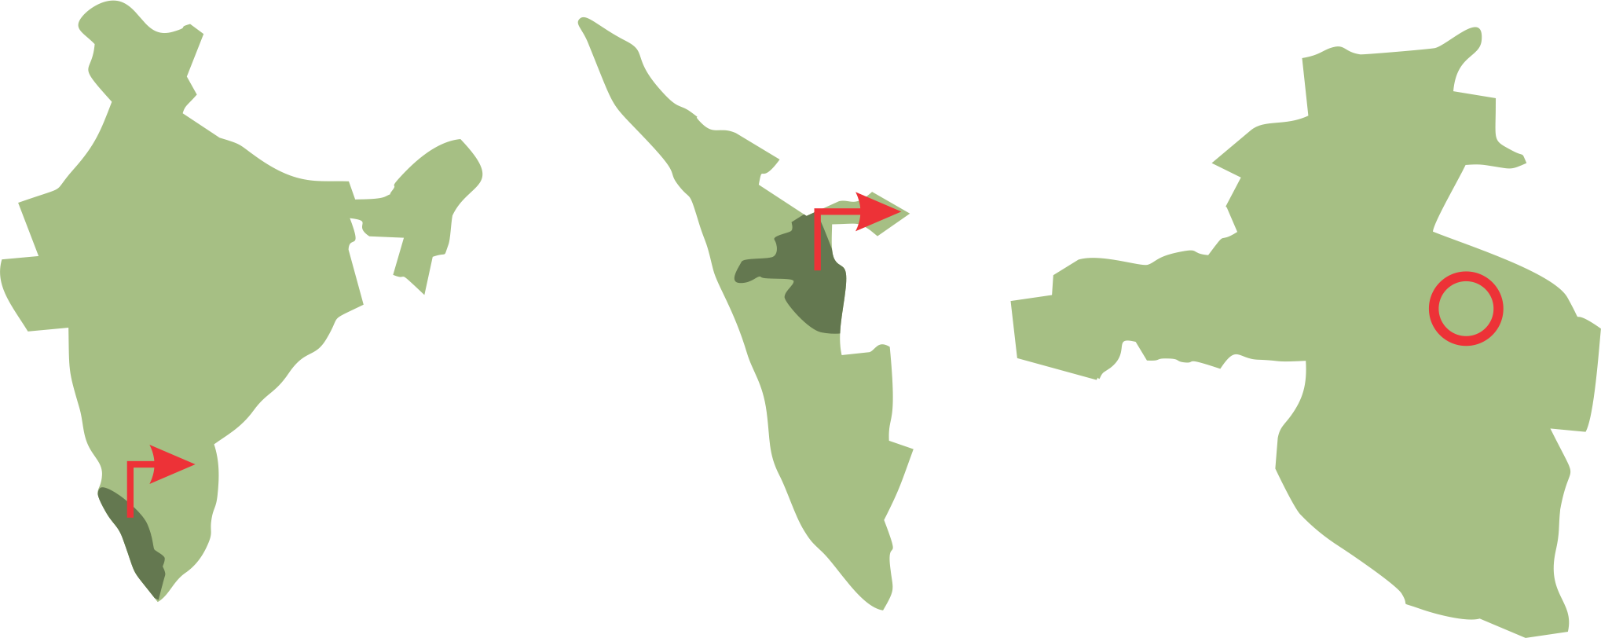
Project Accessibility
Coimbatore International Airport 1hr 15 Min away.
Cochin International Airport 4 hr away.
Palakkad Junction station is 5km from the city.
Accessibility of National Highway 47.
Nearest city – Palakkad
KTAHV 2017 6

Slide 8
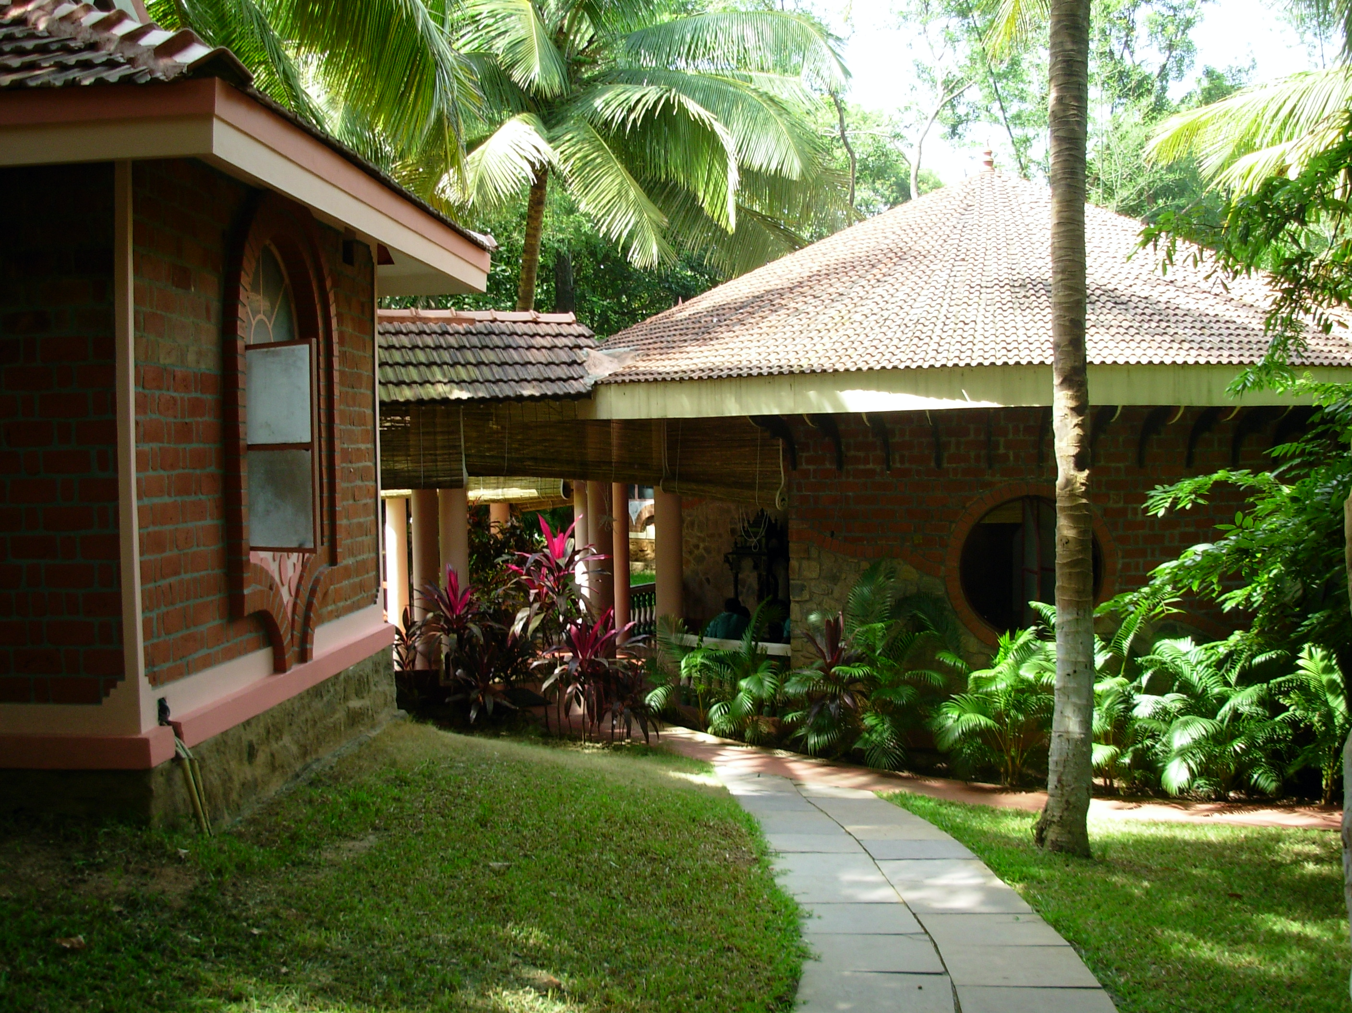
Ayurveda Treatment Centre
Following the age-old Ayurvedic techniques, we Treat various Ailments and provide Therapies that focusses on the overall healthy development and sustenance of body.
Our Specialty :
Panchakarma Therapy
Weight loss Treatment
Spondylitis treatment
Rejuvenation and Detox Therapy
Treatment for Bronchial diseases
Treatment for Eye Care
Revitalization & strengthening
treatment for cancer patients (No cure)
And many more…
KTAHV 2017 7

Slide 9
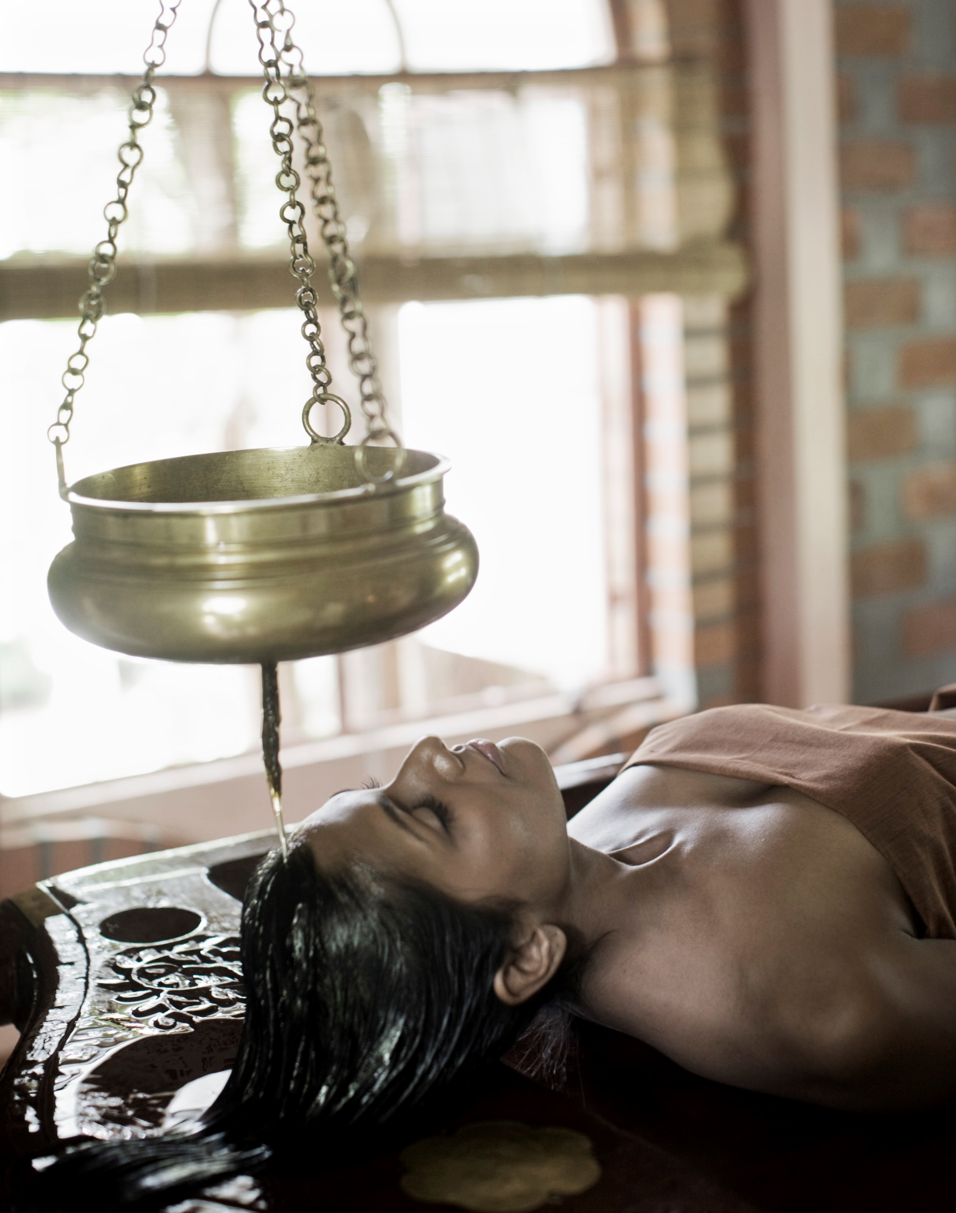
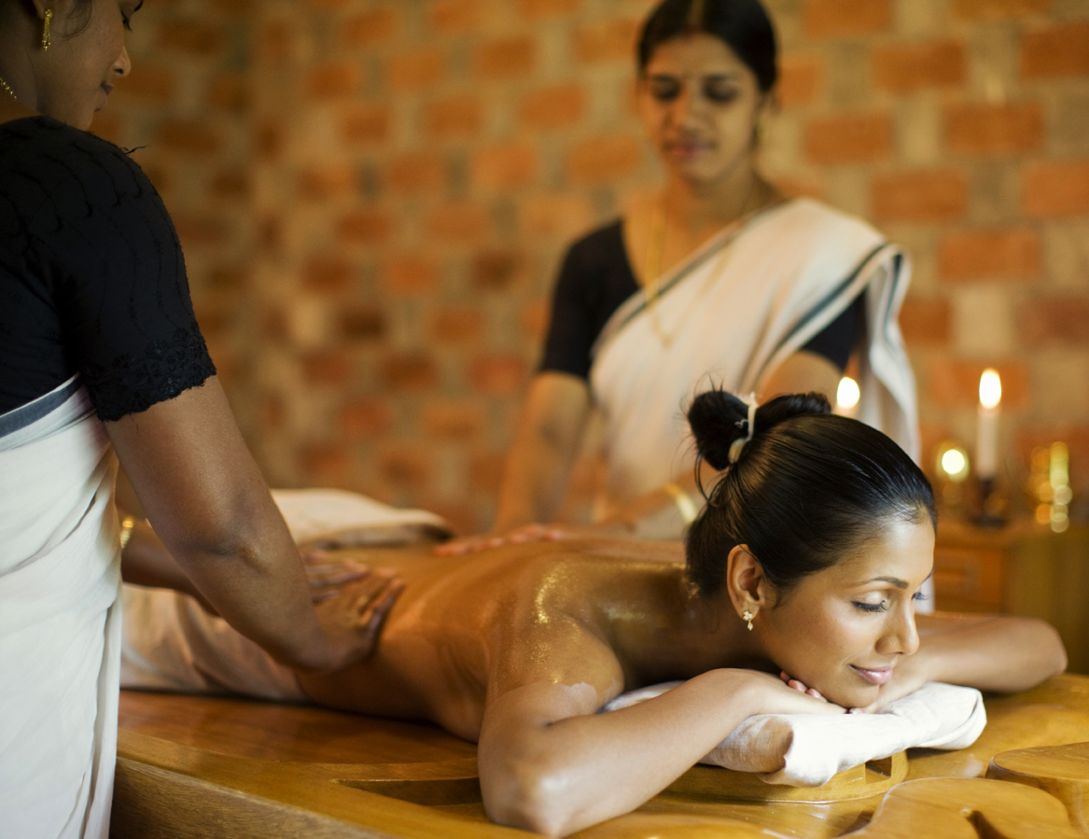
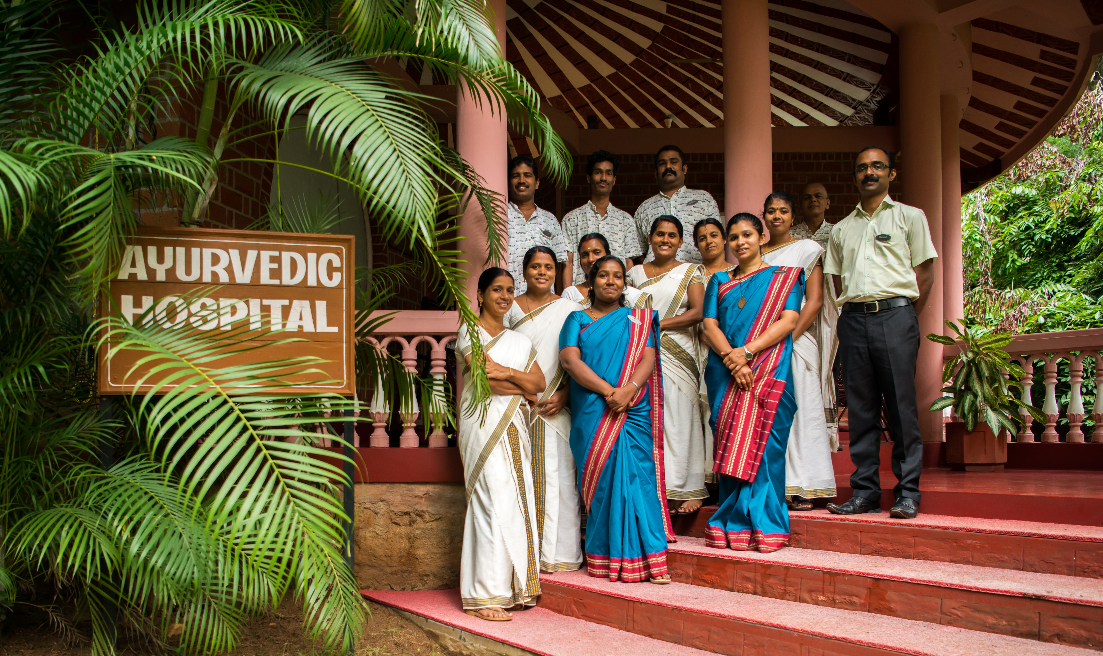
Undivided Attention
With the presence of 4 full time Doctors, 9 therapists, 2 Yoga teachers & 100 plus staff members we ensure undivided attention is given to our guests
KTAHV 2017 8

Slide 10
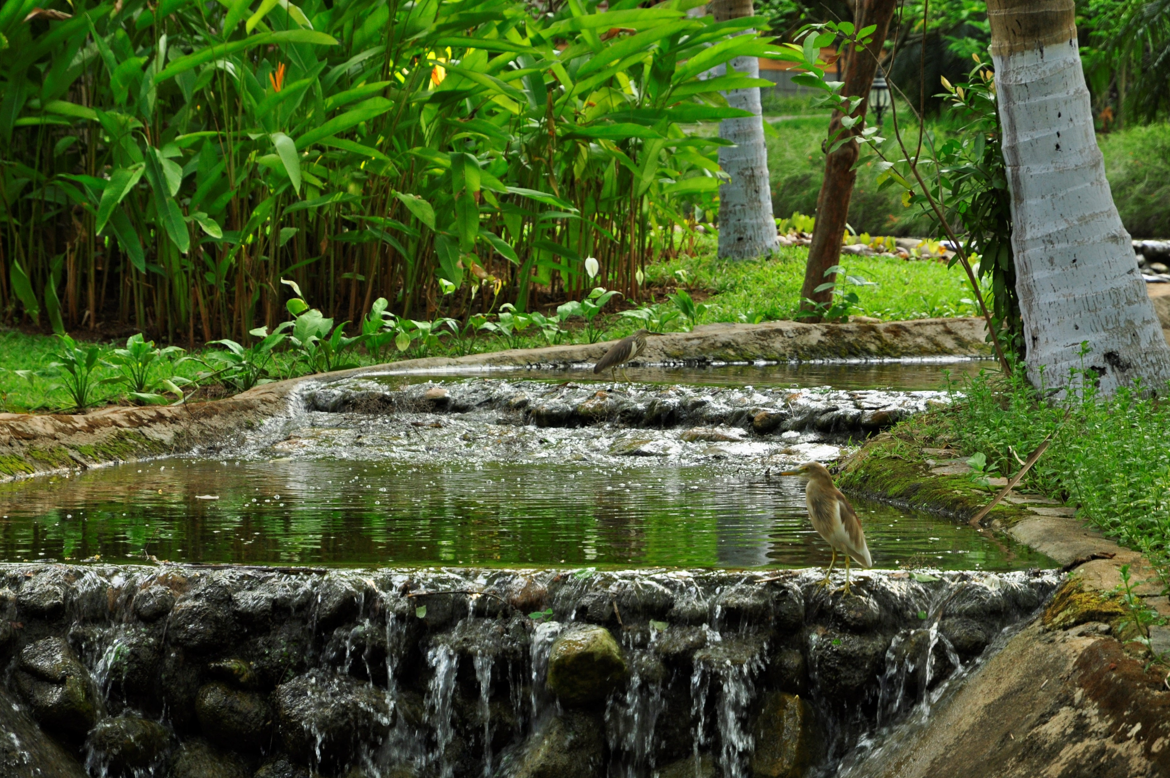
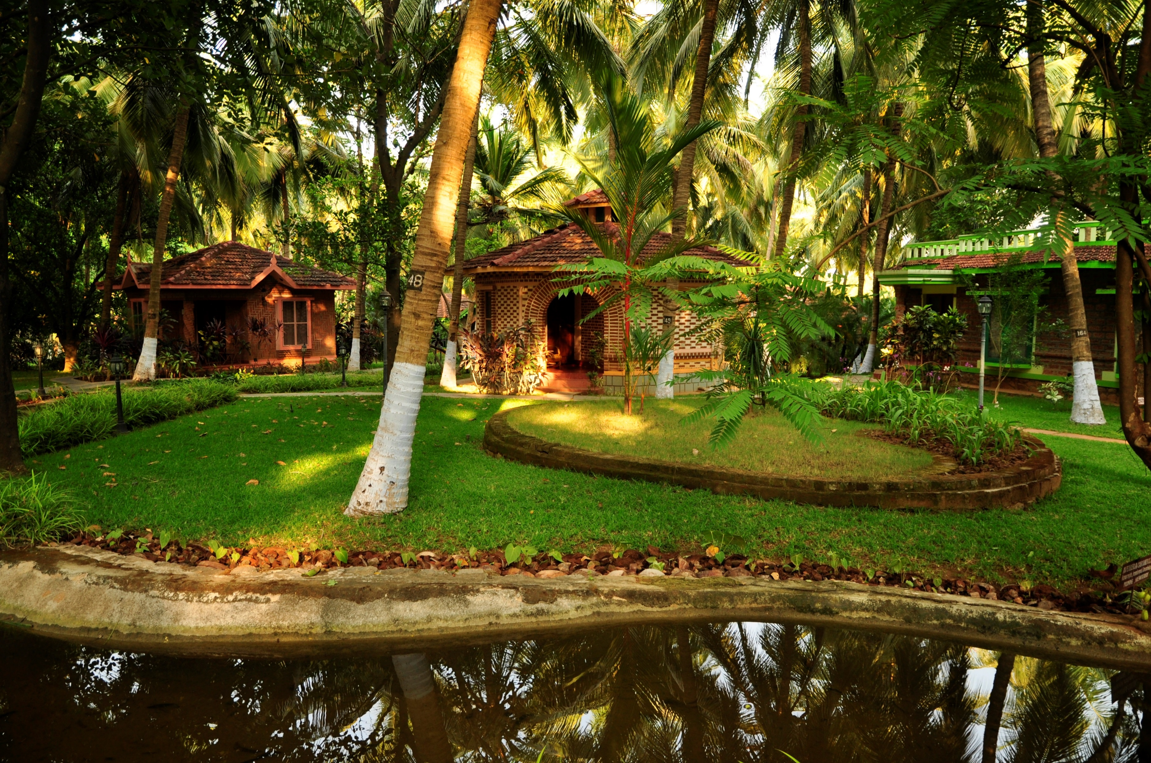
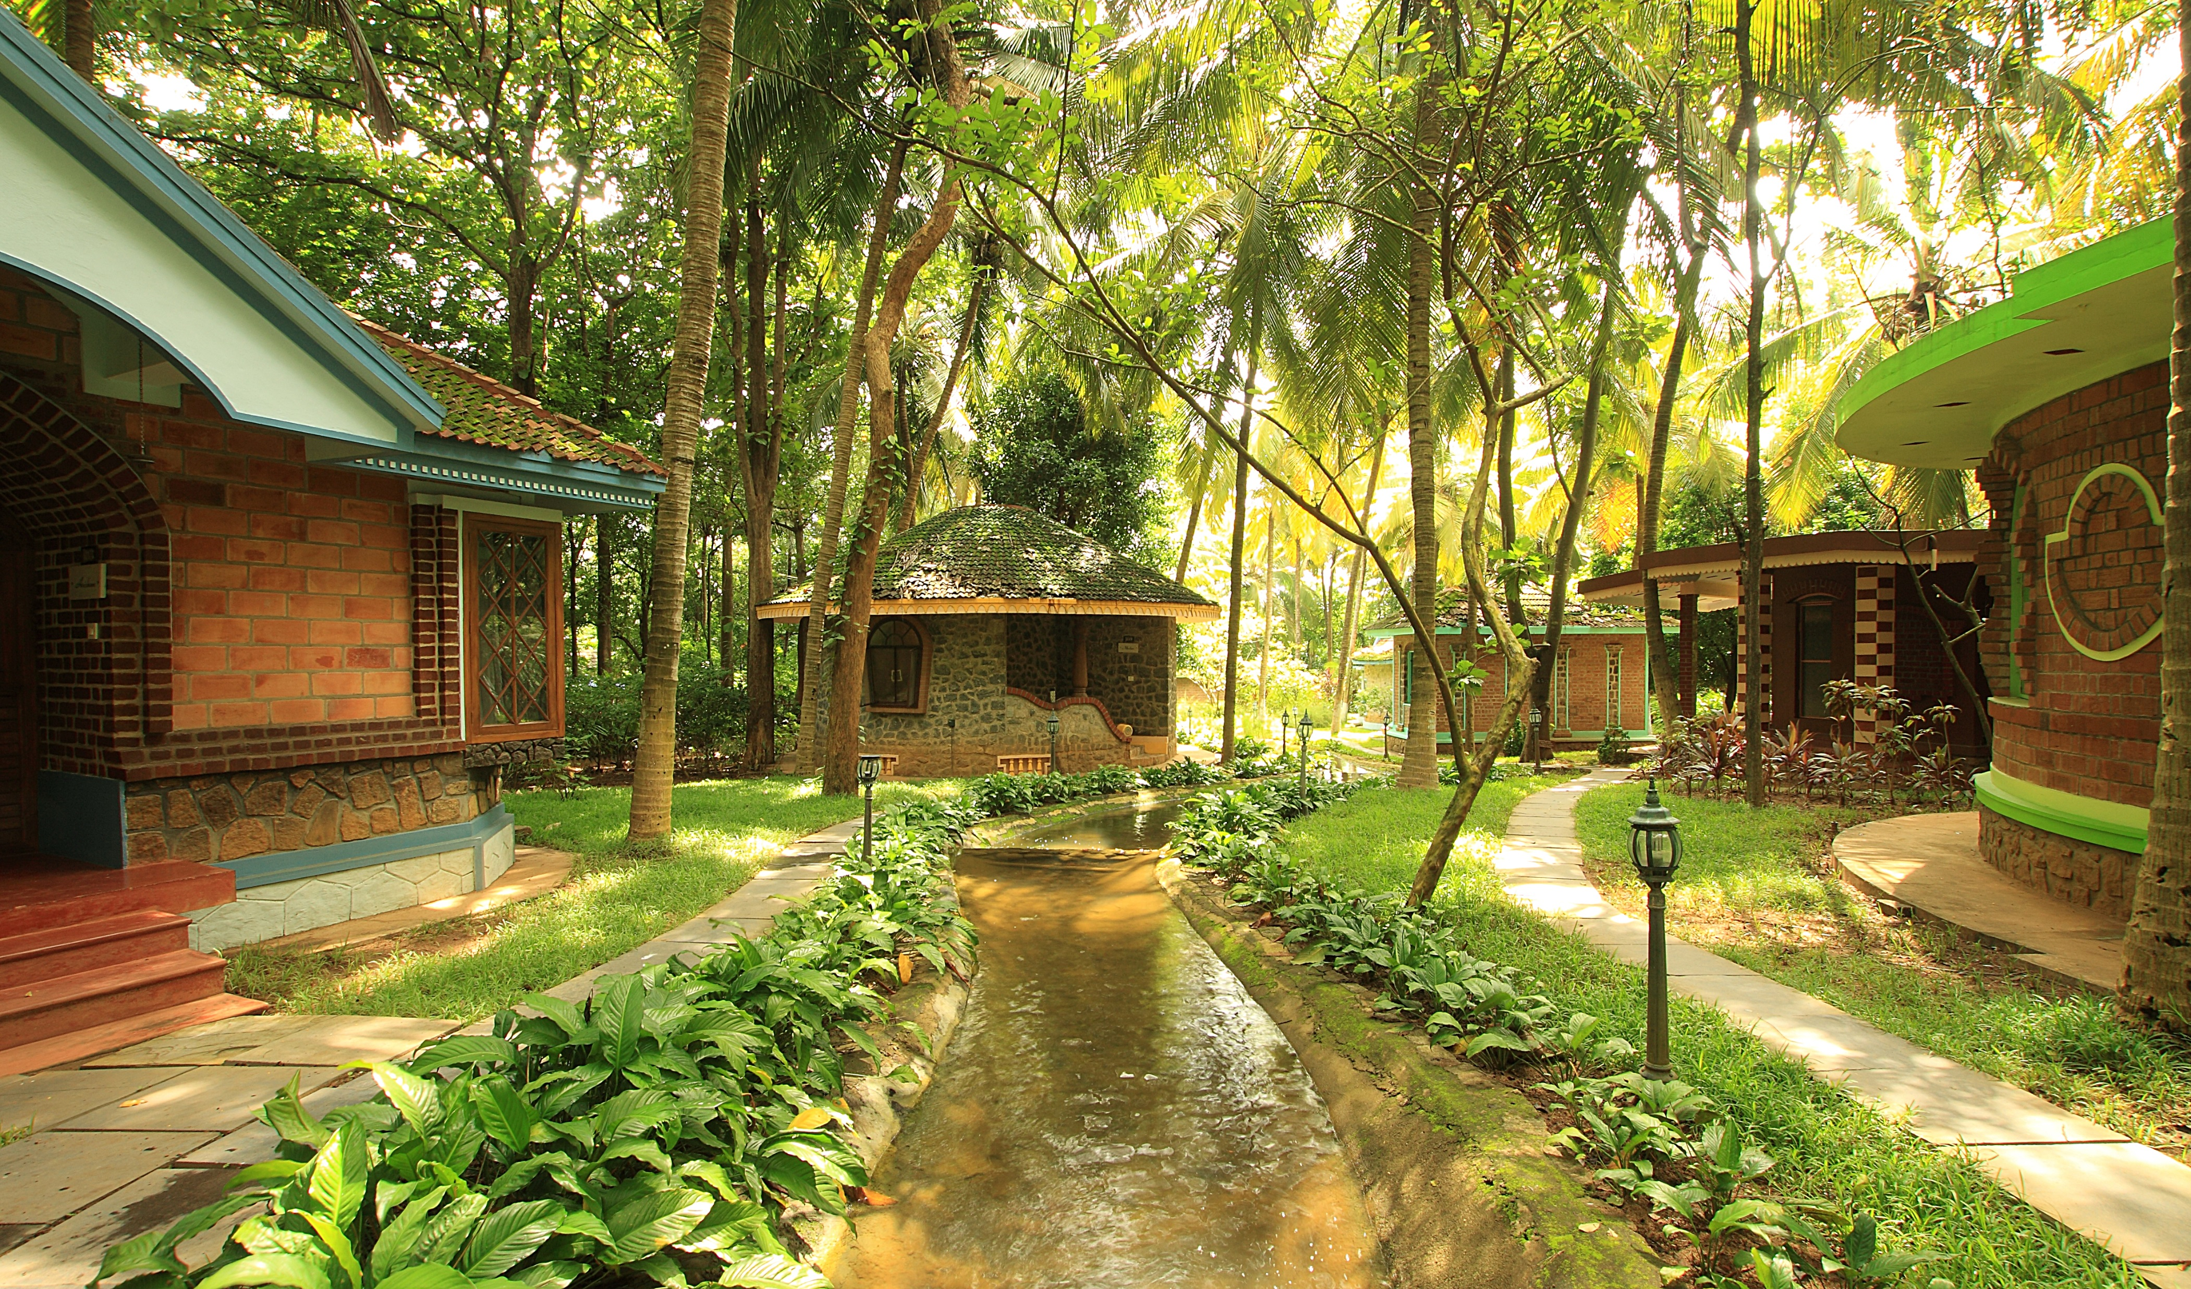
Close to Nature
Kairali Ayurvedic Healing Village is strategically designed in such a way that each villa and amenities is surrounded with best of the nature with natural looking water bodies flowing throughout property gives guest a “close to nature” feel.
KTAHV 2017 9

Slide 11
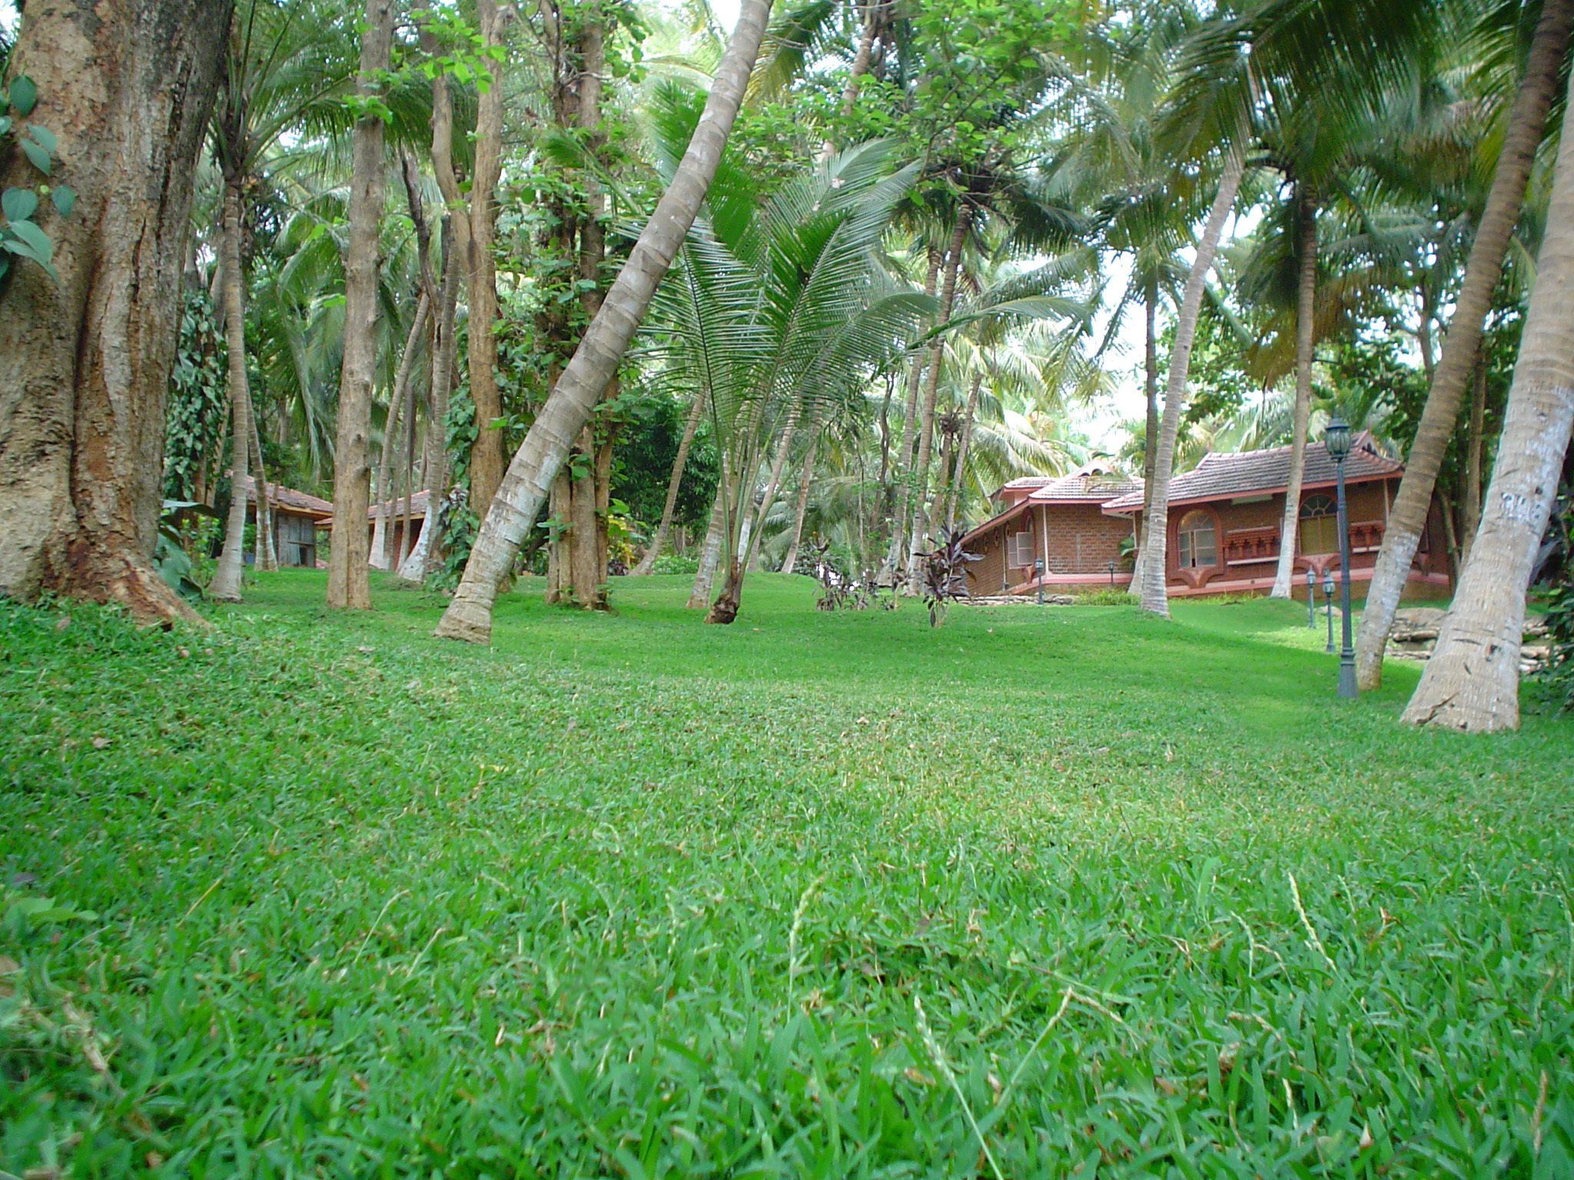
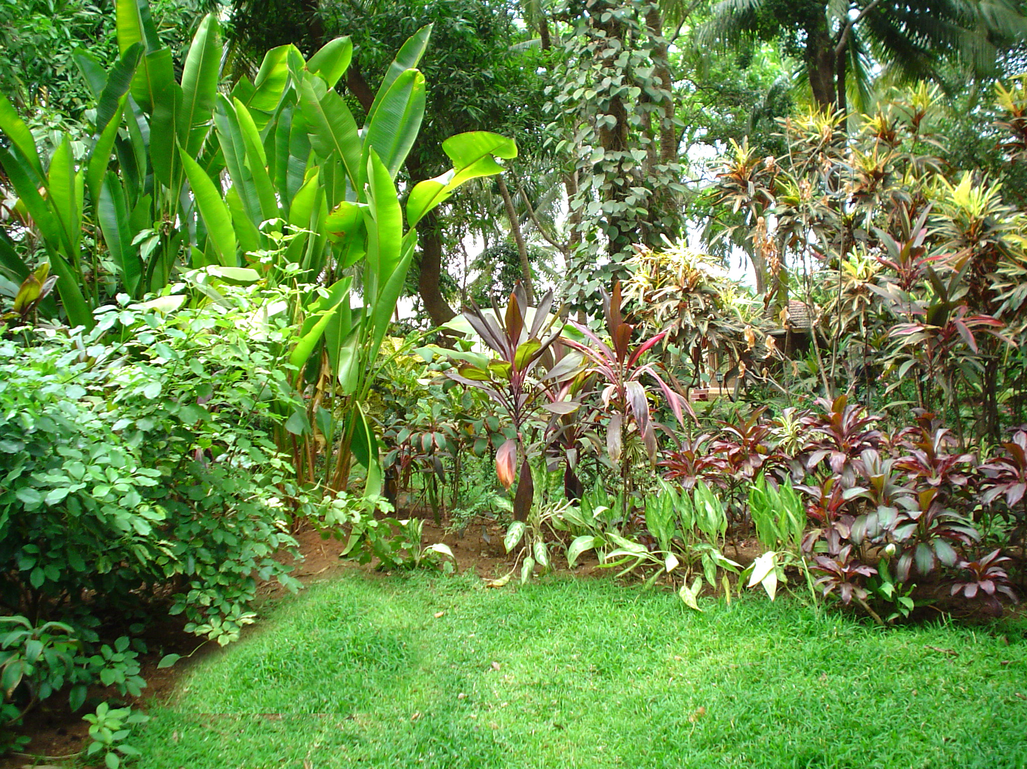
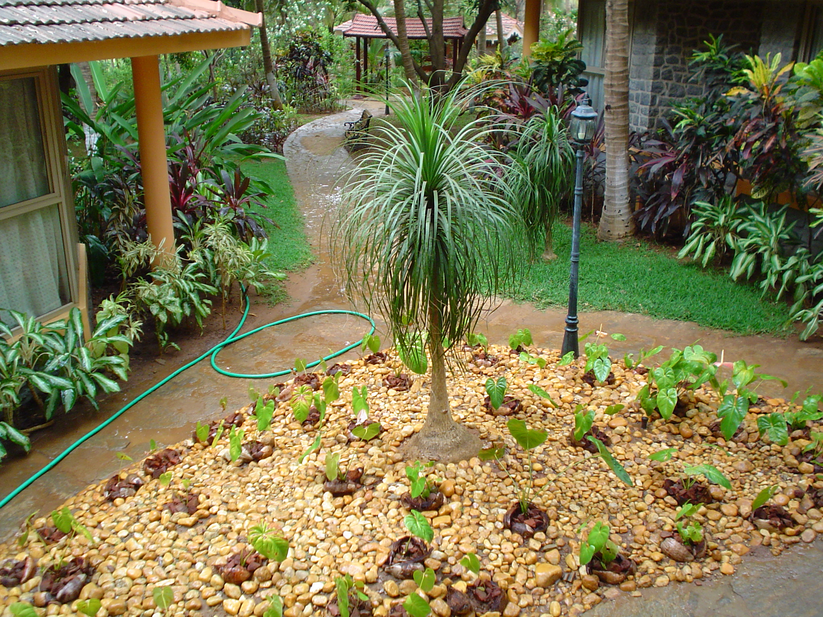
Green Landscaping
Kairali – The Ayurvedic Healing Village is situated at Palakkad, a land of palm and Paddy fields and is the one of the biggest mountain pass in the world separating Western Ghats. Studded with rich flora and fauna.
Our Village is also extremely rich in biodiversity. We have Organic Garden with various species of Medicinal and fruiting plants. Our Products and Medicine are made up from the produce Organic Garden.
KTAHV 2017 10

Slide 12
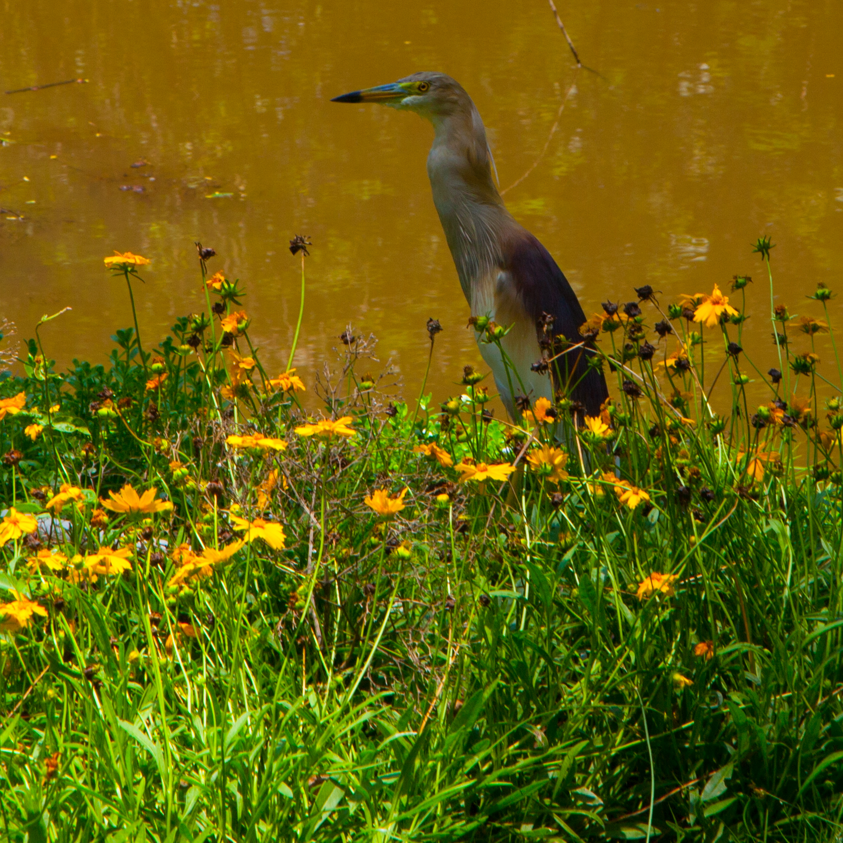
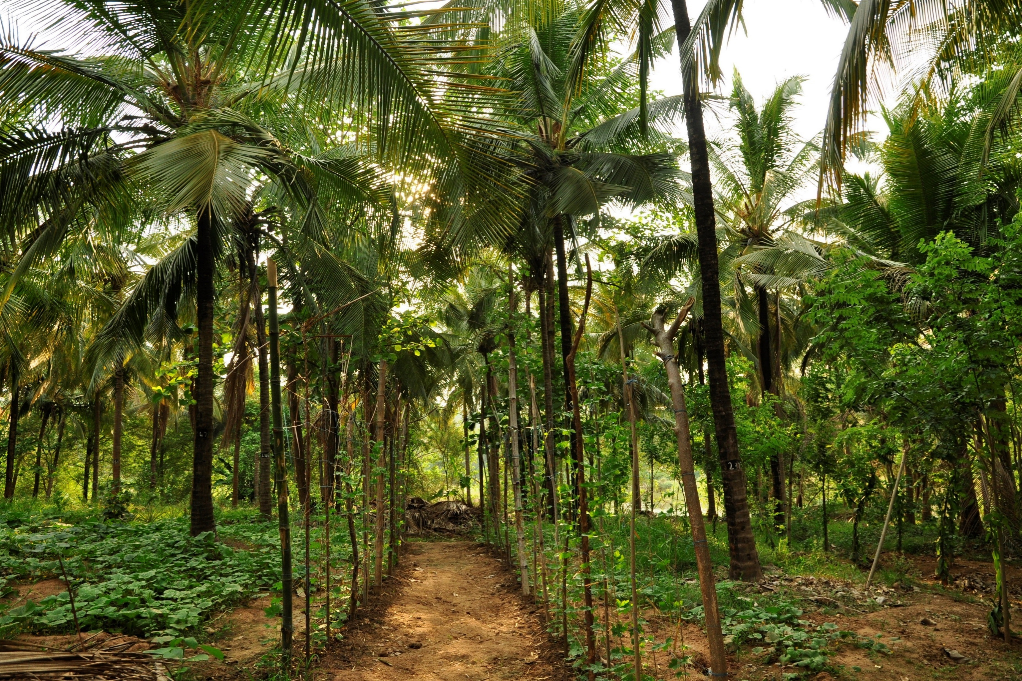
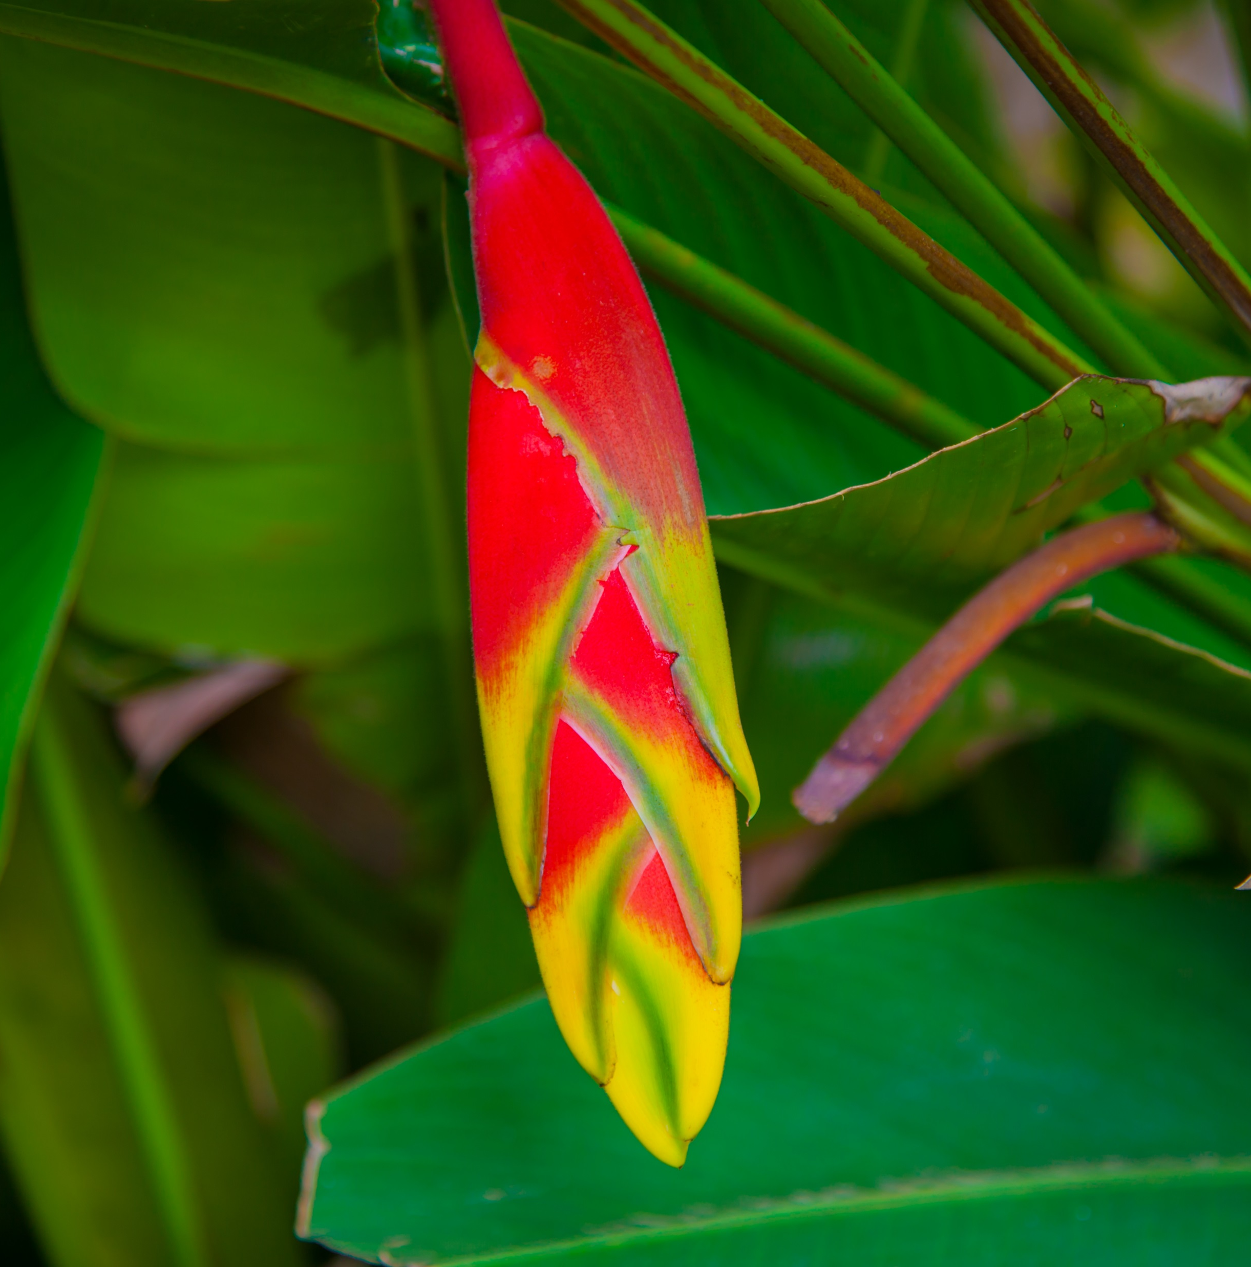
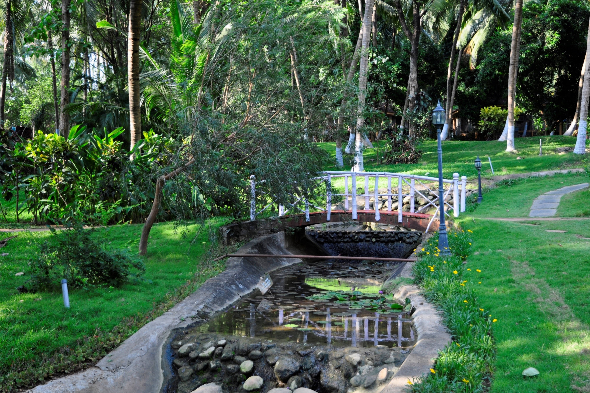
Diverse Flora & Fauna
Ayurvedic Healing Village have around 600 Coconut Trees, 200 Teak tree, 20 Mango Trees, various Medicinal plants.
More than 100 species of Birds and Butterfly.
KTAHV 2017 11

Slide 13
Our Villas
Our Villas are designed according to the zodiac signs.
Astrologer presence to give you a peek into your future.
Rare Valambari conch is placed in each villas to give positive vibrations.
Flooring is done with Red Oxide because of its cooling properties.
We have 30 Villas with us, divided in 3 Villas : Deluxe Villa, Royal Villa and Maharaja Suite.
Deluxe Villa – 21 in Number
Royal Villa – 7 in Number
Maharaja Suite – 2 in Number
KTAHV 2017 12

Slide 14
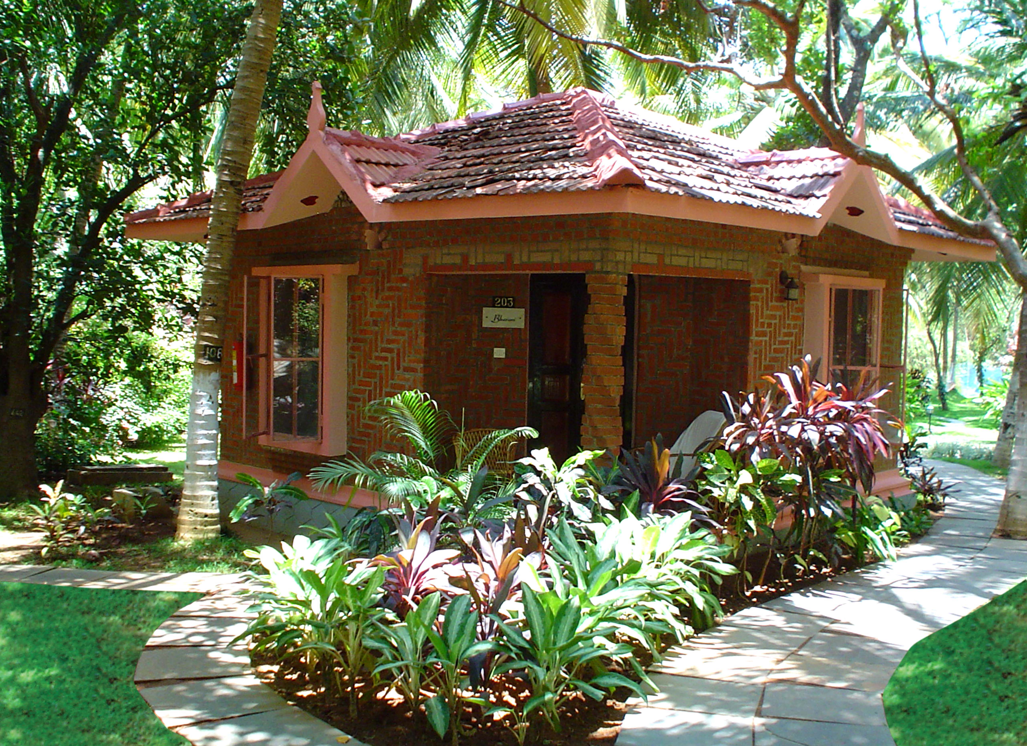
Deluxe Villa
KTAHV 2017 13

Slide 15
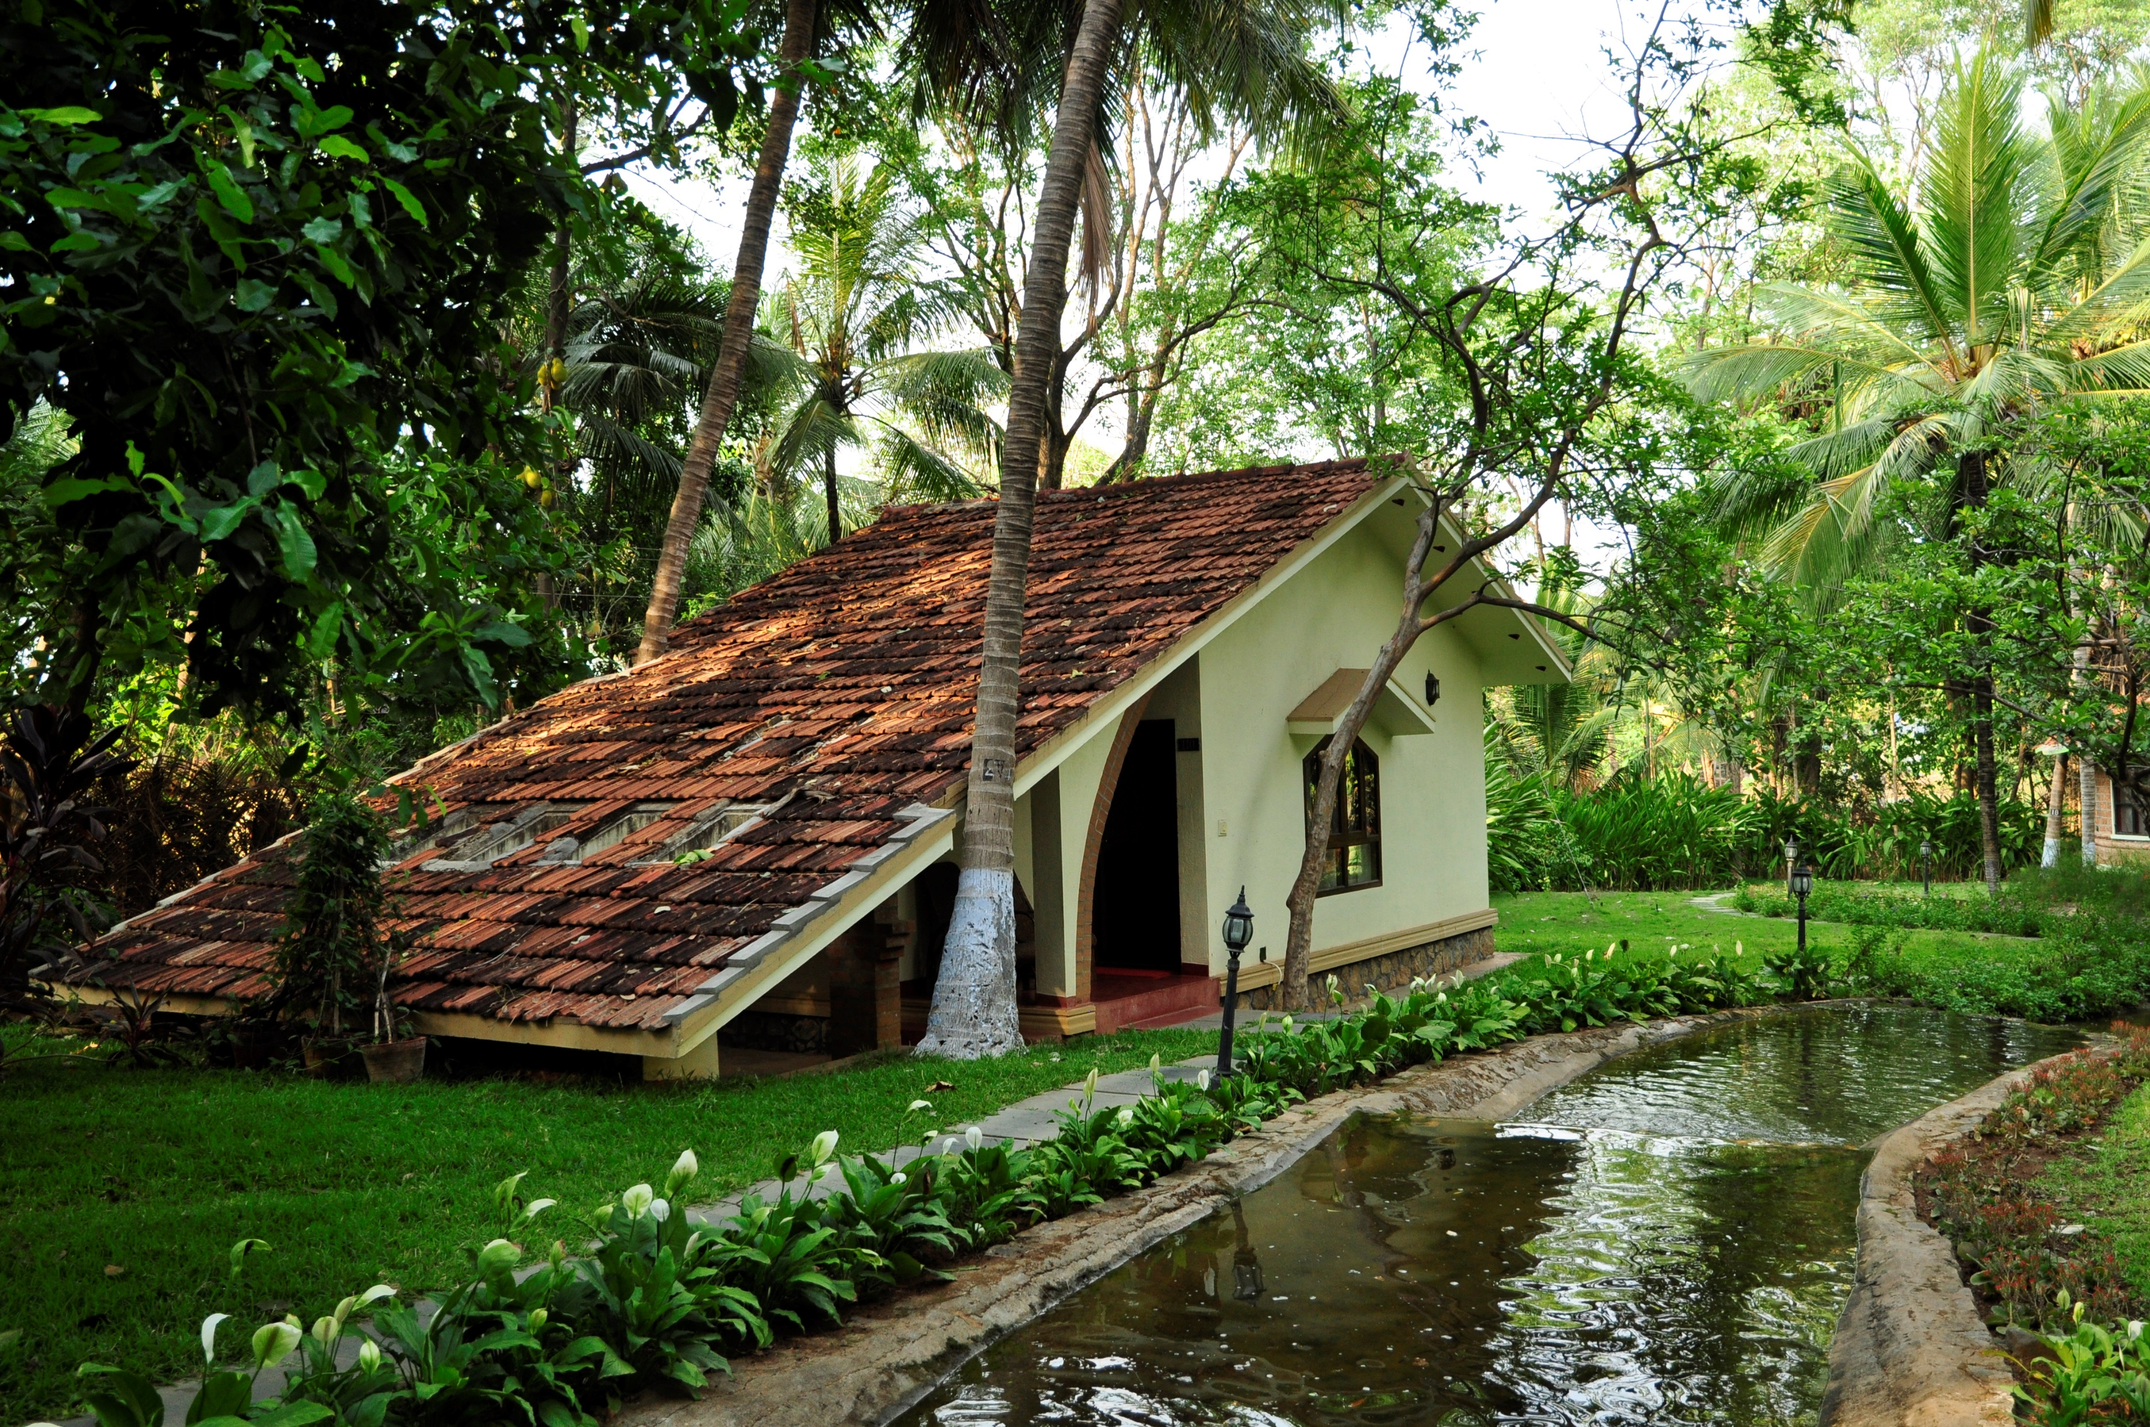
Royal Villa
KTAHV 2017 14

Slide 16
Maharaja Suite
KTAHV 2017 15

Slide 17
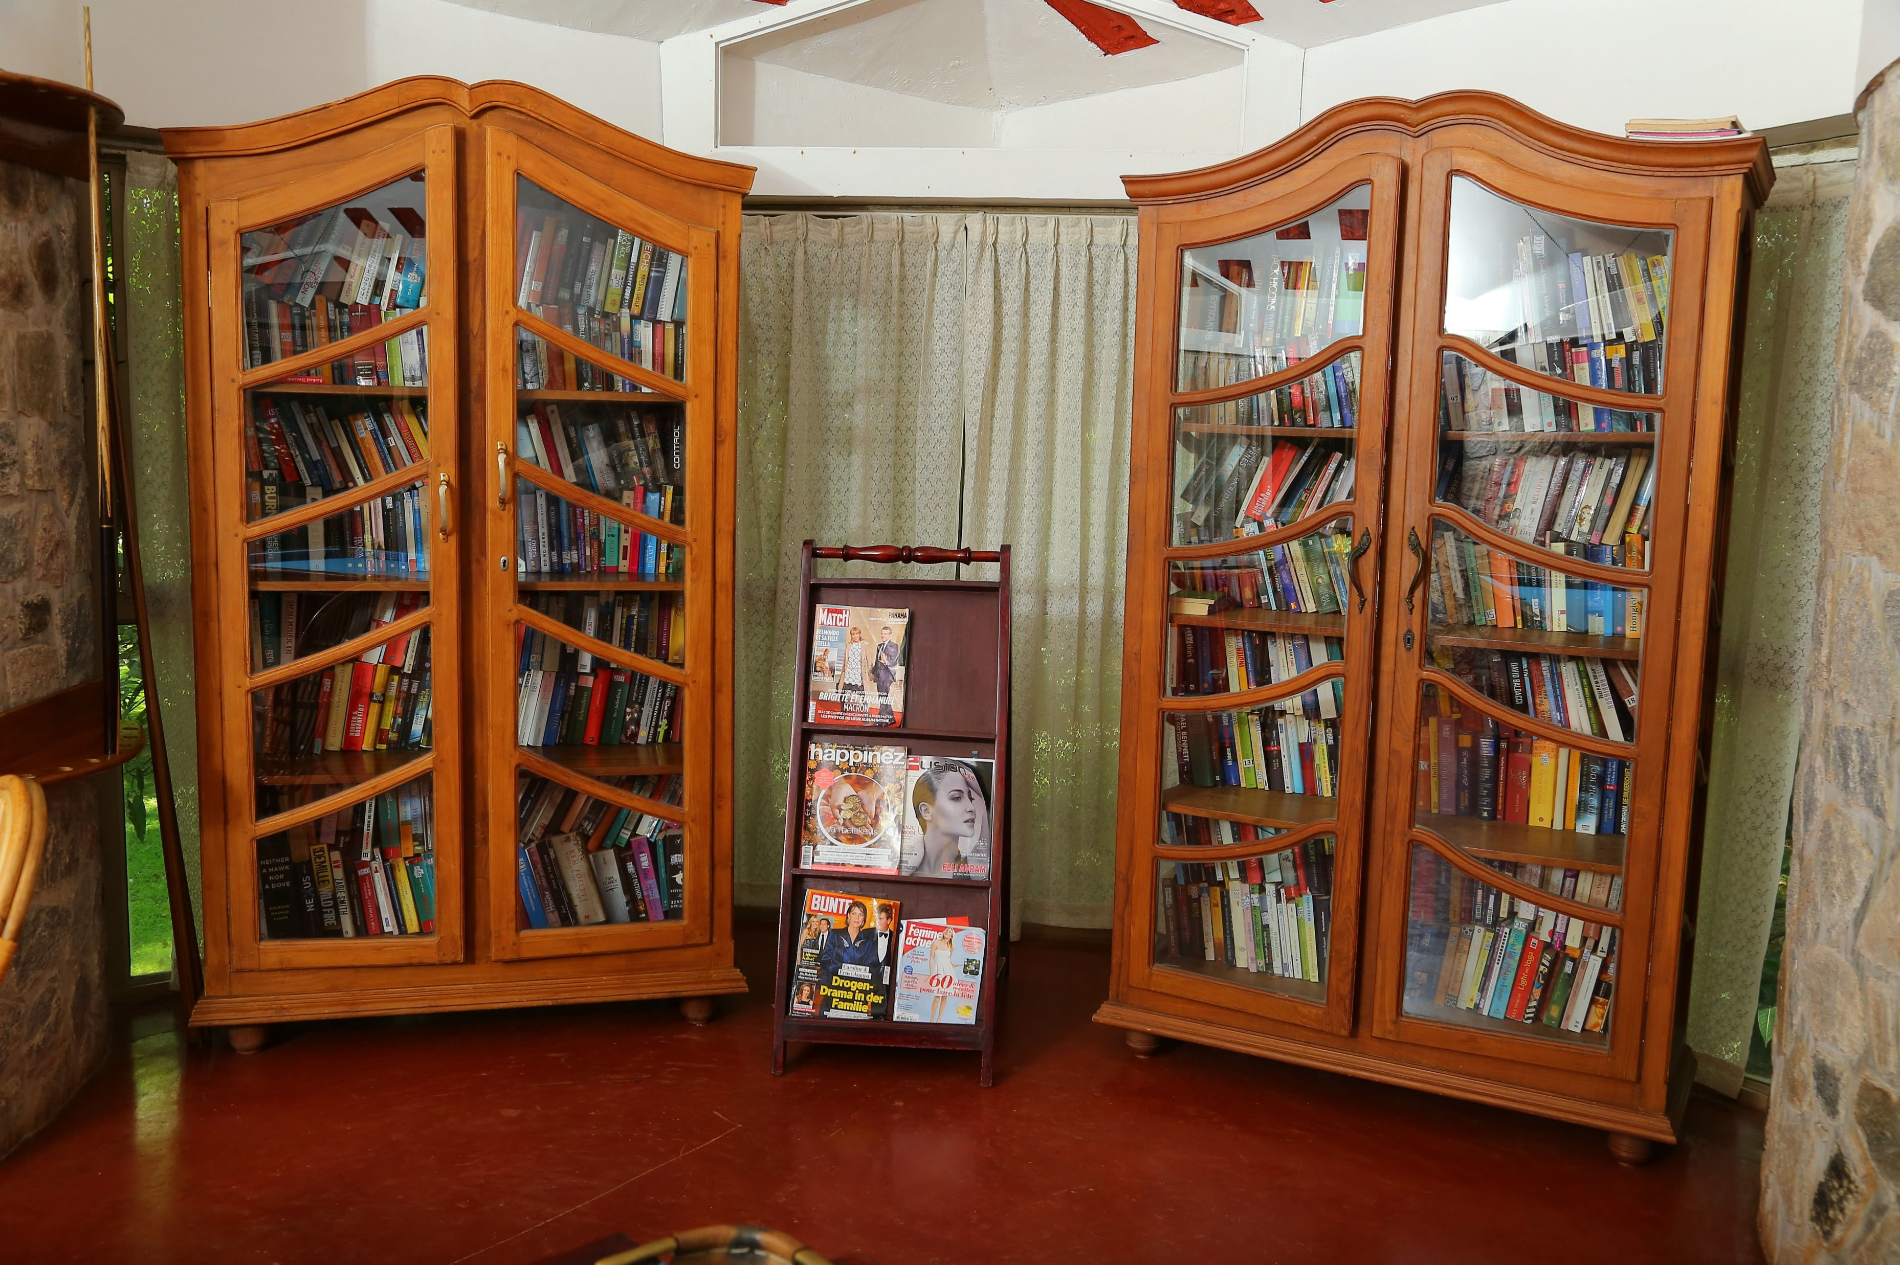
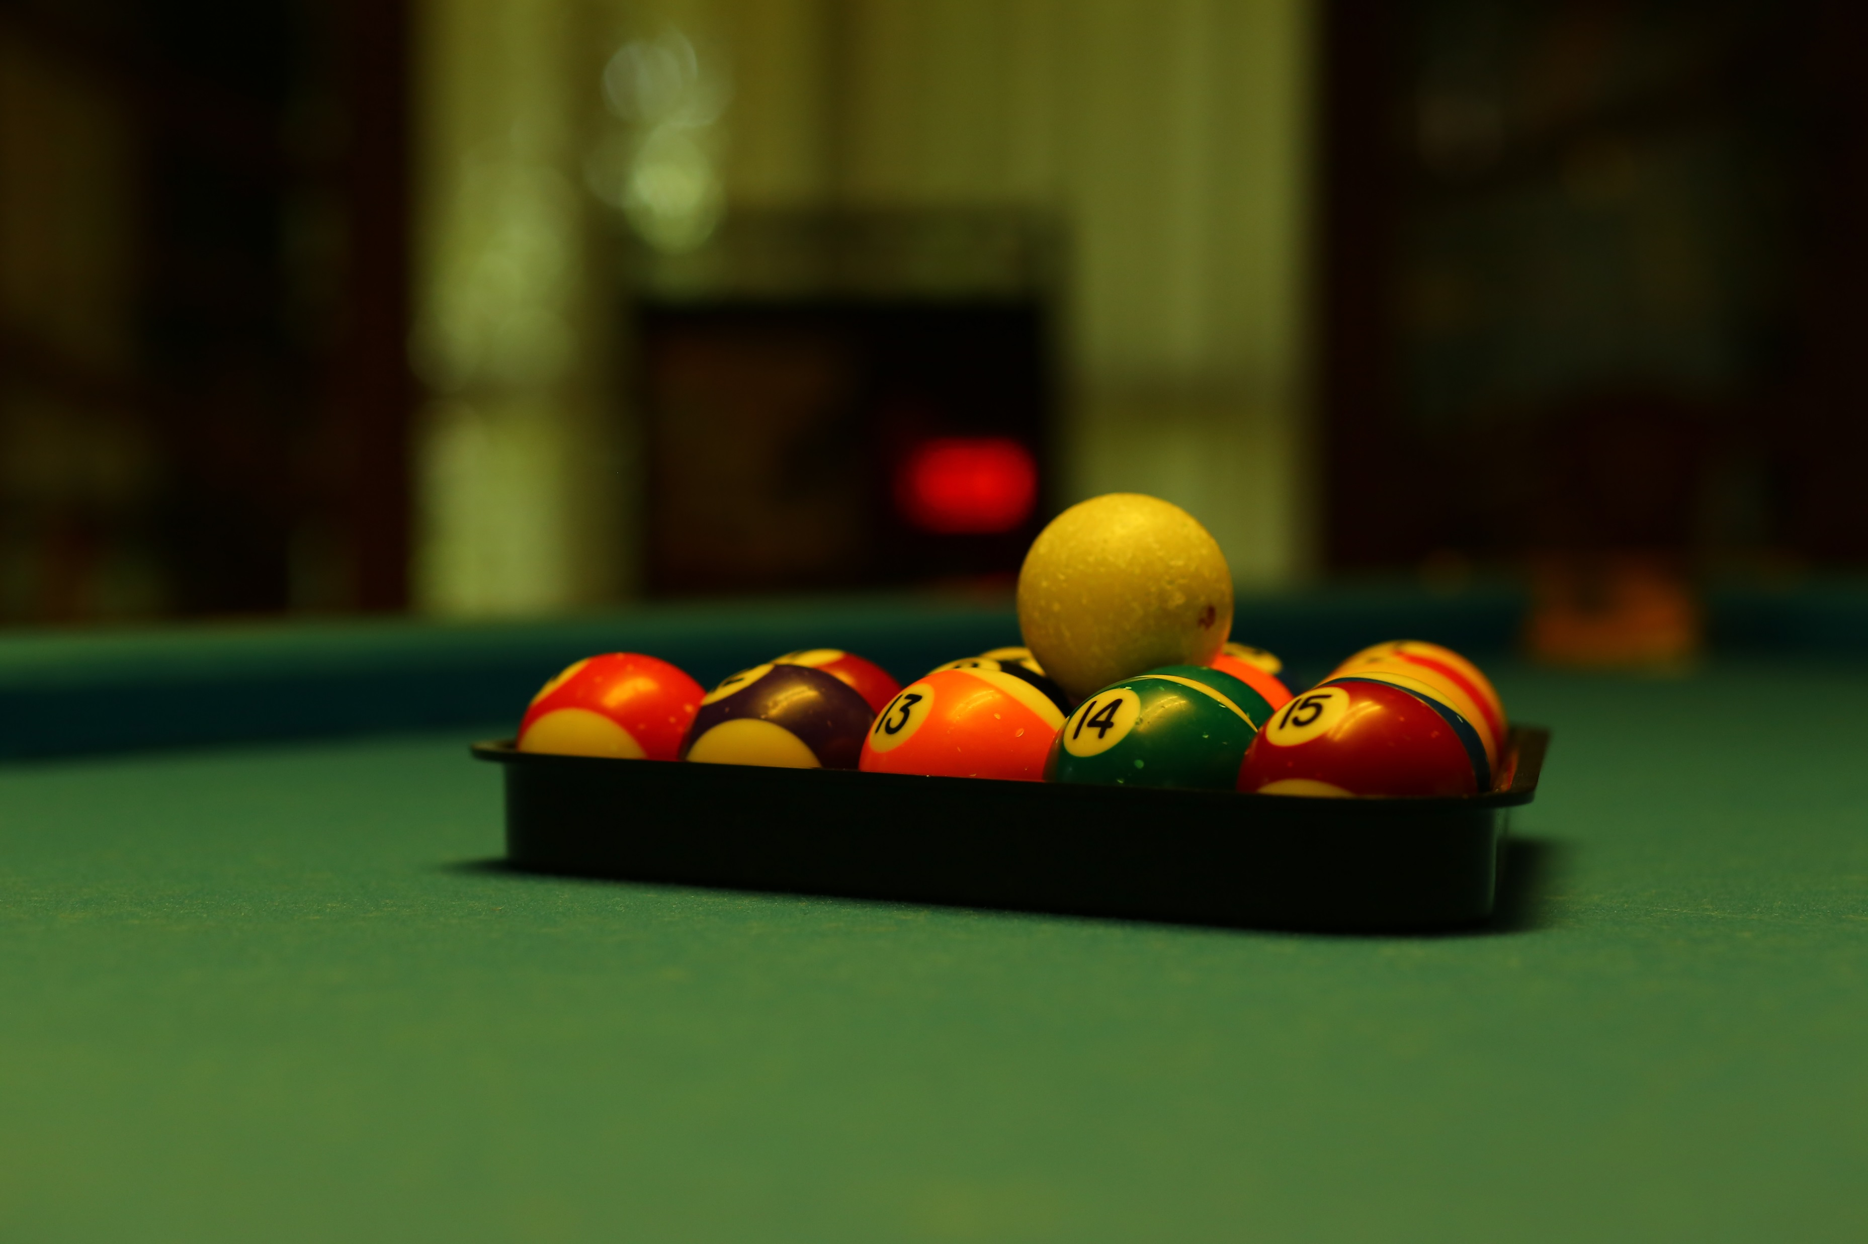
Our Facilities
Yoga & Meditation
Gym
Consultation by Doctors
Pure Organic & Veg Food
Astrology & Palmist
Cooking Classes
Swimming pool
Indoor Games
Library
Recreational facilities for Kids
KTAHV 2017 16

Slide 18
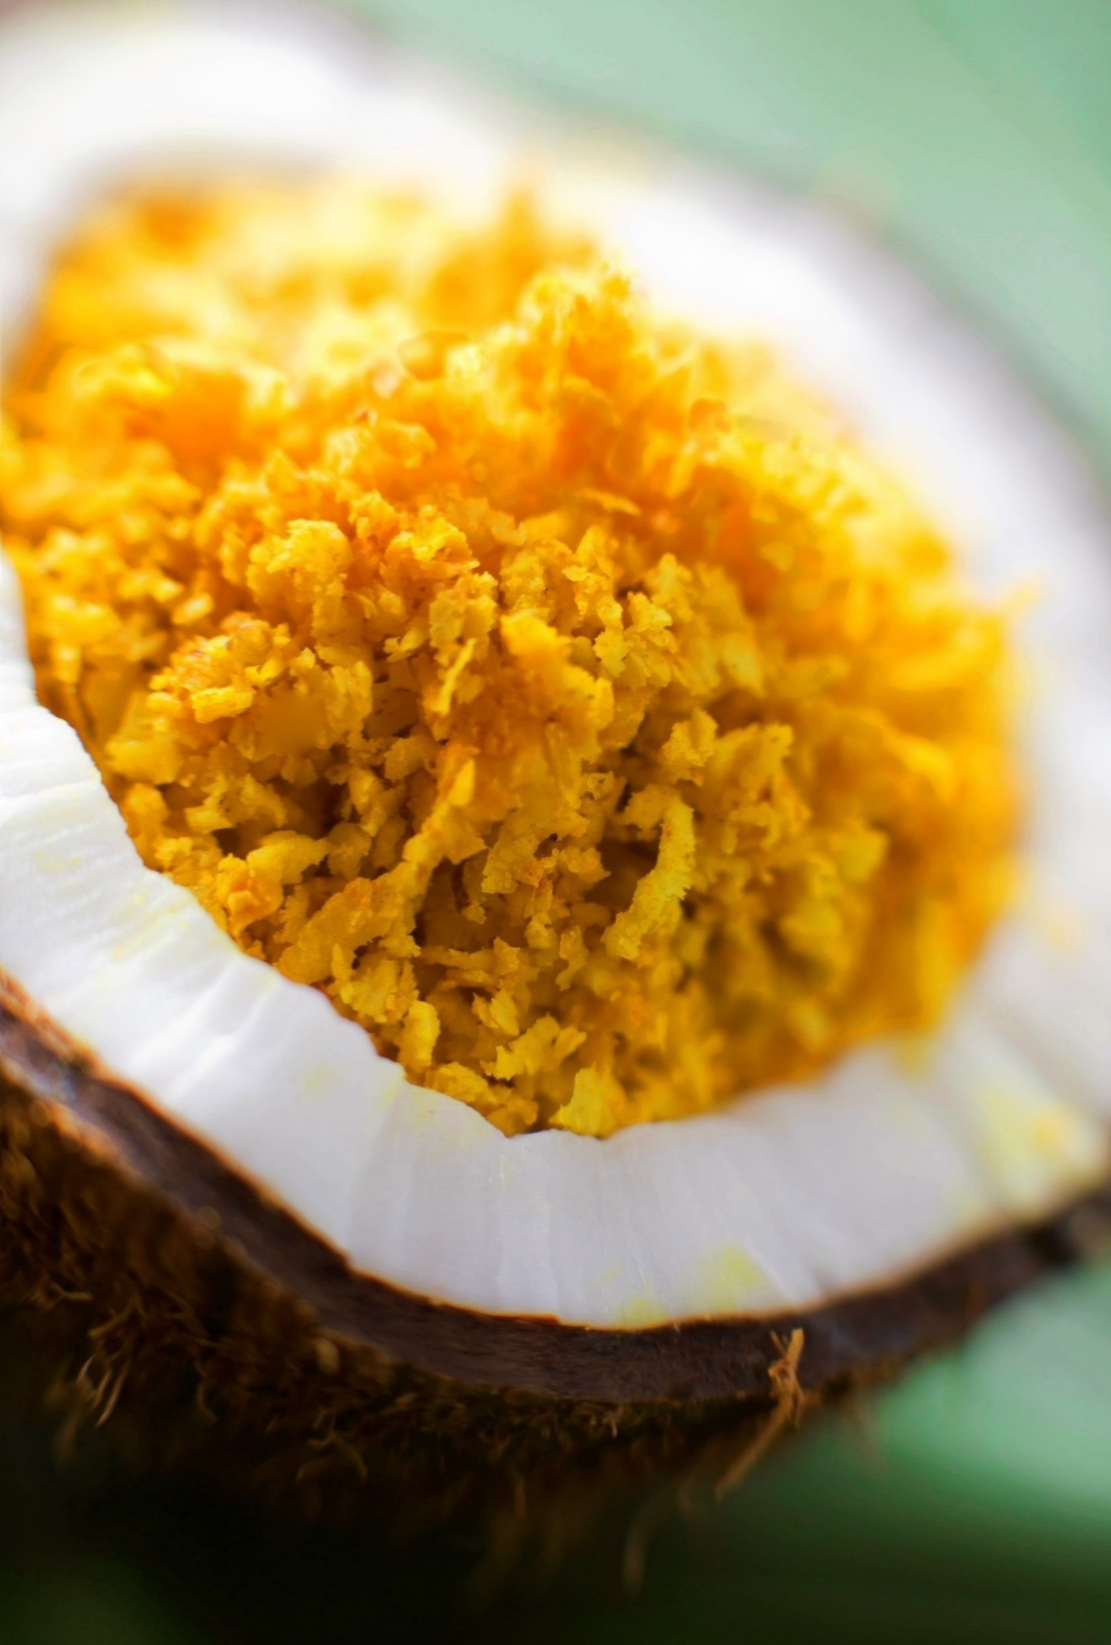
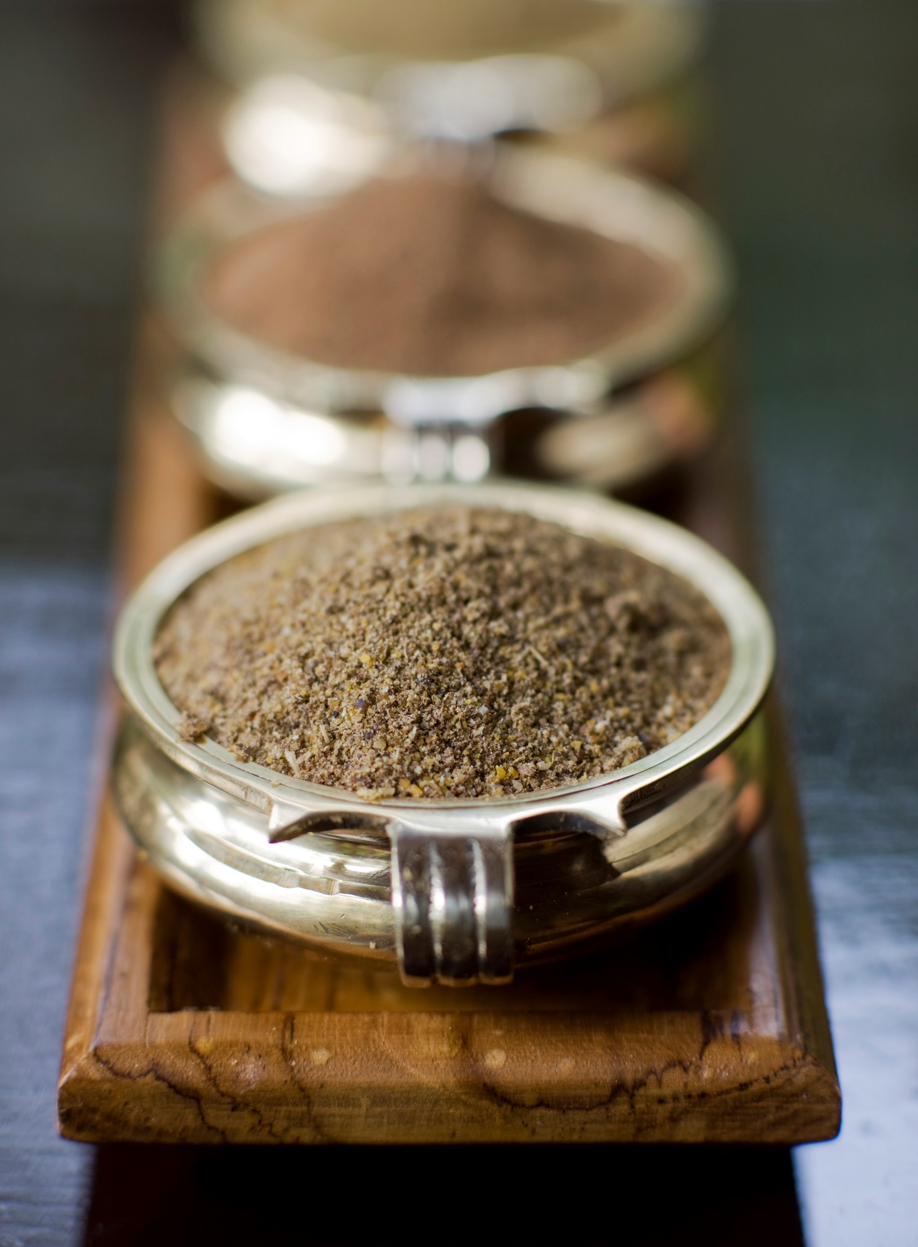
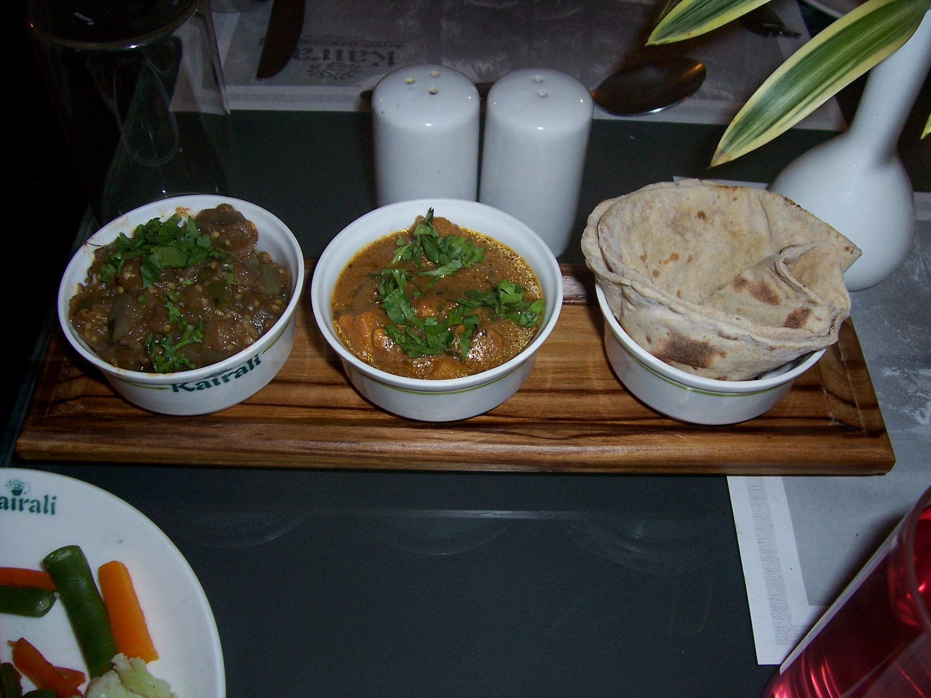
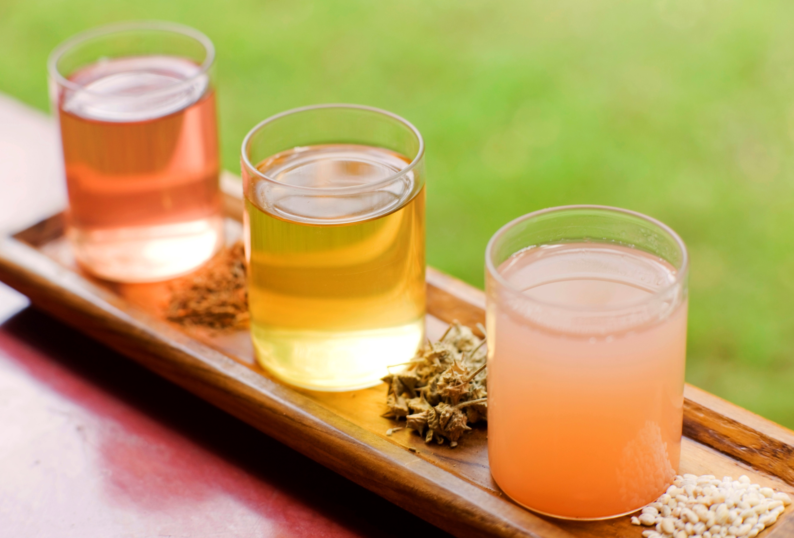
Organic Food
We serve pure Organic Vegetarian food to our Guest.
Vegetables and fruit our grown in our own Herbal Garden in pure natural condition free from chemicals. We also serve the Vegan and Satvik food.
As per Vedic Knowledge – we abstain from ingesting Non vegetarian food and Alcoholic Drinks.
KTAHV 2017 17

Slide 19
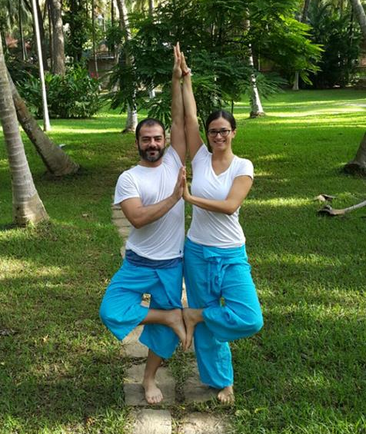
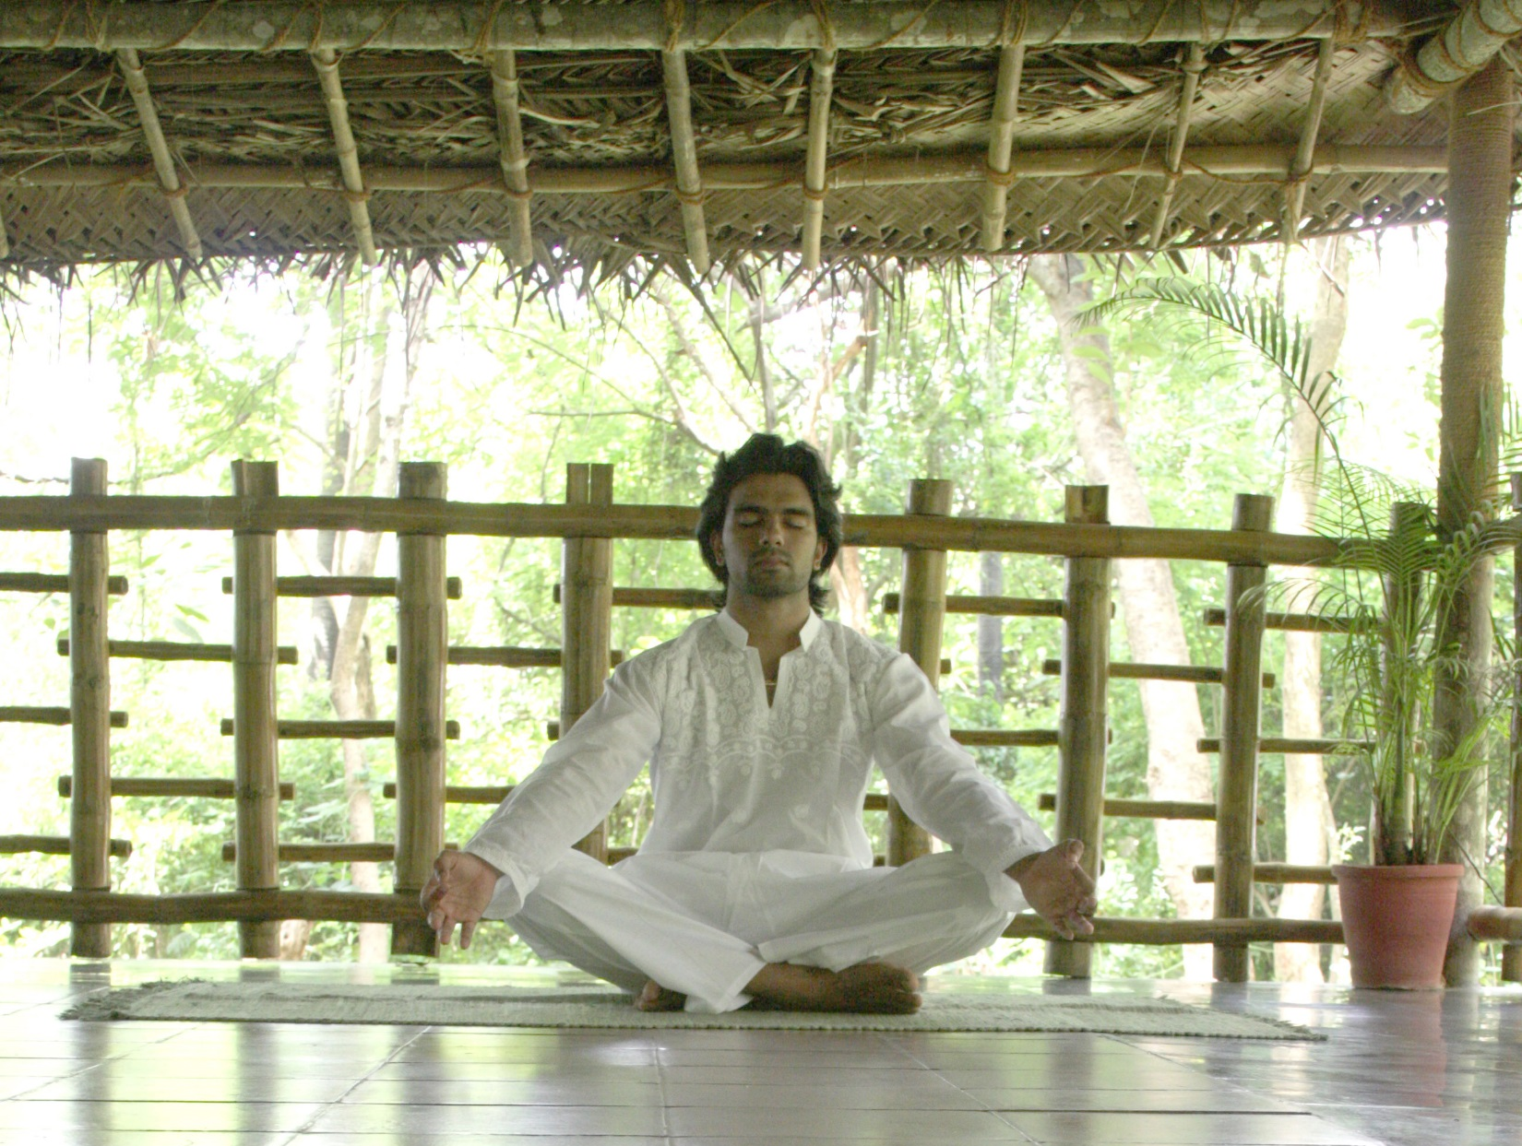
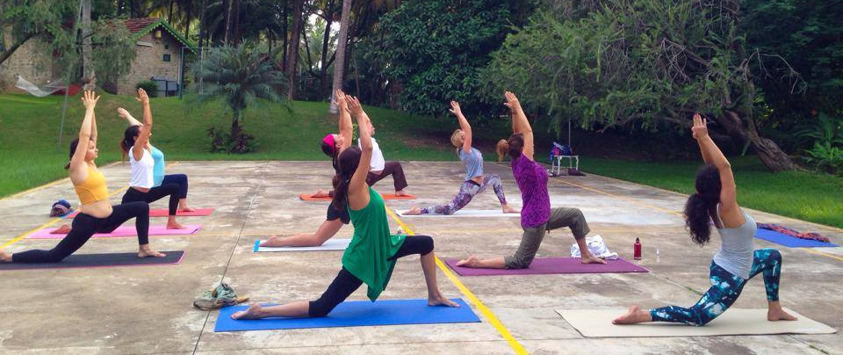
Yoga Meditation
At Village our focus is providing Holistic Health and Rejuvenation. For the same the we provide the Early Yoga session and Evening Meditation Session.
We also conduct various Yoga Retreat – Lakshya Yoga Retreat etc.
KTAHV 2017 18

Slide 20
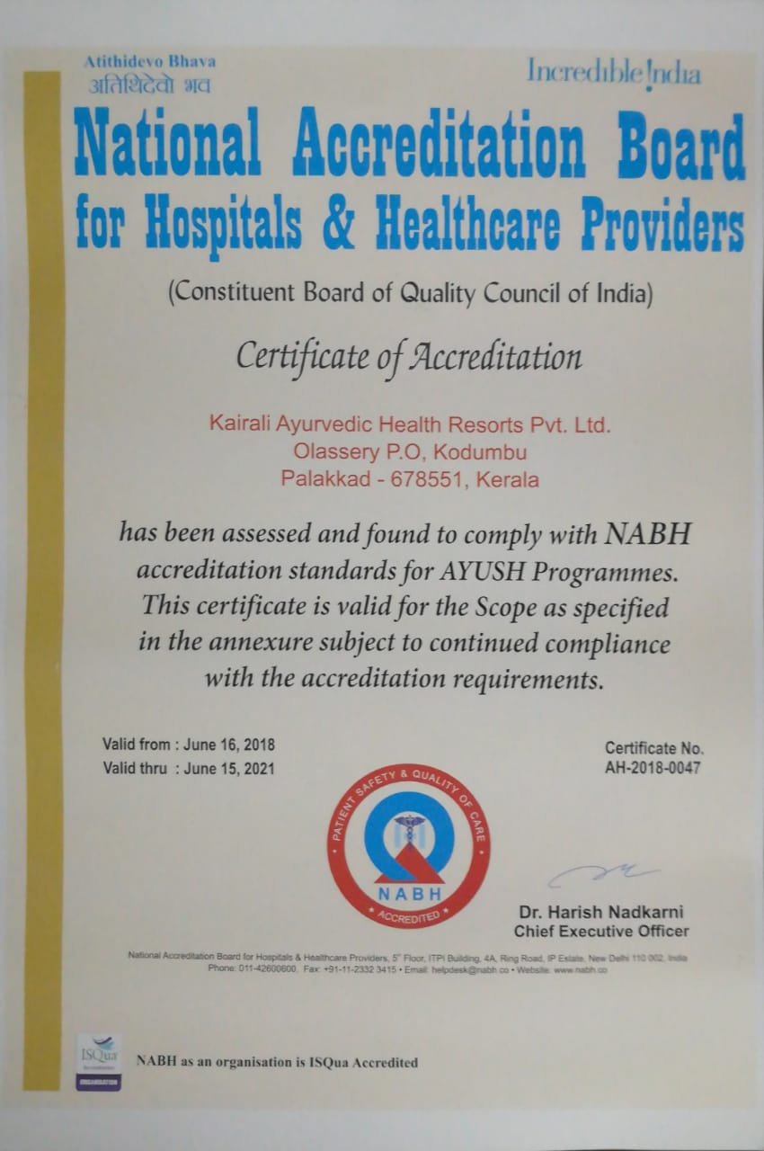
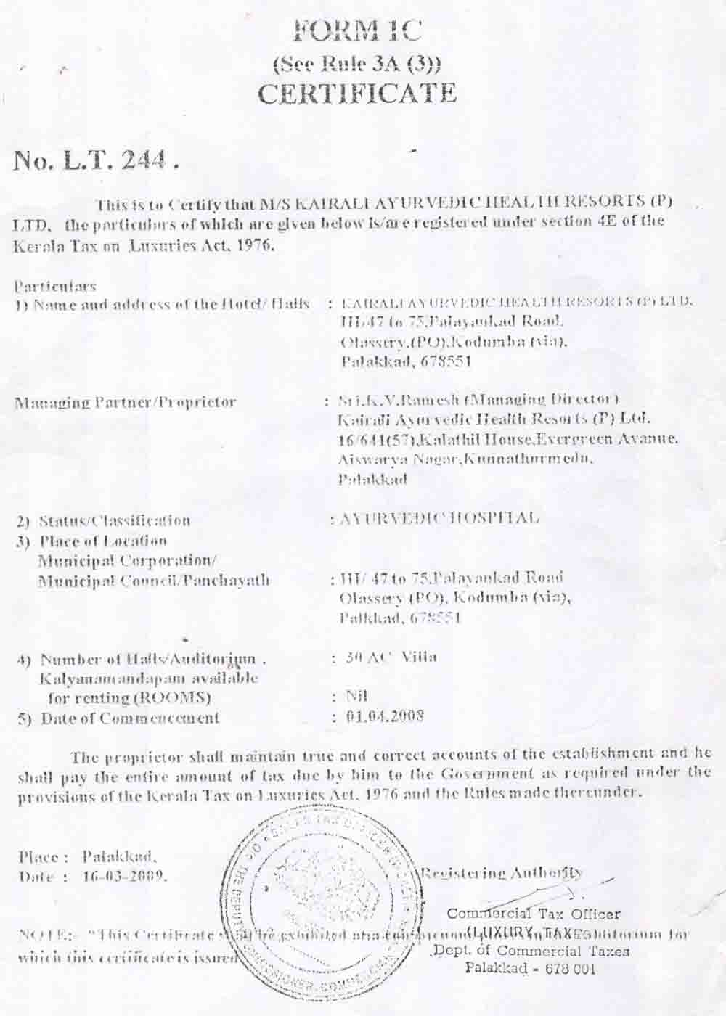
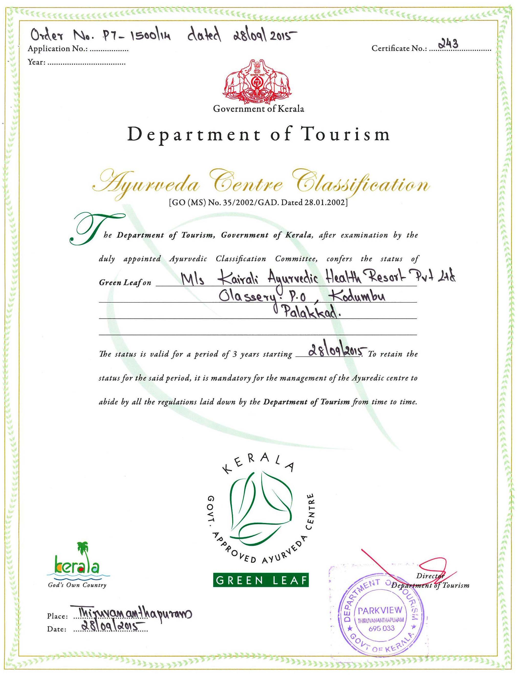
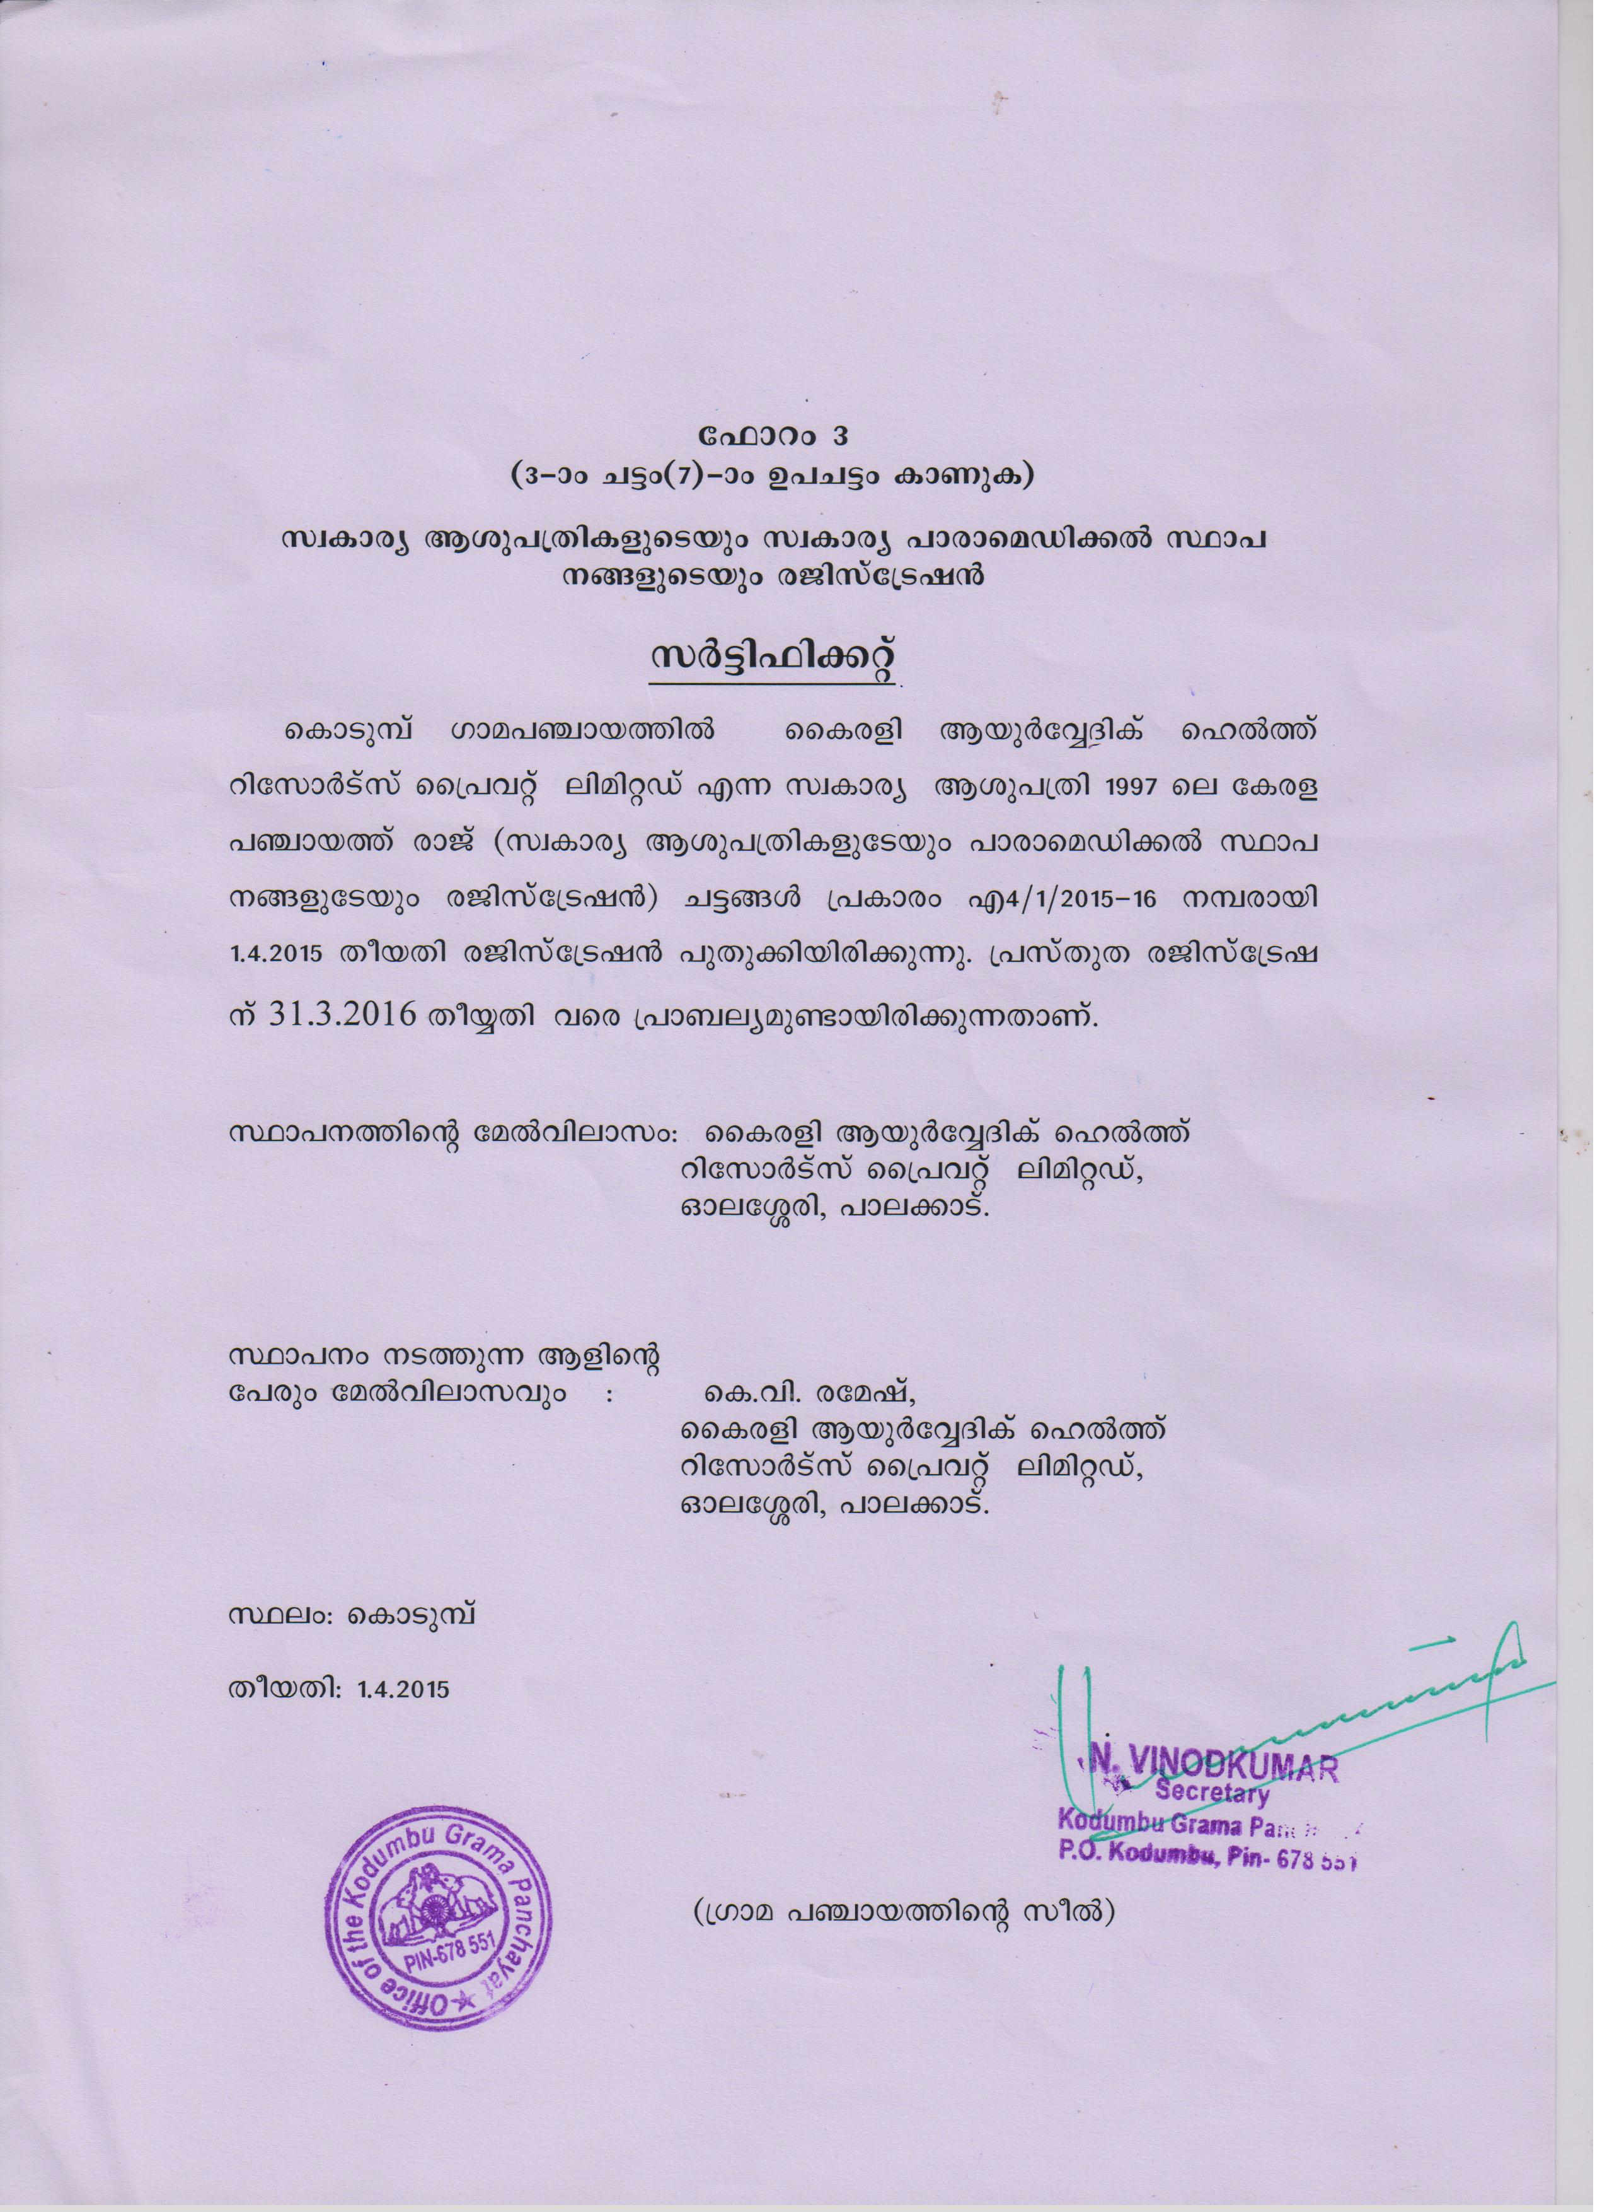
Our Certificates
Kairali Ayurvedic Healing Village holds following certifications:
NABH certified
Hospital License
Green Leaf Certification
Paramedical Certified
KTAHV 2017 19

Slide 21
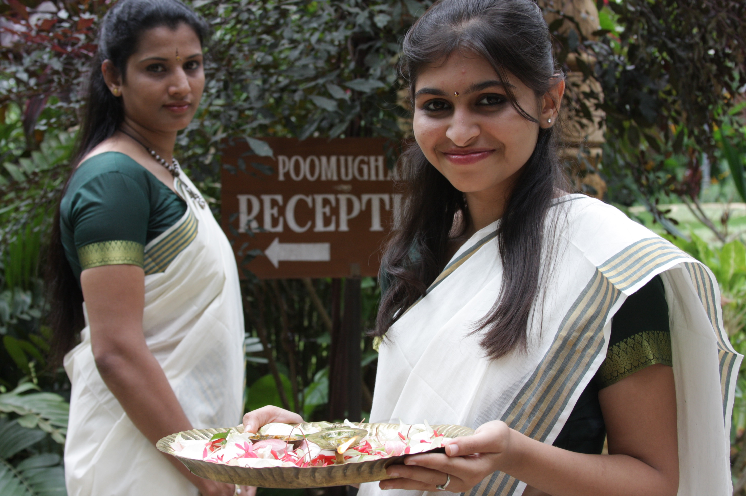
Thank You for your Attention!!
We will look forward to Welcome You!!
Kairali – The Ayurvedic Healing Village (KTAHV)
Kerala
KTAHV 2017 20

