Slide 1



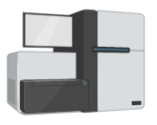
5 advanced-stage metastatic prostate cancer patients
For each patient:
Treat with DMSO for 24 hours (control)
Harvest cells, extract total RNA
Prostate tumor biopsy
Tumor cells grown in petri dish
Bulk RNA-seq
Harvest cells, extract total RNA
Treat with LSD1i (SP2509) for 24 hours
5 patient samples that are DMSO treated
5 matched patient samples that are LSD1i treated

