Slide 1
Elementary Mathematics for “Advanced Programming” - Concept to Code ( Arithmetic & Basic Algebra)
Praseed Pai K.T.
Gadgeon Engineering Solutions
Kochi , Kerala

Slide 2
About the Presenter
A Seasoned Software Engineering Professional with more than twenty five years of Exposure
Author of Two books on Computer Programming
Explorer in “Philosophical Tools for Software Engineering” ( Has Presented on it, Written one university accredited paper, Designed a Pattern based on Advaita Vedanta to transition from OOP to FRP)
An Expert level professional in Cross Cultural Encounters
A Critique of Digital Technology Fads ( Programmers will be better off , if they stick to Programming. Do not run after so called AI/ML, BlockChain etc ) - “Plumbing is preferred over Painting!”
I also help Programmers eliminate their “Math-Phobia”
Currently, Designated as Sr. Solutions Architect @ Gadgeon

Slide 3
A Disclaimer
Aim of this session can be summed up as “Learn For Reasoning”
Programs given here are “Toy” programs which will help one to reason about programs and programming models
Mathematics has got representational and computational facets. The session focuses on representational aspects
The session only focuses on Arithmetic and Algebraic aspects of basic mathematics
In the future, sessions on “Trignometry,Geometry and 2D/3D Transformations” , “Linear Algebra” , “Abstract Algebra” etc will be taken

Slide 4
Source Code Available from
http://github.com/praseedpai/ElementaryMathForProgrammingSeries/tree/master/AlgebraNArith

Slide 5
Natural Number – Peano Way!
Zero is a natural number.
Every natural number has a successor in the natural numbers.
Zero is not the successor of any natural number.
If the successor of two natural numbers is the same, then the two original numbers are the same.
If a set contains zero and the successor of every number is in the set, then the set contains the natural numbers.

Slide 6
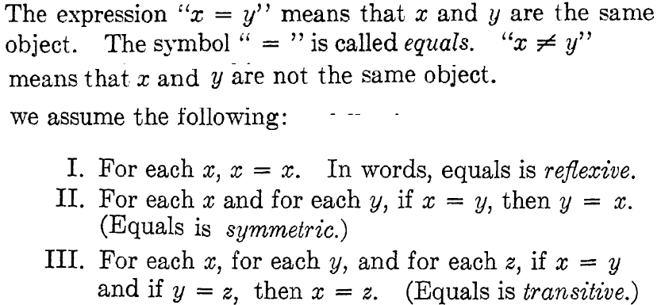
Some notions about Equality

Slide 7
Peano’s Arithmetic in Semi Formal Terms
0 is a natural number.
For every natural number x, x = x. That is, equality is reflexive.
For all natural numbers x and y, if x = y, then y = x. That is, equality is symmetric.
For all natural numbers x, y and z, if x = y and y = z, then x = z. That is, equality is transitive.
For all a and b, if b is a natural number and a = b, then a is also a natural number. That is, the natural numbers are closed under equality.
For every natural number n, S(n) is a natural number. That is, the natural numbers are closed under S.
For all natural numbers m and n, m = n if and only if S(m) = S(n). That is, S is an injection.
For every natural number n, S(n) = 0 is false. That is, there is no natural number whose successor is 0.

Slide 8
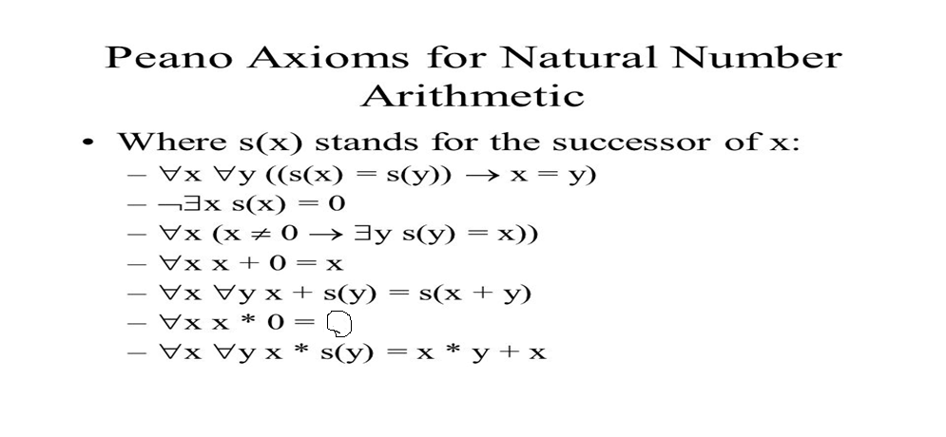
Peano’s Axiom for Natural Number in Formal Notation

Slide 9
A C# Program to Implement Addition and Multiplication using Peano Arithmetic
zero = Lf.Lx.x one = Lf.Lx.(f x) two = Lf.Lx.(f (f x)) three = Lf.Lx.(f (f (f x))) four = Lf.Lx.(F (f (f (f x))))
FP to the Rescue!

Slide 10
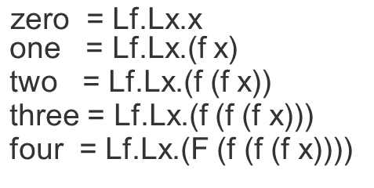
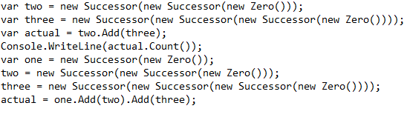
Church Numerals

Slide 11
Operands can be any of the below in Arithematic
Adding More Power to Arithematic
Natural Numbers (N)
Whole Numbers ( W )
Integers ( Z )
Rationals ( Q )
Reals ( R )
Complex Numbers (C)
Quaternions
Octonions

Slide 12
Arithematic Expressions
What is an Expression ?
Expression is a chain of operations which are glued together
An Expression consits of Terms , Factors and ( Sub ) Expressions!
Terms are what you add and Factor is what you multiply
Egs :- (2+3*4 ) = > 2 and 3*4 are terms
2 is a factor as it is 2*1
3 and 4 are factors as they are multiplied
The Following Backus Naur Form can express an Expression
<Expr> := <Term> ( + | * ) <Expr>
<Term> := <Factor> ( * | / ) <Term>
<Factor> := + <Factor> | ( <Expr> ) | <Number> | -<Factor>

Slide 13
Mixed Mode Expressions in Arithematic
We can mix number types in an expressions
The necessity of Casting ( Promotion or Coercion )
E:= C + R => C + (C)R ( 0i + R )
R + N => R + (R)N

Slide 14
Representing Expressions as Data (Abstract Syntax Trees )

Slide 15
Representing Numerical Value as AST

Slide 16
Representing Binary Expressions as AST

Slide 17
Representing Unary Expressions as AST

Slide 18
Representing Unary Expressions as AST

Slide 19
Mathematics has got Unary Operators and Binary Operators . How Operator Composition works?
+ N and – N are basically Binary Expressions
+N == o + N
-N == 0 - N
A op N and B op N are Binary Expressions
How do Ternary and Higher Order Expression Works ?
If an Operator has got Closure, Associativity and Identity Higher Order Expressions can work!
a + b + c + d is ( ( ( a + b ) + c ) + d )

Slide 20
Want to Learn Compiler Construction?
Check SlangForDotnet
https://github.com/praseedpai/SlangForDotNet
An Electronic Book titled , “The Art of Compiler Construction” included as part of the resource kit
A Seven Step Iterative Approach
A One Pass Compiler with Support for if/else,while,recursive functions
A Tree Walking Interpreter and IL Code Generator included
Has been ported to Java, Python, C++ and JavaScript

Slide 21
Properties of Arithematic Operators
A Good Operator(s) should have
Associativity
Commutativity
Closure (Type of Result does matter)
Distributivity (Two ops in an Expression)
Inverse Element (Additive/Multiplicative)
Identity Element ( 0 | 1 | “” )

Slide 22
Associative Property
( (A op B ) op C ) == (A op ( B op C ))
2 + 3 + 4 can be written as
( (2 + 3 ) + 4 ) or (2 + ( 3 + 4 ))
If a operator is associative, we can do parallel reduction ( a long sequence of numbers can be chunked into small sequence to be reduced by different people, processors or mechanical devices )

Slide 23
Commutative Property
(A op B ) == (B op A )
2 * 3 can be written as 3 * 2
If a operator is commutative, order in which one performs operation does not matter
We can do Out of Order Execution ( Relational DB Engine exploits this property to evaluate relational cross products )
On top of Parallel reduction, we can perform Parallel shuffle as well

Slide 24
Closure
When two Homogeneous Types of numbers are Operated Upon, if we get the same Type as result, it is called “Closure”
Addition of Two natural numbers are closed
So do Multiplication of Two Natural Numbers
Closure helps us to Chain Operations without much “trouble”

Slide 25
Closure in Regular Expressions
Re( NULL) => NULL
Re(“”) => “”
Re([a-z]) => [a-z]
Re.Re => Re
(Re | Re ) => Re
Re* => Re
The above stuff defines Re ( Recursive definition)
What about R+?
Re+ = Re.Re*

Slide 26
Closure in SQL
Data is stored in a data structure called Relation
Relations can be combined using Rel Ops
CartesianProduct(Rel1,Rel2..Reln) => Rel
Restrict(Rel,Predicate) => Rel
Project(Rel,fieldlist) => Rel
Rename(Rel)=> Rel
SetOperators(Rel1..Reln) => Rel
Group(Rel,Pred) => Rel
And so on…

Slide 27
Infix/Prefix and Postfix notation
Different Notations for Expressions
Infix Notation ( Mathematics and most Programming languages )
Prefix Notation ( LISP/Scheme uses it )
PostFix Function ( Stack based Evaluation , FORTH and Display PostScript )

Slide 28
How Lisp/Scheme Works ?
The Code is stored as a List
The First Element of List is denoted by Car(Lst)
The Rest of the List is denoted by Cdr(Lst)
Eval(Lst) is the Evaluation Function
Apply(fn)
Eval(Lst) :=> if (C := Car(Lst)) { return Value(C) }
else if (V := Car(Lst)) { return Env.Lookup(V) }
else { return Apply(Car(Lst),Eval(Cdr(Lst)))|
Apply(fn,Lst) :=> { return fn(Lst) }

Slide 29
How do I aggregate numbers from 1 to N ?
A For Loop and an accumulator is the obvious solutions. It is a Linear Solution ( O(N)
Can we have a O(1) Solution for this problem ? ((n*(n+1))/2)
What about sum from K to N ?

Slide 30
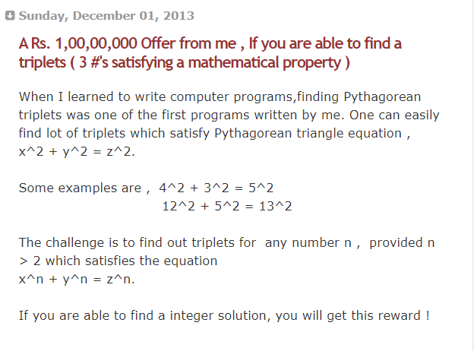
A Challenge – What is the basis for this “cocksureness” ?

Slide 31
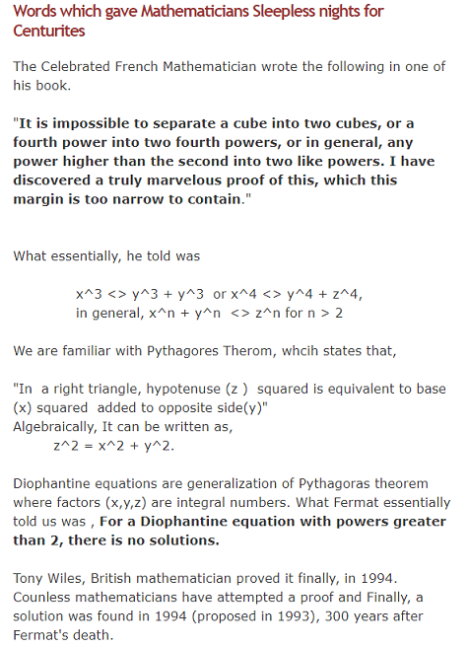
Fermat’s Last Theorom

Slide 32
Pythagorean Triplets ( Square exists, Cube does not!)

Slide 33
Two case Studies of Formal Verification
The Verification of “COM Component”
The Verification of a Custom Type which mimics the semantics of int, double , float

Slide 34
Java/C# has builtin Interface Verification

Slide 35
Calendar Calculation
Compute Leap Year
Gregorian Calendar
Modulo 7 Arithmetic
0 – 6 ( Sunday To Saturday )

Slide 36
How to Compute CDOW ?

Slide 37
MRF SpeedCheck @ Sharjah and It’s Math

Slide 38
Russian Multiplication

Slide 39
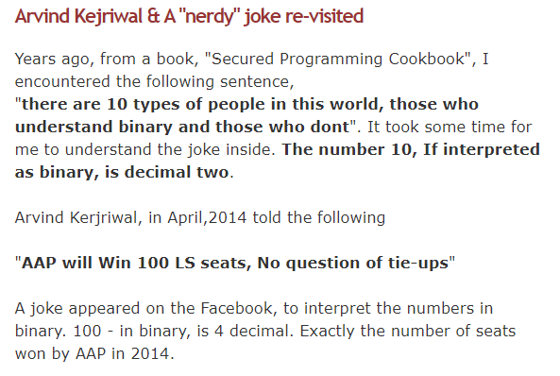
A Mathematical Trivia

Slide 40
How To Permute a Sequence ?

Slide 41
How To generate a Subset?

Slide 42
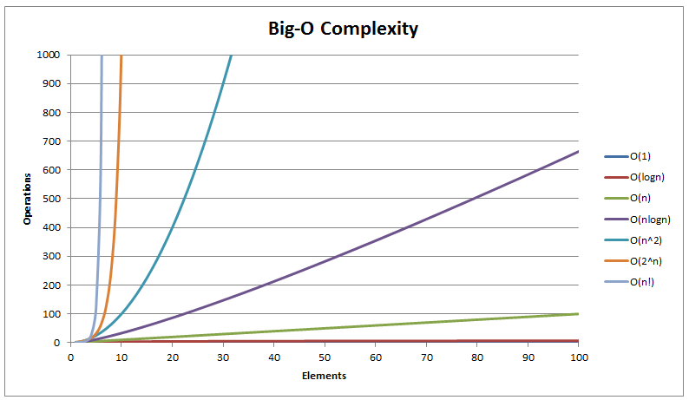
Algorithmic Complexity

Slide 43
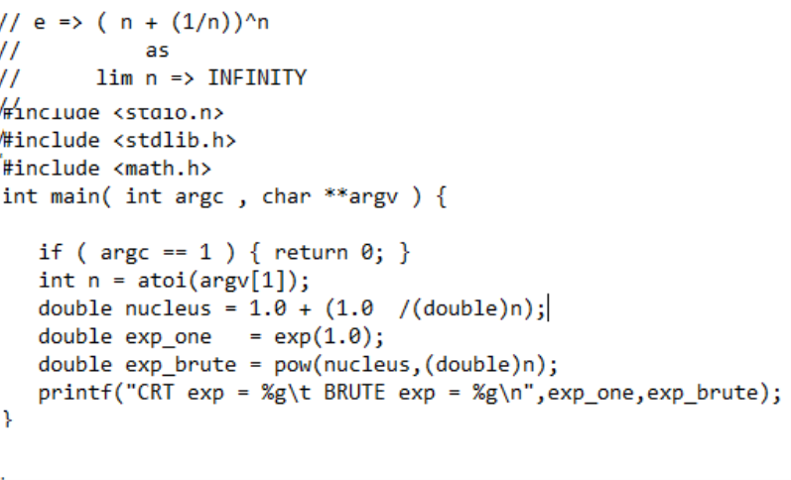
What is “e” ?

Slide 44
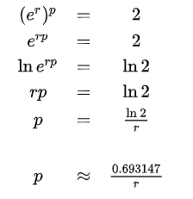
Rule of 70

Slide 45

Logarithm Soup

Slide 46
Nth Root

Slide 47
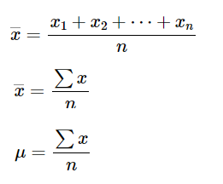



Arithmetic Mean

Slide 48

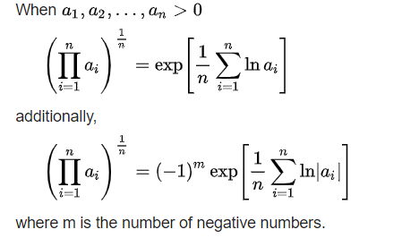
Geometric Mean

Slide 49
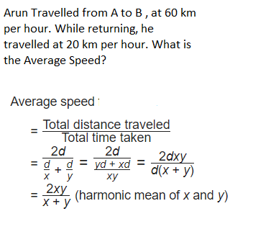
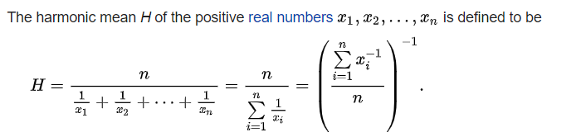

Harmonic Mean

Slide 50
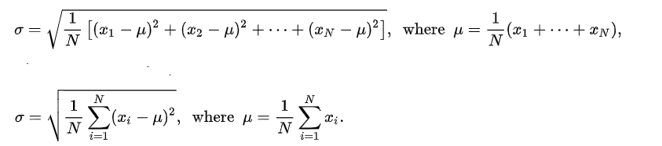
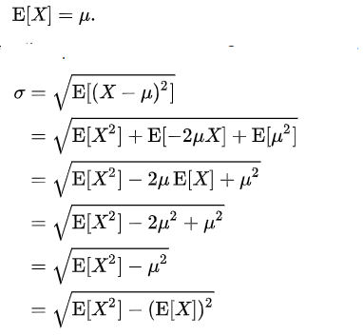
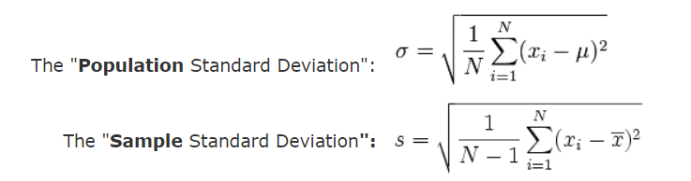
Standard Deviation

Slide 51
Standard Deviation (STD )

Slide 52
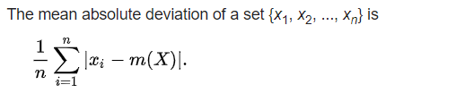
Mean Absolute Deviation

Slide 53

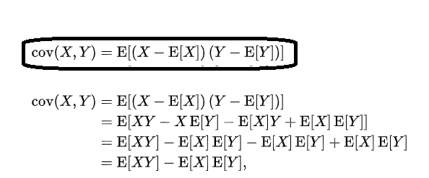
Covariance

Slide 54
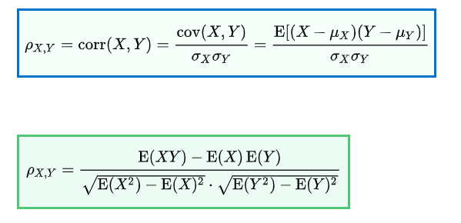
Correlation

Slide 55
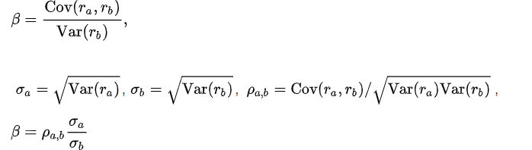
BETA (Finance)

Slide 56
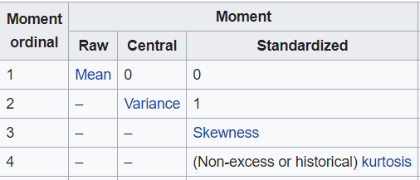
Moment

Slide 57
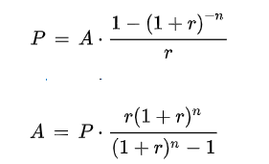
EMI

Slide 58
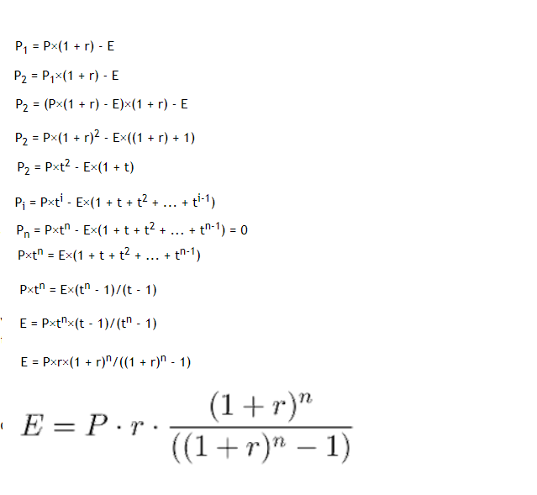
Derivation of EMI

Slide 59
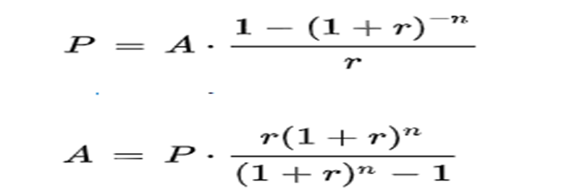
EMI Computation

Slide 60
IRR – Internal Rate of Return

Slide 61

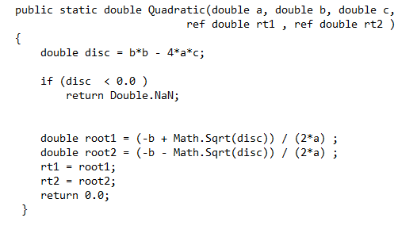

Quadratic Equation

Slide 62
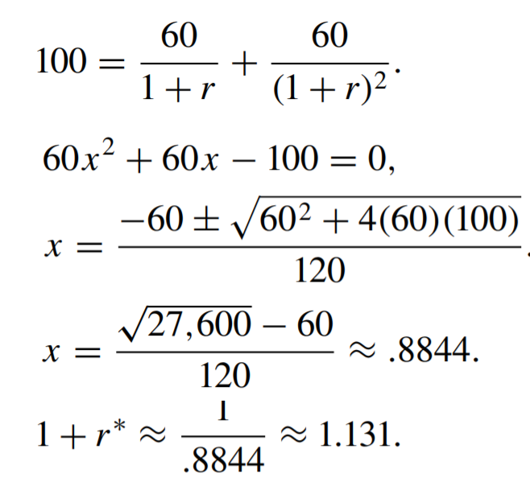
For investing 100, if u get 60 rs each for two years, what is IRR

Slide 63

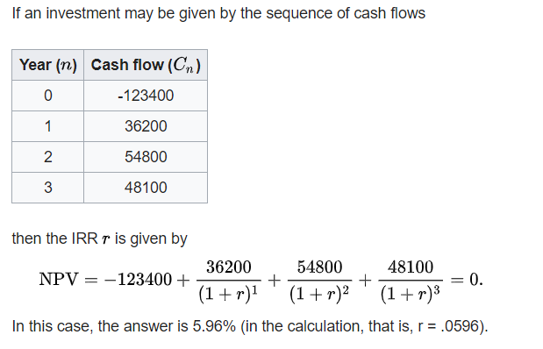
IRR

Slide 64
Algebra To Modern Algebra
Why Limit Algebra to Number Types?
Algebra of Sets ( Operations on Sets )
Algebra of Relations
Algebra of Matrices
Algebra of Vectors
Algebra on Groups, Rings, Fields, Lattices
We Create Hierarchy of Mathematical Structures with Varying Property
Mathematical Properties like Associativity,Commutativity, Closure nicely extrapolates to Modern Algebra

Slide 65
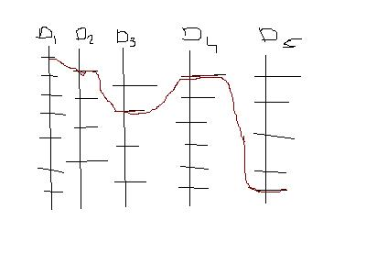
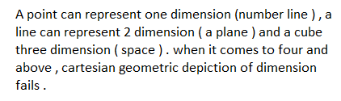

How to Visualize more than three dimensions

Slide 66
Any Questions?!

