Slide 1
GraphQL
Banuprakash
banuprakashc@yahoo.co.in

Slide 2
What is GraphQL
Created by Facebook in 2012
GraphQL is a replacement for REST
GraphQL uses a QUERY LANGUAGE
GraphQL is a PATTERN not a technology

Slide 3
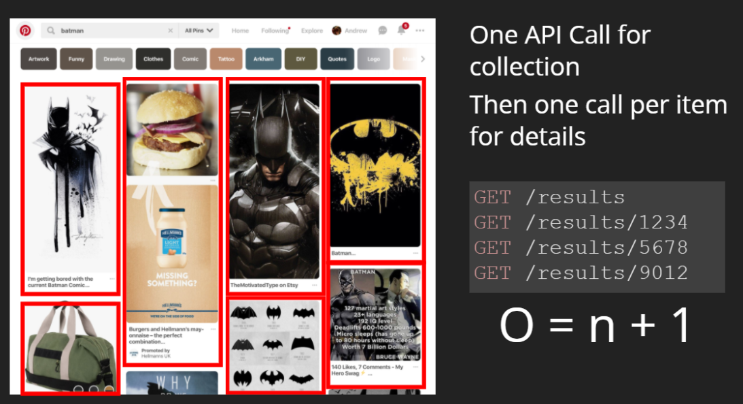
Using REST in applications

Slide 4
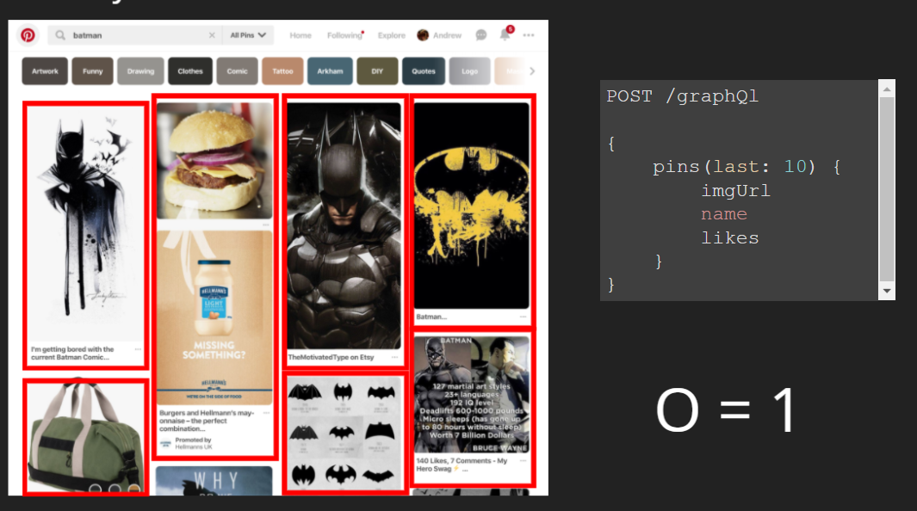
GraphQL vs REST
GraphQL can bundle lots of data into one query instead of many

Slide 5
Other benefits
Strongly typed schema
Can be shared with client & server
Can validate requests at build time
Auto complete queries and mutations
Can be mocked easily
No under-fetching and over-fetching
Reduce those spinner times!

Slide 6
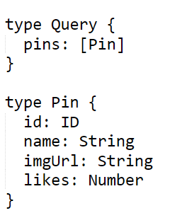
Schema definition
First, you describe your data with a schema
Strongly Typed
Types can be a Scalar (boolean, string, ID)
Or Object

Slide 7
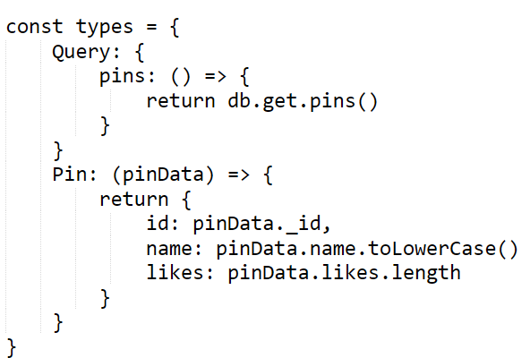
Resolvers
A resolver is a function that's responsible for populating the data.
It can populate that data in any way you define, such as by fetching data from a back-end database or a third-party API.

Slide 8
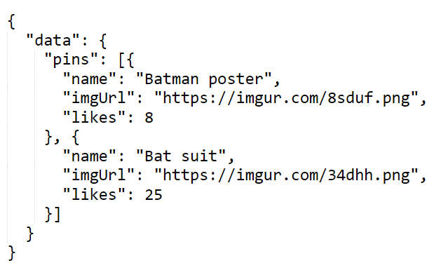
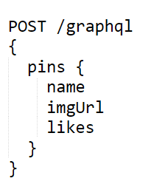
Query the data
Client can request the data, and query which data it likes

Slide 9
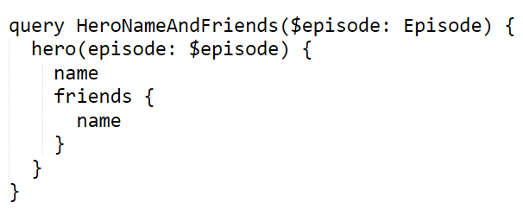
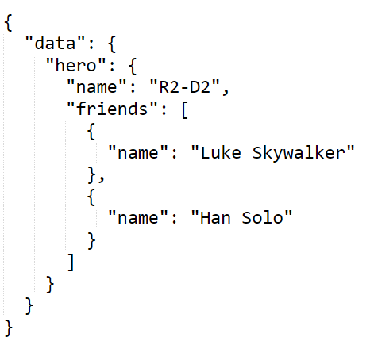

Query the data
Query
Response
variables

Slide 10
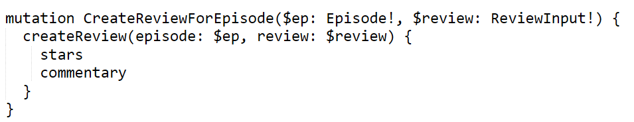
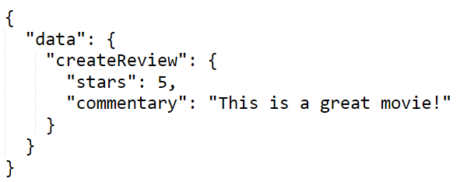
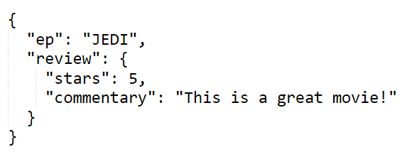
Mutations
Response
variables

