Slide 1
Passport: Releasing Bit By bit
Cape Town
Barend Erasmus & Noora AKhtar
June 2017

Slide 2
Passport: Releasing Bit By bit
How are we going to release Passport Reload?
Big Bang?
Feature Toggle?
Other?

Slide 3
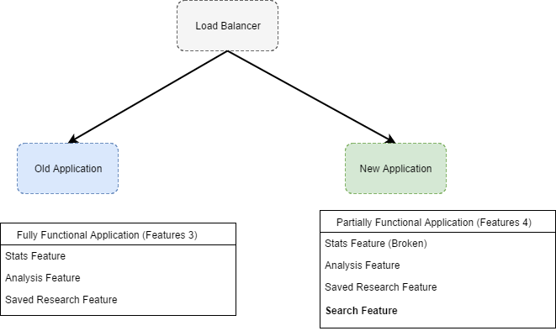
Passport: Releasing Bit By bit
Canary Release
Canary release is a technique that helps reduce the impact of negative changes by gradually rolling out the changes. If a problem with the new release is detected during the rollout then it can be rolled back, and only a subset of the traffic will have been impacted.

Slide 4
Passport: Releasing Bit By bit
Advantages
Both, Old and New, can run in parallel without affecting each other.
Rollbacks are simple.
New releases can be deployed with low risk.

Slide 5
Passport: Releasing Bit By bit
Before we can implement…
Services / API's need to be versioned.
Database Stored Procedures needs to be versioned.
Phoenix Server Strategy need to be in place.

Slide 6
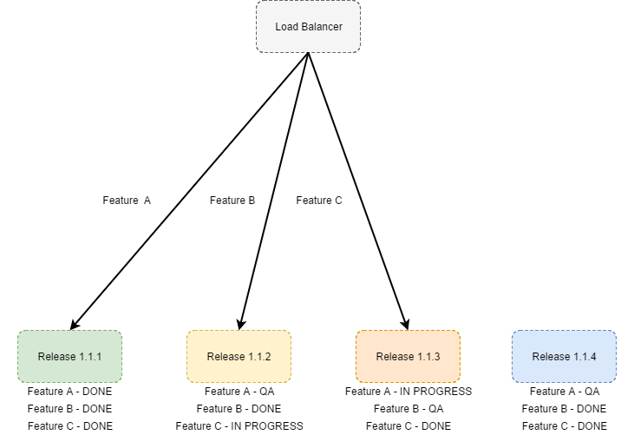
Passport: Releasing Bit By bit
Release Pipelines

Slide 7
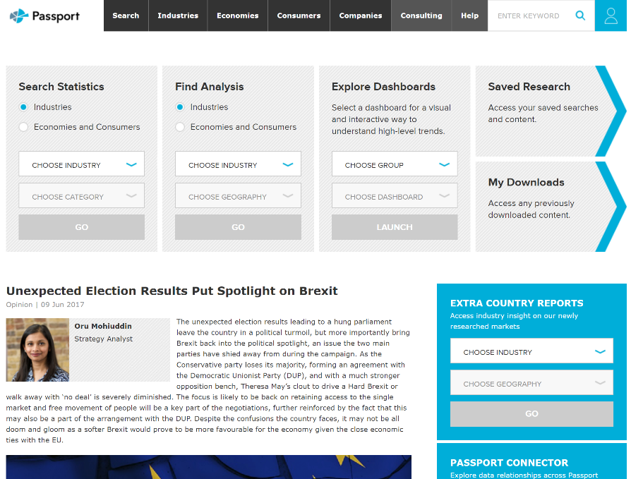
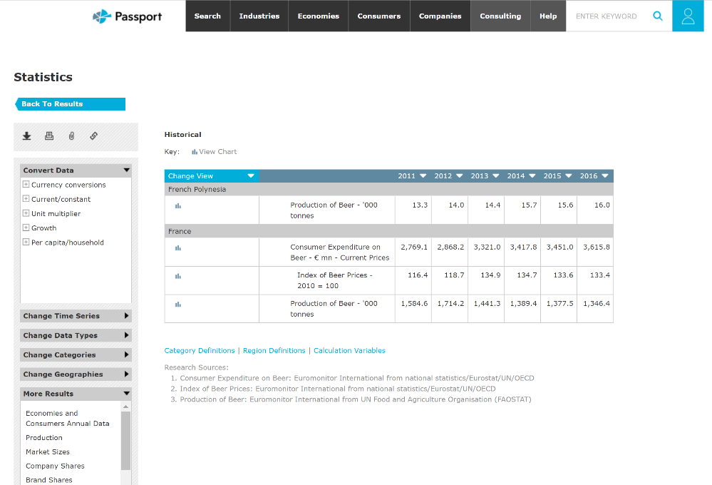
Passport: Releasing Bit By bit
Old Application

Slide 8
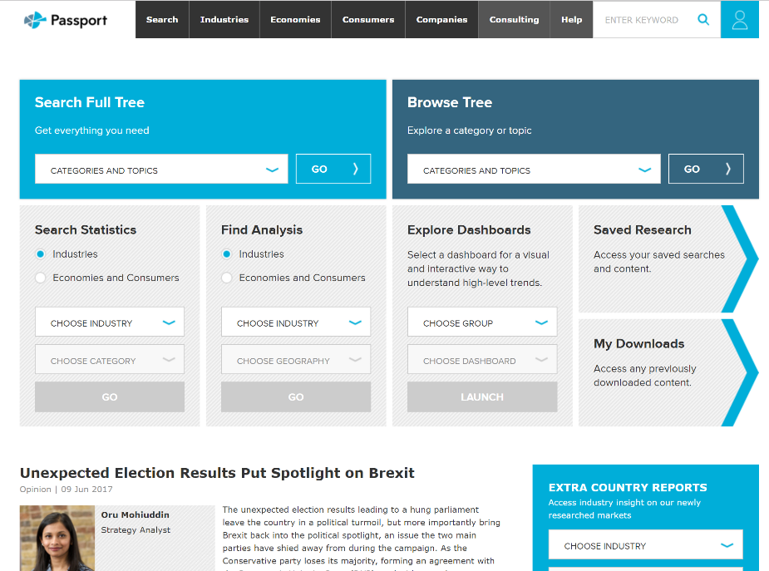
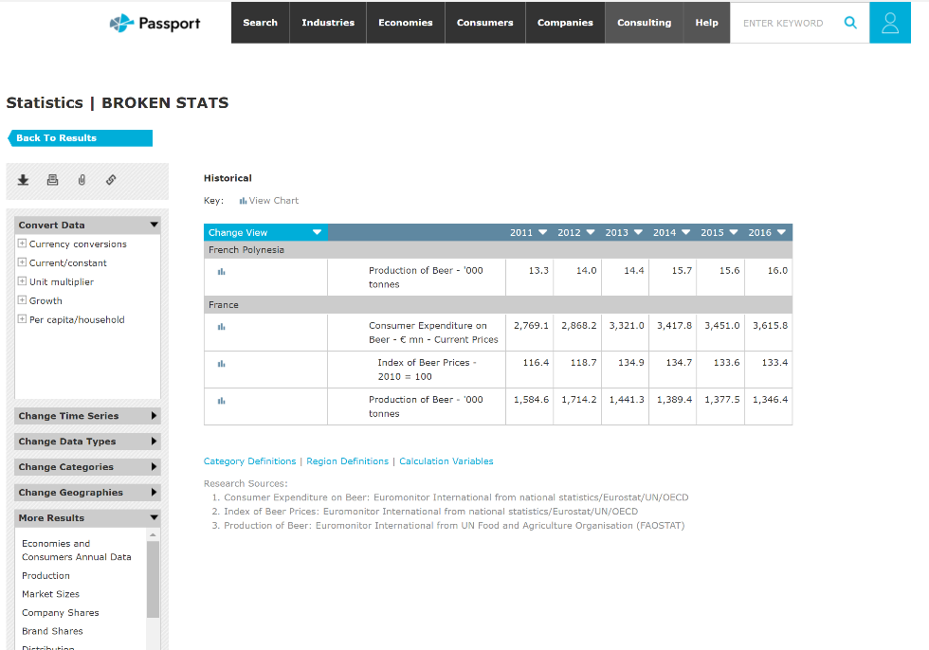
Passport: Releasing Bit By bit
New Application

Slide 9
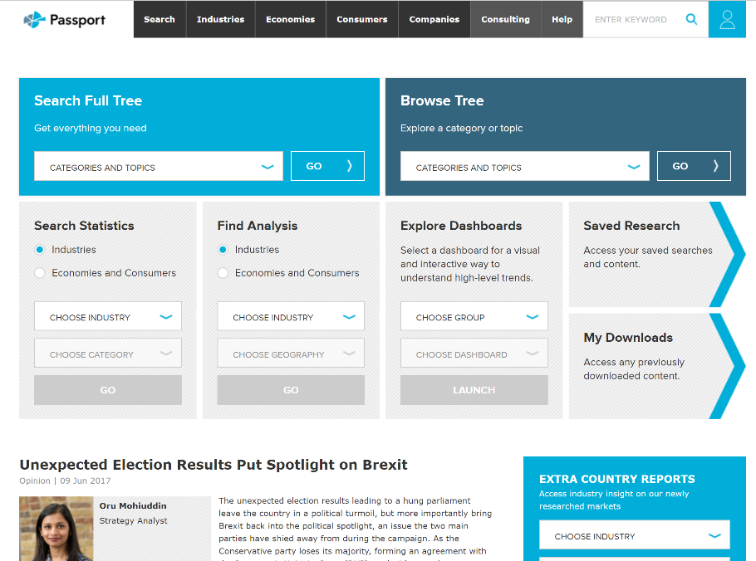

Passport: Releasing Bit By bit
Solution

