Slide 1
DAN602 Module 1: An Abridged Introduction to Probability and Distributions
Rob Harbert

Slide 2
Schedule
9:00 – 10:00 Refocus & Probability Lecture
10:00 – 10:30 Break
10:30 – 11:30 SAS Studio Distribution Analysis Demo
11:30-12:00 Break 2
12:00-12:30 Work on SAS lab prompts
12:30 → Lunch

Slide 3
Objectives
Discuss probability
Get comfortable with terminology
Introduce common probability functions
Discuss the Normal Distribution and its role in inferential statistics

Slide 4

Probability

Slide 5
Why?
Why do we study probability?
Really important for hypothesis testing
We’ll use it to ask:
What’s the chance that my hypothesis is true (population) given my measurements (sample)?

Slide 6
Random Events (variables)
A random variable x takes on a defined set of values with different probabilities.
For example, if you roll a die, the outcome is random (not fixed) and there are 6 possible outcomes, each of which occur with probability one-sixth.
For example, if you poll people about their voting preferences, the percentage of the sample that responds “Yes on Proposition 100” is a also a random variable (the percentage will be slightly differently every time you poll).
Roughly, probability is how frequently we expect different outcomes to occur if we repeat the experiment over and over (“frequentist” view)

Slide 7
Random Variables
Discrete random variables have a countable number of outcomes
Examples: Heads/Tails, treatment/placebo, dice, counts, etc.
Continuous random variables have an infinite continuum of possible values.
Examples: blood pressure, weight, the speed of a car, the real numbers from 1 to 6.

Slide 8
Probability Functions
A probability function maps the possible values of x against their respective probabilities of occurrence, p(x)
p(x) is a number from 0 to 1.0.
The area under a probability function is always 1.

Slide 9
Example: A fair die
Roll
P(x=A)
What is the probability of:
Rolling a 1?
Rolling a 4 or higher?
An odd number?
A 6 of lower?
1
P(x=1)=1/6
2
P(x=2)=2/6
3
P(x=3)=3/6
4
P(x=4)=4/6
5
P(x=5)=5/6
6
P(x=6)=6/6

Slide 10
Important distributions for discrete data
Bernoulli/Binomial
Yes/no outcomes (dead/alive, treated/untreated, smoker/non-smoker, sick/well, etc.)
Ordinal categories (survey rating scales,
Poisson
Counts (e.g., how many cases of disease in a given area)
https://seeing-theory.brown.edu/probability-distributions/index.html
Relatively rare to use directly in hypothesis testing

Slide 11
Probability functions for continuous data
The probability function that accompanies a continuous random variable is a continuous mathematical function that integrates to 1.
The probabilities associated with continuous functions are just areas under the curve for a finite range.
Probabilities are given for a range of values, rather than a particular value (e.g., the probability of getting a math SAT score between 700 and 800 is 2%).

Slide 12
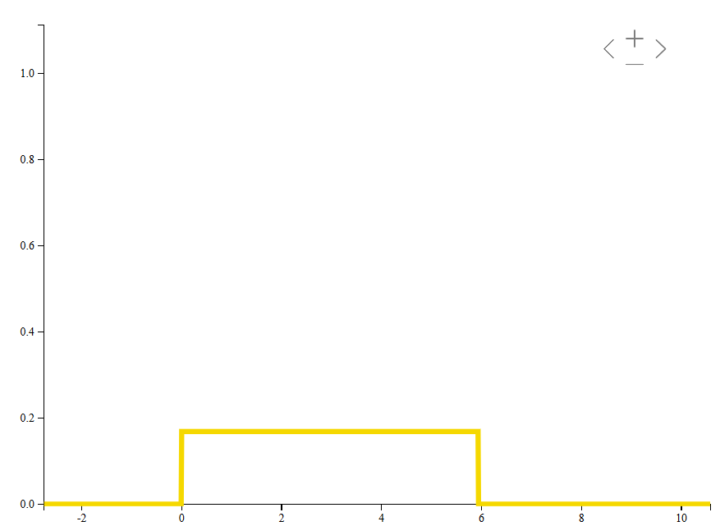
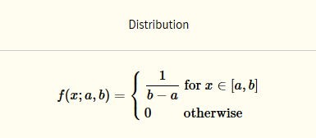
Example: The Uniform Distribution
All possible values of X are equally likely.
“Random”

Slide 13
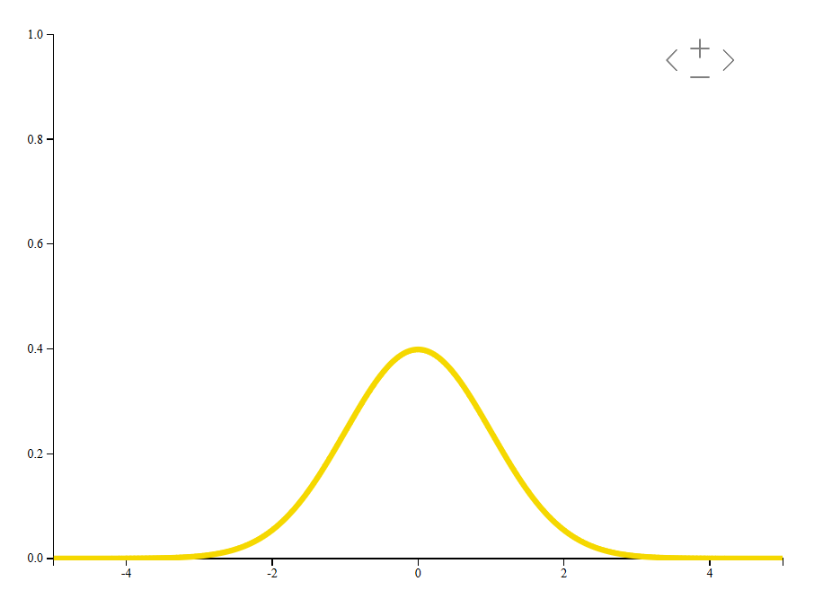
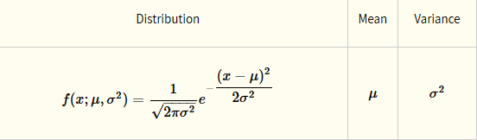
Example: The Normal Distribution
Describes a scenario with random variation around a real optimum.
Many measured and observed variables behave this way.
e.g., political polling, income, sampling of traffic data, daily monitoring of COVID

Slide 14
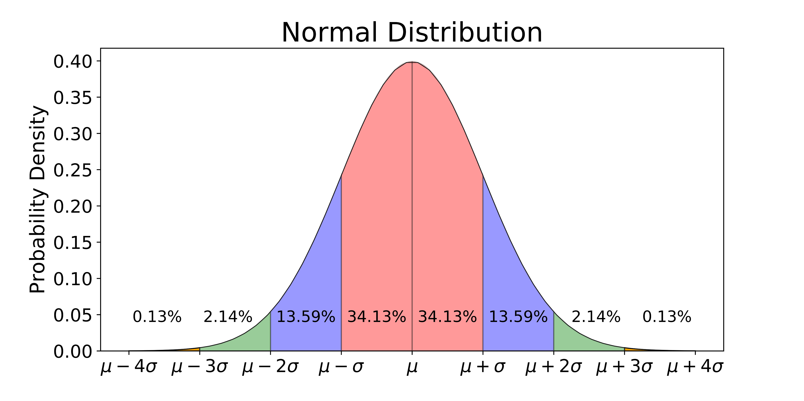

Slide 15
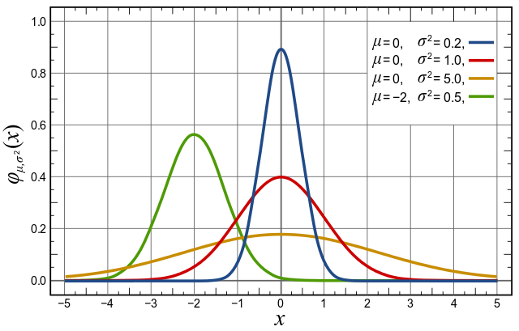

Slide 16
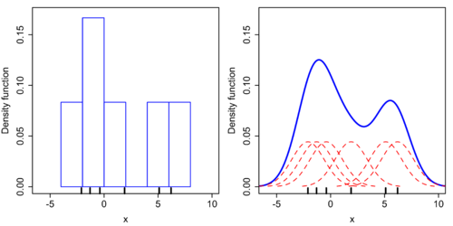
Probability Density Estimation
For non-normally distributed data
Useful for visualization (density plots) and informal inference
Kernel Density Estimation – Continuous probability inference using local probability functions of known structure (e.g., normal prob)

Slide 17
The basis for inferential statistics
If we understand the underlying probability function of a certain phenomenon, then we can make informed decisions based on how we expect x to behave on-average over the long-run…(so called “frequentist” theory of probability).
The “Expected Value” is (in various forms) the mean.
Population mean
Compare to: Sample mean, median, mode
Variation also matters
Standard deviation, variance, standard error
These are the kinds of assessments we intuit from histograms, scatterplots, etc.

Slide 18
Short break

Slide 19
Central Limit Theorem and Sampling

Slide 20
Central Limit Theorem
The central limit theorem states that if you have a population with mean μ and standard deviation σ and take sufficiently large random samples from the population with replacement , then the distribution of the sample means will be approximately normally distributed.
How large is “sufficiently large”? (TBD)
https://seeing-theory.brown.edu/probability-distributions/index.html

Slide 21
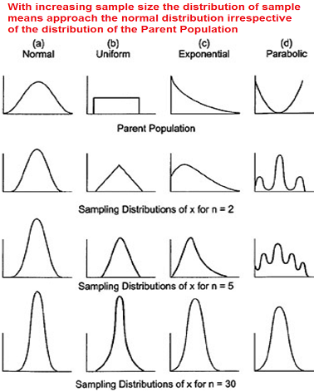

Slide 22
Samples
Data is never a complete sampling of the entire population of outcomes
Well sampled events can tell us about the population
That’s why we need statistics!

Slide 23
Descriptive Stats: For samples
We can derive meaning from a sample relative to a hypothetical normally distributed population with:
Central Tendency:
Mean (average)
Median (middle value)
Mode (most common value)
Variation around the mean:
Variance (avg. squared deviation from the mean)
Standard Deviation (standardize: square root of the variance)
Standard Error (normalized: SD / square root N)

Slide 24
Important Consideration
Often both descriptive and inferential statistics are assuming normality
When normality is violated, things fall apart
What can you do?

Slide 25
PLOT YOUR DATA!

Slide 26
Testing Normality
Plot your data (histogram)
Quantile-Quantile plots (look for patterns of skewness)
Measures of distribution shape:
Skewness
Kurtosis (sampling of the normal curve)

Slide 27
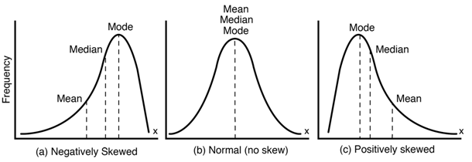
Skewness

Slide 28
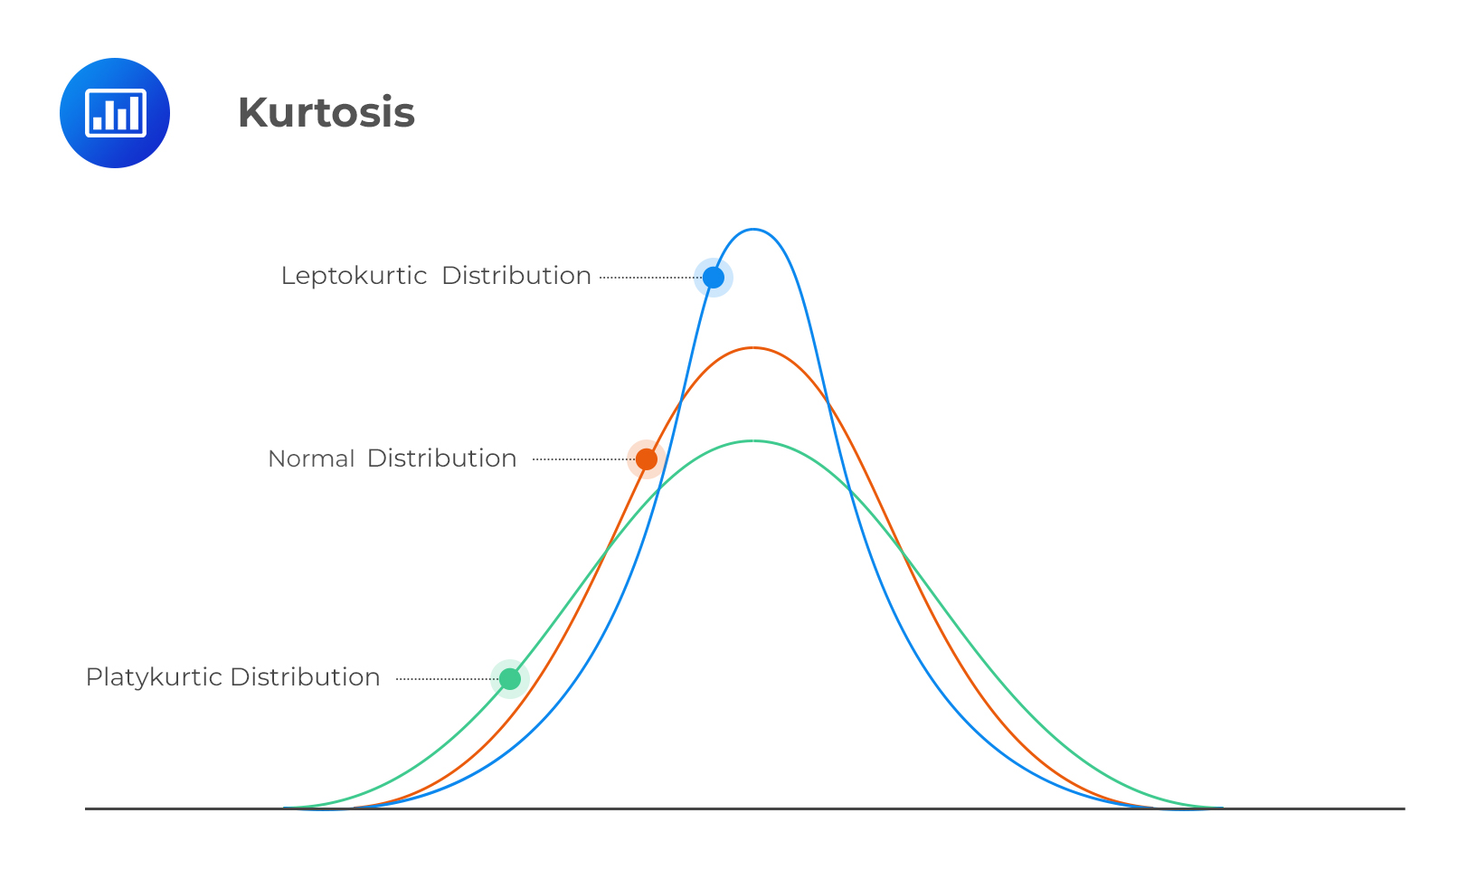

Slide 29
So what’s your probability of getting COVID?
(not really, but let’s think about sampling)

Slide 30
But we can play with some data
Recently there have been ~ 400 new positive cases each day in MA
https://www.nytimes.com/interactive/2020/us/massachusetts-coronavirus-cases.html
The population of MA is ~6.7 million

Slide 31
P(COVID) = 400/6,700,000 = 0.00005970149
Not bad!

Slide 32
What about testing rate?
Not everyone in the state is tested each day
What is the probability of *testing* positive (pos. tests / total tests)

Slide 33
What about testing rate?
On September 18, 2020 Massachusetts had:
421 positive tests
22,217 total tests
https://www.mass.gov/doc/covid-19-dashboard-september-18-2020/download

Slide 34
P(Positive Test) = 421 / 22217 = 0.01894945312 = ~1.9%

Slide 35
But who is getting tested?
In the general population (all of MA), still mostly those with symptoms.
What happens if we have full population surveillance testing?
The story changes and we have a full(er) picture of risk:
Stonehill has ~3,000 tests per week, so how many positive tests should we expect?
https://www.stonehill.edu/news/emergencies/updates/coronavirus/coronavirus-faqs/dashboard/
In contrast:
https://www.providence.edu/coronavirus/

Slide 36
In summary

Slide 37
Distributions
All variable events have some inherent distribution (e.g., flipping a coin, election polling, etc.)
Mathematical descriptions of probability distributions aid us in inference
Most inferential statistics for continuous data (that we will be dealing with) rely on reference to the Normal Distribution

Slide 38
Lab
Practice distribution analysis with SAS Studio
Work with COVID data to examine distribution and normality
Practice filtering and transforming data
Will use COVID tracking data from Our World In Data:
https://covidtracking.com/data/download

Slide 39
Break

