Slide 1
Big Data

Slide 2
Schedule
Syllabus + Course Overview
Introduction to the BU cluster
Unix Shell workshop
Big Data workshop (for online discussion)

Slide 3
Course Overview
Syllabus
Assignments and homework (30%)
In-class/homework problems assigned with each module.
Online Discussion (15%)
Semi-weekly class discussion on #dan606 slack channel.
Exams (15%)
Two practical exams given online at the midpoint (after residency XX) and at the end of the course. The second exam will not be cumulative.
Code Portfolio (30%)
You will keep and document a portfolio of all of your code files for in-class and homework assignments in a repository on https://github.com.
Community Contribution (10%)
Participation during residencies as well as online forums in constructive and professional ways counts towards successful completion of this course.

Slide 4
What is Big Data?

Slide 5
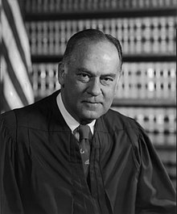

Justice Stewart Potter on Pornography
“I shall not today attempt further to define the kinds of material I understand to be embraced within that shorthand description; and perhaps I could never succeed in intelligibly doing so. But I know it when I see it, and the motion picture involved in this case is not that.”
Opinion on Jacobellis v Ohio, 1964
More

Slide 6
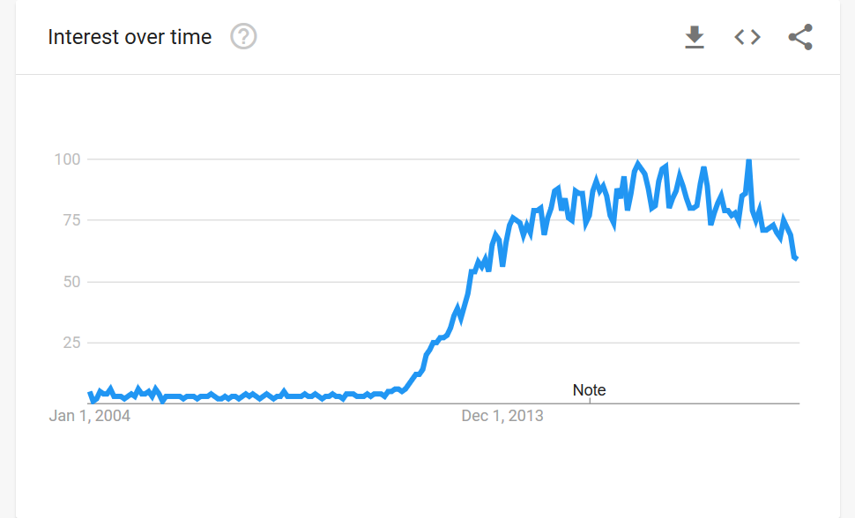
But we CAN define (describe?) big data
Big data Google search trends

Slide 7
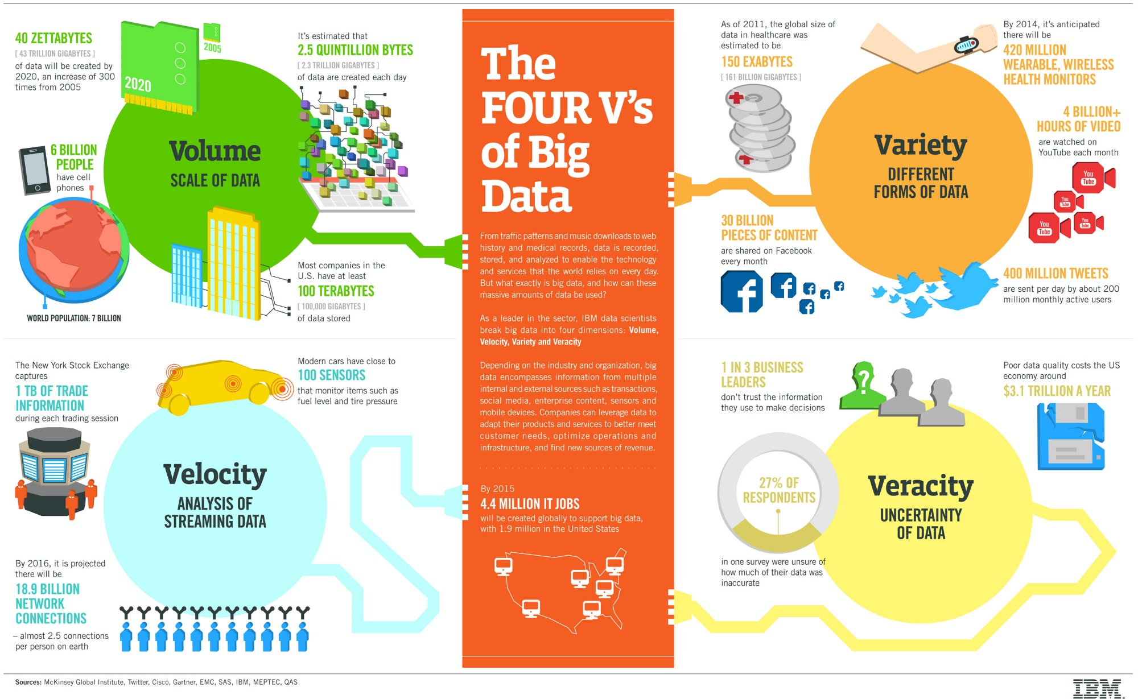
The 4 ‘V’s of Big-Data

Slide 8
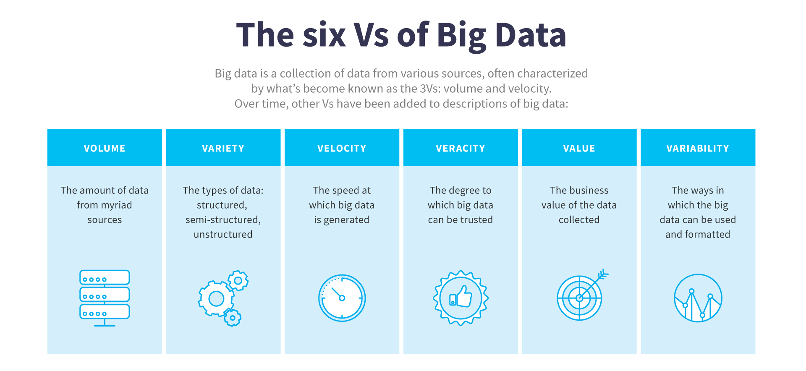
More ‘V’s

Slide 9
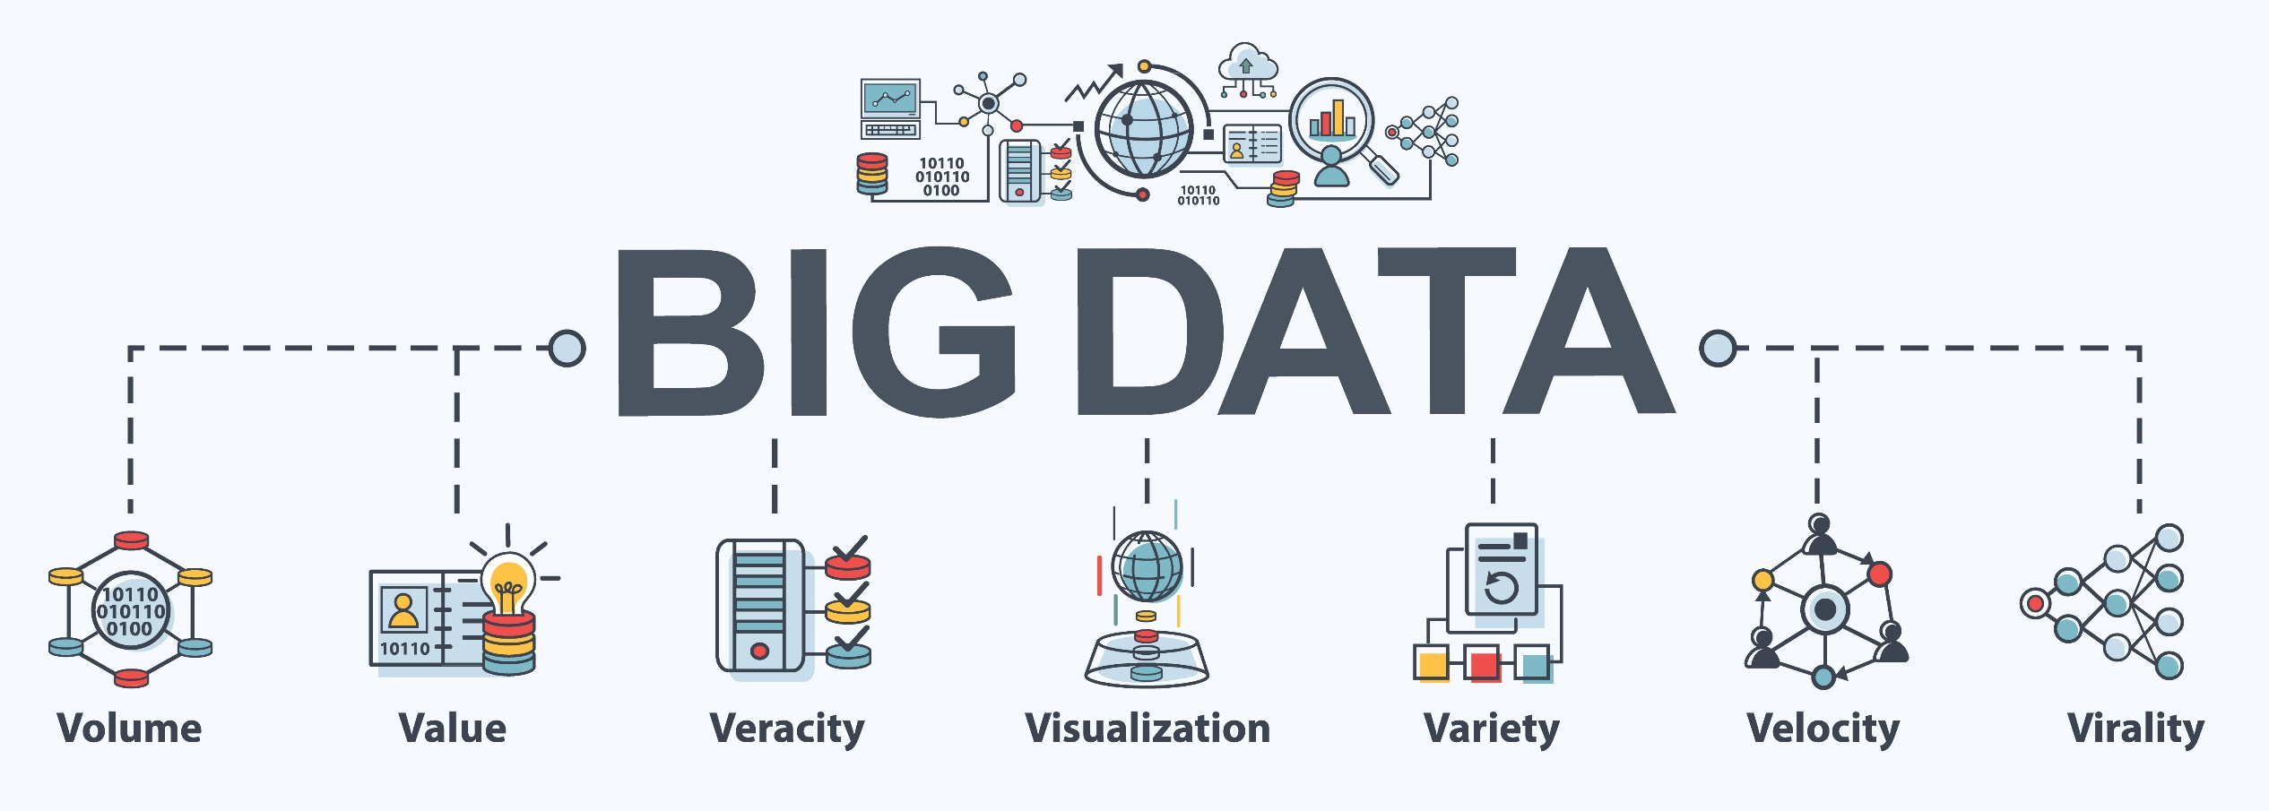
Even more ‘V’s….

Slide 10
A better question: What do we need to know about solving big data problems?
Big “data problems” or “Big data” problems

Slide 11
Asking the right questions
If you have data that becomes difficult for normal workflows you have big data problems.
What can we do? Solutions:
Hardware
More powerful processors
Faster storage
Software
Distributed computing

Slide 12
Hardware Solutions

Slide 13
First, what’s in your box?
In groups of 3 draw a diagram of how your computer works.
Consider the physical spaces for:
Where does your computer keep files?
How does your computer do things? (count, math, search,…)
What happens when you open a file or program? (data moves)
How does it communicate with the outside world?
What organizes and connects all of this?
Take ~10 minutes

Slide 14
A few hardware solutions
Increased computing capacity with more powerful processors
Multicore processors (8, 16, 32, 64)
High speed processors (higher clock speeds)

Slide 15
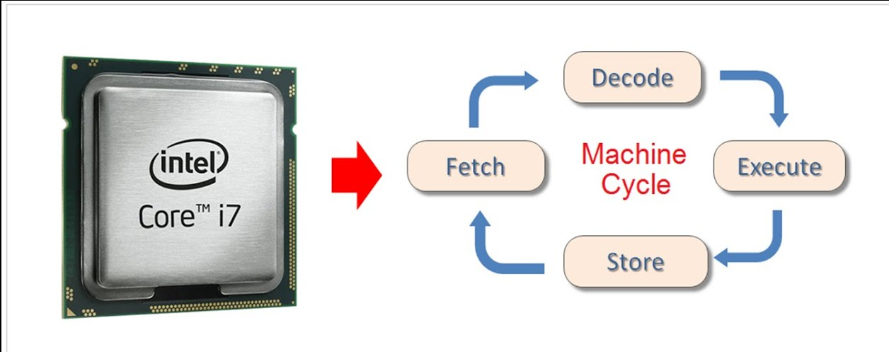
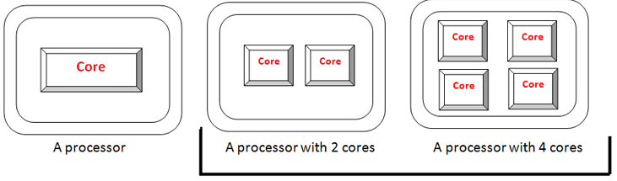
Processors
Speed this up
Or make more cores

Slide 16
A few hardware solutions
Increased computing capacity with more powerful processors
Multicore processors (8, 16, 32, 64)
High speed processors (higher clock speeds)
Increase data access speeds:
Solid State Drives (SSDs)
increase speed ~5-10x
RAID (Redundant Array of Independent Disks)
Split data across several disks so lookup can happen faster

Slide 17
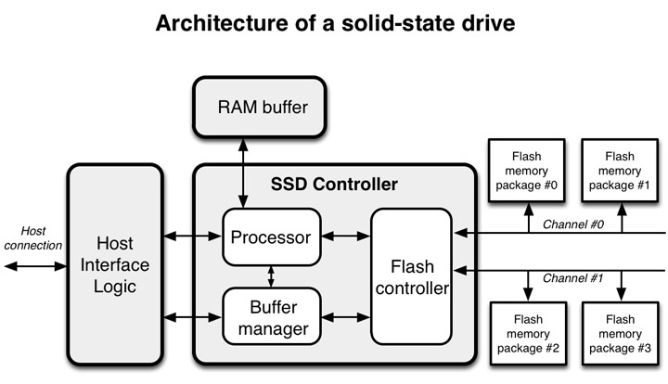
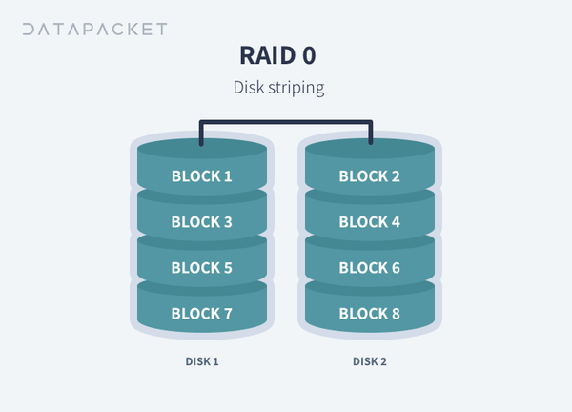
Disks

Slide 18
A few hardware solutions
Increased computing capacity with more powerful processors
Multicore processors (8, 16, 32, 64)
High speed processors (higher clock speeds)
Increase data access speeds:
Solid State Drives (SSDs)
increase speed ~5-10x
RAID (Redundant Array of Independent Disks)
Split data across several disks so lookup can happen faster
Problems persist: SCALABILITY!
Often not cost effective to maintain big systems to deal with changing needs

Slide 19
Software Solutions

Slide 20
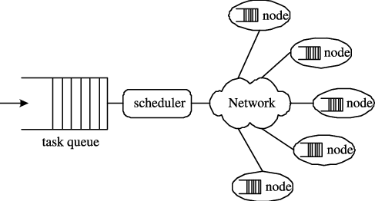
Distributed Computing
The Cloud

Slide 21
Asking the right questions
This class is going to walk through *some* of the tools available for building scalable analysis pipelines for “big-data” problems.
The Hadoop ecosystem for distributed data management
Hadoop -> Distr file system
Pig -> Execute queries and analyses
Hive -> Data warehousing
Spark -> Analytics engine
…?
High performance computing
SAS PROC HADOOP

