Slide 1

HazKit
Alex Farries
Alex Palma
Clayton Wong
Notes:
Introduction of team

Slide 2
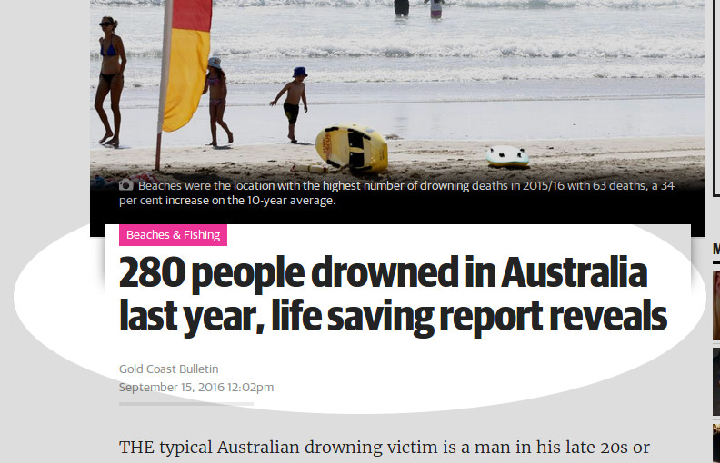
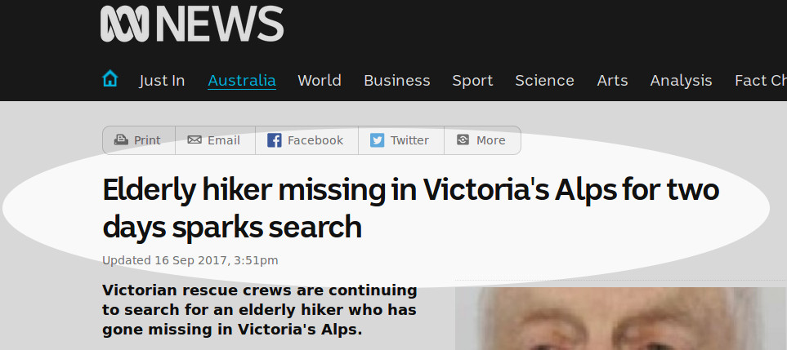
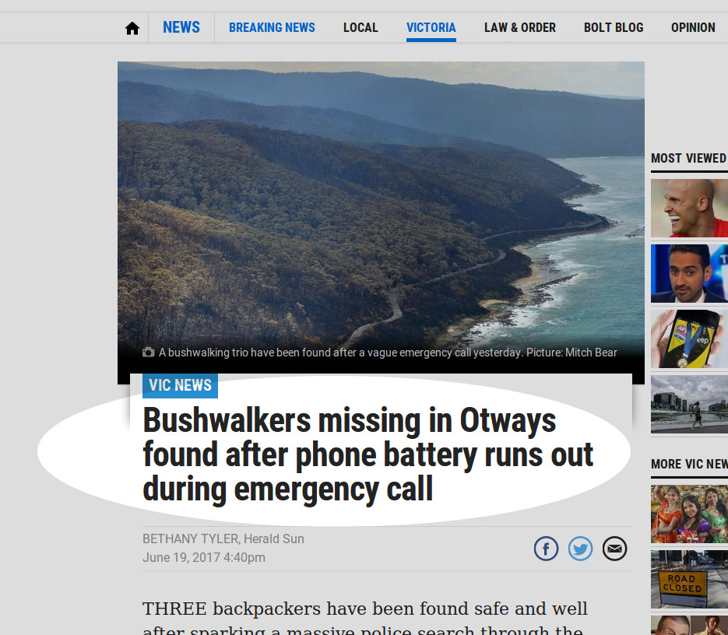
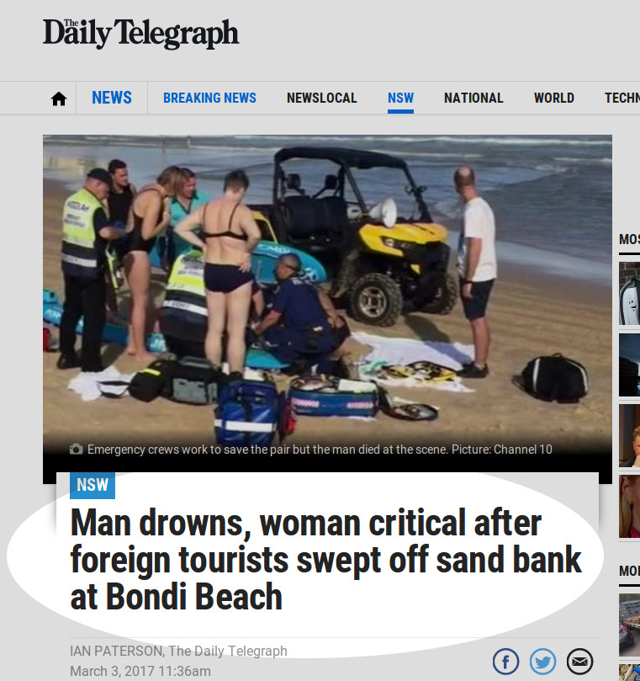
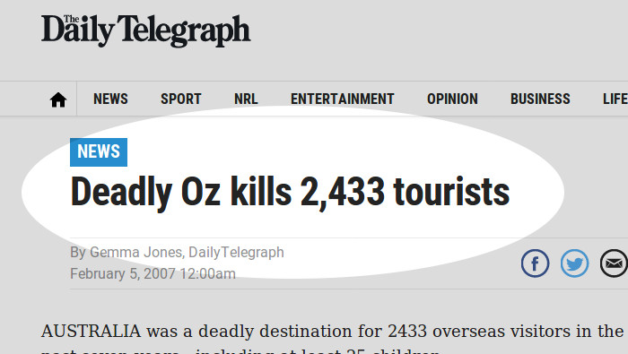
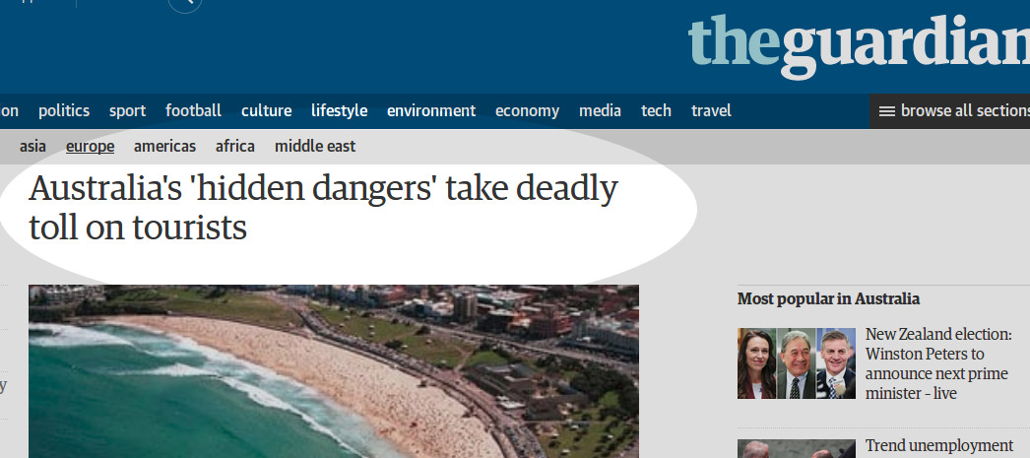
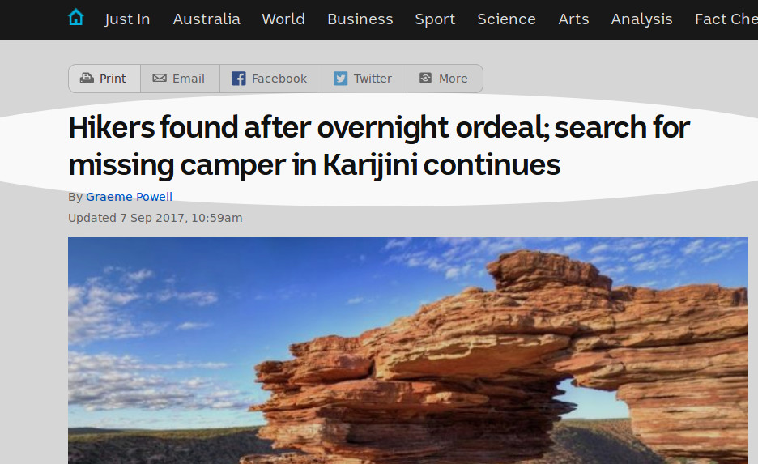
Notes:
Emphasise the very real dangers of not understanding the area you’re travelling in

Slide 3

Notes:
Everyone loves to travel! Travelling to new places is exciting, but some of those places can have inherent dangers

Slide 4

Notes:
Being a foreigner in a new land without the locals knowledge is like walking blind and not being able to see the hazard you’re walking into!

Slide 5
“ Knowledge is power ”
Local
Notes:
But knowledge is power! The locals know what the hazards are of their area because they have local knowledge of the area. TAP INTO THAT !

Slide 6

Notes:
Our site helps facilitate the knowledge transfer from local to tourist to help prepare tourists with the knowledge they need to avoid serious hazards.

Slide 7

Notes:
So how does it work? Community powered!

Slide 8
Incentive?
Notes:
Incentive?

Slide 9


Slide 10


Slide 11



Prestige!
It’s even part of the fundamental human needs...

Slide 12
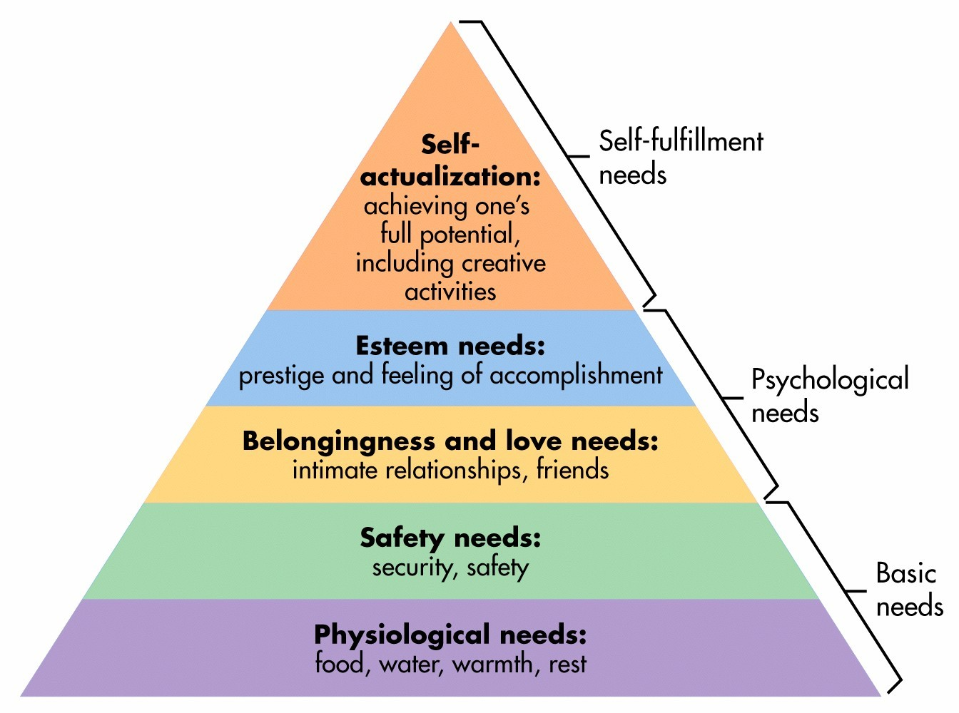

Slide 14
Demonstration time!

Slide 15
Questions?

