Slide 1
Build project from scratch and fix common bugs
Net Core 5.0 via Test Server + XUnit via ClassFixture

Slide 2
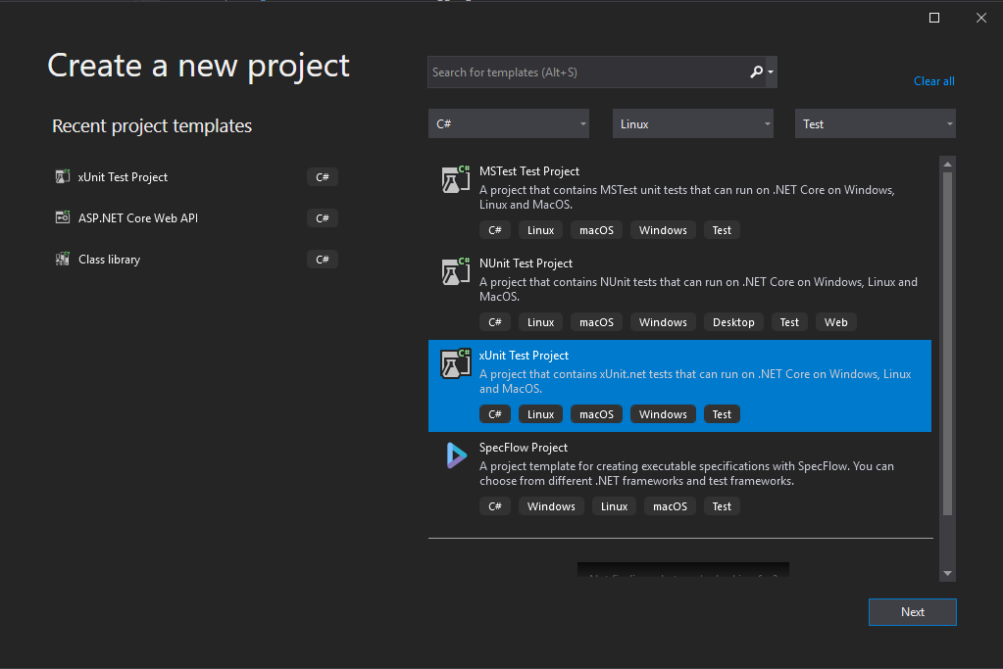
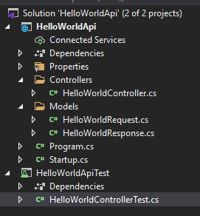
Creating new web api with xunit test project

Slide 3
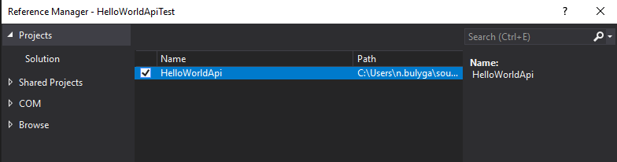
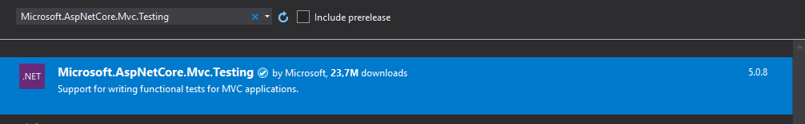
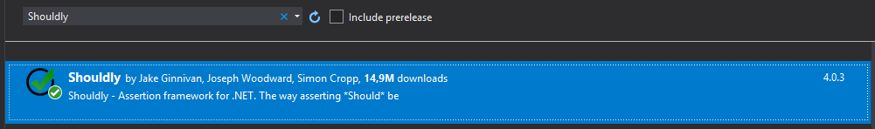
Configure test project dependencies

Slide 4
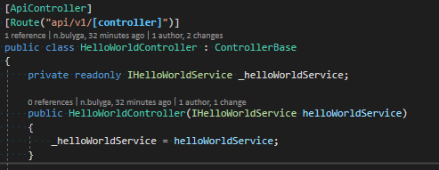
Adding service for getting different hello worlds IN DI container

Slide 5
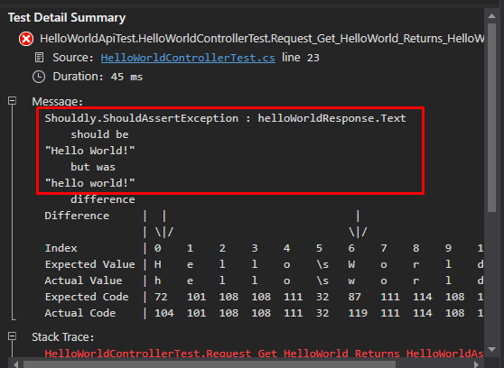
Uuups… what just happen???

Slide 6
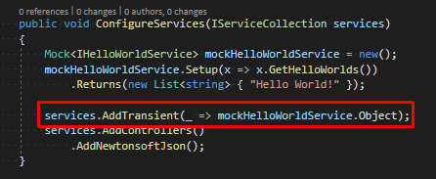
Hello world, I’m a tester! So let’s just mock service in startup
What can go wrong???

Slide 7
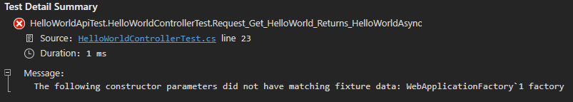
Another problem

Slide 8
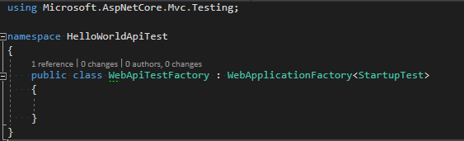
Fixing tests… trying different solutions

Slide 9
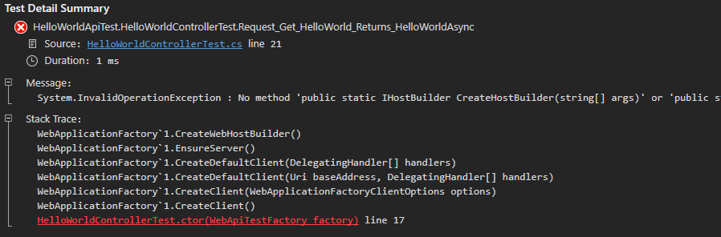
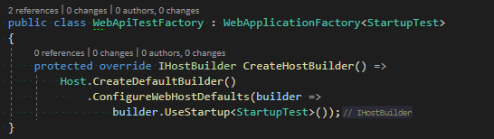
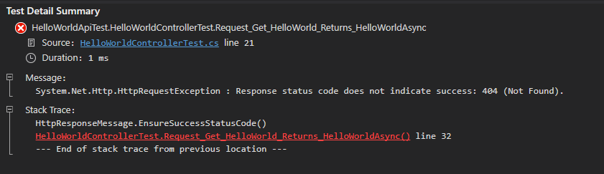
Still Fixing tests…

Slide 10
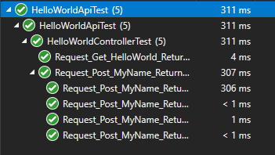
The solution

Slide 11
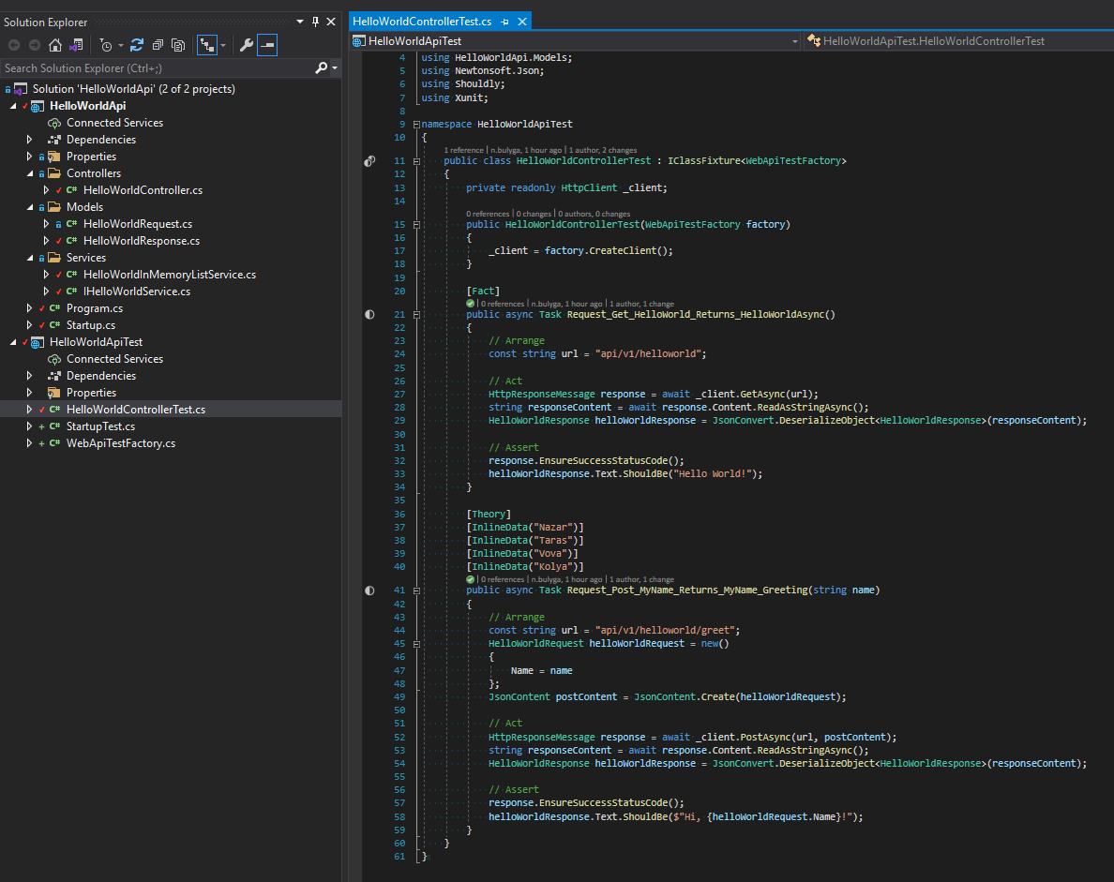
Final project Solution

