Slide 1

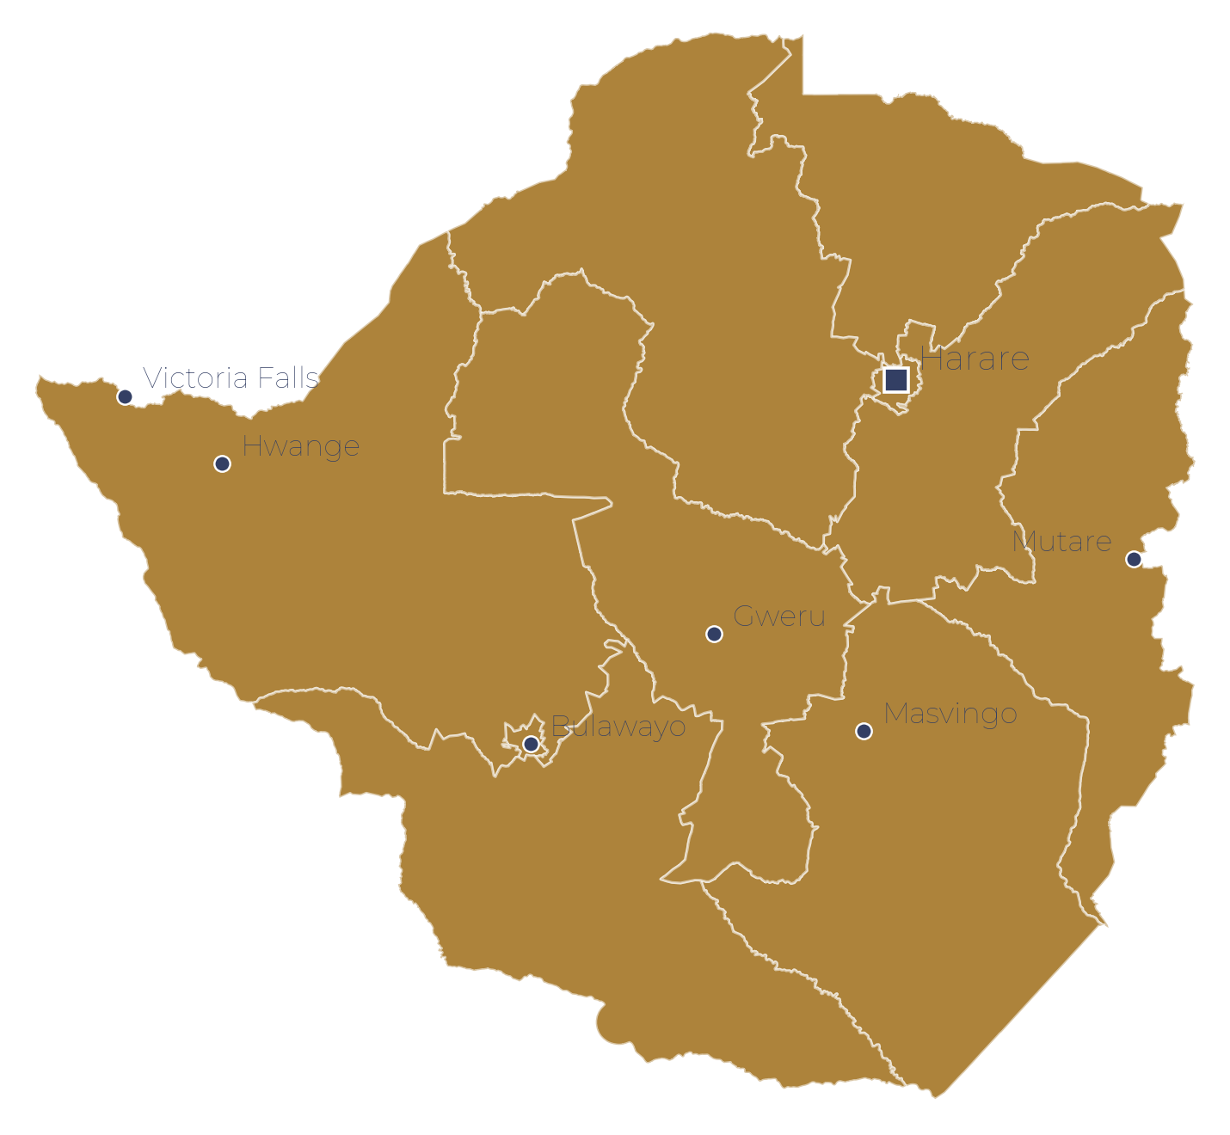
NATIONAL SNAPSHOT · JULY 2026
GENERAL
ECONOMIC
SOCIAL & HUMANITARIAN
~1.48B
UN mid-2026
~$4.1tn
IMF 2025
27/1K
UN IGME 2024
COUNTRY OVERVIEW
Total Population
GDP · ~7% growth 2026f
Under-5 Mortality
India
72.5 yrs
UN WPP '24
~4%
May 2026
~5%
WB 2023
Life Expectancy
Inflation (CPI y/y)
Poverty Rate
Republic of India
~78%
WB 2024
3.1%
Youth 9.9%
~100%
Rural ~99%
STATUS
Adult Literacy
Unemployment
Electricity Access
Lower-middle income
CAPITAL
GEOGRAPHIC CONTEXT · SECTOR STATUS
New Delhi
GDP / CAP
SECTOR STATUS
~$2,700 (2024)
Health
AMBER
CURRENCY
Education
AMBER
Indian Rupee (INR)
Food Security
AMBER
LANGUAGES
Hindi, English + 21 others
Economic
GREEN
PERIOD
WASH
AMBER
July 2026
Infrastructure
AMBER
JULY 2026
ODA 01 / 23
World Bank · UN IGME · IMF · WHO/UNICEF JMP

Slide 2
INDIA · CROSS-SECTOR SNAPSHOT
Sector Overview — key indicators and recommended interventions by sector
Health & Nutrition
Education
Food Security
Agriculture
Wildlife & Conservation
Infrastructure
WASH
U5 mortality 27/1K; neonatal declining
~2.6M living with HIV; low prevalence
Child stunting 35.5%; wasting 18.7%
Anaemia affects >50% women age 15-49
Literacy ~78%; rising steadily
Gender gap persists (M 85%, F 70%)
Quality varies by state & district
NEP 2020 reforms under rollout
~172M undernourished (12% pop.)
GHI 2024 score 27.3 — 'serious'
Largest PDS in world; leakage issues
43% cannot afford healthy diet
~16% of GDP; 42% of employment
Growth slowed to 1.4% in 2023-24
2nd largest global producer rice/wheat
Climate risk: El Niño; monsoon shift
~3,682 tigers — 75% of global pop.
52 tiger reserves under Project Tiger
Human-wildlife conflict rising
Corridors fragmented by urbanisation
Access 99.9%; rural ~99.2%
Grid capacity expanded rapidly
Renewables target: 500GW by 2030
Transmission & distribution losses ~17%
Basic water 96%; sanitation 83%
Open defecation ~7%
Urban piped water coverage gaps
Safely managed water ~76%
RECOMMENDED
RECOMMENDED
RECOMMENDED
RECOMMENDED
RECOMMENDED
RECOMMENDED
RECOMMENDED
Nutrition convergence; anaemia control; immunisation reach.
Quality outcomes; girls' secondary; digital access.
PDS efficiency; diet diversification; fortification.
Drip irrigation; cold chains; crop diversification.
Corridor protection; conflict mitigation; eco-tourism.
Storage; rooftop solar; smart grids.
Jal Jeevan Mission; faecal sludge mgmt; groundwater recharge.
Sources: World Bank · UN IGME · UNAIDS · GHI 2024 · JMP · NTCA · NFHS-5
ODA 02 / 23

Slide 3
KEY ACTORS & ENGAGEMENT · POLITICAL CONTEXT · JULY 2026
Engagement approach with key stakeholders
Modi (BJP) began third term Jun 2024 with NDA coalition (293 seats). BJP regained Delhi Feb 2025 & won Bihar Nov 2025. Opposition INDIA bloc holds 234 seats; Rahul Gandhi leads as LoP.
BLOC · KEY FIGURES
ENGAGE ON
HOW TO ENGAGE
EFFECT
Central government · NDA Modi (PM) · Sitharaman (Finance) · Shah (Home)
Viksit Bharat priorities · infrastructure · climate · digital economy.
NITI Aayog + line ministries; align with Viksit Bharat @2047 framework; capex-focused.
Reinforces government's development narrative.
Security & strategic elite NSA Doval · Chief of Defence Staff · Service Chiefs
Nothing directly — strategic stability context.
Formal state frameworks only. Highly sensitive.
Any tilt reads as picking a side.
Political opposition Rahul Gandhi (LoP) · Kharge (INC) · INDIA bloc allies
Inclusive growth · civic space — cautiously.
Low-key, even-handed; no state election interference.
Signals plurality; space is contested.
State governments & local bodies CMs of 28 states · Panchayati Raj Institutions (PRIs)
Rural development · livelihoods · climate resilience.
Best entry point for community delivery — PRIs hold last-mile service authority.
Empowers local delivery; watch fiscal capacity.
Multilateral & bilateral UN · WB · ADB · JICA · bilateral donors
Climate · health · skills · infrastructure.
Lowest-risk channel — align with Viksit Bharat national priorities.
Technical; national scale.
BTI · Freedom House · Carnegie · PIB India · PRS India (Jan–Jul 2026)
ODA 03 / 23

Slide 4
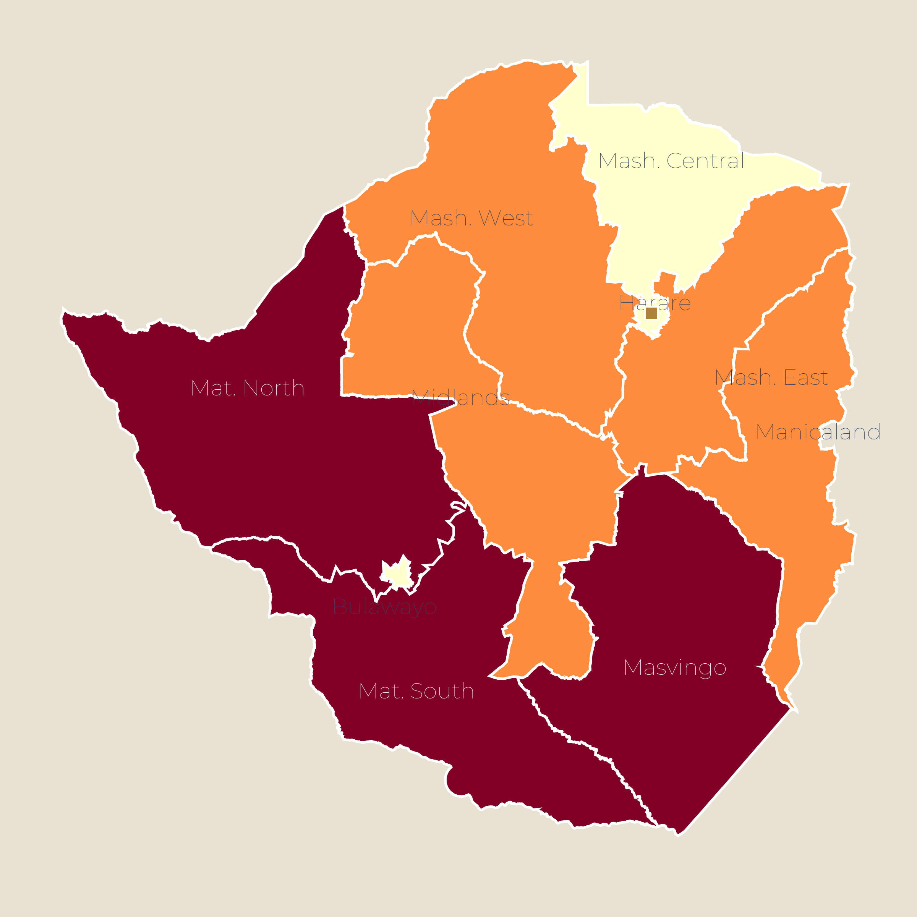
SHOCK & RECOVERY GEOGRAPHY · JULY 2026
India faces compounding climate shocks — extreme weather, energy volatility & fiscal pressure — amid robust growth
CRISIS GEOGRAPHY — 2025 extreme weather severity
01
CLIMATE — unprecedented extreme weather
Extreme weather hit 331 of 334 days in 2025; 4,419 deaths & 17.4M ha crops damaged. Floods killed 2,707; Punjab worst floods in 40 yrs. States face flood-to-drought whiplash patterns.
02
FISCAL — $763bn external debt, 20.8% of GDP
External debt US$762.8bn (Mar 2026); debt-to-GDP 20.8%. Fiscal deficit 4.3% (FY27 target); central debt 55.6% of GDP. Full IFI/market access; debt service ratio stable at 6.6%.
High climate/disaster risk (est.)
03
ENERGY — peak demand surge & storage gaps
Medium climate/disaster risk (est.)
Peak demand hit 256GW (Apr 2026); energy shortage fell to 0.03%. Rural supply rose to 22.6 hrs/day. Solar intermittency requires grid-scale storage; evening shortfalls persist.
Low climate/disaster risk (est.)
Flood-prone NE, coastal belts
The climate-vulnerable belt overlaps the agrarian belt — Eastern India, coastal states and the Deccan combine flood/drought exposure, high rural density and crop dependence. Treat resilient infrastructure and irrigation as climate-adaptation anchors.
Drought-risk Deccan & semi-arid
Lower-risk interior & irrigated plains
CSE · IMD · RBI · Ministry of Finance · PIB · ICRA · IEEFA
ODA 04 / 23

Slide 5
STRATEGY · NATIONAL DEVELOPMENT PLAN
India's Viksit Bharat @2047 — Vision for a Developed Nation
First articulated August 2022; operationalised via NITI Aayog
2022-47
~7%+
4
Developed nation / $30tn economy
Plan horizon — centenary of Independence
Sustained growth target (FY26 est. 7.4%)
Core pillars: Yuva, Garib, Mahila, Kisan
Stated 2047 goal
OVERVIEW
STRUCTURE
Viksit Bharat @2047 is India's master vision for the centenary of Independence — a $30tn developed economy. Coordinated by NITI Aayog, it spans economic growth, social progress, sustainability and governance.
Four pillars — Youth, Poor, Women, Farmers — delivered through flagship schemes (Make in India, Skill India, Digital India) and sectoral targets across manufacturing, services and agriculture.
FINANCING
DEVELOPMENT LENS
FY27 budget: ₹53.5 lakh cr expenditure; capex ₹12.2 lakh cr (4.4% GDP). Interest payments absorb 26% of spend. Debt-to-GDP to fall to 50% by 2031. Full IFI and market access supports investment.
For partners: align programmes with Viksit Bharat pillars; note India's scale means demonstration projects carry replication leverage across states.
PIB · NITI Aayog · Union Budget 2026-27 · PRS India · ORF
ODA 05 / 23

Slide 6
SECTION 02
Detailed Sector Analysis
Economy · Health · Education · Food Security · Agriculture · Rural Development · Infrastructure · WASH
ODA 06 / 23

Slide 7
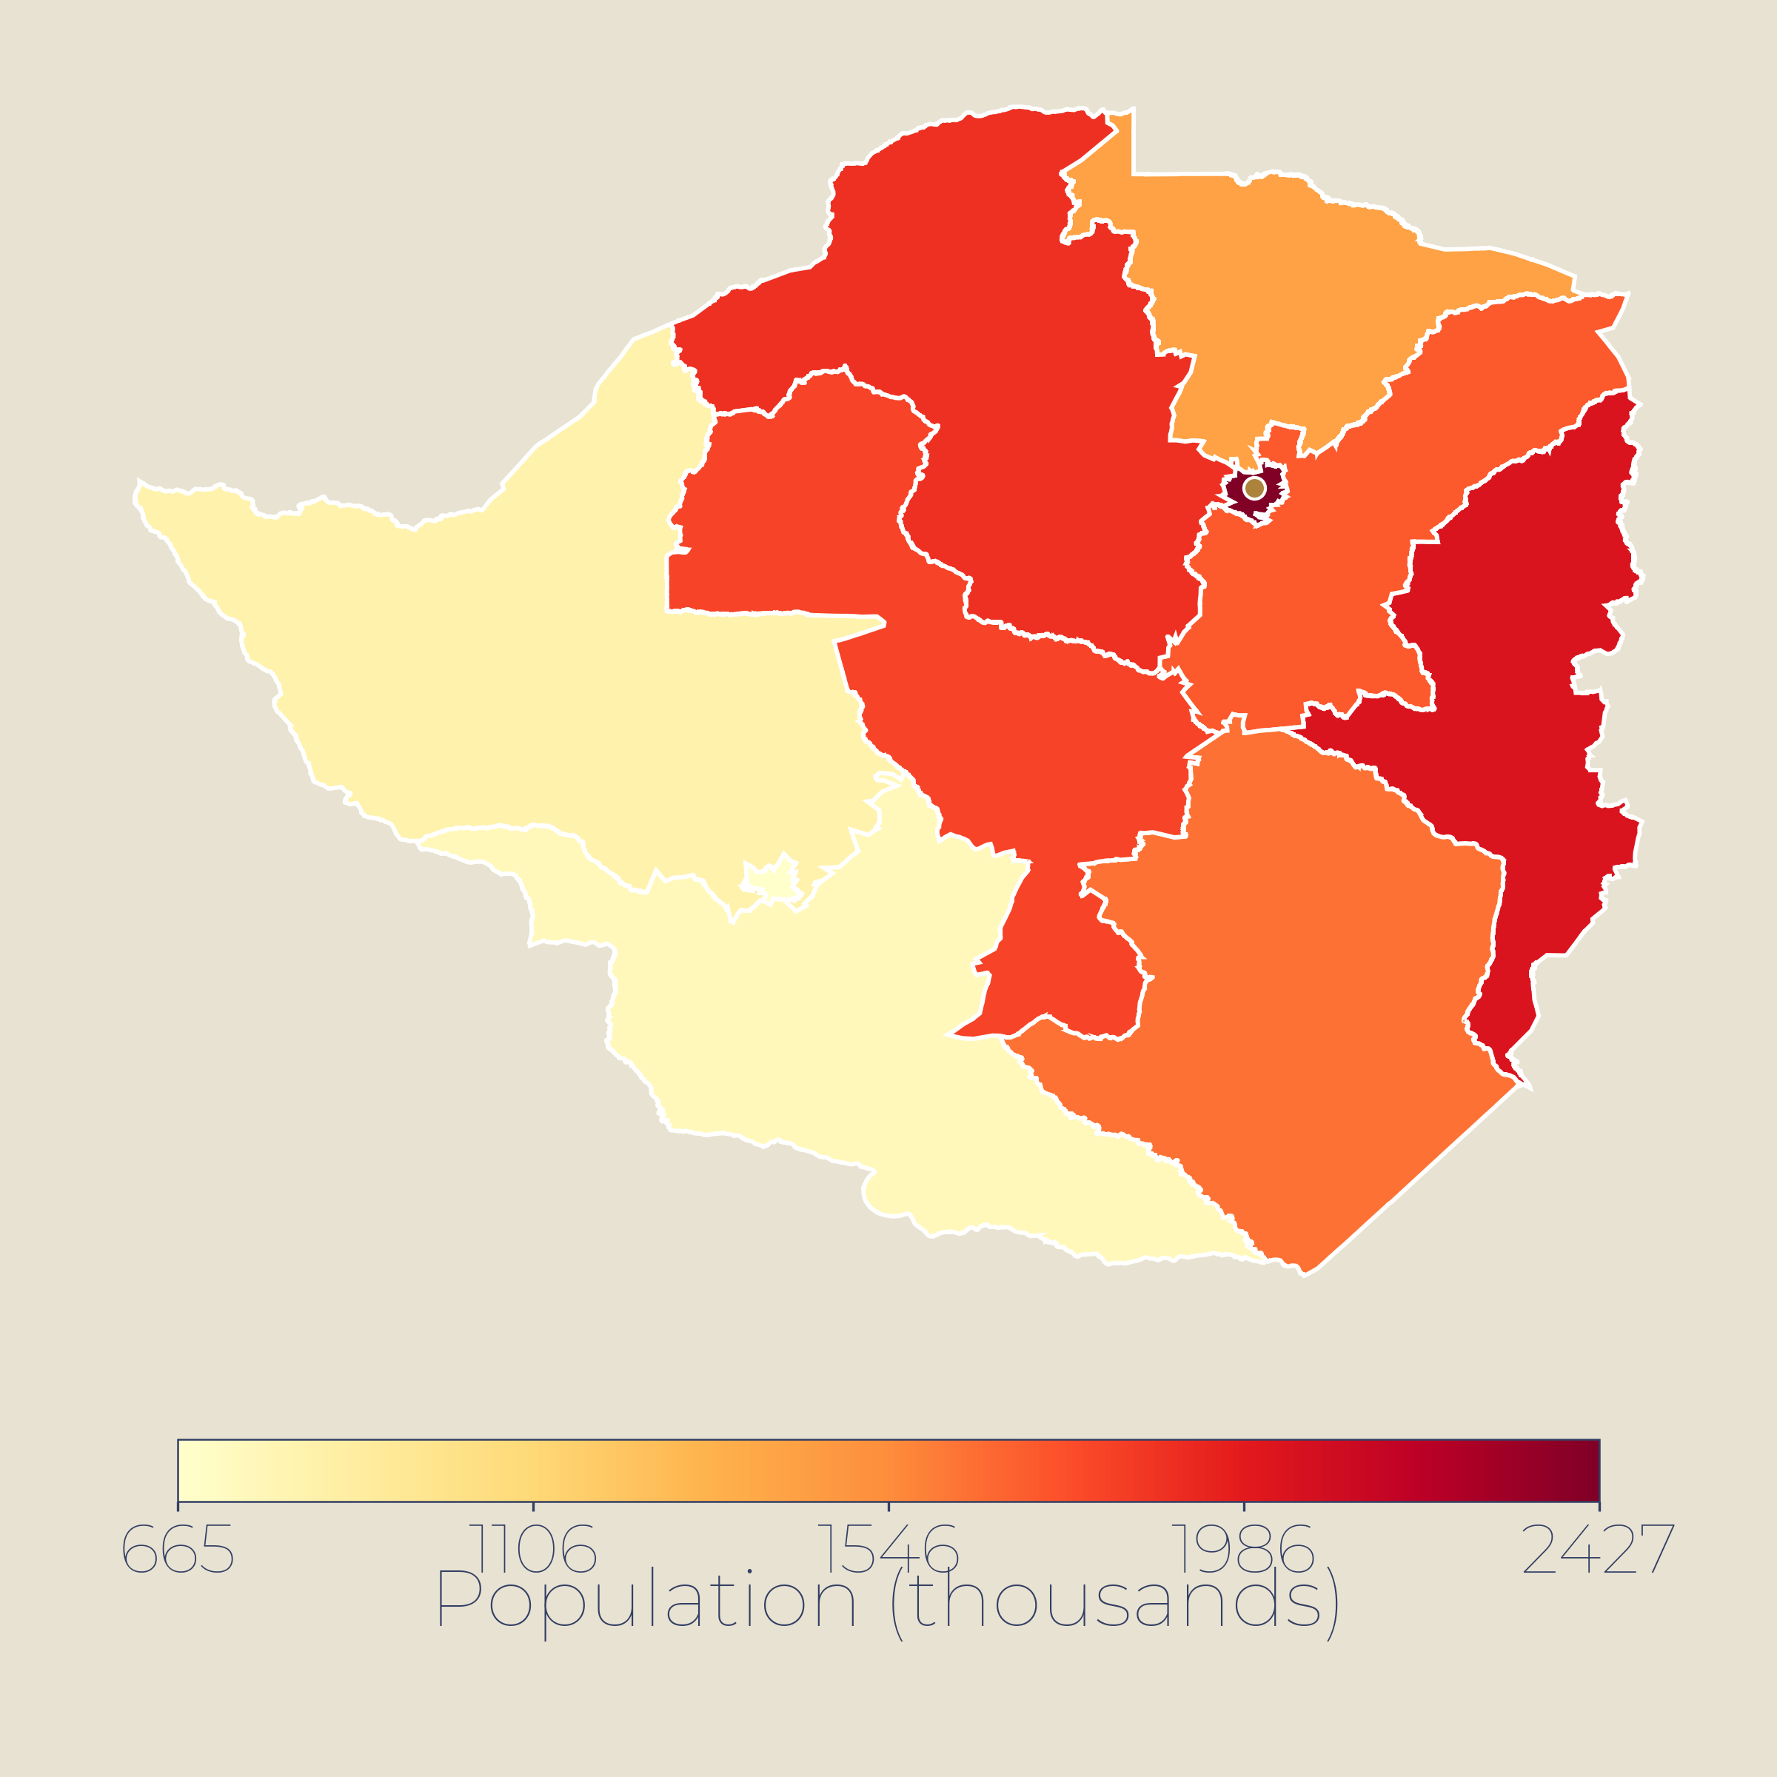
02 · NATIONAL OVERVIEW
At a Glance — India's key development indicators
~1.48bn
~$3.9tn
72.5 yrs
Population by state (millions)
Population
GDP (2024)
Life expectancy
Census of India 2011 · projections
UN WPP mid-2026
World Bank
UN WPP 2024
27
130/193
~5%
U5 mortality / 1,000
HDI rank (0.685)
Poverty rate
UN IGME 2025
UNDP HDR 2025
WB 2025
~90%
~$543bn
20.8%
Informality
Reserves (2026)
Ext. Debt-to-GDP
ILO 2025
Was ~$700bn in Jan 2026
$763bn · Mar 2026
KEY INSIGHTS
HDI 0.685 (130/193); extreme poverty reduced to ~5% while informality at ~90% remains structurally high.
Strong growth: 7.3% GDP growth FY25-26 (RBI); FX reserves ~$543bn; external debt ratio 20.8% remains stable.
Scale opportunity: 1.48bn population with median age 29; U5 mortality at 27 nearing SDG target of 25.
Over 80 million (est.)
30-80 million (est.)
Under 30 million (est.)
Census of India · World Bank · UNDP HDR 2025 · UN IGME 2025 · RBI
ODA 07 / 23

Slide 8
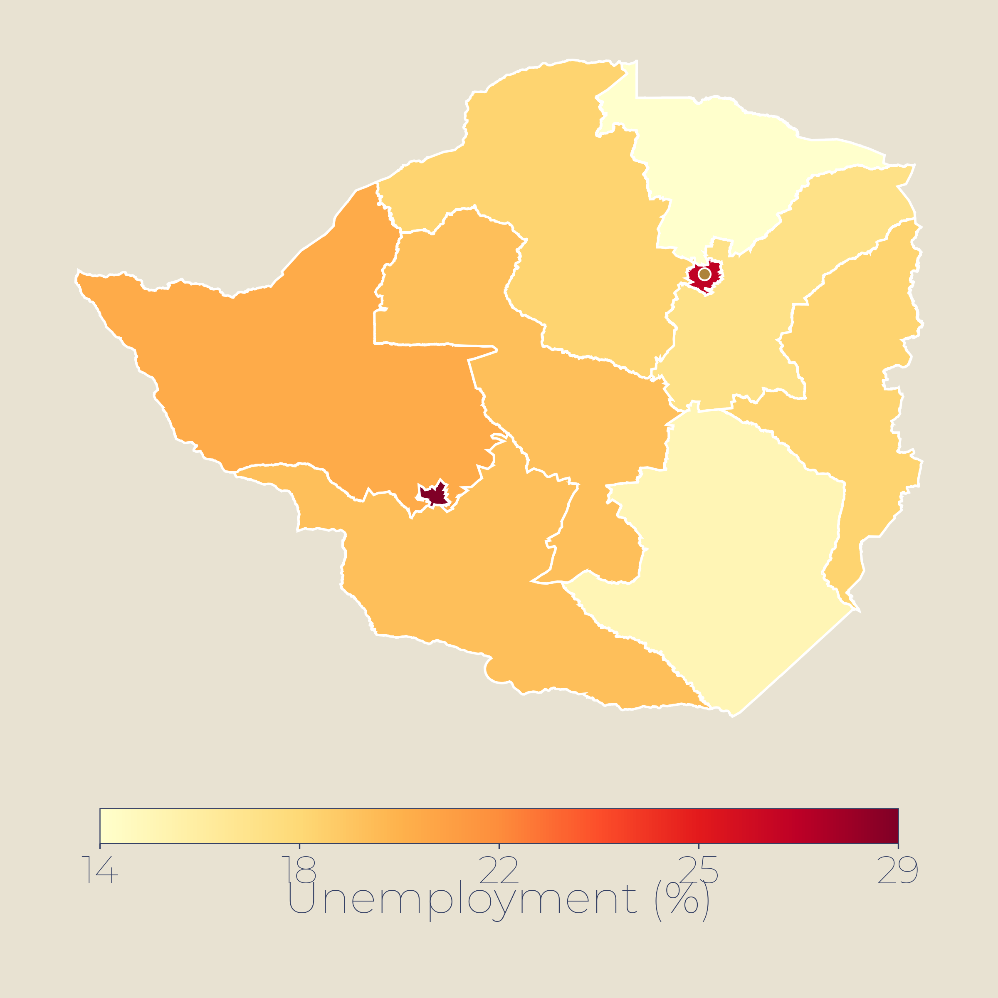
03 · ECONOMY
Economy — 7.6% growth in FY2025-26 with record-low inflation near 2%, world's fastest-growing major economy
7.6%
4.4%
$3.9tn
Unemployment by state (%)
PLFS 2025 pattern · MoSPI (est.)
GDP growth FY2025-26
CPI inflation y/y
Nominal GDP
MoSPI · IMF 6.4% CY2026f
Jul 2026 · avg 2.1% in 2025
84% debt-to-GDP · 2025
KEY INSIGHTS
Growth led by services (+10%) and manufacturing (+7%); CPI fell to record lows in 2025; forex reserves ~$700bn.
Diversified exports but services deficit persists; repo rate 6%; informal sector ~90% of workforce; unemployment 3.1% (youth 10%).
Fiscal deficit 4.3% of GDP targeted for FY2026-27; debt consolidation path aims for 50% by 2030-31.
POTENTIAL INTERVENTIONS
▸
Support manufacturing PLI schemes to reduce import dependence and boost exports.
Above 8% unemployment (est.)
▸
Formalisation and MSME finance for youth and women entrepreneurs.
5-8% unemployment (est.)
▸
Infrastructure investment in logistics, energy and digital connectivity.
Below 5% unemployment (est.)
MoSPI · RBI · IMF 2025 · OECD 2026 · Union Budget 2026-27
ODA 08 / 23

Slide 9
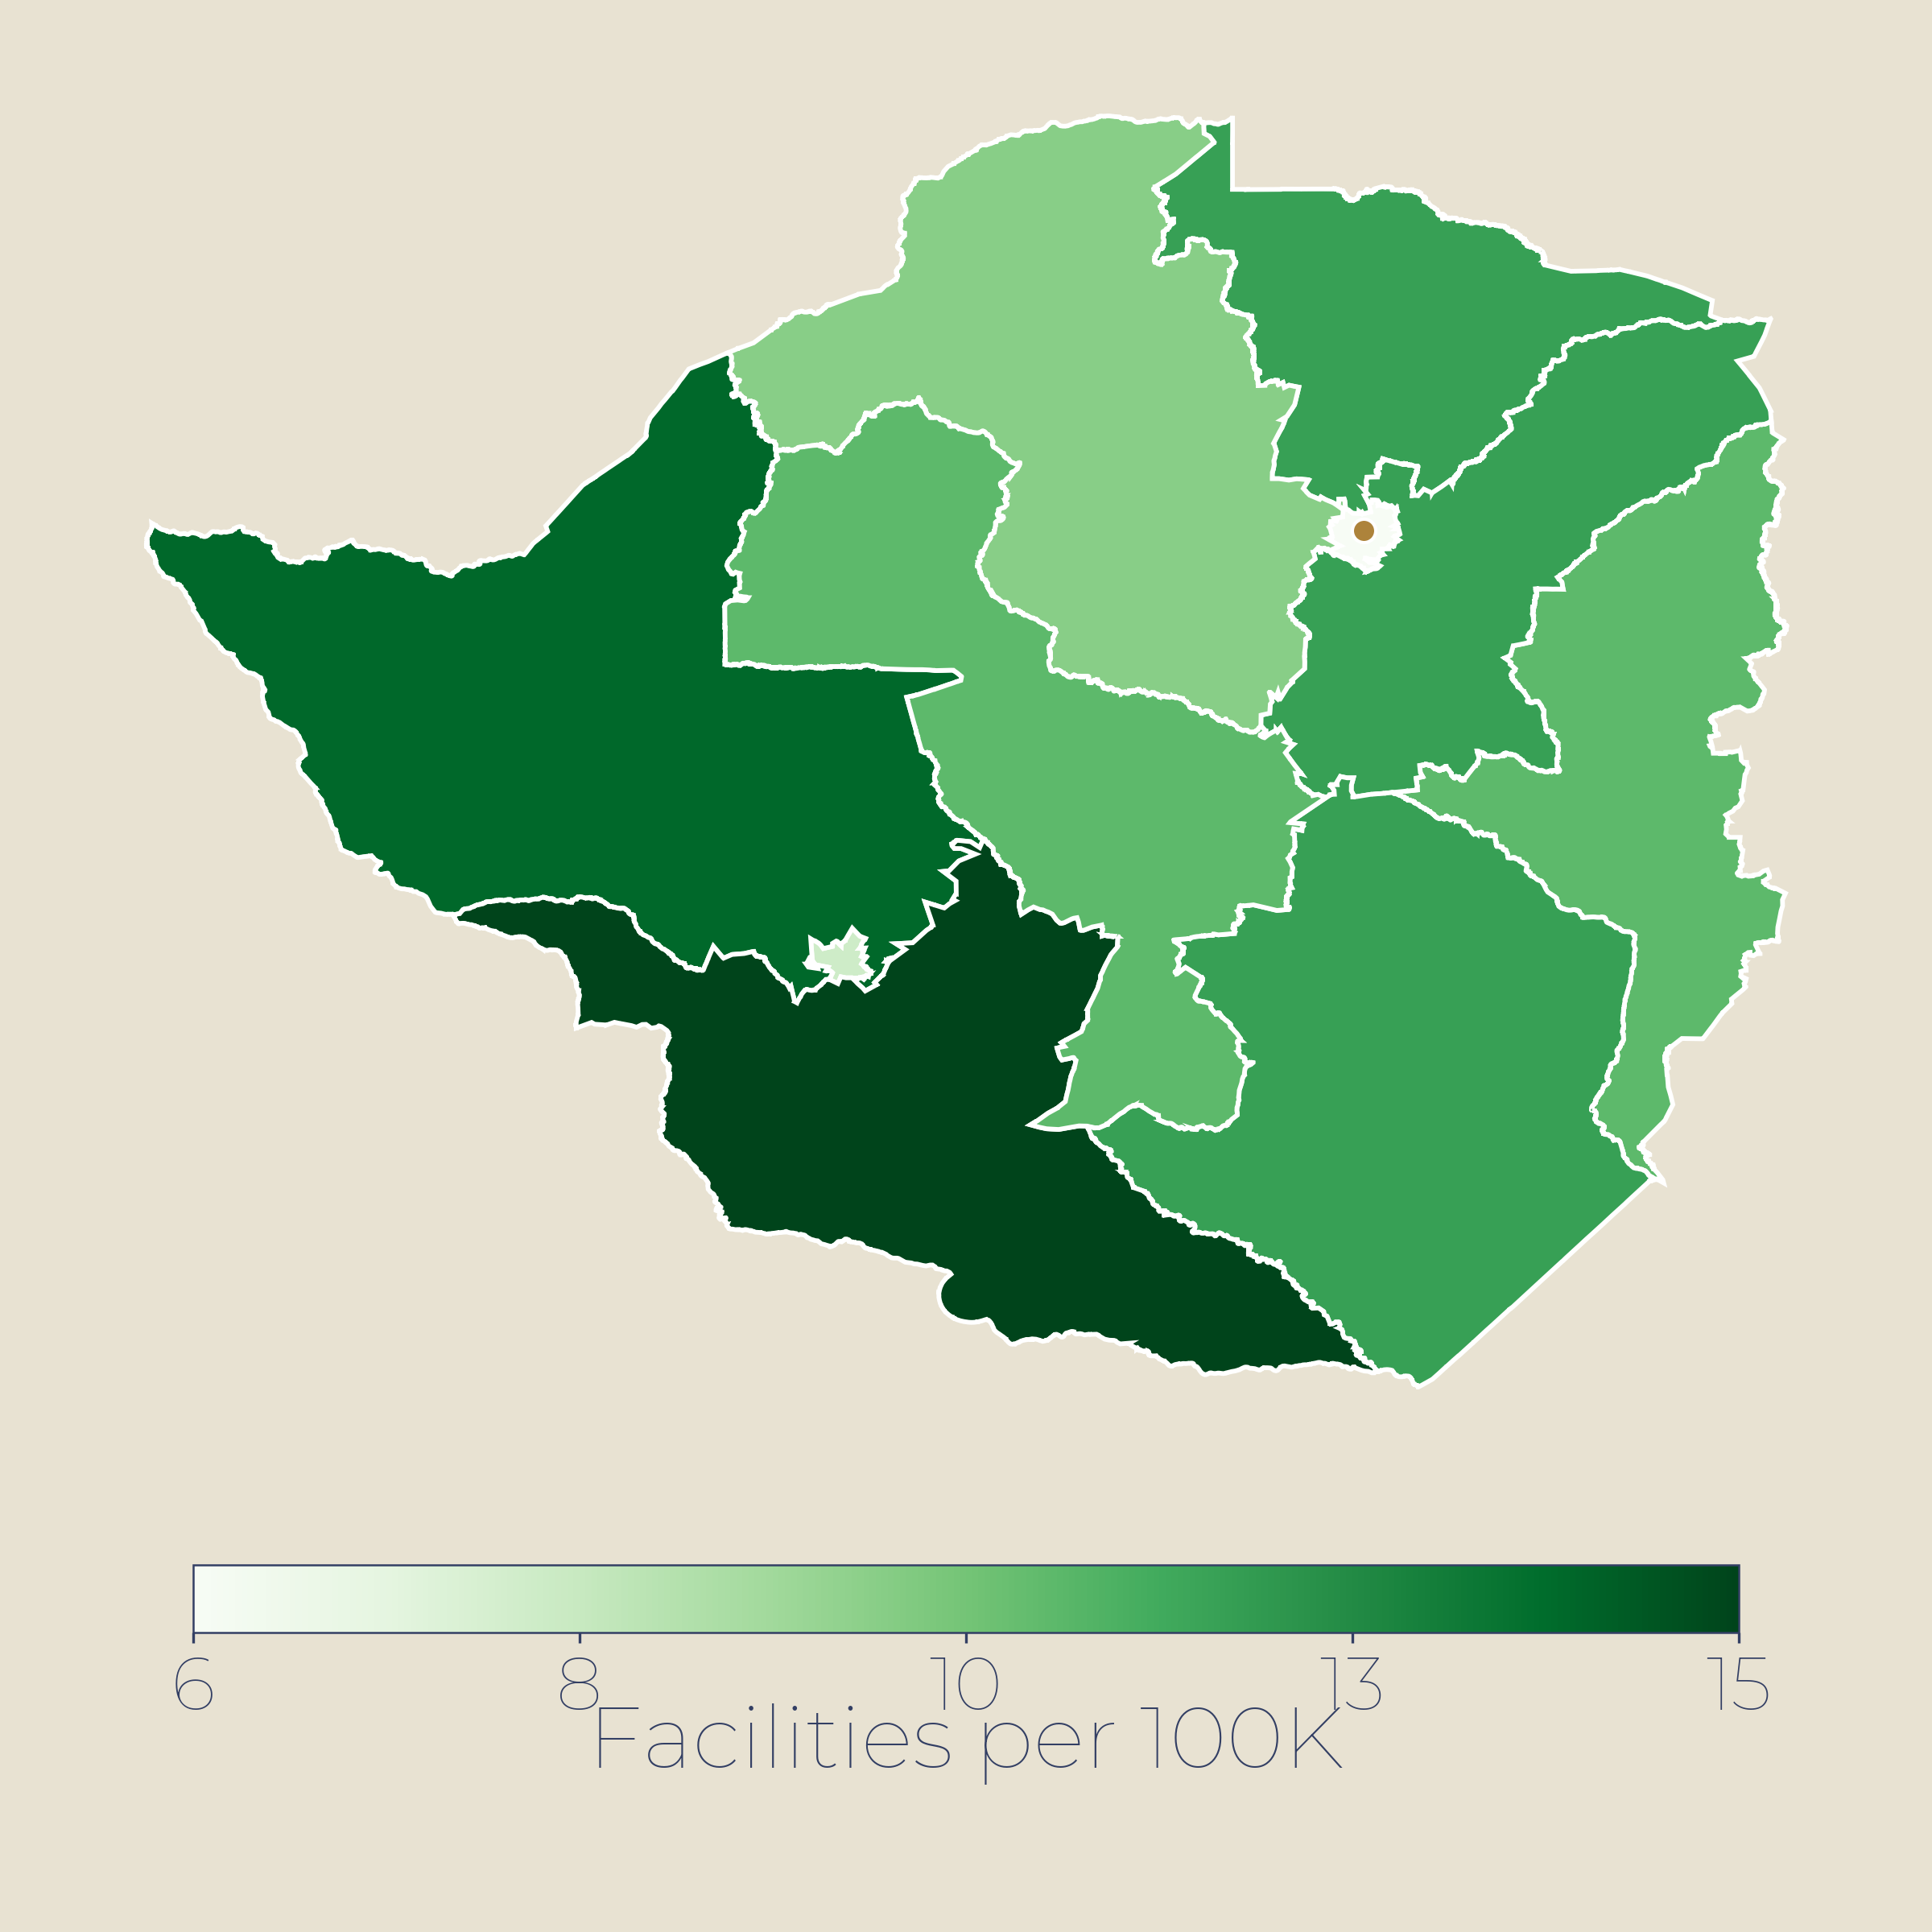
04 · HEALTH
Health — 27 under-5 deaths per 1,000, a 79% decline since 1990, but neonatal burden remains
27/1K
17/1K
~2.5M
Health facilities per 100,000
MoHFW pattern (est.)
Under-5 mortality
Neonatal deaths
Living with HIV
UN IGME 2025 · was 48 in 2015
UN IGME 2025 · down from 28
NACO 2023
KEY INSIGHTS
TB remains a leading cause of death; maternal mortality 80/100K live births; stunting persists at ~35% among children.
Neonatal mortality 17/1K still above SDG target of 12; 63% of under-5 deaths occur in first 28 days.
Health expenditure ~3.3% of GDP; 0.7 physicians per 1,000; rural-urban disparities in access persist.
POTENTIAL INTERVENTIONS
▸
Strengthen district maternal-newborn units in high-burden states.
Over 25 per 100,000 (est.)
▸
Rural health workforce expansion: incentives, training, infrastructure.
15-25 per 100,000 (est.)
▸
Integrate nutrition and primary healthcare at community level.
Under 15 per 100,000 (est.)
UN IGME 2025 · NACO 2023 · UNAIDS · WHO · UNICEF
ODA 09 / 23

Slide 10
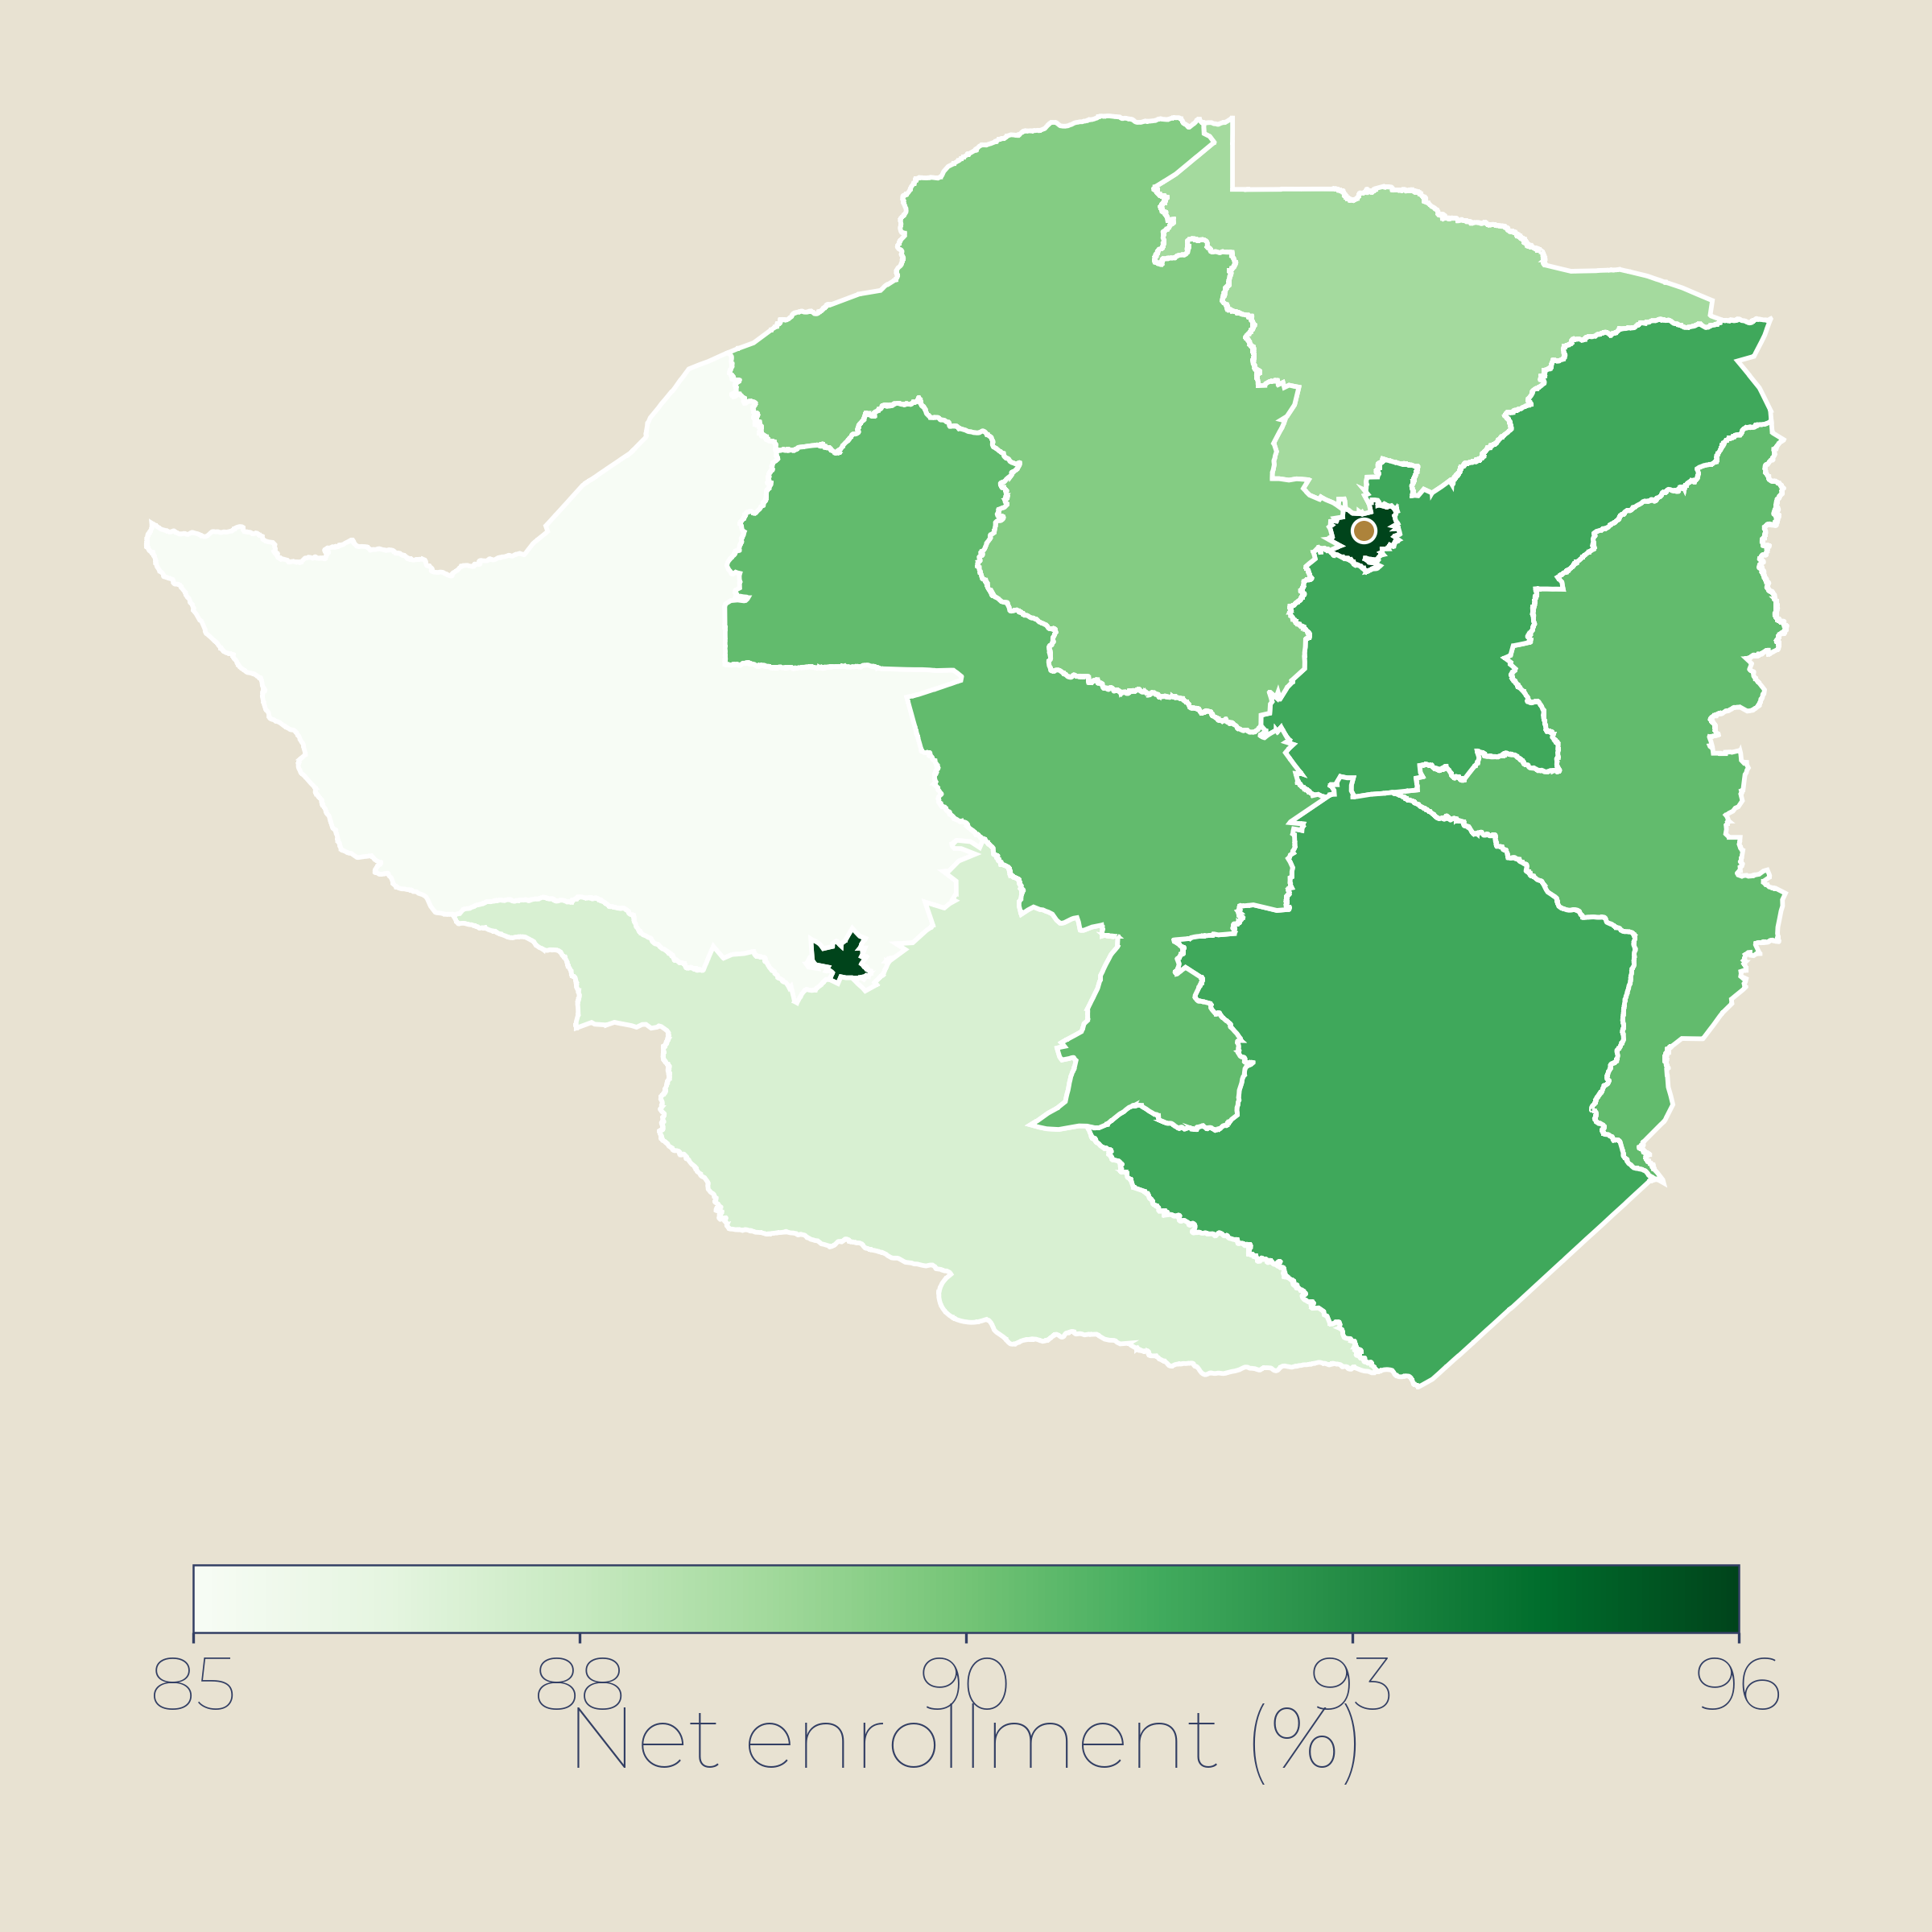
05 · EDUCATION
Education — ~78% adult literacy, but 97% youth literacy signals generational gains
~78%
25%
10%
Secondary enrolment (%)
UDISE+ pattern (est.)
Adult literacy
Youth NEET rate
Youth unemployment
Youth literacy 97% · WB 2024
PLFS 2025 · age 15-29
PLFS 2025
KEY INSIGHTS
Adult literacy 78% but youth literacy 97% indicates near-universal literacy among the young.
Primary enrolment >100% gross but learning outcomes lag; NEET rate 25% signals skills-jobs mismatch.
Youth unemployment 10% overall; female youth unemployment ~21% vs male ~15%; gender gap persists.
POTENTIAL INTERVENTIONS
▸
Expand Skill India and apprenticeship programmes linked to industry demand.
Over 85% enrolment (est.)
▸
TVET pipelines for manufacturing, IT services, renewable energy sectors.
70-85% enrolment (est.)
▸
Female workforce participation: childcare, transport, safety initiatives.
Under 70% enrolment (est.)
World Bank · UNESCO UIS · PLFS 2025 · MoSPI
ODA 10 / 23

Slide 11
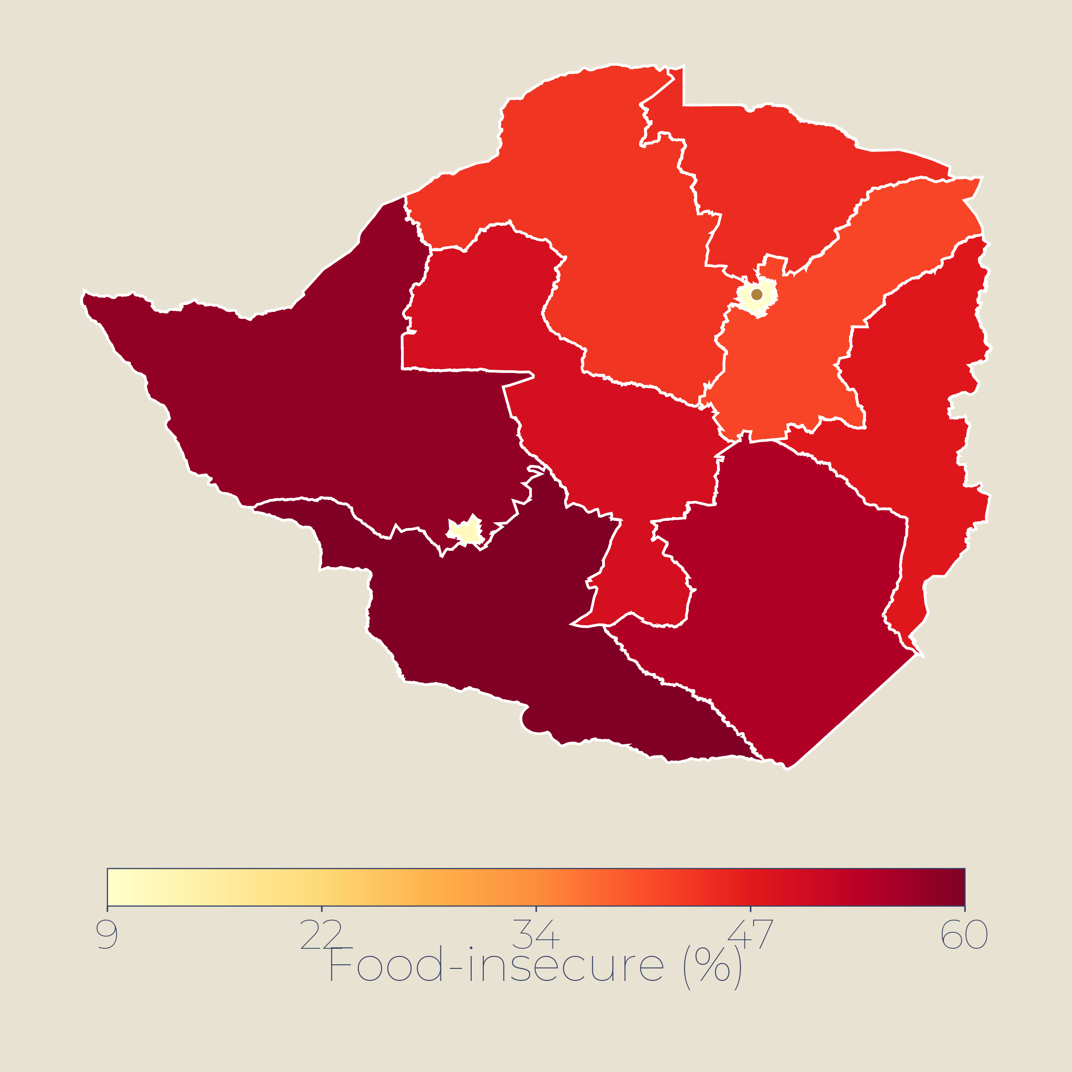
06 · FOOD SECURITY
Food Security — 12% undernourished; GHI score 'serious' despite record food production
194M
GHI 25.8
35%
Stunting prevalence by state (%)
NFHS-5 pattern (est.)
Undernourished
Hunger Index
Child stunting
FAO SOFI 2025 · 12%
2025 · rank 102/123
NFHS-5 · 2019-21
KEY INSIGHTS
World's largest PDS covers 800M beneficiaries, but ~12% remain undernourished per FAO 2025.
Paradox: record grain production but GHI 'serious' at 25.8; child stunting ~35%, wasting ~19%.
Climate shocks — heatwaves, erratic monsoons — threaten yields; food inflation volatile.
POTENTIAL INTERVENTIONS
▸
Fortification and diversification of PDS beyond rice and wheat.
Above 35% stunting (est.)
▸
POSHAN Abhiyaan scale-up: nutrition-sensitive agriculture linkages.
25-35% stunting (est.)
▸
Climate-resilient crops: millets, pulses, drought-tolerant varieties.
Under 25% stunting (est.)
FAO SOFI 2025 · GHI 2025 · NFHS-5 · WFP · NITI Aayog
ODA 11 / 23

Slide 12
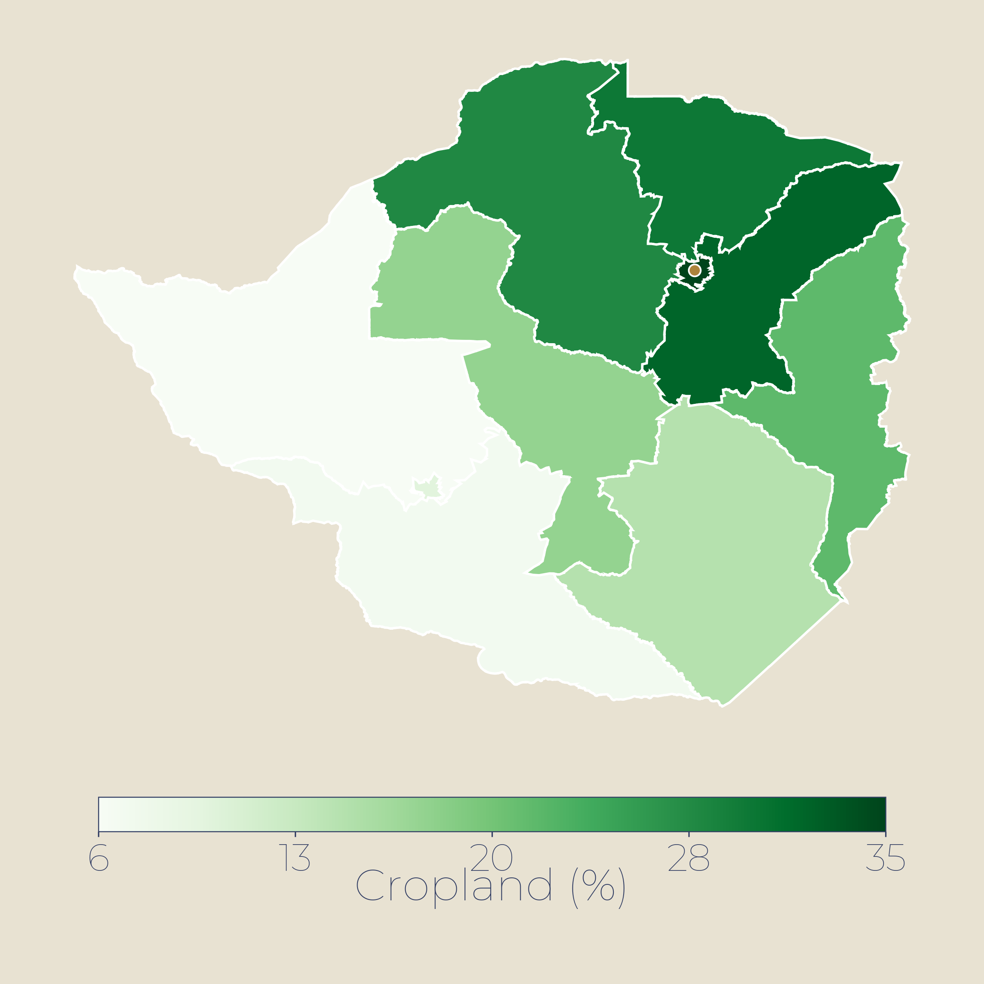
07 · AGRICULTURE
Agriculture — ~16% of GDP but ~46% of livelihoods; steady growth driven by policy and technology
+3.7%
~16%
55%
Cultivated cropland (% of area)
FAO / Ministry of Agriculture pattern (est.)
Ag growth 2025
Share of GDP
Irrigated area
Govt of India · highest globally
Supports 46% of workforce
Of gross cropped area
KEY INSIGHTS
Record foodgrain output of 358MT in 2024-25; agriculture grew 3.7% — globally highest rate.
Irrigation covers 55% of cropped area; micro-irrigation only 8%; PM-KUSUM expanding solar pumps.
Allied sectors (dairy, fisheries, horticulture) now key drivers; India is world's largest milk producer.
POTENTIAL INTERVENTIONS
▸
Scale micro-irrigation (drip/sprinkler) in water-stressed states.
Over 60% cultivated (est.)
▸
Climate-resilient seeds and digital extension services.
35-60% cultivated (est.)
▸
Agri-value chains and cold storage under PM Gati-Shakti.
Under 35% cultivated (est.)
Economic Survey 2024-25 · PIB · Ministry of Agriculture · MOSPI
ODA 12 / 23

Slide 13
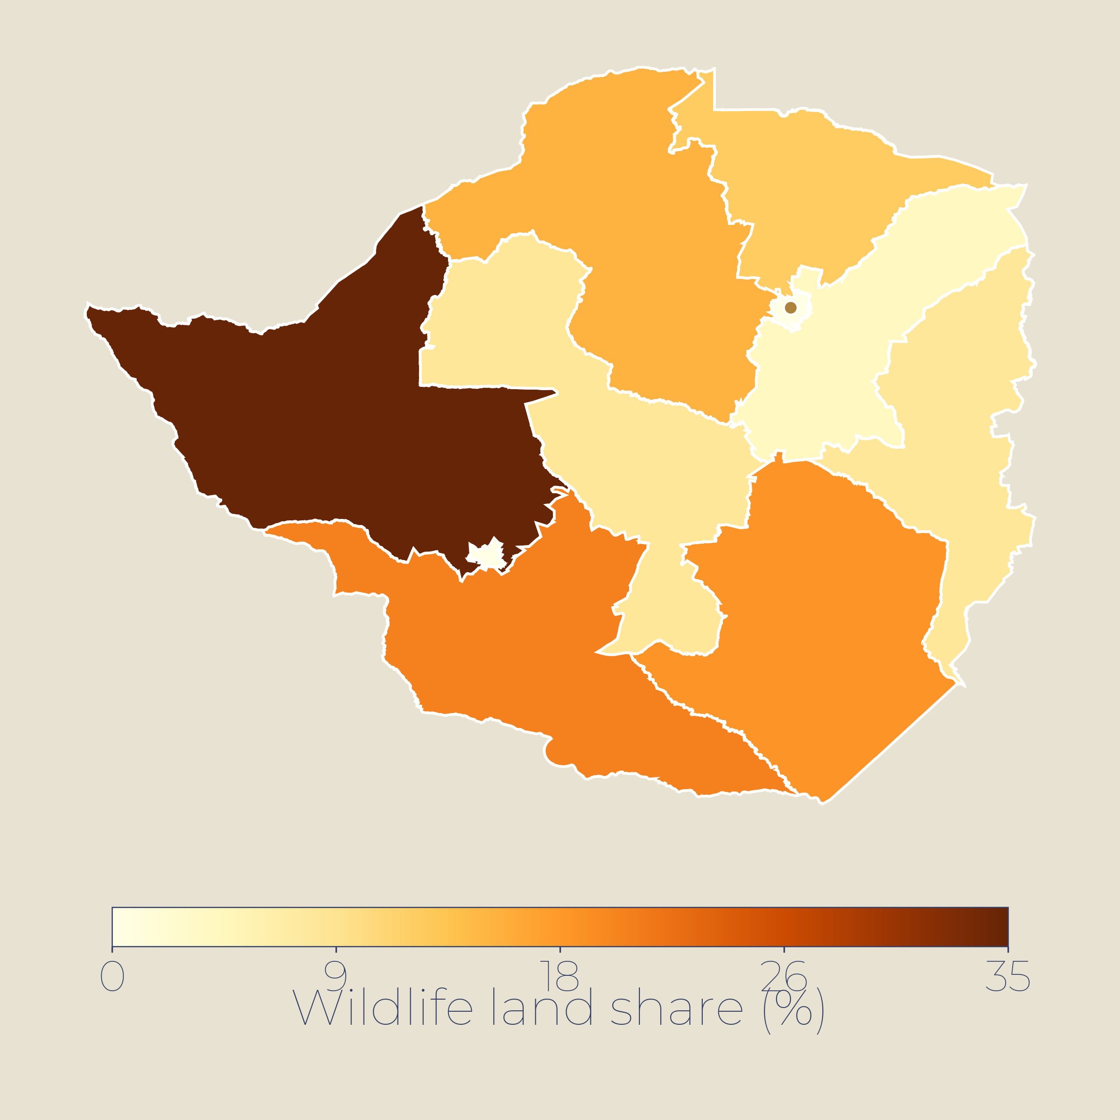
08 · WILDLIFE ECONOMY & TIGER CONSERVATION
Wildlife Economy — 75% of the world's tigers; a global conservation success driving ecotourism
~3,700
52
~$3B
Land under wildlife management (%)
NTCA / protected areas pattern (est.)
Tiger population
Tiger reserves
Wildlife tourism rev.
NTCA 2022 · doubled since 2010
~5% of forest area protected
Est. direct + indirect
KEY INSIGHTS
Project Tiger (since 1973) has delivered one of the world's greatest wildlife recoveries — 75% of global tigers now in India. Ecotourism generates revenue and local jobs; human-wildlife conflict remains a challenge at reserve margins. Strains: corridor fragmentation, rail/road kills, poaching pressure. Key need is habitat connectivity.
POTENTIAL INTERVENTIONS
▸
Wildlife corridors: underpasses, overpasses, reduced linear intrusions.
Over 10% wildlife land (est.)
▸
Conflict mitigation: GPS collars, rapid-response teams, compensation.
5-10% wildlife land (est.)
▸
Community-based ecotourism and conservation finance models.
Under 5% wildlife land (est.)
NTCA 2022 · Science Jan 2025 · WWF · Ministry of Environment
ODA 13 / 23

Slide 14
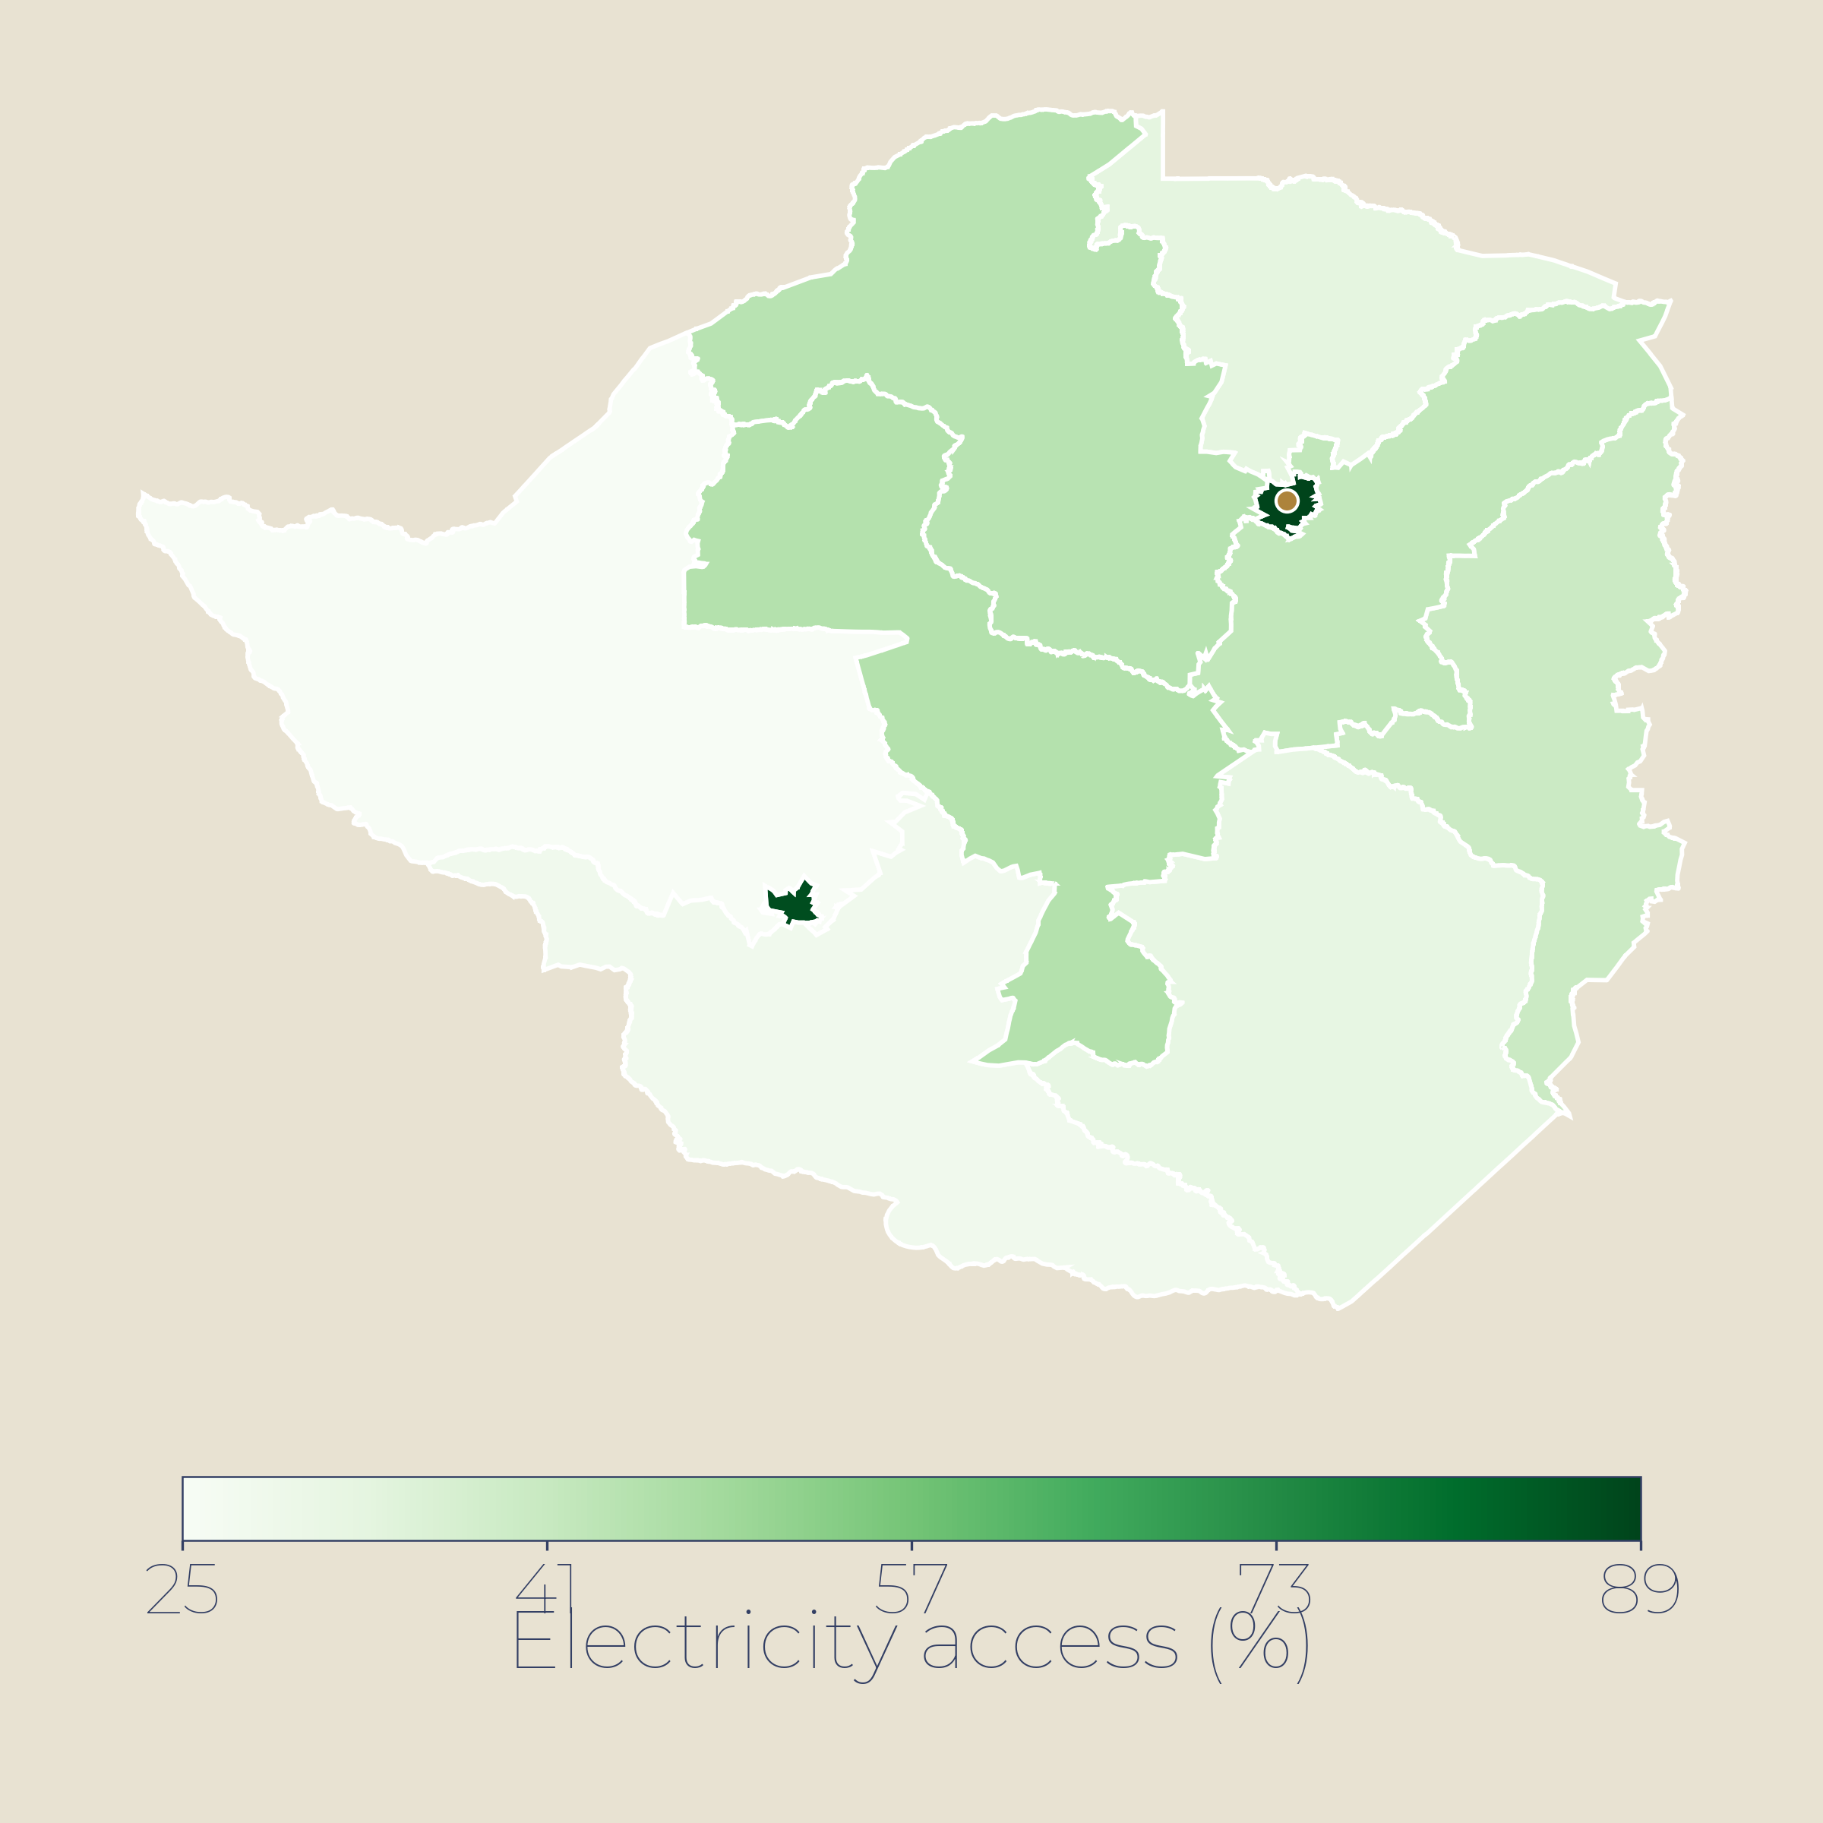
09 · INFRASTRUCTURE
Infrastructure — near-universal electrification; record renewable expansion leading clean transition
99%+
254GW
+44.5GW
Electricity access (%)
WB Tracking SDG7 pattern (est.)
Electricity access
Renewable capacity
RE additions 2025
Rural ~99% · WB SDG7
Nov 2025 · +23% YoY
Record; solar led at 35GW
KEY INSIGHTS
India achieved near-universal electrification; 99%+ households connected including 99% rural.
Renewable capacity reached 254GW in Nov 2025; 50% of installed power now from non-fossil sources.
Solar additions of 35GW in 2025 alone; 500GW non-fossil target by 2030 on track.
POTENTIAL INTERVENTIONS
▸
Grid strengthening and battery storage for renewable integration.
Above 99% access (est.)
▸
Rooftop solar scale-up under PM Surya Ghar Yojana.
95-99% access (est.)
▸
Rural roads and logistics under PM Gati-Shakti.
Under 95% access (est.)
World Bank/ESMAP · MNRE · CEA · Ministry of Power
ODA 14 / 23

Slide 15
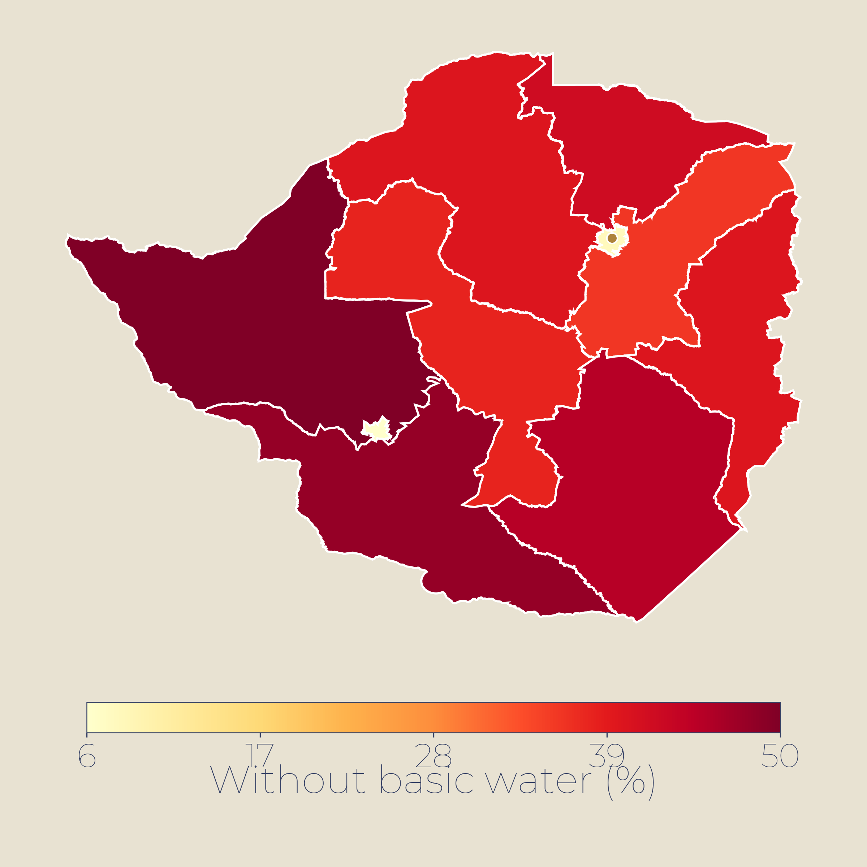
10 · WASH
WASH — open defecation reduced to ~7%; piped water push reaching 80% of rural homes
~7%
~96%
150M+
Without basic water (%)
JMP WHO/UNICEF pattern (est.)
Open defecation
Basic drinking water
Tap connections
Down from 39% in 2015
JMP · sanitation ~63%
Jal Jeevan Mission since 2019
KEY INSIGHTS
Swachh Bharat Mission built 109M+ toilets; open defecation dropped from 39% (2015) to ~7% (2024).
Jal Jeevan Mission installed 150M+ rural tap connections; 80% of rural homes now covered.
Remaining gaps in safely managed services; groundwater stress and quality issues persist.
POTENTIAL INTERVENTIONS
▸
Sustain Jal Jeevan with O&M, water quality monitoring.
Over 15% without water (est.)
▸
Faecal sludge management and sewage treatment in towns.
5-15% without water (est.)
▸
Groundwater recharge and conservation in water-stressed blocks.
Under 5% without water (est.)
WHO/UNICEF JMP · Jal Jeevan Mission · Ministry of Jal Shakti
ODA 15 / 23

Slide 16
SECTION 03
UAE Projects
ODA 16 / 23

Slide 17
SECTION 04
Proposed Projects
A three-tier programme menu — resilience & crisis response · human capital & systems · growth unlocks
ODA 16 / 23

Slide 18
11 · PROPOSED PROGRAMS
Program Menu
PROJECT
SECTOR
COST
DURATION
PARTNERS
TIER 1 · RESILIENCE & CRISIS RESPONSE
P1
Nutrition Security & Malnutrition Reduction
Food security · Health
~$40-60M
3-4 yrs
WFP · UNICEF · WB
P2
WASH & Sanitation Quality Surge
WASH · Health
~$20-35M
2-3 yrs
WHO · UNICEF · JICA
TIER 2 · HUMAN CAPITAL & SYSTEMS
P3
Health Workforce & Maternal-Newborn Care
Health
~$25-40M
4 yrs
WHO · UNICEF · USAID
P4
Youth Skills & TVET for Growth Sectors
Education & jobs
~$20-35M
3-4 yrs
UNESCO · ILO · ADB
P5
Irrigation & Agro-Processing Value Chains
Agriculture · industry
~$50-100M
5 yrs
FAO · IFAD · WB
TIER 3 · GROWTH UNLOCKS
P6
Rural Solar Mini-Grids & Institutions
Energy · Agri
~$40-80M
4-5 yrs
UNDP · WB · GEAPP
P7
Tiger Landscape & Community Livelihoods
Wildlife · rural dev.
~$15-30M
4 yrs
NTCA · WWF · WCS
Indicative cost bands for scoping; all figures subject to design studies and co-financing.
ODA 17 / 23

Slide 19
11 · PROPOSED PROGRAMS
Program Menu (1/3)
Tackles the malnutrition burden
TIER 1 · RESILIENCE & CRISIS RESPONSE
P1
P2
Nutrition Security & Malnutrition Reduction
WASH & Sanitation Quality Surge
FOOD SECURITY · HIGH-BURDEN STATES
WASH / HEALTH · LAGGING STATES + TRIBAL AREAS
Strengthen ICDS & POSHAN to cut child wasting
Anaemia reduction for 200M+ women (15-49 yrs)
Affordable healthy diet access (43% cannot afford)
Scale Jal Jeevan Mission in lagging states
Address sanitation inequality (Gini 0.29)
Target eastern & central districts below 50% coverage
IMPACT Address world's highest child wasting (18.7%, 21M children) & stunting (35.5%). GHI rank 105/127 'serious'.
IMPACT Accelerate SDG-6 in lagging states; 140M rural households reached under JJM by 2024.
COST ~$40-60M
DURATION 3-4 yrs
COST ~$20-35M
DURATION 2-3 yrs
JMP 2024 · Heliyon 2024 · India Water Portal
ODA 18 / 23

Slide 20
11 · PROPOSED PROGRAMS
Program Menu (2/3)
Builds the human-capital base
TIER 2 · HUMAN CAPITAL & SYSTEMS
P3
P4
P5
Health Workforce & Maternal-Newborn Care
Youth Skills & TVET for Growth Sectors
Irrigation & Agro-Processing Value Chains
HEALTH · HIGH-BURDEN RURAL STATES
EDUCATION & JOBS · NATIONAL
AGRICULTURE · EASTERN & CENTRAL STATES
Equip district maternal-newborn units
Rural health worker retention & training
Scale 1,087 SNCUs & 2,868 NBSUs nationwide
Employer-linked TVET: IT, manufacturing, green jobs
Digital skills with women's targets (16.3% female youth unemployed)
Link graduates to MSME finance & internships
Expand solar irrigation (32M pumps in use)
Rural processing: horticulture, grains, dairy
Micro-irrigation: 95.6 lakh ha covered by Dec 2024
IMPACT Sustain MMR decline (88/100k in 2021-23) & cut NMR (17/1,000 in 2024).
IMPACT Close employability gap (42.6% job-ready); youth form 83% of unemployed.
IMPACT Boost smallholder productivity; agri exports reached $53B in FY25.
COST ~$25-40M
DURATION 4 yrs
COST ~$20-35M
DURATION 3-4 yrs
COST ~$50-100M
DURATION 5 yrs
SRS 2023 · ILO 2024 · Economic Survey 2024-25
ODA 19 / 23

Slide 21
11 · PROPOSED PROGRAMS
Program Menu (3/3)
Unlocks the other tiers
TIER 3 · GROWTH UNLOCKS
P6
P7
Rural Solar Mini-Grids & Institutions
Tiger Landscape & Community Livelihoods
ENERGY · UNSERVED REMOTE DISTRICTS
WILDLIFE / RURAL DEV. · TIGER RESERVE BUFFERS
Solarise clinics, schools & irrigation pumps
DRE mini-grids in northeast & tribal areas
PM Suryodaya Yojana: 10M rooftops by 2026
Ecotourism benefit-sharing to fringe communities
Conflict mitigation: corridors, early warning, insurance
Diversify: nature tourism & sustainable livelihoods
IMPACT Close last-mile gap (2.4% unelectrified); solar capacity reached 98 GW by Dec 2024.
IMPACT Sustain 3,682 tigers (75% global pop); 58 reserves across 84,500 km². Reduce ~400+ conflict deaths/yr.
COST ~$40-80M
DURATION 4-5 yrs
COST ~$15-30M
DURATION 4 yrs
NTCA 2023 · WWF · PNAS 2021 · PIB 2025
ODA 20 / 23

Slide 22
APPENDIX
Supporting Analysis
ODA 21 / 23

Slide 23
SEVERITY / TRIAGE · GPS MATRIX · 2026-07-19
2 of 11 sectors in the red band (GPS ≥ 15)
GPS = Need Severity × (6 − Coverage Adequacy). Range 1-25. NP reported, never multiplied in.
SECTOR
NS
NP
CA
GPS
FLAGS
Humanitarian & Protection
4
3
3
12
monsoon-flood dependent
Health
3
4
4
6
MMR 88 nearing SDG target
Education
3
4
4
6
high enrolment; learning gap
WASH
3
4
3
9
sanitation 63%; regional disparity
Infrastructure & Energy
2
5
4
4
99.5% access; grid quality gap
Social Protection
3
5
3
9
90% informal workforce
Climate & disaster risk reduction
5
4
2
20
331 extreme-weather days 2025
Gender & Inclusion
4
4
3
12
53% women anaemic
Food Security & Agriculture
4
4
3
12
18.7% child wasting; 35.5% stunting
Economy & Jobs
2
5
4
4
7.6% GDP growth FY26
Governance & public financial mgmt
3
4
4
6
GST digitalisation gains
GPS BAND Red ≥ 15 Amber 8-14 Green < 8 GPS defines severity tiers, not a rank order.
GPS gap register · 2026-07-19 · NS Need Severity · NP National Priority · CA Coverage Adequacy
ODA 22 / 23

