Slide 1
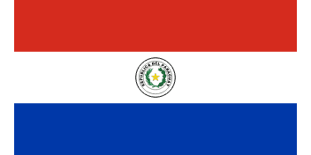
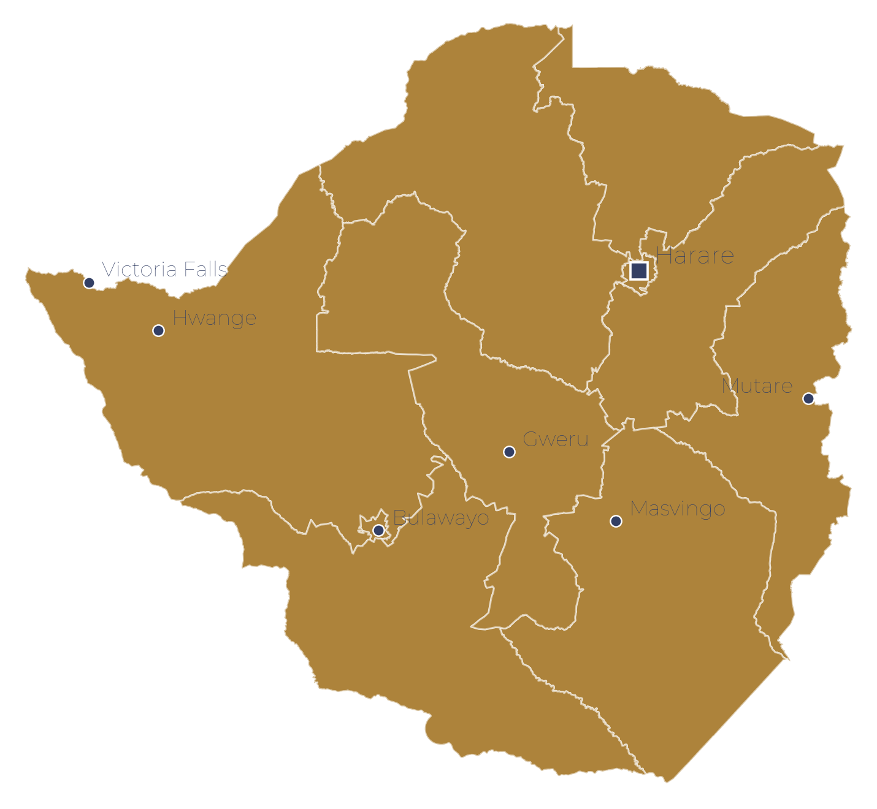
NATIONAL SNAPSHOT · JULY 2026
GENERAL
ECONOMIC
SOCIAL & HUMANITARIAN
~7.1M
UN mid-2026
~$46bn
WB 2026
16/1K
UNICEF 2024
COUNTRY OVERVIEW
Total Population
GDP · 6.6% growth 2025
Under-5 Mortality
Paraguay
74.0 yrs
WB 2024
~2%
6-yr low
~18%
WB 2025
Life Expectancy
Inflation (y/y Jun 26)
Poverty Rate
Republic of Paraguay
~95%
UNESCO 2024
3.6%
Youth 11.7%
99.8%
Hydropower surplus
STATUS
Adult Literacy
Unemployment
Electricity Access
Upper-middle income
CAPITAL
GEOGRAPHIC CONTEXT · SECTOR STATUS
Asunción
GDP / CAP
SECTOR STATUS
~$6,640 (2024)
Health
AMBER
CURRENCY
Education
GREEN
Guaraní (PYG)
Food Security
GREEN
LANGUAGES
Spanish, Guaraní
Economic
GREEN
PERIOD
WASH
AMBER
July 2026
Infrastructure
AMBER
JULY 2026
ODA 01 / 23
World Bank · UN IGME · UNICEF · WHO/UNICEF JMP

Slide 2
PARAGUAY · CROSS-SECTOR SNAPSHOT
Sector Overview — key indicators and recommended interventions by sector
Health & Nutrition
Education
Food Security
Agriculture
Biodiversity & Forests
Infrastructure
WASH
U5 mortality 16/1K; neonatal stable
HIV prevalence 0.5%; TB rising
Obesity 69% adults; NCDs key
Stunting 3.2% — low for region
Literacy 95% — above LAC mean
Secondary enrolment ~79%
Teacher quality; rural access gap
Avg schooling 8.9 yrs (2020)
GHI score 5.2 — low hunger
Undernourishment 5.2% (FAO)
No IPC acute-crisis zones
Agro-export economy strong
~12% of GDP; 40% exports
Soy 10.3Mt 2024/25 (USDA)
6th global soy producer
Beef 8th largest exporter
Forest 38% land; Chaco at risk
Chaco lost 2.4M ha 2010–19
688 bird & 181 mammal species
Only 15% protected areas
Electricity access 99.8%
100% hydropower; major exporter
Itaipú & Yacyretá generation
River logistics constrained
Safely managed water ~64%
Basic sanitation ~96%
Open defecation <1%
Rural piped water gap persists
RECOMMENDED
RECOMMENDED
RECOMMENDED
RECOMMENDED
RECOMMENDED
RECOMMENDED
RECOMMENDED
NCD prevention; maternal care; health system equity.
Rural school access; teacher training; TVET expansion.
Diversification; social protection; smallholder support.
Sustainable intensification; value-add processing; logistics.
Protected-area enforcement; REDD+; anti-deforestation law.
Waterway modernisation; transmission upgrades; rural roads.
Rural water networks; utility efficiency; pipe replacement.
Sources: World Bank · UN IGME · PAHO · FAO · JMP · USDA FAS · UNESCO UIS
ODA 02 / 23

Slide 3
KEY ACTORS & ENGAGEMENT · POLITICAL CONTEXT · JULY 2026
Engagement approach with key stakeholders
Peña (Colorado) won 2023 (~43%). Sep 2025 protests over INDI reversed; Cartes retains party grip. Opposition fragmented — PLRA weakened, Cruzada Nacional split. Economy strong; investment-grade from all three agencies.
BLOC · KEY FIGURES
ENGAGE ON
HOW TO ENGAGE
EFFECT
Central government · Colorado Party Peña (President) · Alliana (VP) · Fernández (Economy)
Infrastructure · digital transition · energy monetisation · Itaipú renegotiation.
Presidency + technocratic ministries; pro-market framing; avoid endorsing Cartes wing.
Empowers reformist wing amid Cartes influence.
Colorado Party machinery Cartes (ex-President, party chief) · Honor Colorado bloc
Nothing directly — political context.
Formal state frameworks only. Highly sensitive.
Any tilt reads as backing internal faction.
Political opposition Alegre (PLRA) · Concertación bloc · Cubas (Cruzada)
Rule of law · civic space · transparency — cautiously.
Low-key, even-handed; no internal contest interference.
Signals concern; opposition remains weak.
Indigenous & rural councils INDI · Indigenous communities · Rural cooperatives
Land rights · Chaco resilience · social services.
Entry point for rural delivery — note Sep 2025 INDI protests.
Empowers community voice; politically charged.
Multilateral & development WB (~$2bn CPF) · IDB · IMF · UN agencies
Infrastructure · climate · digital · social protection.
Lowest-risk channel — align with WB CPF 2027-34 & IDB 2025-29 Strategy.
Least charged; national scale.
World Bank · IDB · IMF · BTI 2026 · Freedom House (Oct 2025 - Jul 2026)
ODA 03 / 23

Slide 4
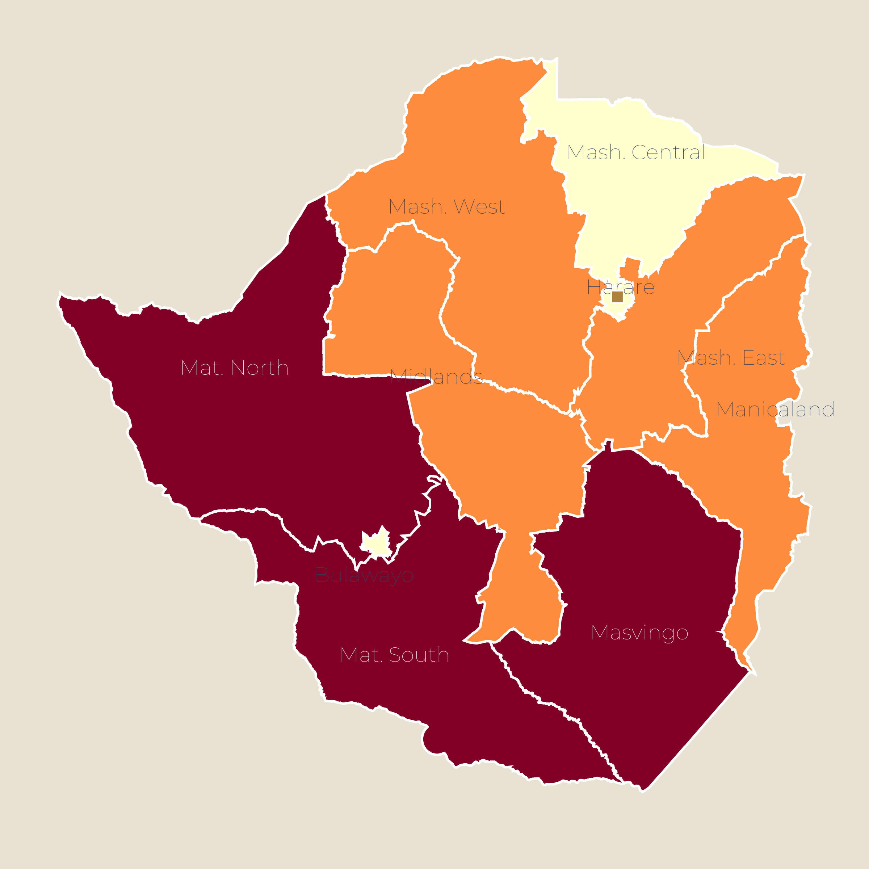
SHOCK & RECOVERY GEOGRAPHY · JULY 2026
Paraguay is emerging from drought-driven agricultural stress into a strong growth rebound
CLIMATE GEOGRAPHY — 2024/25 drought impact
01
CLIMATE — El Niño & recurring drought
El Niño 2023/24 drove 60-year low on the Paraguay River at Asunción; Chaco faced extreme drought affecting indigenous and smallholder livelihoods. 2025 rains recovered; river levels normalised but Chaco remains structurally vulnerable.
02
FISCAL — 41% debt-to-GDP, investment grade
Debt 41.3% of GDP (2025); deficit 2%. All three agencies at investment grade (Moody's Jul 2024; S&P Dec 2025; Fitch). IMF RSF engagement supports climate resilience finance.
High: Severe shock exposure (est.)
03
ENERGY — hydro surplus but domestic demand rising
Medium: Moderate shock exposure (est.)
Itaipú (14GW) and Yacyretá supply ~100% of electricity. Record supply 25,500GWh in 2025, up 26%. But domestic demand rose 18% H1 2026; $5bn investment needed by 2030 to avoid deficit.
Low: Limited shock exposure (est.)
Severe-deficit Chaco & west
The Chaco is the climate-risk belt — Gran Chaco combines the driest climate, indigenous communities and agricultural frontier. Drought resilience and waterway logistics are critical infrastructure.
Stress belt (Pilcomayo/Central)
Surplus & cities (Eastern region)
WMO · FAO · WB · BCP · MEF Paraguay · ANDE
ODA 04 / 23

Slide 5
STRATEGY · NATIONAL DEVELOPMENT PLAN
Paraguay's National Development Plan 2030 — PND 2030 (2014-2030)
Launched 2014; updated 2021
2014-30
~4%+
16
Competitive, high HDI
Plan period — final leg to Vision 2030
Target growth (2026 projection 4.2-4.4%)
Strategic objectives across 4 axes
Stated 2030 goal
OVERVIEW
STRUCTURE
PND 2030 is Paraguay's master plan for 2014-2030 — structured around 3 strategic axes (poverty reduction, inclusive growth, global insertion) plus institutional strengthening. It is the framework every ministry, budget and donor agreement aligns to.
Four strategic axes: poverty reduction & social development; inclusive economic growth; global insertion; institutional-political strengthening. Four cross-cutting lines: equal opportunities; transparent governance; territorial planning; environmental sustainability.
FINANCING
DEVELOPMENT LENS
Full capital market access with investment-grade status. WB CPF 2027-34 mobilises $2bn+; IDB Strategy 2025-29 active. IMF RSF supports climate finance. Public debt at 41% of GDP leaves fiscal space intact.
For partners: frame programmes as delivering PND 2030 priorities; leverage Paraguay's strong macro standing and hydropower surplus for green and digital infrastructure.
Government of Paraguay PND 2030 · MEF 2026 Outlook · WB CPF · IDB Strategy 2025-29
ODA 05 / 23

Slide 6
SECTION 02
Detailed Sector Analysis
Economy · Health · Education · Food Security · Agriculture · Rural Development · Infrastructure · WASH
ODA 06 / 23

Slide 7
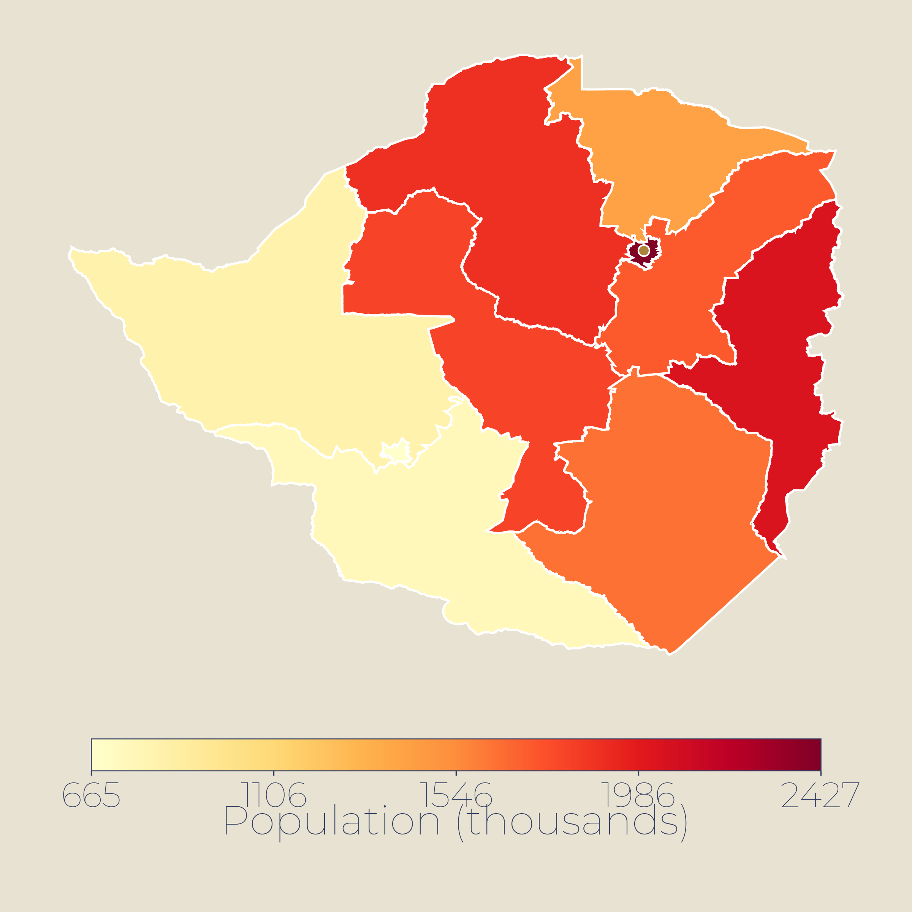
02 · NATIONAL OVERVIEW
At a Glance — Paraguay's key development indicators
~7.1M
~$151bn
74.0 yrs
Population by department (thousands)
Population
GDP (2024)
Life expectancy
INE Census 2022
UN WPP mid-2026
World Bank
WB 2024
16
99/193
~20%
U5 mortality / 1,000
HDI rank (0.756)
Poverty rate
UN IGME 2024
UNDP HDR 2025
WB 2024
62.5%
~$11bn
44.6%
Informality
Reserves (2026)
Debt-to-GDP
INE 2024
Was ~$9.6bn in Mar 2026
$19.9bn · Dec 2024
KEY INSIGHTS
HDI 0.756 (99/193); poverty ~20% and informality 62.5% persist despite strong 6.6% GDP growth in 2025.
Macro stability: investment-grade credit rating; reserves ~$11bn; inflation target 3.5%; current account −2.5% of GDP.
The constraint: high informality and limited fiscal space constrain inclusive growth — structural reforms key.
High: >400,000 inhabitants (est.)
Medium: 150,000-400,000 (est.)
Low: <150,000 inhabitants (est.)
INE Census 2022 · World Bank · UNDP HDR 2025 · IMF 2026 · BCP
ODA 07 / 23

Slide 8
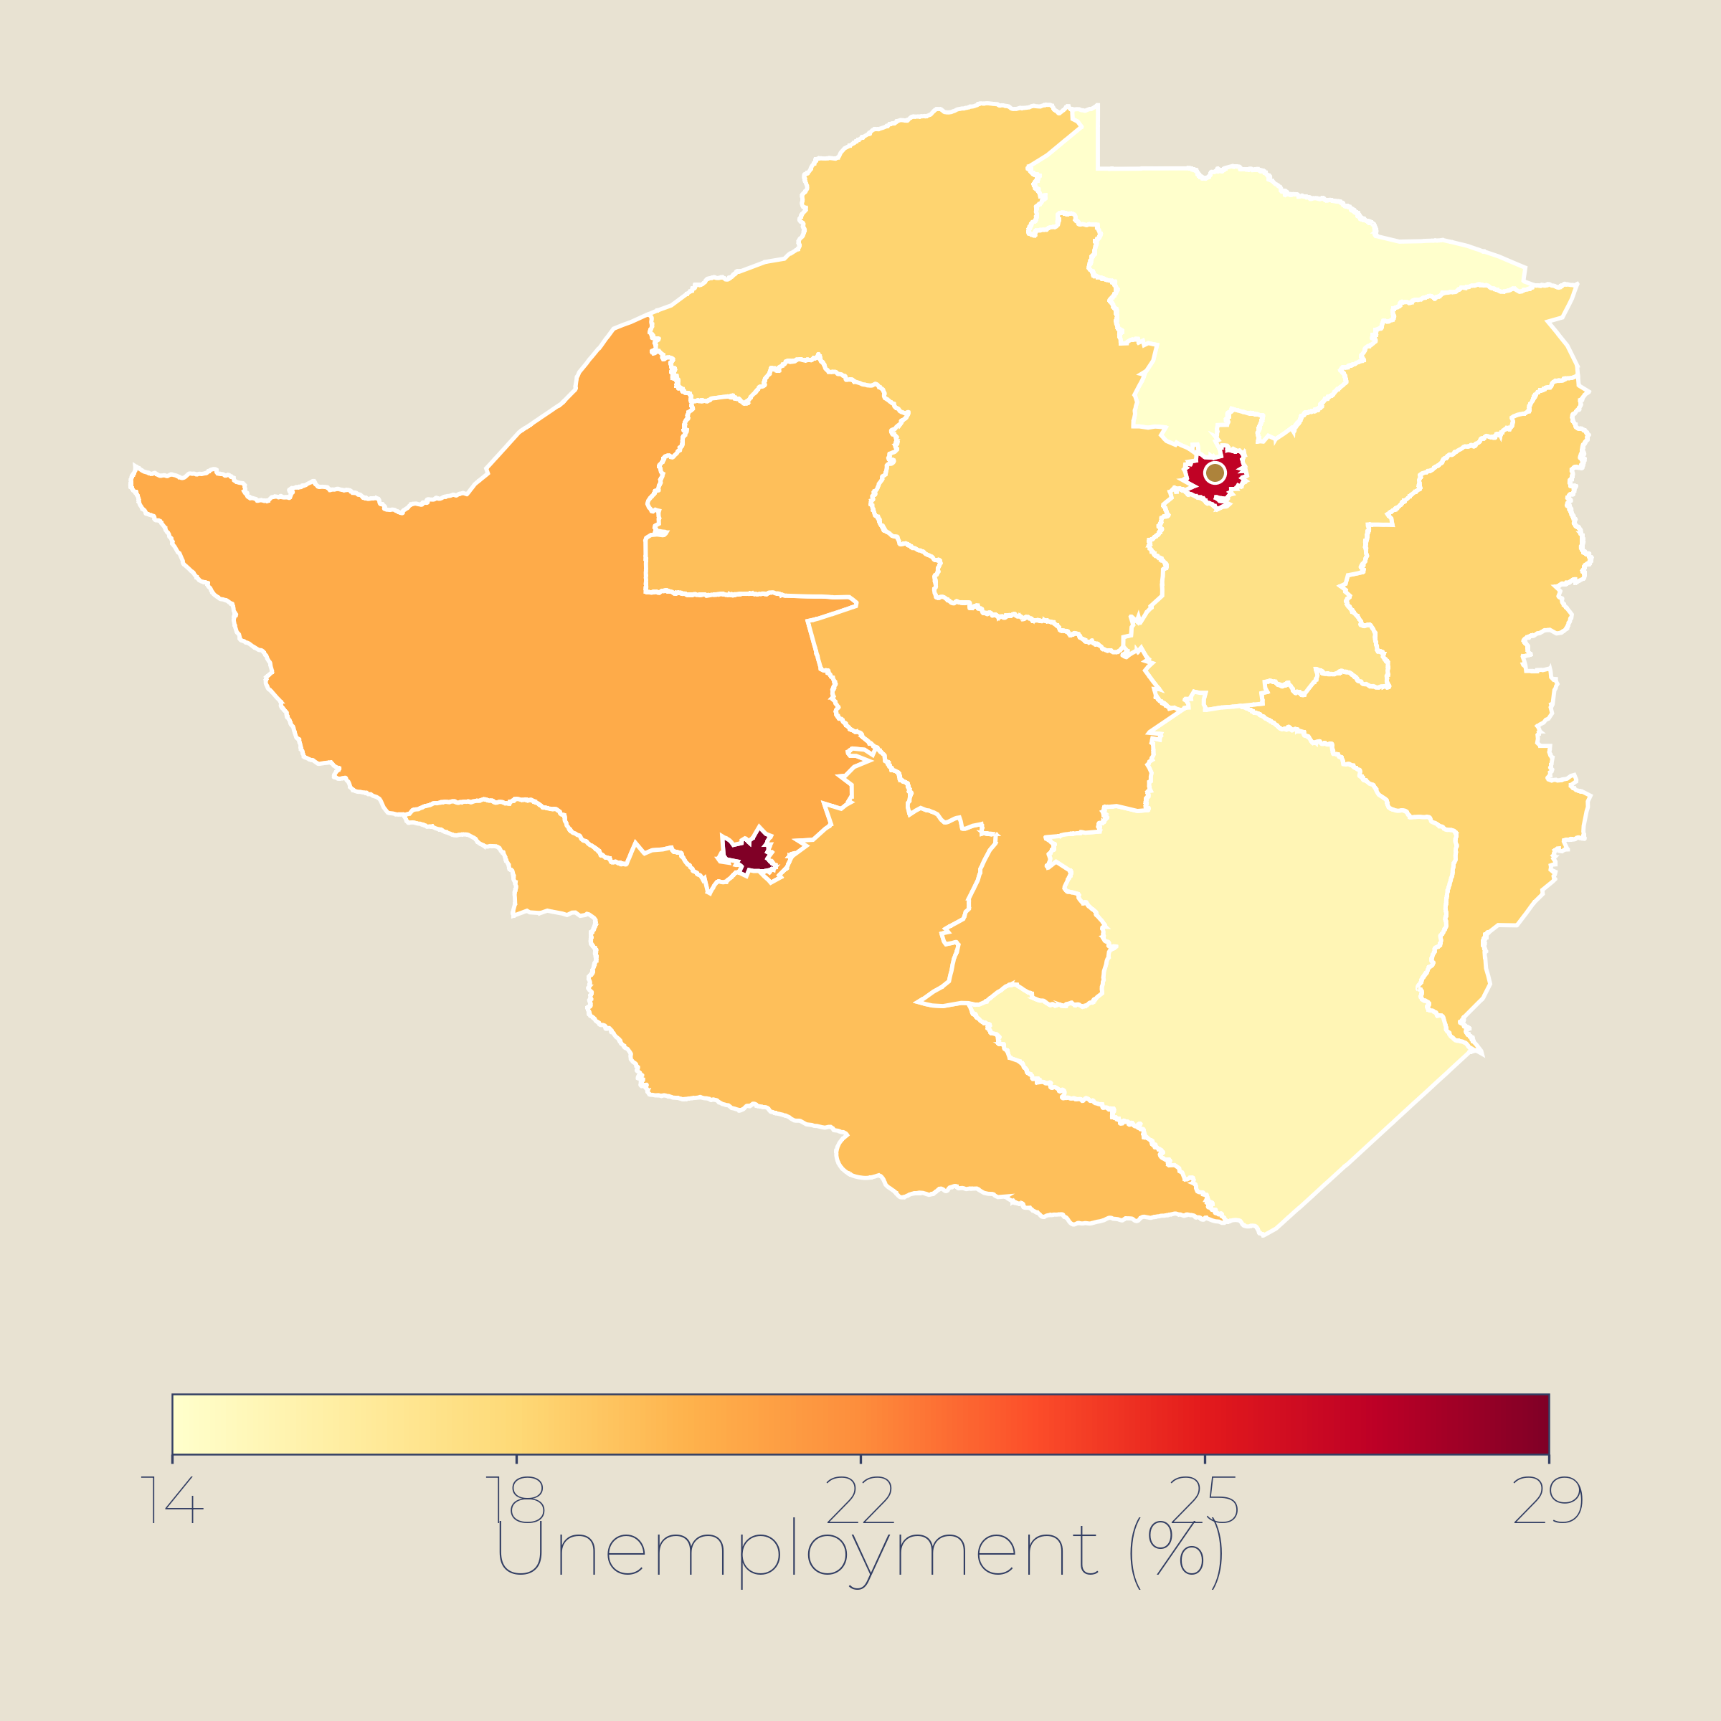
03 · ECONOMY
Economy — 6.6% growth in 2025, fastest in 12 years; investment-grade rating achieved
6.6%
2.1%
$20.5bn
Unemployment by department (%)
INE Q1 2025 pattern (est.)
GDP growth 2025
Inflation y/y
Public debt
WB · 4.3% avg 2026–28f
Jun 2026 · target 3.5%
41.3% of GDP · 2025
KEY INSIGHTS
Growth led by agriculture (+21%), services (+6%), electricity (+13%); S&P upgraded to investment grade Dec 2025; reserves stable.
Narrow export base (soy, beef, electricity); policy rate 6%; informality ~62%; unemployment 3.6% (Q4 2025); youth 11.7%.
Fiscal deficit reduced to 2% of GDP in 2025; poverty fell from 20.5% to 17.9%; target 1.5% deficit under fiscal law.
POTENTIAL INTERVENTIONS
▸
Support formalisation and social security expansion — 62% informality persists.
High: >6% unemployment (est.)
▸
SME and rural finance for women and youth in agriculture value chains.
Medium: 4-6% unemployment (est.)
▸
Value-addition in agro-processing and clean energy exports.
Low: <4% unemployment (est.)
World Bank 2026 · BCP · IMF · INE Paraguay
ODA 08 / 23

Slide 9
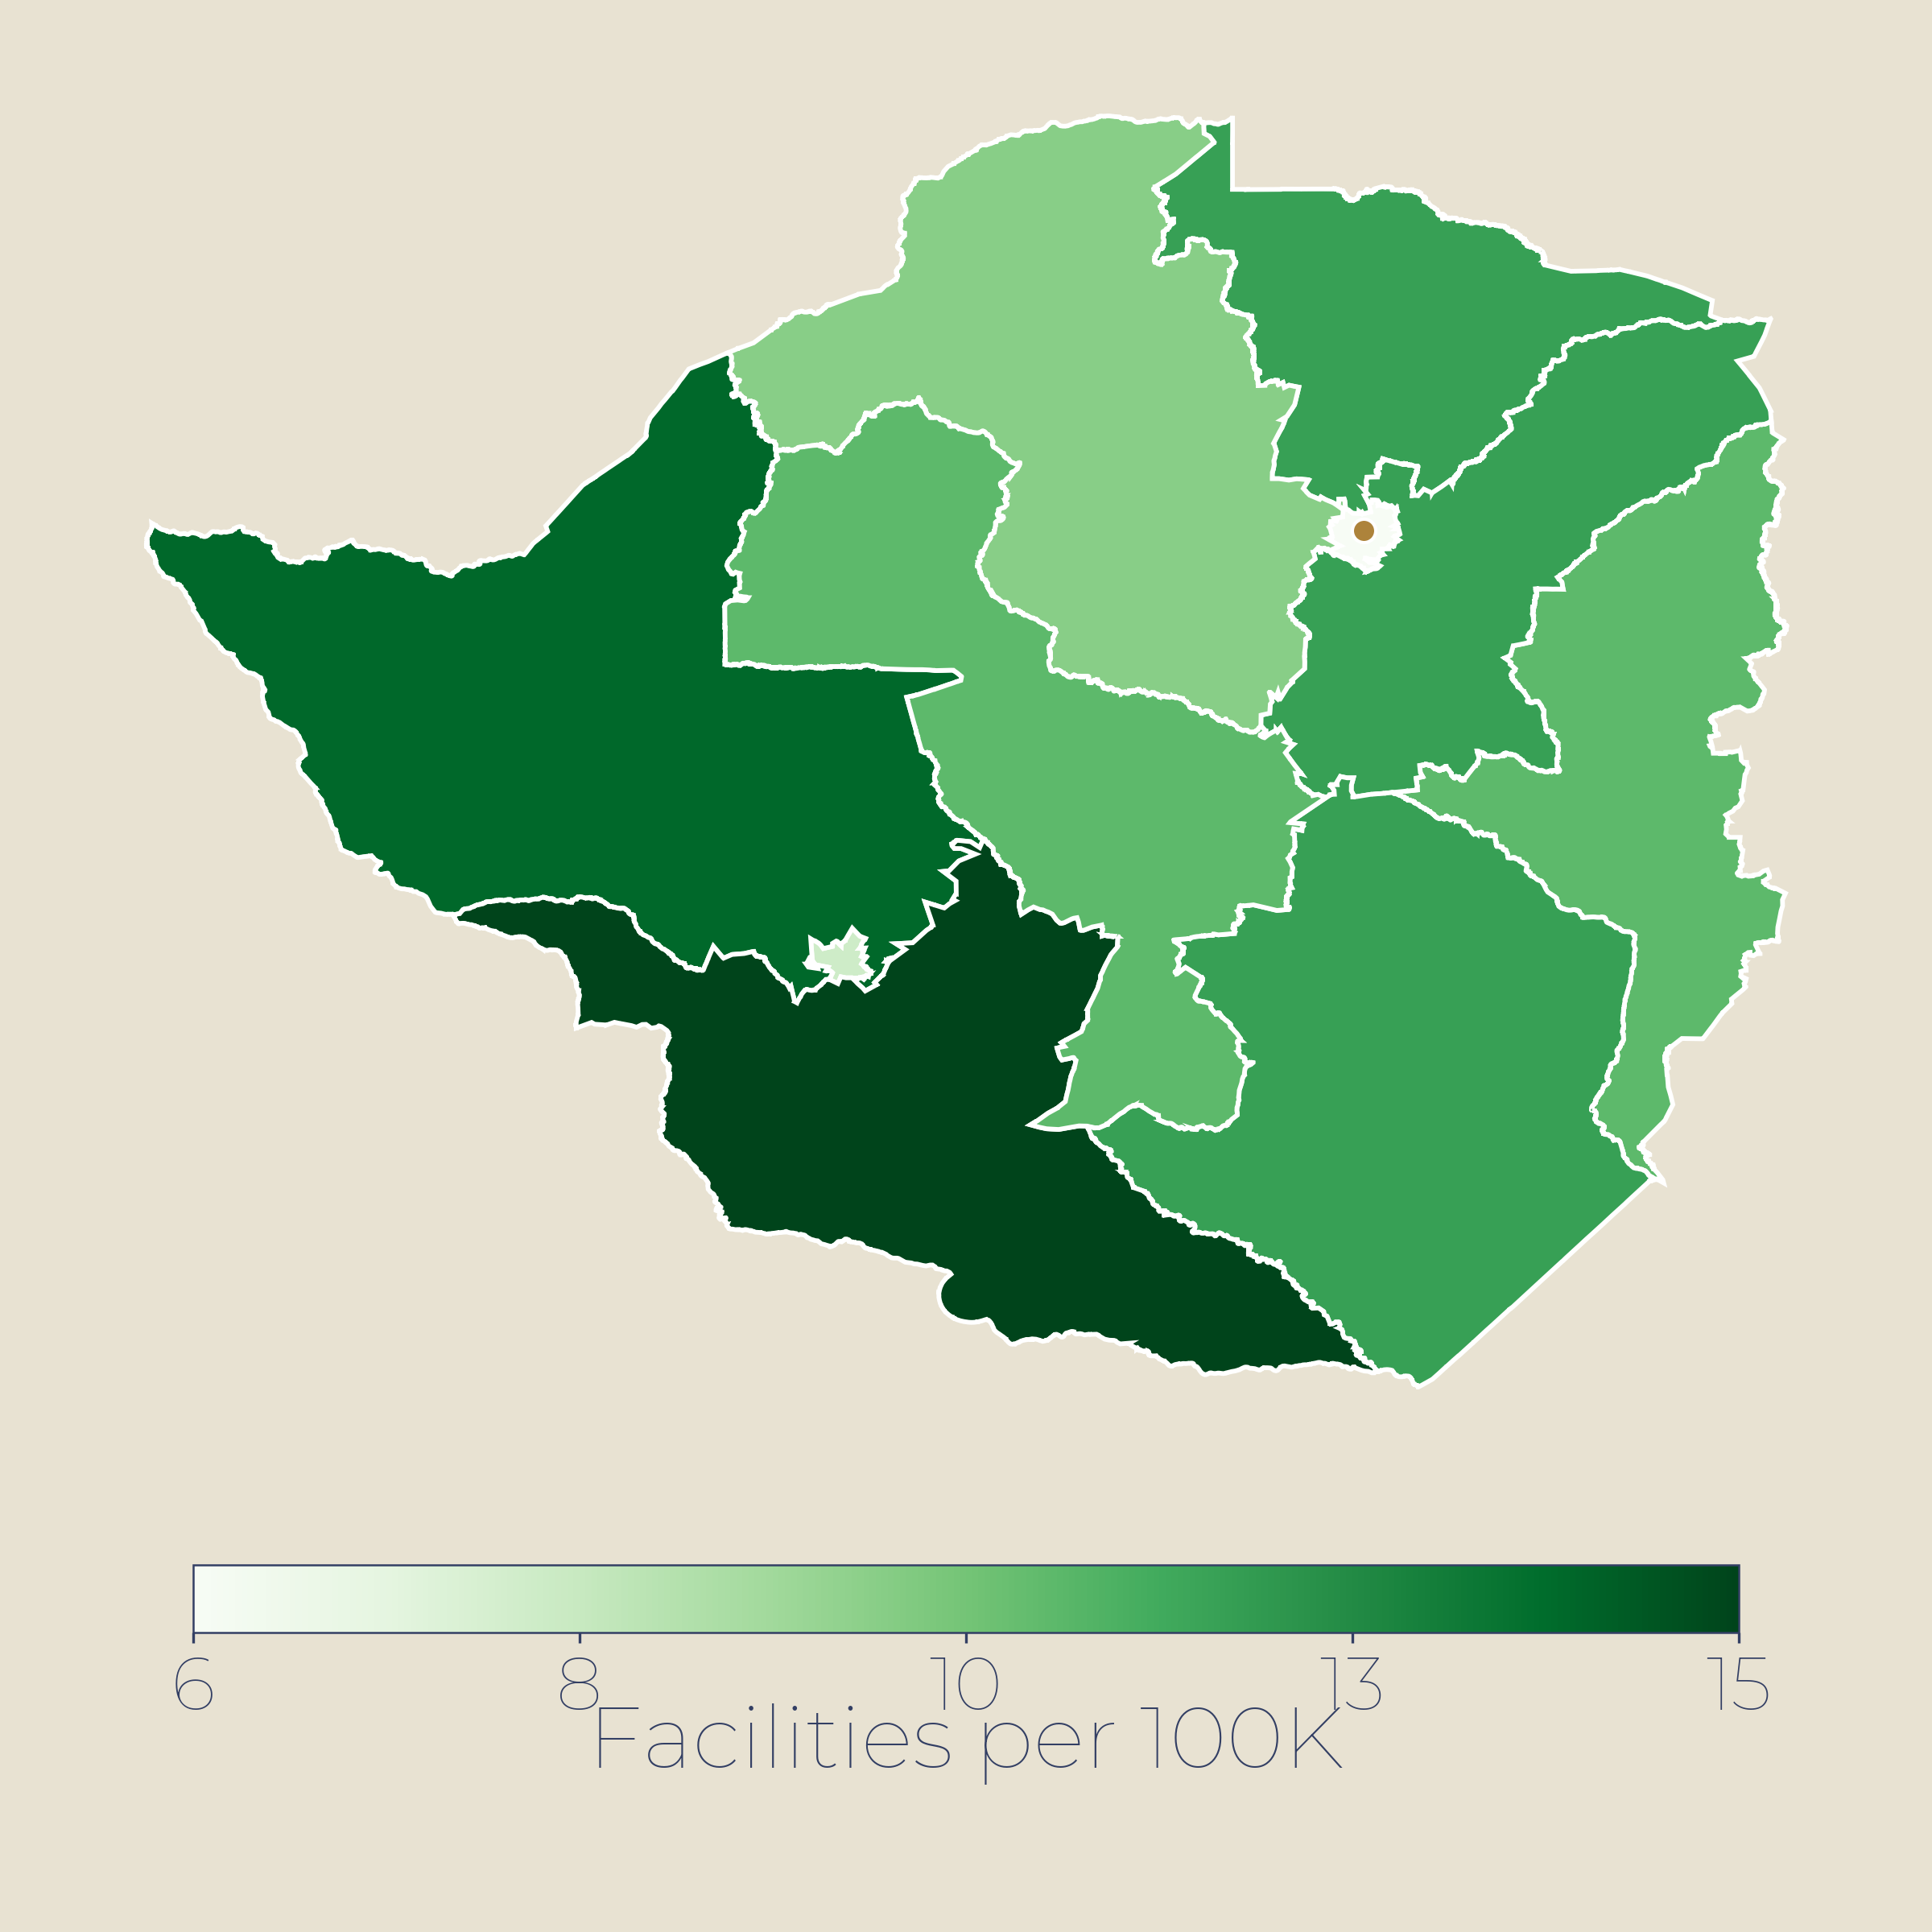
04 · HEALTH
Health — 16 under-5 deaths per 1,000, steady gains but rural gaps persist
16/1K
9/1K
~21K
Health facilities per 100,000
MSPBS pattern (est.)
Under-5 mortality
Neonatal deaths
Living with HIV
UN IGME 2024 · was 46 in 1990
UNICEF 2022 · down from 12
UNAIDS · 0.5% prev
KEY INSIGHTS
Child mortality fell from 46 to 16/1K since 1990; stunting low at 3.2%; 91% of births attended by skilled personnel.
Neonatal deaths fell 12→9/1K; maternal mortality 58/100K; rural health access gaps remain; physician density 3.9/1K.
HIV prevalence 0.5%; new infections rising among youth; PAHO mission 2025 strengthened TB/HIV/MTCT response.
POTENTIAL INTERVENTIONS
▸
Expand primary care in Chaco and rural departments with high maternal mortality.
High: >15 facilities/100k (est.)
▸
Rural retention: housing, training and incentive packages for health workers.
Medium: 8-15 facilities/100k (est.)
▸
Scale TelePrEP and HIV prevention among young key populations.
Low: <8 facilities/100k (est.)
UN IGME 2024 · UNICEF 2025 · UNAIDS · PAHO · WHO
ODA 09 / 23

Slide 10
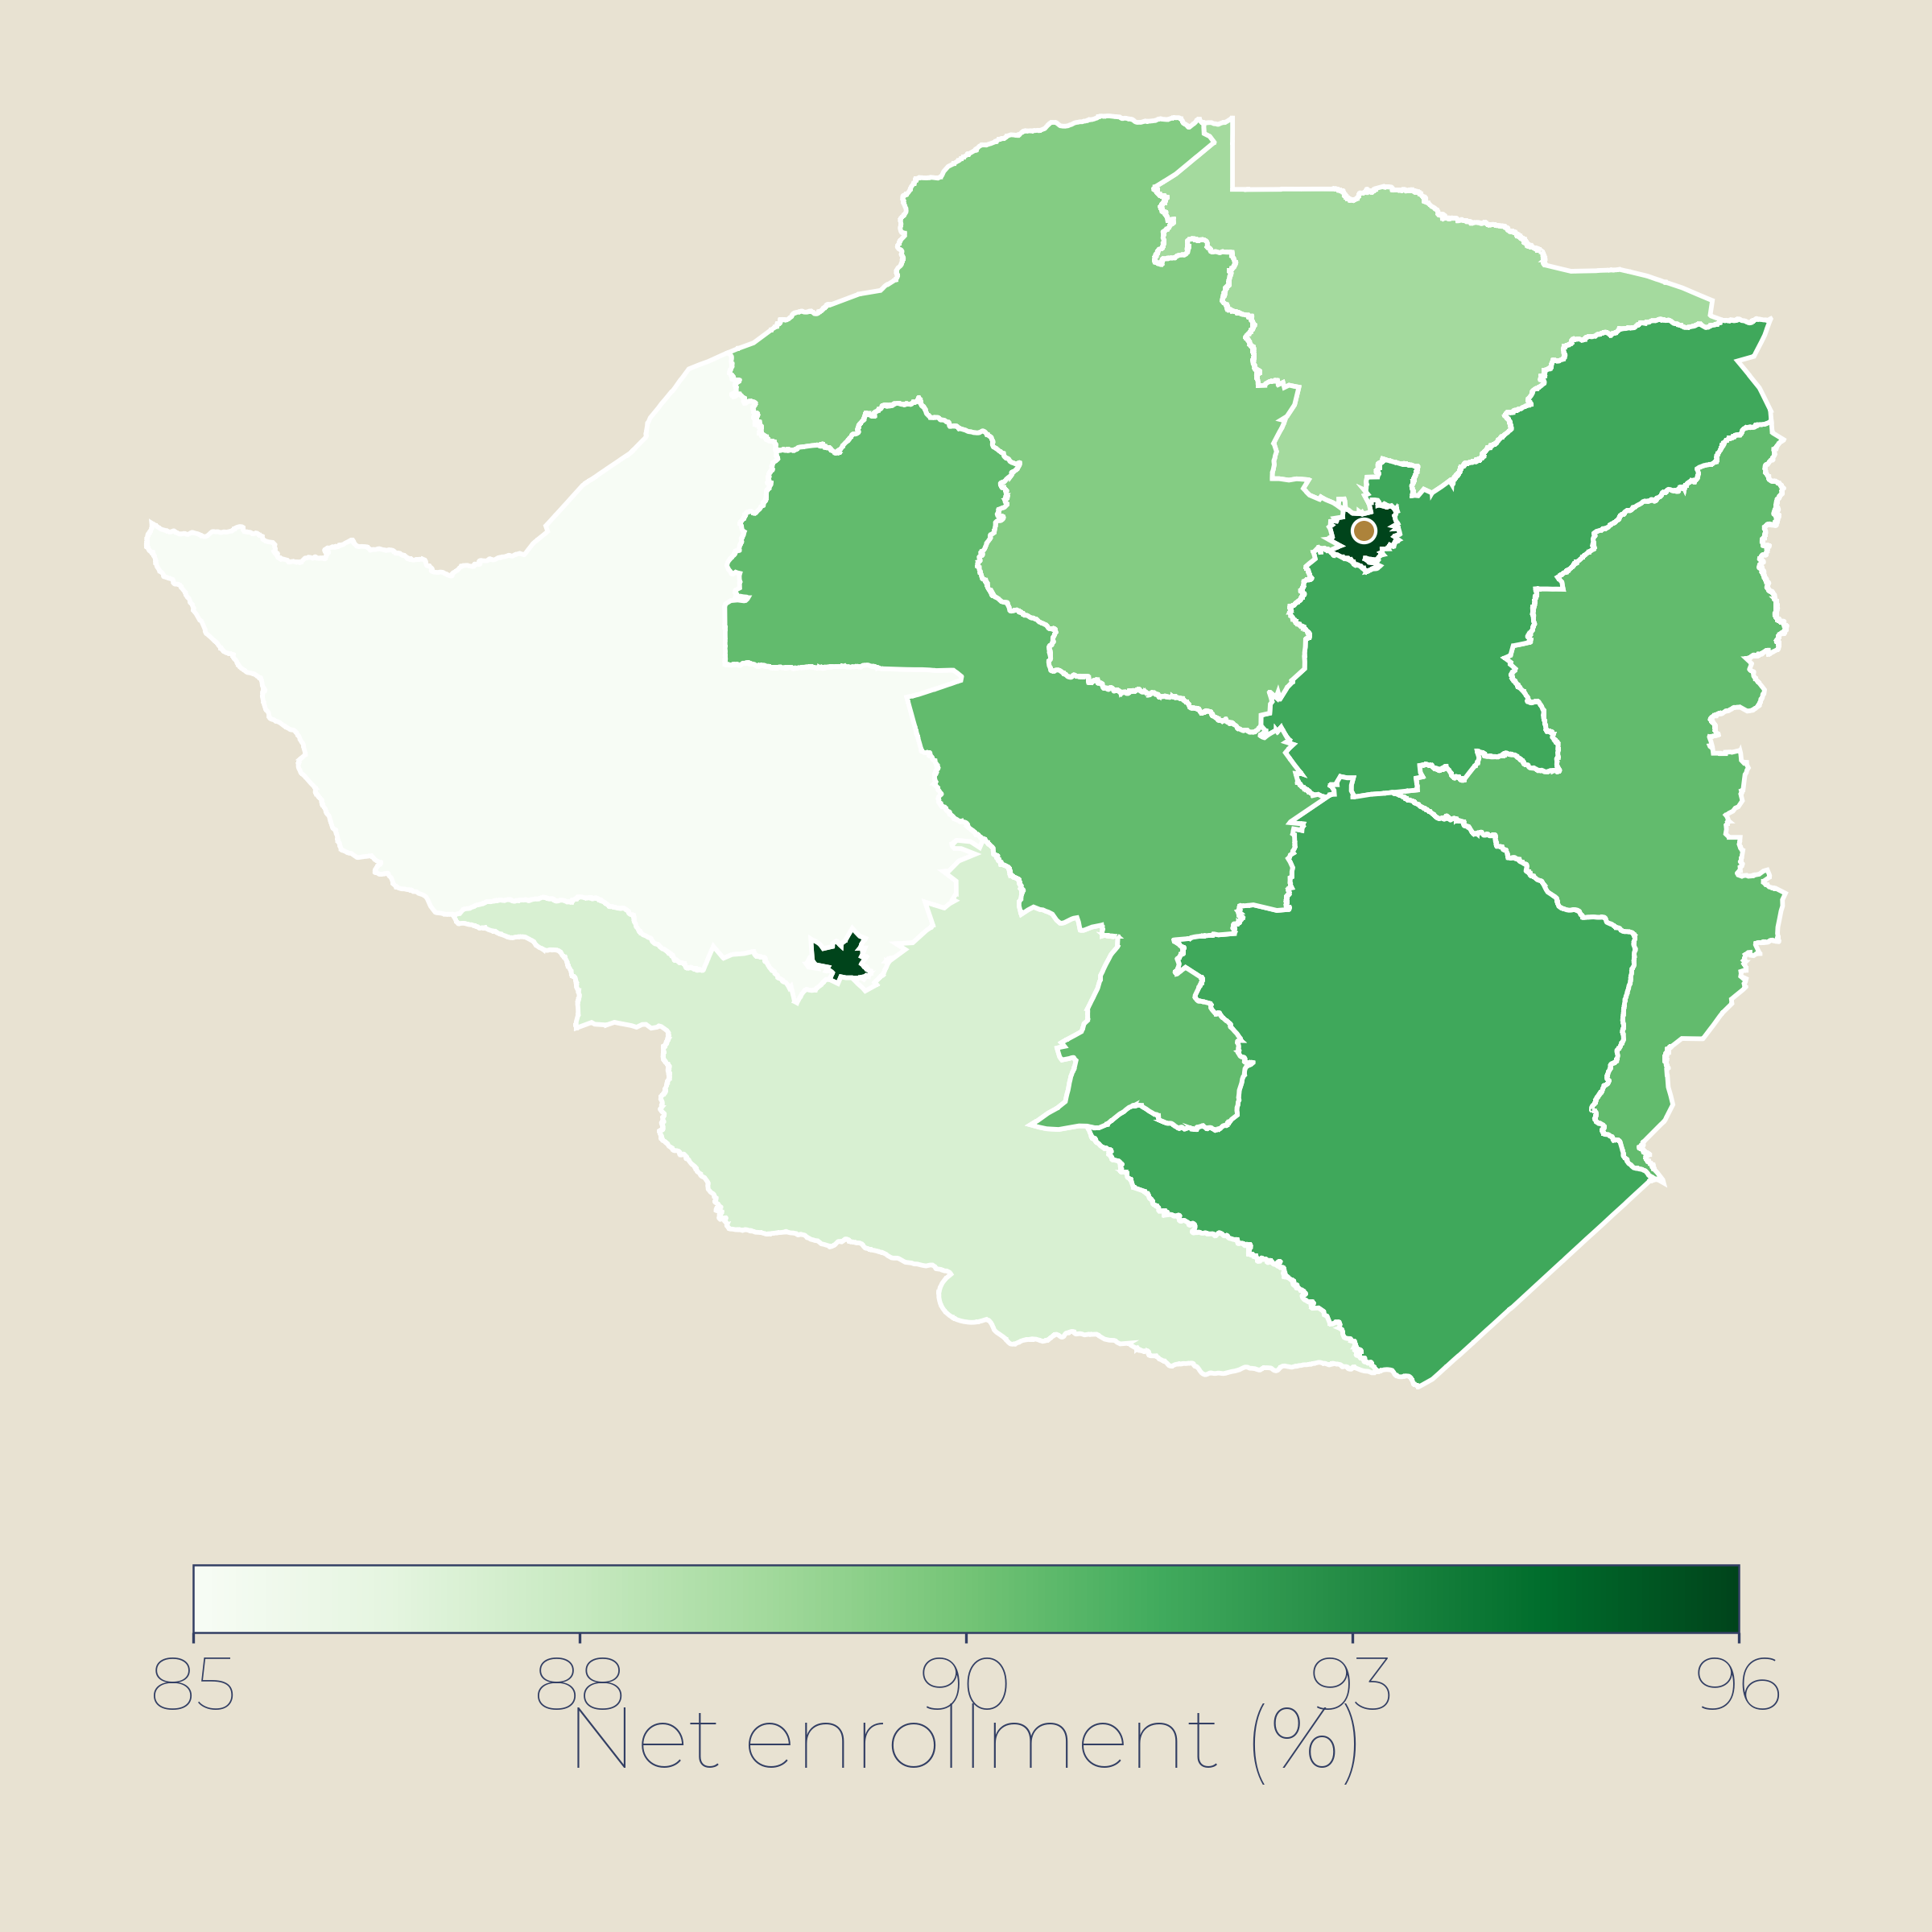
05 · EDUCATION
Education — ~95% adult literacy, but quality and completion gaps remain
~95%
89%
11.7%
Primary net enrolment (%)
MEC pattern (est.)
Adult literacy
Primary completion
Youth unemployment
Above LAC average
WB 2024 · enrolment 89%
ILO 2025
KEY INSIGHTS
Literacy ~95% is a regional asset; youth literacy 98.6% — but secondary enrolment 79% exposes retention gaps.
Out-of-school children concentrated in rural Central, Caaguazú, Alto Paraná; UNICEF-MEC campaign targets 6 depts.
Youth unemployment 11.7% against 62% informality — skills-to-formal-jobs is the binding constraint.
POTENTIAL INTERVENTIONS
▸
Fee support and school feeding in high out-of-school departments.
High: >95% net enrolment (est.)
▸
TVET pipelines for agro-industry, construction, logistics.
Medium: 85-95% enrolment (est.)
▸
Rural teacher incentives and bilingual (Spanish-Guaraní) training.
Low: <85% net enrolment (est.)
World Bank · UNESCO UIS · INE · UNICEF 2025
ODA 10 / 23

Slide 11
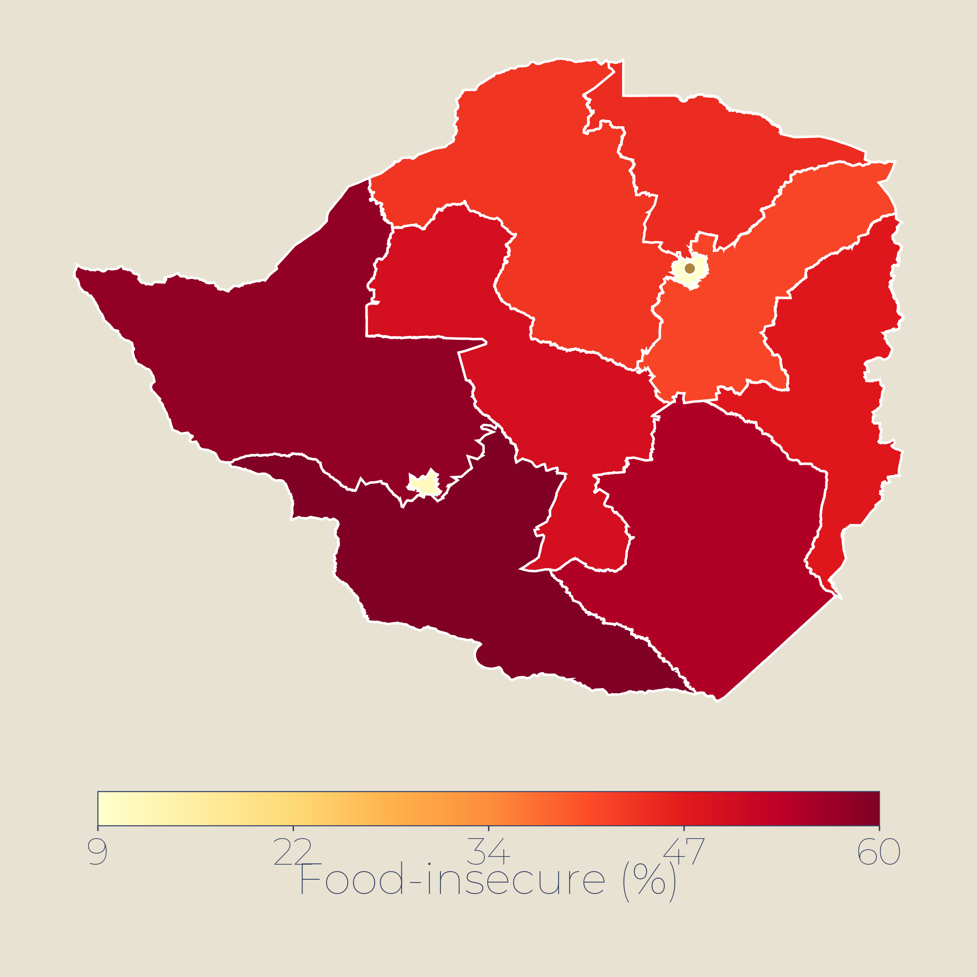
06 · FOOD SECURITY
Food Security — low hunger score (GHI 5.2), but rural Chaco and indigenous areas lag
5.2%
GHI 5.2
3.2%
Rural food-insecure (%)
FAO/WFP 2025 pattern (est.)
Undernourishment
Hunger score
Child stunting
FAO 2023 · low hunger
GHI 2025 · rank 28/123
JME 2024
KEY INSIGHTS
GHI score 5.2 — ranked 28th globally; produces food for ~60M people yet pockets of rural hunger persist.
Stunting 3.2% is low regionally; overweight affects >50% of adults; healthy-diet cost above LAC average.
Chaco and indigenous communities face highest food insecurity; school feeding (Hambre Cero) reaches 18K+ jobs.
POTENTIAL INTERVENTIONS
▸
Expand Hambre Cero school feeding and cash transfers to Chaco departments.
High: >25% food-insecure (est.)
▸
Smallholder market linkages and grain-storage support.
Medium: 12-25% food-insecure (est.)
▸
Indigenous land and water access; nutrition-sensitive agriculture.
Low: <12% food-insecure (est.)
GHI 2025 · FAO SOFI 2026 · WFP · UNICEF · JME
ODA 11 / 23

Slide 12
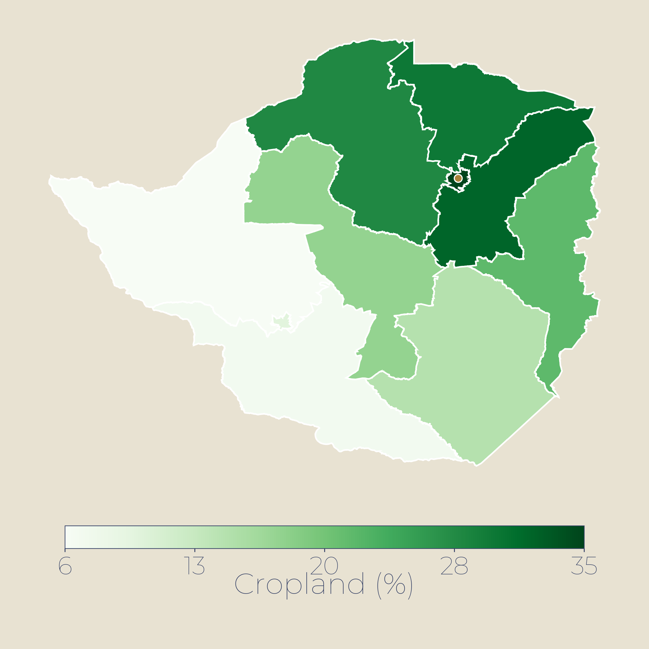
07 · AGRICULTURE
Agriculture — soy and beef export powerhouse; ~11% of GDP but over half of export earnings
+21%
~11%
10.9M
Cultivated cropland (% of area)
FAO / MAG pattern (est.)
Ag growth Q4 2025
Share of GDP
Soybean tonnes
BCP · rebound year
4th largest soy exporter
2025/26 forecast · USDA FAS
KEY INSIGHTS
Agriculture rebounded sharply in Q4 2025, growing +20.8% year-on-year after La Niña conditions eased.
Soy, beef and cereals account for 65% of exports; 80% of soybeans go to Argentina for crushing.
Rainfed production faces yield volatility; 2022 drought cut yields below 22 bu/acre vs 47 bu in good years.
POTENTIAL INTERVENTIONS
▸
Expand irrigation and climate-resilient seed systems.
High: >50% cultivated land (est.)
▸
Strengthen domestic soy crushing capacity (currently 50% utilised).
Medium: 25-50% cultivated (est.)
▸
Diversify export markets beyond Argentina/Brazil.
Low: <25% cultivated land (est.)
USDA FAS 2026 · BCP · World Bank · CAPPRO
ODA 12 / 23

Slide 13
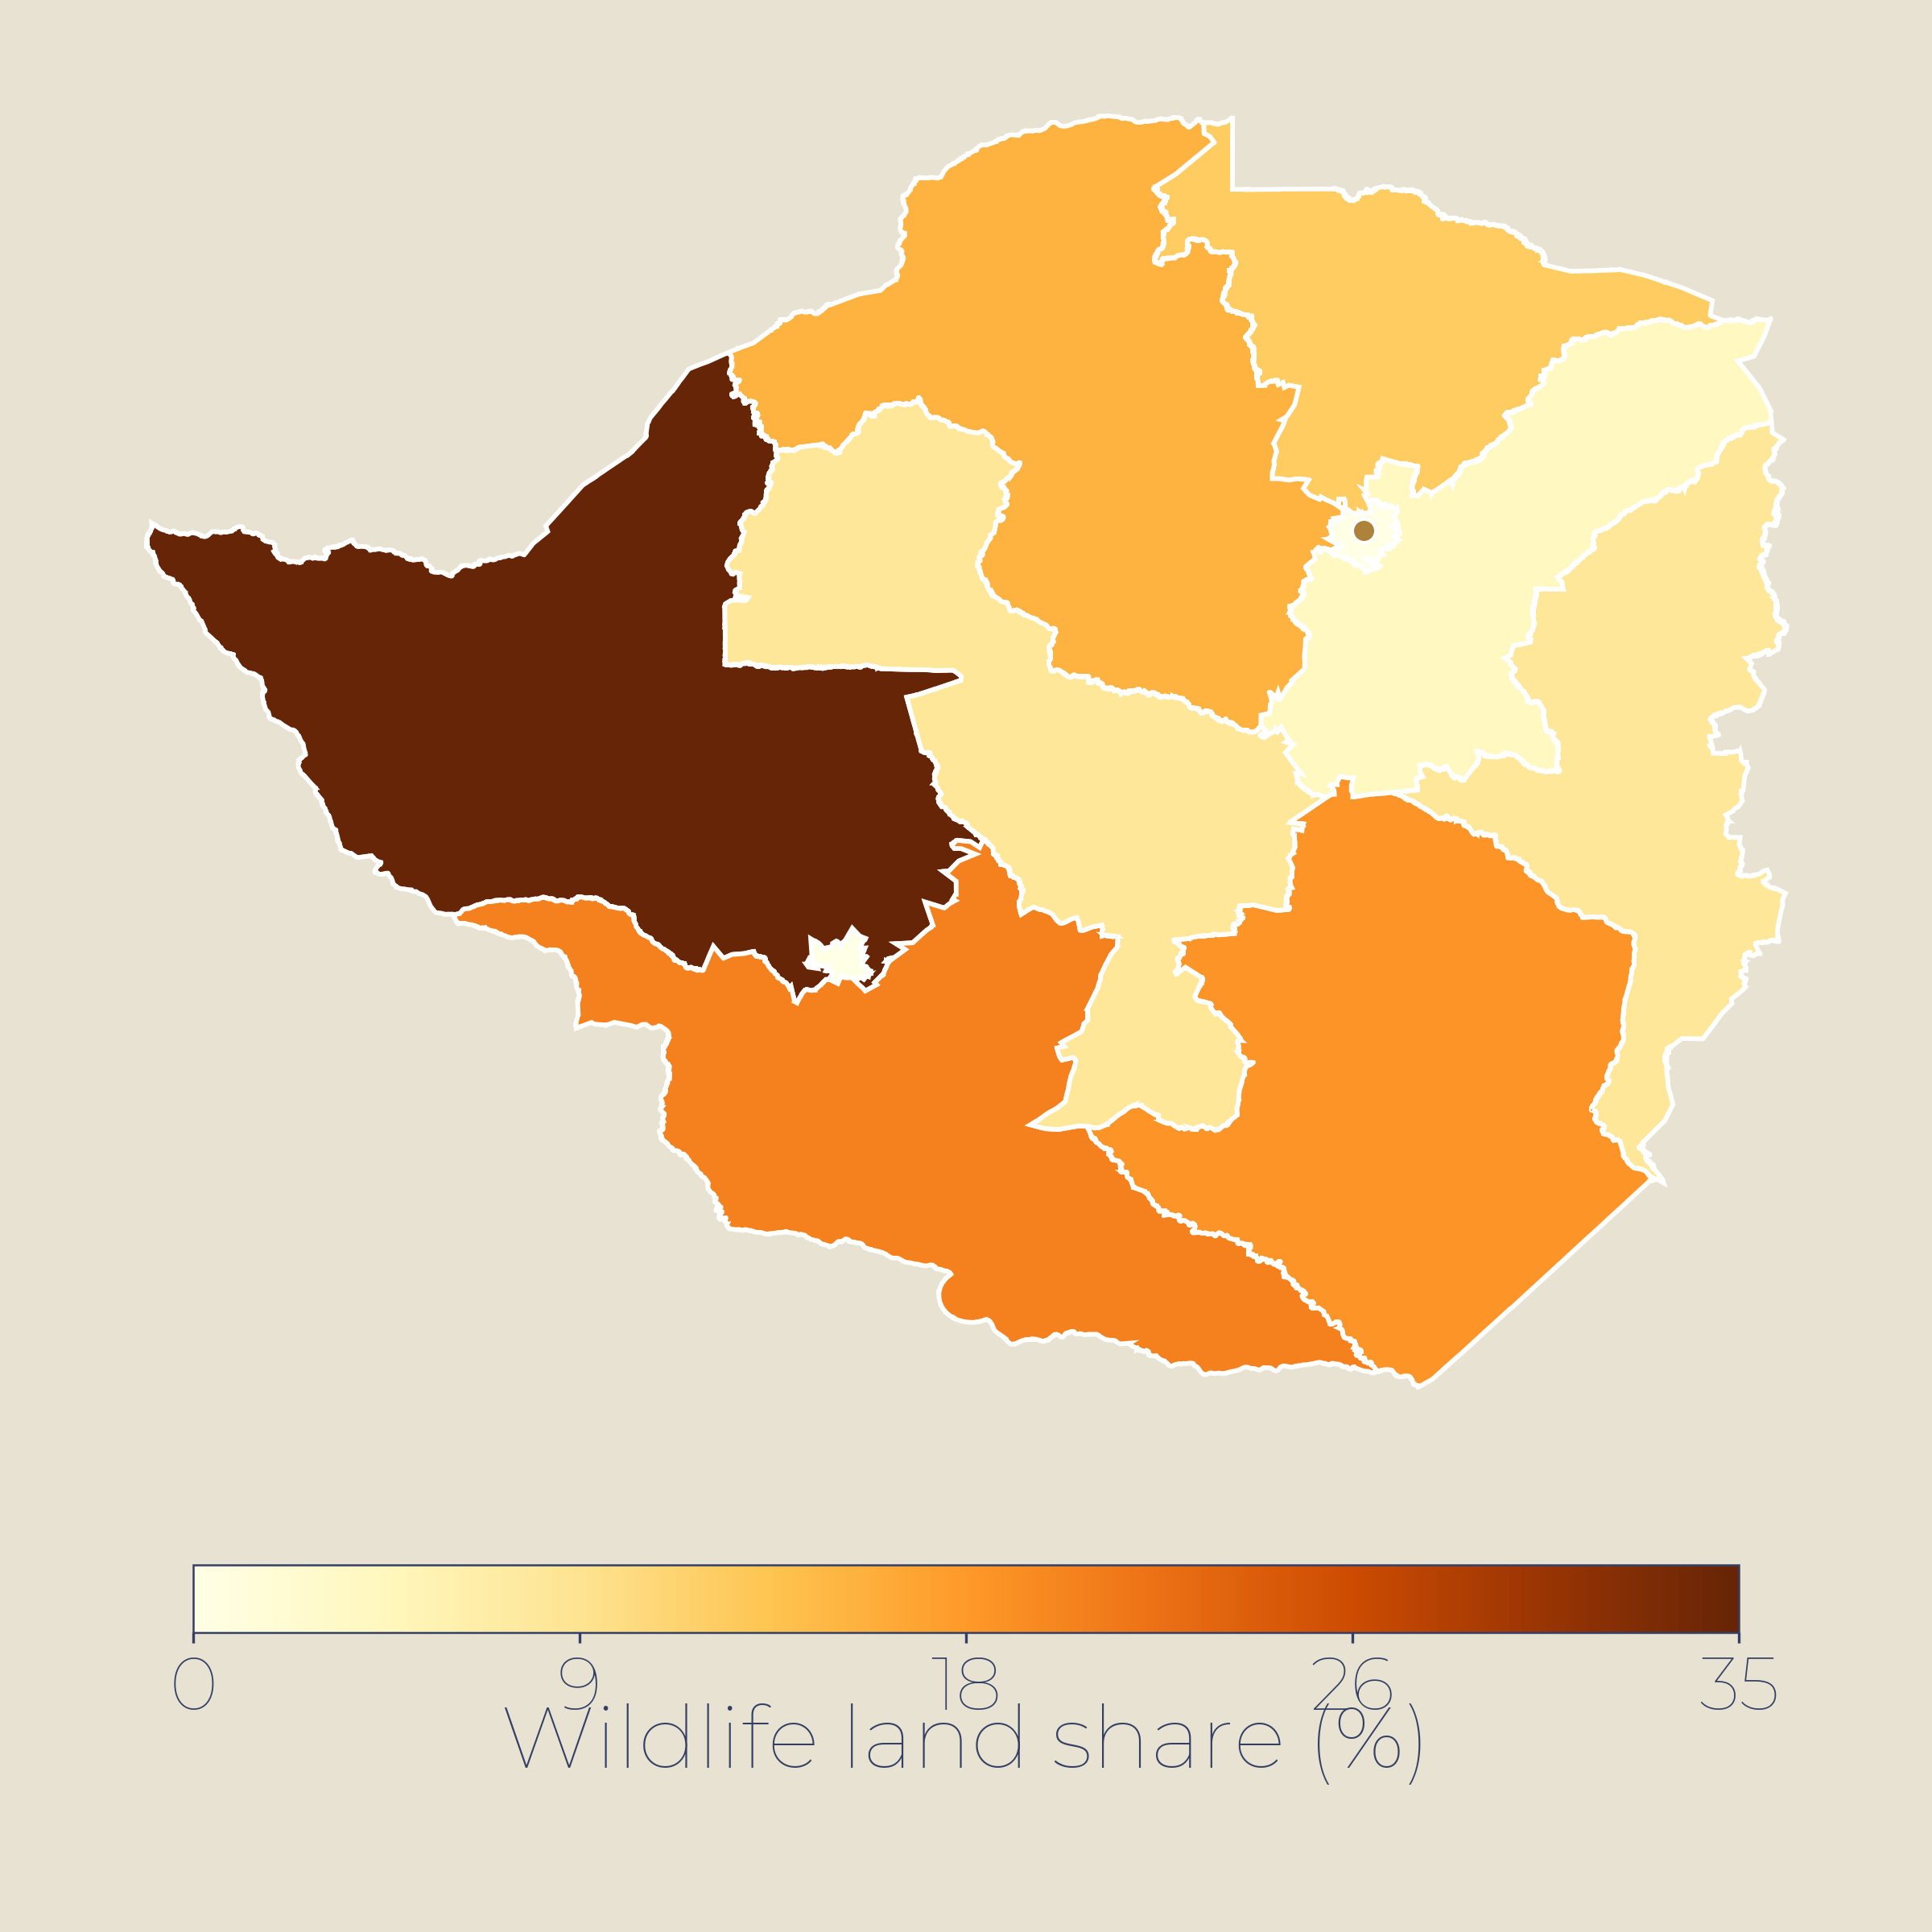
08 · CHACO BIOSPHERE & WILDLIFE ECONOMY
Chaco Biosphere — South America's second-largest forest, under strain from ranching expansion
~15%
720k ha
~50%
Land under wildlife management (%)
SINASIP / MADES pattern (est.)
Protected areas
Defensores del Chaco
Chaco forest loss
SINASIP · 100 areas
Largest national park
Predicted by 2030
KEY INSIGHTS
Since 2017 Federación por la Autodeterminación de los Pueblos Indígenas —(FAPI) has digitally mapped indigenous lands across the Chaco and Eastern Forest regions — home to 19 distinct peoples.
Cattle ranching is the dominant driver — beef exports, leather, pasture expansion — but deforestation claims 1,000+ ha/day at the forest margin.
Strains: INDI acquires only 47% of entitled land; EU import limits and traceability demands squeeze earnings. The weakness is enforcement, not demand.
POTENTIAL INTERVENTIONS
▸
Forest4Life: strengthen fire management and buffer zones in key reserves.
High: >15% wildlife mgmt (est.)
▸
Wildlife corridors: GPS collars, fencing, water separation for conflict zones.
Medium: 5-15% wildlife mgmt (est.)
▸
Diversify: ecotourism, sustainable ranching, conservation finance.
Low: <5% wildlife mgmt (est.)
UNEP-WCMC 2025 · Guyra Paraguay · World Land Trust · EU Forest4Life
ODA 13 / 23

Slide 14
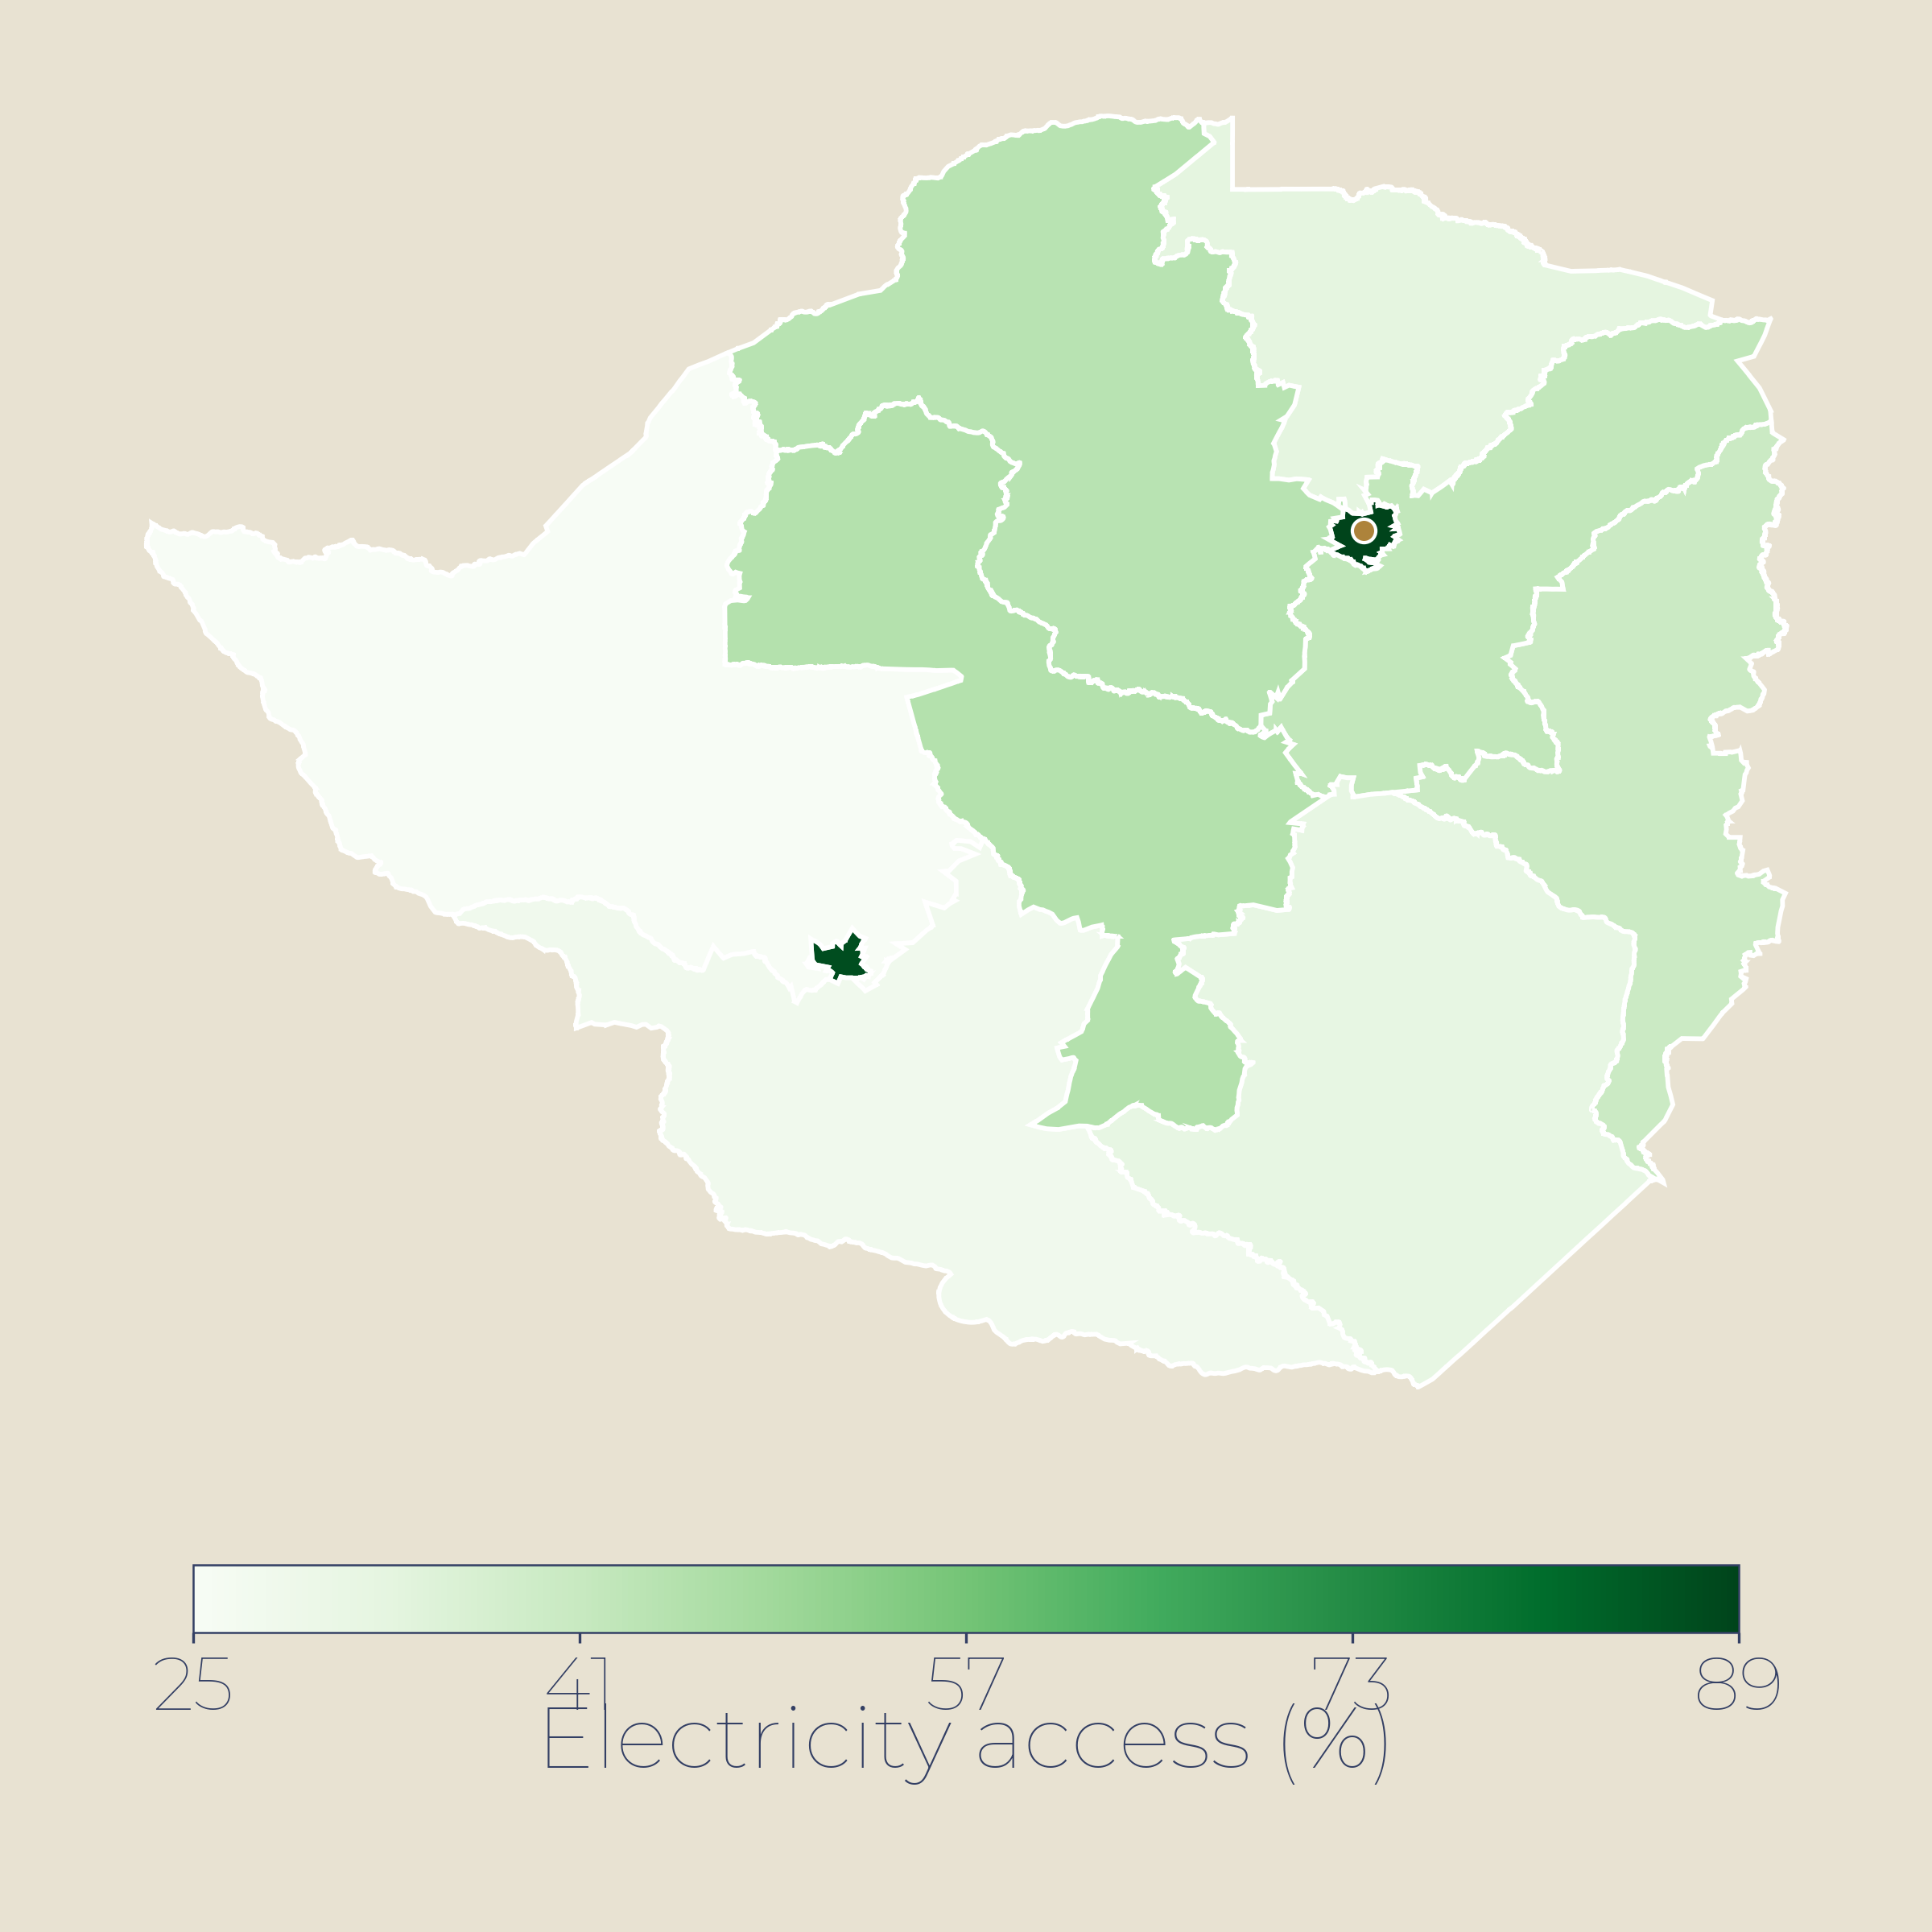
09 · INFRASTRUCTURE
Infrastructure — hydropower surplus but rising domestic demand; grid upgrades urgent
99.5%
100%
+26%
Electricity access (%)
WB Tracking SDG7 pattern (est.)
Electricity access
Renewable share
Itaipú supply 2025
Rural gaps in Chaco
Itaipú + Yacyretá hydro
Record 25,500 GWh to ANDE
KEY INSIGHTS
Paraguay produces 100% renewable electricity from hydropower but domestic demand is rising fast, straining surplus.
Itaipú provides ~90% of electricity consumed and sets record supply to ANDE in 2025; new Brazil deal enables market sales.
Grid ageing and 31% distribution losses require $5bn investment by 2030 to avoid blackouts.
POTENTIAL INTERVENTIONS
▸
Grid modernisation: reduce 31% distribution losses.
High: >98% electricity access (est.)
▸
Off-grid solar for remote Chaco communities.
Medium: 90-98% access (est.)
▸
Diversify generation mix: solar, biomass complement hydro.
Low: <90% electricity access (est.)
World Bank/ESMAP · ANDE · Itaipú · Energy Policy 2024
ODA 14 / 23

Slide 15
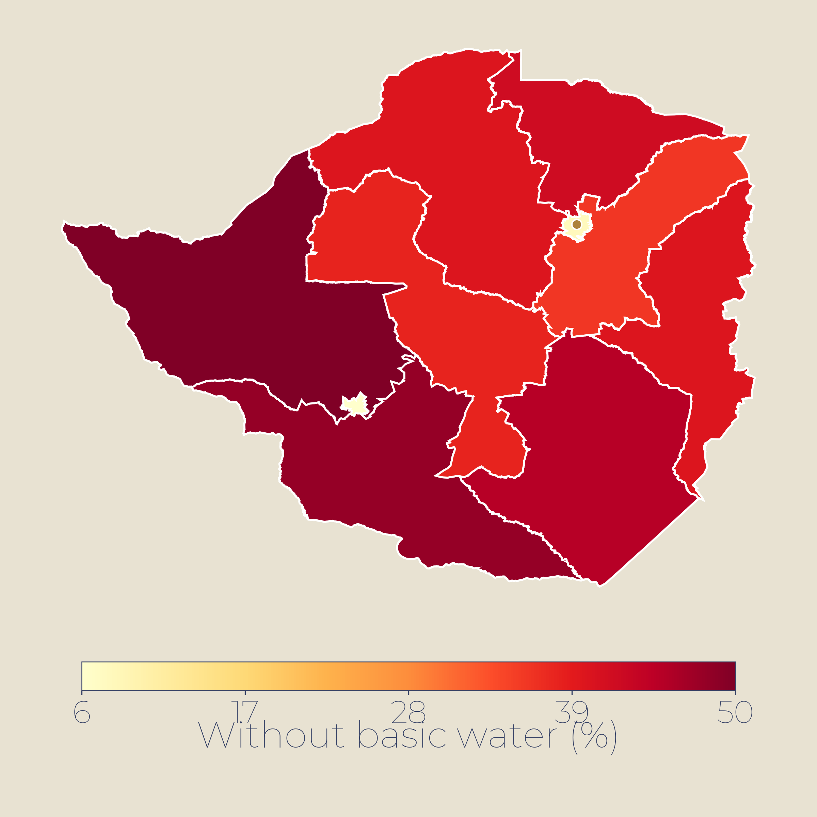
10 · WASH
WASH — near-universal basic water but groundwater quality issues in the Chaco
<1%
~64%
~96%
Without basic water (%)
JMP WHO/UNICEF pattern (est.)
Open defecation
Safely managed water
Basic sanitation
LAC region eliminated
JMP · basic ~100%
JMP 2024
KEY INSIGHTS
Open defecation is nearly eliminated (<1%) in Latin America including Paraguay; basic water coverage ~100%.
The Chaco faces droughts and poor-quality groundwater affecting indigenous communities; climate risk high.
Safely managed water (~64%) and sanitation (~59%) still lag basic coverage; rural-urban gaps persist.
POTENTIAL INTERVENTIONS
▸
Climate-resilient water supply in Chaco indigenous communities.
High: >30% without basic water (est.)
▸
Upgrade basic to safely managed services in rural areas.
Medium: 10-30% without water (est.)
▸
Urban utility efficiency: reduce non-revenue water.
Low: <10% without basic water (est.)
WHO/UNICEF JMP 2025 · UNICEF Paraguay · World Bank
ODA 15 / 23

Slide 16
SECTION 03
UAE Projects
ODA 16 / 23

Slide 17
SECTION 04
Proposed Projects
A three-tier programme menu — hydropower & climate resilience · human capital & health systems · agri-export growth
ODA 16 / 23

Slide 18
11 · PROPOSED PROGRAMS
Program Menu
PROJECT
SECTOR
COST
DURATION
PARTNERS
TIER 1 · RESILIENCE & CRISIS RESPONSE
P1
Chaco Climate-Resilient Food Systems & Livelihoods
Food security · Social
~$15-25M
3-4 yrs
WFP · FAO · IDB
P2
Rural WASH & Sanitation Acceleration
WASH · Health
~$12-20M
3 yrs
WHO · UNICEF · IDB
TIER 2 · HUMAN CAPITAL & SYSTEMS
P3
Maternal-Neonatal Care & Health Workforce
Health
~$15-25M
4 yrs
PAHO · UNICEF · IDB
P4
Youth Skills & TVET for Growth Sectors
Education & jobs
~$12-20M
3-4 yrs
UNESCO · IDB · ILO
P5
Agro-Processing & Soy Value Chain Upgrade
Agriculture · industry
~$30-50M
5 yrs
FAO · IFAD · IDB
TIER 3 · GROWTH UNLOCKS
P6
Off-Grid Solar & Clean Cooking for Chaco
Energy · WASH
~$20-40M
4-5 yrs
UNDP · IDB · ANDE
P7
Gran Chaco Conservation & Indigenous Livelihoods
Environment · rural dev.
~$8-15M
4 yrs
Guyra · WWF · UNEP
Indicative cost bands for scoping; all figures subject to design studies and co-financing.
ODA 17 / 23

Slide 19
11 · PROPOSED PROGRAMS
Program Menu (1/3)
Protects the drought-vulnerable Chaco
TIER 1 · RESILIENCE & CRISIS RESPONSE
P1
P2
Chaco Climate-Resilient Food Systems & Livelihoods
Rural WASH & Sanitation Acceleration
FOOD SECURITY · BOQUERÓN & ALTO PARAGUAY
WASH / HEALTH · CHACO + RURAL EASTERN REGION
Water harvesting, resilient seed systems & inputs
Scalable social protection with climate triggers
Indigenous livelihood support (50% women)
Climate-proof wells & solar-pumped systems
Sanitation & hygiene with health extension teams
Strengthen rural service provider networks
IMPACT Protect the arid Chaco & indigenous communities; cut recurring drought emergency cycles. Benchmark: FAO appeal $7.1M, 2023.
IMPACT Close rural safe-water gap (64% safely managed); reach 200,000+ underserved. Align w/ SIASAR platform.
COST ~$15-25M
DURATION 3-4 yrs
COST ~$12-20M
DURATION 3 yrs
FAO 2023 · JMP 2024 · UNICEF · IDB
ODA 18 / 23

Slide 20
11 · PROPOSED PROGRAMS
Program Menu (2/3)
Defends the human-capital edge
TIER 2 · HUMAN CAPITAL & SYSTEMS
P3
P4
P5
Maternal-Neonatal Care & Health Workforce
Youth Skills & TVET for Growth Sectors
Agro-Processing & Soy Value Chain Upgrade
HEALTH · CHACO & RURAL DEPARTMENTS
EDUCATION & JOBS · NATIONAL
AGRICULTURE · EASTERN & CHACO REGIONS
Equip district maternal-newborn units
Rural retention: allowances, housing, training
Integrate indigenous maternal health practices
Employer-linked TVET: agribusiness, logistics, energy
Digital skills with women's targets
Link graduates to MSME finance
Expand domestic crush capacity (4.7 MMT potential)
Rural processing: soy, rice, livestock
Climate-resilient inputs & logistics
IMPACT Reduce MMR (71/100k in 2020); Paraguay is a PAHO priority country for maternal mortality reduction.
IMPACT Close the skills-to-jobs gap behind 13.4% youth unemployment (ILO 2024).
IMPACT Raise value-add from 3rd-largest soy exporter; soy exports $4.4B in 2024 under NDP 2030.
COST ~$15-25M
DURATION 4 yrs
COST ~$12-20M
DURATION 3-4 yrs
COST ~$30-50M
DURATION 5 yrs
USDA GAIN 2025-26 · FAO · IDB 2025
ODA 19 / 23

Slide 21
11 · PROPOSED PROGRAMS
Program Menu (3/3)
Unlocks the other tiers
TIER 3 · GROWTH UNLOCKS
P6
P7
Off-Grid Solar & Clean Cooking for Chaco
Gran Chaco Conservation & Indigenous Livelihoods
ENERGY · SCATTERED RURAL & CHACO
ENVIRONMENT / RURAL DEV. · CHACO BIOSPHERE
Solarise clinics, schools, boreholes & farms
Off-grid & mini-grid solutions for remote areas
Clean cooking access (71% current coverage)
REDD+ & sustainable ranching incentives
Indigenous territorial management & co-benefits
Ecotourism & wildlife economy diversification
IMPACT Complete last-mile electrification where access ~99.8% but remote Chaco gaps persist. Policy 2050 target.
IMPACT Slow highest deforestation rate in Gran Chaco (2.4M ha lost 2010-19); protect 688 bird & 150 mammal spp.
COST ~$20-40M
DURATION 4-5 yrs
COST ~$8-15M
DURATION 4 yrs
Guyra Paraguay · WLT · Pew 2024 · Verra
ODA 20 / 23

Slide 22
APPENDIX
Supporting Analysis
ODA 21 / 23

Slide 23
SEVERITY / TRIAGE · GPS MATRIX · 2026-07-19
2 of 11 sectors in the red band (GPS ≥ 15)
GPS = Need Severity × (6 − Coverage Adequacy). Range 1-25. NP reported, never multiplied in.
SECTOR
NS
NP
CA
GPS
FLAGS
Humanitarian & Protection
2
3
4
4
Chaco floods/drought cycles
Health
3
4
3
9
70% uninsured; PHC gaps
Education
3
4
3
9
learning outcomes lag enrolment
WASH
3
3
4
6
rural sanitation deficit
Infrastructure & Energy
2
4
4
4
99.8% electrification
Social Protection
4
4
3
12
Tekoporã 200k families; gaps remain
Climate & disaster risk reduction
4
3
2
16
Chaco drought; El Niño floods
Gender & Inclusion
3
3
3
9
indigenous marginalisation
Food Security & Agriculture
3
5
3
9
agro-export boom; rural poor lag
Economy & Jobs
2
5
4
4
6.6% GDP growth 2025
Governance & public financial mgmt
3
4
3
9
fiscal consolidation on track
GPS BAND Red ≥ 15 Amber 8-14 Green < 8 GPS defines severity tiers, not a rank order.
GPS gap register · 2026-07-19 · NS Need Severity · NP National Priority · CA Coverage Adequacy
ODA 22 / 23

