Slide 1
Project Aurora
2023 DFW IT Talent Champion Competition
Team Aurora - August 23, 2023

Slide 2
Problem Statement
In today's Information Age, there are countless websites and services offering recommendations on any imaginable topic. However, choosing a trustworthy source can be a stressful task, even for those who are technology-savvy. This can further widen the gap between privileged and underprivileged groups in society.
Enter Project Aurora: a one-stop service that provides a ubiquitous user interface leveraging OpenAI's LLM model for easy, natural language-based recommendation requests. With Aurora, anyone can make requests, regardless of their technical background.
Team Aurora - August 23, 2023

Slide 3
Product Strategy and Vision
Project Aurora aims to:
Serve as a one-stop application for all recommendation requests.
Offer a ubiquitous UI that is available on any internet-enabled device.
Be accessible to anyone who can put together a simple question in their natural language of choice
Team Aurora - August 23, 2023

Slide 4
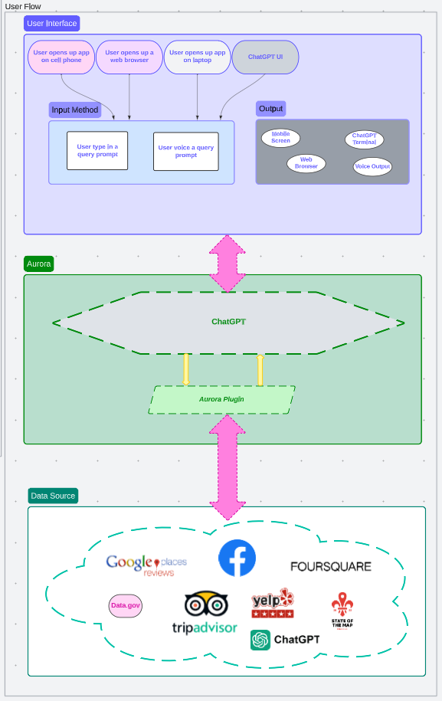
Team Aurora - August 23, 2023
Caption

Slide 5
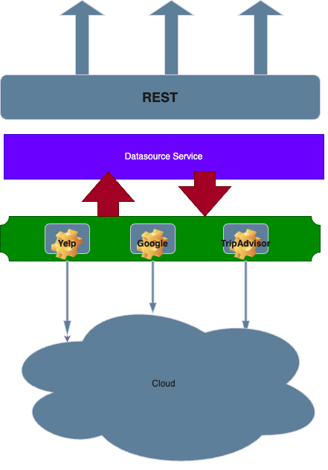
Team Aurora - August 23, 2023
Caption

Slide 6
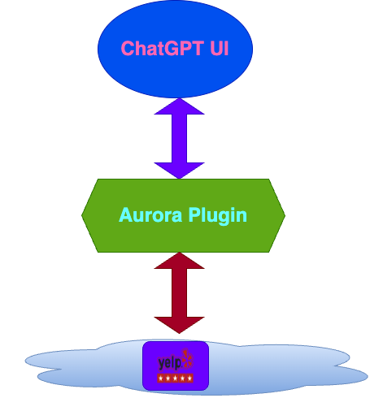
Demo
Caption
Team Aurora - August 23, 2023

Slide 7
Summary
The project initially had an ambitious goal, but due to limited resources, the scope had to be scaled down. Despite the challenges, the team enjoyed working on the project and gained knowledge about ChatGPT.
Future plans for enhancement/development include:
Expanding data source providers.
Developing a more effective ranking engine by training the algorithm with machine learning.
Implementing user-based recommendation engine at the individual level where possible commercialization solutions could be explored.
Setting up the Aurora service in the cloud to anticipate scalability needs if the user base grows.
Designing a more secure front-end and back-end, particularly if persistent data needs arise.
Team Aurora - August 23, 2023

Slide 8
Acknowledgments
Thanks to DFWCIA for the opportunity and to all the experts who provided educational presentations throughout the competition!
Team Aurora - August 23, 2023

