Slide 1

Helm study
윤상준
2018.10
sj.yun@sk.com
chris.sj.yun@gmail.com

Slide 2
Step
Helm 운영
Helm 호스팅
Helm 개발
Helm 사용
Helm 개념

Slide 3
Helm?

Slide 4
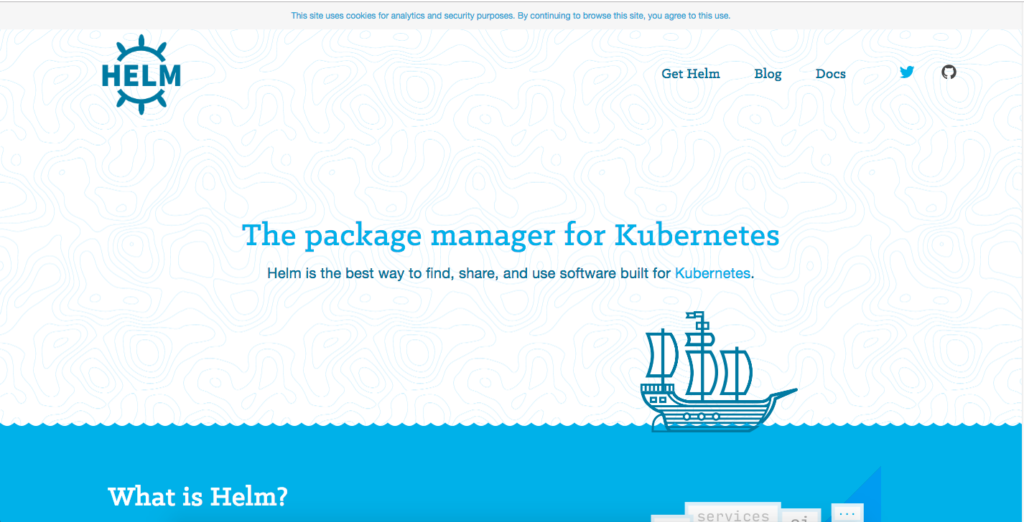
Helm?
“Helm is the best way to find, share, and use software built for Kubernetes”
[https://helm.sh]

Slide 5
Helm
Kubernetes를 위한 패키지 관리 툴
//Kubetnetes
$ helm install stable/mysql
//Homebrew
$ brew install mysql
//Apt
$ apt-get install mysql-server
//Yum
$ yum install mysql-server

Slide 6
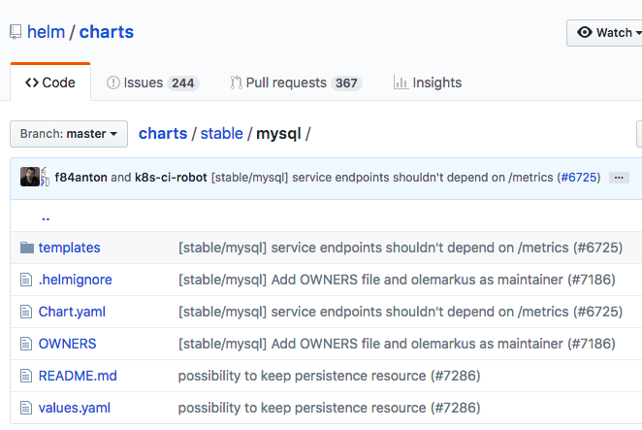
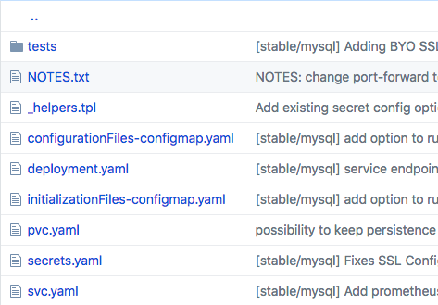
Chart
Helm에서 애플리케이션 패키징을 하기 위해 사용하는 형식
Chart는 Kubernetes resource의 집합

Slide 7
Helm Features

Slide 8
#1 Manage Complexity
//Kubernetes yaml
$ kubectl create -f deployment.yaml
$ kubectl create -f svc.yaml
$ kubectl create -f pvc.yaml
$ kubectl create -f secret.yaml
$ kubectl create -f configmap.yaml
Access
Endpoint
(Service)
MySQL
Server
(Deployment)
/etc/mysql/conf.d
(Configmap)
Persistent
Volume
(PVC)
Password
(Secret)
//Helm
$ helm install stable/mysql

Slide 9
#2 Easy Updates
Upgrade 명령을 사용하여 설정이나 버전을 쉽게 업데이트
$ helm upgrade mysql-release stable/mysql \
--set mysqlRootPassword="password"
$ helm upgrade mysql-release stable/mysql \
--version x.x.x

Slide 10



#3 Simple Sharing
Package
$ helm package demo
$ mv demo-0.1.0.tgz stable $ helm repo index stable --url https://example.github.io/my-charts/stable
Share
$ helm repo add my-charts https://example.github.io/my-charts
$ helm install my-charts/demo
Download

Slide 11
#4 Rollback
Rollback 명령을 사용하여 이전 버전 또는 특정 버전으로 쉽게 복구
$ helm history
REVISION UPDATED STATUS CHART DESCRIPTION 1 Thu Aug 15 00:49:37 2018 SUPERSEDED mysql-5.0.1 Install complete
...
10 Thu Aug 16 00:49:37 2018 DEPLOYED mysql-5.0.10 Upgrade complete
$ helm rollback mysql [REVISION_NUMBER]

Slide 12
Helm 사용하기

Slide 13
5

Slide 14
#1 Search
#2 Install
#3 Upgrade
#4 Rollback
#5 Delete

Slide 15
[참고] Helm & Tiller 설치
Helm을 사용하기 위해서는 Tiller와 Helm Client를 설치 필요
Tiller : Helm의 서버로 일반적으로 Kubernetes cluster에 설치
Helm client : Helm 명령어를 실행하기 위한 CLI
설치 방법은 아래 블로그 참고
https://yunsangjun.github.io/blog/helm/2018/05/27/installing-helm.html

Slide 16
#1 Search
Helm을 최초 설치하면 Kubernetes official repository에 기본적으로 연동
$ helm repo list NAME URL stable https://kubernetes-charts.storage.googleapis.com local http://127.0.0.1:8879/charts
$ helm search NAME CHART VERSION APP VERSION DESCRIPTION stable/wordpress 2.1.10 4.9.8 Web publishing platform for building... stable/jenkins 0.16.19 2.121.2 Open source continuous integration... stable/mariadb 4.3.3 10.1.35 Fast, reliable, scalable, and easy to... stable/mysql 0.8.3 5.7.14 Fast, reliable, scalable, and easy to... …
$ helm search mysql NAME CHART VERSION APP VERSION DESCRIPTION stable/mysql 0.8.3 5.7.14 Fast, reliable, scalable, and easy... stable/mysqldump 0.1.0 5.7.21 A Helm chart to help backup... stable/mariadb 4.3.3 10.1.35 Fast, reliable, scalable, and easy...

Slide 17
#1 Search
Inspect 명령으로 상세 정보 출력
$ helm inspect stable/mariadb appVersion: 10.1.35 description: Fast, reliable, scalable, and easy to use open-source relational database system. MariaDB Server is intended for mission-critical, heavy-load production systems as well as for embedding into mass-deployed software. Highly available MariaDB cluster. engine: gotpl home: https://mariadb.org icon: https://bitnami.com/assets/stacks/mariadb/img/mariadb-stack-220x234.png keywords: - mariadb - mysql - database - sql - prometheus

Slide 18
#2 Install
Install 명령으로 원하는 chart를 바로 설치
// helm install [REPO_NAME/CHART_NAME] --name [RELEASE_NAME] --namespace [NAMESPACE]
$ helm install stable/grafana --namespace NAMESPACE
NAME: bumptious-rottweiler RESOURCES: ==> v1/ConfigMap NAME AGE bumptious-rottweiler-grafana 1s ==> v1/ClusterRole bumptious-rottweiler-grafana-clusterrole 1s ==> v1/ClusterRoleBinding bumptious-rottweiler-grafana-clusterrolebinding 1s ==> v1beta1/Role bumptious-rottweiler-grafana 1s ==> v1beta1/RoleBinding bumptious-rottweiler-grafana 1s ==> v1beta2/Deployment bumptious-rottweiler-grafana 1s ==> v1/Pod(related) NAME READY STATUS RESTARTS AGE bumptious-rottweiler-grafana-8d9885d54-kxldg 0/1 ContainerCreating 0 1s

Slide 19
#2 Install
NOTES: 1. Get your 'admin' user password by running: kubectl get secret --namespace edu1 bumptious-rottweiler-grafana -o jsonpath="{.data.admin-password}" | base64 --decode ; echo 2. The Grafana server can be accessed via port 80 on the following DNS name from within your cluster: bumptious-rottweiler-grafana.edu1.svc.cluster.local Get the Grafana URL to visit by running these commands in the same shell: export POD_NAME=$(kubectl get pods --namespace edu1 -l "app=bumptious-rottweiler-grafana,component=" -o jsonpath="{.items[0].metadata.name}") kubectl --namespace edu1 port-forward $POD_NAME 3000 3. Login with the password from step 1 and the username: admin
$ kubectl get po -n NAMESPACE NAME READY STATUS RESTARTS AGE bumptious-rottweiler-grafana-8d9885d54-kxldg 1/1 Running 0 2m
$ kubectl get secret --namespace edu1 bumptious-rottweiler-grafana -o jsonpath="{.data.admin-password}" | base64 --decode ; echo
xxxxxxxxx
$ export POD_NAME=bumptious-rottweiler-grafana-8d9885d54-kxldg
$ kubectl --namespace edu1 port-forward $POD_NAME 3000
Forwarding from 127.0.0.1:3000 -> 3000

Slide 20
#3 Upgrade
Upgrade 명령을 통해 설정이나 버전을 업데이트
$ helm list
NAME REVISION UPDATED STATUS CHART NAMESPACE bumptious-rottweiler 1 Thu Oct 18 02:58:05 2018 DEPLOYED grafana-1.17.2 edu1
// helm upgrade [RELEASE_NAME] --set [OPTIONS] [REPO_NAME/CHART_NAME]
$ helm upgrade bumptious-rottweiler --set replicas=2 stable/grafana
Release "bumptious-rottweiler" has been upgraded. Happy Helming!
$ kubectl get po -n edu1 NAME READY STATUS RESTARTS AGE bumptious-rottweiler-grafana-8d9885d54-kxldg 1/1 Running 0 10m bumptious-rottweiler-grafana-8d9885d54-lh9lg 1/1 Running 0 3m

Slide 21
#4 Rollback
Rollback 명령을 사용하여 이전 버전 또는 특정 버전으로 쉽게 복구
$ helm list NAME REVISION UPDATED STATUS CHART NAMESPACE bumptious-rottweiler 2 Thu Oct 18 03:05:30 2018 DEPLOYED grafana-1.17.2 edu1
$ helm history bumptious-rottweiler REVISION UPDATED STATUS CHART DESCRIPTION 1 Thu Oct 18 02:58:05 2018 SUPERSEDED grafana-1.17.2 Install complete 2 Thu Oct 18 03:05:30 2018 DEPLOYED grafana-1.17.2 Upgrade complete
$ helm rollback bumptious-rottweiler 1 Rollback was a success! Happy Helming!
$ helm history willing-armadillo REVISION UPDATED STATUS CHART DESCRIPTION 1 Thu Oct 18 02:58:05 2018 SUPERSEDED grafana-1.17.2 Install complete 2 Thu Oct 18 03:05:30 2018 SUPERSEDED grafana-1.17.2 Upgrade complete 3 Thu Oct 18 03:11:14 2018 DEPLOYED grafana-1.17.2 Rollback to 1
$ kubectl get po -n edu1 NAME READY STATUS RESTARTS AGE bumptious-rottweiler-grafana-8d9885d54-kxldg 1/1 Running 0 13m

Slide 22
#5 Delete
Delete 명령을 사용하여 설치된 Kubernetes 리소스 삭제
$ helm list NAME REVISION UPDATED STATUS CHART NAMESPACE bumptious-rottweiler 3 Thu Oct 18 03:11:14 2018 DEPLOYED grafana-1.17.2 edu1
// “--purge” 옵션을 주면 release name 까지 삭제. 아니면 list에는 남아있음. $ helm del --purge bumptious-rottweiler
release "bumptious-rottweiler " deleted

Slide 23
Helm Chart 만들기

Slide 24
Helm chart 생성 및 구조 #1
Create 명령으로 Helm chart sample 생성
# helm create [CHART_NAME]
$ helm create demo Creating demo
Sample chart 구조
demo/
.helmignore # 형상관리에서 제외할 파일이나 디렉토리 목록 Chart.yaml # Chart의 정보를 저장 charts # 이 chart에서 의존성을 가지고 있는 chart가 위치 templates # Kubernetes 리소스의 템플릿 파일(deployment, service, ingress 등의 yaml) values.yaml # 이 helm chart의 기본 설정 값을 저장. templates yaml 파일에서 사용

Slide 25
Helm chart 생성 및 구조 #2
values.yaml 과 templates 구조
$ cat values.yaml replicaCount: 1 image: repository: nginx tag: stable pullPolicy: IfNotPresent nameOverride: "" fullnameOverride: "" service: type: ClusterIP port: 80
ingress: enabled: false ...
$ cat templates/service.yaml apiVersion: v1 kind: Service metadata: name: {{ include "demo.fullname" . }} labels: app.kubernetes.io/name: {{ include "demo.name" . }} helm.sh/chart: {{ include "demo.chart" . }} app.kubernetes.io/instance: {{ .Release.Name }} app.kubernetes.io/managed-by: {{ .Release.Service }} spec: type: {{ .Values.service.type }} ports: - port: {{ .Values.service.port }} targetPort: http protocol: TCP name: http selector: app.kubernetes.io/name: {{ include "demo.name" . }} app.kubernetes.io/instance: {{ .Release.Name }}

Slide 26
Helm chart validation
Lint 명령으로 Helm chart의 문법적인 오류 체크
$ helm lint demo ==> Linting ./ [INFO] Chart.yaml: icon is recommended [ERROR] templates/: render error in "demo/templates/deployment.yaml": template: demo/templates/deployment.yaml:11:22: executing "demo/templates/deployment.yaml" at <.Values.replica.coun...>: can't evaluate field count in type interface {} Error: 1 chart(s) linted, 1 chart(s) failed
$ cat demo/templates/deployment.yaml
... spec: replicas: {{ .Values.replica.count }} => .Values.replicaCount로 수정 필요
$ cat demo/values.yaml
... replicaCount: 1

Slide 27
Helm chart package
Package 명령으로 Helm chart package
$ ls -all total 3 drwxr-xr-x 7 sangjunyun staff 224 10 3 15:56 . drwxr-xr-x 41 sangjunyun staff 1312 10 3 11:49 .. drwxr-xr-x 7 sangjunyun staff 224 10 3 12:01 demo
$ helm package demo Successfully packaged chart and saved it to: PATH/demo-0.1.0.tgz
$ ls -all total 3 drwxr-xr-x 7 sangjunyun staff 224 10 3 15:56 . drwxr-xr-x 41 sangjunyun staff 1312 10 3 11:49 .. drwxr-xr-x 7 sangjunyun staff 224 10 3 12:01 demo
-rw-r--r-- 1 sangjunyun staff 2608 10 3 12:01 demo-0.1.0.tgz

Slide 28
Helm chart template
Template 명령으로 Kubernetes 리소스 파일이 어떻게 생성될 지 미리 확인
$ helm template demo > output.yaml
$ cat output.yaml --- # Source: demo/templates/service.yaml apiVersion: v1 kind: Service
metadata: name: RELEASE-NAME-demo ..
--- # Source: demo/templates/deployment.yaml apiVersion: apps/v1beta2 kind: Deployment
metadata: name: RELEASE-NAME-demo
...

Slide 29
Helm chart simulate
Install 명령에 “--dry-run --debug” 옵션을 붙여 Helm install 시뮬레이션
$ helm install demo --dry-run --debug ... NAME: lame-sasquatch
… --- # Source: demo/templates/service.yaml apiVersion: v1 kind: Service metadata: name: lame-sasquatch-demo
…
--- # Source: demo/templates/deployment.yaml apiVersion: apps/v1beta2 kind: Deployment metadata: name: lame-sasquatch-demo
…

Slide 30
Helm Chart 호스팅하기

Slide 31
Helm chart repository
내가 만든 Helm chart를 다른 사용자에게 공유하기 위해서는 Helm repository가 필요
Official repository(https://github.com/helm/charts)에 Contribution하는 방법과 자체 repository를 사용하는 두 가지 방식 있음
자체 repository는 크게 3가지 형태로 지원(웹 서버 기능 필요)
Github Pages
Object Storage(GCS, AWS S3, ICOS 등)
Ordinary Web Servers(Nginx, Apache)

Slide 32
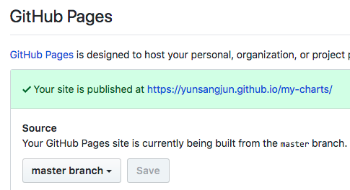
Helm chart repository with Github Pages #1
쉽고 무료로 사용할 수 있는 방법
Github Pages는 웹 서버 기능을 지원함
1. Github에 Repository 생성(여기서는 my-charts라고 가정)
2. Github Page 설정
Repository -> Settings -> Github Pages > Source > master branch 선택 > Save 선택
(설정 완료 후 나타나는 https://example.github.io/my-charts/ 주소가 웹 서버 주소

Slide 33
Helm chart repository with Github Pages #2
3. git repository checkout 및 stable 디렉토리 생성
$ git checkout https://github.com/example/my-charts.git
$ cd my-charts & mkdir stable
4. helm 파일을 stable 디렉토리에 복사(앞에서 생성한 demo-0.1.0.tgz 사용)
$ mv FILE_PATH/demo-0.1.0.tgz stable
5. Index 파일 생성. stable 디렉토리 하위에 index.yaml 파일 생성됨
# helm repo index [INDEX_FILE_PATH] --url [CHART_REPO_URL]
$ helm repo index stable --url https://example.github.io/my-charts/stable
6. 변경사항 git에 commit
$ git add --all & git commit -m 'init' & git push origin master
7. Chart repository 주소에 접속해 index 파일 확인
https://example.github.io/my-charts/stable/index.yaml

Slide 34
Helm chart repository with Github Pages #3
apiVersion: v1 entries: demo: - apiVersion: v1 appVersion: "1.0" created: 2018-10-03T12:14:26.693334507+09:00 description: A Helm chart for Kubernetes digest: c677efc778b455ad3b9d53c03d37cf0002d067ac80da35d0921672a77f3c9bc3 name: demo urls: - https://example.github.io/my-charts/stable/demo-0.1.0.tgz version: 0.1.0 generated: 2018-10-03T12:14:26.690034532+09:00
8. Index 파일의 helm chart 패키지 다운로드 확인
https://example.github.io/my-charts/stable/demo-0.1.0.tgz
[참고] 샘플 helm repository
https://github.com/YunSangJun/my-charts

Slide 35
Helm chart 공유 및 사용 #1
준비된 helm chart와 repository를 다른 사용자들이 추가 및 사용
1. helm repository 추가
# helm repo add [REPO_NAME] [REPO_URL]
$ helm repo add my-charts https://example.github.io/my-charts/stable
2. 추가한 repository 확인
$ help repo list NAME URL ... my-charts https://example.github.io/my-charts/stable
3. repository에서 chart 검색
$ helm search my-charts NAME CHART VERSION APP VERSION DESCRIPTION my-charts/demo 0.1.0 1.0 A Helm chart for Kubernetes

Slide 36
Helm chart 공유 및 사용 #2
4. chart 사용하기
$ helm install my-charts/demo -n NAMESPACE NAME: flippant-narwhal LAST DEPLOYED: Wed Oct 3 15:11:52 2018 NAMESPACE: default STATUS: DEPLOYED
RESOURCES: ==> v1beta2/Deployment NAME AGE flippant-narwhal-demo 0s
…
NOTES: 1. Get the application URL by running these commands: export POD_NAME=$(kubectl get pods --namespace default -l
"app.kubernetes.io/name=demo,app.kubernetes.io/instance=flippant-narwhal" -o
jsonpath="{.items[0].metadata.name}") echo "Visit http://127.0.0.1:8080 to use your application" kubectl port-forward $POD_NAME 8080:80

Slide 37
현실에서의 고민

Slide 38




Multi Cloud & Cluster?
Kubernetes로 만든 애플리케이션 어떻게 Multi Cloud & Cluster에 배포?
$ cat pvc.yaml
kind: PersistentVolumeClaim
spec:
storageClassName: [???]
storageClassName:
gp2
storageClassName:
ibm-file-bronze
storageClassName:
standard
storageClassName:
default

Slide 39
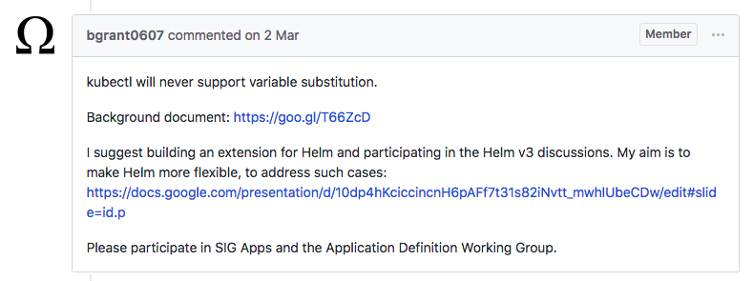
Kubernetes?
Kubernetes 에서는 변수 치환 기능을 제공할 계획 없음. (make by design)
https://github.com/kubernetes/kubernetes/issues/52787

Slide 40
Helming!
Helm
$ export STORAGE_CLASS = gp2 | ibm-file-bronze | standard | azurefile
$ helm install stable/mariadb \ --set master.persistence.storageClass="${STORAGE_CLASS}"

Slide 41
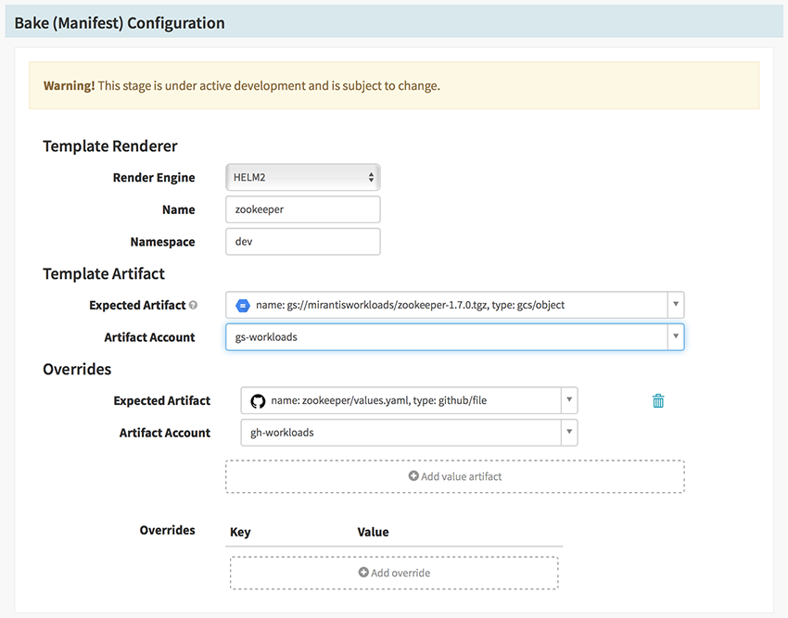
Spinnaker + Helm
Spinnaker의 Helm bake 기능을 활용과 연계
https://yunsangjun.github.io/blog/spinnaker/2018/10/14/using-spinnaker-6.html

Slide 42
Monocular + Helm
Monocular와 Helm repository를 연계해 앱 마켓플레이스 활용
https://github.com/helm/monocular

Slide 43
Helm 사용하기
고급

Slide 44
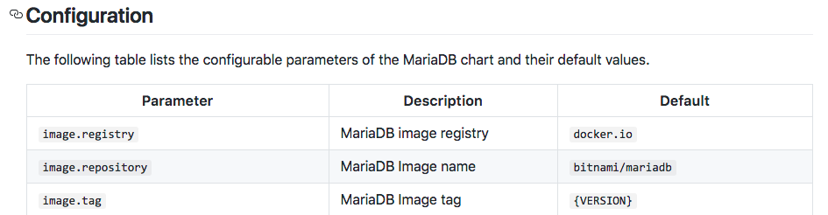
Chart의 설정 변경 #1 매개변수 사용
Chart source repository 문서의 설정 정보를 참고하여 설정 변경
https://github.com/helm/charts/tree/master/stable/mariadb
$ helm install stable/mariadb \ --set image.tag=x.x.x

Slide 45
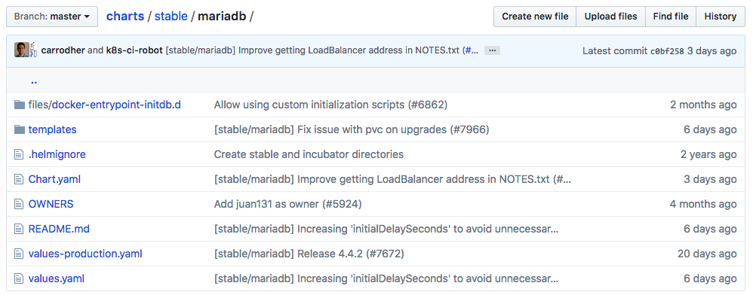
Chart의 설정 변경 #2 파일 사용
yaml file 형태로 설정 변경도 가능. Chart의 values.yaml의 형식을 참고해서 작성
$ cat values.yaml
image: tag: x.x.x
...
$ helm install stable/mariadb \ -f values.yaml

Slide 46
Contribution

Slide 47
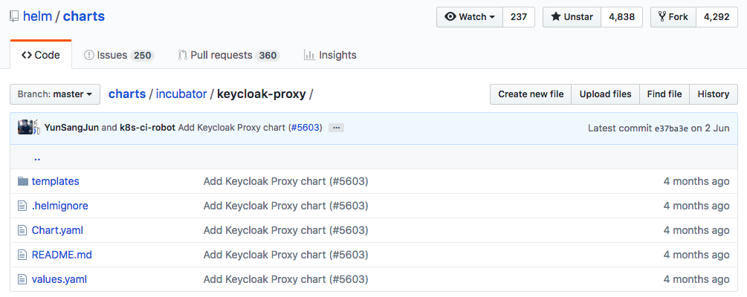
Helm chart contribution
내가 만든 애플리케이션을 kubernetes helm repository에 배포하고 싶다면?

Slide 48
Tips for contribution
Kubernetes helm code repository fork
아래 가이드 참고하여 contributor 서명 후 commit
https://github.com/helm/charts/blob/master/CONTRIBUTING.md
“helm create”로 만들어진 최신 버전 chart를 참고하여 내가 만든 chart 검토
Guidelines을 참고하여 내가 만든 chart 검토
https://github.com/helm/charts/blob/master/REVIEW_GUIDELINES.md
내가 만든 chart를 incubator 디렉토리에 commit
Pull request!

Slide 49
참고자료
Helm 참고 자료
블로그 : https://yunsangjun.github.io/blog/
Kubernetes 참고 자료
블로그 : http://tech.cloudz-labs.io/

