Slide 1

COGNITIVE CHAOS 2026 · FINALE · CONVEX OPEN INNOVATION TRACK
AEGIS
AI Emergency Grid & Incident System
Every phone in the crowd becomes a sensor. Every second becomes coordinated action.
Scan to open
A working, publicly reachable prototype — not a mockup.
Open the live system →
490cbec14e504e7aa506bc0208460713.prod.enterapp.pro
PROJECT TITLE
AEGIS — AI Emergency Grid & Incident System
TEAM
EVENT
TRACK
Ninja Coders
Cognitive Chaos 2026
Convex — Open Innovation (self-proposed problem)
PROBLEM STATEMENT
Emergencies at mass gatherings unfold in seconds, but incident information is scattered, duplicated and unverified, and dispatch is manual — wasting the 5 to 10 minute window in which a crush or cardiac arrest is still survivable.
TEAM MEMBERS
Sourav Kumar · Manish Joshi · Siddharth Singh · Rajat Kushwaha
A real-time web platform — nothing to install

Slide 2
PROBLEM & EXISTING GAP
In a crowd, the tools we rely on are the tools that fail
121
11
5-10
0
lives lost, Hathras
stampede, 2024
lives lost, RCB victory crowd,
Bengaluru stadium, 2025
minutes — the survivable window
in a crush or cardiac arrest
shared live picture of the venue
at any of these events
Police, medics and fire were already on site every time. What was missing was information, not manpower.
WHY CALLING FOR HELP DOES NOT WORK IN A CROWD
WHO IS AFFECTED, AND WHAT THEY HAVE TODAY
You cannot hear, and cannot be heard. A crowd runs past 100 dB. The control room mishears the location — the one detail that matters.
The cell network is congested. Thousands of phones on one tower means voice calls drop exactly when everyone needs them at once.
Nobody knows the number. The venue control room number is not on your ticket, and 112 cannot see inside the venue.
A call carries one report, once. Thirty callers about one crush create thirty conversations, not one prioritised incident.
Attendees — no way to report that works in noise and congestion.
Marshals and volunteers — first to see it, no channel to escalate.
Medics, fire and police — on site, but sent by guesswork.
Organisers and administration — own the liability, see fragments.
Current solution: walkie-talkies and WhatsApp groups.
No single live picture — every channel sees a fragment. Duplicate, unverified reports with no way to merge them. No severity triage, so a lost phone and a cardiac arrest arrive identical. Manual dispatch spends minutes working out who is nearest. No audit trail to learn from.

Slide 3
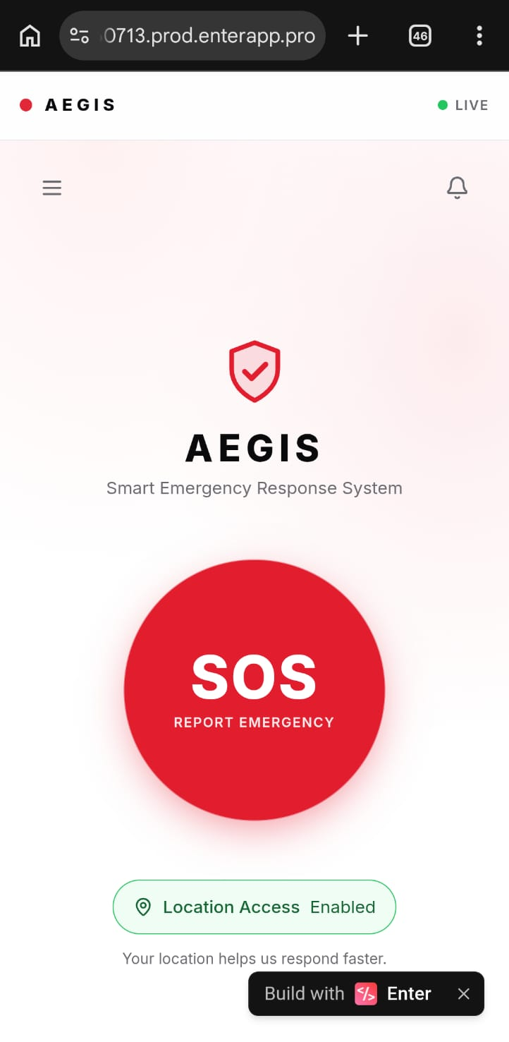
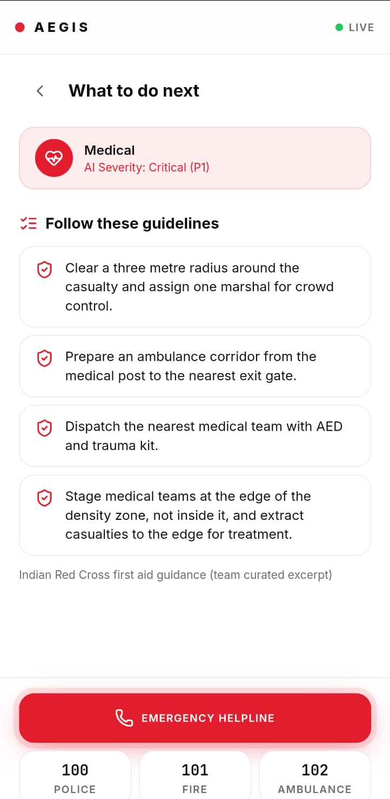
PROPOSED SOLUTION
One tap replaces the call that cannot get through
AEGIS is a live emergency response system for crowded places. Anyone reports in one tap — no login, no OTP, no typing and no speaking. A tap is a few hundred bytes, so it gets through congested networks where a voice call will not. An AI scores how serious it is, merges duplicate reports of the same event into one incident, and retrieves the correct response steps from real NDMA government guidance. A control room dashboard dispatches the nearest right-role unit in one click, and the person who reported it watches help approach with a live ETA.
01
02
03
REPORT
AI TRIAGE
COORDINATE
One tap sends it, with GPS attached automatically. Photo, description and a callback number are optional and offered afterwards — help is already moving while you add them.
The AI scores severity P1–P4, writes an operator summary, merges duplicates, and retrieves protocol steps from real NDMA and Red Cross guidance by meaning, not keyword.
The nearest role-matched unit is dispatched in one click. The reporter sees a live ETA. Every action is written to an immutable audit timeline.
WHAT MAKES IT DIFFERENT
The advice is traceable to a government document, never invented — and the system degrades instead of failing: if the AI is unavailable it falls back to deterministic rules and says so on screen, while still triaging and dispatching.
Report in one tap
NDMA guidance, sourced

Slide 4
TECHNICAL APPROACH & ARCHITECTURE
EnterPro front end, Convex back end, one AI brain
INPUT — ANY PHONE BROWSER
PROCESS — CONVEX BACKEND
OUTPUT — CONTROL ROOM
Reporter (public, no login)
Responder (staff passcode)
One tap · GPS · photo · callback
Built and deployed on EnterPro
Mutations ingest each report atomically, merge duplicates within 120 s
Actions call the LLM for severity, summary and protocol selection
Vector search 1536-dimension semantic retrieval over the NDMA corpus
Reactive DB pushes live state to every open screen, no polling
Scheduler escalates an unacknowledged P1 after 60 seconds
File storage incident photographs as evidence
Live incident map and queue
AI panel with NDMA actions
Role-matched nearest dispatch
Exit-guidance broadcast to all phones
→
→
THE AI LAYER
GROUNDING & INTEGRATIONS
Gemini for triage and summary
Embeddings for semantic retrieval
Three-model fallback chain
Deterministic rules if AI is down
14 protocols from real NDMA and Indian Red Cross guidance
Source shown on every step
Helplines 112 · 100 · 101 · 102, one-tap dial
Why Convex. It replaces four separate systems with one typed TypeScript backend — the database, the serverless functions, the vector database for our NDMA search, and the job scheduler for our escalation timer. Every query is a live subscription, so the dashboard updates with zero real-time networking code written by us. That is the only reason a live product of this shape was buildable at our scale.

Slide 5
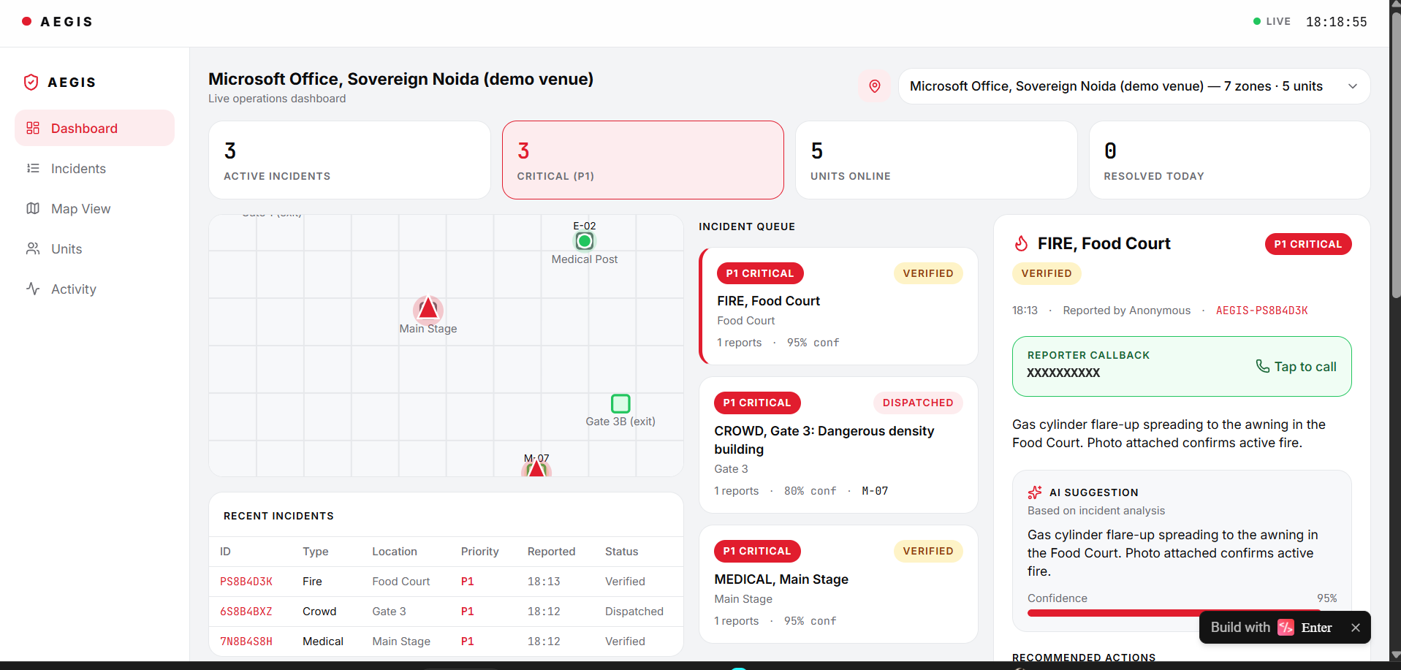
DEMO WALKTHROUGH
What we will show you live, in this order
The dashboard starts empty. Everything you see appear is filed live, from a phone in this room.
1
REPORTER — a teammate files a real emergency
Opens the public link, taps SOS, taps Fire. One tap, no login. GPS places it at the Food Court automatically.
2
COMMAND — it appears in about one second
AI has scored it P1 Critical, written the summary and retrieved the fire protocol from NDMA guidance, with the source shown.
3
COMMAND — duplicate merge, then dispatch
A second report of the same fire merges into one incident with a count of two. One click dispatches the nearest fire unit.
4
RESPONDER — accept, then broadcast
The unit accepts on a second phone; the reporter's screen flips to a live ETA. We broadcast exit guidance to every phone.
Command dashboard — live venue map, incident queue, AI panel, NDMA actions, reporter callback and photo evidence
WE WILL SAY THIS BEFORE YOU ASK
Reporting, triage, merging, dispatch and tracking are all real and running. Venue responders are simulated for this demo, not live staff. Location is device GPS only, never from a phone number.

Slide 6
KEY FEATURES & DIFFERENTIATOR
Six capabilities, and what makes each one hard to copy
01
Live command map
02
AI triage and de-duplication
03
Protocol-grounded response
Every report appears on every dashboard the instant it is filed — one shared source of truth for the venue.
Severity scored by the LLM; reports of the same event, same zone, within 120 seconds merge into one counted incident.
Steps retrieved from real NDMA guidance by meaning, with the source document named on screen.
Convex reactive queries are live subscriptions
Actions call the model, mutations write the result
Convex vector search over the protocol table
04
Role-matched dispatch
05
Live responder tracking
06
Evidence and audit trail
The nearest correct unit in one click — a medic for medical, a fire unit for fire. Unacknowledged P1 escalates in 60 s.
The reporter watches the assigned unit approach with a live ETA, the way you track a delivery.
Photograph, callback number and an immutable timestamped timeline for every incident.
Scheduler functions and indexed queries
Location updates through the reactive database
File storage plus an append-only event log
WHAT ACTUALLY SETS US APART
1. The AI cannot invent procedure. It searches real NDMA and Red Cross documents first and may only compose steps from what it retrieved — the source is printed on screen. 2. It degrades instead of failing. If the AI is rate-limited we fall through three models, then to deterministic rules, and the dashboard says so openly.
3. Panic becomes signal. Thirty reports of one crush become one P1 incident with a count of thirty. 4. The venue is data, not code. One record re-points AEGIS from a campus to Jantar Mantar or a stadium, switchable live from the dashboard.

Slide 7
IMPACT & FEASIBILITY
Minutes saved are lives saved — and it runs today for almost nothing
3
14
₹0
1 tap
venues live across two states,
switchable from the dashboard
real NDMA and Red Cross protocols
grounding every recommendation
infrastructure cost at pilot scale —
free tiers, no servers to run
for any citizen to summon a
role-matched responder
WHO BENEFITS
WHY IT IS REALISTICALLY DEPLOYABLE
Every attendee — nothing to install, it is a web link.
Marshals and volunteers — a channel that works in noise.
Medics, fire and police — sent to the right spot, first time.
Organisers and district administration — one live picture, and an audit trail afterwards.
Beyond event venues this extends directly to campuses, religious gatherings, railway stations, hospitals and industrial sites — anywhere crowds and risk meet.
No app store, no install. A venue prints a QR code; anyone with a browser can report.
The venue is a data record. Zones, exits and responding units — a new site needs no code change.
Serverless throughout. Convex scales with crowd size and the front end is static. We load-tested 50 simultaneous reports with zero failures; capacity is not our bottleneck, it is a platform concern.
Costs nothing to pilot. A district could run this for a festival on free tiers.
HONEST LIMITS — WE STATE THESE OURSELVES
Venue responders are simulated for this demo, not live staff. There is no AI verification of photographs yet — the image is shown to the operator for human judgement. Offline queueing is designed but not implemented, so a report needs a moment of connectivity. The operator login gates the screen rather than the API; production uses role-scoped authentication. Facility coordinates in our alternate venues are real institutions at approximate positions, not a verified government feed.

Slide 8
ROADMAP & TEAM
What we build next, and who built this
WHAT COMES NEXT
Voice reporting
Offline-first reporting
AI photo verification
Speak instead of tapping, for anyone who cannot type or see the screen in an emergency.
Queue the report on the device and sync the moment signal returns.
Flag reports whose image does not match the reported category.
Crowd-density warning
Verified facility data
Open-source release
Read density from CCTV and warn before the crush, not after.
Ingest the government facility directory for real hospital, police and fire locations nationwide.
So any district administration or college can run it — cost should never be why a crowd has no system.
TEAM NINJA CODERS
TRY IT YOURSELF, RIGHT NOW
Sourav Kumar
Team lead — EnterPro front end, design system, pitch and live demo
Open it on your own phone and file a report. It appears on our dashboard in about a second.
Siddharth Singh
Convex data core — schema, de-duplication, dispatch and escalation logic
Rajat Kushwaha
AI triage and retrieval — LLM prompting, protocol grounding, fallback chain
Open the live system →
Manish Joshi
Integration, deployment and testing — EnterPro to Convex bridge, load and failure testing
490cbec14e504e7aa506bc0208460713.prod.enterapp.pro
AEGIS turns the chaos of a crowd emergency into calm, coordinated, AI-guided response — in real time.
Built with EnterPro · Powered by Convex · Grounded in NDMA guidance

