Slide 1
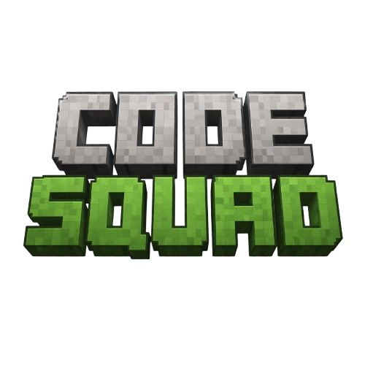
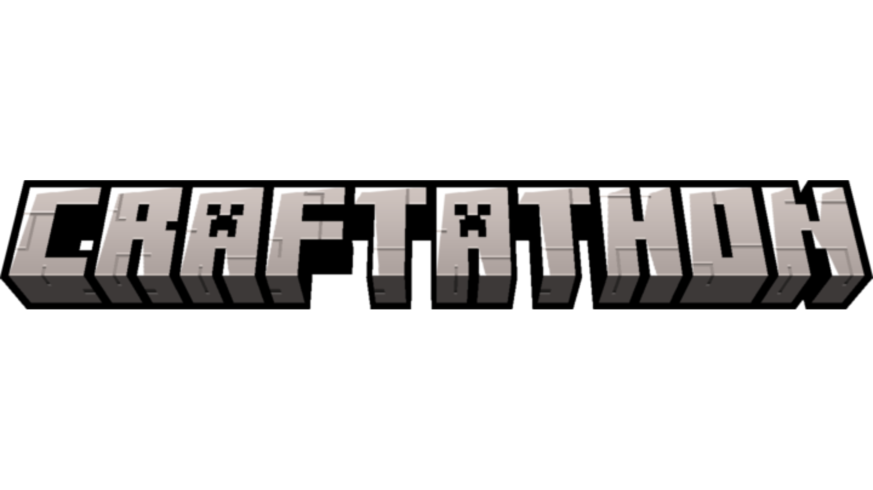
Problem Statement ID - 1
Problem Statement Title – Medication Non-Adherence
PS Domain – Health Tech
Team Name (Registered on portal) – Code Squad
Team Leader Name – Narvin Sachaniya Branch, Stream, Year : BTech, CSE, 2 Email ID – sachaniyanarvin21@gmail.com Contact Number – 9879582006 College/University Name – Rai University | Team Member 1 Name – Kiran Chaudhary Branch, Stream, Year : BTech, CSE, 2 Email ID – kiran.chaudhary.cg@gmail.com Contact Number – 9106003382 College/University Name – Rai University
Team Member 2 Name – Pavan Patel Branch, Stream, Year : BTech, IT, 2 Email ID – patel.pavan.cg@gmail.com Contact Number – 9978140125 College/University Name – Rai University | Team Member 3 Name – Het Barasara Branch, Stream, Year : BTech, IT, 2 Email ID – hetbarasara@gmail.com Contact Number – 8200920651 College/University Name – Rai University
craftathon.gu-tech.org | hackathon.info@gandhinagaruni.ac.in

Slide 2
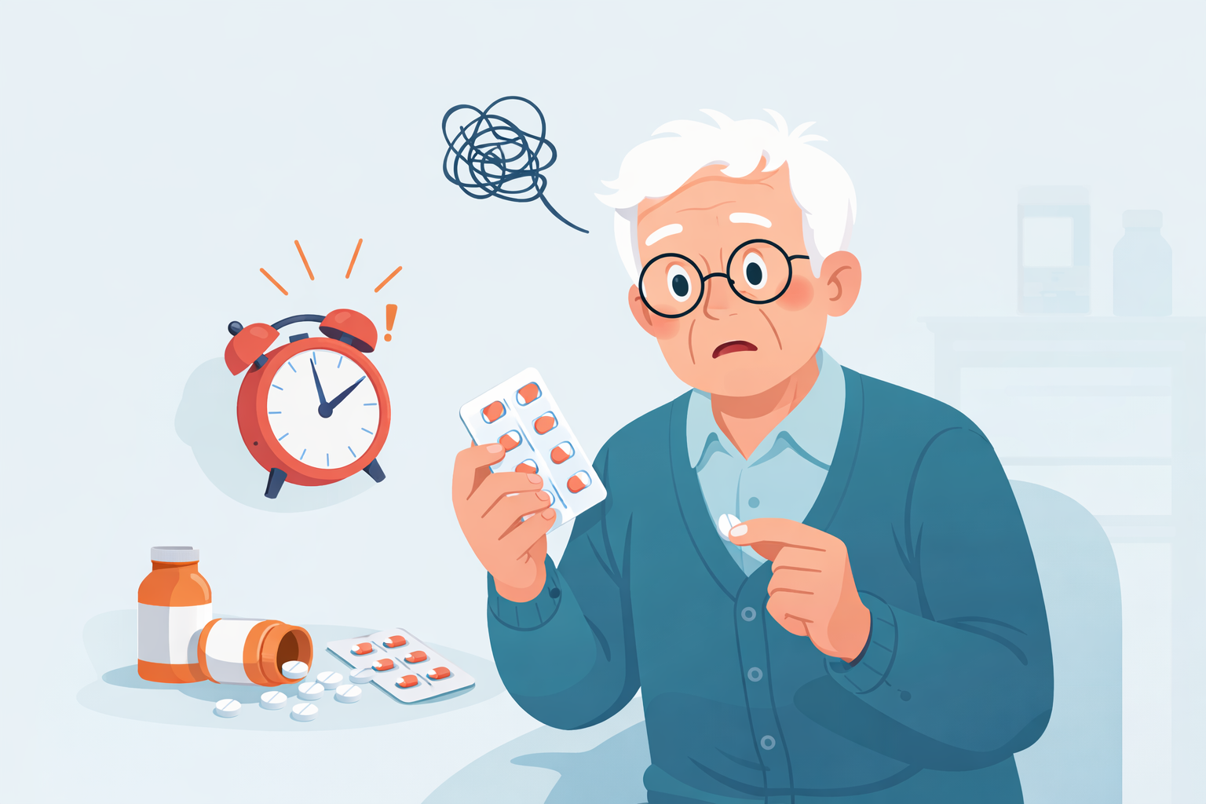
Problem Statement
Real-World Context
Chronic diseases require regular medication
50% patients don’t follow medication properly
Reasons: busy lifestyle, forgetfulness, complex schedules
Who Faces This Problem
Elderly patients
Chronic disease patients
Busy working individuals
Caregivers and doctors who monitor patients
Current Limitations / Pain Points
Patients frequently miss doses
No proper tracking system
Doctors lack real-time patient data
Supporting Insight
Around 50 percent of patients do not follow medication properly
Leads to poor outcomes and higher health risks
One-Line Problem Definition
“Patients often fail to follow their prescribed medication schedule due to lack of proper tracking, monitoring, and accountability systems.”
craftathon.gu-tech.org | hackathon.info@gandhinagaruni.ac.in

Slide 3

Proposed Solution
Core Idea
We propose a smart Medication Adherence System that ensures timely medication through reminders, tracking, and real-time monitoring.
Workflow / Approach
Patient adds medication schedule
System sends reminders at set times
Patient logs dose (Taken / Missed)
System calculates adherence score
Doctor monitors data & gets alerts
[ Patient ]
↓
[ Add Medicine ]
↓
[ Set Schedule ]
↓
[ Reminder Sent 🔔 ]
↓
[ Mark Dose (Taken ✅ / Missed ❌) ]
↓
[ Adherence Calculated 📊 ]
↓
[ Doctor Dashboard 👨‍⚕️ ]
↓
[ Alerts Generated ⚠️ ]
Why This is Better
Unlike basic reminders, it tracks actual intake
Provides real-time monitoring for doctors
Reduces manual effort and improves accuracy
Increases patient accountability
Key Features
Smart medication reminders
Easy dose logging (Taken / Missed)
Adherence tracking Missed dose detection & alerts
Real-time doctor dashboard
Patient history & reports
craftathon.gu-tech.org | hackathon.info@gandhinagaruni.ac.in

Slide 4
Tech Stack / Architecture
Patient App (Frontend)
(React Native)
↓
Doctor Dashboard (Web)
(React.js)
↓
Backend Server
(Node.js / Express)
↓
Database
(PostgreSQL + MongoDB + Firebase)
↓
Notification Service
(Firebase Push Notifications)
craftathon.gu-tech.org | hackathon.info@gandhinagaruni.ac.in

Slide 5
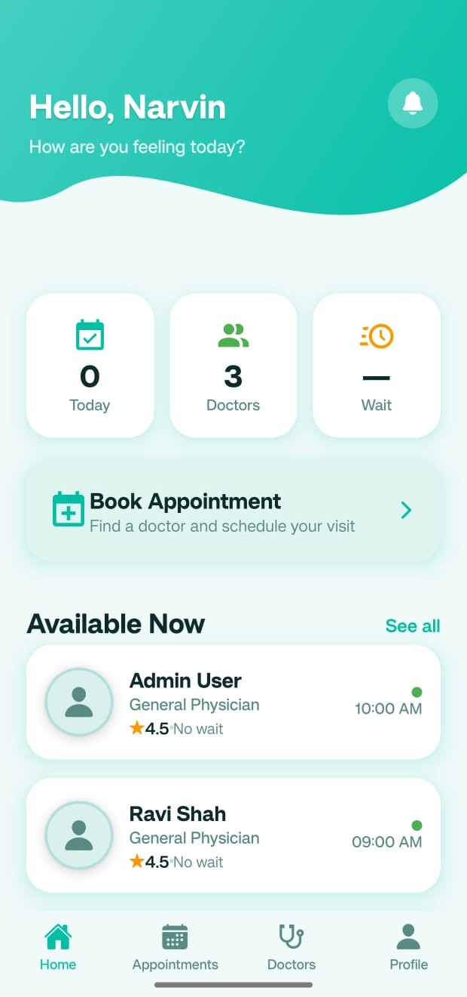
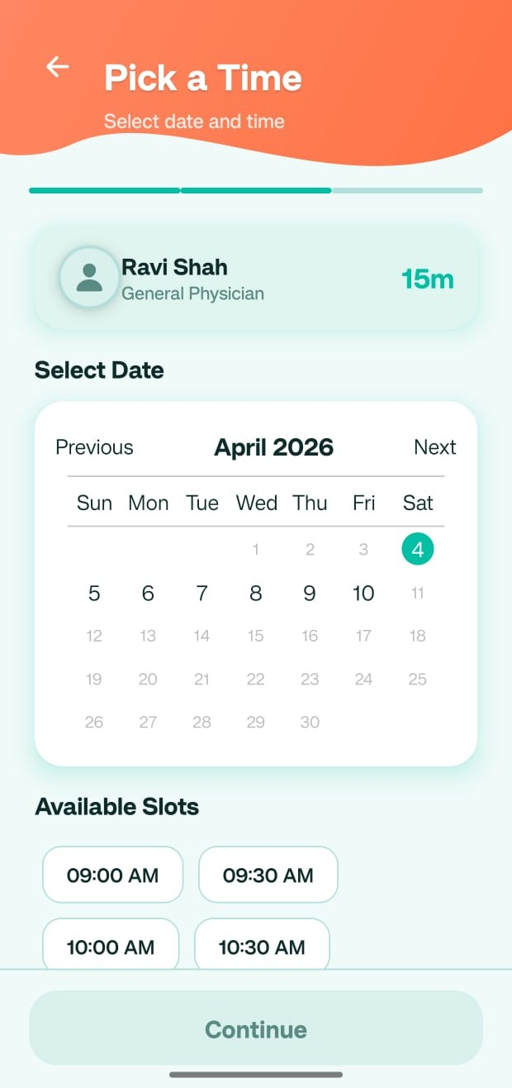
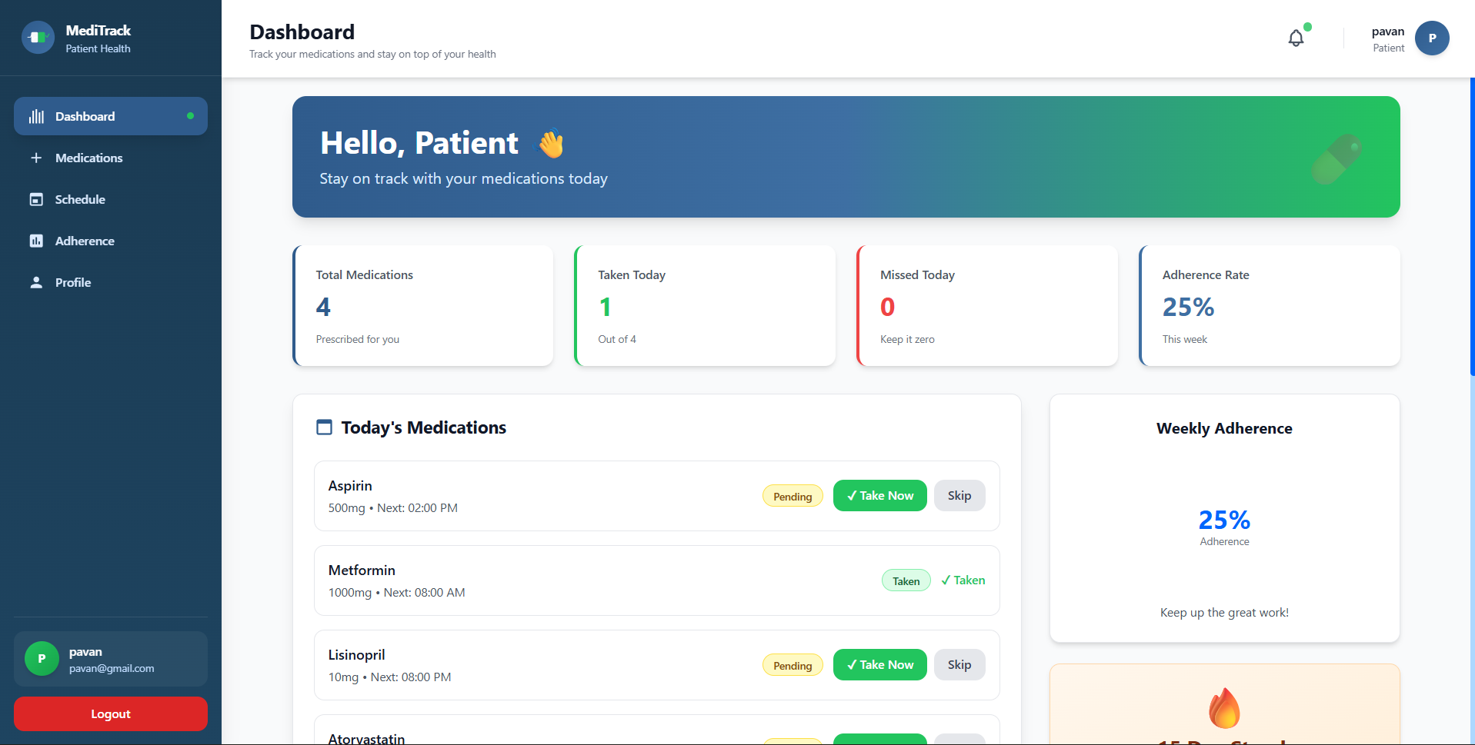
Demo / Implementation
System Workflow
User logs into the application
Adds medication details (name, dosage, timing)
Sets a daily/weekly schedule
System sends timely reminders
User marks dose as Taken ✅ or Missed ❌
System calculates adherence percentage
Data is updated on the doctor dashboard
craftathon.gu-tech.org | hackathon.info@gandhinagaruni.ac.in

Slide 6
Impact & Future Scope
Impact (Why it matters)
Improves patient medication adherence and consistency
Enables real-time monitoring for doctors and caregivers
Saves time through automated reminders and tracking
Quantifiable ImprovementsEnvironmental or social impact
30–50% reduction in missed doses
Lower hospitalization and treatment costs
Improved patient recovery rates
Social / Healthcare Impact
Better management of chronic diseases
Supports elderly and dependent patients
Reduces burden on healthcare systems
Industry Applicability
Hospitals & clinics
Telemedicine platforms
Health insurance companies
ScalabilityFuture enhancements or features
Can be used in hospitals, clinics, and home care
Scalable to millions of users via mobile apps
Integrates with existing healthcare systems (EHR)
Key Features
Smart Medication Reminders
Adherence Tracking & Score
Missed Dose Alerts
Patient Monitoring Dashboard
Future Scope
High-risk patient detections
Repeat reminders until confirmed
Personalized treatment recommendations
craftathon.gu-tech.org | hackathon.info@gandhinagaruni.ac.in

Slide 7
Final Conclusion
Final Conclusion
Medication non-adherence leads to poor treatment outcomes
Proposed a smart monitoring and alert system
Enables real-time tracking, reminders, and compliance analysis
Improves patient adherence and reduces health risks
Key Achievements
Prototype design completed
Core features implemented (tracking + alerts)
Ready for real-world testing and validation
craftathon.gu-tech.org | hackathon.info@gandhinagaruni.ac.in

