Slide 1



Desired Outcome Discussion
Derek Nielsen
Customer Success Architect

Slide 2

Introductions
Current Role
(and how it relates to GitHub)
Background
SDLC/DevOps experience

Slide 3
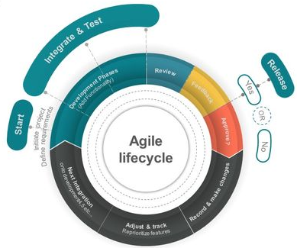
Current SDLC Processes
How many Developers do you have?
How many applications do you develop?
What tools make up your SDLC?
What is your SCM branch strategy?
What portion of your development is Open Source and what is the process around managing the components and binary packages?

Slide 4

Desired Outcome
"Our security team is asking for help ensuring proper reviews are being done to code being added into our repositories.
We have hundreds of repositories in our organization.
What is the best way we can achieve at scale?
We are new to some of the out-of-the-box settings and the GitHub API.
Can you please help us create a solution that will accomplish this for our security team?"
Notes:
The 100s of repos could have branch protection applied via API script
EX: curl -X PUT -u $GITHUB_USER:$GITHUB_TOKEN -H "Accept: application/vnd.github.luke-cage-preview+json" https://api.github.com/repos/$REPOORG/$REPO/branches/main/protection -d '{"required_status_checks": null,"enforce_admins": null,"required_pull_request_reviews" : {"dismissal_restrictions": {},"dismiss_stale_reviews": false,"require_code_owner_reviews": true,"required_approving_review_count": 1},"restrictions":null}’
How many new repos do you anticipate throughout this year and the next 3 years?
Webhook and listener to apply branch protection and other required parameters may be the best approach.

Slide 5

Options
Peer Code Reviews
Pull Requests
Pull Request Reviews
Enforcing reviews (branch protection)
Static Code Analysis
Analysis Tool Examples
OSS Code Scanners
Dependabot

Slide 6
Backup Slides

Slide 7
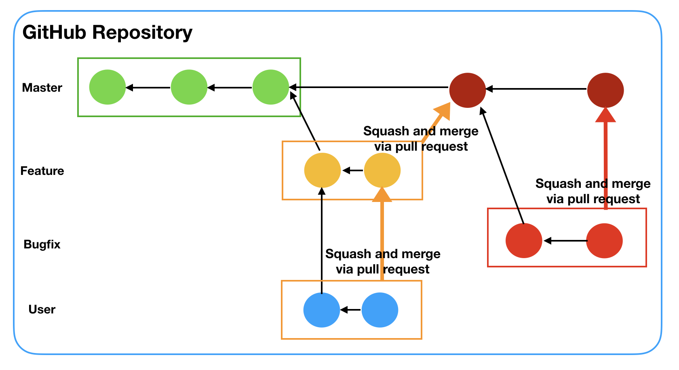
Branch Strategies

Slide 8
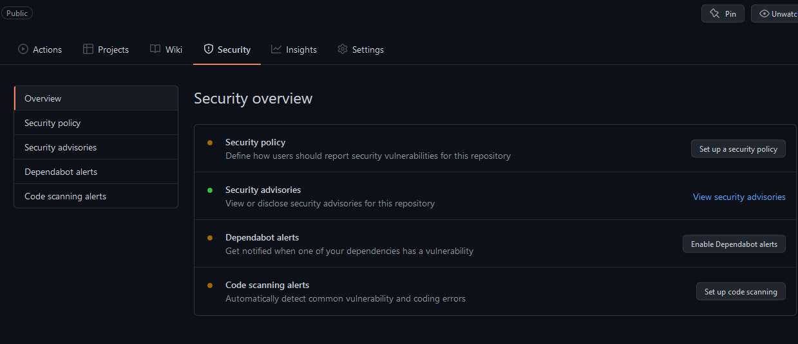
Repo Security

