Slide 1
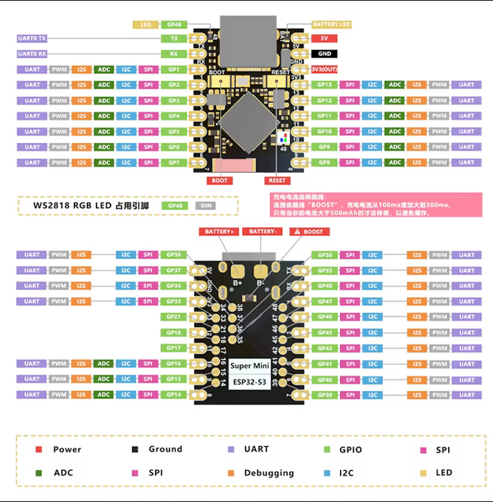


















Slide 2
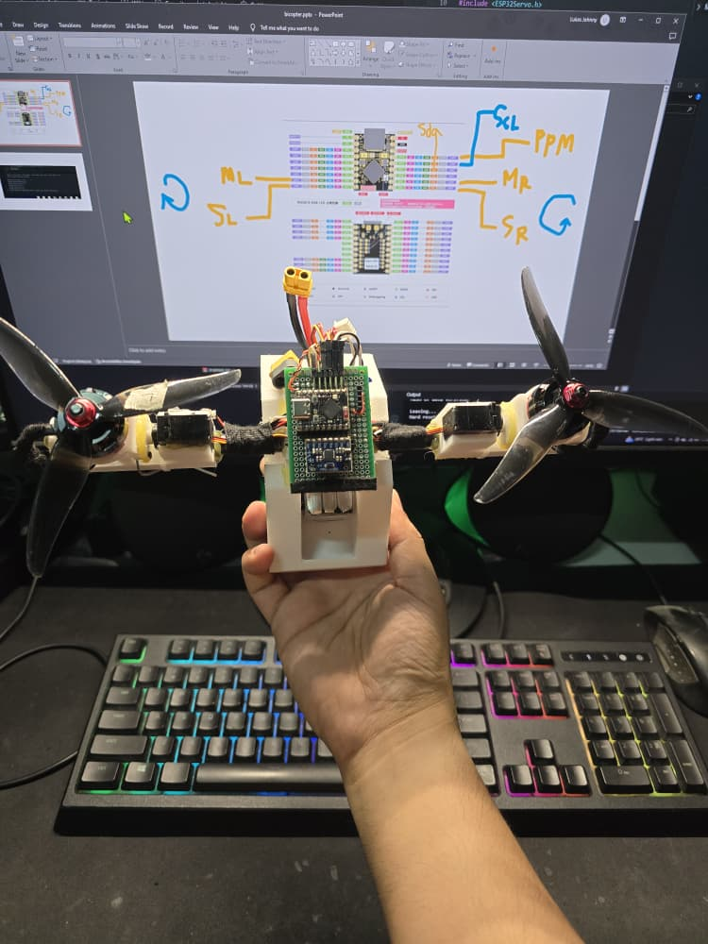
Left
Servo_Left_Pin = 10
Motor_Left_Pin = 8
Right
Servo_Right_Pin = 11
Motor_Right_Pin = 9
LEFT
RIGHT
MPU6050
Custom_SDA_Pin = 4
Custom_SCL_Pin = 5
Receiver
PPM_Pin = 13
NOSE

Slide 3
