Slide 1
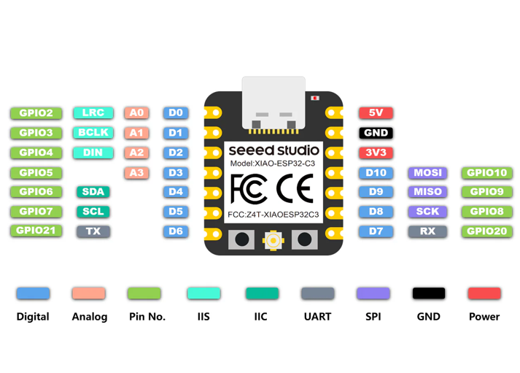
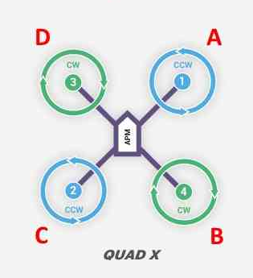
M1
G
VIN
M2
G
VIN
M3
G
G
V
Flysky FS-A8S signal (PPM)
V
G
MPU6050
G
M4
V
G
M4
M1
M3
M2
Note – Do not connect VIN when you power up EPS32-C3 using USB C to prevent short and damage to the microcontroller. You may have to disconnect the VIN first and then plug in USBC

