Slide 1
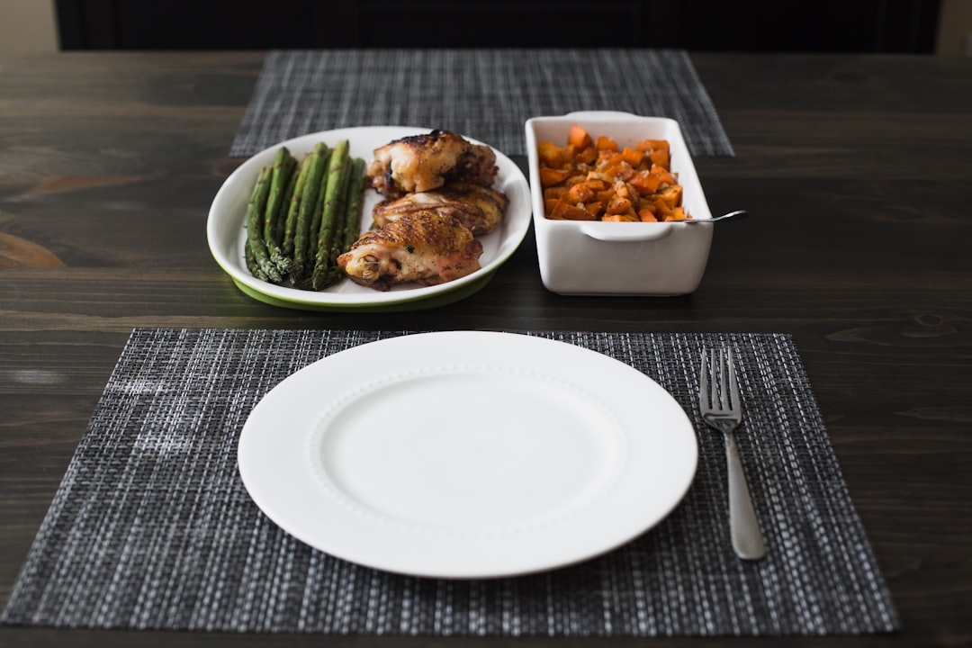
Smart Meal Planning
🥗
Smart Meal Planning
Eat Right, Stay Bright!
Presented by Mayank Raj | Grade 7

Slide 2
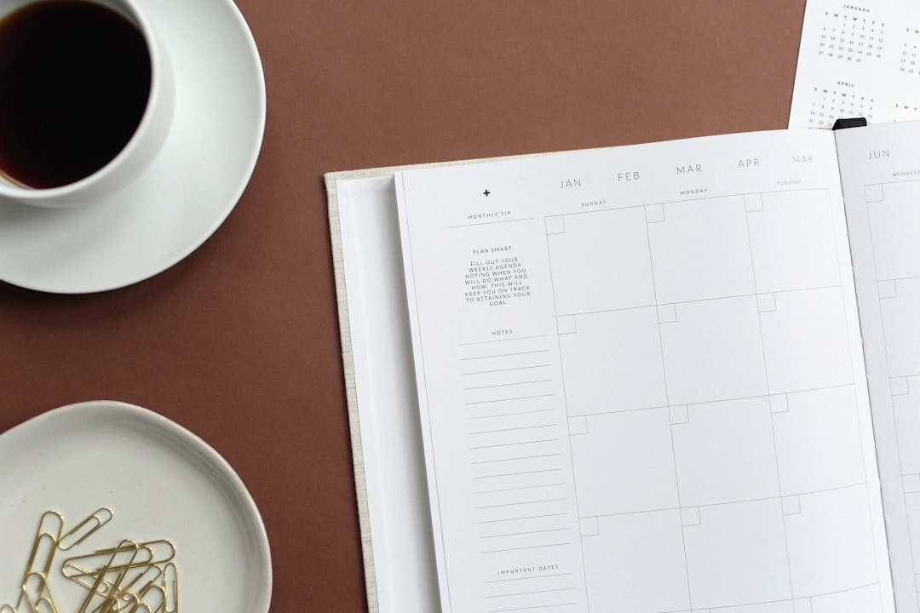
Smart Meal Planning
🥗
What is Meal Planning?
Planning your meals ahead of time
Deciding what to eat for breakfast, lunch, and dinner
Creating a shopping list for healthy ingredients
Preparing meals in advance to save time
Making smart food choices for better health
Balancing nutrition throughout the week
Presented by Mayank Raj | Grade 7

Slide 3
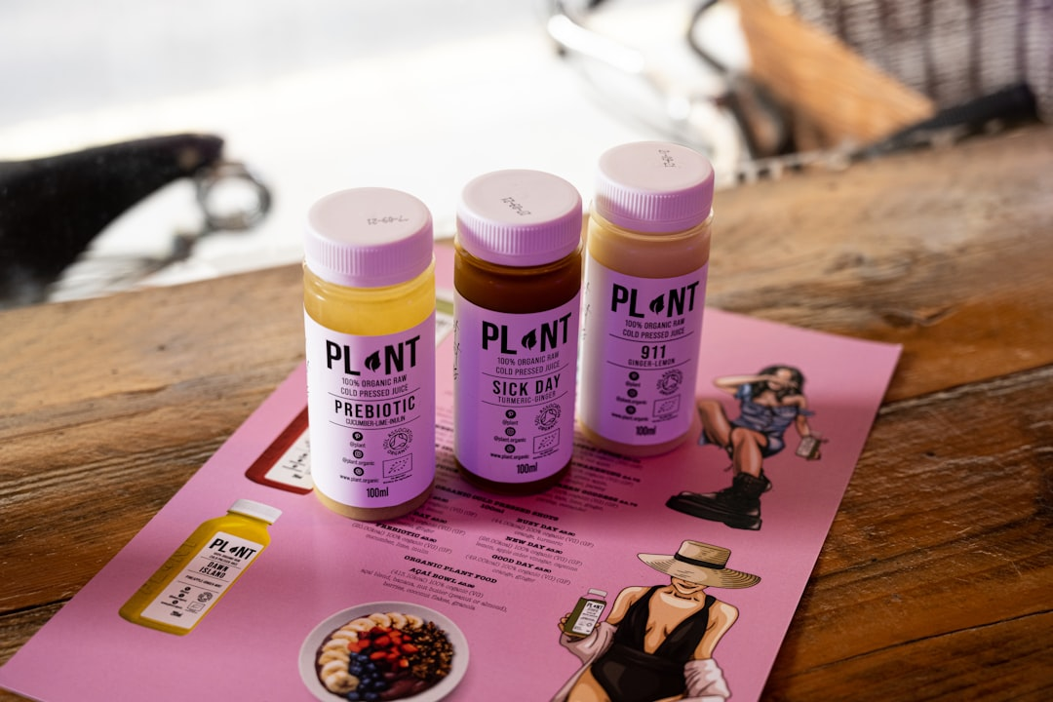
Smart Meal Planning
🥗
Why Meal Planning is Important
Helps maintain good health and energy levels
Saves time during busy school days
Reduces food waste and saves money
Ensures balanced nutrition every day
Develops healthy eating habits for life
Makes grocery shopping easier and faster
Presented by Mayank Raj | Grade 7

Slide 4
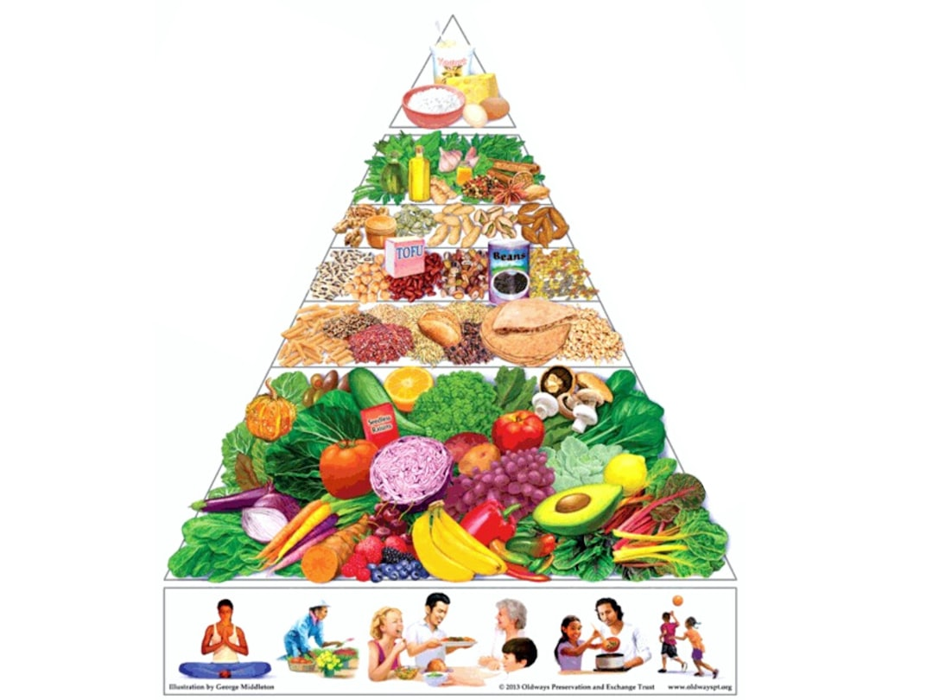
Smart Meal Planning
🥗
How to Plan a Healthy Meal
Start with fruits and vegetables (half your plate)
Add whole grains like brown rice or whole wheat
Include protein sources like beans, eggs, or chicken
Don't forget dairy or dairy alternatives
Limit sugar, salt, and unhealthy fats
Drink plenty of water with meals
Include variety for all nutrients
Presented by Mayank Raj | Grade 7

Slide 5
Smart Meal Planning
🥗
My One Day Meal Plan
🥣
Breakfast
Oatmeal with fruits & milk
🍎
Mid-Morning Snack
Apple and handful of nuts
🍱
Lunch
Brown rice, dal, vegetables, salad
🥪
Evening Snack
Whole wheat sandwich
🥗
Dinner
Roti, vegetables, yogurt
Presented by Mayank Raj | Grade 7

Slide 6
Smart Meal Planning
🥗
Balanced Diet and Its Importance
1. A balanced diet contains all essential nutrients
Carbohydrates: 50-60% (primary energy source)
2. Proteins: 15-20% (growth, repair, immunity)
3. Fats: 20-30% (energy, vitamins, brain function)
4. Vitamins & Minerals: Essential for all body functions
5. Fiber: Important for healthy digestion
6. Water: Vital for every cell in the body
Presented by Mayank Raj | Grade 7

Slide 7
Smart Meal Planning
🥗
Healthy Food vs Junk Food
Healthy Food ✅
Junk Food ❌
✓ Fresh fruits and vegetables✓ Whole grains (brown rice, wheat)✓ Lean proteins (fish, chicken)✓ Nuts, seeds, and legumes✓ Water and fresh juices✓ Low-fat dairy products
✗ Burgers, pizza, and fries✗ Sugary sodas and drinks✗ Chips, cookies, and pastries✗ Candy and chocolates✗ Processed fast food✗ High-sugar breakfast cereals
Presented by Mayank Raj | Grade 7

Slide 8
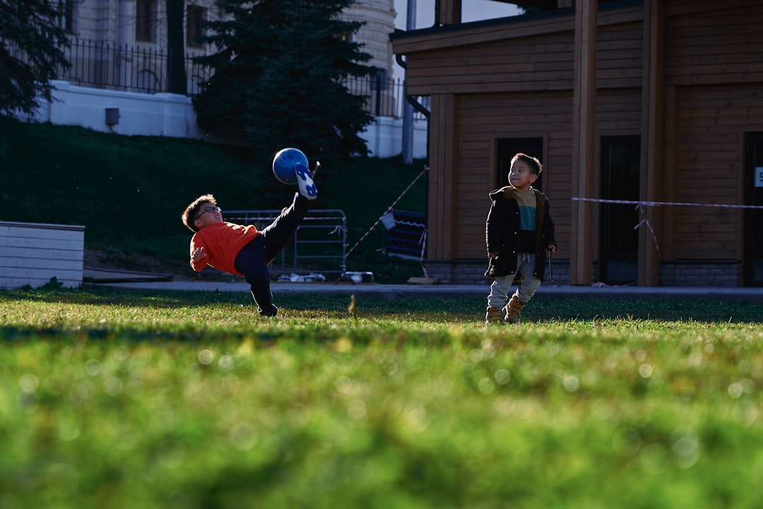
Smart Meal Planning
🥗
How Meal Planning Keeps Us Fit
Provides energy for sports and activities
Helps maintain healthy body weight
Improves concentration in studies
Boosts immunity and prevents illness
Develops good eating habits for life
Supports muscle and bone development
Enhances overall physical performance
Presented by Mayank Raj | Grade 7

Slide 9
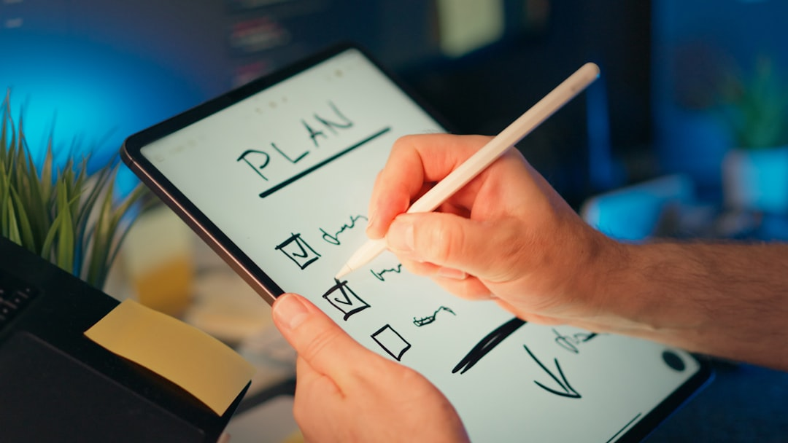
Smart Meal Planning
🥗
Steps to Make a Good Meal Plan
✓ List your favorite healthy foods
✓ Plan meals for the whole week
✓ Include variety - different colors and types
✓ Make a shopping list with all ingredients
✓ Prepare some ingredients in advance
✓ Keep healthy snacks ready
✓ Review and adjust your plan each week
Presented by Mayank Raj | Grade 7

Slide 10
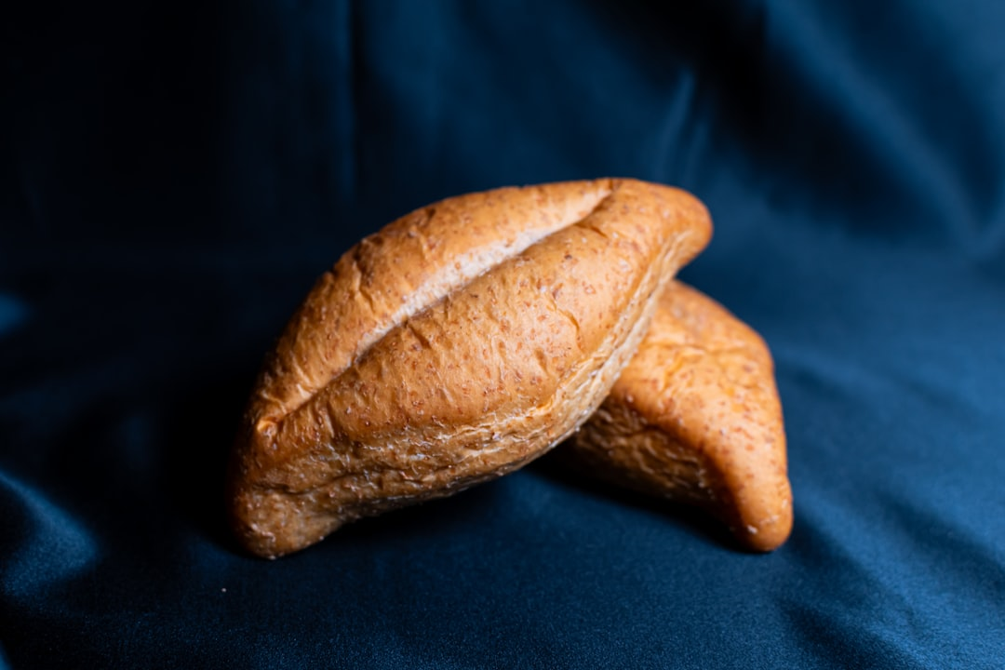
Smart Meal Planning
🥗
Food Groups in a Balanced Diet
🌾 Carbohydrates - Rice, bread, pasta for energy
🍗 Proteins - Eggs, beans, chicken, fish for growth
🥑 Healthy Fats - Nuts, olive oil for brain health
🥕 Vitamins & Minerals - Fruits & vegetables
🥛 Dairy - Milk, yogurt, cheese for strong bones
💧 Water - Essential for all body functions
Presented by Mayank Raj | Grade 7

Slide 11
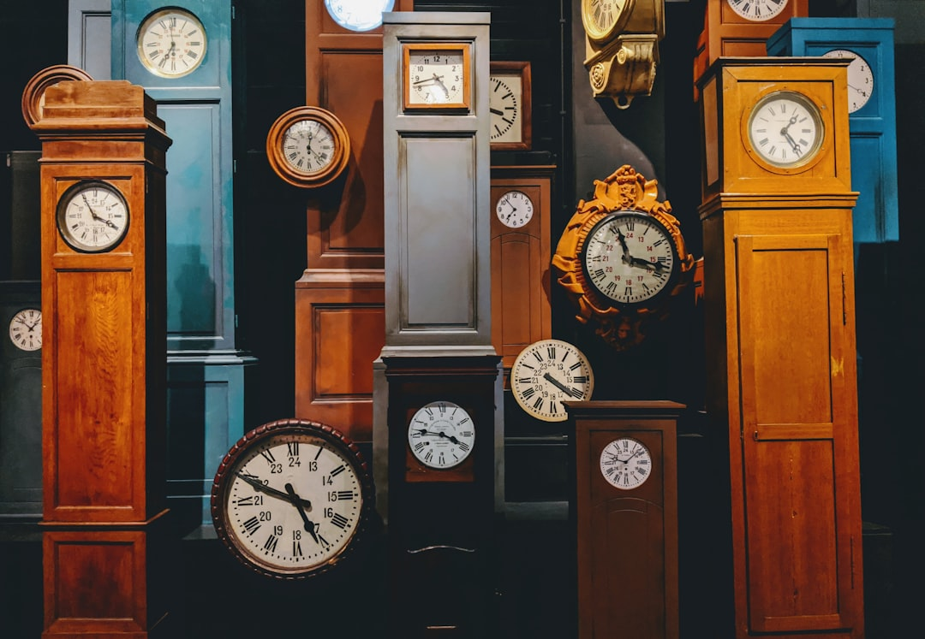
Smart Meal Planning
🥗
Importance of Eating on Time
Regular meal times regulate body clock
Prevents overeating and unhealthy snacking
Maintains steady energy throughout the day
Improves digestion and metabolism
Helps maintain focus during school hours
Supports better sleep patterns at night
Presented by Mayank Raj | Grade 7

Slide 12
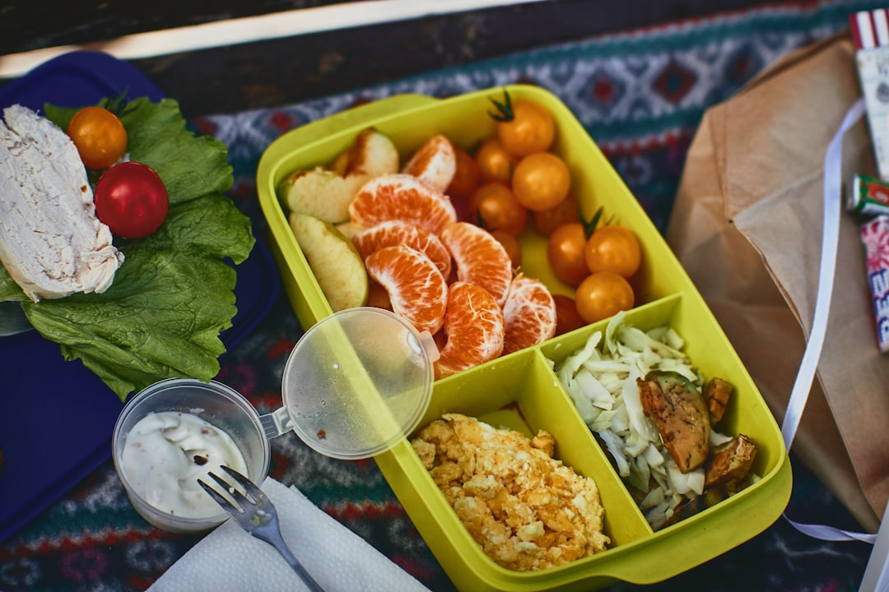
Smart Meal Planning
🥗
Healthy Meals for School Students
🍱 Pack a colorful lunch box
🥪 Whole wheat sandwiches with veggies
🥗 Fresh salads with lean protein
🍎 Fresh fruits instead of packaged snacks
🥤 Water or fresh juice, avoid sodas
🥜 Trail mix with nuts and dried fruits
Presented by Mayank Raj | Grade 7

Slide 13
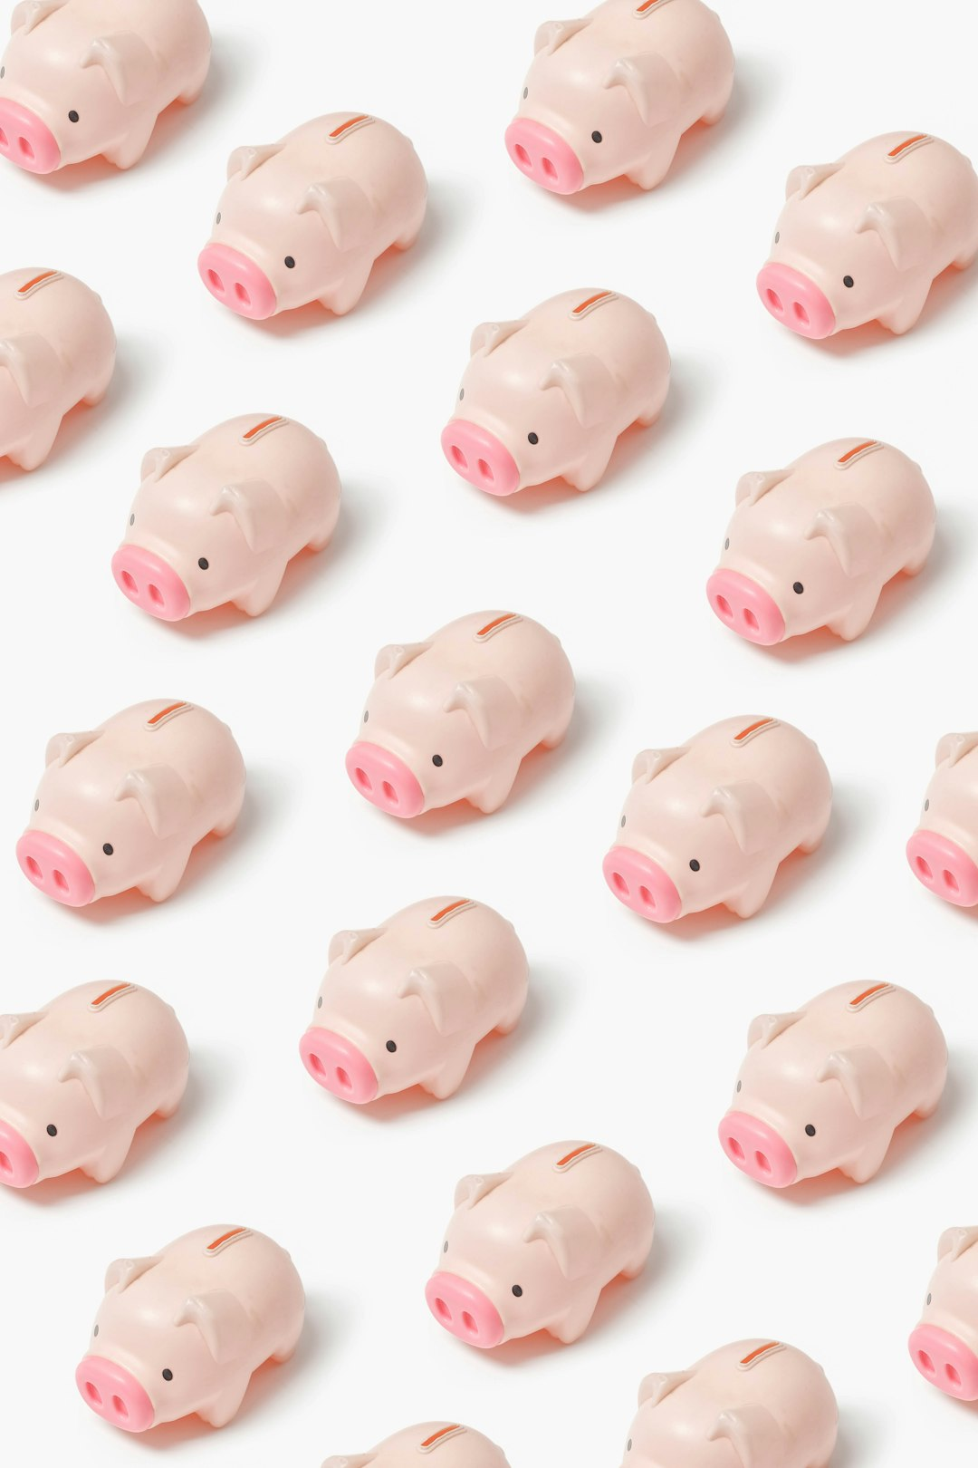
Smart Meal Planning
🥗
How Meal Planning Saves Time & Money
💰 Buy only what you need - less waste
⏰ Prepare ingredients in advance
🛒 Fewer trips to the grocery store
🍽️ Avoid expensive takeout and fast food
📋 Use leftovers creatively
📝 Stick to your shopping list
⚡ Save energy and reduce stress
Presented by Mayank Raj | Grade 7

Slide 14
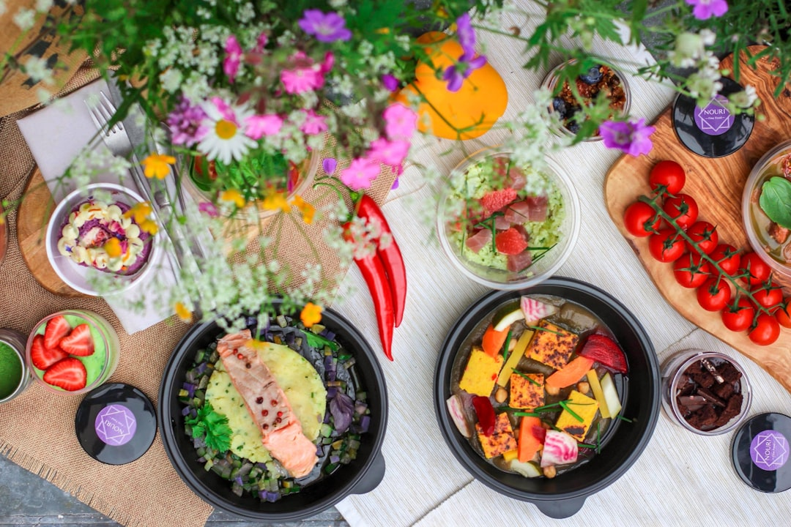
Smart Meal Planning
🥗
Role of Vegetables & Fruits
🌈 Eat a rainbow - different colors have different nutrients
🍊 Rich in vitamins and minerals
🥬 High in fiber for good digestion
🫐 Packed with antioxidants
🍓 Natural sweetness without added sugar
🥕 Keeps skin healthy and eyes sharp
Presented by Mayank Raj | Grade 7

Slide 15
Smart Meal Planning
🥗
Eating Right for a Healthy Life
""Eating right isn't dieting — it's nourishing your body to be the best version of yourself.""
Presented by Mayank Raj | Grade 7

Slide 16
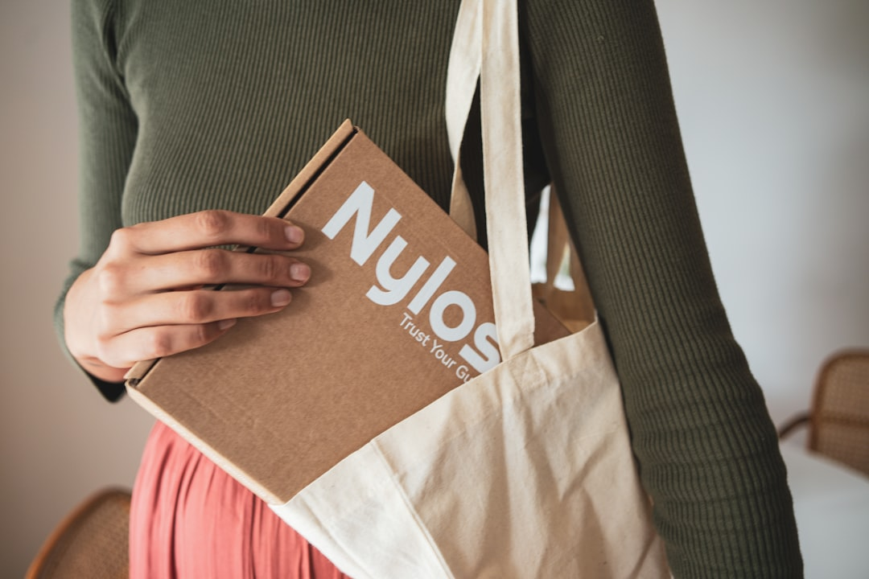
Smart Meal Planning
🥗
Tips for Making a Balanced Meal
🍽️ Use smaller plates to control portions
💧 Drink water before and during meals
❤️ Listen to your body - eat when hungry
👨‍🍳 Try cooking with family - make it fun!
✨ Make meals colorful and appealing
🥗 Include at least 3 different food groups
⏱️ Chew slowly and enjoy your food
Presented by Mayank Raj | Grade 7

Slide 17
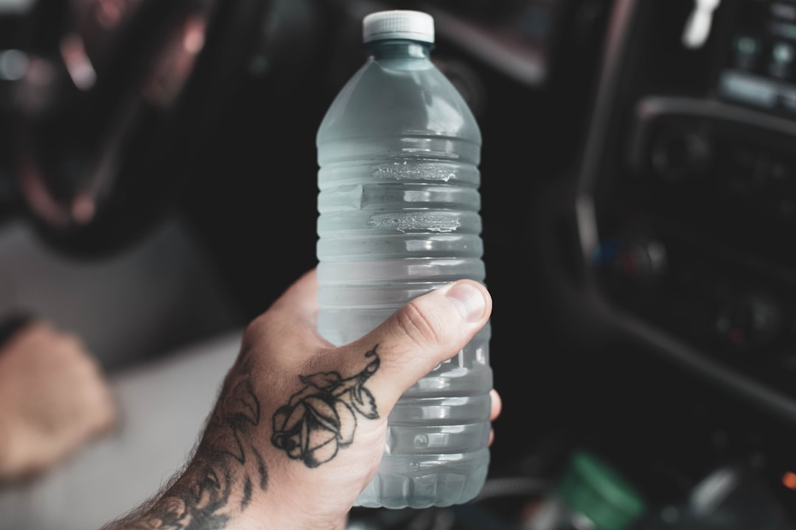
Smart Meal Planning
🥗
Importance of Drinking Enough Water
💧 Drink 6-8 glasses of water daily
🌡️ Keeps body temperature regulated
🧠 Helps brain function and concentration
💪 Transports nutrients to all body parts
✨ Keeps skin healthy and glowing
🏃 Essential for physical activity
Presented by Mayank Raj | Grade 7

Slide 18
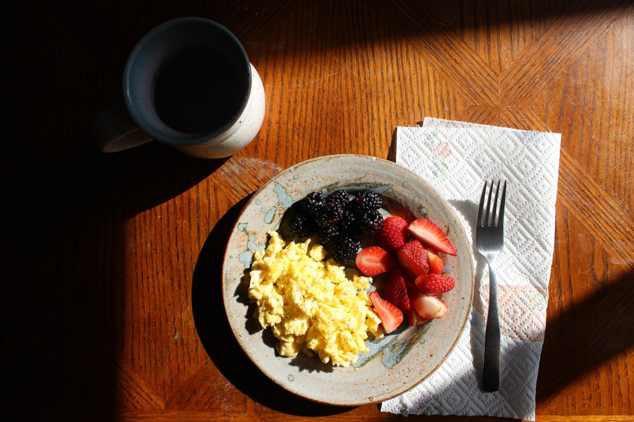
Smart Meal Planning
🥗
Why We Should Avoid Skipping Meals
⚡ Skipping meals leads to low energy
🧠 Reduces concentration in class
😟 Can cause mood swings and irritability
🍽️ May lead to overeating later
📉 Slows down metabolism
❗ Breakfast is especially important!
💪 Regular meals support physical growth
Presented by Mayank Raj | Grade 7

Slide 19
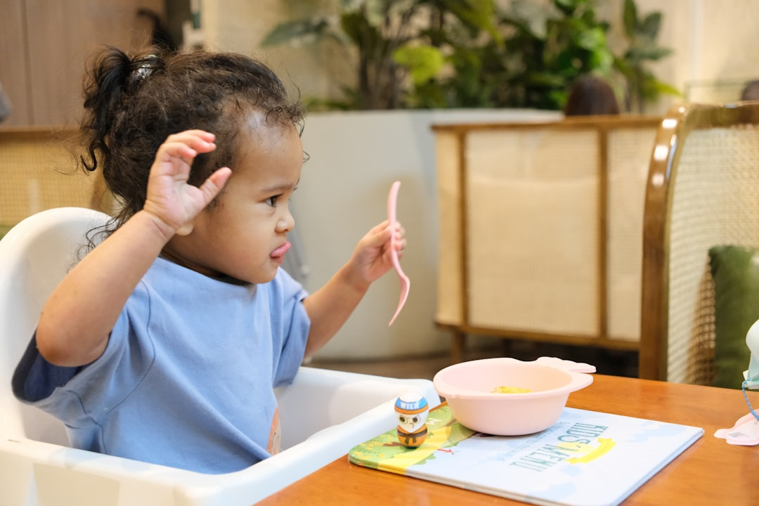
Smart Meal Planning
🥗
Meal Planning for a Busy Day
📦 Prepare lunch the night before
🥤 Keep a water bottle handy
🍎 Pack easy-to-eat healthy snacks
⏰ Set reminders for meal times
🎯 Keep it simple - not every meal needs to be fancy
👨‍👩‍👧 Ask family to help with preparation
🥙 Batch cook on weekends to save time
Presented by Mayank Raj | Grade 7

Slide 20
Smart Meal Planning
🥗
From Farm to Plate - The Journey
🌾
🚛
🏪
🏠
🍽️
Farm
Transport
Market
Kitchen
Plate
Fresh produce grown
Delivered to markets
We buy ingredients
Prepared with love
Ready to enjoy!
Presented by Mayank Raj | Grade 7

Slide 21
Smart Meal Planning
🥗
Thank You!
Eat Healthy. Think Healthy. Live Healthy.
🌟 Remember: Small changes make a big difference! 🌟
🌟 🥗 🌟
Presented by Mayank Raj | Grade 7

