Slide 1
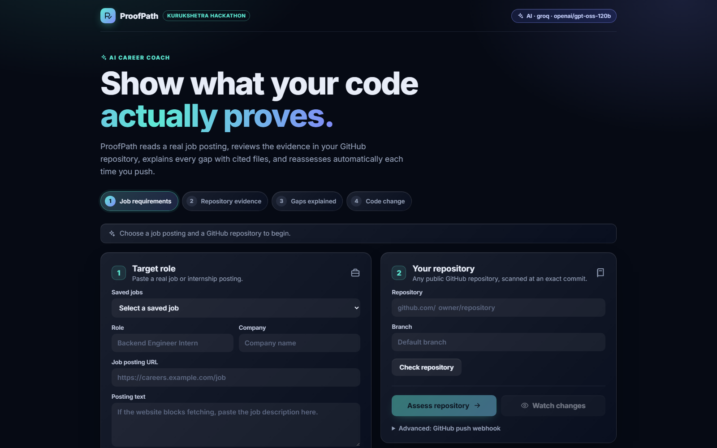
ProofPath
KURUKSHETRA HACKATHON · AI CAREER COACH
Show what your code actually proves
An AI agent that compares a real job posting with evidence in a student's GitHub repository, explains every gap with cited files, and reassesses automatically on every push.
proofpath-8r5b.onrender.com
Deven Rikame
Challenge sponsored by Worcflow
Notes:
Hi, I'm Deven. This is ProofPath, my project for the Kurukshetra Hackathon AI Career Coach challenge. Resumes make claims; ProofPath shows proof from real code, and it is clear about what it cannot prove. Everything you'll see is live on Render.

Slide 2
Resumes make claims. Judges want proof
01 · THE PROBLEM
Students list skills that their public code may not show. The brief asks for something stricter: every verdict must trace back to a real job posting on one side and a file at an exact commit on the other.
1
Absence is scoped
No signal means “not demonstrated in this scan”, never “the student lacks the skill”.
2
Mentions are not evidence
A word in a comment or a URL matches a keyword, but the AI rejects it and the rejected signal stays visible.
CORE RULE
The AI may judge evidence, but it can never invent it. A skill is only “demonstrated” when a file we actually scanned, at a specific commit, proves it.
3
Coverage is reported
Files read, files skipped and partial trees are shown, so a missing signal is never over-read.
Notes:
Most career tools read a resume and give advice. This brief asks for traceable evidence. Our core rule: the AI can judge evidence but never invent it. Three honesty rules follow: absence is scoped to the scan, mentions are not evidence, and we always report coverage.

Slide 3
One loop, end to end, with nothing refreshed by hand
02 · THE LOOP
1
2
3
4
5
Job requirements
→
Repository evidence
→
Gaps explained
→
Code change
→
Updated assessment
Real posting, source link kept, every skill quoted
Files read at an exact commit, with permalinks
Verdict, confidence and a concrete next step
A real push is detected by webhook or polling
Reassessed automatically, cites the new files
THE BRIEF'S EXAMPLE
SQL is “not demonstrated”. The student pushes queries/applications.sql. Within about a minute SQL becomes “demonstrated”, citing that file at the new commit.
Notes:
This is the loop from the brief. Steps one to three build the assessment; steps four and five, highlighted, are the live part: a real push is detected and the assessment updates by itself. The brief's own example is SQL going from not demonstrated to demonstrated after a commit adds a query.

Slide 4
One service, one database, live by default
03 · ARCHITECTURE
Teal outline = part of the live change-detection path
EXTERNAL
INGESTION
ANALYSIS
STORAGE & UI
Job posting
Job discovery
Requirement extractor
PostgreSQL
public URL or pasted text
safe fetch, strip HTML
skills + verbatim quotes
jobs, watches, assessments, history
GitHub
Portfolio scanner
AI evidence reviewer
REST API
REST API + signed push webhook
commit SHA, tree, up to 80 files
verdict, confidence, next step
jobs, assessments, repositories
AI provider
Webhook receiver
Guardrails
React dashboard
Groq (default), Gemini, Claude
HMAC check, branch filter
citations must be scanned files
checks status every 4 s
Repository monitor
Reassessment
head SHA every 60 s
rebuild every tracked job
LIVE LOOP git push → webhook or 60 s poll → scan new SHA → AI review + guardrails → save version → “Improved” on screen
Notes:
One Spring Boot service serves both the React dashboard and the API, backed by one PostgreSQL database. Teal outlines mark the live path: GitHub push or polling, reassessment, and the dashboard update. Polling is a durable fallback, so the demo never depends on a tunnel.

Slide 5
Every requirement quotes the posting
04 · JOB REQUIREMENTS
1
Fetch safely
10 s timeout, no redirects, private network addresses refused. Pasted text works when a site blocks fetching.
REAL EXTRACTION FROM A SAVED JOB
Fresher – Software Development Engineer
2
Extract with AI
Wohlig · read by AI (openai/gpt-oss-120b)
The AI maps the posting onto the skill taxonomy and marks each skill required or preferred.
“develop software in Java”
JAVA
3
Verify every quote
A skill is kept only if its quote appears word for word in the posting.
“SQL”
SQL
4
Student reviews
“test-driven development”
Skills can be toggled before assessing; the source link is always one click away.
TESTING
Notes:
Requirements come from a real posting. We fetch it safely, the AI maps it to our skill taxonomy, and we drop any skill whose quote isn't found word for word in the posting. On the right is a real extraction from a saved job: each skill shows the exact phrase that asked for it.

Slide 6
Three verdicts, each backed by cited files
05 · ASSESSMENT
DEMONSTRATED
PARTIAL
NOT DEMONSTRATED
The code really implements or meaningfully uses the skill.
A real but thin signal.
Nothing in this scan shows real use.
A repository method running SELECT … WHERE; a working REST controller.
Only configuration or boilerplate, or a positive verdict that cited no scanned file.
No candidate file, or only keyword false positives. Never “lacks the skill”.
80%
Role readiness = (demonstrated + ½ × partial) ÷ required skills
Example scan of deven065/bmg-interiors: 4 demonstrated, 1 not shown yet. Each skill also shows HIGH, MEDIUM or LOW confidence.
Notes:
Every required skill gets one of three verdicts, and each verdict cites the files it relied on. The readiness score is a progress indicator for the student: demonstrated skills count fully, partial ones count half.

Slide 7
Guardrails stop invented evidence
06 · TRUST
No candidate file for a skill
→
Always NOT DEMONSTRATED, whatever the model says
1
Positive verdict without a valid citation
→
Downgraded to PARTIAL with low confidence
2
Cited path that was never scanned
→
Citation discarded; only scanned files count
3
Keyword signal the AI rejected
→
Kept visible, so the student sees what was checked
4
AI unavailable or rate-limited
→
Keyword-rule results, labelled “Keyword rules”
5
Notes:
This is how we answer 'how do you know the AI isn't making things up?'. The AI only sees excerpts we scanned and can only cite those paths. Untraceable claims are downgraded, and if the AI is down the page says so instead of pretending.

Slide 8
Push a commit, watch the verdict change
07 · CHANGE DETECTION
1
2
3
4
5
Watch
Detect
Pending
Reassess
Publish
Register repo and branch; optionally install a signed webhook
Signed push, or the head SHA checked every 60 s
Dashboard shows “abc1234 reassessing…”
Rescan at the new SHA, AI review + guardrails
New version saved; changed skills marked “Improved”
Signed GitHub webhook
Polling fallback
Verified with X-Hub-Signature-256 (HMAC-SHA256), filtered to the watched branch, answered with 202 so GitHub never waits.
If a webhook is missed or blocked, the monitor still finds the new commit within 60 seconds. The dashboard checks for updates every 4 seconds.
Notes:
This is the part a static report can't fake. After we watch a repository, a signed push or the 60-second poll detects the new commit. The dashboard shows it as reassessing, then publishes the new version and marks the skills that improved.

Slide 9
Deployed and usable today
08 · LIVE PRODUCT
Live on Render
proofpath-8r5b.onrender.com, Docker image with PostgreSQL, auto-deployed from main
Animated dashboard
Loop tracker, readiness ring, cited evidence cards and a live “Improved” moment
AI on by default
Groq openai/gpt-oss-120b, swappable to Gemini or Claude with one variable
Notes:
This is the real deployed app on Render, not a mock-up. It uses PostgreSQL in production, redeploys on every push to main, and runs the AI review with Groq by default.

Slide 10
Built to be checked, not just demoed
09 · ENGINEERING
13
60 s
4 s
automated tests
polling fallback
dashboard refresh
full loop, guardrails, fallbacks, persistence, secret scan
a missed webhook never breaks the loop
pending commits appear almost at once
~250 MB
63 kB
80
memory in use
first page load
files per scan
fits a free 512 MB instance
gzip; animation code loads afterwards
coverage and skipped files always shown
Java 17 · Spring Boot 4.1 · React 18 · Vite 5 · Framer Motion · PostgreSQL · Groq / Gemini / Claude · Docker · Render
Notes:
Quality of execution in numbers: thirteen automated tests including a secret scan, a polling fallback, a fast dashboard, and a small footprint that fits a free hosting plan.

Slide 11
Five-minute demo plan
10 · DEMO
TIME | SHOW | SAY
0:00–0:30 | Landing page and the loop tracker | “Resumes make claims. ProofPath shows proof.”
0:30–1:15 | Paste a real posting | Open the source; point at each quoted phrase
1:15–2:15 | Assess: ring, cards, summary | Open a cited file at the exact commit and line
2:15–2:45 | The SQL gap | “Not shown in this repository, not a missing skill”
2:45–4:15 | Watch, then push queries/applications.sql | Tracker shows reassessing; SQL turns Demonstrated
4:15–5:00 | Architecture and guardrails | Verified citations, polling fallback, history
Notes:
Prepare the commit in advance on a branch and merge it during the demo. Open the live site two minutes early so the free instance is awake, and keep a backup recording ready.

Slide 12
Where each criterion is earned
11 · JUDGING
1
Functional completeness
2
Quality of execution
Real posting with source link → cited evidence → explained gaps → real push → automatic reassessment, live on the deployed site.
Commit-pinned permalinks, HMAC-verified webhooks with polling fallback, PostgreSQL, 13 tests, Docker deployment.
3
Thought
4
Effort & creativity
Scoped absence, guardrails against invented evidence, visible rejected signals, coverage reporting, honest fallback labels.
Animated glass dashboard, live loop tracker, readiness ring, guided close-the-loop panel, free swappable AI providers.
Notes:
Mapping to the four judging criteria. Each card names something you can verify directly in the live app or the repository.

Slide 13
Proof, not claims
THANK YOU · QUESTIONS WELCOME
TRY IT LIVE
proofpath-8r5b.onrender.com
SOURCE CODE
github.com/deven065/JobApplication
BUILT BY
Deven Rikame · Kurukshetra Hackathon 2026
Notes:
To close: ProofPath turns a resume claim into evidence a judge can click through, and it updates the moment the student improves their code. Thank you, I'm happy to take questions.

