Slide 1
Deployment Dashboard

Slide 2
Deployment Dashboard
Core Problem
Organizations follows CI and CD processes that differ across teams
Manual interventions are involved making deployment error prone
Multiple versions/releases of a product runs at different stages, such as development, e2e testing, acceptance testing, staging, client-side deployment, production
Manual interventions do not reflect the latest state a product is in to other stakeholders
Consolidating current state of a product running at different stages in diverged geographical location is cumbersome when done manually
Solution
A web-based deployment dashboard that provides:
A continuous delivery platform
A consolidated view of the different stages a product is currently in.
Application
Devops/operations team follow a standard fully automated deployment process
Management uses the deployment dashboard to make business predictions and decisions based on current state of different products of the organization
Technical teams track the states of a product and plan delivery
On site teams track the states of a product and plan client-side testing and deployment to production
Clients have a single view to track progress of their products

Slide 3
Deployment Dashboard
Create a new project in Jenkins
Create a .Jenkins file in current project
Project setup
Making a new entry in Jenkins file
Creating a new set of deployment instructions
New deployment setup
Fire a new deployment
Build the project (Docker Compose vs Docker Stack)
Deploying new stack and shutting down the old one
Generating deployment report
Docker swarm provision
Jenkin agent

Slide 4
Manual Request
Web hook (svn)
Build Scheduler
Dkron Time scheduler
Kafka
New build event
Jenkins agent
Jenkin
Event relay agent
Triggers

Slide 5
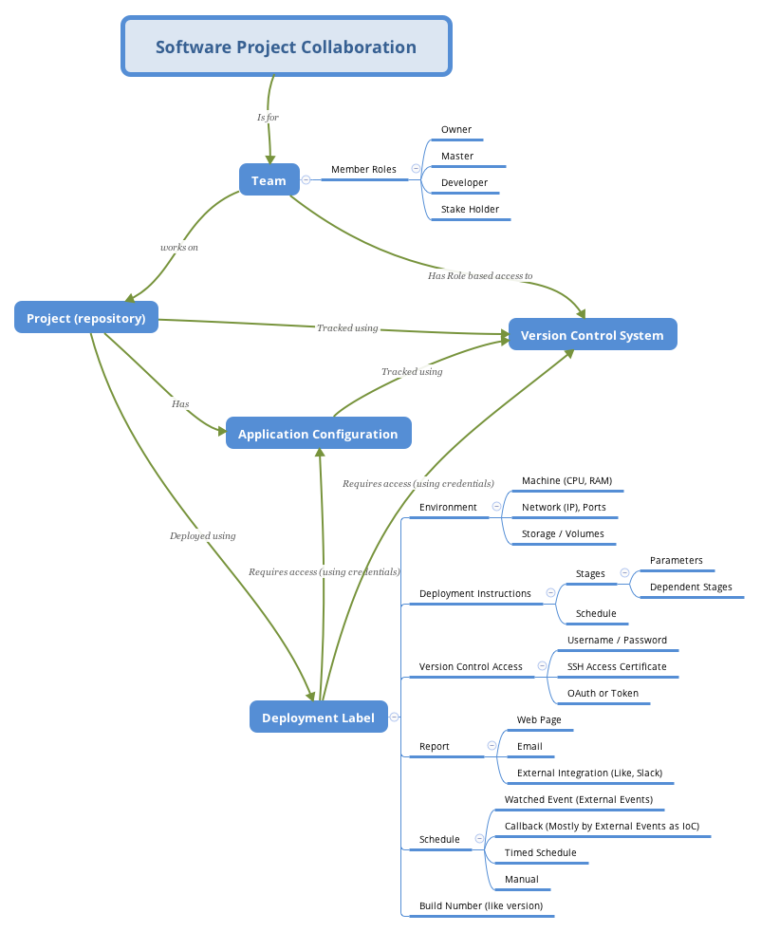

Slide 6
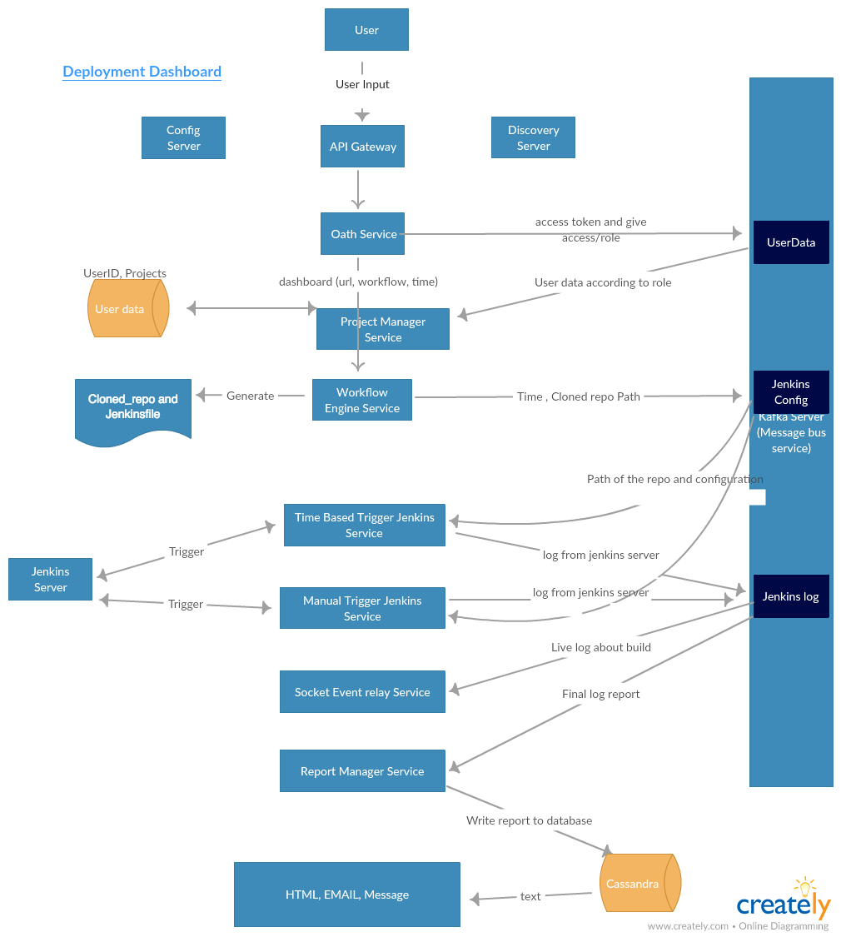

Slide 7
