Slide 1
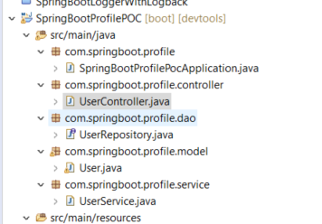
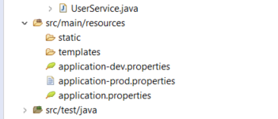
Spring Boot Profiles

Slide 2
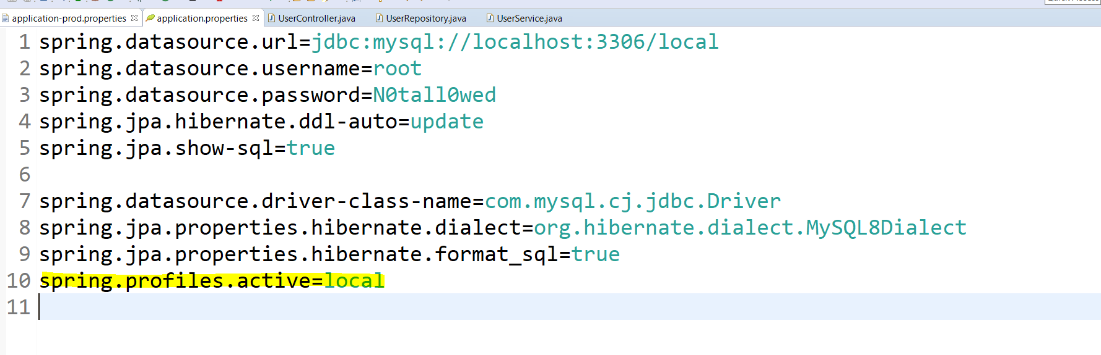
Spring Boot Profiles

Slide 3
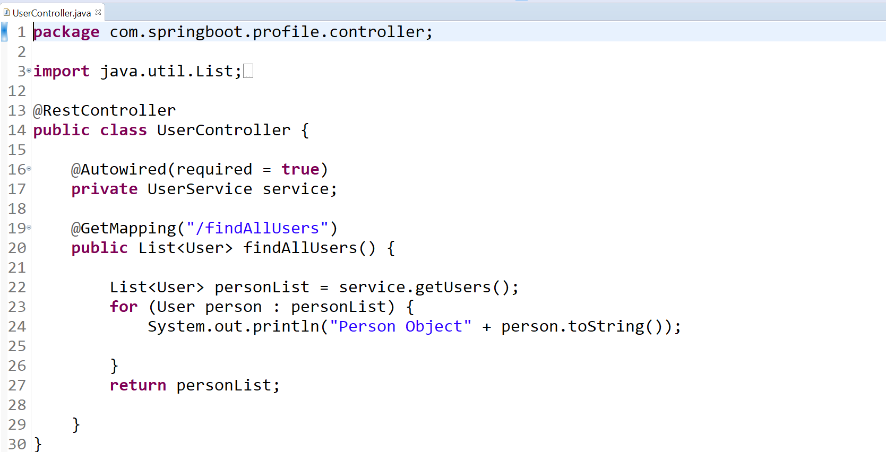
Spring Boot Profiles

Slide 4
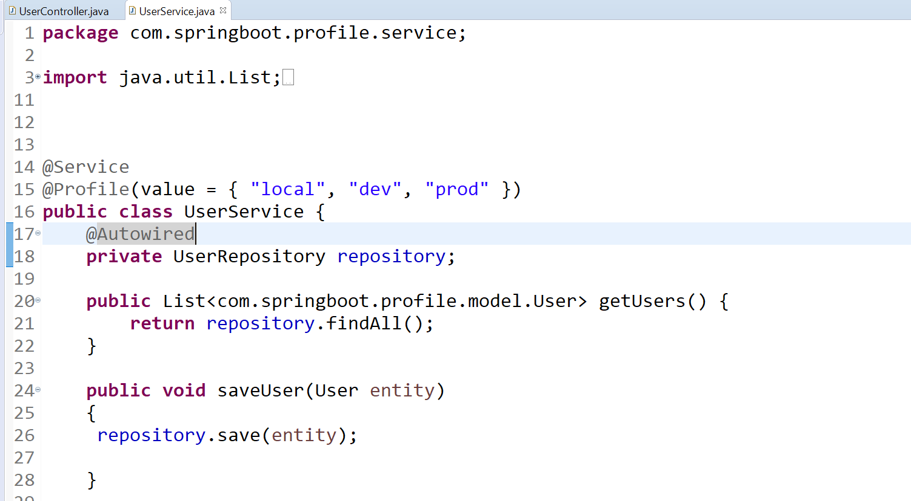
Spring Boot Profiles

Slide 5
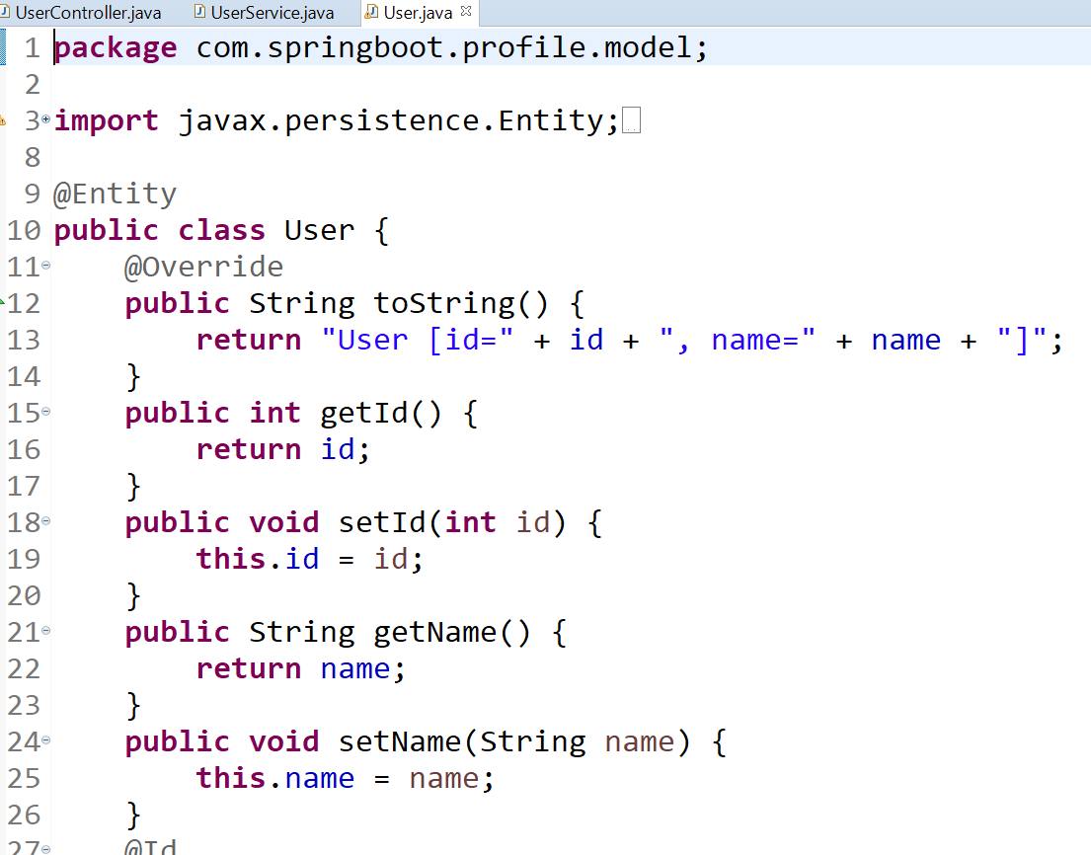
Spring Boot Profiles

Slide 6
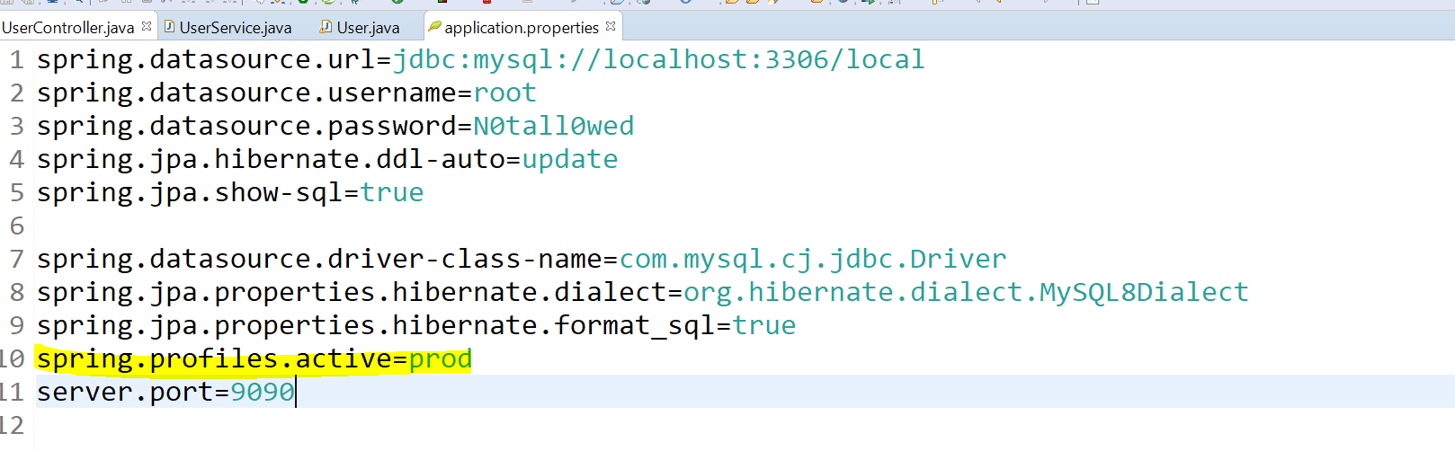
Spring Boot Profiles

Slide 7
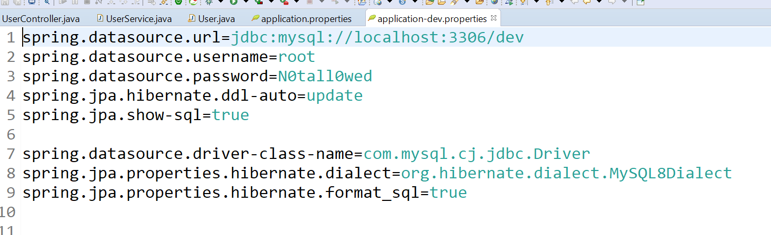
Spring Boot Profiles --- Dev Profile

Slide 8
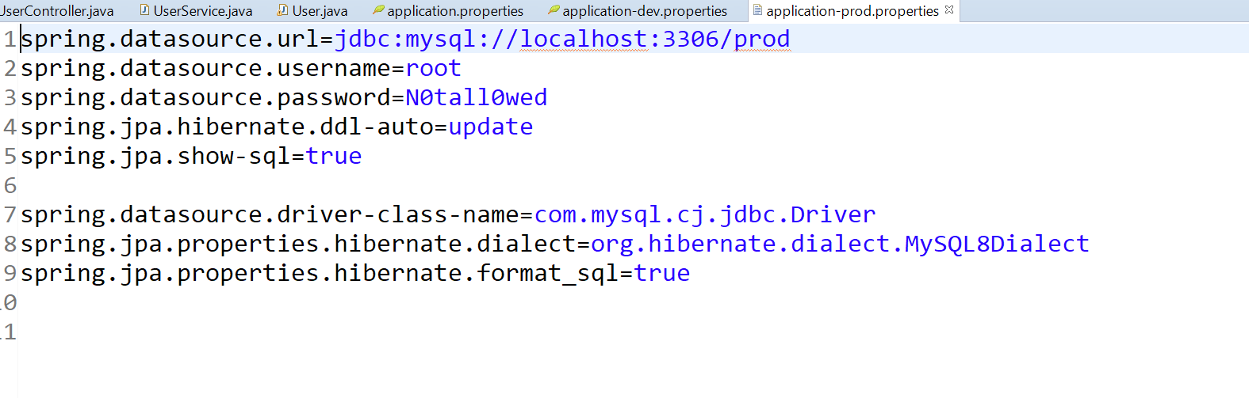
Spring Boot Profiles- Prod Profile

Slide 9
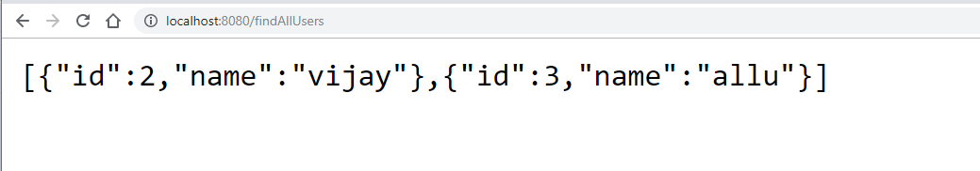
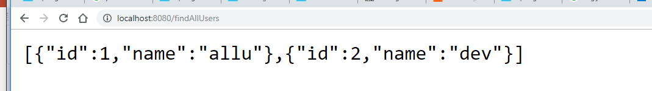

Spring Boot Profiles
Dev DB
Prod DB

Slide 10
Source Code

