Slide 1
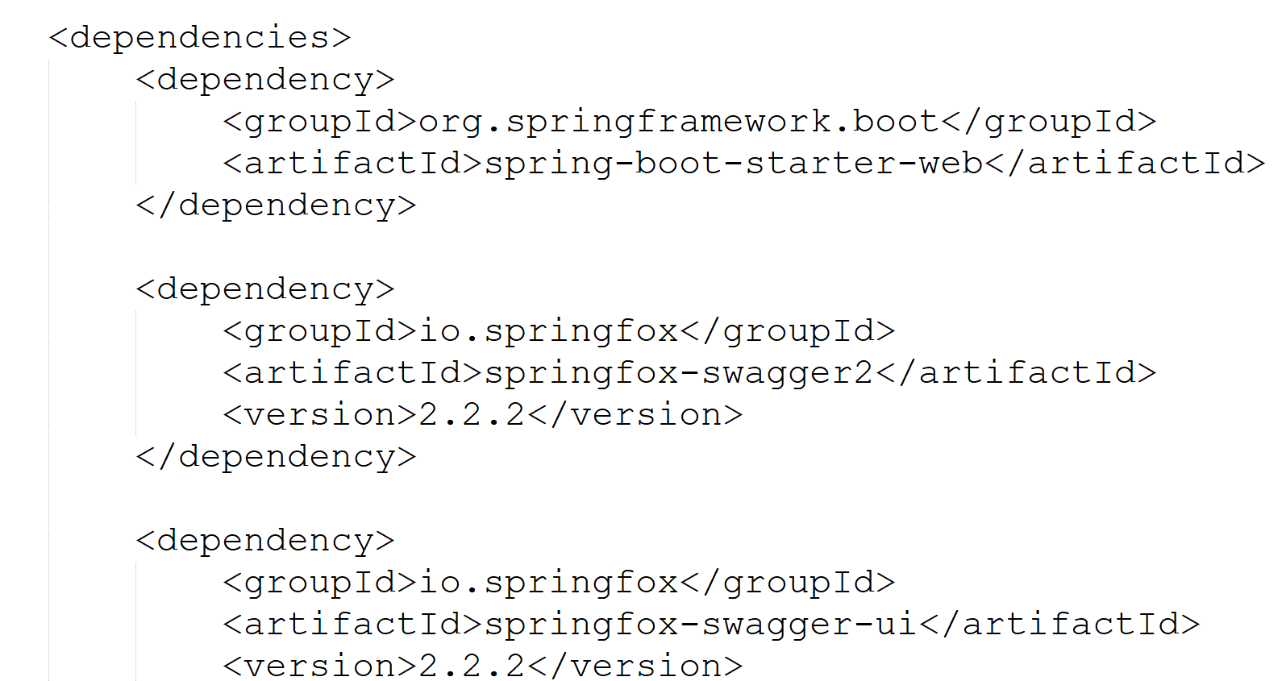
Spring Boot Swagger

Slide 2
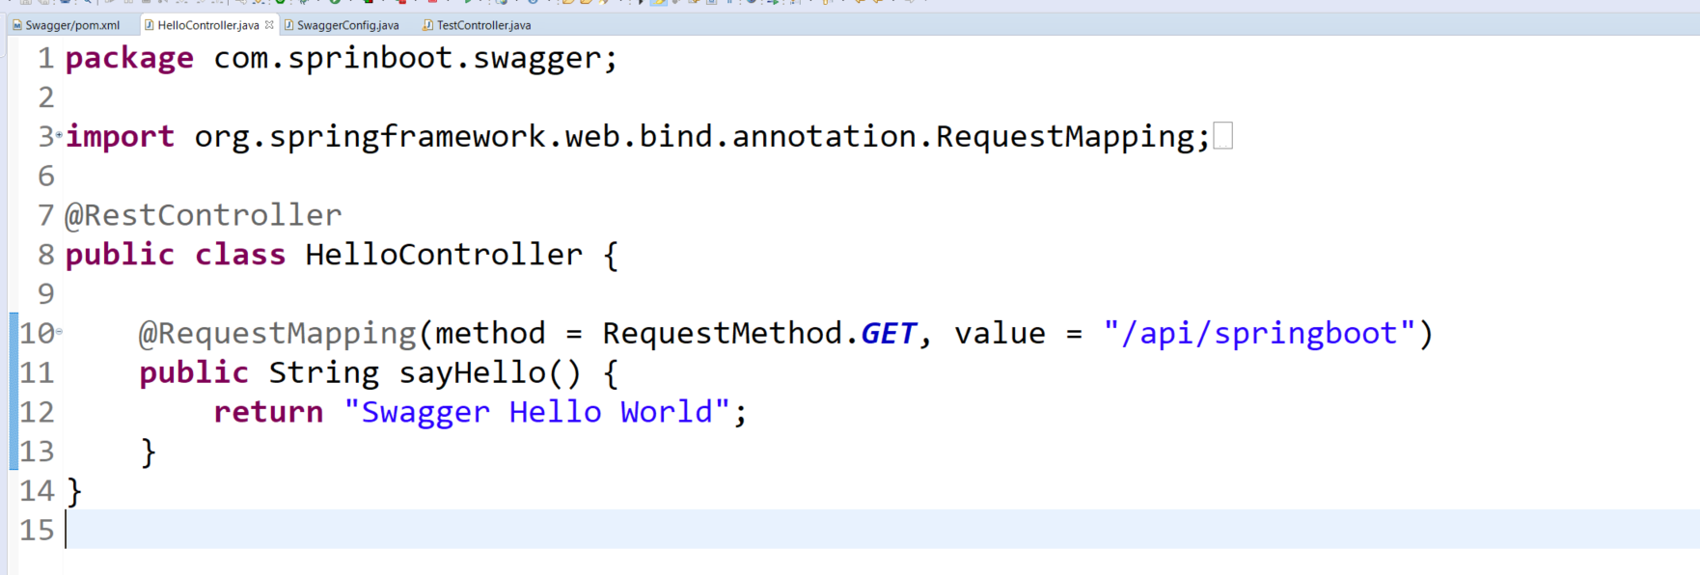
Spring Boot Swagger

Slide 3
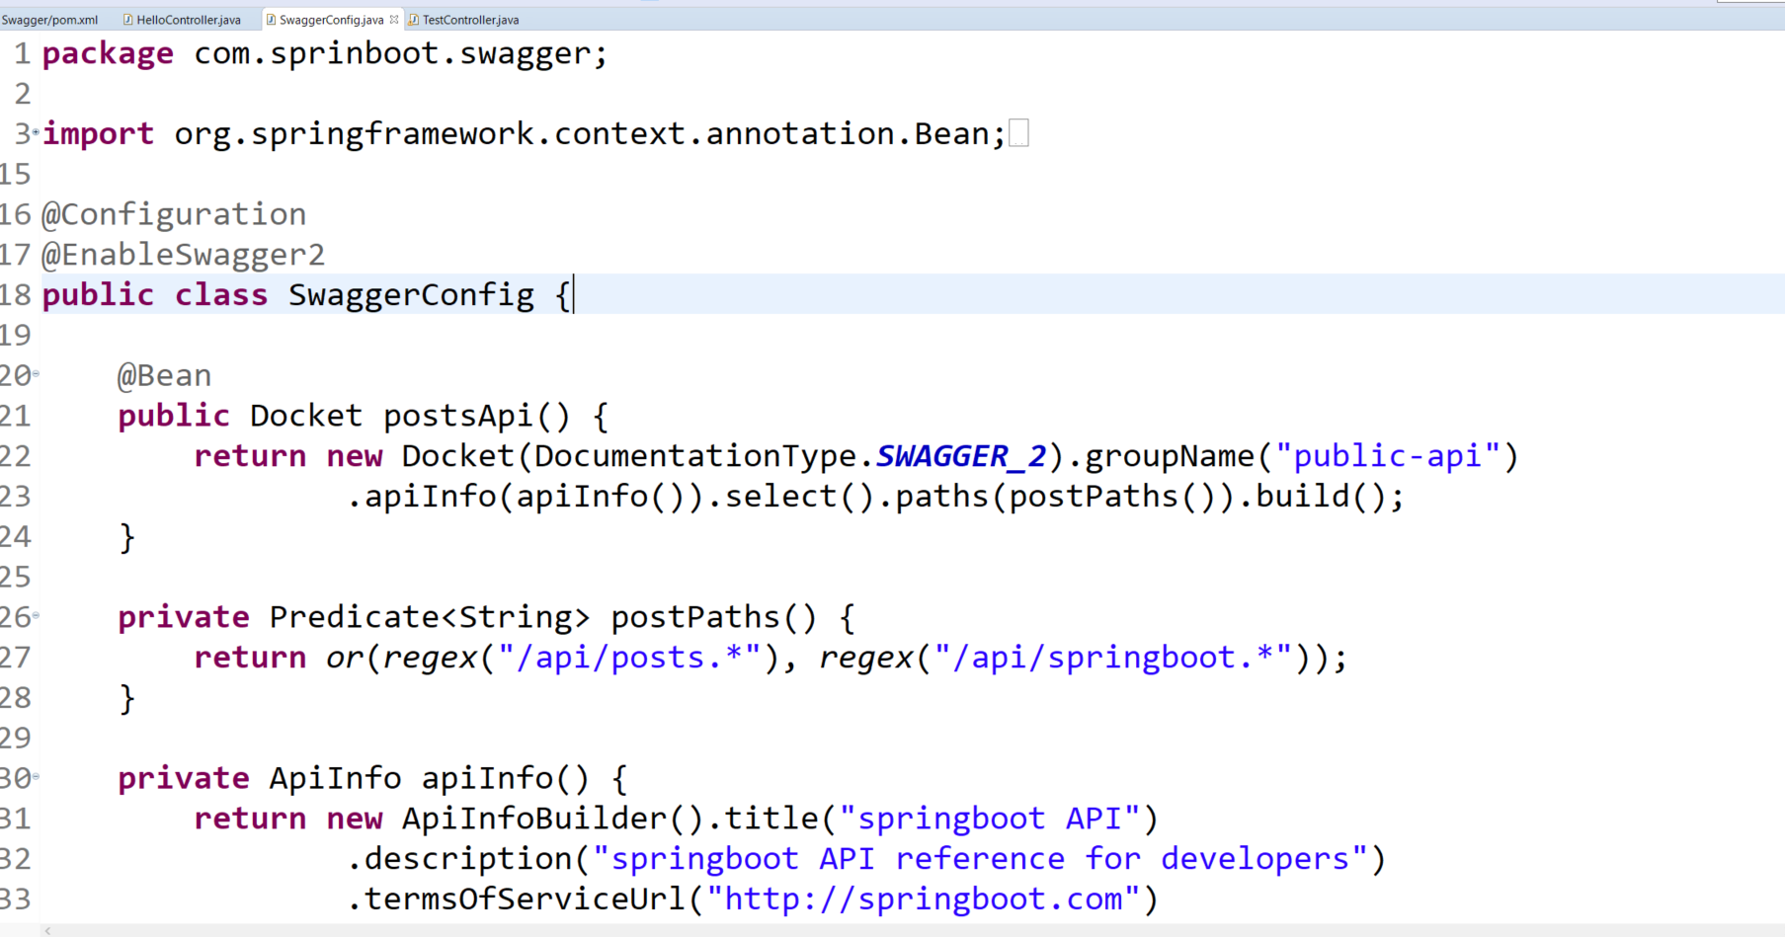
Spring Boot Swagger

Slide 4
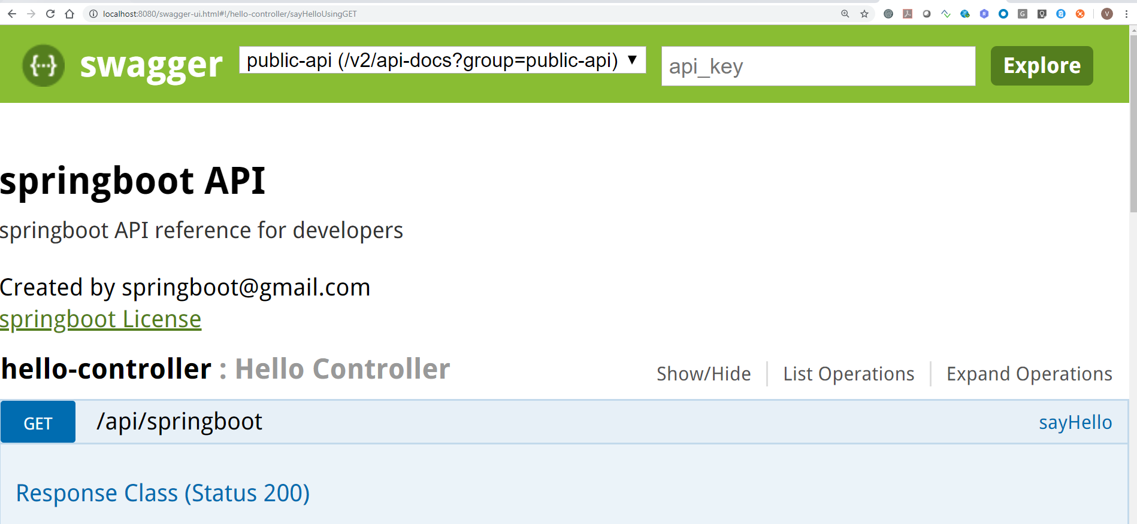
Spring Boot Swagger

Slide 5
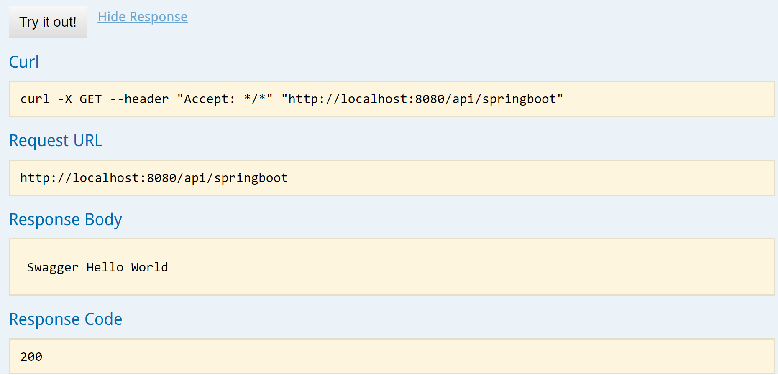
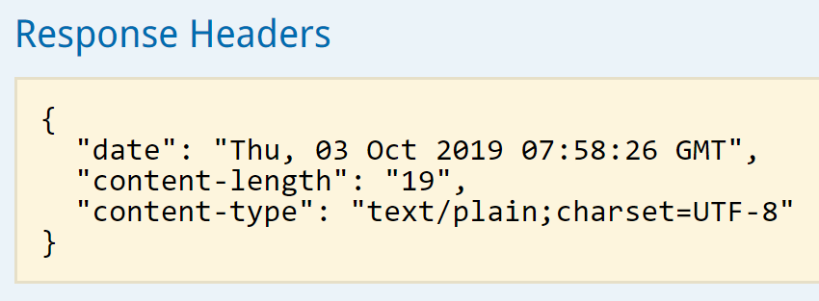
Spring Boot Swagger

Slide 6
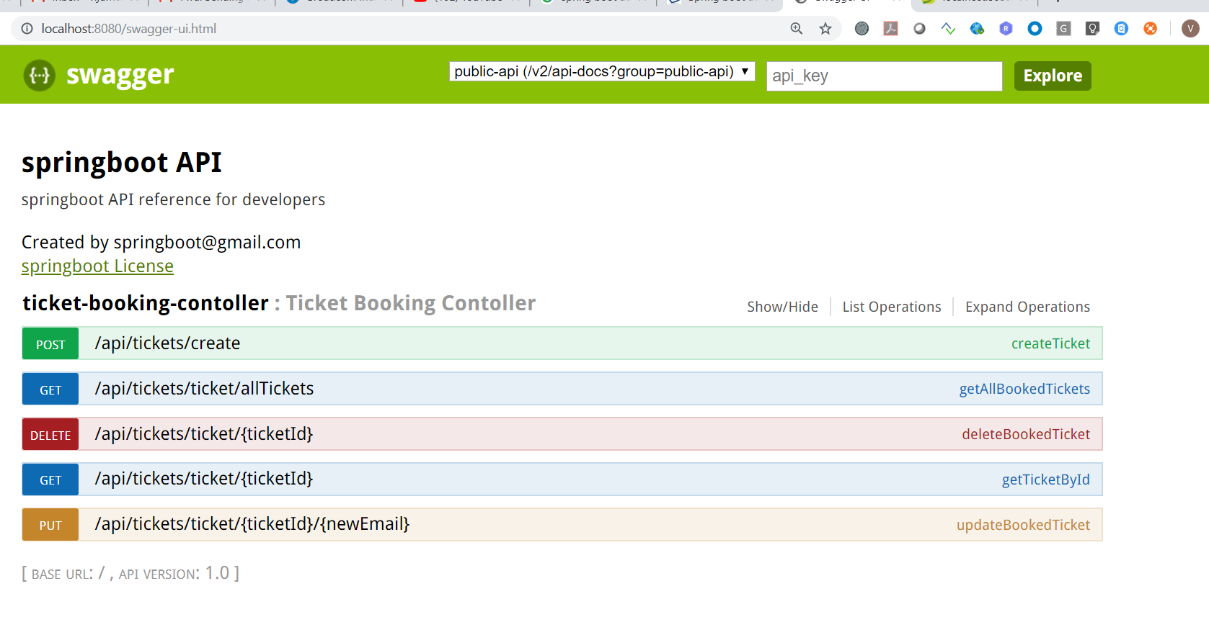
Spring Boot Swagger

Slide 7
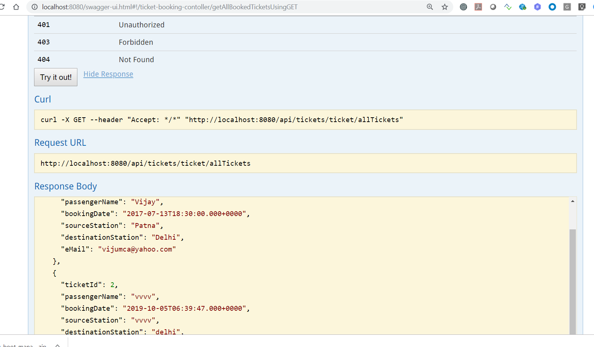
Spring Boot Swagger

Slide 8
Spring Boot Swagger

