Slide 1


Docker

Slide 2
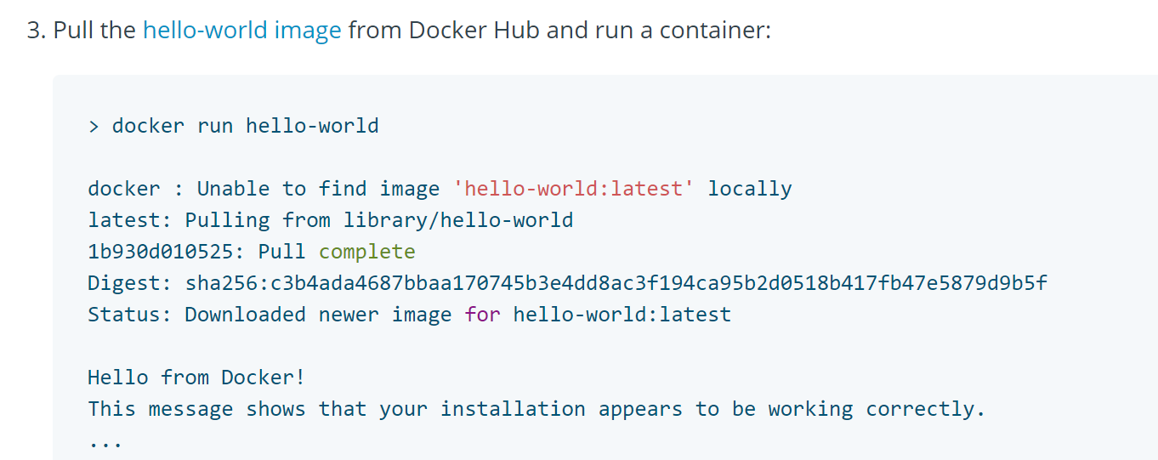
Docker

Slide 3
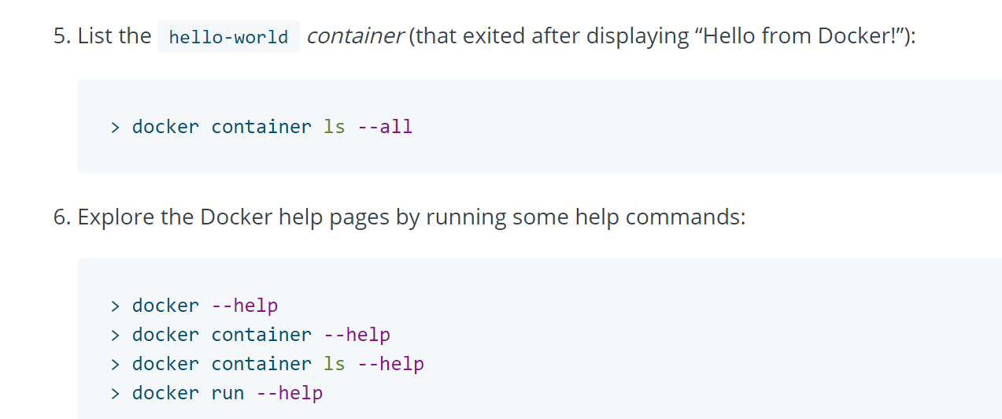
Docker

Slide 4
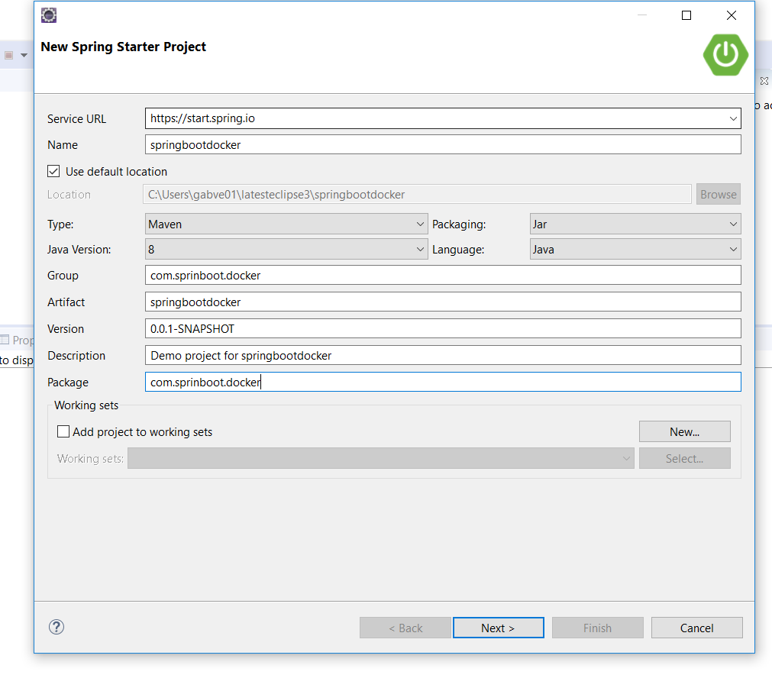
Docker

Slide 5
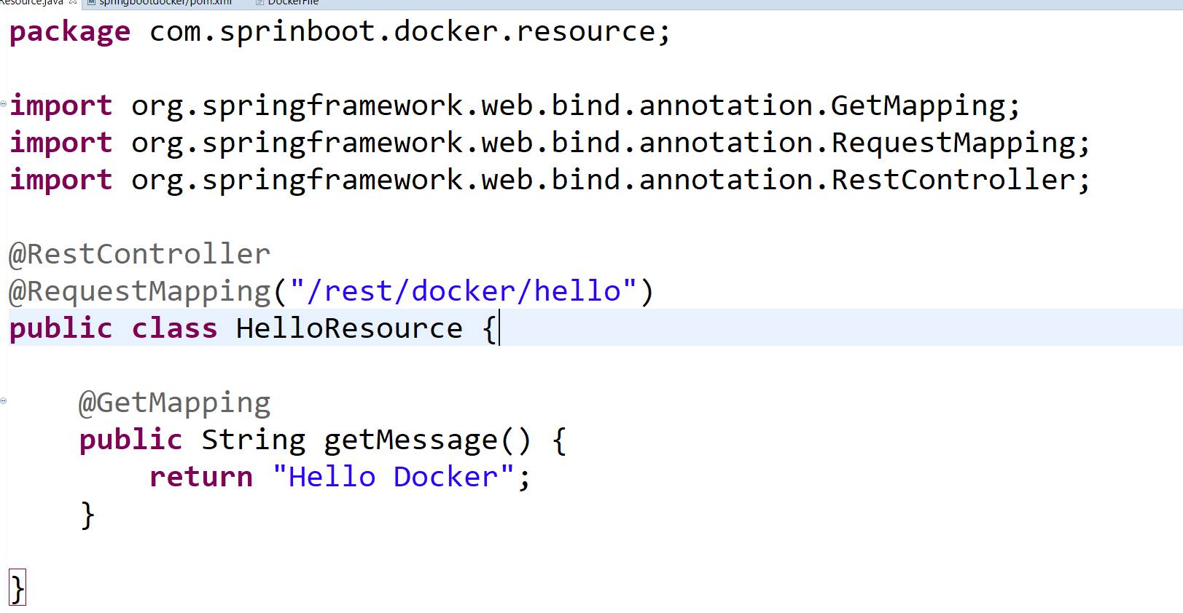
Docker

Slide 6
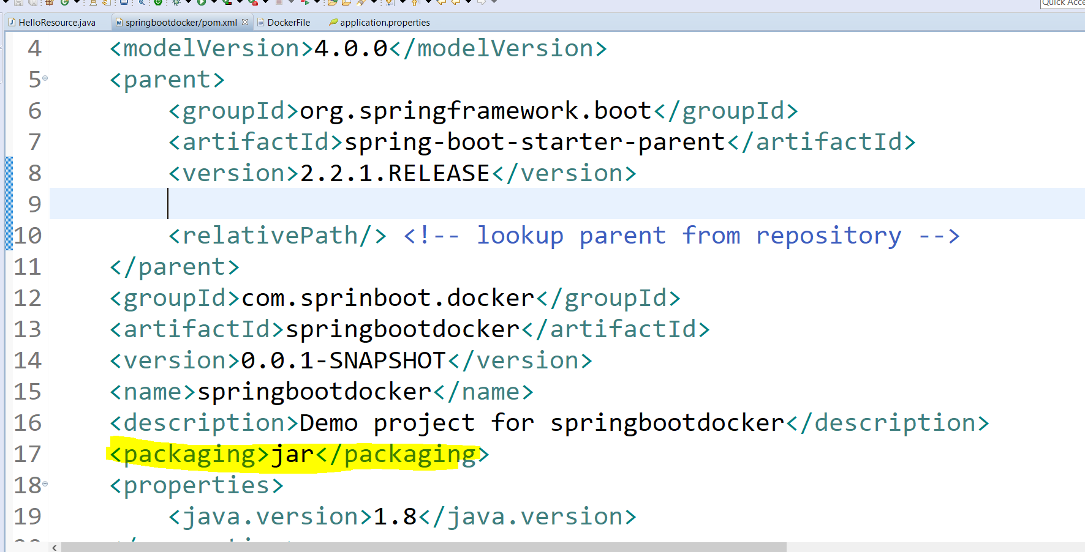
POM.XML

Slide 7
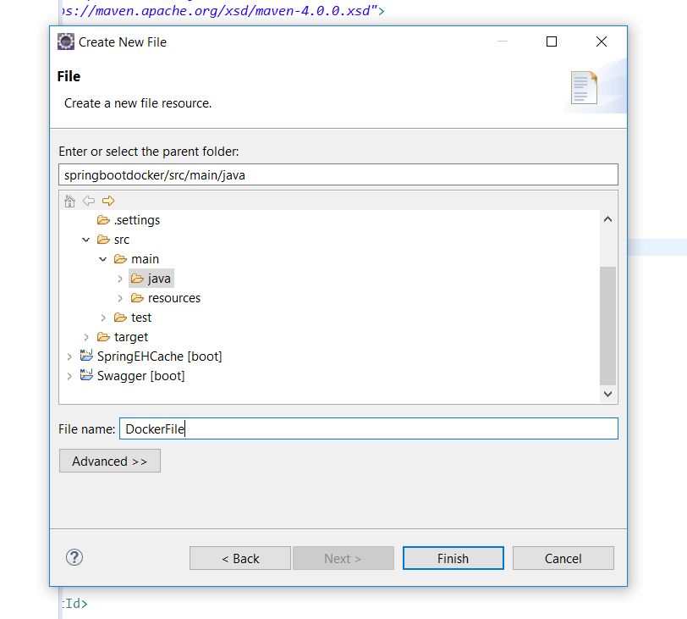
Docker

Slide 8

Docker File

Slide 9
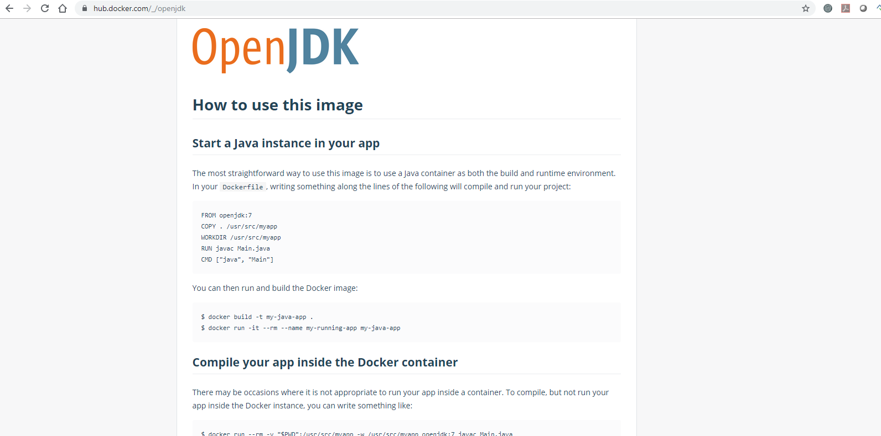
Docker

Slide 10

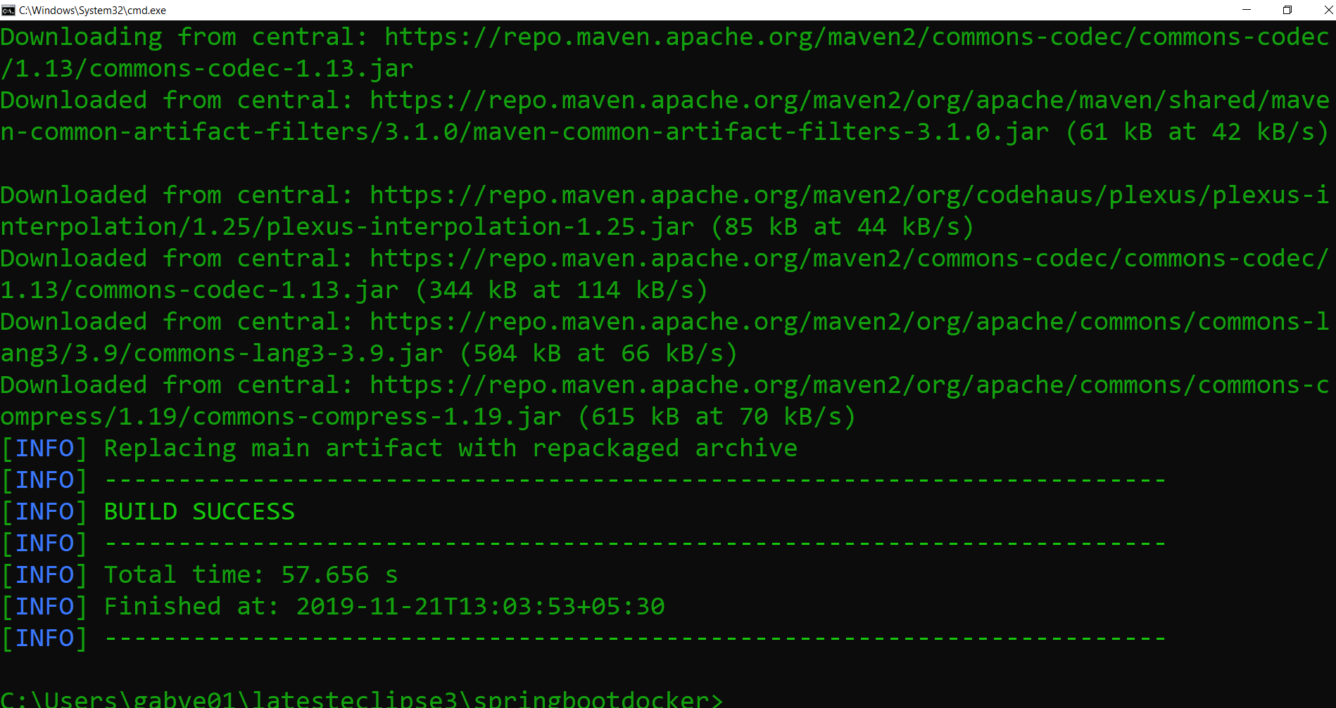
Docker

Slide 11
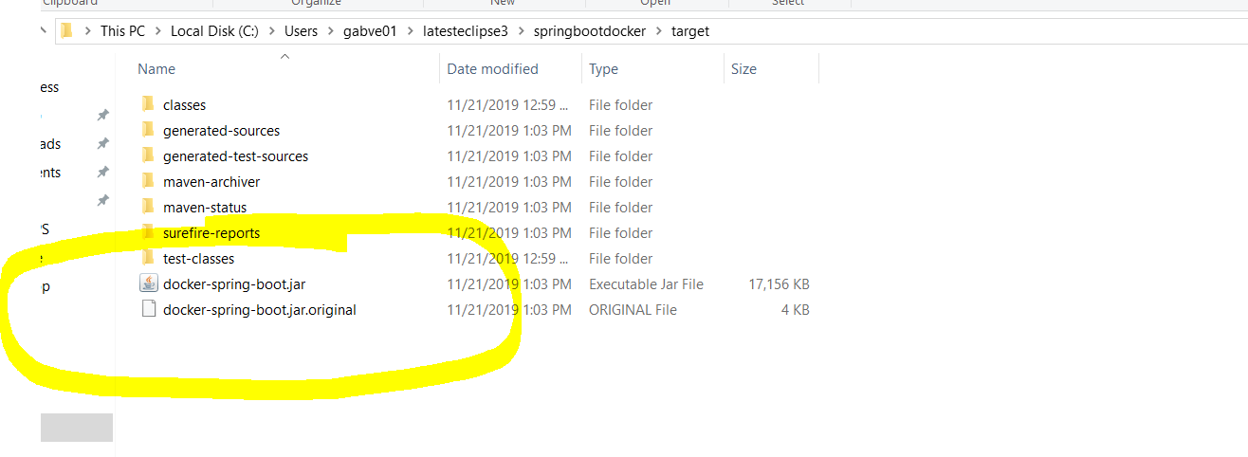
Docker

Slide 12


Docker

Slide 13

Docker
Docker Command to Build : docker build –f <Docker FileName> -t <targetFileName> <current directoryto build>

Slide 14
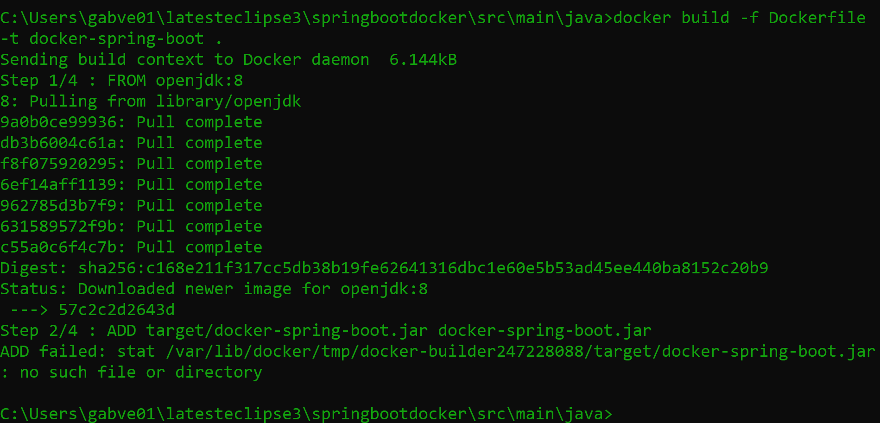
Docker

Slide 15
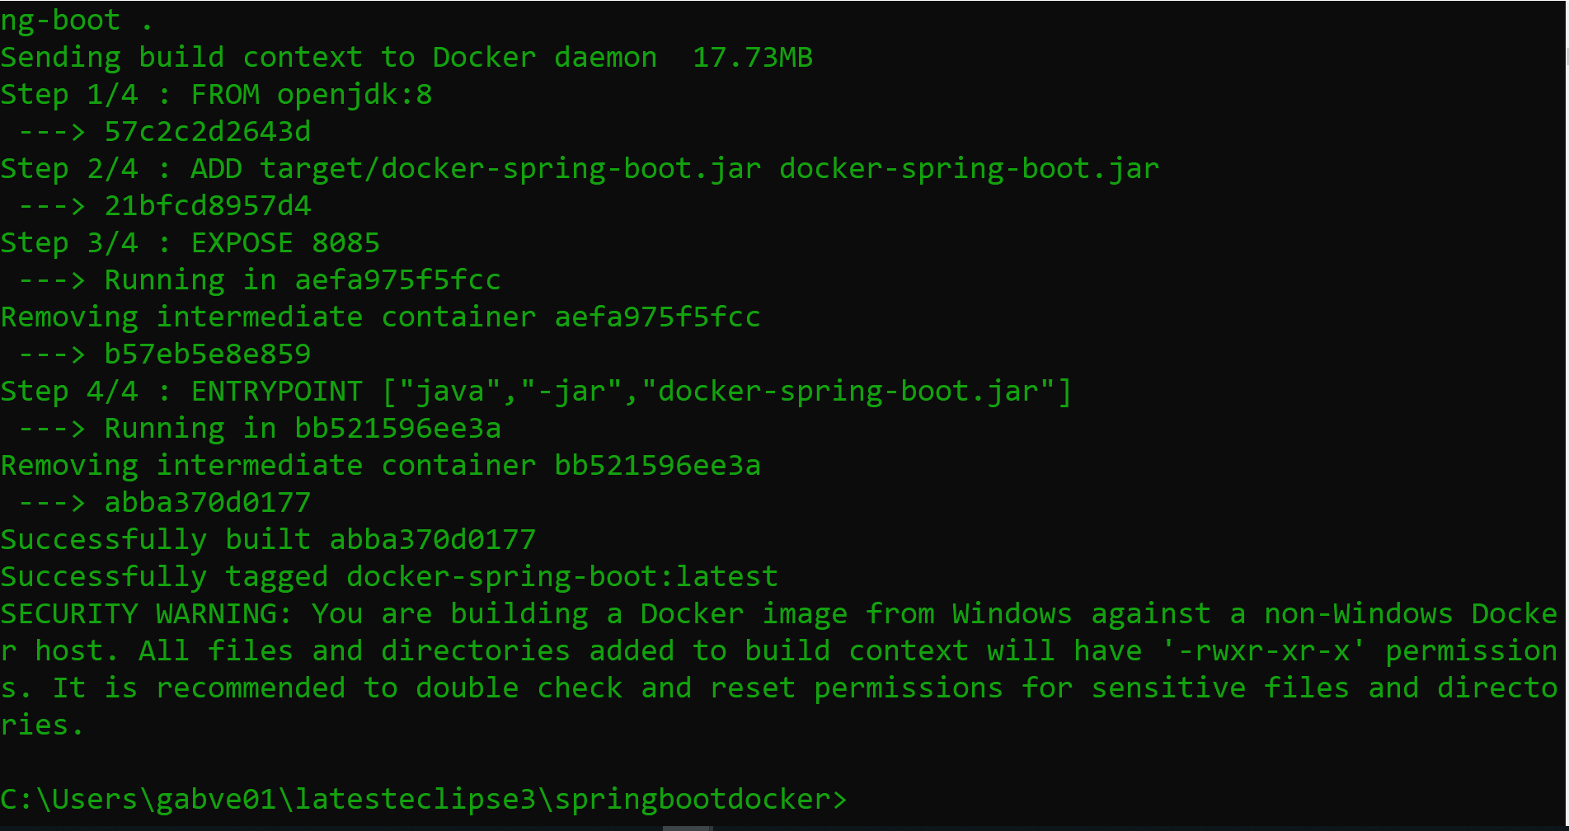
Docker

Slide 16

Docker

Slide 17
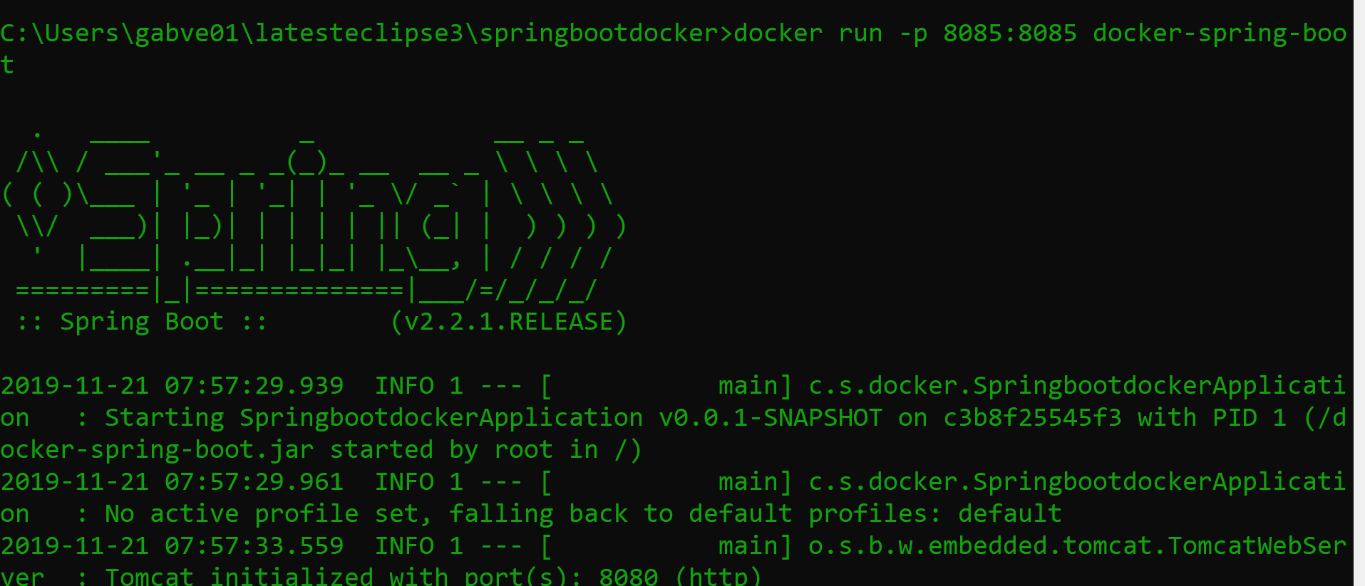
Docker
Docker Command to Build : docker run –p <portNumber>:<portNumber> image Name

Slide 18
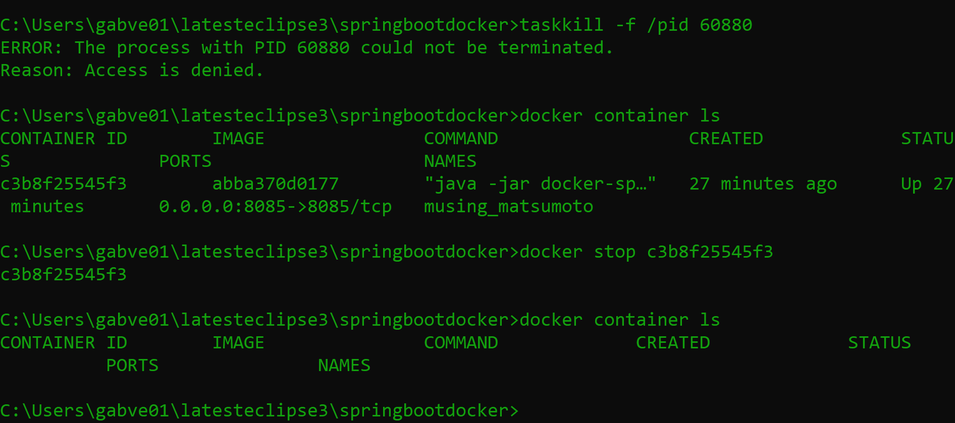
Docker

Slide 19
Docker
Output: HelloDocker

