Slide 1
Capstone Project : Marketing and Retail Analytics
To Reduce The Excess Inventory Management Costs For E-commerce company ‘OList’
Notes:
Objective

Slide 2
AGENDA
Objective
Background
Insights
Recommendations
Conclusion
Appendix:
Data sources
Data methodology
Data model assumptions
Notes:
Objective

Slide 3
OBJECTIVE
To manage the inventory effectively and reduce any unnecessary costs that the company ‘OList’ is incurring.
Identify top products contributing to the majority of the revenue.
Identify the product categories which can be omitted without significantly impacting business revenue.
Analyze the purchase behavior of customers to identify the sales pattern of products.
Notes:
Objective

Slide 4
BACKGROUND
To be able to meet the demands of the customers, any e-commerce company would obviously need to store tons and tons of products in warehouses which includes fast-moving products as well as slow-moving products.
Each of the products being stored incurs a cost to the company in terms of space and maintenance, Because of which it is absolutely necessary for the organizations to plan their inventory well.
‘OList’, a e-commerce company, has faced some losses recently and they want to manage their inventory very well so as to reduce any unnecessary costs that they might be bearing.
Notes:
Objective

Slide 5
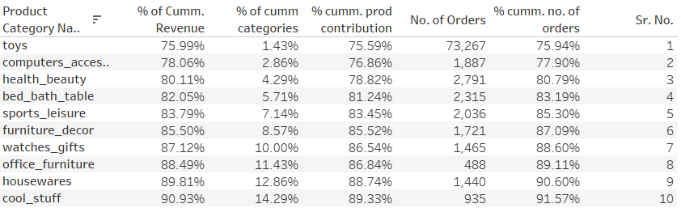
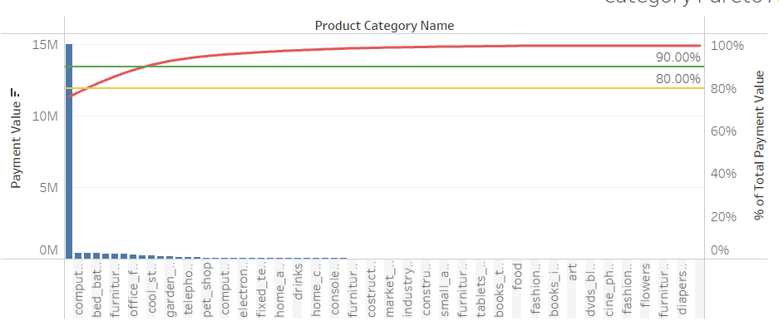
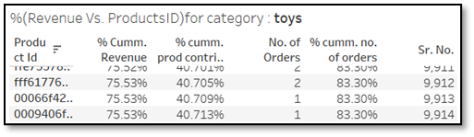
Optimizing Inventory of Toys category should be our first priority
76% of the revenue is generated from individual ‘Toys’ category which also accounts to 76% of the inventory(unique products). (fig.1)
Top 40% products from toys category contribute to 75% of the current revenue from toys category. (fig.2)
Approx. 13% of the categories (9), generate almost 90% of the revenue and contribute to 91% of the orders. Only 10% of revenue is generated from remaining 87% of the categories and contribute to 9% of the orders.(fig.1&3)
1
3
2
Notes:
Objective

Slide 6
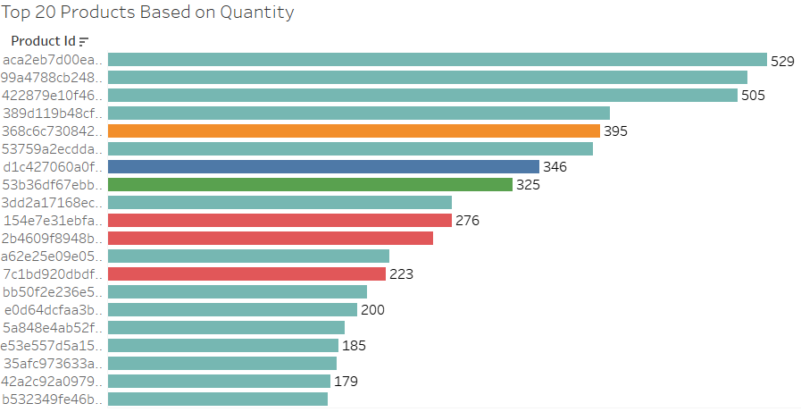
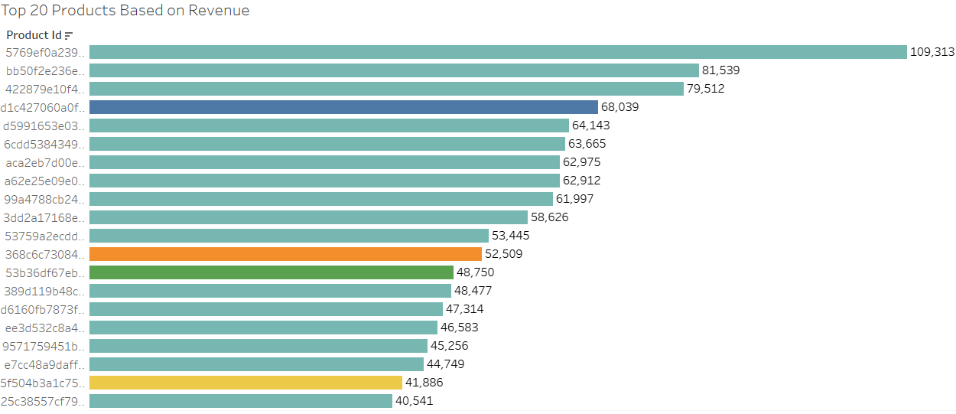
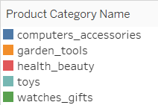
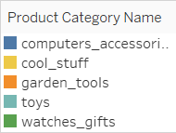
Fast moving products does not mean high revenue
Most of the top 20 products belong to Toys category. garden_tools, computer_accessories & watches_gifts categories also come under high quantity and high revenue category.
Some of the products having higher quantity sales fails to overcome products having lower quantity sales, on the basis of revenue.
Inventory mix should contain slow moving but high revenue generating products
Notes:
Objective

Slide 7
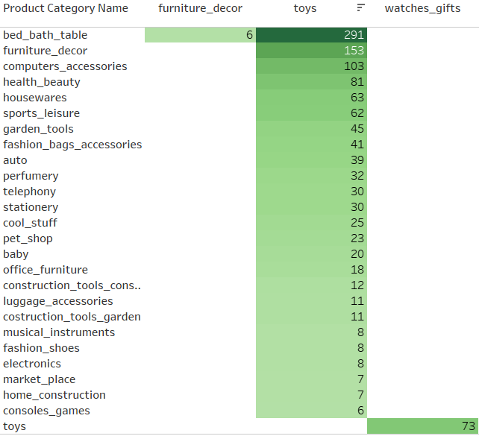
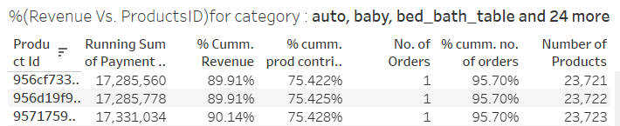
Frequent category sets should be our primary revenue source
Toys is the most frequently purchased category bought individually as well as with other categories like bed_bath_table, furniture_decor, computer accessories, health_beauty, watches_gifts etc.
All these 27 categories are present in 94677 orders out of total 96477 orders, together contribute to 31451 products out of 32216 products and can yield 97% of the current revenue.
As majority of our business is dependent on these categories, we can achieve almost 90% revenue while only focusing on top 75% products.
Notes:
Objective

Slide 8
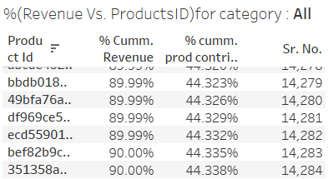
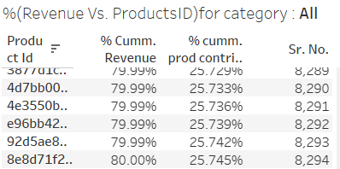
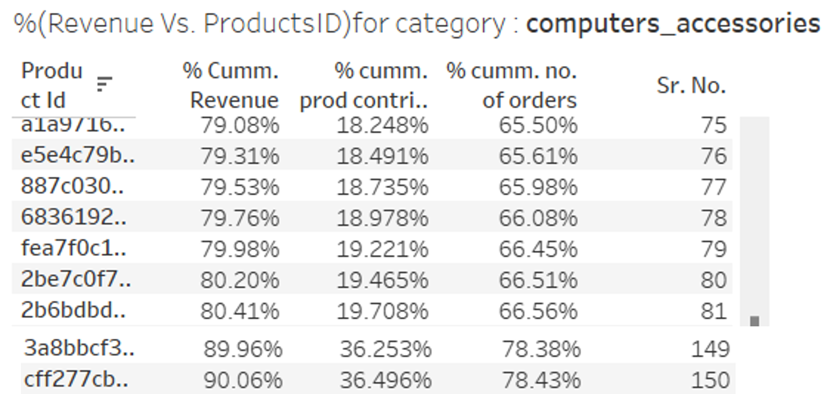
Ideal Category depth comprises top revenue generating products
According to pareto 80-20 principle, 80% of the revenue contribution is from 20% of the products. (fig.2)
Category depth refers to the number of SKUs within that category. Overall, 90% of revenue can still be achieved from 44% of the products, provided that the purchase behavior of customers does not vary significantly from the current condition.(fig.1)
We can tweak the pareto principle and find out ideal category depth for individual category by deciding the revenue % we want to achieve from that category. e.g. computer_accessories, ideal category depth is 80 if we want to achieve 80% revenue, and 150 if we want to achieve 90% revenue.(fig.3)
1
2
3
Notes:
Objective

Slide 9
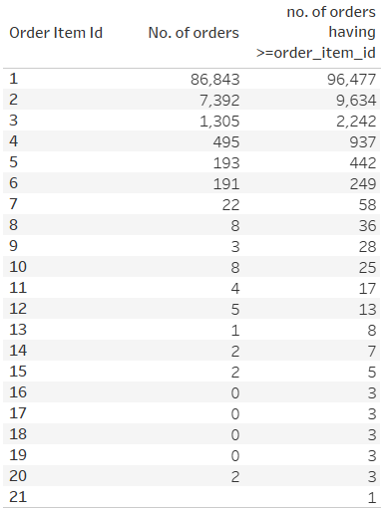
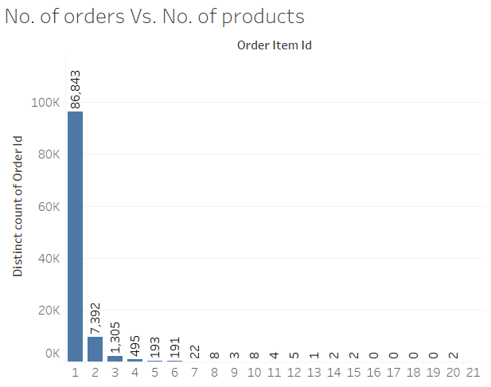
We need to stimulate purchase of multiple products
Almost 87000 orders were consisting of individual products.
Only 10%, approx. 9600 orders were having two or more than two products.
In future, we will need to drive business from limited number of categories and products.
Notes:
Objective

Slide 10
RECOMMENDATIONS
We can reduce the category breadth by only focusing on 27 categories which are frequently selling together like toys, bed_bath_table, furniture_decor, computer accessories etc. at the cost of only 3 % revenue hit while reducing the inventory by almost 900 unique products.
If category depth is high then it can be reduced by targeting 80% or 90% revenue from that category and retaining only the top revenue generating products which can help us achieve the revenue target.
Although toys being highest selling as well as revenue generating category, it is the main culprit behind excessive inventory management costs, we can get rid of the products from toys category with only single unit sales and still achieve 75% of the current revenue from toys category and cater to 83% of the customer demand (toys orders) but on the contrary reduce the toys inventory by almost 60%.
Personalized suggestions and recommendations is required to increase the purchase of products in combination with other products or categories.
It is recommended to avoid any abrupt changes in the inventory mix, gradual implementation of the above strategies would make sure that the customers also get some time to adapt to the changes.
The products which we would discontinue or get rid from our warehouse, should be kept under ‘on-demand’ order category so that we can outsource that product and deliver it to customers if possible. This would ensure that we don’t lose the customer to our competitor.
Notes:
Objective

Slide 11
CONCLUSION
Initially, if we focus on only top 27 categories, we can achieve almost 90% revenue while reducing the inventory by approx. 25%.
Categories which show comparatively higher confidence (more than 10%) of purchase along with toys are bed_bath_table, construction_tools_lights, construction_tools_garden, fashion_bags_accessories, fashion_shoes.
While reducing the category depth, it is important to keep an inventory mix of fast moving and slow moving inventory to maintain the revenue as well as inventory management costs.
Low revenue generating Non-moving inventory could go under ‘on-demand’ order category.
Notes:
Objective

Slide 12
APPENDIX-Data Sources
Data Sources :
1) Here is a snapshot of the data dictionary
Orders information like unique order_id, order_item_id, order purchase-approval-delivery timestamp. etc
Customer’s information like unique customer_id, zipcode, city and state
Payment information like payment_value, payment_type etc.
Product dimension and specification information like category, weight, length etc.
Customer preference information like number of reviews and number of reviews per month
2) The provided data is captured from the CRM tool used by ‘OList’. (till 17-10-2018 17:30).

Slide 13
APPENDIX
Data Methodology :
Checked and Cleaned the data for any duplicate, null, insignificant values.
Checked for outliers, as outliers were actual values, the values were kept as it is instead, used median as central measure.
Merged the datasets for further analysis and performed EDA.
Created new dataset with only order_id and product_category for Market Basket Analysis.
Exported the cleaned datasets in Excel format to upload in Tableau.
Used Tableau for visualization of data and created appropriate calculated fields to get the insights.
Data Assumptions :
Only ‘delivered’ orders are considered for analysis.
order_purchased_timestamp< order_approved_at < order_delivered_timestamp.
Shipping charges given are assumed to be for individual product.

Slide 14
Thank You
Presentation link:-
https://drive.google.com/file/d/1y7EaNtN-IBFWviEV-pdX_BCa4j44sGeT/view?usp=drive_link
Notes:
Objective

