Slide 1
Employee Management System (EMS) 23-10-2025
By
Devendra Yadav & Gang Ferdinand

Slide 2
Project goal
Project goal: The primary goal of this project is to design and implement a non-framework-dependent N-Tier Java application using pure JDBC for data persistence.

Slide 3
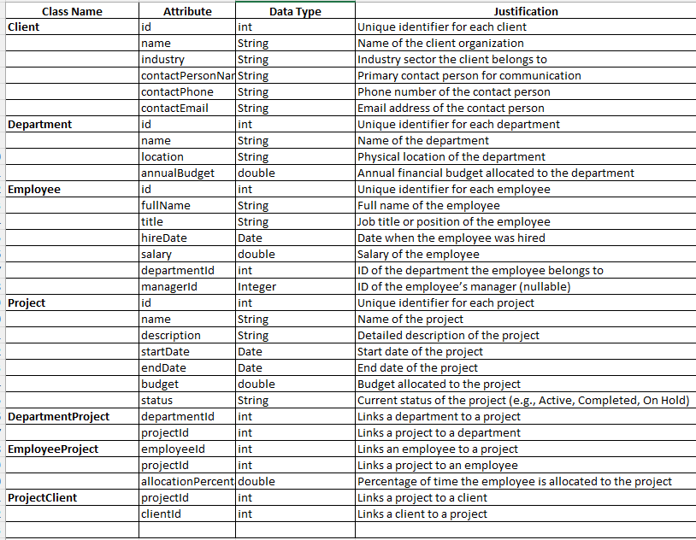
Domain classes and Attributes

Slide 4
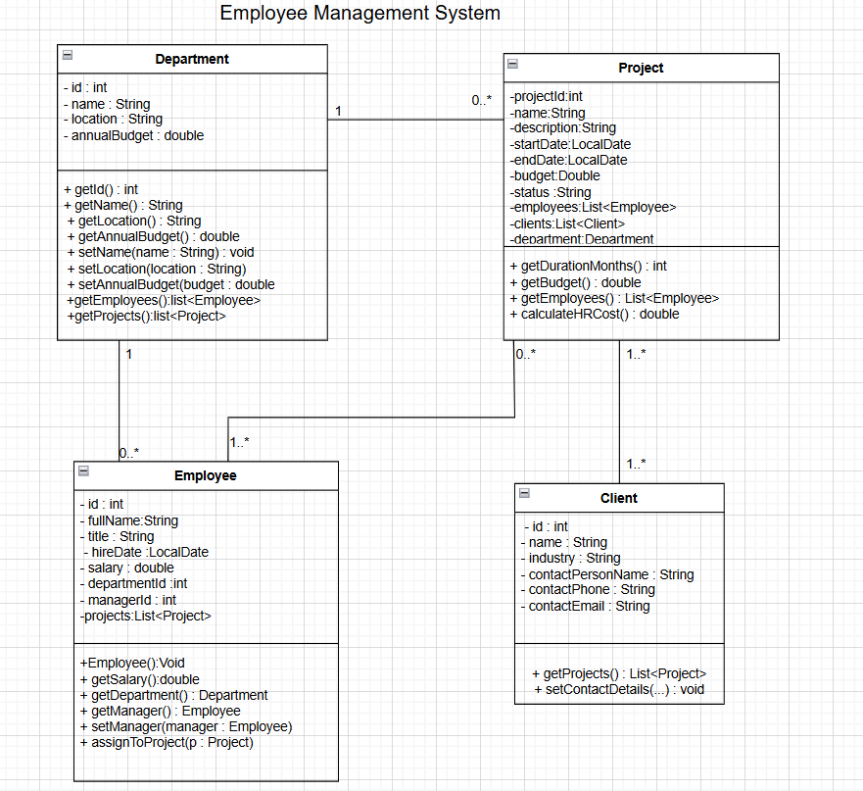
UML Diagram for EMS

Slide 5
Functional & Non Functional Requirements
Functional Requirements:
Calculate project HR cost
Generate department project reports
Identify high-value clients
Perform employee transfer transactions
Support full CRUD for employees and projects
Non Functional Requirements:
Reliability and accuracy
User-friendly interface
Efficient performance
Secure data handling
Maintainable and scalable codebase

Slide 6
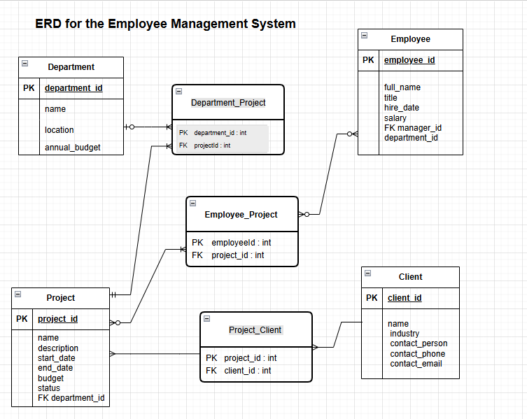
Database Tables

Slide 7
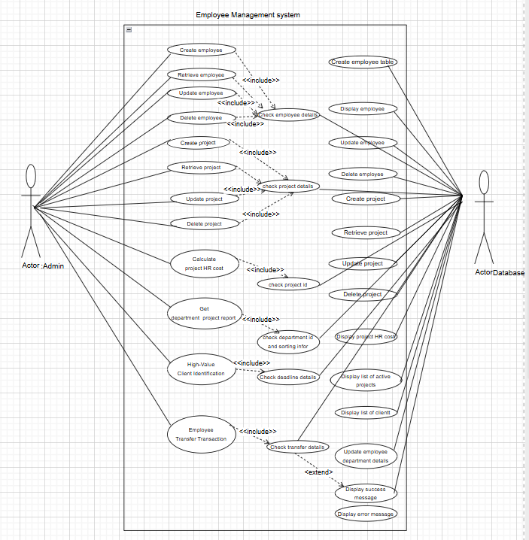
Use Cases Overview
1. Calculate Project HR Cost
2. Department Project Report
3. High-Value Client Identification
4. Employee Transfer Transaction
5. CRUD for Employees and Projects

Slide 8
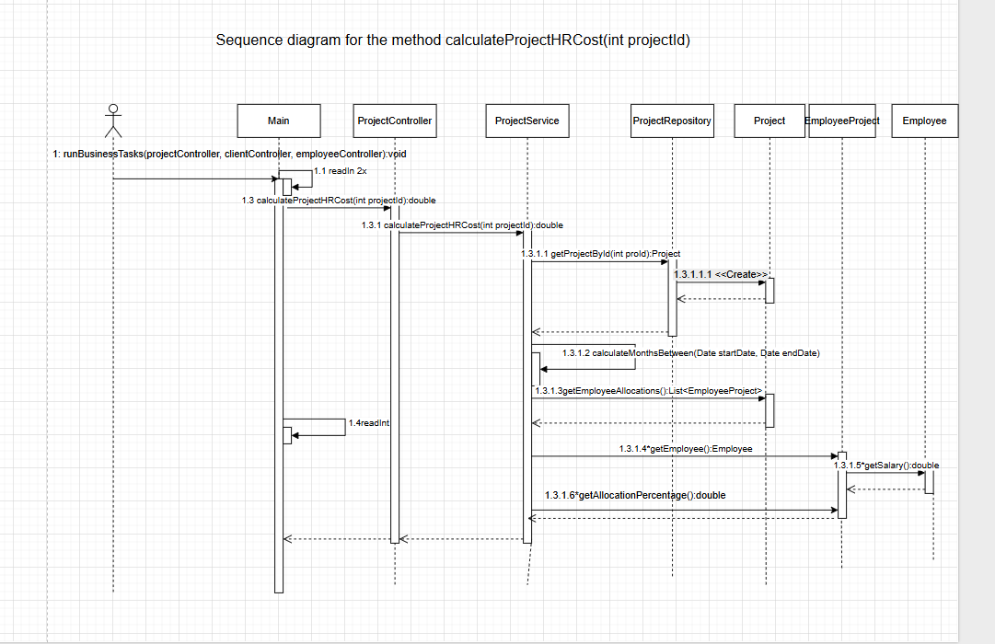
Sequence diagram for calculateProjectHRCost

Slide 9
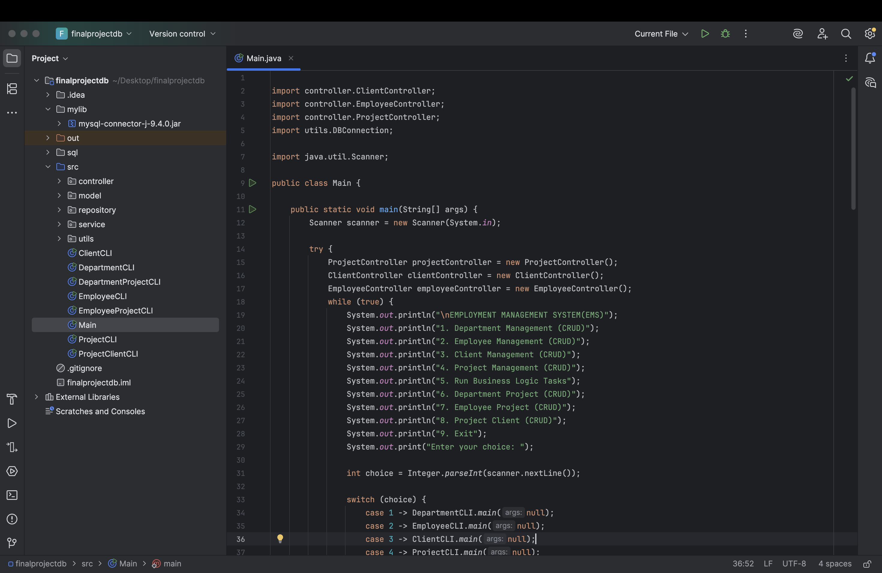
Implementation

Slide 10
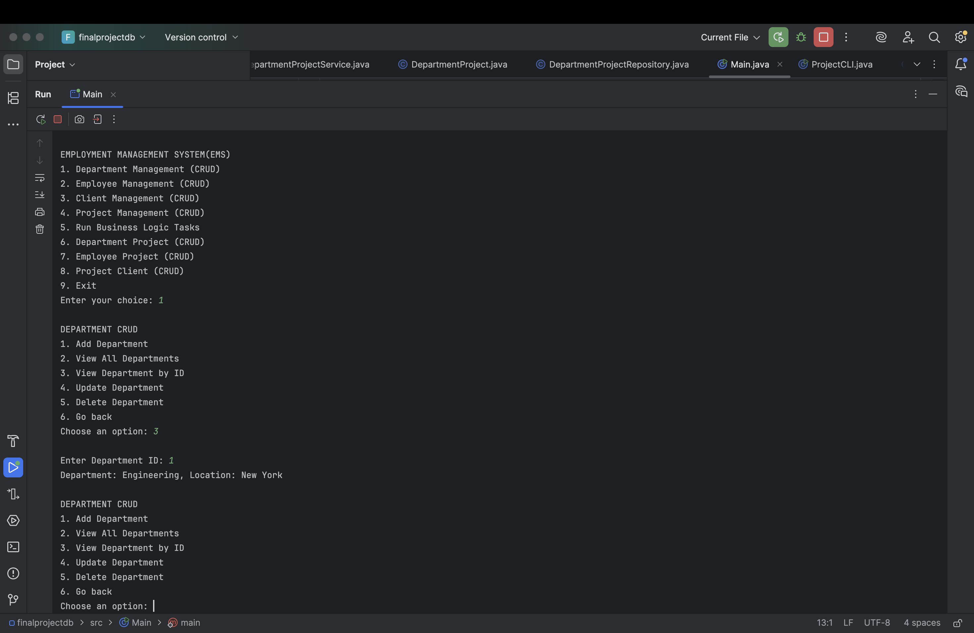
Results

