Slide 2
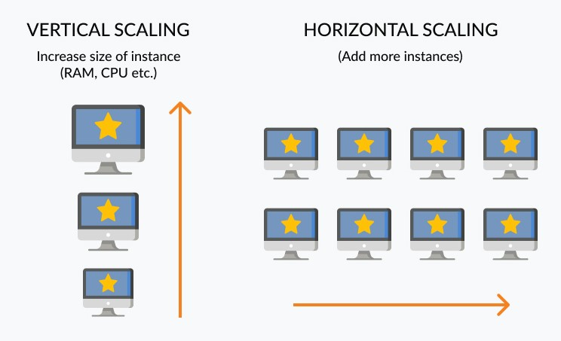

Slide 3
SQL vs NoSQL
 | SQL | NoSQL
Types | All types support SQL standard | Multiple types exists, such as document stores, key value stores, column databases, etc
History | Developed in 1970 | Developed in 2000s
Examples | SQL Server, Oracle, MySQL | MongoDB, HBase, Cassandra
Data Storage Model | Data is stored in rows and columns in a table, where each column is of a specific type | The data model depends on the database type. It could be Key-value pairs, documents etc
Schemas | Fixed structure and schema | Dynamic schema. Structures can be accommodated
Scalability | Scale up approach is used | Scale out approach is used
Transactions | Supports ACID and transactions | Supports partitioning and availability
Consistency | Strong consistency | Dependent on the product [Eventual Consistency]
Support | High level of enterprise support | Open source model
Maturity | Have been around for a long time | Some of them are mature; others are evolving

Slide 4
MongoDB Overview
Developed by 10gen in 2007
Publicly available in 2009
Open-source database which is controlled by 10gen
Document oriented database → stores JSON documents
Stores data in binary JSON

Slide 5
Install MongoDB
Install MongoDB by downloading community edition
(https://www.mongodb.com/download-center/community)
Linux and Mac Users
Extract the downloaded file somewhere in the disk.
Set the environment path to use the tools without going to the bin directory in the ~/.bash_profile or ~/.basrc file.
Ubuntu (20.04) Mongo installation
terminal> wget -qO - https://www.mongodb.org/static/pgp/server-4.4.asc | sudo apt-key add -
terminal> echo "deb [ arch=amd64,arm64 ] https://repo.mongodb.org/apt/ubuntu focal/mongodb-org/4.4 multiverse" | sudo tee /etc/apt/sources.list.d/mongodb-org-4.4.list
terminal> sudo apt-get update
terminal> sudo apt-get install -y mongodb-org
Windows Users
Install the MongoDB by following all the steps in the installation wizard
Set the the environment path to include the <path>/bin

Slide 6
JSON
Java Script Object Notation
Hierarchical way of organizing data
Defined as part of the JS language by JavaScript creator Douglas Crockford (2000).
JavaScript objects are associative containers, wherein a string key is mapped to a value
JSON shows up in many different cases.
APIs
Configuration files
Log messages
Database storage
JSON is not ideal for usage inside of a database.
JSON is a text-based format, and text parsing is very slow
JSON’s readable format is far from space-efficient, another database concern
JSON only supports a limited number of basic data types
Mongo stores JSON data into Binary form.

Slide 7
JSON have
String -> “hello” “name”
Numbers -> 30 1.5 -40 1.2e10
Booleans -> true false
Array -> [“Jan”, “feb”, “Mar”] [10 ,20 ,30]
Object -> {“key”,”value”} {“age”: 20}
Key is always a string
At top level typically have an array or object

Slide 8
BSON
BSON simply stands for “Binary JSON”
Binary structure encodes type and length information, which allows it to be parsed much more quickly
It has been extended to add some optional non-JSON-native data types
It allows for comparisons and calculations to happen directly on data
MongoDB stores data in BSON format both internally, and over the network
Anything you can represent in JSON can be natively stored in MongoDB
 | JSON | BSON
Encoding | UTF-8 String | Binary
Data Support | String Boolean Number Array | String Boolean Number Integer Float Long Decimal Array Date Raw Binary
 | Human and Machine | Machine Only

Slide 9
JSON
{
"_id": 1,
"name" : { "first" : “Sanjay", "last" : “Pawar" },
“Language" : [ “C++", “JAVA", “Python", “Kotlin“,”Go” ],
"awards" : [
{ “Winner" : "Best developer", "year" : 1998 },
{ “2nd Runner-Up" : "Best Programmer", "year" : 2000 }
]
}

Slide 10
Mongo Server and Client
MongoDb server (mongod) is developed in C, C++ and JS.
MongoDb data is accessed via multiple client tools
mongo : client shell (JS).
mongofiles : stores larger files in GridFS.
mongoimport / mongoexport : tools for data import / export.
mongodump / mongorestore : tools for backup / restore.
MongoDb data can be accessed in application through client drivers available for all major programming languages e.g. Java, Python, Ruby, PHP, Perl, …
Mongo shell is follows JS syntax and allow to execute JS scripts.

Slide 11
MongoDb: Data Types
data | bson | values
null | 10
boolean | 8 | true, false
number | 1 / 16 / 18 | 123, 456.78, NumberInt(“24”), NumberLong(“28”)
string | 2 | “....”
date | 9 | new Date(), ISODate(“yyyy-mm-ddThh:mm:ss”)
array | 4 | [ …, …, …, … ]
object | 3 | { … }

Slide 12
MongoDB Terminology
Database
This is a container for collections like in RDMS wherein it is a container for tables
Each database gets its own set of files on the file system
A MongoDB server can store multiple databases
Collection
This is a grouping of MongoDB documents
A collection is the equivalent of a table which is created in any other RDMS such as Oracle or MS SQL
Collections don't enforce any sort of structure
Document
A record in a MongoDB collection is basically called a document
The document, in turn, will consist of field name and values
Field
Field names are strings
A name-value pair in a document
A document has zero or more fields
Fields are analogous to columns in relational databases

Slide 13
Document
MongoDB stores data records as BSON documents
Maximum size of document is 16MB
Restrictions
The field name _id is reserved for use as a primary key
Field names cannot contain the null character
Top-level field names cannot start with the dollar sign ($) character

Slide 14
_id field
Each document requires a unique _id field that acts as a primary key
If an inserted document omits the _id field, the MongoDB driver automatically generates an ObjectId for the _id field
Behaviors
By default, MongoDB creates a unique index on the _id field during the creation of a collection
The _id field is always the first field in the documents. If the server receives a document that does not have the _id field first, then the server will move the field to the beginning.
The _id field may contain values of any BSON data type, other than an array
Autogenerated _id (of type ObjectId) will be of 12 bytes which contains
Timestamp: 4 bytes
Machine Id: 3 bytes
Process Id: 2 bytes
Counter: 3 bytes

Slide 15
CRUD operations

Slide 16
Database Operations
List existing databases
> show dbs
> show databases
Create and use database
> use <db name>
Get the selected database name
> db
Show the database statistics
> db.stats()

Slide 17
Collection operations
Get the list of collections
> show collections
Create Collection
> db.createCollection(‘contacts’)
Drop Collection
> db.contacts.drop()

Slide 18
Create Document (Insert data)
Create one document
> db.contacts.insert({ name: ‘ravi’, mobile: ‘7709859986’ })
Create many documents
> db.contacts.insertMany([
{ name: ‘contact 1’, address: ‘pune’ },
{ name: ‘contact 2’, address: ‘mumbai’ }
])
Note: if you are passing the _id field, make sure that it is unique. If it is not unique, the document will not get inserted

Slide 19
Read/Find Documents (Query data)
Find documents
> db.contacts.find()
Returns cursor on which following operations allowed
hasNext(): returns if cursor can iterate further
next(): returns the next document
skip(n): skips first n documents
limit(n): limit the result to n
count(): returns the count of result
toArray(): returns an array of document
forEach(fn): Iterates the cursor to apply a JavaScript function to each document from the cursor
pretty(): Configures the cursor to display results in an easy-to-read format
sort(): sorts documents
Shell by default returns 20 records. Press ”it” for more results

