Slide 2
Today’s Topics
Data Modeling
Aggregation operations
Mongo import
Mongo – Indexes
GeoSpatial Queries
Capped Collections
Mongo - GridFS

Slide 3
Data Modeling

Slide 4
Data Modeling
Embedded Data Models
{ name : { fname : "Nilesh", lname : "Ghule" }, age : 34 }
Suitable for one-to-one or one-to-many relationship.
Faster read operation. Related data fetch in single db operation.
Atomic update of document.
Document growth reduce write performance and may lead to fragmentation.

Slide 5
Data Modeling
Normalized Data Models
contacts → { _id: 11, email : "Jay@gmail.com", mobile: "9527331338" }
persons → { _id: 1, name : "Jay Patil", contact: 11 }
Preferred for complex many-to-many relationship.
Reduce data duplication.
Can use DBRef() to store document reference:
contacts → { _id: 11, email : "Jay@gmail.com", mobile: "9527331338" }
persons → { _id: 1, name: "Jay Patil", contact: { $db : "test", $ref : "contacts", $id: 11 } }
DBRef() are not supported in all client-drivers.

Slide 6
Aggregation Pipeline

Slide 7
Overview
Aggregation operations process data records and return computed results
Aggregation operations group values from multiple documents together, and can perform a variety of operations on the grouped data to return a single result
Documents enter a multi-stage pipeline that transforms the documents into aggregated results
Pipeline
The MongoDB aggregation pipeline consists of stages
Each stage transforms the documents as they pass through the pipeline
Pipeline stages do not need to produce one output document for every input document
e.g., some stages may generate new documents or filter out documents

Slide 8
Operators
$project: select columns (existing or computed)
$match: where clause (criteria)
$group: group by
{ $group: { _id: <expr>, <field1>: { <accum1> : <expr1> }, ... } }
The possible accumulators are: $sum, $avg, etc.
$unwind: extract array elements from array field
$lookup: left outer join
$out: put result of pipeline in another collection (last operation)

Slide 9
Optimization

Slide 10
Mongo - Indexes
db.books.find( { "subject" : "C" } ).explain(true);
explain() → explains the query execution plan.
Above query by default does full collection scan, hence slower.
db.books.createIndex( { "subject" : 1 } );
Searching on indexed columns reduces query execution time.
Options can be provided (2nd arg): { unique : true }
Duplicate values are not allowed in that field.
By default "_id" field is indexed in mongodb (unique index).
db.books.getIndexes();
db.books.dropIndex({ "subject" : 1 });

Slide 11
Indexes - Types
Regular index (Single Key)
Composite index
Unique index
TTL index
Geospatial indexes

Slide 12
Mongo - GeoSpatial Queries
mongodb support three types of geo-spatial queries:
2-d index: traditional long-lat. used in older mongodb (2.2-).
2-d sphere index: data can be stored as GeoJSON.
geo-haystack: query on very small area. not much used.
GeoJSON stores geometry and coordinates: https://geojson.io
{ type: "geometry", coordinates: [ long, lat ] };
{ type: "Point", coordinates: [ 73.86704859999998, 18.4898445 ] };
Possible geometry types are:
Point, LineString, MultiLineString, Polygon
allowed queries:
inclusion - $geoWithin
intersection - $geoIntersects
proximity - $geoNear

Slide 13
Mongo - GeoSpatial Queries
For faster execution create geo-index :
db.busstops.createIndex( { location : "2dsphere" } );
Example proximity query:
db.busstops.find( { location : { $near : {
$geometry : { type : "Point" ,
coordinates : [73.86704859999998, 18.4898445]
},
$maxDistance : 200
} } } );

Slide 14
Mongo - Capped Collections
Capped collections are fixed sized collections for high-throughput insert and retrieve operations.
They maintain the order of insertion without any indexing overhead.
The oldest documents are auto-removed to make a room for new records. The size of collection should be specified while creation.
The update operations should be done with index for better performance. If update operation change size, then operation fails.
Cannot delete records from capped collections. Can drop collection.
Capped collections cannot be sharded.
db.createCollection("logs", { capped: true, size: 4096 }); → if size is below 4096, 4096 is considered. Higher sizes are roundup by 256.

Slide 15
Mongo - GridFS
GridFS is a specification for storing/retrieving files exceeding 16 MB.
GridFS stores a file by dividing into chunks of 255 kb. When queried back, driver collect the chunks as requested. Query can be range query. Due to chunks file can be accessed without loading whole file in memory.
It uses two collections for storing files i.e. fs.chunks, fs.files.
It is also useful to keep files and metadata synced and deployed automatically across geographically distributed replica set.
GridFS should not be used when there is need to update contents of entire file atomically.
It can be accessed using mongofiles tool or compliant client driver.

Slide 16
Mongo - GridFS
fs.chunks
_id, files_id, n, data
fs.files
_id, length, chunkSize, updateDate, md5, filename, contentType
Files can be searched using
db.fs.files.find( { filename: myFileName } );
db.fs.chunks.find( { files_id: myFileID } ).sort( { n: 1 } )
GridFS automatically create indexes for faster search.
mongofiles:
Mongofiles -d test put test.jpg
Mongofiles -d test get test.jpg

Slide 17
Mongo - WiredTiger Storage
Storage engine is managing data in memory and on disk.
MongoDB 3.2 onwards default storage engine is WiredTiger; while earlier version it was MMAPv1.
WiredTiger storage engine:
Uses document level optimistic locking for better performance.
Per operation a snapshot is created from consistent data in memory.
The snapshot is written on disk, known as checkpoint → for recovery.
Checkpoints are created per 60 secs or 2GB of journal data.
Old checkpoint is released, when new checkpoint is written on disk and updated in system tables.
To recover changes after checkpoint, enable journaling.

Slide 18
Mongo - WiredTiger Storage
WT uses write-ahead transaction in journal log to ensure durability.
It creates one journal record for each client initiated write operation.
Journal persists all data modifications between checkpoints.
Journals are in-memory buffers that are synced on disk per 50 ms.
WiredTiger stores all collections & journals in compressed form.
Recovery process with journaling:
Get last checkpoint id from data files.
Search in journal file for records matching last checkpoint.
Apply operations in journal since last checkpoint.
WiredTiger use internal cache with size max of 256 MB and 50% RAM - 1GB along with file system cache.

Slide 19
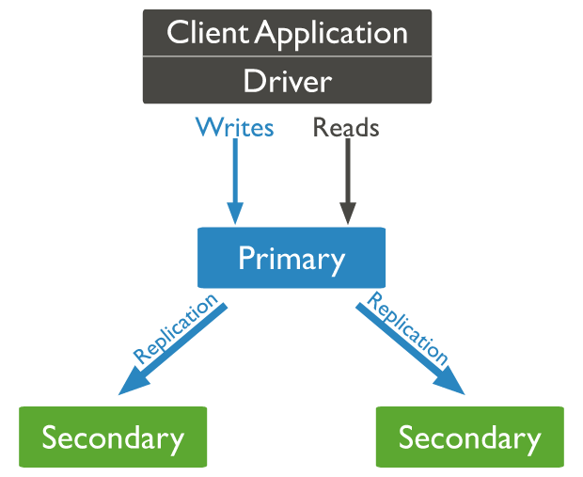
Mongo - Replication
A replica set is a group of mongod instances that maintain the same data set.
Only one member is deemed the primary node, while other nodes are deemed secondary nodes.
The secondaries replicate the primary’s oplog.
If the primary is unavailable, an eligible secondary will become primary.

Slide 20
Mongo - Replication
Secondary servers communicate with each other via heart-beat.
Secondary applies operations from primary asynchronously.
When primary cannot communicate a secondary for more than 10 seconds, secondary will hold election to elect itself as new primary. This automatic failover process takes about a minute.
An arbiter (do not store data) can be added in the system (with even number of secondaries) to maintain quorum in case of election.
By default client reads from primary, but can set read preference from secondary. Reading from secondary may not reflect state of primary; as read from primary may read before data is durable.

Slide 21
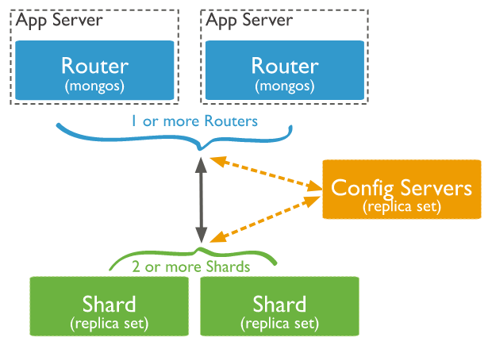
Mongo - Sharding
Sharding is a method for distributing large data across multiple machines.
This is mongodb approach for horizontal scaling/scaling out.
shard: part of collection on each server (replica set).
mongos: query router between client & cluster.
config servers: metadata & config settings of cluster.

Slide 22
Mongo - Sharding
Collections can be sharded across the servers based on shard keys.
Shard keys:
Consist of immutable field/fields that are present in each document
Only one shard key. To be chosen when sharding collection. Cannot change shard key later.
Collection must have index starting on shard key.
Choice of shard key affect the performance.
Advantages:
Read/Write load sharing
High storage capacity
High availability

Slide 23
Mongo - Sharding
Sharding strategies:
Hashed sharding
MongoDB compute hash of shard key field's value.
Each chunk is assigned a range of docs based on hashed key.
Even data distribution across the shards. However range-based queries will target multiple shards.
Ranged sharding
Divides data into ranges based on shard key values.
mongos can target only those shards on which queried range is available.
Efficiency of sharding is based on choosing proper shard key.

