Slide 1
MongoDb Databases

Slide 2
Mongo - WiredTiger Storage
Storage engine is managing data in memory and on disk.
MongoDB 3.2 onwards default storage engine is WiredTiger; while earlier version it was MMAPv1.
WiredTiger storage engine:
Uses document level optimistic locking for better performance.
Per operation a snapshot is created from consistent data in memory.
The snapshot is written on disk, known as checkpoint → for recovery.
Checkpoints are created per 60 secs or 2GB of journal data.
Old checkpoint is released, when new checkpoint is written on disk and updated in system tables.
To recover changes after checkpoint, enable journaling.
collection-9-5033127685441071718.wt

Slide 3
Mongo - WiredTiger Storage
WT uses write-ahead transaction in journal log to ensure durability.
It creates one journal record for each client initiated write operation.
Journal persists all data modifications between checkpoints.
Journals are in-memory buffers that are synced on disk per 50 ms.
WiredTiger stores all collections & journals in compressed form.
Recovery process with journaling:
Get last checkpoint id from data files.
Search in journal file for records matching last checkpoint.
Apply operations in journal since last checkpoint.
WiredTiger use internal cache with size max of 256 MB and 50% RAM - 1GB along with file system cache.

Slide 4
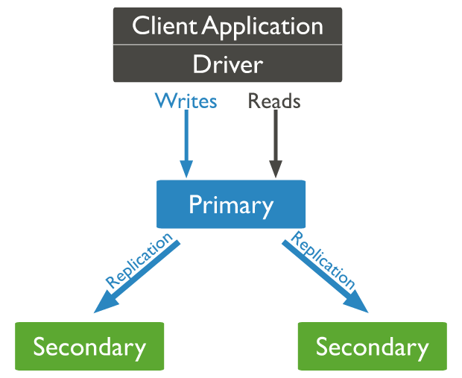
Mongo - Replication
A replica set is a group of mongod instances that maintain the same data set.
Only one member is deemed the primary node, while other nodes are deemed secondary nodes.
The secondaries replicate the primary’s oplog.
If the primary is unavailable, an eligible secondary will become primary.

Slide 5
Mongo - Replication
Secondary servers communicate with each other via heart-beat.
Secondary applies operations from primary asynchronously.
When primary cannot communicate a secondary for more than 10 seconds, secondary will hold election to elect itself as new primary. This automatic failover process takes about a minute.
An arbiter (do not store data) can be added in the system (with even number of secondaries) to maintain quorum in case of election.
By default client reads from primary, but can set read preference from secondary. Reading from secondary may not reflect state of primary; as read from primary may read before data is durable.

Slide 6
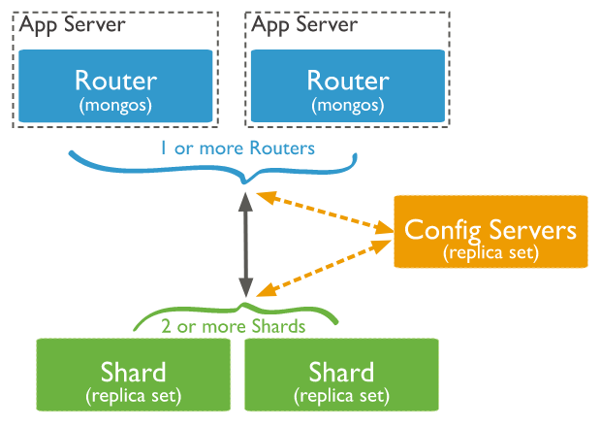
Mongo - Sharding
Sharding is a method for distributing large data across multiple machines.
This is mongodb approach for horizontal scaling/scaling out.
shard: part of collection on each server (replica set).
mongos: query router between client & cluster.
config servers: metadata & config settings of cluster.

Slide 7
Mongo - Sharding
Collections can be sharded across the servers based on shard keys.
Shard keys:
Consist of immutable field/fields that are present in each document
Only one shard key. To be chosen when sharding collection. Cannot change shard key later.
Collection must have index starting on shard key.
Choice of shard key affect the performance.
Advantages:
Read/Write load sharing
High storage capacity
High availability

Slide 8

Cassandra

Slide 9
Gossip Protocol
Cassandra uses a gossip protocol to
communicate with nodes in a cluster
It is an inter-node communication mechanism
similar to the heartbeat protocol in Hadoop
Cassandra uses the gossip protocol to discover
the location of other nodes in the cluster and get
state information of other nodes in the cluster
The gossip process runs periodically on each
node and exchanges state information with three
other nodes in the cluster
Eventually, information is propagated to all
cluster nodes. Even if there are 1000s of nodes,
information is propagated to all the nodes within
a few seconds

Slide 10
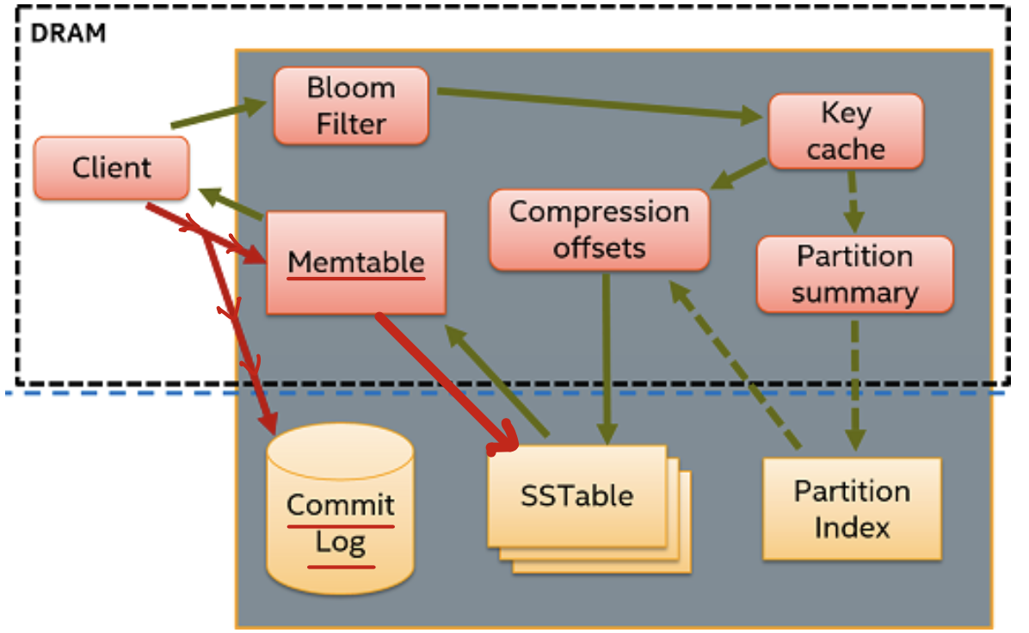
Architecture
Commit Log
Append only log of all mutations local to a node.
Client data commit log > memtable.
Durability in the case of unexpected shutdown
On startup, any changes in log will be applied to tables
Memtable
In-memory structures to write Cassandra buffers.
One active memtable per table.
Sorted String Table
Immutable data files for persisting data on disk.
Multiple memtables merged into single SSTable.
LSM Tree
Disk based data structure to provide low-cost
indexing for a file, in which records are to be inserted at very high rate

Slide 11
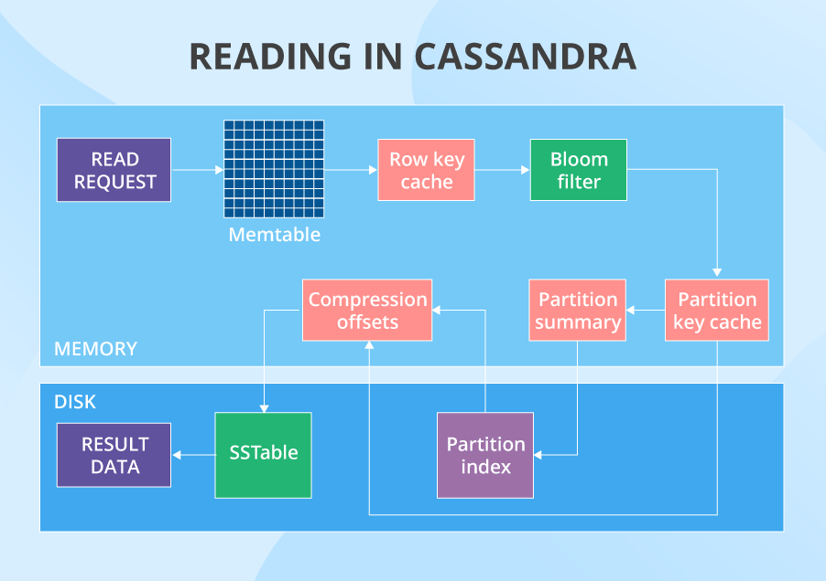
Architecture
Bloom filter
In the read path, Cassandra merges data on disk (in STables) with data in RAM (in memtables).
To avoid checking every SSTable data file for the partition being requested, Cassandra employs a data structure known as a bloom filter.
Bloom filters are a probabilistic data structure that allows Cassandra to determine one of two possible states
The data definitely does not exist in the given file
The data probably exists in the given file

Slide 12
Components
SSTable
It is a disk file to which the data is flushed from the mem-table when its contents reach a threshold value
Bloom filter
These are nothing but quick, algorithms for testing whether an element is a member of a
set
It is a special kind of cache
Bloom filters are accessed after every query

Slide 13
Data Model
Cassandra provides the Cassandra Query Language (CQL), an SQL-like language, to create and update database schema and access data
CQL allows users to organize data within a cluster of Cassandra nodes using:
Keyspace
Defines how a dataset is replicated, per datacenter
Replication is the number of copies saved per cluster. Keyspaces contain tables
Table
Defines the typed schema for a collection of partitions. Tables contain partitions, which contain rows, which contain columns. Cassandra tables can flexibly add new columns to tables with zero downtime.
Partition
Defines the mandatory part of the primary key all rows in Cassandra must have to identify the node in a
cluster where the row is stored
All performant queries supply the partition key in the query.
Row
Contains a collection of columns identified by a unique primary key made up of the partition key and optionally
additional clustering keys
Column
A single datum with a type which belongs to a row

Slide 14

Thank you!

