Slide 1
Automated Artwork Narrative Generation Using Deep Learning
Devendrakumar Rajput
x23318643
MSc Research Project/Internship/ Practicum
Master of Science in Data Analytics Information(MSCDAD_C)

Slide 2
Abstract
Background:
Traditional captioning systems lack depth and fail to reflect the emotional and artistic nuances of artworks. This limits accessibility and engagement, highlighting the need for richer, AI-generated narratives.
Objectives:
To develop a vision-language pipeline that classifies artworks and generates descriptive, human-like narratives using EfficientNet-B0 and GPT-based models, deployed via a user-friendly Flask web application.
Methodology:
The project uses the WikiArt dataset to train EfficientNet-B0 for image classification. GPT-2 and GPT-4o models are used for text generation. A full-stack solution is developed using Python and Flask, with evaluation based on classification accuracy and narrative quality. The interface was tested on a full dataset with various artworks to assess reliability and output richness.
Results:
The classifier achieved an accuracy of 75%, while GPT-4o consistently generated richer, more contextually aware narratives compared to GPT-2. The Flask app successfully processed real-time image uploads and returned meaningful narratives.
Findings:
The approach demonstrates how AI can bridge the gap between visual content and language, making art more accessible and interpretable. The system can be extended for use in museums, education, and digital art platforms.

Slide 3
Introduction
Traditional captioning systems provide basic, factual descriptions and lack the ability to convey the emotional and artistic depth of visual artworks.
This project explores the use of AI to generate rich, descriptive narratives by combining image classification (EfficientNet-B0) and natural language generation (GPT-2 / GPT-4o).
The goal is to improve art interpretation and accessibility through a web-based Flask application that showcases narrative outputs.
The study is limited to paintings from the WikiArt dataset and currently does not support genre-specific or emotion-driven customization.
The report includes literature review, methodology, results, evaluation, and conclusions with recommendations for future work.

Slide 4
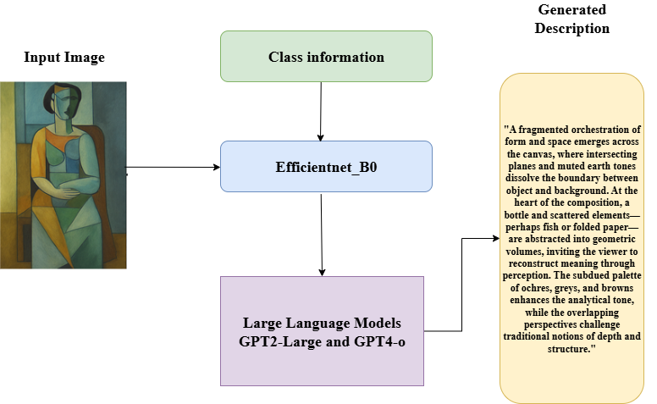
Block Diagram

Slide 5
Literature Review
Work | Domain | Key Contribution | Relevance to Project
Tan & Le (2019) – EfficientNet | Computer Vision (CNN) | Introduced compound scaling for efficient and accurate CNN architectures | Used EfficientNet-B0 for classifying artwork genres in a resource-efficient manner
Radford et al. (2019) – GPT-2 | Natural Language Processing | Open-ended, large-scale text generation with strong contextual coherence | Enabled narrative generation from genre-based prompts; GPT-2 Large used initially
OpenAI – GPT-4o (2024) | Vision-Language (VLM) | Advanced multimodal generation with emotional and stylistic fluency | Improved narrative depth, genre sensitivity, and linguistic quality over GPT-2
CLIP (OpenAI) | Vision-Language (VLM) | Learned joint embeddings for images and text from web-scale data | Referenced for image-text alignment; not used due to high computational demands
BLIP / BLIP-2 | Vision-Language (VLM) | Two-stage training for image captioning and robust text-vision alignment | Considered as alternatives, ultimately not used due to resource constraints
Hybrid Vision-Language Architecture | System Design / Integration | Modular pipeline separating vision and language components for interpretability | Central framework for the project; balances performance, interpretability, and scalability

Slide 6
Research Methodology
The research followed the CRISP-DM framework, progressing through business understanding, data preparation, modeling with EfficientNet and GPT models, evaluation of narrative quality, and deployment via a Flask web application.
Workflow Design: The system follows a pipeline: image upload → classification with EfficientNet-B0 → narrative generation with GPT-2/GPT-4o → display via Flask web interface.
Dataset & Preprocessing: The WikiArt dataset was used, consisting of paintings across various styles and artists. Images were resized, normalized, and augmented where needed for EfficientNet-B0 input.
Modeling Techniques: EfficientNet-B0 was used for image feature extraction and classification. The predicted class labels were passed as context to GPT-2 (local) and GPT-4o (API) for generating descriptive narratives.
Measurement & Evaluation: Classification performance was measured using accuracy (75% achieved). Narrative quality was evaluated qualitatively through fluency, coherence, and descriptiveness across test samples.
Tools & Libraries: Python, PyTorch, Transformers (Hugging Face), Flask, OpenAI API, Pandas, and Matplotlib were used throughout the development and testing phases.

Slide 7
Design Specification
Framework and Tools: Built using Python 3.10 with Flask for the web interface, PyTorch for model training and inference, and Hugging Face Transformers/OpenAI API for language generation.
Model Components:
EfficientNet-B0 for image classification of artworks.
GPT-2 (local) and GPT-4o (API) for generating descriptive narratives based on predicted class labels.
System Architecture Overview:
Image is uploaded and preprocessed.
EfficientNet-B0 predicts the artwork style or artist category.
The label is passed as a prompt to GPT-2 or GPT-4o for text generation.
The final narrative is displayed alongside the image on the Flask web app.
Technical Requirements: RAM ≥ 8 GB, Disk ≥ 35 GB, optional GPU (CUDA), and internet for GPT-4o access. Supports both notebook and web interface execution modes.

Slide 8
Design Specification
Component | Technology Used
Language | Python 3.10
Model Training | PyTorch
Web Framework | Flask
Front-End | HTML, CSS (Bootstrap)
Data Visualization | Matplotlib, Seaborn
Deployment (Local) | WSGI + Flask
Cloud Access (API) | OpenAI GPT-4o API

Slide 9
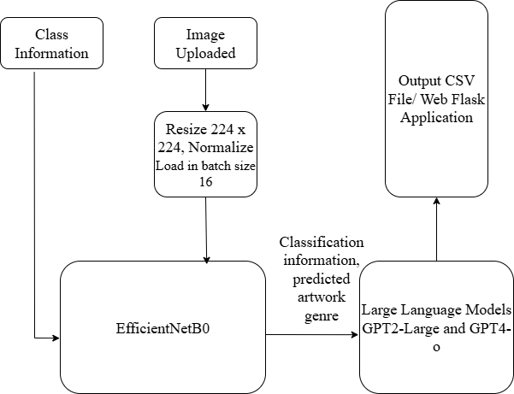
Design Specification – Architecture Diagram

Slide 10
Implementation
The final implementation resulted in a fully functional Flask web application that accepts artwork images, performs classification, and generates AI-based descriptive narratives in real time.
EfficientNet-B0 was trained on the WikiArt dataset and achieved 75% classification accuracy. GPT-2 and GPT-4o were integrated for narrative generation, producing context-aware textual outputs based on classified artwork labels.
Outputs include transformed and labeled image data, a trained classification model, a Flask interface, and a set of generated narrative texts for evaluation and demonstration purposes.
Tools and languages used: Python 3.10, PyTorch, Hugging Face Transformers, OpenAI API, Flask, Pandas, Matplotlib, and HTML/CSS for frontend display.

Slide 11
Results and Evaluation
Classification Performance: EfficientNet-B0 achieved 75% accuracy on the WikiArt dataset. While adequate for general style/artist recognition, further fine-tuning is needed for subtle artistic variations.
Narrative Generation: GPT-4o produced more fluent and descriptive narratives than GPT-2, especially in terms of coherence and creativity. GPT-2 showed occasional repetition or lack of detail.
Evaluation Criteria & Observations:
Adequacy: Models performed reliably on diverse artworks.
Coverage: Handled a wide range of genres, though not fine-tuned per artist.
Effectiveness: Clear improvement in quality from GPT-2 to GPT-4o.
User Friendliness: Flask app successfully renders images and narratives with minimal delay and intuitive layout.
Statistical Measures: Accuracy, F1-score, and visual analysis (narrative richness) were used. Narrative assessment was qualitative but guided by fluency, relevance, and contextual accuracy.

Slide 12
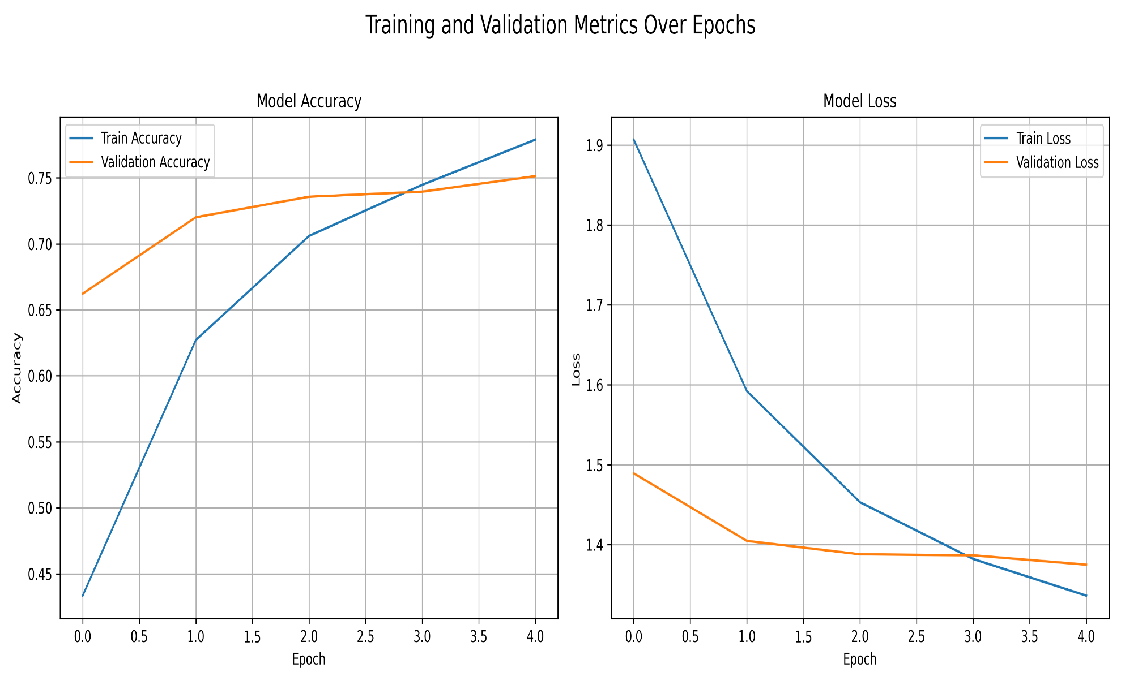
Results and Evaluation – EfficientNet model Performance

Slide 13
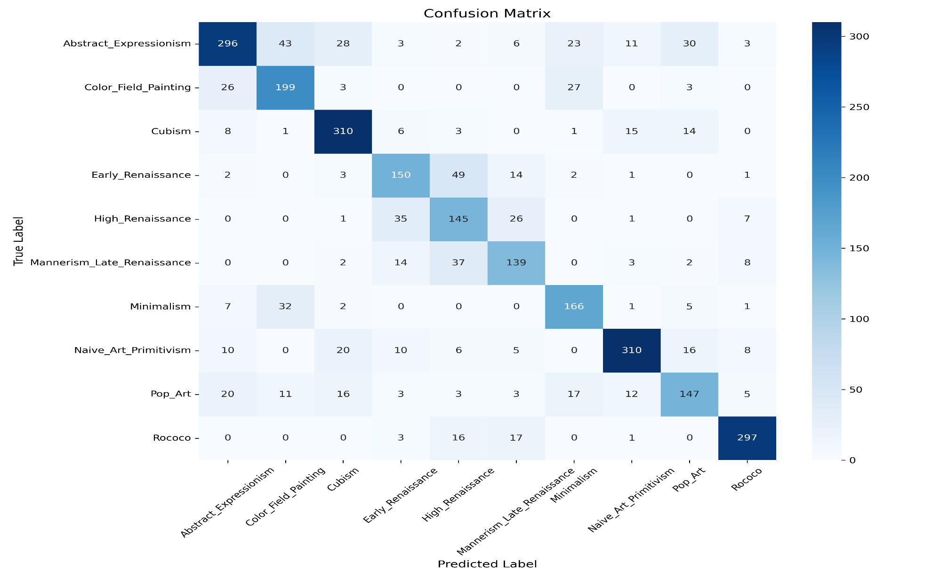
EfficientNet model Performance – Confusion Matrix

Slide 14
EfficientNet model Performance metrics
Genre | Precision | Recall | F1-Score | Support
Abstract Expressionism | 0.8022 | 0.6652 | 0.7273 | 445
Color Field Painting | 0.6958 | 0.7713 | 0.7316 | 258
Cubism | 0.8052 | 0.8659 | 0.8345 | 358
Early Renaissance | 0.6696 | 0.6757 | 0.6726 | 222
High Renaissance | 0.5556 | 0.6744 | 0.6092 | 215
Mannerism/Late Renaissance | 0.6619 | 0.6780 | 0.6699 | 205
Minimalism | 0.7034 | 0.7757 | 0.7378 | 214
Naive Art/Primitivism | 0.8732 | 0.8052 | 0.8378 | 385
Pop Art | 0.6774 | 0.6203 | 0.6476 | 237
Rococo | 0.9000 | 0.8892 | 0.8946 | 334
Overall Accuracy |  |  | 0.7515
Macro Avg | 0.7344 | 0.7421 | 0.7363 | 2873
Weighted Avg | 0.7575 | 0.7515 | 0.7523 | 2873

Slide 15
Model Parameters
Parameter | Value
Image Size | 224x224
CNN Model | EfficientNet-B0
Epochs | 5
Batch Size | 16
Learning Rate | 0.001
Text Generator | GPT-2 Large (local) + GPT-4o (cloud-based)
Sampling | Top-k=50, Temperature=0.9

Slide 16
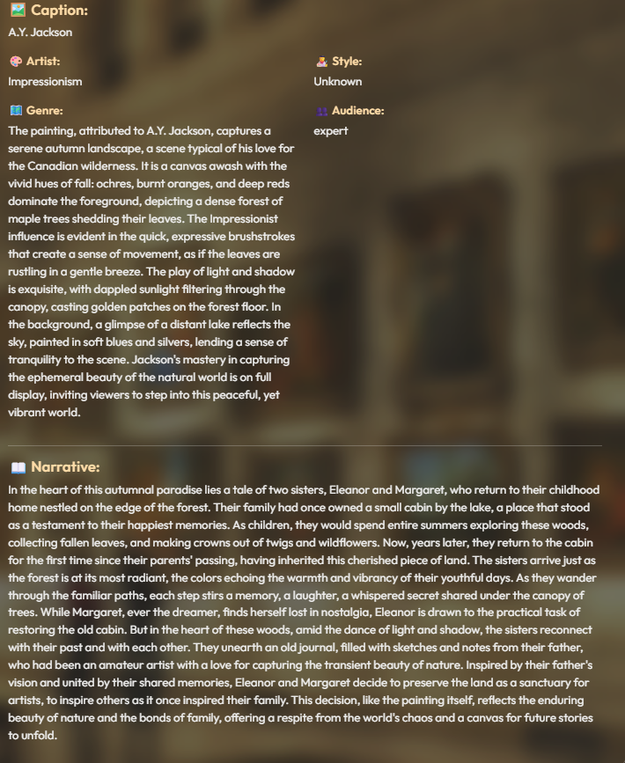
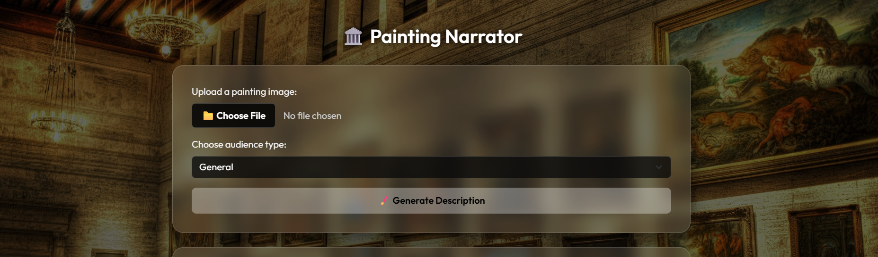
UI and Sample Output

Slide 17
Discussion
Confidence & Validity: Classification results (75% accuracy) are consistent with EfficientNet-B0 benchmarks on similar datasets. Narrative generation showed high fluency using GPT-4o, although qualitative evaluation was subjective.
Scope of Work: The project successfully integrates image classification and language generation into a unified web application, tested on both subsets and the full WikiArt dataset.
Generalizability: While designed for artworks, the pipeline is adaptable to other domains such as product descriptions or museum artifacts with minimal changes.
Strengths & Limitations: Strengths include modular architecture, real-time generation, and API flexibility. Limitations involve GPT-2 narrative inconsistency and lack of style-specific fine-tuning, which could affect
user interpretability in nuanced artworks.

Slide 18
Conclusion and Future Work
Conclusion:
This project aimed to generate rich narratives for artworks by integrating image
classification (EfficientNet-B0) and language generation (GPT-2/GPT-4o) in a Flask web app. The objective of enhancing interpretability of artworks through AI storytelling was largely achieved. Classification reached 75% accuracy, and GPT-4o provided contextually rich narratives, effectively meeting research goals.
Key Findings:
EfficientNet-B0 balanced performance and speed for classification.
GPT-4o outperformed GPT-2 in narrative quality and coherence.
The deployed web app demonstrated practical usability with a clean UI and real-time inference.
Future Work:
Fine-tune narrative models for specific art genres or emotional tones.
Add multilingual support and personalized storytelling based on viewer preferences.
Explore integration with museum systems or AR/VR for immersive visitor experiences.
Investigate potential for commercial licensing or public-facing educational platforms.

