Slide 1
ANON A multiple of E-com
USING
JSON

Slide 2
GROUP MEMBER
Surbhi Singh (2002820109012)
Sheeba Parveen (200282109007

Slide 3
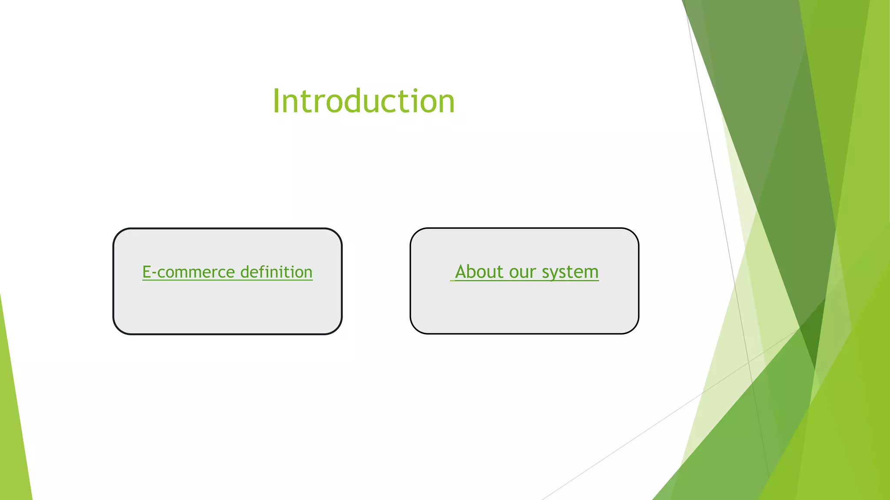

Slide 4
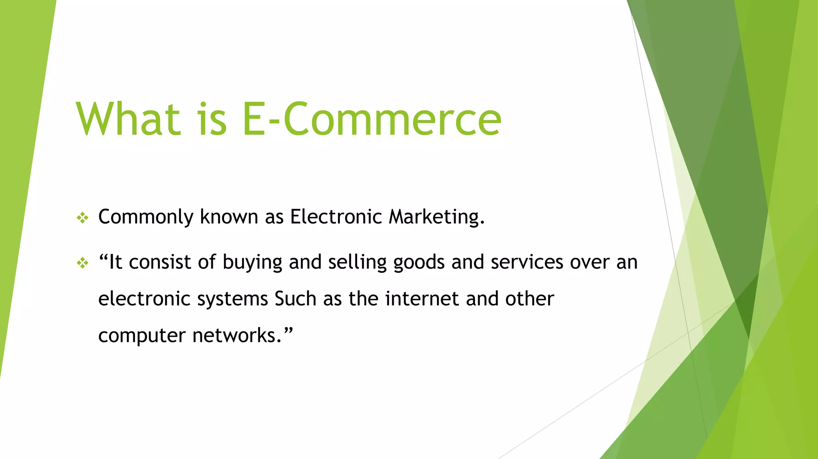

Slide 5
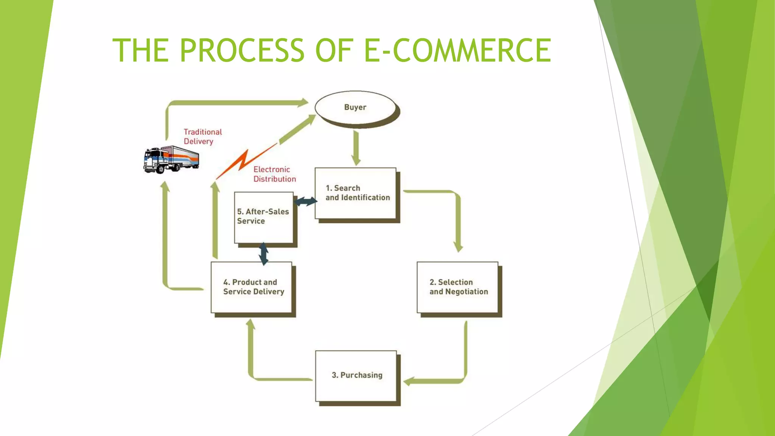

Slide 6
OUR SYSTEM
Our system is a multiple e-commerce website from people can buy the product from different E-commerce website.
Admin are monitoring the activity of the user and help to redirect to where the user wants to go.

Slide 7
Feature:
Menu
Catalog Browsing
Product Deals
Sorting Product
Product Review
Product Deals
Top Ecom Website
Payment Gateway

Slide 8
Language
HTML 5
CSS3
JAVASCRIPT
JSON
BOOTSTRAP
TOOLS
VS Code
Live Server
Netifly

Slide 9
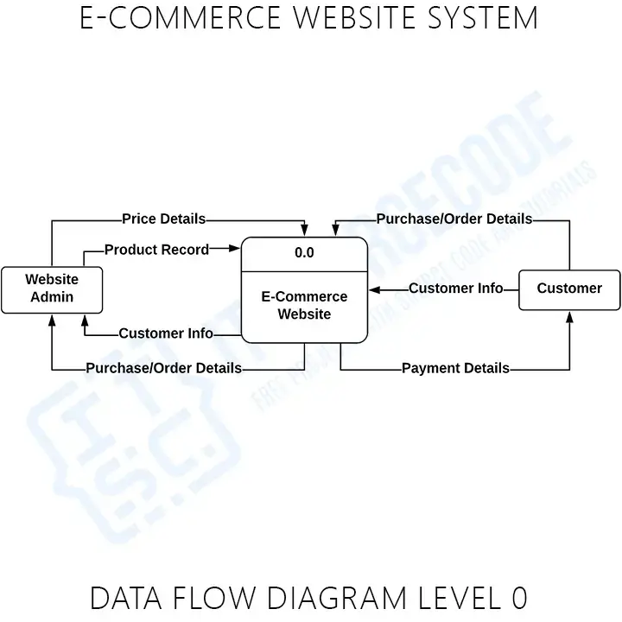
DATA FLOW

Slide 10
OUR MODEL
Customer
START
Myntra
Website List
Buy product
ADMIN
ANON
END

Slide 11
GUI (Graphical User Interface)

Slide 12
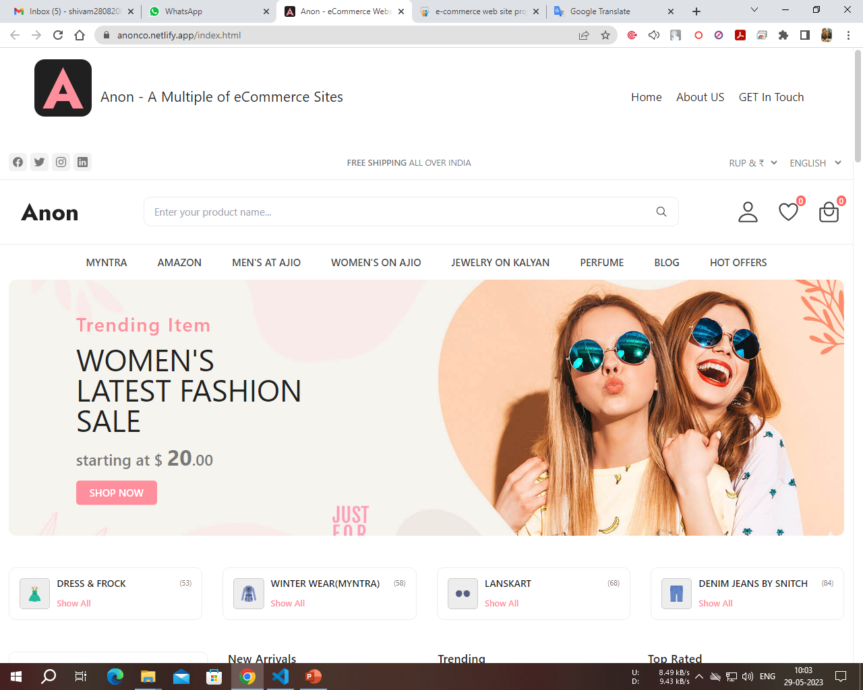
HOMEPAGE

Slide 13
Any Question

Slide 14
THANK YOU

