Slide 1
ANON A multiple of E-com
USING
JSON

Slide 2
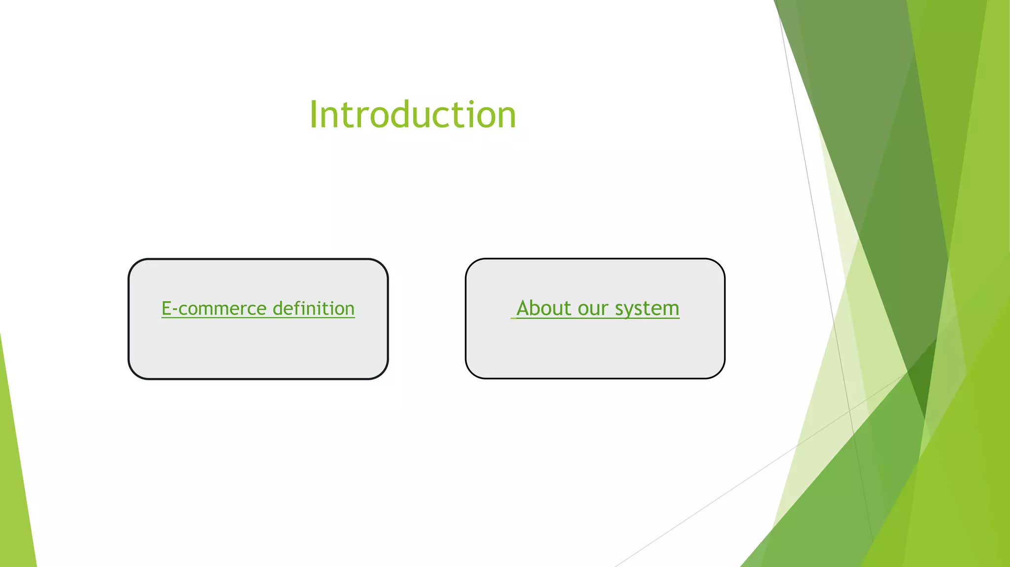

Slide 3
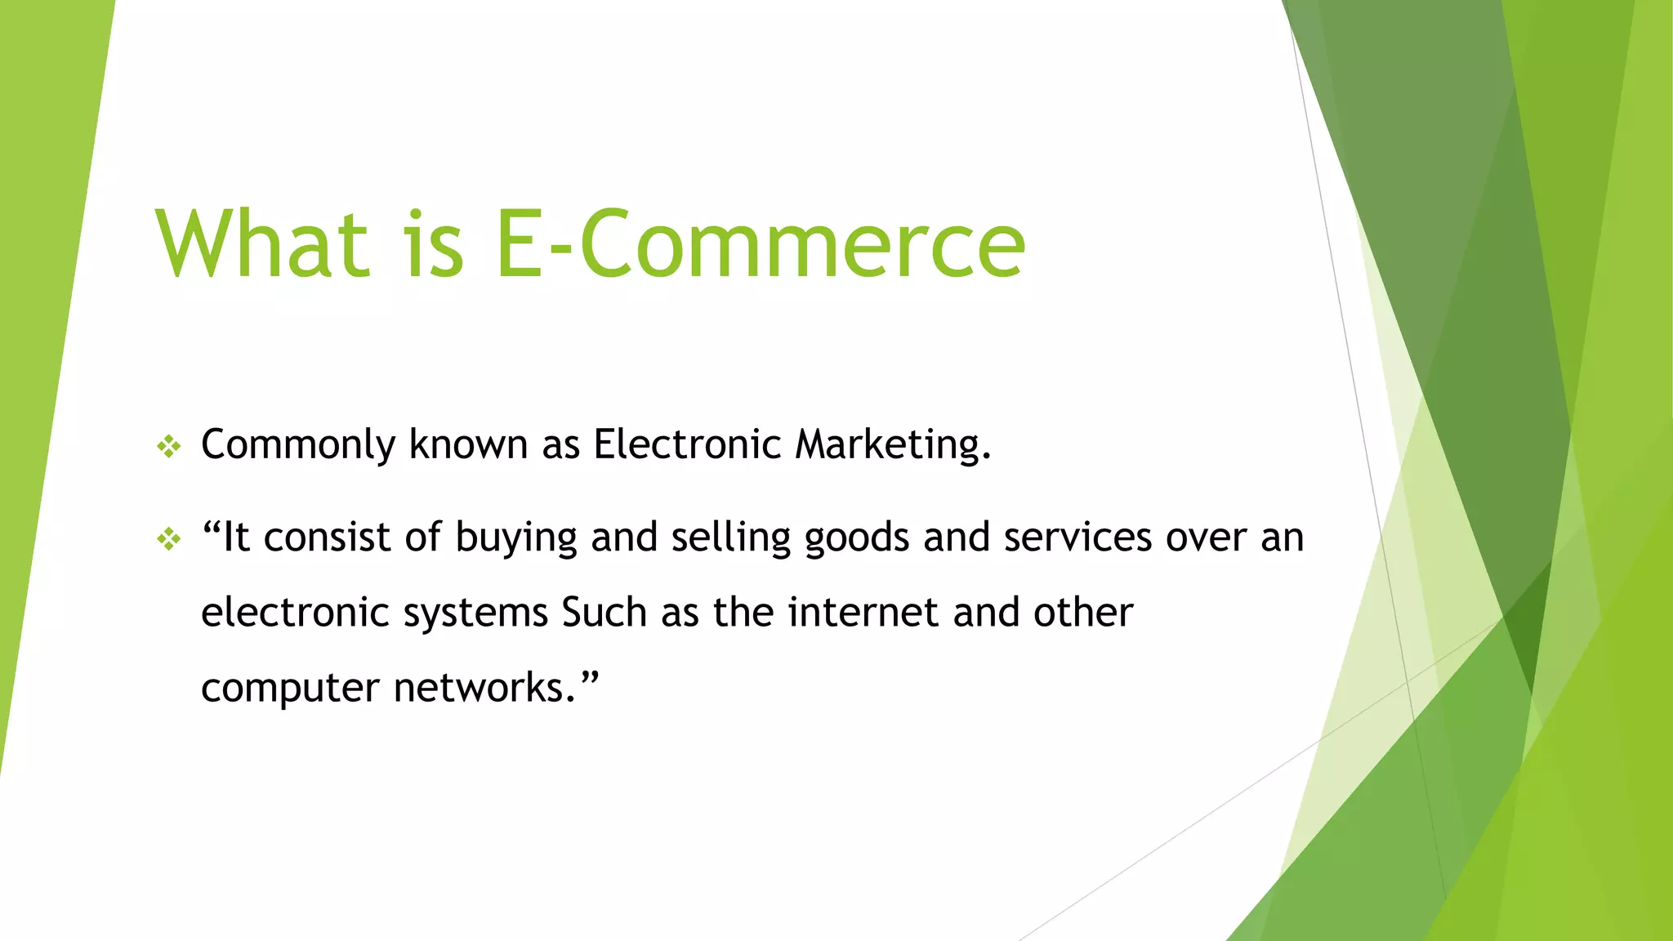

Slide 4
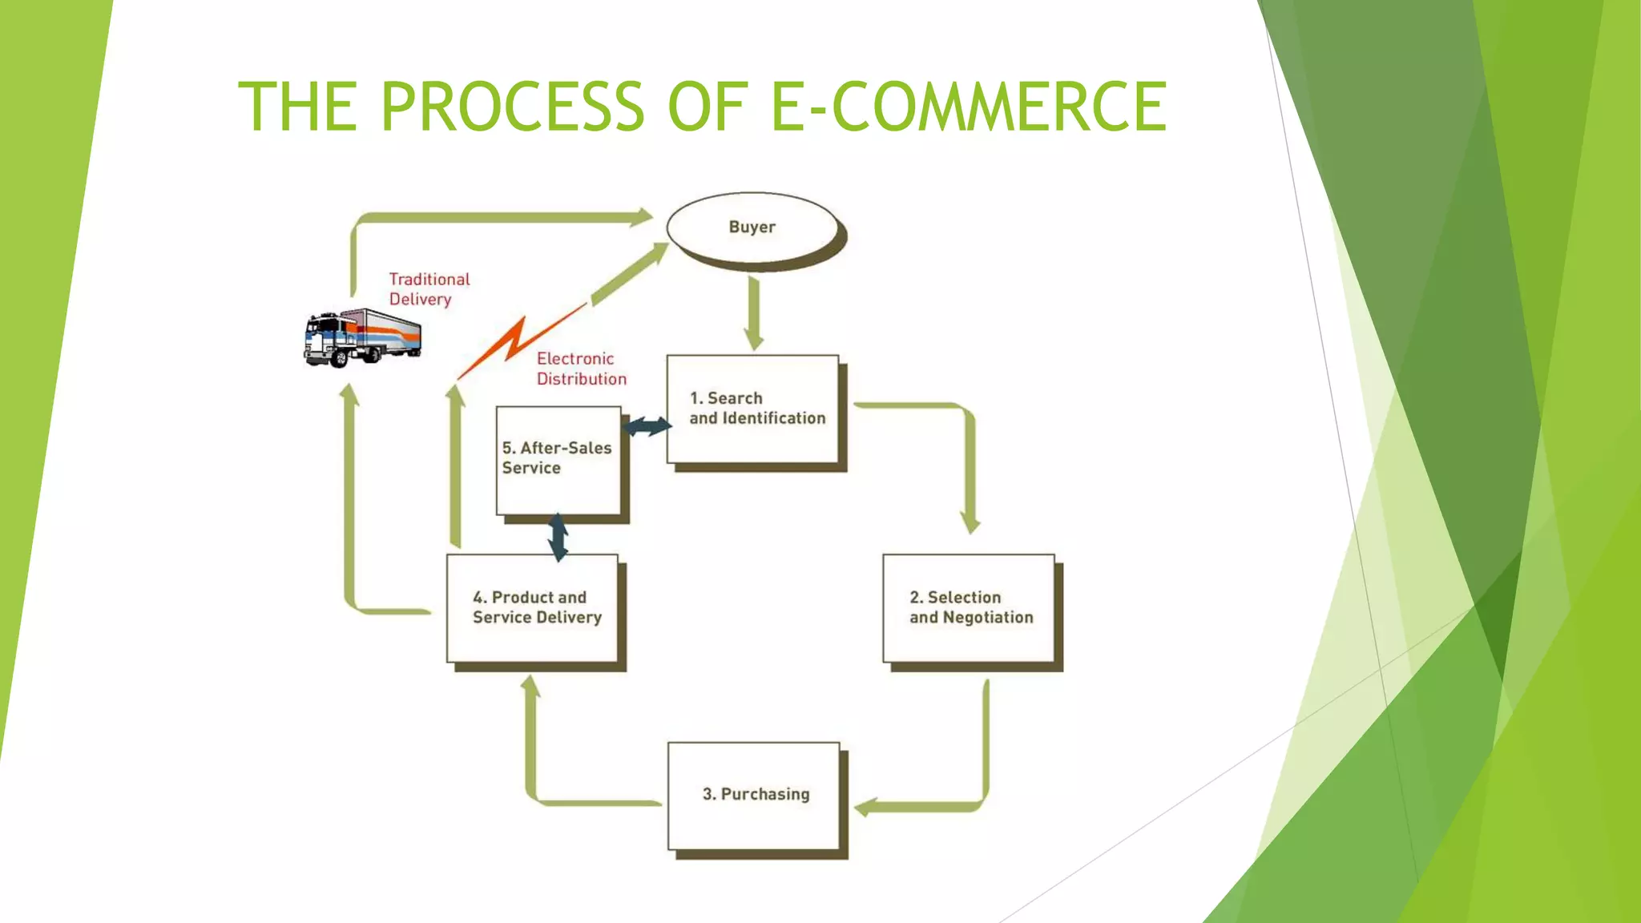

Slide 5
OUR SYSTEM
Our system is a multiple e-commerce website from people can buy the product from different E-commerce website.
Admin are monitoring the activity of the user and help to redirect to where the user wants to go.

