Slide 1
Model Context and Tooling Protocols
Notes:
Good morning, everyone, and welcome to a new module: Model Context and Tooling Protocols.
Quick question to start. How many different phone chargers do you have at home, in a drawer somewhere?
(Wait for answers and laughs. Usually "too many!")
Now, how many chargers does a new phone, laptop or earphone need today? Mostly one: USB-C.
Hold on to that picture. Today's whole topic is basically USB-C, but for AI.

Slide 2
Model Context Protocol (MCP): One Plug for Every AI Tool
Notes:
Today's lesson is the Model Context Protocol, or MCP for short.
In one line: MCP is a standard plug that lets any AI app, like ChatGPT or Claude, connect to any tool or data source, in the same way.
By the end of today, you'll understand why it exists, how it works, and you'll see ChatGPT use a tool we built ourselves, live.

Slide 3
Priya, a product manager, spends two days every month on one report: competitors’ news, prices and launches, copied from 20 browser tabs into slides.
Her company wants ChatGPT, Claude and Copilot to do it for her, each connected to the same five data sources. That’s 15 separate connectors to build and maintain.
Is there a way to build each connection once, and let every AI app use it?
Notes:
Meet Priya. She's a product manager.
Every month, she spends two full days on one report: what are our competitors doing? She opens 20 browser tabs, reads news, checks pricing pages, and copies it all into slides. Two days, every single month.
Her company says: let's get AI to do this. But different teams use different AI apps. Product uses ChatGPT, engineering uses Claude, sales uses Microsoft Copilot. And Priya's data comes from five places: news, pricing pages, company databases, and so on.
So the developers sit down to connect them, and realise: three AI apps times five data sources is fifteen separate connectors. Each one built differently. Each one breaks differently. And every time a new AI app comes along, they start again.
So here's my question for you: is there a way to build each connection once, and let every AI app use it?
(Take a few answers. Someone will usually say "a common standard" or "one plug".)
Exactly. That's what we're going to learn today.

Slide 4
Explain why connecting AI apps to tools gets messy as you grow (the M × N problem)
Describe how MCP works with everyday examples: host, client, server, and how they talk
Name what an MCP server offers: tools, resources and prompts
Read a small FastMCP server, and watch ChatGPT use one live
Notes:
Here's what you'll walk away with.
First, you'll understand why connecting AI apps to tools gets messy as a company grows. There's a name for it: the M times N problem.
Second, you'll understand how MCP works, using everyday examples like ordering food on Swiggy.
Third, you'll know the three things an MCP server can offer: tools, resources and prompts.
And finally, you'll see a real MCP server, in a few lines of Python, and watch ChatGPT use it live.

Slide 5
Part 1: Why AI Needs a Standard Plug
Notes:
Part 1: why AI needs a standard plug.
To understand the solution, let's first feel the problem.

Slide 6
Agents Get Things Done Through Tools
An AI agent is the brain; tools are its hands: search the web, check prices, read the news.
AI assistant
Agent
LLM
Search
Pricing
News
Finds company info
Checks prices
Reads latest news
The agent picks the right tool for each request and fills in the details, like a receptionist sending you to the right department.
Notes:
Let's start with how AI agents actually get things done.
The AI model is the brain. It's great at understanding and writing. But on its own, it can't look up today's news or check a competitor's prices. It needs hands. Those hands are called tools.
In Priya's case, the tools might be: a web search to find company information, a pricing source, and a news feed.
When Priya asks, "What's AMD up to?", the agent decides which tool to use and fills in the details, like "company: AMD".
Think of a good receptionist at a big office. You say what you need, and they send you to the right department with the right form already filled in. That's what an agent does with tools.
The problem is: how does the agent connect to each of those tools in the first place?

Slide 7
The Wiring Mess: The M × N Problem
Without a standard, every AI app needs its own custom connection to every tool. Each one is built, tested and fixed separately.
M × N connections
ChatGPT
GitHub
Claude
Slack
Copilot
Salesforce
Note:
3 AI apps × 3 tools = 9 connections. Add one more tool, and you build 3 more.
Notes:
Here's how it worked before a standard existed.
Every AI app needed its own custom connection to every tool. ChatGPT to GitHub, ChatGPT to Slack, ChatGPT to Salesforce. Then Claude to GitHub, Claude to Slack, Claude to Salesforce. Then Copilot, all over again.
Three apps times three tools: nine connections. That's what we call the M times N problem. M is the number of AI apps, N is the number of tools, and you have to build M times N connections.
And every single one is built, tested and fixed separately. Add one new tool, and you build three more. Add a new AI app, and you rebuild all of them.
Remember the drawer full of chargers? Every phone brand had its own plug. That's exactly this.

Slide 8
How MCP Fixes It: Connect Once
With one shared standard, each AI app and each tool connects once to MCP. Just like UPI: every bank joined one network, so any app can pay any bank.
M + N connections
ChatGPT
GitHub
Claude
MCP
Slack
Copilot
Salesforce
Note:
3 AI apps + 3 tools = 6 connections. Add one more tool, and you build just 1 more.
Notes:
Now here's what MCP does.
Instead of every app connecting to every tool, each one connects once, to the shared standard. Three apps plus three tools: six connections, not nine. And when a new tool arrives, you build one connection, not three.
With 5 apps and 9 tools, that's 14 connections instead of 45. The bigger the company, the bigger the saving.
Here's an analogy every one of you has used: UPI.
Before UPI, if you had a Paytm wallet, you could mostly only pay other Paytm users. Every wallet was its own island. Then NPCI created UPI: one shared standard. Every bank connected to it once. And now any app, Google Pay, PhonePe, Paytm, can pay anyone at any bank.
MCP is doing the same thing for AI tools.

Slide 9
Why does the M × N approach stop working as a company grows?
Every tool needs extra training data
Every AI app must be wired to every tool separately
Every user needs their own setup
Every question must be handled by hand
Notes:
Quick check! Why does the M times N approach stop working as a company grows?
A: every tool needs extra training data.
B: every AI app must be wired to every tool separately.
C: every user needs their own setup.
D: every question must be handled by hand.
(Give the room a few seconds.)
It's B. Every new app or tool multiplies the work. That's the drawer of chargers again.

Slide 10
Part 2: How MCP Works
Notes:
Part 2: how MCP actually works.
Don't worry, no heavy technology here. We'll use a phone charger, a food delivery app and a phone call.

Slide 11
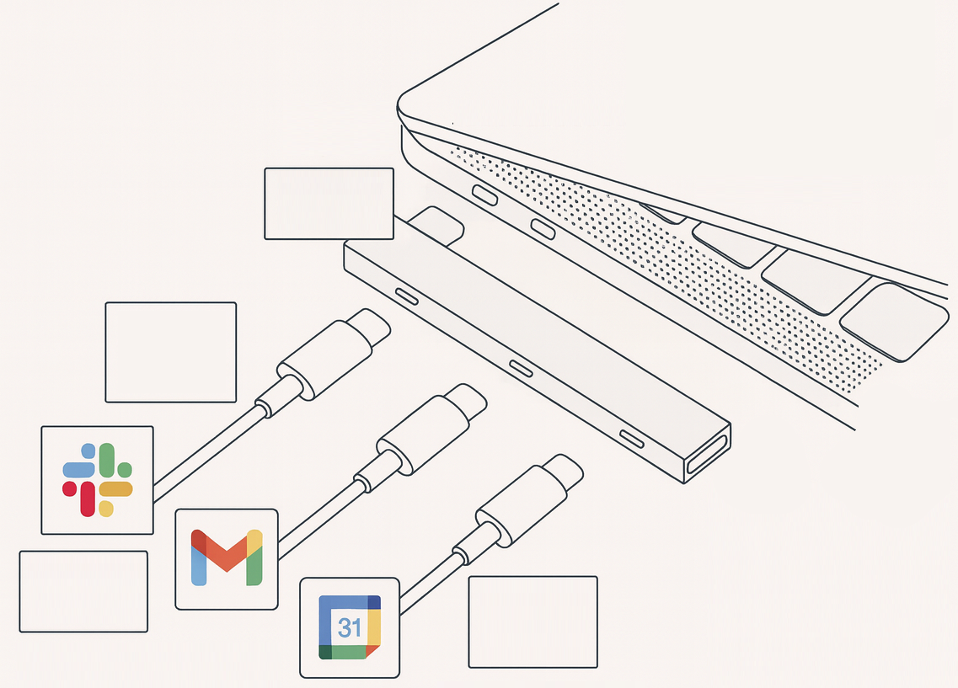


MCP: The USB-C Port for AI
MCP (Model Context Protocol) is an open standard, introduced by Anthropic in 2024, for connecting AI apps to tools and data. One plug shape, any device.
MCP host
MCP client
client.py
MCP
MCP
server
Remote services
MCP
server
Source: https://pub.towardsai.net/mcp-the-flip-side-of-the-usb-c-analogy-af98e07bdb30
Notes:
MCP stands for Model Context Protocol. A protocol is just an agreed set of rules for communicating, like the rules that let a Gmail user email an Outlook user.
Anthropic, the company behind Claude, introduced MCP as an open standard in November 2024. And here's the remarkable part: within months, its competitors adopted it too. OpenAI added it in 2025, then Google, then Microsoft. And in December 2025, Anthropic handed MCP over to a neutral foundation under the Linux Foundation, so no single company controls it.
When fierce competitors all agree on one plug, you know it solves a real problem.
The best picture is USB-C. The European Union even made USB-C the required charging port for new phones from the end of 2024, because one standard is better for everyone. MCP is the USB-C port for AI: one plug shape, and any AI app can connect to any tool built for it.

Slide 12
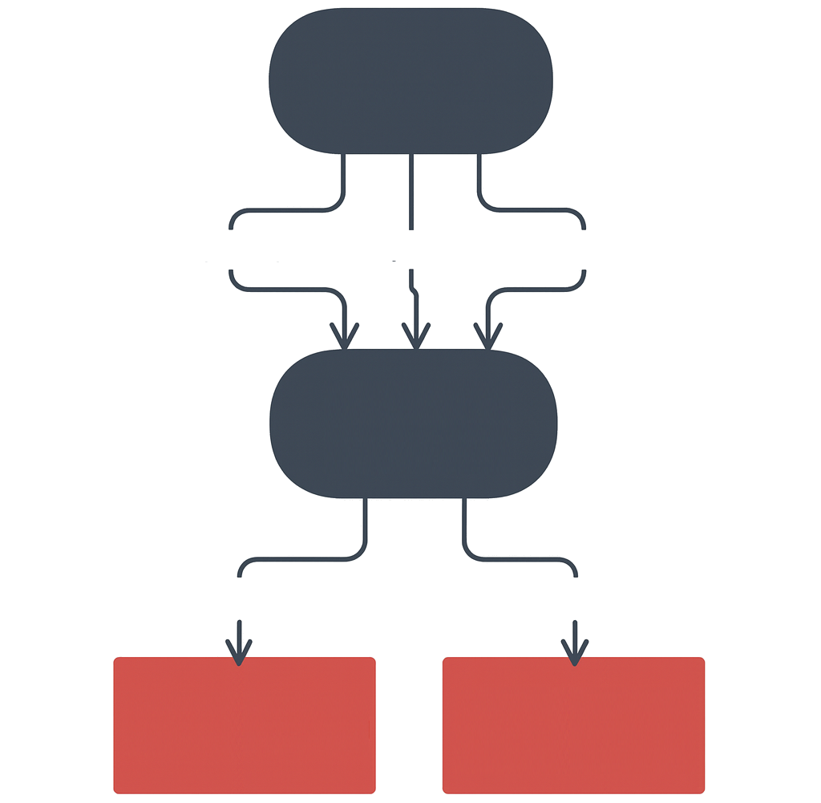
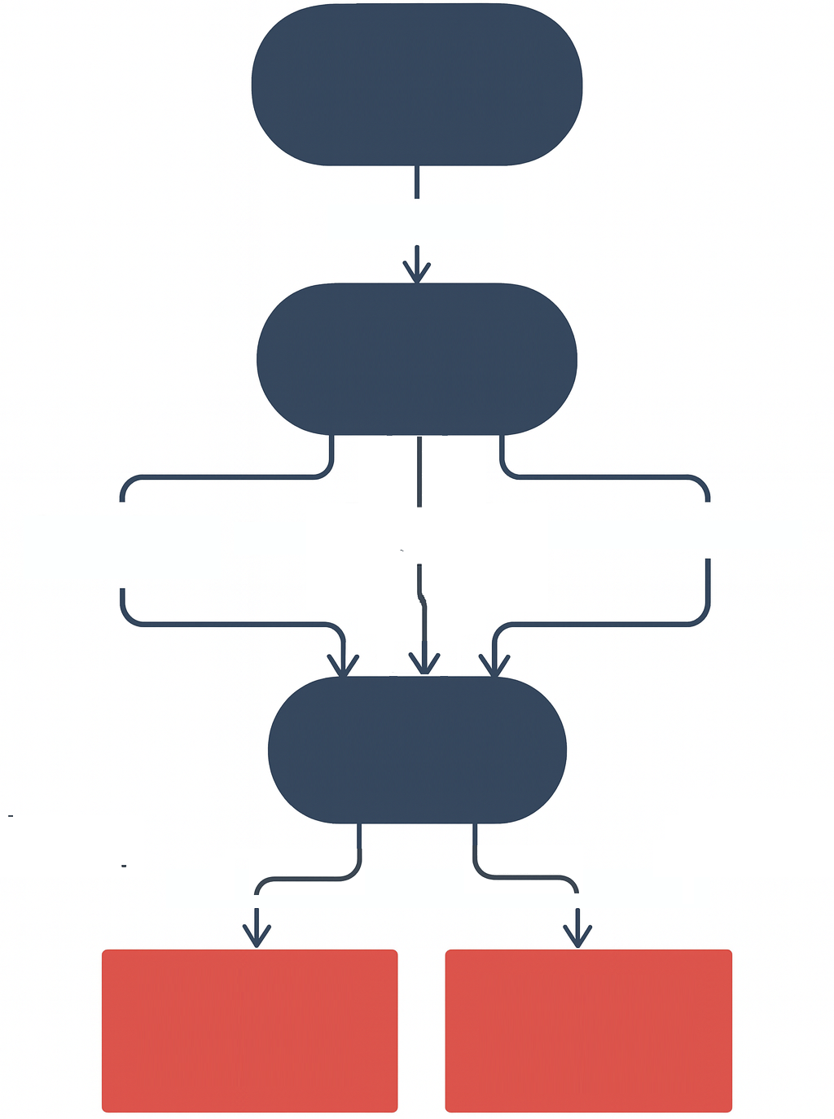
Before and After MCP
Without MCP, every connection is hand-built and breaks easily. With MCP, any AI app can plug into any MCP server.
Without MCP
With MCP
AI assistant
AI assistant
USB-C plug
Google flights
Expedia
Payment APIs
MCP client
Custom API integration
Google flights MCP
Expedia MCP
Payment
MCP
Slow and painful
Breaks easily
MCP server
Hours of coding
Fragile connection
Hours of coding
Fragile connection
Plug and play
Standard protocol
Instant connection
Shared language
Instant connection
Shared language
Notes:
Here's the before and after, side by side.
On the left, without MCP: an AI travel assistant has custom wiring to Google Flights, to Expedia, to a payment service. Hours of coding for each one, and it breaks whenever one of them changes something.
On the right, with MCP: each of those services offers an MCP server, the assistant has one standard way to plug into all of them. Plug and play.
Think of it this way: without MCP, you hire an electrician to hard-wire every appliance into the wall. With MCP, you just put a standard socket in the wall, and anything with the right plug works.

Slide 13



Three Roles: Host, Client, Server
Think of ordering food on Swiggy:
Host
Client
Server
The AI app you use (ChatGPT, Claude)
Like the Swiggy app
The connector inside the app, one per server
Like the delivery partner
Offers tools and data
Like the restaurant and its menu
They talk in JSON-RPC: a standard “order slip” every side understands.
Notes:
MCP has three roles. Let's use something you've all done: ordering food on Swiggy.
The host is the AI app you actually use: ChatGPT, Claude, Copilot. It's like the Swiggy app on your phone: it's where you ask for what you want, and where the answer shows up.
The client is a connector inside the host. There's one client for each server it talks to. It's like the delivery partner assigned to one restaurant: it carries your order there and brings the food back. It doesn't cook anything itself.
The server is where the work happens. It offers tools and data. It's the restaurant, with its menu and kitchen.
And they all talk in a standard format called JSON-RPC. Think of it as a printed order slip: every restaurant understands it, no matter which app sent it.
In today's demo: ChatGPT is the host, ChatGPT's connector is the client, and our MarketIntel program is the server.

Slide 14
How Messages Travel: Same Computer or Internet
stdio: both sides on the same computer, like an office intercom. HTTP: over the internet, like a phone call. Our demo server uses HTTP.
MCP host
MCP server
AI application
Servers with sources and tools
Transport layer
Local file system
MCP client 1
Protocol layer
Protocol layer
Server 1
Server 1
stdio
Transport layer
Remote services
MCP client 2
Protocol layer
Protocol layer
Server 2
HTTP
SSE
Server 2
Whichever route, every message uses the same format (JSON-RPC 2.0), like a standard printed order slip.
Notes:
How do the messages actually travel? That's called the transport, and there are two main options.
stdio is when the AI app and the server run on the same computer. Think of an office intercom: quick, private, and only inside the building.
HTTP is when they talk over the internet. Think of a phone call: the server can be anywhere in the world.
Our demo server uses HTTP, because ChatGPT runs in the cloud and needs to reach our server over the internet.
And here's the nice part: whichever route the message takes, the message itself always looks the same: the same standard order slip. Just like a letter is a letter whether it goes by post or by courier.

Slide 15
The Handshake: How a Connection Starts
Like the start of a phone call: “Hello, I’m ChatGPT.” “Hi, I’m MarketIntel, here’s what I offer.” “Great, let’s talk.”
Protocol layer
Client
Server
1. Client: hello
2. Server: hello
3. Client: ready
Connected: list tools, then call them
Client
Server
Notes:
Before any work happens, the client and server do a quick handshake. It's exactly like the start of a phone call.
Step one, the client says hello: "Hi, I'm ChatGPT, and this is what I support."
Step two, the server says hello back: "Hi, I'm MarketIntel, and this is what I offer."
Step three, the client says: "Great, I'm ready."
Now the connection is ready, and the client can ask: what tools do you have? And then: please run this tool for me.
Watch for this in the demo. Our server prints a line for each step. You'll literally see the word INIT for the handshake, LIST when ChatGPT asks for the menu, and CALL when it places an order.

Slide 16
How does MCP solve the M × N problem?
Custom code for every app–tool pair
One shared standard every app and tool connects to
Each AI model manages all its own connections
Replacing tools with the model’s own knowledge
Notes:
Quick check! How does MCP solve the M times N problem?
A: custom code for every app and tool pair.
B: one shared standard that every app and tool connects to.
C: each AI model manages all its own connections.
D: replacing tools with the model's own knowledge.
(Take an answer.)
It's B. Just like UPI: one shared standard, and everyone connects once.

Slide 17
Part 3: What a Server Offers, and How to Build One
Notes:
Part 3: what an MCP server offers, and how to build one.
This is where it gets practical. In a few minutes, you'll see a real server, and ChatGPT using it.

Slide 18
What an MCP Server Offers
Three things, like a restaurant:
Tools
Resources
Prompts
Actions the AI can ask for, like placing an order
Information the AI can read, like the menu card
Ready-made instructions, like the chef’s set combos
Our demo server, MarketIntel, offers 7 tools: search, competitors, pricing, news and more.
Notes:
An MCP server can offer three kinds of things. Let's stay in the restaurant.
Tools are actions the AI can ask for, like placing an order: "search the news about AMD", "get pricing for NVIDIA". Something happens, and a result comes back.
Resources are information the AI can read, like the menu card on the wall. Nothing gets done; it's just data to look at, like a price list or a company file.
Prompts are ready-made instructions, like the chef's set combo meals. Instead of explaining every time, you pick "competitor brief" and the server provides a well-written instruction for the AI to follow.
Our demo server, MarketIntel, focuses on tools. It offers seven of them: company overview, competitors, product portfolio, pricing, recent news, an all-in-one competitor brief, and a server status check.

Slide 19
Building a Server in Python with FastMCP
FastMCP is a Python library that turns ordinary functions into tools, resources and prompts, with one line each.
From our demo server
from fastmcp import FastMCP
mcp = FastMCP(name="MarketIntel") # name it
@mcp.tool # a TOOL
def list_competitors(name: str) -> dict:
"""Top competitors of a company."""
return search(f"Competitors of {name}")
@mcp.resource("data://watchlist") # a RESOURCE
def watchlist(): return ["NVIDIA", "AMD"]
@mcp.prompt # a PROMPT
def brief(company: str): return f"Brief on {company}"
mcp.run(transport="http", port=8000) # open shop
The sentence in triple quotes tells the AI when to use the tool; the type hint (name: str) tells it what to send.
Notes:
So how do you build a server? With a Python library called FastMCP. A library is just a ready-made toolkit.
Don't worry about reading every line. Look at the pattern.
Line 2: we give the server a name, MarketIntel.
Then there's a normal Python function, list competitors. The magic is the one line above it: at mcp dot tool. That single line turns an ordinary function into a tool any AI app can use.
Notice the sentence in triple quotes: "Top competitors of a company." That's not for humans. That's how ChatGPT knows when to use this tool. Write a vague description, and the AI will pick the wrong tool, like a badly labelled switch in a new house.
And "name: str" tells the AI it needs to send a piece of text, the company name.
At mcp dot resource does the same for data to read, and at mcp dot prompt for a ready-made instruction.
The last line opens the shop: run it over HTTP on port 8000.
This is a simplified version of our demo server. The real one has seven tools and adds logging, but the pattern is exactly this.

Slide 20
Demo: ChatGPT Uses Our MarketIntel MCP Server
15
Scenario:
Priya needs a competitor brief on AMD before Monday’s strategy meeting. Instead of 20 browser tabs, she asks ChatGPT, and ChatGPT calls our MarketIntel MCP server.
What you’ll see:
The server starting up, offering 7 tools: company overview, competitors, product portfolio, pricing, recent news, an all-in-one competitor brief, and server status
ChatGPT connecting through a public link (ngrok) and asking for the list of tools
A live log line for every step: INIT (the handshake), LIST (the menu), CALL (the order), DONE (delivered)
Live web data from Tavily, or built-in demo data if there’s no key, so the demo never breaks
Watch for:
Which tool ChatGPT chooses by itself, and what it sends
Notes:
Demo time! Let's help Priya.
(Start the server in a terminal: python server.py)
Look at the banner. It tells us the mode: LIVE if we have a Tavily key, which is a search engine made for AI, or DEMO, which uses built-in sample data. That fallback means the demo never breaks, even if the internet is slow.
(Start ngrok and paste the public link plus /mcp into ChatGPT's connector settings.)
ChatGPT runs in the cloud and can't see my laptop. ngrok gives my server a temporary public web address, like giving a delivery partner a proper address instead of "the house near the temple".
Now watch the terminal as ChatGPT connects. You'll see INIT: that's the handshake we just learned. Then LIST: ChatGPT asking for the menu, and our server answering with seven tools.
(In ChatGPT, ask: "Give me a competitor brief on AMD in GPUs, with sources.")
Now watch the terminal again. CALL: ChatGPT decided, on its own, to call the competitor brief tool, and you can see exactly what it sent: company AMD, category GPUs. Then DONE, with how long it took.
And in ChatGPT, the answer appears, built from what our server returned.
Ask the room: who chose which tool to use? Not us. ChatGPT read the tool descriptions and picked one. That's why those descriptions matter so much.
Backup plan: if ChatGPT or ngrok is slow, run python test_client.py. It connects to the server just like ChatGPT would, lists the tools and calls three of them, so you can show the same log lines.

Slide 21
Which of these can an MCP server offer?
Tools
Resources
Prompts
All of the above
Notes:
Quick check! Which of these can an MCP server offer?
Tools, resources, prompts, or all of the above?
(Take an answer.)
It's D, all of the above. Tools are the orders, resources are the menu card, and prompts are the set combos.

Slide 22






Where MCP Servers Come From
You don’t always build your own. MCP servers come in three kinds:
Reference servers
Official integrations
Community servers
Samples from the MCP team, to learn from
Built by companies for their own products
Built by independent developers
They include:
Used in real work because they are:
Their use cases are often:
Sample tools
Sample data
Sample prompts
Ready to use
Trusted
Experimental
Specialized
Example:
Example:
Example:
PostgreSQL
Slack
Stripe
Apify
Discord
Docker
Notes:
Here's good news: you don't always have to build your own server.
Reference servers are samples from the MCP team, made to learn from. Early examples included connectors for PostgreSQL databases and Slack.
Official servers are built by companies for their own products. Stripe, for payments, and many other big platforms have their own. They're ready to use and trusted, because the company itself maintains them.
Community servers are built by independent developers. Thousands exist, for everything from Discord to Docker. They're great for experiments, but check them carefully before using them with real company data, just as you'd check an app before giving it access to your phone.
So the real question is often: is there already a trusted server for this? If not, build one, like we did with MarketIntel.

Slide 23
Your Turn: Design One More Tool for MarketIntel
10
Scenario:
Priya’s team loved the demo. Now they want one more tool for their monthly competitor report.
Discuss in pairs:
Which tool would save Priya the most time? (e.g. compare two companies’ prices, track app-store ratings, summarise an earnings call)
What should it receive as input? (e.g. two company names, a region)
What should it give back? (e.g. a table, a short summary with sources)
Is it a tool (an action), a resource (data to read) or a prompt (a ready-made instruction)?
Notes:
Your turn!
Priya's team loved the demo. Now they want one more tool for their monthly competitor report. In pairs, take a few minutes to design it.
Which tool would save Priya the most time? Maybe comparing two companies' prices side by side, tracking app-store ratings, or summarising an earnings call.
What would it need as input? Two company names? A region?
What should it give back? A table? A short summary with sources?
And is it really a tool, an action, or would a resource, data to read, or a prompt, a ready-made instruction, fit better?
(Give pairs a few minutes, then take two or three ideas and write them on the board.)
Great ideas. Notice that you just designed an MCP tool without writing any code: a name, a description, inputs and an output. That's exactly what the at mcp dot tool line needs.

Slide 24
Jargon Buster
Every new word from today, in plain language:
Word | Plain meaning | Everyday picture
MCP | Model Context Protocol: a standard way to connect AI apps to tools and data | A USB-C port
M × N problem | Every AI app wired separately to every tool | A drawer full of different chargers
Host | The AI app the user talks to (ChatGPT, Claude) | The Swiggy app
Client | The connector inside the host; one per server | The delivery partner
Server | A program that offers tools, resources and prompts | The restaurant
Tool | An action the AI can ask the server to do | Placing an order
Resource | Data the AI can read | The menu card
Prompt | A ready-made instruction template | A set combo meal
Transport | How messages travel: same computer (stdio) or internet (HTTP) | Intercom vs. phone call
JSON-RPC | The standard message format MCP uses | A printed order slip
FastMCP | A Python library for building MCP servers quickly | A ready-made shop-counter kit
Notes:
Here's your jargon buster. Every new word from today, in plain language. Feel free to take a photo.
MCP is the USB-C port for AI. The M times N problem is the drawer full of different chargers.
The host is the Swiggy app, the client is the delivery partner, and the server is the restaurant.
A tool is placing an order, a resource is the menu card, and a prompt is a set combo meal.
The transport is how messages travel: an intercom on the same computer, or a phone call over the internet.
JSON-RPC is the printed order slip everyone understands. And FastMCP is a ready-made kit for setting up your own shop counter.

Slide 25
Without a standard, every AI app needs its own wiring to every tool: the M × N problem.
MCP is the USB-C port for AI: build each connection once, use it from any AI app.
Three roles: the host (the AI app), the client (its connector) and the server (tools and data).
Servers offer tools (actions), resources (data to read) and prompts (ready-made instructions).
FastMCP turns ordinary Python functions into an MCP server, like our MarketIntel demo.
Notes:
Let's bring it together with five takeaways.
One: without a standard, every AI app needs its own wiring to every tool. That's the M times N problem.
Two: MCP is the USB-C port for AI. Build each connection once, and use it from any AI app.
Three: three roles. The host is the AI app, the client is its connector, and the server holds the tools and data.
Four: servers offer tools, which are actions, resources, which are data to read, and prompts, which are ready-made instructions.
Five: FastMCP turns ordinary Python functions into an MCP server, just like our MarketIntel demo.
Now think back to Priya. Two days of copying from 20 tabs. With one MCP server, her report is one question away, from ChatGPT, Claude or Copilot, whichever app her team prefers.

Slide 26
Notes:
That's it for today. Thank you for your energy!
What questions do you have? Nothing is too basic. If you're wondering about something, I promise someone else is too.
(If the room is quiet, ask:) If you could give your favourite AI app one new tool for your own job, what would it be?

