Slide 1
VB – Voice Banking
Assistive Technology
Natural Language Generation
web: https://dpresume.com/vb
Devendra Prasad
Tech Lead Software Engineer
New Delhi, India
Mobile and Zoom: 958 279 7772
devendraprasad1984@gmail.com
https://dpresume.com

Slide 2
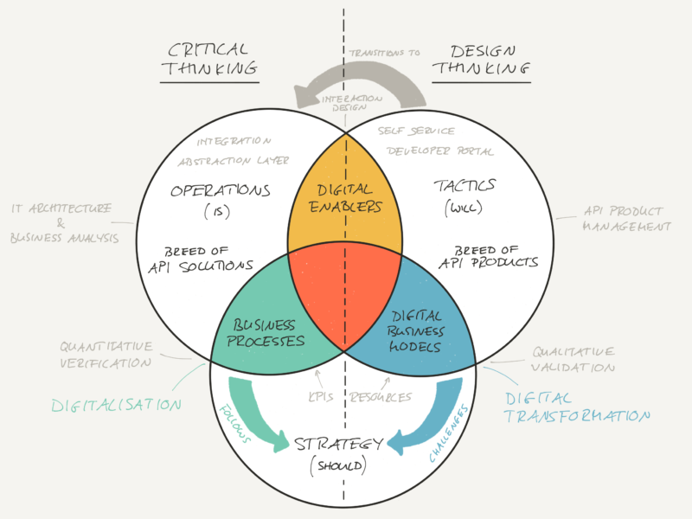
Idea Vision & Solution
Problem Statement for everyday banking…
Future Thinking: technologies are going through the advancements but many people who use banking are still left behind due to being in village, disabled, lack of knowlege and elderly who use less of smart banking
Simple: Banking an arduous task for customers? For some section of the population, banking is still difficult
Decision: due to operational inconsistencies, people dont want to go to bank eg passbook printing or just balance retrieval.
Easy: If a users needs any information related to his banking, he needs to visit lot of URLs, bank sites, branches / ATMs, calling customer care which is nothing but like a pain for anyone of us
How can we make Banking simpler for every customer?
What if we could trigger our selective banking needs right from our cell phones / devices without even to login anywhere or browsing web pages or going to branches
The idea is about a feature/service that can interpret the factual banking data in Natural Languages with regional support that can be heard directly on the phones as if we are talking with the bank
I have made a small web app UI that is just an exhibit of the idea and presents some of such banking information in English text as a short story and that can be read or spoken out by the computer or phone for customer (multi language and regional support is also part of the idea)

Slide 3
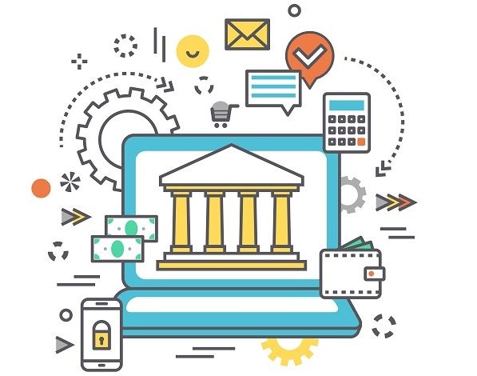
Value gained by the Idea & Market
Value to Every Customer…
Simplicity: No login, no reading, no analysis, no walking and yet most of banking into their devices
Access: banking information / interaction on the move
PA: command activated personal assistant (ex. Alexa or dialing a service eg *9898#)
WoW: Discover better and modern ways of banking and insights for almost every customer
Reach: with modern days technologies, this service can reach to older phones also and can help elderly/disabled/villagers with great ease
Value to the Bank (Internal stakeholders)
Transparent: Leverage the opportunities that banking / Open Banking offered to champion transparency, serve new demographics of customers
Revenue: Earn from monetizing the services offered by this application, say 200 INR or equivalent annual subscription for service
Cut down on customer complaints, grievances and walking over to branches
WoW: Adoption of new ways of working such as API inspired solutions, micro services, server less, cloud based and eventually complete ecosystem that churns out new features at a faster pace
Deployment: Services can be hot pluggable eg moratorium / payment holiday requests handler deployed/revoked as and when needed
Product: Convert this service modal into product and collaborate with other organisation & banks

