Slide 1
Leaf Identification & Leaf Disease Detection
Group Members:
Sushmita Sharma (5141079)
Harshit Bhatia (5141053)
Devendra Pratap Singh (5141055)
Mentor: Dr. Kapil
Co-Mentor: Mr. Prantik Biswas

Slide 2
Outline
Introduction
Computer Vision
Leaf Identification and Disease Detection
Motivation
Prerequisites
Literature Survey
Comparative analysis
Deliverables
Tools and Technique
Challenges
Gantt chart
Existing System
Future Direction
References

Slide 3

Computer Vision
Image source : www.merl.com
Computer vision is concerned with the theory behind artificial systems that extract information from images. The image data can take many forms, such as video sequences, views from multiple cameras, or multi-dimensional data from a medical scanner.

Slide 4
Image Processing
Agriculture
Optical Character Recognition
Applications of
Computer Vision
Biometrics
Robotics
Gesture Analysis
Face Recognition
Machine Vision

Slide 5
Our flow of study
Computer Vision
Image Processing
Leaf Identification
Disease
Detection

Slide 6
Leaf Identification and Disease Detection
Plants play an important role in both human life and other lives that exist on the earth.
Due to environmental deterioration and lack of awareness, many rare plant species are at the margins of extinction.
Leaf classification and recognition for plant identification plays a vital role in all these endeavors.

Slide 7
Motivation
Bio-Diversity
Today, thousands of plants are on the verge of extinction and are still unknown to the human world. The inclusion of such bio-diversity to the data set will certainly be a major achievement.
Agriculture
In most of the countries farmers detect pests manually through their observation of naked eyes, which requires continuous monitoring of the crop stems and leaves, which is a difficult, labor intensive, inaccurate and expensive task for large farms.[6]

Slide 8
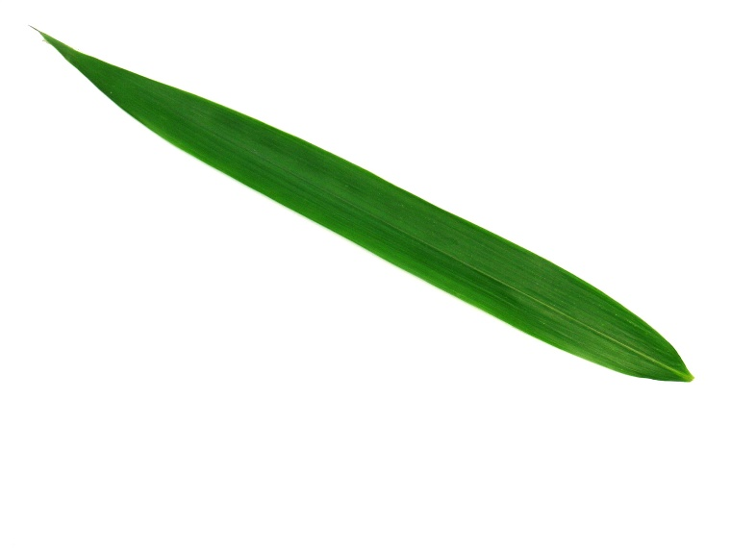
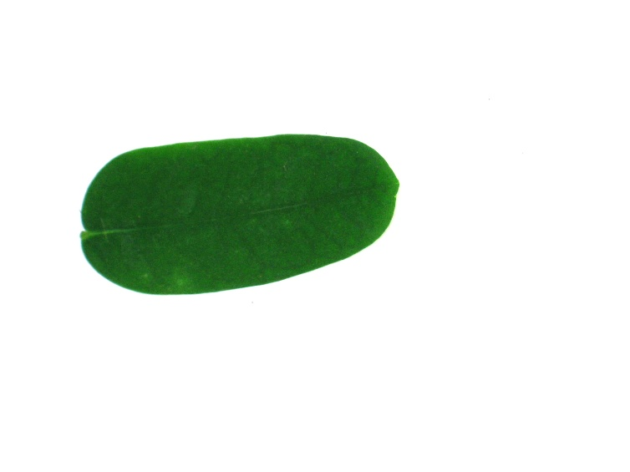
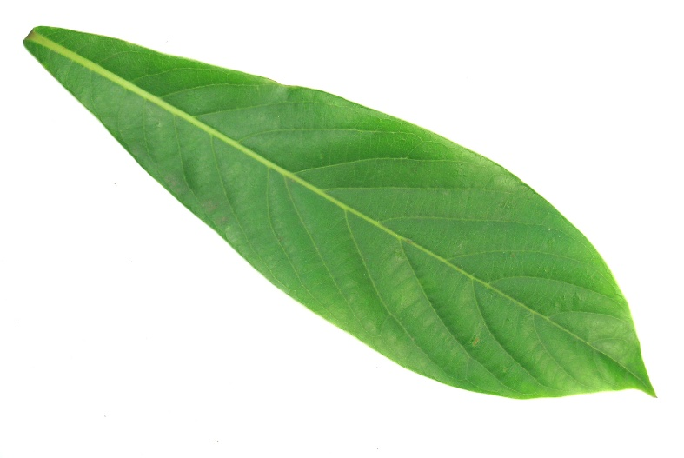
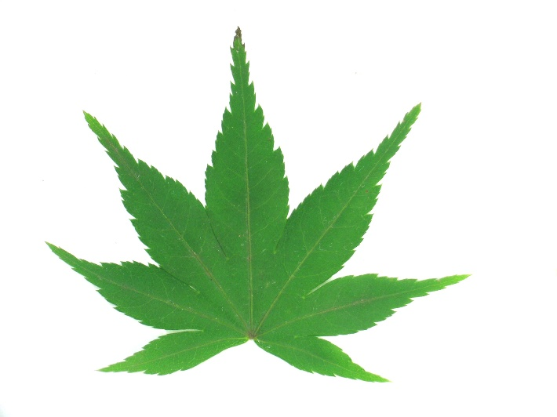
Some examples of Leaves from Data Set
Pubescent Bamboo
True Indigo
Japanese maple
Nanmu
Source: www.image-net.org

Slide 9
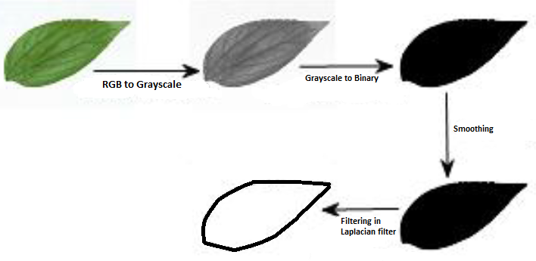
Converting RGB image to binary image
Image processing Source :- [5]

Slide 10
Disease Detection
Digital image recognition of plant diseases could reduce the dependence of agricultural production on the professional and technical personnel in plant protection field and is conducive to the development of plant protection informatization.

Slide 11
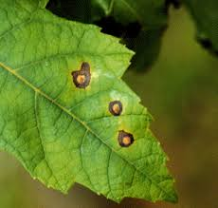
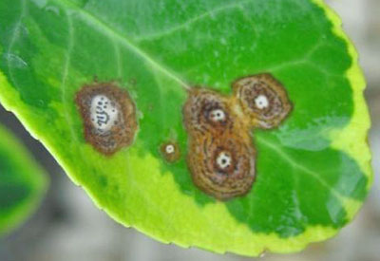
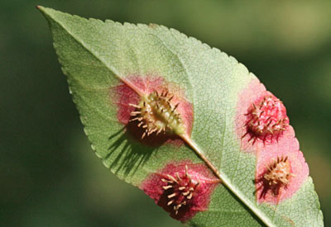
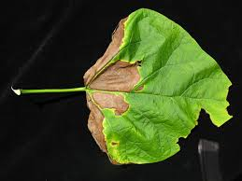
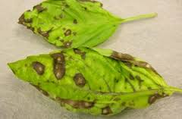
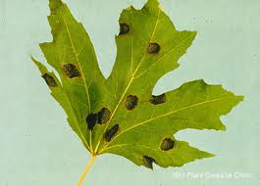
Leaf with Disease
Source: www.image-net.org

Slide 12
Prerequisites
Image Processing
ML-Algorithm
Programming Environment
MATLAB-script

Slide 13
Literature Survey
1. Wu, Stephen Gang, et al. "A leaf recognition algorithm for plant classification using probabilistic neural network, 2007.
They employ Probabilistic Neural Network (PNN) with image and data processing techniques to implement a general purpose automated leaf recognition for plant classification.
They Extracted 12 leaf features and orthogonalized into 5 principal variables which consist the input vector of the PNN.
The PNN is trained by 1800 leaves to classify 32 kinds of plants with an accuracy greater than 90%. Compared with other approaches.
This algorithm is an accurate artificial intelligence approach which is fast in execution and easy in implementation.

Slide 14
Flow diagram of proposed scheme
Capture digital leaf image
Process Image
Some Imp. Terms:
Process Image
Extract features
PCA Algorithm
PNN Algorithm
Extract Features
PCA Algo
Train PNN
Test PNN
Display and Compare Result

Slide 15
2. Al- Hiary H., S. Bani -Ahmad, M. Reyalat, M., Braik and Z. Al Rahamneh, “Fast and accurate detection and classification of plant disease,2011.
They propose and experimentally evaluate a software solution for automatic detection and classification of plant leaf diseases.
The Process contains two phase .
In the first step we identify the mostly green colored pixels.
The other additional step is that the pixels with zero's red, green and blue values and the pixels on the boundaries of the infected cluster (object) were completely removed.
The developed algorithm’s efficiency can successfully detect and classify the examined diseases with a precision between 83% and 94%.

Slide 16
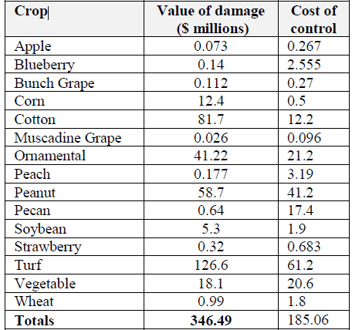
Summary of total losses due to disease damage and cost of control in Georgia, USA in 2007 [3].

Slide 17
The Proposed approach for segmentation and classification plant diseases can be divided into Three phases:
Phase 1 - K-means Clustering Technique
Phase 2 – Features Extraction
Phase 3 – Neural Networks (ANN)

Slide 18
3. Huang, Guang-Bin, et al. "Extreme learning machine for regression and multiclass classification,2012.
Extreme learning machines(ELM) are feedforward neural network for classification or regression with a single layer of hidden nodes.
The hidden layer is called Feature Mapping .
This paper cover the following topics:
ELM(Extreme Learning Machine)

Slide 19
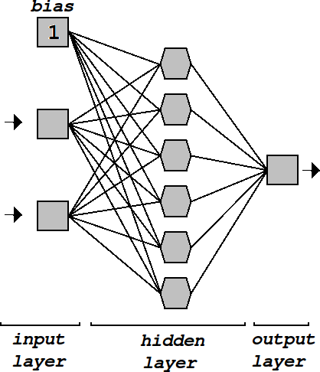
Fig. ELM
Source: MIT Computer Vision Lab

Slide 20
4. Mao, Ke Zhi, K-C. Tan, and Wee Ser. "Probabilistic neural-network structure determination for pattern classification,2000.
Network structure determination is an important issue in pattern classification based on a probabilistic neural network.
The proposed algorithm consists of two parts and runs in an iterative way.
The first part identifiesan appropriate smoothing parameter using a genetic algorithm
The second part determines suitable pattern layer neurons using a forward regression orthogonal algorithm.

Slide 21
Diagram of a PNN [1]

Slide 22
Comparative Analysis
Identification Techniques | Merit’s | Demerit’s | Accuracy
1. K-means Clustering [3] 2. SVM (Support Vector Machine) [4] 3. Principal Component Analysis[5] 4. Probabilistic Neural Network [5] | With a large number of variables, K-Means may be computationally faster than hierarchical clustering (if K is small). Learning Result is more robust. Prediction accuracy is generally high. Choose weights depending on the frequency in frequency domain and Used for variable reductions. PNN is much faster and more accurate than multi-layer perception networks. | Does not work well with non-Globular clusters. This method is time-consuming and complex. Learning takes long training time. Large complexity of network structure and Long training time. PNN requires more memory space to store the model | between 83% and 94% between 65% and 90%. More than 90 % More than 90 %

Slide 23
Deliverables
Minor Project
Leaf Identification
Major Project
Leaf identification And Leaf Disease Detection.

Slide 24
Flow Diagram for Leaf Identification
Capture digital leaf image
Process Image
Extract Features
Leaf Identified
Algo X
PCA

Slide 25
Flow Diagram for Disease Detection
Capture digital leaf image
Detect Leaf
Green Pixel Removal
Result
Texture Analysis
Segmentation

Slide 26
Tools
MATLAB: MATLAB (matrix laboratory) is a multi-paradigm numerical computing environment and fourth-generation programming language.
Latest Release: R2015b (Version 8.6) - 3 Sep 2015
GNU Octave: GNU Octave is a high-level interpreted language, primarily intended for numerical computations. It provides capabilities for the numerical solution of linear and nonlinear problems, and for performing other numerical experiments.
Latest Release: Octave 4.0.0 - May 29, 2015

Slide 27
Challenges
Limited Data sets
Leaf Angles
Size/shape /convex
Damaged leaf

Slide 28
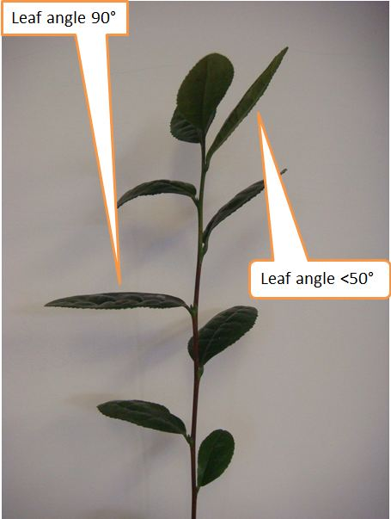
Challenges: Leaf angles
Source: www.image-net.org

Slide 29
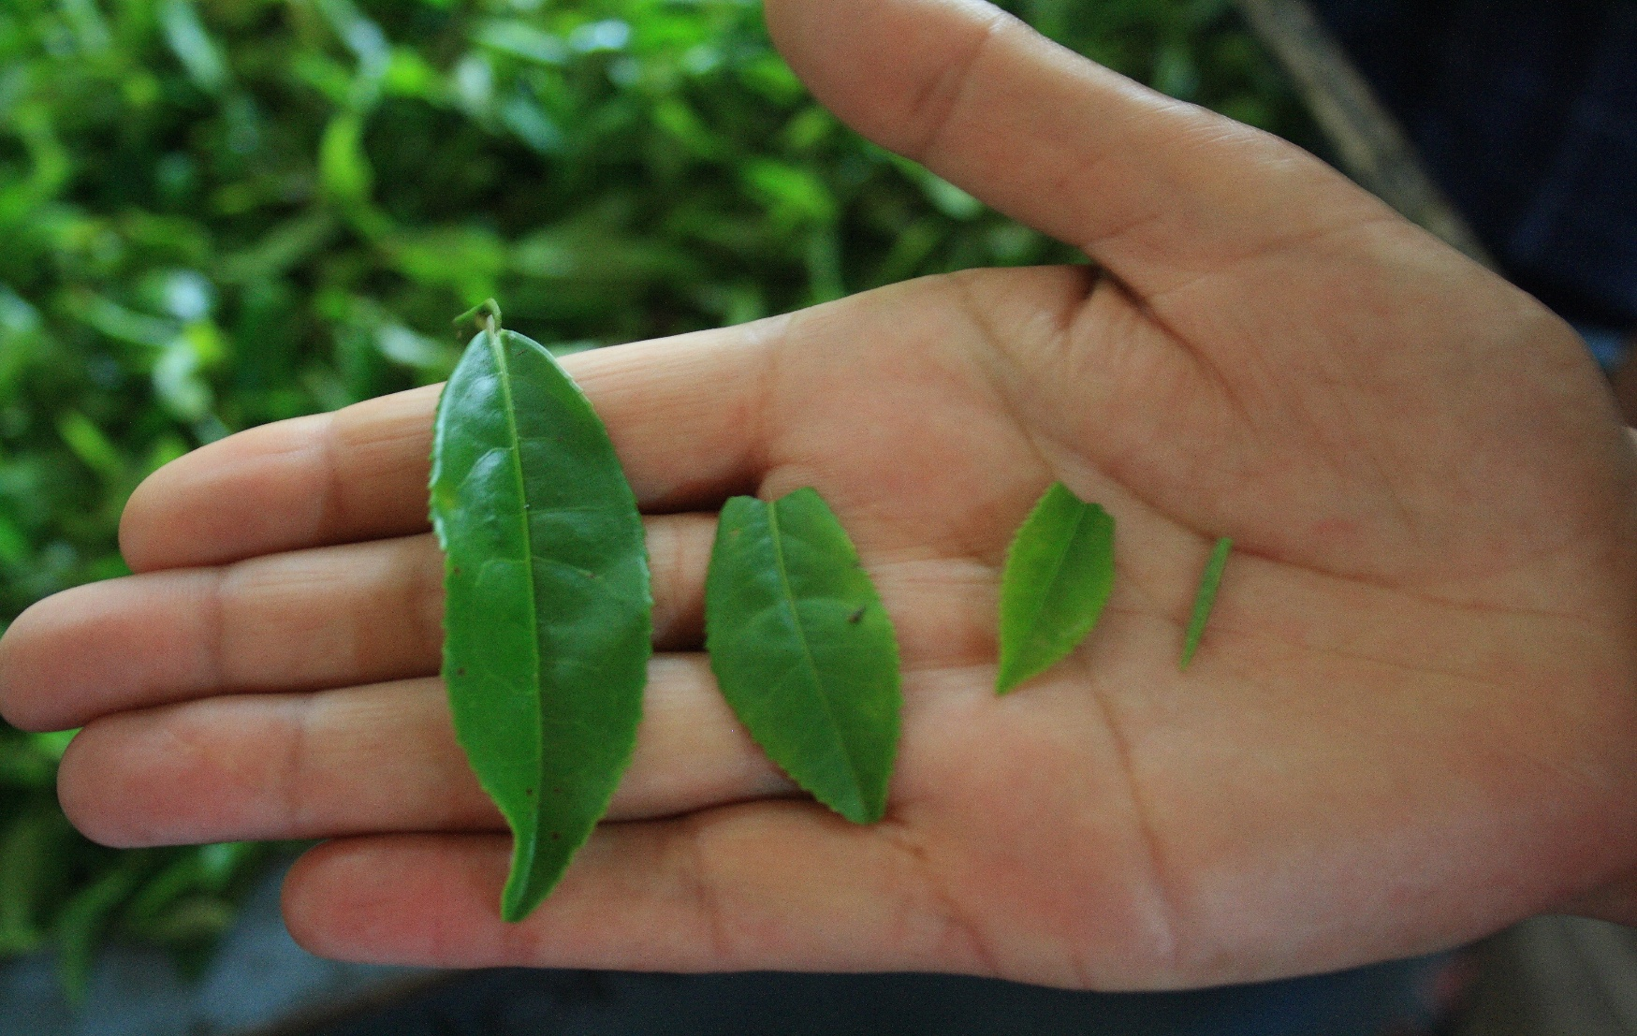
Challenges: size/shape/surface
Source: www.image-net.org

Slide 30
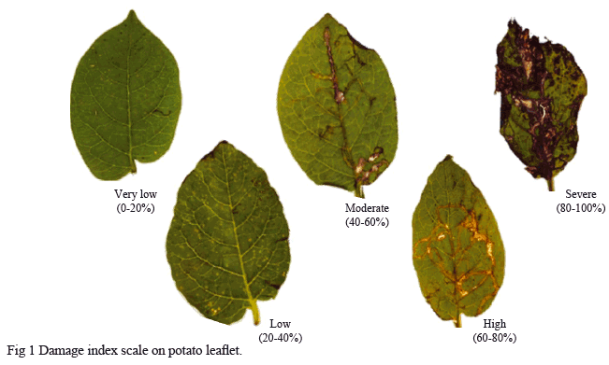
Challenges: Damaged Leaf
Source: www.image-net.org

Slide 31
Problem
Analysis_1
Literature Survey
Testing and Development 2
Testing & Deployment 1
Design and Coding 2
Design & coding 1
Problem Analysis_2
2015
2015
2016
2016
2016
Today
Sem-5
Sem-3
Sem-4
Aug-15
Target 4
Leaf Disease Detection
Target 2
Target 3
Target 1
Leaf identification

Slide 32
Existing System
Leaf Snap app (only in US, white background mandatory )
Plantifier (only in France,4100 species)
Arboral (118 species)
Plants (only in US,50K species)

Slide 33
Future Directions
Expand data Set
Online Learning (Cloud)
Semi Supervised Learning

Slide 34
References
[1] Mao, Ke Zhi, K-C. Tan, and Wee Ser. "Probabilistic neural-network structure determination for pattern classification." Neural Networks, IEEE Transactions on 11.4 (2000): 1009-1016.
[2] Huang, Guang-Bin, et al. "Extreme learning machine for regression and multiclass classification." Systems, Man, and Cybernetics, Part B: Cybernetics, IEEE Transactions on 42.2 (2012): 513-529.
[3] Al-Hiary H., S. Bani-Ahmad, M. Reyalat, M., Braik and Z. Al Rahamneh, “Fast and accurate detection and classification of plant disease”, International Journal of computer Application, ISSN 0975- 8887,vol.17, No1, pp. 31-38, 2011.
[4] Rumpf, T., et al. "Early detection and classification of plant diseases with Support Vector Machines based on hyperspectral reflectance." Computers and Electronics in Agriculture 74.1 (2010): 91-99.

Slide 35
[5] Wu, Stephen Gang, et al. "A leaf recognition algorithm for plant classification using probabilistic neural network." Signal Processing and Information Technology, 2007 IEEE International Symposium on. IEEE, 2007.
[6] Wang, Haiguang, et al. "Image recognition of plant diseases based on Backpropagation networks." Image and Signal Processing (CISP), 2012 5th International Congress on. IEEE, 2012.
[7] Rastogi, Aakanksha. "Leaf Disease Detection and Grading using Computer Vision Technology & Fuzzy Logic.” Signal Processing and Integrated Networks (SPIN), 2015 2nd International Conference on Year: 2015.
[8] Ghaiwat, Savita N., and Parul Arora. "Detection and Classification of Plant Leaf Diseases Using Image processing Techniques: A Review." (2014).

Slide 36
Some Useful Web Sites(no)
1. Machine Learning (Coursera),by Andrew NG, Standford University
2. International Computer Vision Summer School(ICVSS),ICVSS- 2016,Sicily,Italy
3. CS-143 Introduction to Computer Vision ,by James Hays, Fall 2013,Kasser House, Foxboro Auditorium, US
4. MathWorks-www.mathworks.com
5. https://www.gnu.org/software/octave/
https://www.image-net.co.in
MIT Computer Vision Lab

Slide 37
Thank You !!

