Slide 1
WebRestraint
A Web Project
In
Cyber & Information Security
By
Devendra R. Revdandkar
(M.Sc. CS, Semester 4)

Slide 2
TABLE OF CONTENTS
Outline
Vulnerable Site
Secure Site
Attacks
Timeline of each attack
Prevention of the same

Slide 3
OUTLINE
Vulnerable Site
This site is a demonstration of various vulnerabilities that occur in websites.
We’ll first attack this site and see the timeline of each attack & what caused the attacks.
Secure Site
This site secures all vulnerabilities explained in the above site and also tries to show secure practice of programming.
It uses https using self signed SSL certificate

Slide 4
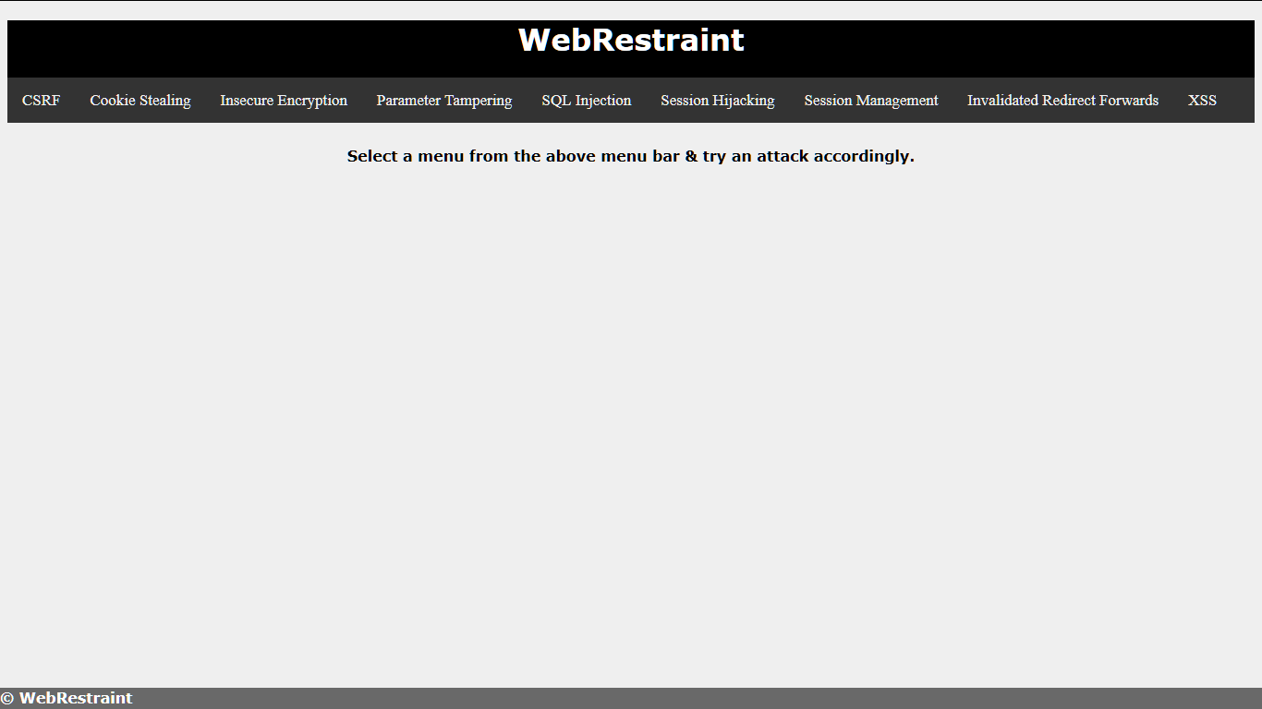

Slide 5
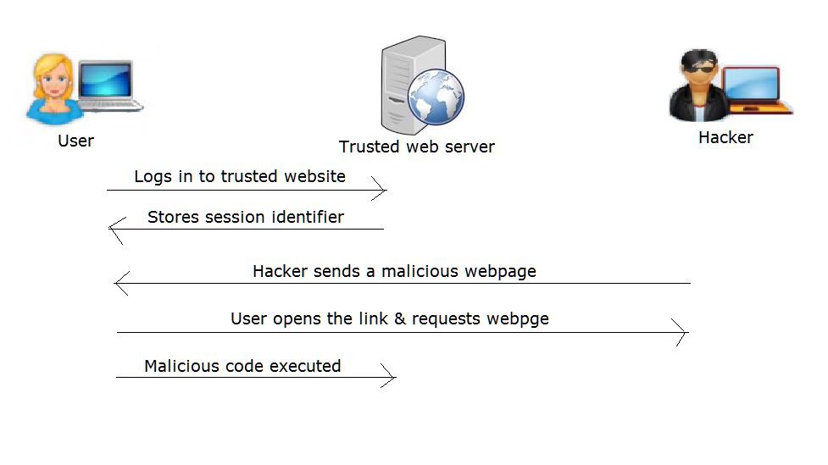
ATTACKS
1. CSRF (Cross Site Request Forgery)

Slide 6
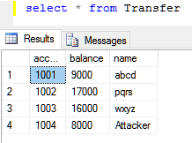
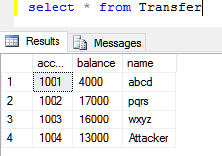
Before execution of fake page:
After execution of fake page :
You can see 5000 deposited to attacker’s account.

Slide 7
Prevention
It can be prevented by creating a csrfToken which is stored in hidden form field & verifying it before execution.
An attacker won’t be able to know this token & it’s randomly generated using SecureRandom.

Slide 8
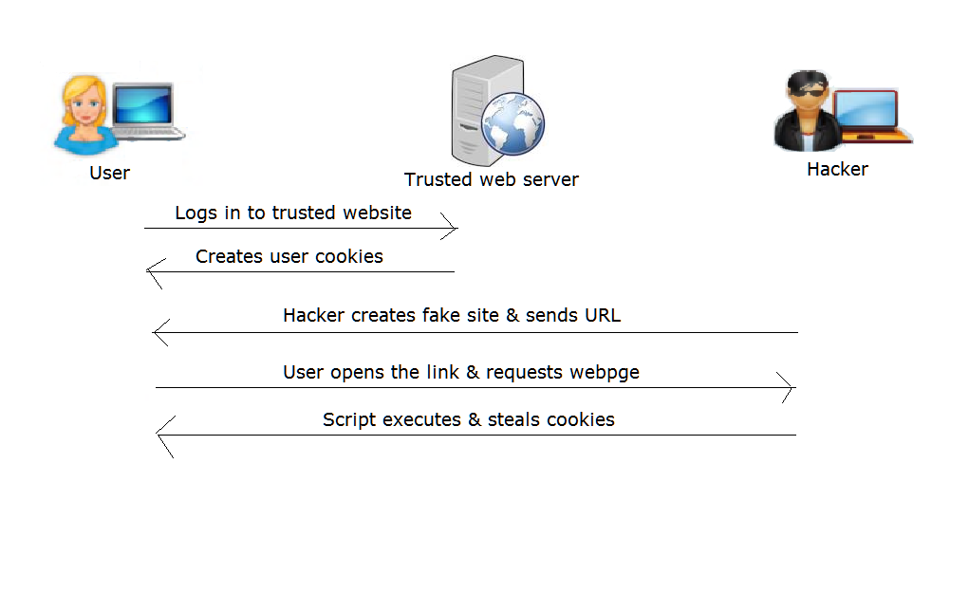
2. Cookie Stealing

Slide 9
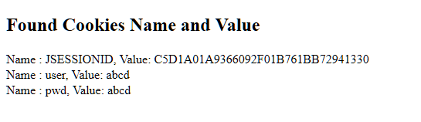
Prevention
It is never good to store password in cookies. If you need to store some sensitive information in cookies, it should be encrypted or hashed. It is also advisable to use session attributes or hidden fields, but with some precautions. In this demo hashing policy is used with SHA 512 algorithm.

Slide 10
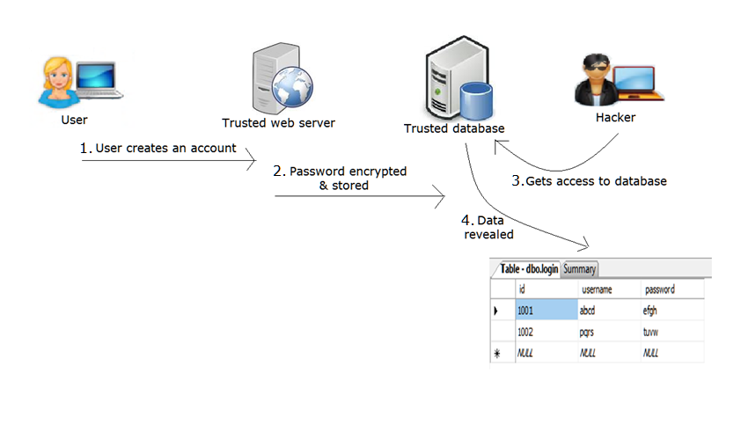
3. Insecure Encryption

Slide 11
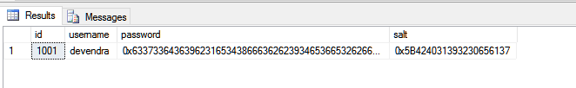
You can see the passwords which are encrypted but still understandable. Password for user ‘abcd’ is ‘efgh’ which possibly means actual password is ‘abcd’, encrypted using shift cipher.
Prevention:
If users’ passwords are hashed & stored, even after seeing it, it would be difficult to crack them. SHA-512 scheme is used for hashing.
Salt can be used to verify integrity.

Slide 12
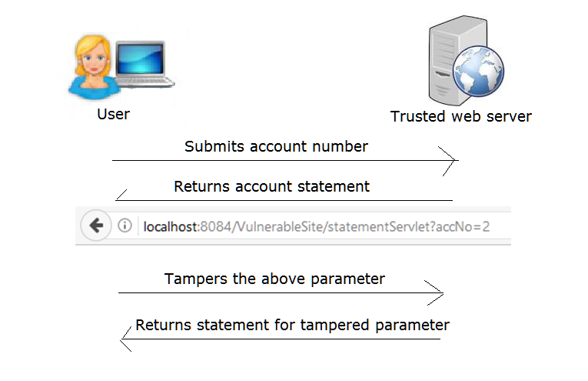
4. Parameter Tampering

Slide 13
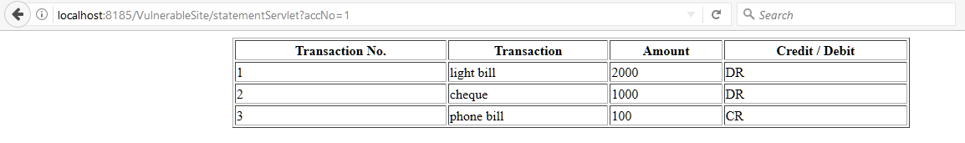
Prevention
Don’t pass account no or other fields to the address bar as parameters. It will avoid tampering. Use session variables or cookies as alternatives.

Slide 14
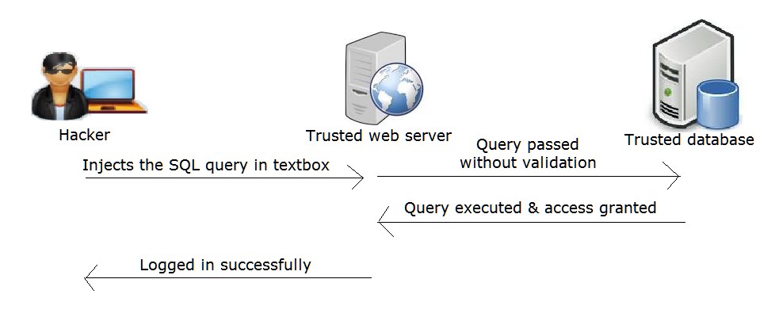
5. SQL Injection

Slide 15
Attacker enters any valid username and injects a query like ‘OR ‘1’=’1 as password. This injections appends to the SQL query & returns a result as true, so the query gets executed & attacker gets the access to the homepage.
Prevention
Use PreparedStatement or stored procedures to avoid such attacks. Validating user inputs is also crucial. Always end the SQL query in the code using ‘;’. Password hashing is also an effective way to prevent this attack.

Slide 16
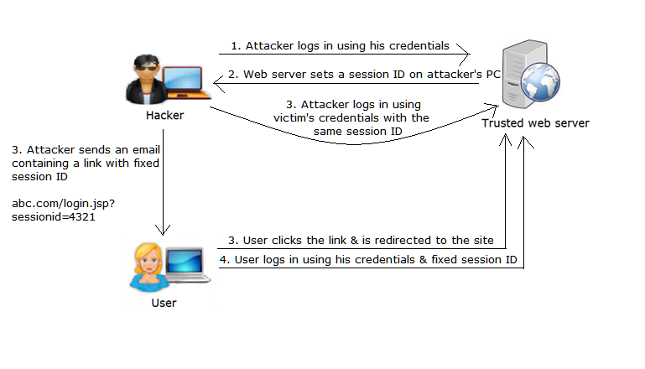
6. Session Hijacking

Slide 17
Prevention
Dynamically destroy an old session id after every login & create a new session id. Even if an attacker has already set an id as a parameter, a new session id will be assigned by the server.

Slide 18
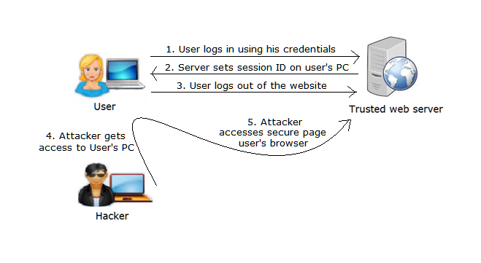
7. Improper Session Handling

Slide 19
http://localhost:8084/VulnerableSite/SessionManagement/Account/Home.jsp?sessionid=A7AAD564A59D9E3AE4DC0FE171DC9B42&name=abcd
Prevention
For every secure page (where used must be logged in), add a code which checks if a user is logged in or not. It might happen that, another person uses a PC when it is idle; this code will manage the session & destroy it as soon as a user is logged out.

Slide 20
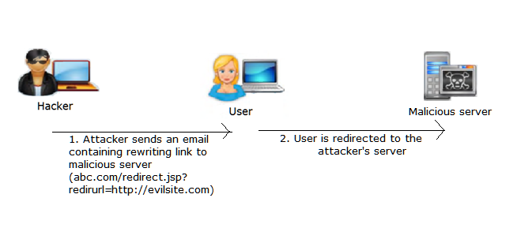
8. Invalidated Redirect & Forwards

Slide 21
Prevention
Instead of passing URLs directly as parameters, create a table in the database which will have all the new site names, their URLs and other data. Then pass a unique identifier of each site. In this sense, an attacker won’t be able to identify which identifier belongs to which site & if he attaches a malicious URL to the code, it will not be accepted as there is no entry of it in the database.

Slide 22
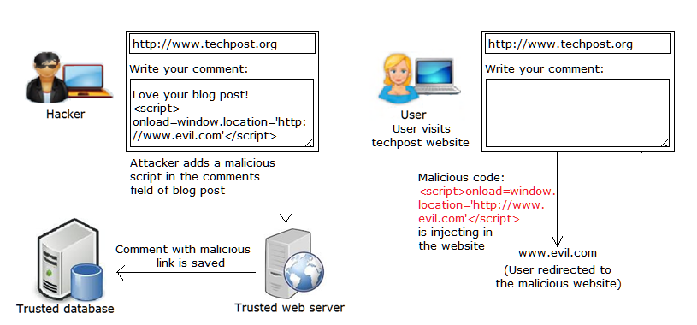
9. XSS (Cross Site Scripting)

Slide 23
Prevention
User input sanitation is essential prevention in this attack. Don’t allow users to add anything to the textbox that begins with ‘<’. Since, most attacks appear in the tag.
Use new versions of the web servers, which have greater security than old ones.

Slide 24
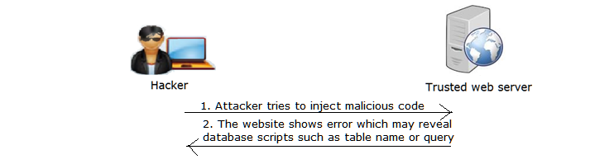
10. Improper Error Handling
Prevention
Instead of showing errors on the screen, It would be essential to show them on the console only to the authorized persons. Use try/catch block whenever required for proper error handling. Redirect users to error pages.

Slide 25
CONCLUSION
There are very complex projects related to web application security available on the internet, which deal with many advance level vulnerabilities. But it requires users to have technical expertise.
Most of the projects deal with theoretical approach of the concept, practical implementation is not considered.
The project is very simple and easy to understand. Any non-technical or developer will be able to understand it.

Slide 26
People having less or no knowledge about website security will get familiar with it.
It gives a practical approach to web application security by actually implementing the concepts with a website.
It first describes what vulnerabilities exist in the web security, then it tries to figure out what measures can be taken against them.

Slide 27
Thank You!!!

