Slide 1
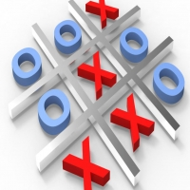
Tic Tac Toe Game
DEVANG PANDEY
Roll no.: 2202221540008
DS 2nd Year

Slide 2
Topics to be discussed!???
introduction
Tic Tac Toe(Description)
Why this project?
Project Features
Project implementation

Slide 3
introduction
Games provide a real source of enjoyment in daily life.
Games also are helpful in improving the physical and mental health of human. Apart from daily life physical games, people also play computer games. These games are different than those of physical games in a sense that they do not involve much physical activity rather mental and emotional activities.

Slide 4
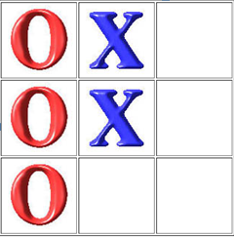
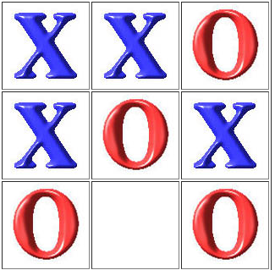
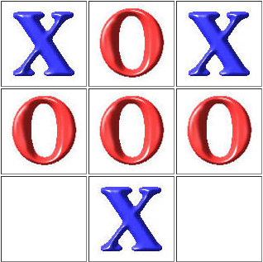
introduction
Tic Tac Toe is a simple two-player game played on a 3x3 grid. The goal of the game is for a player to get three in a row, either horizontally, vertically, or diagonally.
In this game, there is a board with n x n squares. In our game, it is 3 x 3 squares. The goal of Tic-Tac-Toe is to be one of the players to get three same symbols in a row - horizontally, vertically or diagonally - on a 3 x 3 grid.

Slide 5
Tic Tac Toe(Description)
This Tic Tac Toe game is made using HTML, CSS, and JavaScript. It features a responsive design, dynamic game board, and a winning message display. Players take turns clicking on squares to place their X or O marker until a winner is declared or the game ends in a draw.

Slide 6
Why this project?
Developing a Tic Tac Toe game project can be a great way to improve your programming skills, particularly in JavaScript. It is a relatively simple game that can be implemented using basic programming.
Additionally, Tic Tac Toe is a fun and popular game that is enjoyed by people of all ages, making it a great project to share with others or even use as a teaching tool for those new to programming.
Notes:
اصبح الذكاء الاصطناعي موجود في كل مكان وحتى تكون الالعاب اكثر ذكاءا اصبحت تحتوي بشكل كبير على الذكاء الاصطناعي وهنا اليوم نقوم باستخدام الدكاء الاصطناعي لعمل روبوت يلعب الاكس او مع شخص عادي .

Slide 7
Project Features
The game can only be played between two player.
The result after the game finish will see on the screen with a GIF.
After the game finished we put sound of music depending on the result of the game.
The game prevent player to make wrong move

Slide 8
Project implementation
We divided the project into three parts
HTML
CSS
JAVASCRIPT

Slide 9
HTML Part
HTML (Hypertext Markup Language) is the backbone of web development and is used to structure and format content on web pages.
In the case of a Tic Tac Toe game project, HTML is used to create the basic layout of the game board, including the grid of squares where X's and O's are placed.
HTML is also used to create other elements on the page, such as buttons, headings, and messages that are displayed to the user during the game.
Additionally, HTML is used to link the JavaScript and CSS files to the web page to add interactivity and styling to the game board. Overall, HTML plays a crucial role in creating the structure and foundation of the Tic Tac Toe game project.

Slide 10
CSS Part
CSS (Cascading Style Sheets) is used in a Tic Tac Toe game project to style the appearance of the game board and other elements on the web page.
CSS is used to create visual effects such as background colors, borders, fonts, and hover effects that enhance the user experience.
In a Tic Tac Toe game project, CSS can be used to create an attractive and responsive layout, which adjusts to different screen sizes and devices.
Additionally, CSS can be used to add animations and transitions to the game board, such as highlighting the winning squares or displaying messages with fade-in effects. In summary, CSS is a crucial part of a Tic Tac Toe game project, as it adds an important visual and interactive dimension to the game.

Slide 11
JavaScript Part
JavaScript is responsible for detecting when a player makes a move, updating the state of the game board, and checking if there is a winner or a draw.
It is also responsible for controlling the messages displayed to the player, such as announcing the winner or notifying the player when it is their turn to play.
JavaScript is used to add interactivity to the game board, such as highlighting the selected squares or disabling the squares that have already been played.
Finally, JavaScript can also be used to add additional features to the game, such as allowing players to reset the game or keeping a score of wins and losses.
Overall, JavaScript is an essential part of a Tic Tac Toe game project, as it creates the dynamic and interactive logic of the game.

Slide 12

Thank you for your attention :)

