Slide 1
Car Price Predictor using Machine Learning
by Deven Malla

Slide 2
Introduction
The process of accurately assessing the value of a used car in today's dynamic automotive market can be quite intricate. Traditional valuation methods often rely on generalized metrics and human expertise, which may not encompass all the nuanced factors that influence a vehicle's worth. However, machine learning has the potential to revolutionize this process through the use of sophisticated, data-driven models.

Slide 3
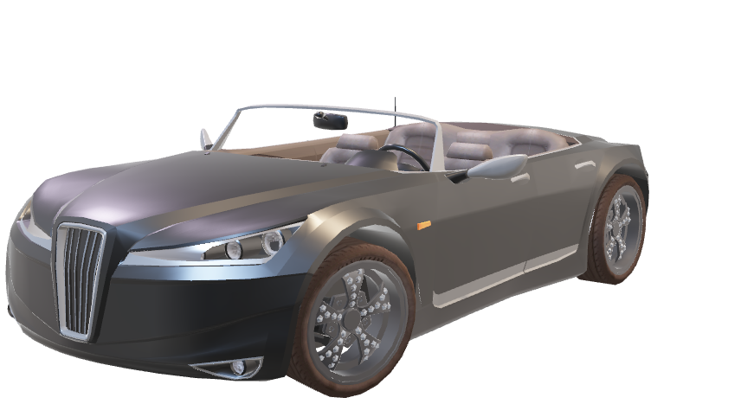
Dataset
Car brand
Mileage
Engine capacity
Transmission
Fuel
Max power

Slide 4
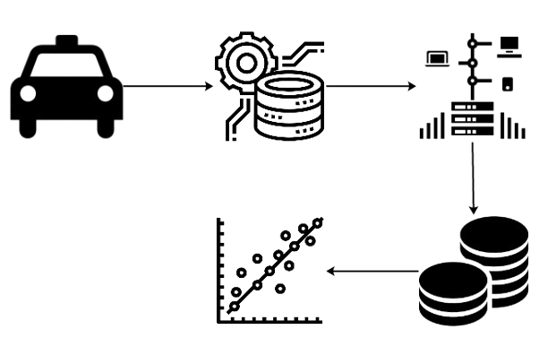
Methodology
The methodology includes Data Pre-processing, Exploratory Data Analysis (EDA), Train-test split, Model Selection, and Deployment.

Slide 5
Conclusion
The 'Car Price Predictor' project demonstrates a comprehensive approach to developing a machine learning model for predicting car prices based on various attributes. The project showcases a structured approach to building, evaluating, and deploying a robust machine learning model ready for real-world application.

Slide 6
References
1. Dataset:
https://drive.google.com/file/d/1UIj8rOmDJn4UgqDTJezMNfzr7jh_behL/view?pli=1
2. Requirements.txt:
https://stackoverflow.com/questions/7225900/how-can-i-install-packages-using-pip-according-to-the-requirements-txt-file-from
3. Streamlit:
https://docs.kanaries.net/topics/Streamlit/streamlit-vscode
4. Github: https:
//github.com/deven-malla/car_price_prediction_project_using_machine_learning.git

