Slide 1
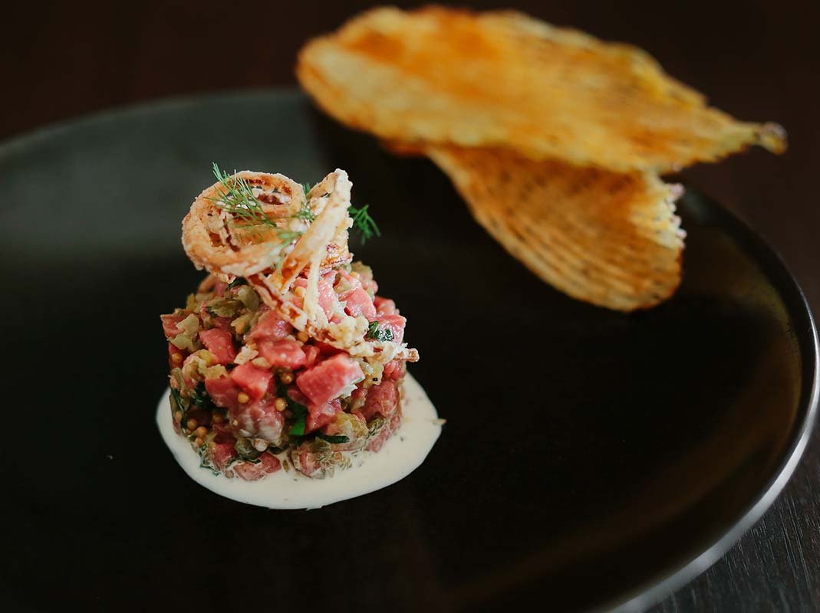
HCI PROJECT
AFFAMATO
FINE DINING WEBSITE
VALDY EKAPUTRA T – LE01 – 2201764262
DEVEN NATHANAEL VS – LE01 – 2201775594
RICHARD LIONGGIWIJAYA – LE01 - 2201761821

Slide 2
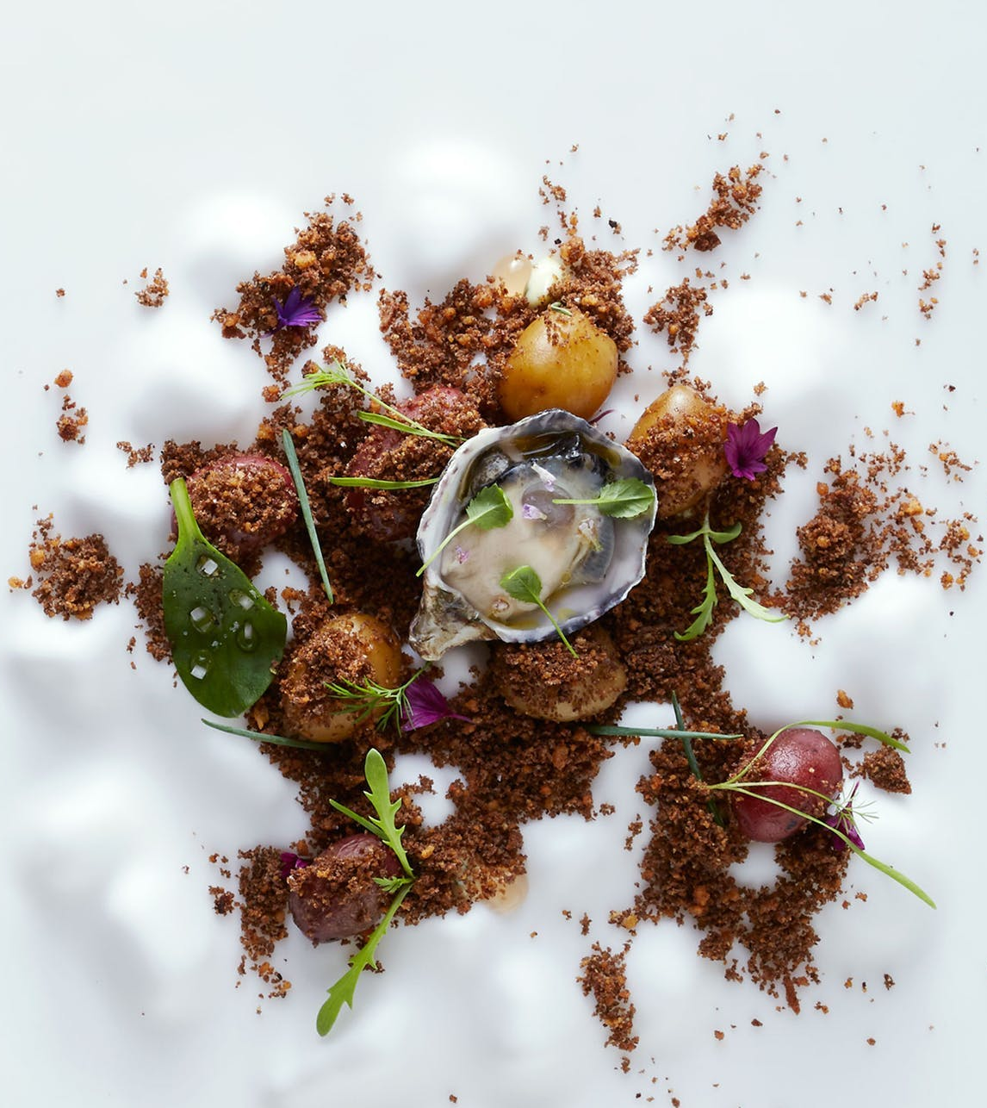
PRESENTATION ROADMAP
Penjelasan Website
Tools Pendukung Pembuatan Website
Demo / Prototype Showcase

Slide 3

About Website
Affamato merupakan website untuk restoran Fine Dining
Restoran Affamato berlokasi di Negara Bagian California, tepatnya di San Francisco, AS
Restoran mewah dengan suasana Fine Dining yang dibuat semaksimal mungkin
Head Chef Tanz mengadakan Special Event rutin setiap akhir bulan
Membuka pesanan Private Dining maupun Reservasi Acara eksklusif bulanan Chef Tanz

Slide 4
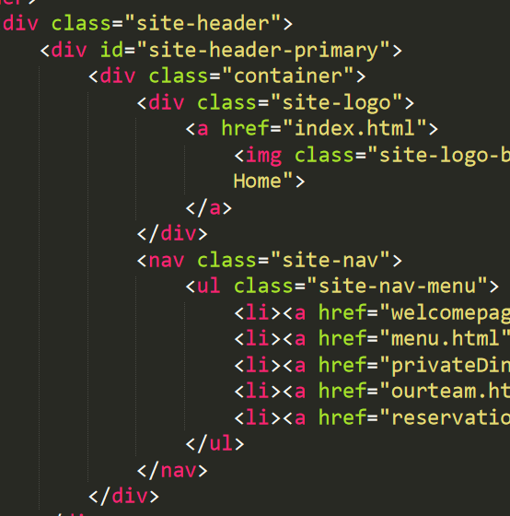
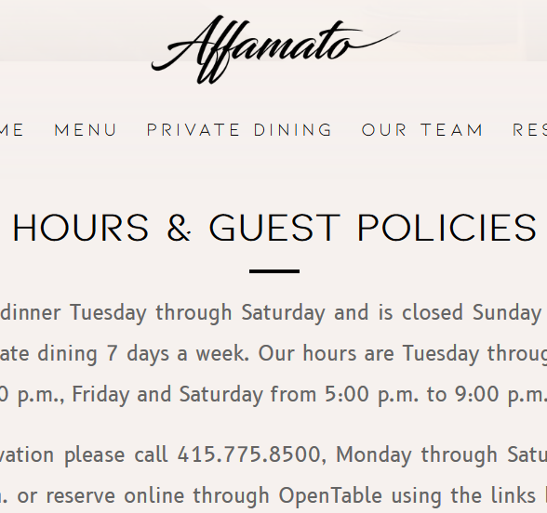
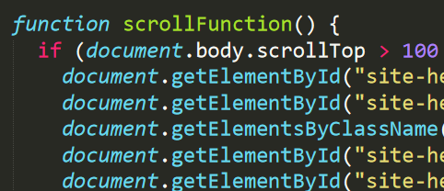
TOOLS USED
Affamato dibuat dengan menggunakan tools – tools pendukung sebagai berikut:
HTML & CSS
Javascript
Mendesain tampilan website secara overall (layouting, form reservasi, highlighting, warna, font, hyperlink, dll)
Mengatur animasi pada early page load
Menjalankan animasi navbar pada saat scrolling
Memunculkan Pop Up Reservation
Ilustrasi:

Slide 5
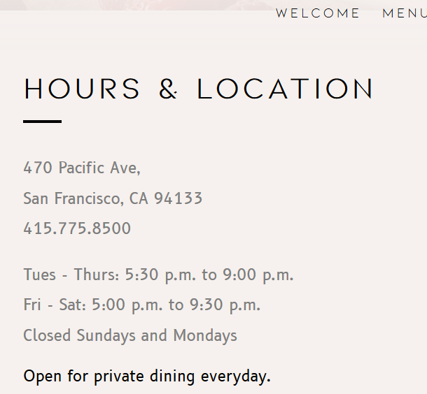
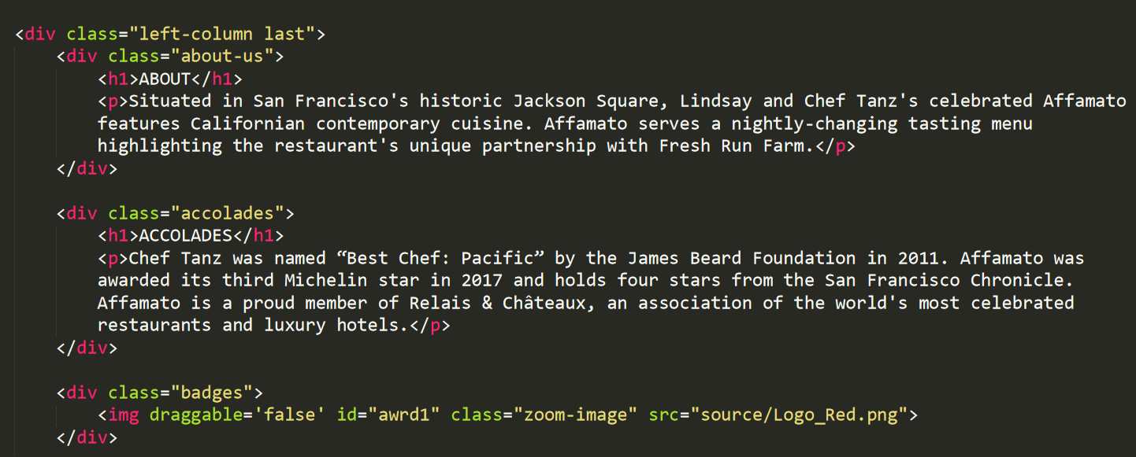


HTML & CSS
Tampilan Layout Overall (HTML)
Image zoomed in on hover (CSS):

Slide 6
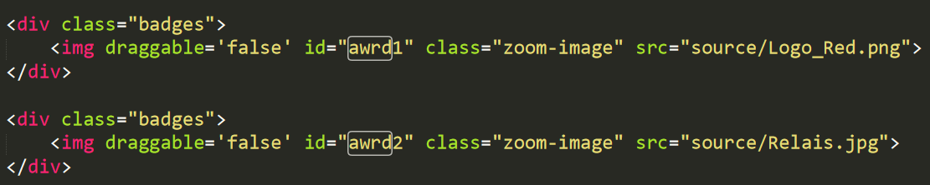
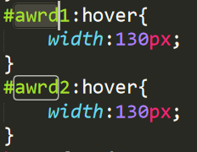
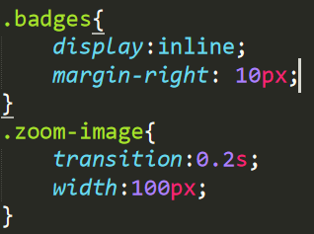
HTML & CSS
Image zoomed in on hover:
HTML:
CSS:

Slide 7

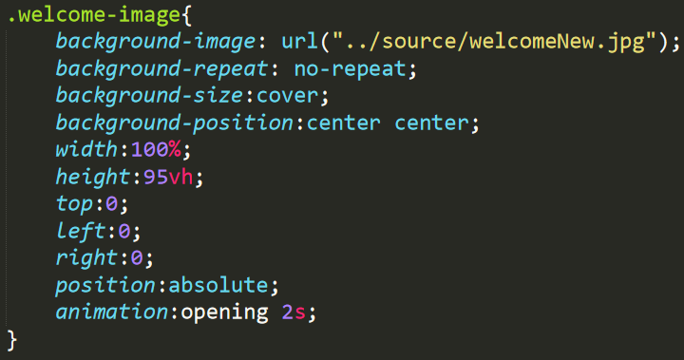
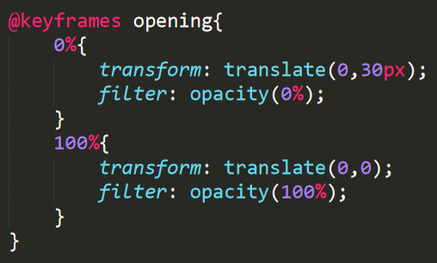
HTML & CSS
Main Background Transition:
HTML:
CSS:

Slide 8
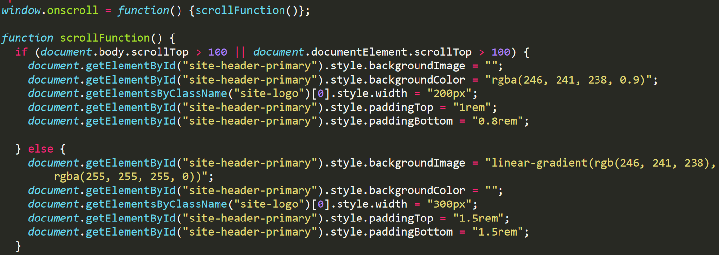
HTML & CSS
Dynamic Navigation Bar
Javascript:

Slide 9
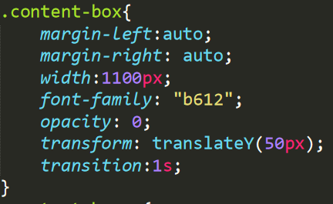
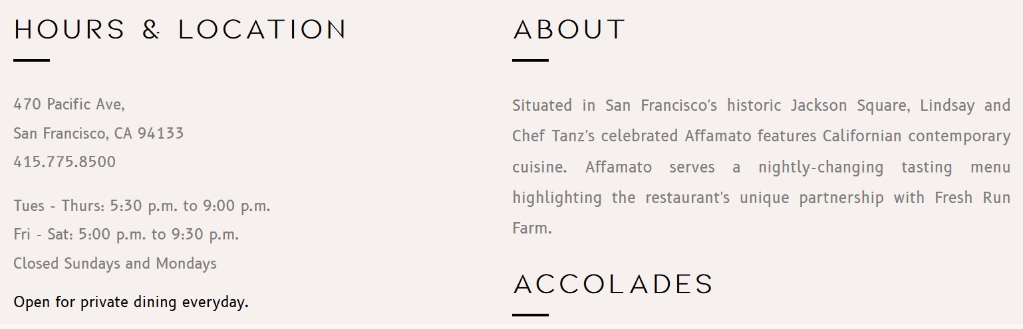
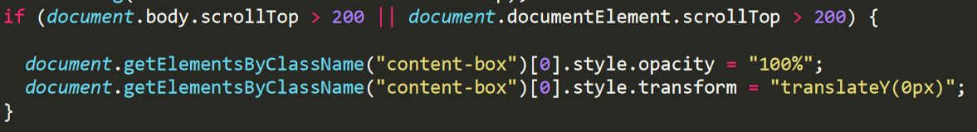
HTML & CSS
Content Welcome Transition:
CSS:
Javascript:

Slide 10
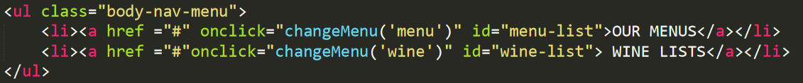
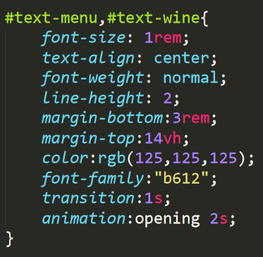
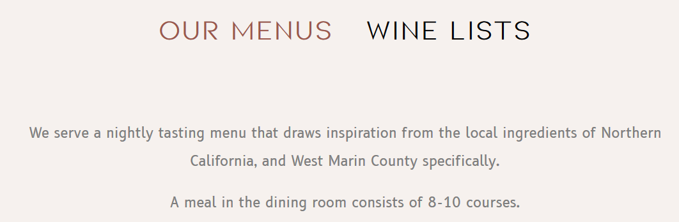
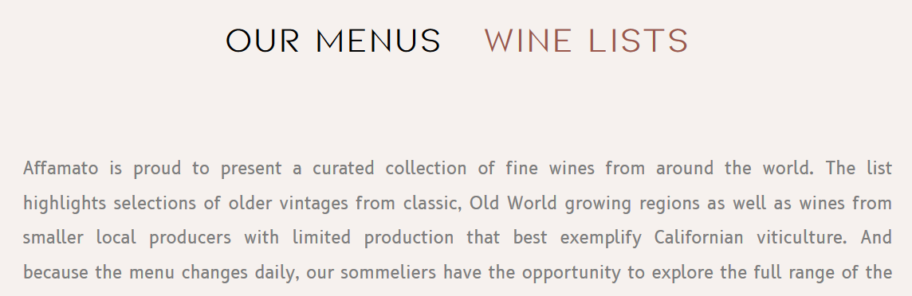
HTML & CSS
Changing Menu & Wine Section:
HTML:
CSS:

Slide 11
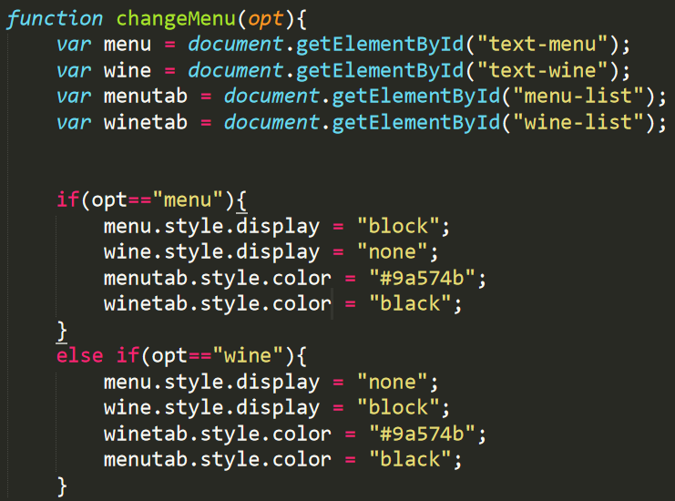
HTML & CSS
Changing Menu & Wine Section:
Javascript:

Slide 12
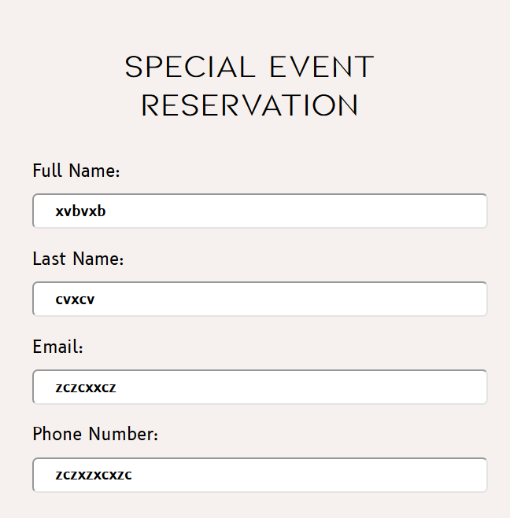

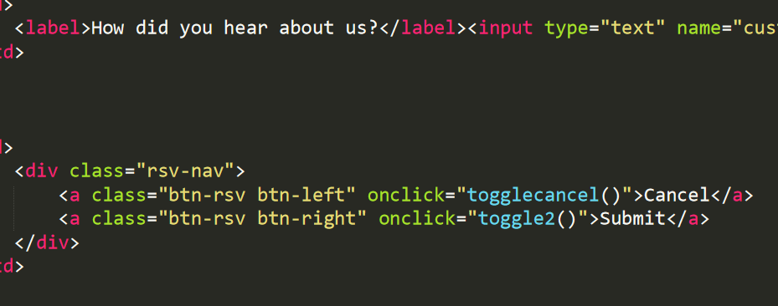
HTML & CSS
Inquire Special Event Pop Up:
HTML:

Slide 13
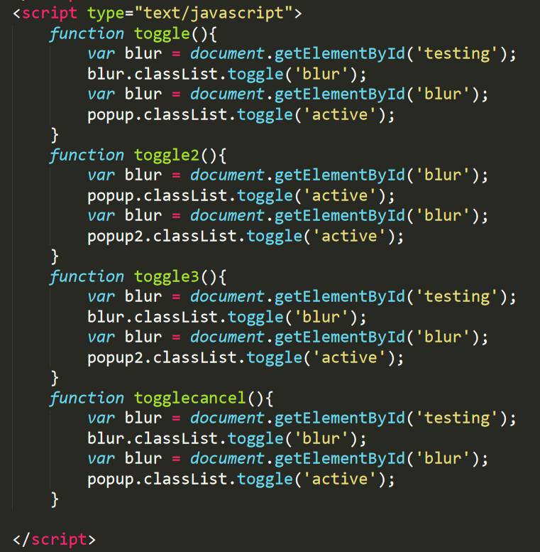

HTML & CSS
Inquire Special Event Pop Up:
Javascript:

Slide 14
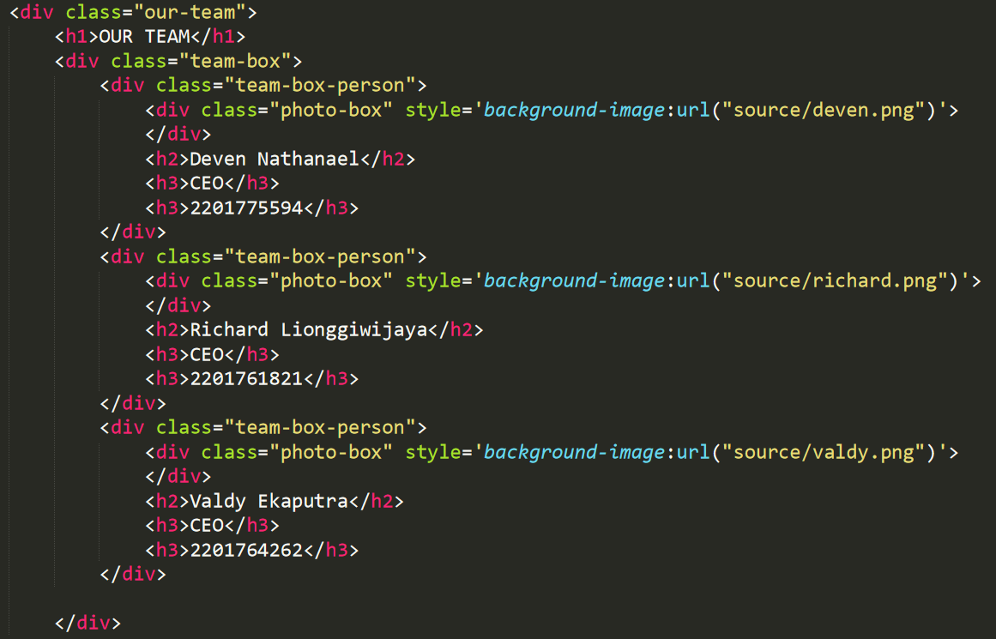
HTML & CSS
Our Team Tab Animation:
HTML:

Slide 15
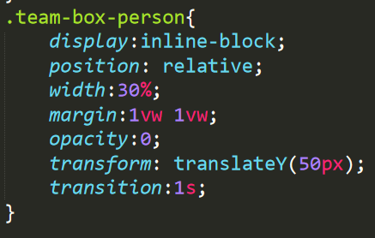
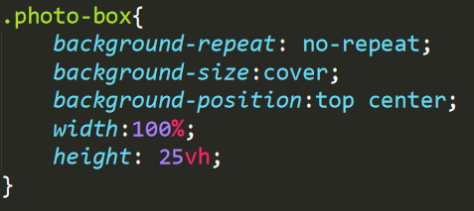
HTML & CSS
Our Team Tab Animation:
CSS:

Slide 16
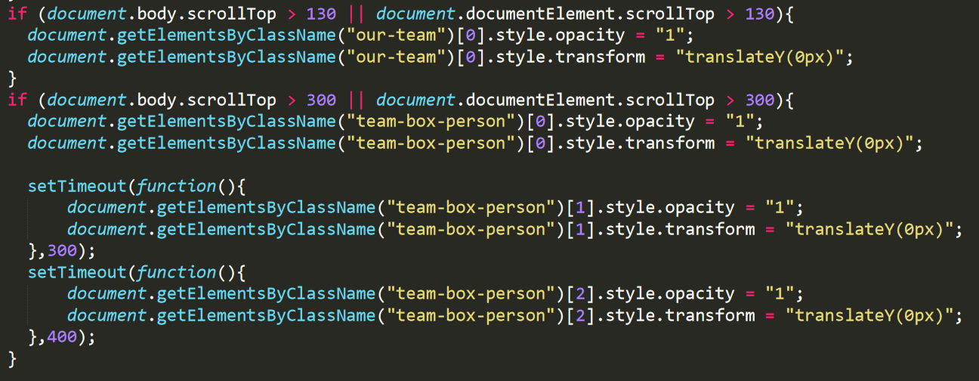
HTML & CSS
Our Team Tab Animation:
Javascript:

Slide 17
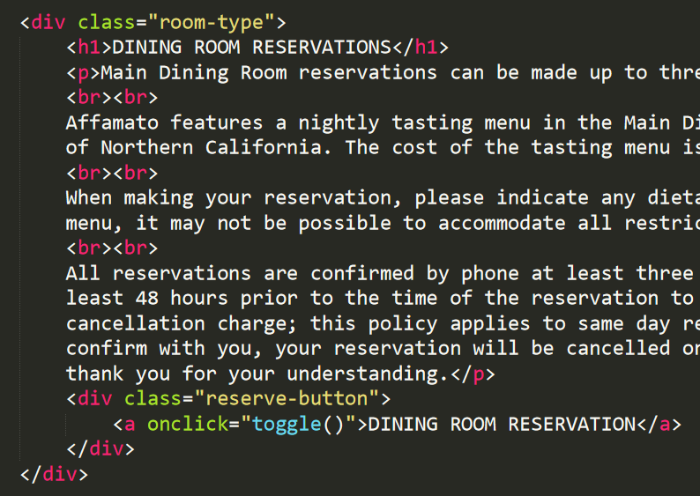
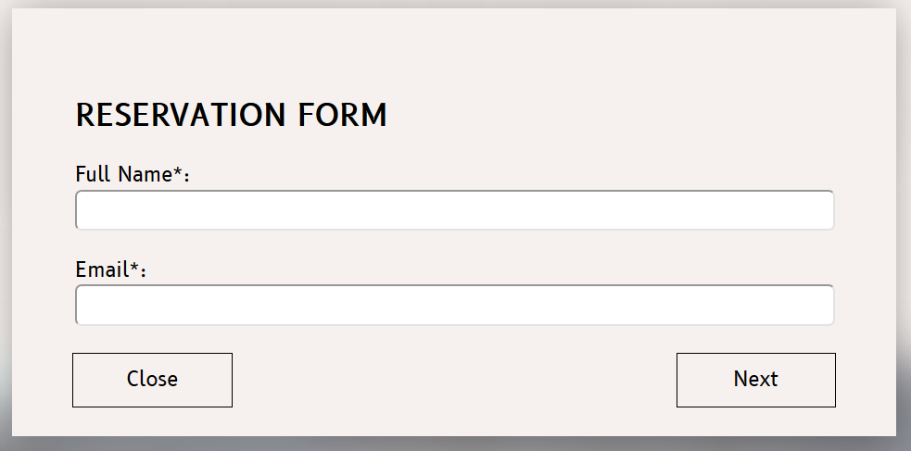
HTML & CSS
Reservation Pop Up:
HTML:

Slide 18
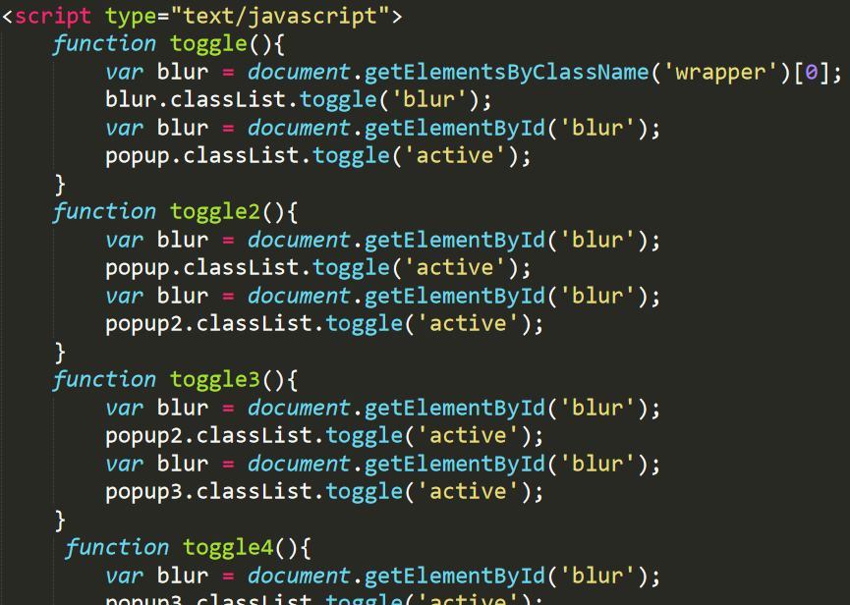
HTML & CSS
Reservation Pop Up:
Javascript:

Slide 19
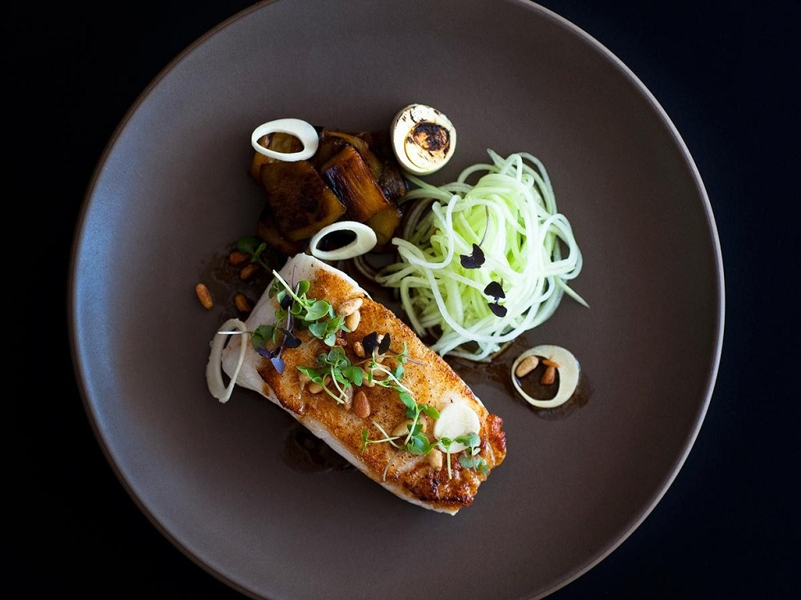
THANK YOU!
DEMO DISPLAY

