Slide 1
Computational Intelligence in Engineering
Group 5: Project B (SHM of Hohenzollernbrücke)

Slide 2
Project B: SHM of Hohenzollernbrücke
INTRODUCTION
METHODS
RESULTS & DISCUSSION
CONCLUSION & OUTLOOK

Slide 3
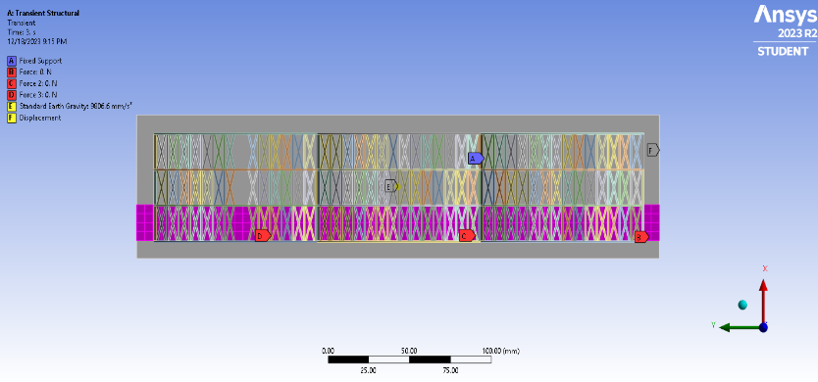
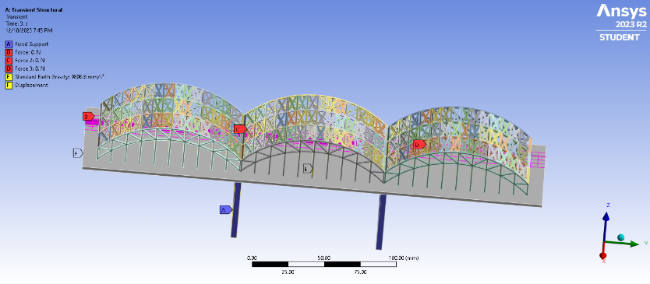
INRODUCTION
The task involves leveraging Computational Intelligence, where Artificial Intelligence has transformed engineering. The aim is to use AI to identify and locate imperfections in the Hohenzollernbrücke bridge structure using simulation data under various loads.
Idea is to use data preprocessing techniques like Data Cleaning, scaling(using Standard Scaler), and feature engineering to handle missing data.
This would enable predictive maintenance through real-time sensor data analysis, preventing and predicting breakdowns, thus reducing costs.
Figure [1]
Figure 1 : Imperfect_no_2_1_train_extreme_track_2000N
Figure 2 : Perfect_structure_1_train_extreme_track_2000N
Figure [2]

Slide 4
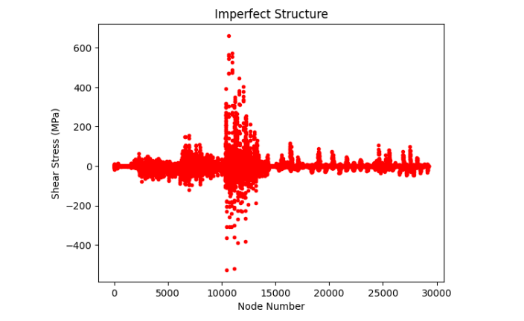
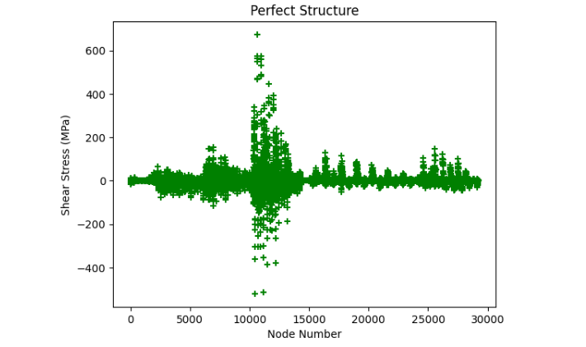
Data (Pre-)processing
Steps :
Before
Raw data in separate CSV files for different structural conditions and time stamps.
Missing nodes in the structural data.
After
Removal of duplicate and un-wanted columns.
Concatenation of data for unified datasets (Perfect and Imperfect).
Transformation of Data-Frames to NumPy arrays.
Custom method for filling missing nodes.
Standard scaling of features.
Figure [1]
Figure 1 : Shear Stress vs Node Number (Imperfect)
Figure 2 : Shear Stress vs Node Number (Perfect)
Figure [2]

Slide 5
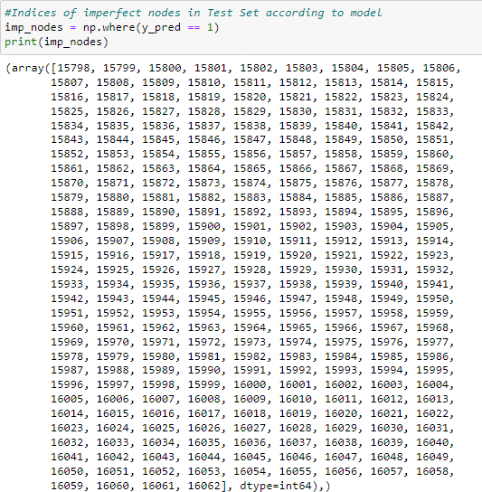
METHODS
Random Forest Classifier
Random Forests Classifier (RFC) is an ensemble learning method for classification. We chose to use RFC since it operates by constructing a multitude of decision trees at training time.
Since our task was to classify the type of structure and return location of imperfections, RCF easily classifies the imperfections and returned imperfect nodes as predictions with high accuracy (99.6%).
Figure 1 : Output for RCF, depicting Imperfect nodes in Test Data
Figure [1]

Slide 6
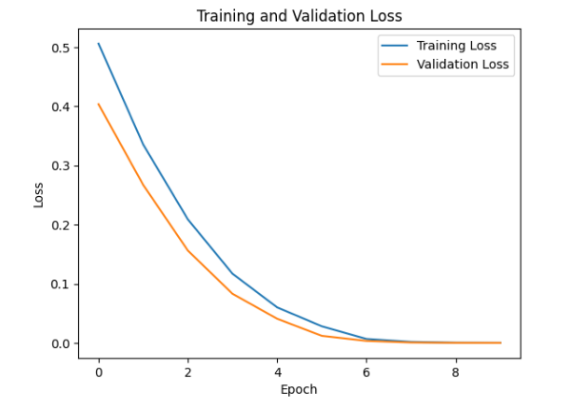
METHODS Contd.
Deep Learning Model (Sequential)
only for your best performing network:
the number and signal assignment of input neurons is 78
Input (Convoluted) Layers: Six layers with 512, 256, 128, 64 and 32. With dropouts and L2 regularizer in 512 and 256 to prevent overfitting.
Dense Layers: Flatten layer, neurons with ReLU activation, and output layer with 1 neuron using sigmoid activation for binary classification.
Output Layer: 1 neuron, using sigmoid activation for binary classification.
Figure [1]
Figure 1 : Loss vs Epoch (Training Data)

Slide 7
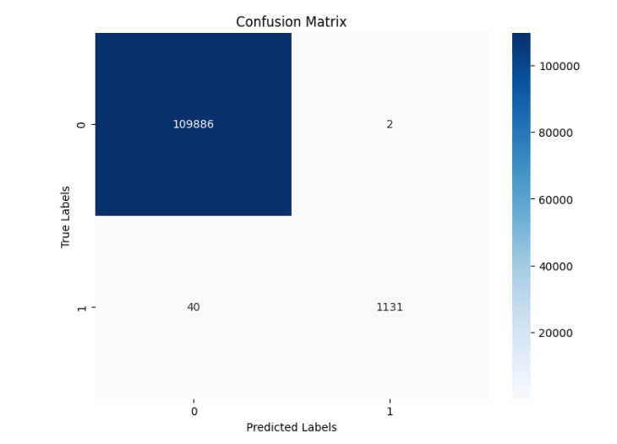
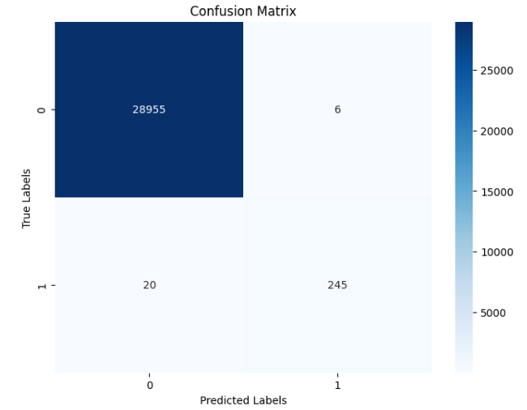
RESULTS & DISCUSSION
Cross validation
only for your best performing network: cross validation with the trainings / validation dataset
show:
the loss variation over epochs
the confusion matrix (model and test_set)
the accuracy: 99.91%
the number of training epochs needed to achieve them: 10 epoch
Figure [1]
Figure [2]
Figure 1 : Confusion Matrix for train data
Figure 2 : Confusion Matrix for test data

Slide 8
CONCLUSION & OUTLOOK
What kind of neural networks / Machine learning model have you tried?
Random Forest Classifier
Long Term Short Term (LSTM) ~ inconclusive results
Sequential Deep Learning Model
Outlook:
Limited data encouraged us to use models like RCF, for Time series data would LSTM be better choice?
Diagnosing the model for overfitting/underfitting was an important step; loss vs epoch graph gave insights more than expected.
Future Work :
Exploring possibilities for Time series data and deployment of such machine learning models in real-time predictive analysis.

